Slide 1
Business Updates
TED eSender workshop – 25 September 2026
Karl Ferrand – Publications Office of the European Union

Slide 2

Back to business
SDK1 roadmap
SDK2 roadmap
New Public Procurement Act
Proposal for notice lifecycle
General updates
Image by kirill_makes_pics from Pixabay

Slide 3

SDK1 roadmap
Image by Mariene Da Silva Jardim from Pixabay
SDK 1.12
  Notice submission no longer accepted after 31 October 2026
  6 eSenders must upgrade before then
SDK 1.13 and SDK 1.14
  Used by 43 and 30 eSenders respectively
  Active and accepted until end of 2027 (at least)
  No further patches for 1.13
SDK 1.15
  Released in July and available in Preview
  Will be activated in Production alongside SDK 1.16
SDK 1.16
  Testing at OP starts (beta3) next week
  Target release in Preview by end of October, and in Production shortly after

Slide 4

SDK 1.16 – content overview
See details on TED
New simplified approach for undisclosed fields: 4 fields that apply to whole notice:
Update of the schema extensions to remove several ‘minOccurs’ checks at schema level + introduction of new validation rules to check at schematron level instead
Modification of the eForms schema to allow the possibility to use custom (e. g. national) extensions
Further rule maintenance, updates to notice type definitions, fields, view templates, code lists and labels and translations
    Undisclosed information group (BT-195-notice): uses new codelist ‘undisclosed-data-group’ where the buyer can select which group(s) of undisclosed fields are to be withheld in this notice; repeatable and no granularity: either all or none of the fields included within one group can be withheld
    Non-disclosure justification code (BT-197-notice): uses existing codelist ‘non-publication-justification’ and provides the reason for withholding the group(s) of information; mandatory, not repeatable (→ same reason applies to all groups of information that were selected as undisclosed)
    Non-disclosure justification additional information (BT-196-notice): free text to put in additional details; optional
    Disclosure date (BT-198-notice): date on which groups(s) of undisclosed information will be disclosed; optional (if not provided, information will stay undisclosed indefinitely), not repeatable (→ same date applies to all groups of information that were selected as undisclosed), must be less than 5 years after submission
Image by Nike Chillemi from Pixabay

Slide 5

SDK2 roadmap
SDK 2.0
  Next focus, in sync with (new final) SDK 1.17 with no business changes to ease migration
  alpha4 released (alongside SDK 1.16 beta3)
  Target RC1 by end of 2026
  Release in early 2027 depending on testing and integration
  SDK 2.1
  Target first half of 2027, including NUTS2027, additional dynamic rules, other maintenance
  Probably followed by SDK 2.2 if further maintenance needed before 3rd amendment
  3rd amendment to eForms implementing regulation
  Earliest in late 2027, implemented with SDK2
  Use it to prepare for new legislation
  Updated SDK roadmap: https://docs.ted.europa.eu/eforms-common/roadmap/index.html
Image by Benjamin Adams from Pixabay

Slide 6
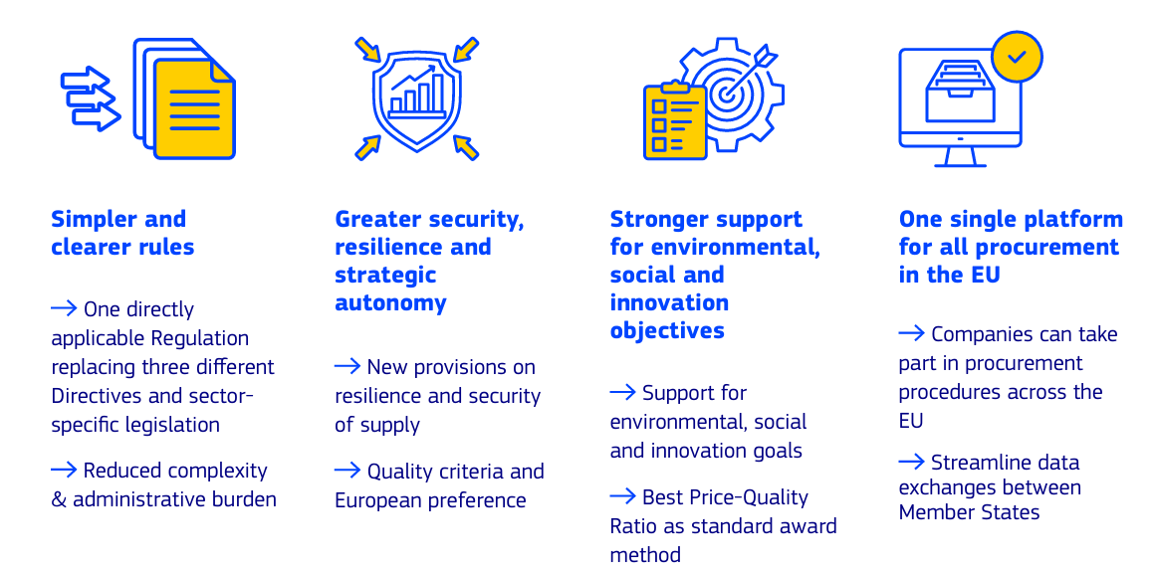
The proposal for the new Public Procurement Act has been unveiled

Slide 7


The digital ecosystem in the proposed Public Procurement Act
Public Procurement Digital Marketplace
Communication + data exchange between public buyer and economic operator using different eProcurement service providers through interoperability network based on harmonised standards
Electronic Eligibility Service as electronic verification scheme inter alia for exclusion grounds and selection criteria based on digital business credential tool (reference to European Business Wallet)
Each Member State to have one central national access point for procurement information: National Public Procurement Data Space
Further relevant Articles:
Part III, Title III, Chapter 5 ‘Publication and documentation rules’: Articles 109-113
Part V ‘Digital ecosystem’: Articles 127–133
Part VI ‘Transparency and Governance’: Articles 134 – 136
Image by Wolfgang Eckert from Pixabay
Notable trend:
Moving away from ‘forms’ into the direction of data:
  ‘notices’ → ‘public summaries’
  ‘procurement documents’ → ‘procurement details’
← Obligations for eProcurement service providers regarding the above can be found in Article 131 of the proposal
Image by Tumisu from Pixabay
Notes:
For NPPDS:
e. g. public summaries (ex notices) will be sent to OJ S via this access point

Slide 8
Processing of submitted notices
Notice reaches "submitted" status after submission with successful validation
  First email notification to buyer (noticeAuthorEmail)
Processing in OP's internal system
  If any lawfulness warnings (CEI, non-EEA/candidate buyer): OP checks manually, usually within 1 working day
  If any "workflow" error: OP may reject or try to fix the issue, e.g.
    Very common: link to a previous notice that hasn't been published
    Sometimes: previous notice is about to be published, so OP retry processing the next day
  During daily export (around 15:00): processing stopped for 5-10 minutes (new next month)
Accepted/processed notices
  Get planned publication date -> ready for next export
  Second email notification to buyer
  See full notice lifecycle at https://docs.ted.europa.eu/api/latest/publish.html

Slide 9
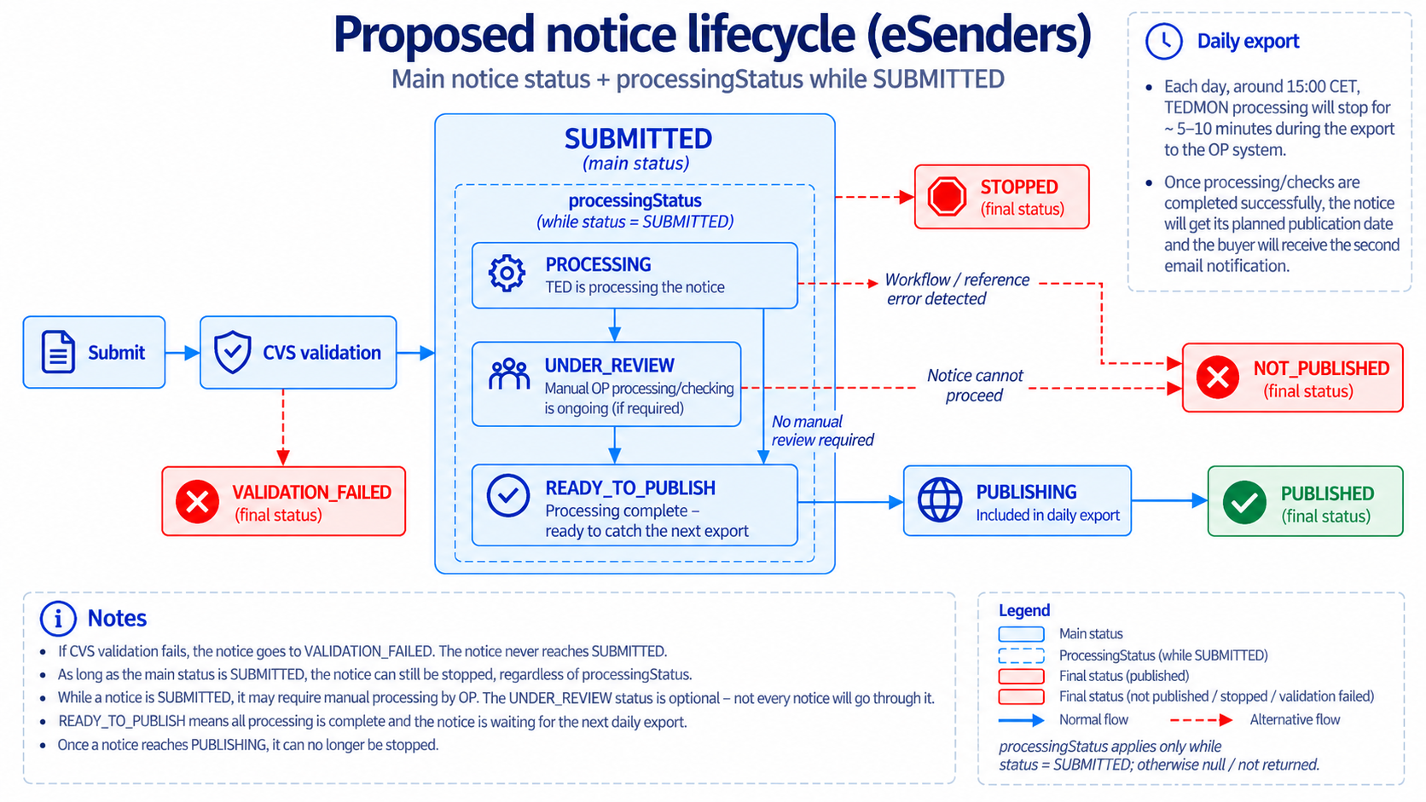
Add processingStatus to API for more details within "submitted" status?
Complement plans in 2027 to have AI-assisted data quality checks (including lawfulness checks)

Slide 10
General updates
Revamped and updated eForms FAQ
  https://docs.ted.europa.eu/eforms-common/FAQ/index.html
eSender catalogue
  Next version of Developer Portal will allow to validate and list (about 25) public eSender profiles
Planned MS/EXEP survey for eForms information
  Collect and link from TED to eForms sources for each country (going beyond eSender profile)
Successful validation reports no longer available via API
  Next eNotices2 release (planned for late October) will delete existing reports
  Only reports for failed validations available
  /v3/notices/{businessId}/validation-report will return http 404 for successful reports
TED-together on 24-25 November in Luxembourg and online
  https://op.europa.eu/en/web/ted-together

Slide 11
Thank you For your Attention
Links​
​https://docs.ted.europa.eu​ - Developer guide, APIs, Preview, FAQ, every SDK version…​
​https://github.com/OP-TED/​ - Components and code for developers, SDK, discussions…​
​https://op.europa.eu/en/web/ted-eforms - OP eSender workshops
Any questions?​
Business TED helpdesk: https://ted.europa.eu/en/contact
Technical: https://github.com/OP-TED/eForms-SDK/discussions/ ​
Unless otherwise noted the reuse of this presentation is authorised under the CC BY 4.0 license. For any use or reproduction of elements that are not owned by the EU, permission may need to be sought directly from the respective right holders

