Slide 1
SDK updates
eSender workshop – 18 June 2026
Karl Ferrand – Publications Office of the European Union

Slide 2

Current SDKs
SDK 1.12 extended lifespan ends on 31 October 2026
    Upgrade needed by 9 eSenders (many planned for Q3)
SDK 1.13 is popular: 43 eSenders
    Standard lifespan ended in March – so no more patches
    Extended lifespan until December 2027
SDK 1.14 is used by 8 eSenders
    Extended lifespan also until December 2027
Image by thefairypath from Pixabay

Slide 3

Next SDKs
Image by Paul Lusch from Pixabay
SDK 1.15: maintenance release
    Testing RC2
    Target: released and in Preview in July
SDK 1.16: revised undisclosed/unpublished fields
    Last SDK 1.x release and business basis for SDK 2.0
    Around 1/3 of eSenders affected
    Target: beta release in August
SDK 2.0: EFX2
    Around 1/3 of eSenders affected
    Target: releases in autumn
  See also updated roadmap at https://docs.ted.europa.eu/eforms-common/roadmap/index.html

Slide 4
Other updates
eSender profiles
    Soon: list public profiles directly on TED Developer Portal
    Planned: TED page about eForms implementation in Member States (survey to come)
Removal of successful reports for submitted notices
    Only store reports with warnings or errors
    Publication API call /validation-report will return 404 if notice validation was successful
No UI actions on notices submitted by API
    eNotices2 user interface should not be part of your workflow
    Use API for operations like stop publication or search notices
    No guarantee that future eNotices2 releases will continue to work

Slide 5
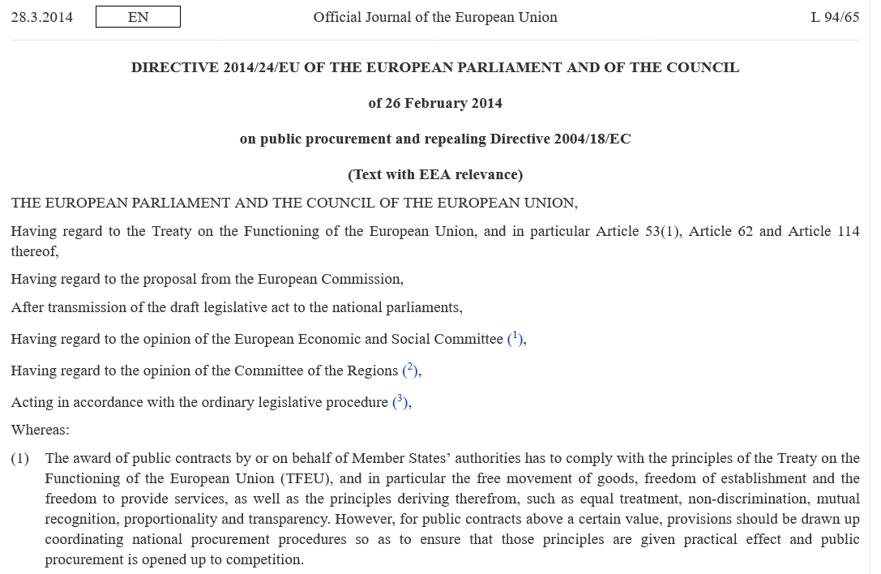
What’s up next
Commission proposal for new Public Procurement Act in July
3rd eForms amendment in 2027 – then implemented in SDK 2.x
Catch up on the latest TED data reusers workshop of 20 May
  Presentations on open data, videos and Q&A at https://op.europa.eu/en/web/ted-reusers-workshops
Q3 eSender workshop on 25 September
  TED-together on 24-25 November 2026
    - Luxembourg and online – we welcome proposals for an eSender presentation

Slide 6

THANK YOU FOR YOUR ATTENTION
Links​
​https://docs.ted.europa.eu​ - Developer guide, APIs, Preview, FAQ, every SDK version…​
​https://github.com/OP-TED/​ - Components and code for developers, SDK, discussions…​
​https://op.europa.eu/en/web/ted-eforms - OP eSender workshops
Any questions?​
Business TED helpdesk: https://ted.europa.eu/en/contact
Technical: https://github.com/OP-TED/eForms-SDK/discussions/ ​
© European Union 2026
Unless otherwise noted the reuse of this presentation is authorised under the CC BY 4.0 license. For any use or reproduction of elements that are not owned by the EU, permission may need to be sought directly from the respective right holders

