Slide 1
SDK-2 Progress Report
eSender workshop – 27 March 2026
Ioannis Rousochatzakis – Publications Office of the European Union

Slide 2
Released yesterday
eForms SDK  2.0.0-alpha.2
eForms Core Library for Java  1.6.0
EFX Toolkit for Java  2.0.0-alpha.6
eForms Notice Viewer  0.12.0
EFX-CLI  0.1.0

Slide 3
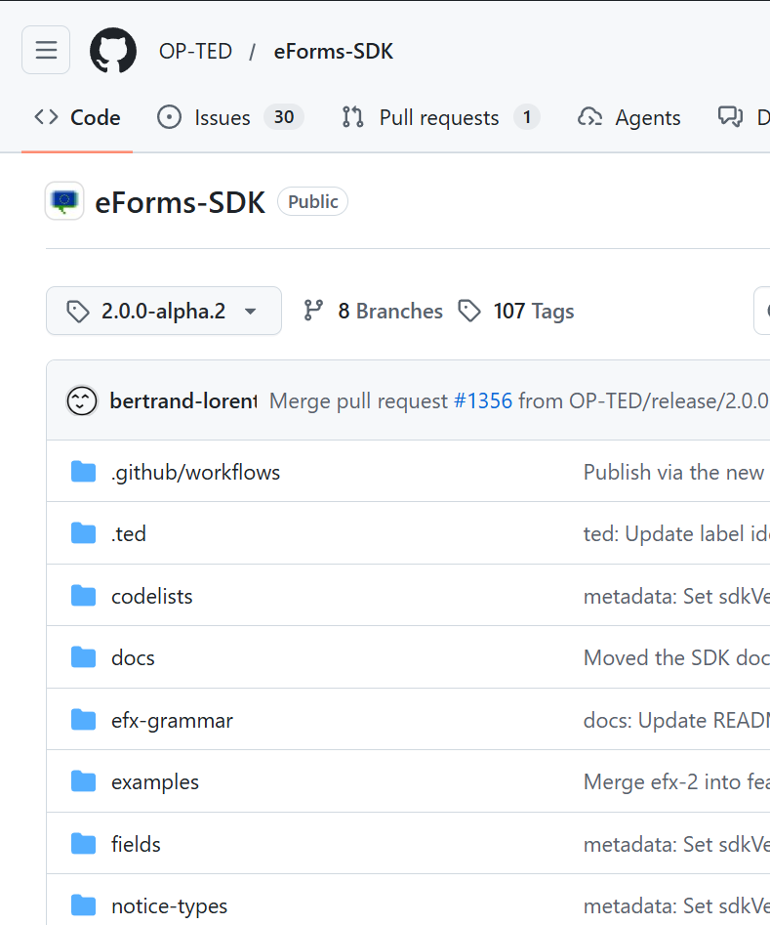
eForms SDK 2.0.0-alpha.2
EFX-2 grammar – very close to final version
Updated SDK metadata in EFX-2

Slide 4
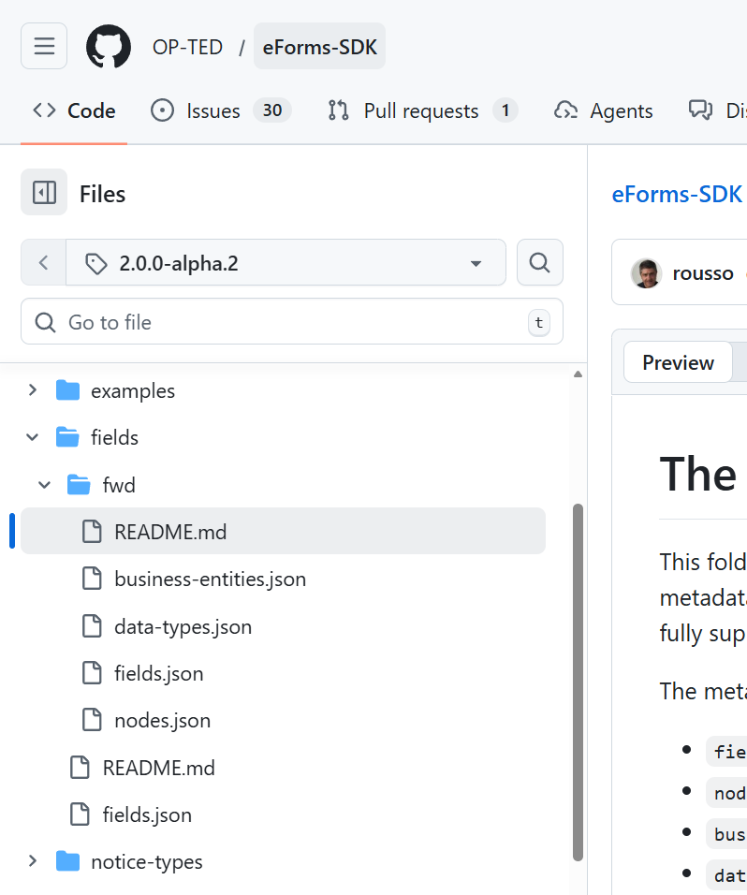
eForms SDK 2.0.0-alpha.2
EFX-2 grammar – very close to final version
Updated SDK metadata in EFX-2
Forward compatibility – work in progress

Slide 5
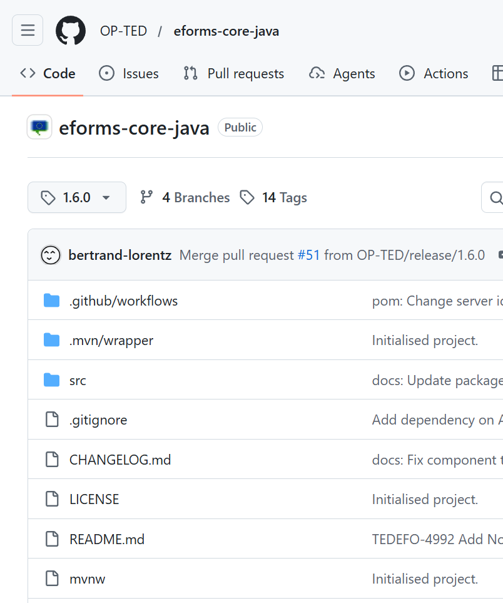
eForms Core Library 1.6.0
Downloading of new SDK versions
Loading of SDK resources
Accessing SDK resources at runtime
Common XML processing tools

Slide 6
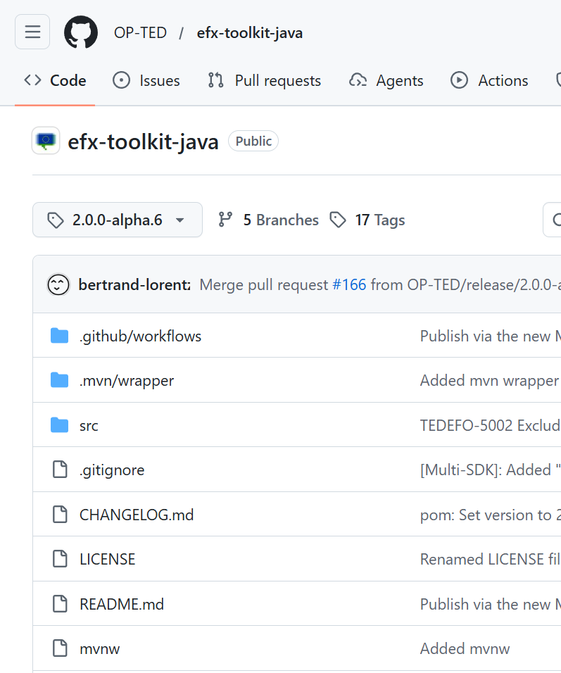
EFX Toolkit 2.0.0-alpha.6
Implements all EFX-2 features
  Expressions
  Templates
  Rules
Translates to XPath, XSLT, Schematron
Extracts dependency graphs
Single-pass parsing and type checking
Importing of #include files

Slide 7
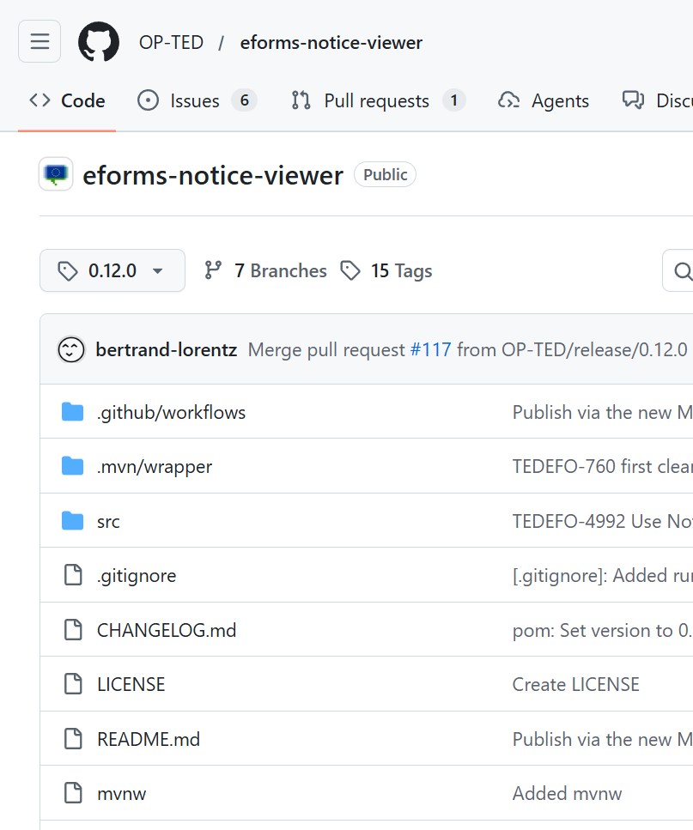
eForms Notice Viewer 0.12.0
Implements EFX-2 Template visualisation features
Supports the new Summary and Navigation sections
Demos implementation of EFX  XSLT  HTML transformation

Slide 8
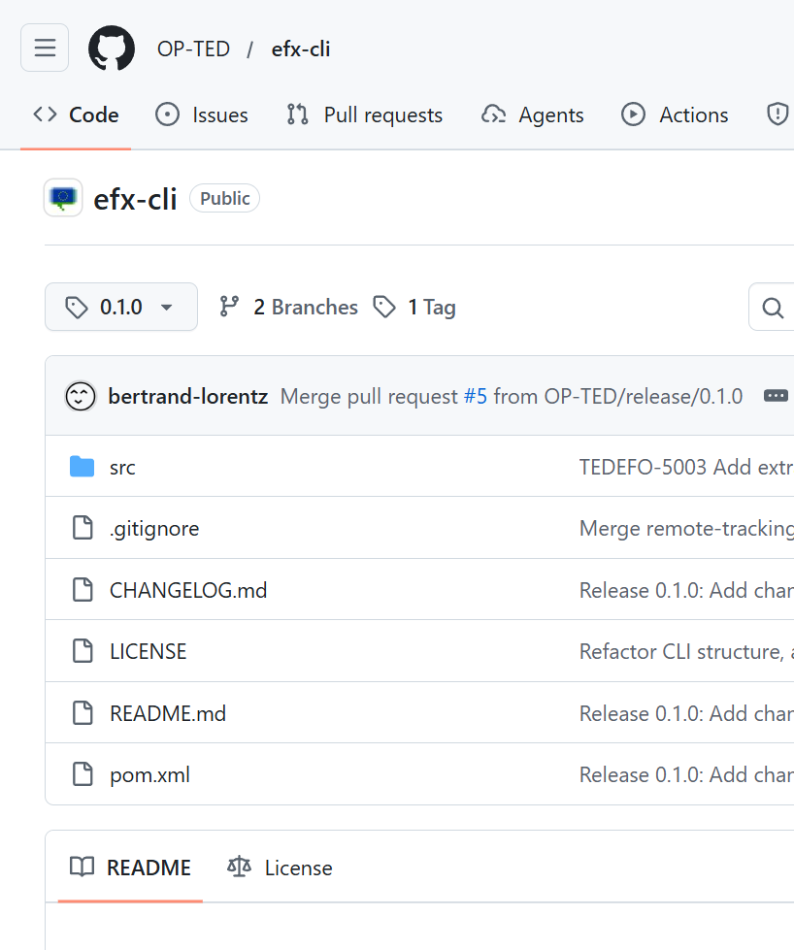
EFX-CLI 0.1.0
Command-line interface for the EFX Toolkit
Validate notices against EFX rules
Visualise notices as HTML

Slide 9
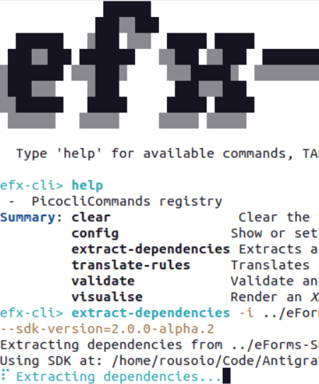
EFX-CLI 0.1.0
Command-line interface for the EFX Toolkit
Validate notices against EFX rules
Visualise notices as HTML
Translate EFX rules to Schematron
Extract field dependency graph
Interactive shell with autocomplete

Slide 10
EFX is no longer “just an expression language”
EFX Expressions
  Still the core of EFX
  Safer to write with strict type system
  More portable
  More expressive and more readable
EFX Templates
  Flexible and usable notice visualisation
  Embedded summary and navigation views
EFX Rules
  Validation is now portable beyond Schematron
  Practical dynamic rule validation
  Enable live, interactive validation scenarios

Slide 11
EFX Expressions
In SDK-1
In SDK-2
Limited set of built-in functions
Type system that was not fully developed
Tied to XPath concepts more than necessary
Strict type system, fully developed
Rich set of built-in functions
More expressive
More portable

Slide 12
EFX Templates
In SDK-1
In SDK-2
Template modelling was too simplistic
Each template line had its own isolated context
  Impossible pass context across template lines
  Reestablishing context was very complicated
  No reusable components or computations
Impossible to optimize output for performance
Reusable computation with variables
Maintains context at any granularity as needed
Allows fast lookups with dictionaries
Reusable templates reduce repetition and improve readability
Uses a less cryptic, more readable and maintainable syntax
Capitalises on EFX Expression improvements
Friendlier, faster and accurate visualisations

Slide 13
EFX Rules
In SDK-1
In SDK-2
we used EFX solely to capture the business logic of each rule
(the pre-condition and logical test to perform)
all other information about a rule was not captured in a concrete portable form
    Rule ID, severity and message,
    Target field and applicable notice subtypes,
    Validation stage and applicable validation environment(s)
The entire validation logic and metadata are captured in EFX.
This makes eForms validation
  Portable to engines beyond Schematron
  Suitable for live, interactive validation (e.g. in form editors)
  Readable and maintainable by domain experts, not just developers
  Open to community contributions and review

Slide 14

Ongoing work for SDK 2.0.0-beta.1
Business Entities – add to EFX syntax
Forward compatibility – finalise formats and metadata
Simplification of non-disclosed (aka “unpublished”) information encoding
Grammar refinements and cleanup

Slide 15

Roadmap
Beta.1 — by end of April 2026
  Grammar freeze — no breaking changes expected after this point
  Legacy EFX-1 syntax removed
SDK 1.15 — June 2026
  Last SDK 1.x release
  Metadata baseline for SDK 2.0 RC
RC.1 — by July 2026
  OJS apps updated and tested (eNotices2,
  CVS, TED Viewer, TED Monitor, TED API)
SDK 2.0 — around September 2026
  Final release after OJS apps fully
  validated

Slide 16

Thank you
Feedback/Questions through GitHub Discussions
© European Union 2026
Unless otherwise noted the reuse of this presentation is authorised under the CC BY 4.0 license. For any use or reproduction of elements that are not owned by the EU, permission may need to be sought directly from the respective right holders

