Slide 1
eFORMS business issues
eSender workshop – 27 March 2026
Karl Ferrand – Publications Office of the European Union

Slide 2

eForms business issues – more than spring cleaning
Lifespan of current SDKs
SDK 1.15 and SDK 2.0 scope and roadmap
From “unpublished” to “undisclosed” in SDK 2.0
Dynamic rules in SDK 2.0
Data Quality Assistant
What’s next
Image by Alexa from Pixabay

Slide 3
SDK lifespans
Newest
SDK 2.0
SDK 1.12 is generally legal but is missing:
  International Procurement Instrument (IPI)
  Energy Efficiency Directive (EED)
  Voluntary forms E1-E6
SDK 1.13 and SDK 1.14 extended lifepsans
  SDK 1.15 and SDK 2.0 will have same lifespan
  Will allow time to upgrade to SDK 2.1
  1.13.3 is last patch (backports from SDK 1.14)
  1.14.2 patch on 2 March for minor fix
After SDK 2.0
  Progress is stalled on 3rd eForms amendment (due to work on new PP Act)
  Legally binding SDK 2.x unlikely before Q2 2027
  Possible SDK 2.1 as maintenance release?
Target: RC1 in July 2026
SDK 1.15
Target: June 2026
SDK 1.14
extend to 31 December 2027: 3 eSenders
SDK 1.13
extend to 31 December 2027: 45 eSenders
SDK 1.12
extend to 31 October 2026: 13 eSenders
Oldest

Slide 4

SDK 1.15 and SDK 2.0
Image by Alexa from Pixabay
SDK 1.15
  Maintenance release, target release in June 2026
  Revision of "unpublished" fields moved to SDK 2.0
  Business equivalence with SDK 2.0, except for "unpublished" fields and dynamic rules
  Last SDK 1.x release; eForms 3rd amendment will be only on SDK 2.x
SDK 2.0
  New EFX2 for rules and view-templates – and more! See next presentation...
  alpha.2 just released, target beta.1 by end April, release candidate 1 by July, release around September 2026
  Don’t use EFX or unpublished fields? Then upgrade to 2.0 = upgrade to 1.15 (except for some dynamic rules)
Updated SDK roadmap at https://docs.ted.europa.eu/eforms-common/roadmap/index.html

Slide 5

Scope SDK 1.15
Note:
Some points listed will be subject to approval by the EXEP eForms community
Updated business rules:
  Data input controls, e.g.:
        new character limits of 100, 400 and 6000 characters for certain fields
        control that certain amount fields only contain positive amounts
        increased controls in Result notices
  Other rule maintenance, e.g.:
        restricted procedure allowed for subtype 8 notices
        allow for fields concerning FAs/DPS in subtype E1 notices
        allow the EED basis only when the EED item is specified
        refinements of regex expressions to prepare for the new EFX2 grammar
Update to codelists (including NUTS codes for Ukraine and Bosnia)
Updates to labels and view templates
SDK
1.15

Slide 6

Revisiting “Unpublished” Fields in SDK 2.0 – New Terminology
“Unpublished” → “Undisclosed”
Usage in different contexts:
      Noun: “undisclosed information”/ “undisclosed fields” corresponding verb: “to withhold”
      Noun: “disclosed information” / disclosed fields, corresponding verb: “to disclose”
      Nouns for general process: “non-disclosure”, “disclosure”
Clean up current mix of terms: unpublished, not immediately published, publish later, privacy, confidential, hidden, etc
Image by Julia Schwab from Pixabay

Slide 7
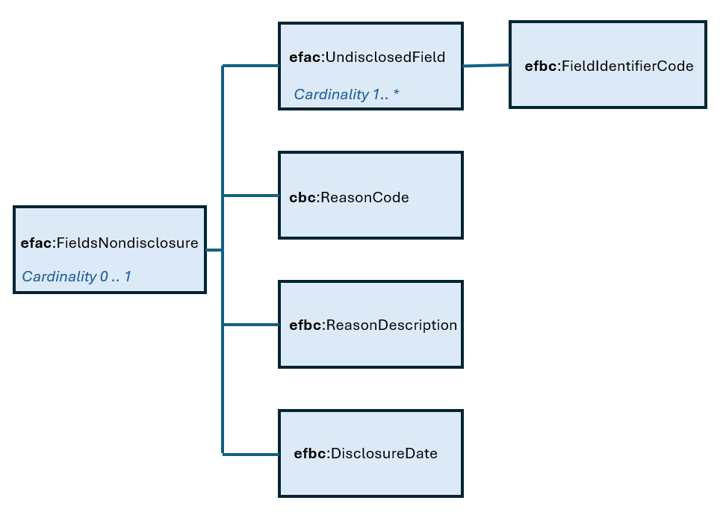
Undisclosed Fields - New Approach
Goal: Simplification
  Before: 500+ fields (all BT-195/196/197/198(BT-xxx) –fields)
  After: 4 fields applying to the entire notice
BT-195-notice: Groups of Undisclosed Fields
(see next slide)
  repeatable
  code list
BT-197-notice: Non-disclosure Justification
  not repeatable
  code list (existing code list non-publication-justification)
BT-196-notice: Non-disclosure Justification Description
  not repeatable
  free text
BT-198-notice: Disclosure Date
  not repeatable
  date format
Notes:
New Approach:
We are aiming to simplify the undisclosed fields as follows:
All BT-195(BT-xxx), BT-196(BT-xxx), BT-197(BT-xxx) and BT-198(BT-xxx) fields will be replaced by only 4 fields located at the top of the notice :
1) Group of undisclosed fields
Repeatable
Code list
Explanation: All fields that can be withheld will be grouped. How the groups are composed is to be decided. We will present a proposal below. According to the current proposal, there are 14 groups. These will be listed in a code list in this field.
2) Non-disclosure justification
not repeatable
Code list
Explanation: A code list containing the justification for the non-disclosure. This code list already exists and remains unchanged (non-publication-justification)
Non-disclosure justification description
not repeatable
free text
Disclosure Date
not repeatable
date format

Slide 8
Undisclosed Fields – Groups of Fields
Group 1: Award Criteria
BT-539 (Award Criterion Type)
BT-734 (Award Criterion Name)
BT-540 (Award Criterion Description)
BT-541 (Award Criterion Number)
BT-5421 (Award Criterion Number Weight)
BT-5422 (Award Criterion Number Fixed)
BT-5423 (Award Criterion Number Threshold)
BT-543 (Award Criteria Complicated)
BT-733 (Award Criteria Order Justification)
Group 2: Framework Value: Notice
BT-118 (Notice Framework Maximum Value)
BT-1118 (Notice Framework Approximate Value)
Group 3: Framework Value: Group
BT-556 (Group Framework Maximum Value Lot Identifier)
BT-156 (Group Framework Re-calculated Maximum Value)
BT-1561 (Group Framework Re-estimated Value)
Group 4: Framework Value: Lot Result
BT-709 (Framework Re-calculated Maximum Value)
BT-660 (Framework Re-estimated Value)
Group 5: Notice Value
BT-161 (Notice Value)
Group 7: Tender information: Tender level
BT-720 (Tender Value)
BT-162 (Concession Revenue User)
BT-160 (Concession Revenue Buyer)
BT-163 (Concession Value Description)
Group 8: Information about the Winner
BT-142 (Winner Chosen)
BT-144 (Not Awarded Reason)
Group 9: Statistics – Received Submissions
BT-759 (Received Submissions Count)
BT-760 (Received Submissions Type)
Group 10: Tender Rank
BT-171 (Tender Rank)
Group 6: Tender Value: Lot Result
BT-710 (Tender Value Lowest)
BT-711 (Tender Value Highest)
Group 13: Information about Subcontracting
BT-773 (Subcontracting)
BT-730 (Subcontracting Value Known)
BT-553 (Subcontracting Value)
BT-731 (Subcontracting Percentage Known)
BT-555 (Subcontracting Percentage)
BT-554 (Subcontracting Description)
Group 12: Country of Origin
BT-191 (Country Origin)
Group 14: Information about Review
BT-712 (Buyer Review Complaints)
BT-635 (Buyer Review Requests Count)
BT-636 (Buyer Review Requests Irregularity Type)
Group 11: Tender Variant
BT-193 (Tender Variant)
Notes:
This is merely a proposal
Based on the fields you can withhold currently, we have formed groups of fields. (Minus a few fields, that we want to propose to know longer be able to withhold, see next slide)
For the groupings, not at all set in stone
Open for input from eSenders
All of this needs to be approved by the EXEP eForms community.
Will create a GitLab Issue for discussions regarding the groupings
It will be presented and conclused at the EXEP at eForms workshop on 27 April for final decision
Group 8: Information about the Winner – please note that in addition to these fields, we are also aiming at making it possible to withhold information about the winning organisation. This is still a “challenge” remaining to be solved.

Slide 9
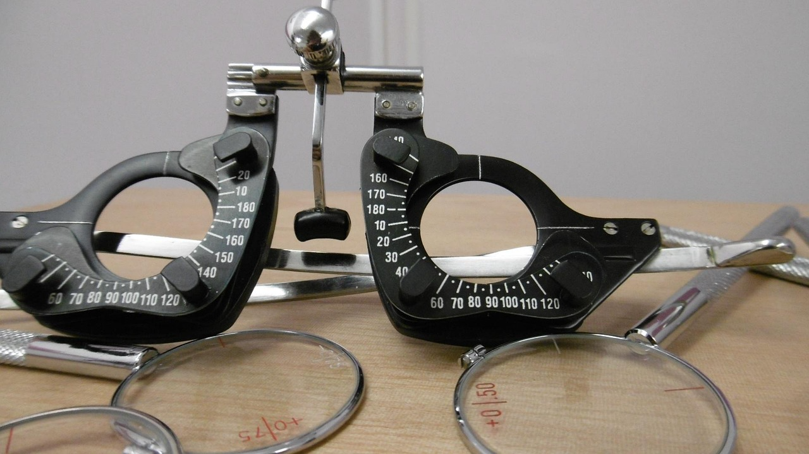
Undisclosed Fields
Fields that should no longer be withholdable (Proposal):
        BT-09 (Cross Border Law)
        BT-88 (Procedure Features)
        BT-105 (Procedure Type)
        BT-106 (Procedure Accelerated)
        BT-135 (Direct Award Justification Text)
        BT-136 (Direct Award Justification Code)
        BT-1251 (Previous Planning Part Identifier)
        BT-1252 (Direct Award Justification Previous Procedure Identifier)
        BT-1351 (Procedure Accelerated Justification)
Undisclosed Fields - Remaining issue:
        How to withhold fields in order to hide the winning and tendering organisations?
Image by bspence81 from Pixabay
Notes:
Stress that it is a proposal, not set in stone, some applies as to groupings: open for discussion.

Slide 10
Dynamic Rules in SDK 2.0
 | Control: Change notice vs. original notice | Control: Contract Modification Notice vs. original notice | Control: Result Notice vs. corresponding Competition Notice
Notice Subtype (OPP-070-notice) | Must be the same | Must be from the same predefined group | Must be from the same predefined group
Procedure Identifier (BT-04-notice) | Must be the same | Must be the same | No control
Procedure Type (BT-105-Procedure) | Must be the same | N/A | Must be the same
Main Nature (BT-23-Procedure) | Must be the same | Must be the same | Must be the same
Notice Official Language(s) (BT-702(a)-notice & BT-702(b)-notice) | Must be the same | Must be the same | Must be the same
Additional dynamic rules:
Time-date controls: adapt existing rule to check dispatch dates is <24 hours

Slide 11

TED Data Quality Assistant – AI-assisted validation
Image by Clker-Free-Vector-Images from Pixabay
Manual validation of every TED notice ended with eForms implementation
Automatic validation by CVS does not check text fields or assess content and meaning
Data Quality Assistant aims to provide algorithm/AI-supported validation
Prototype to explore checks on Language, Similarity and Meaning & Scope
Assistant will return confidence scores per check, with location and basic explanation
If useful, integrate DQA in back-office TED Monitor: low confidence notices will handled as warnings and be flagged for manual checks by OP
Similar to current "lawfulness" checks: DQA will not block submission of notices
Prototype over next 4-5 months, production implementation unlikely before end 2026

Slide 12
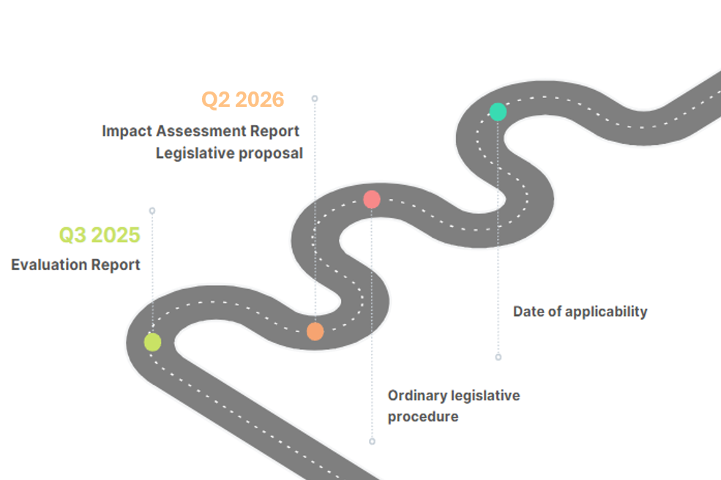
Revision of the EU public procurement framework
The Evaluation Report was published on 14 October 2025
The Open Public Consultation was closed on 25 January 2026
The Impact Assessment Report will be published in Q2 this year
The legislative proposal of a Public Procurement Act is scheduled for June 2026
Revision of defence directive 2009/81 is progressing in parallel - consultation closed on 17 Feburary

Slide 13
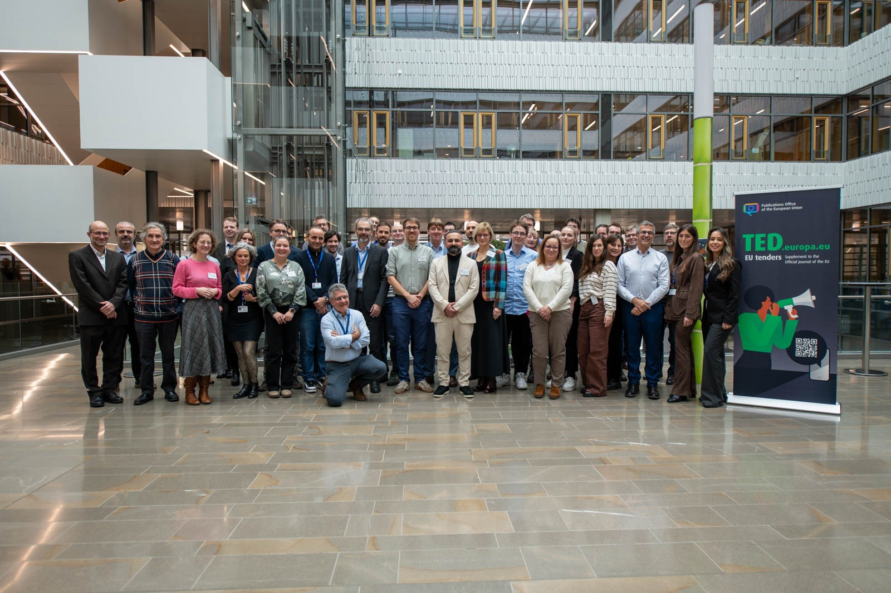
What’s up next
TED data reusers workshop on 20 May
  Keep an eye on https://op.europa.eu/en/web/ted-reusers-workshops
  Declare youself as a reuser in TED Developer Portal
Q2 eSender workshop on 18 June
  Updates on SDK 1.15 and 2.0
  Q3: on 25 September
  Keep your eSender profile updated (or create one in Portal)
  TED-together on 24-25 November 2026
    - Luxembourg and online
  Q&A published for 2025 TED-together (plus videos and presentations)

Slide 14

THANK YOU FOR YOUR ATTENTION
Links​
​https://docs.ted.europa.eu​ - Developer guide, APIs, Preview, FAQ, every SDK version…​
​https://github.com/OP-TED/​ - Components and code for developers, SDK, discussions…​
​https://op.europa.eu/en/web/ted-eforms - OP eSender workshops
Any questions?​
Business TED helpdesk: https://ted.europa.eu/en/contact
Technical: https://github.com/OP-TED/eForms-SDK/discussions/ ​
© European Union 2026
Unless otherwise noted the reuse of this presentation is authorised under the CC BY 4.0 license. For any use or reproduction of elements that are not owned by the EU, permission may need to be sought directly from the respective right holders

