Slide 1
eFORMS business issues
eSender workshop – 28 March 2025
Karl Ferrand – Publications Office of the European Union

Slide 2

eForms business issues – fog clearing?
eSender survey results
New SDK version lifespans
SDK 1.14 and SDK 2.0
3rd eForms amendment
New EU directives
TEDAPI v3
eSender catalogue
OJS publication time
Image by Joe from Pixabay

Slide 3

eSenders survey results – who are you?
Image by Pacholek-cz from Pixabay
Getting to know you, how you use SDK, your needs, difficulties, hopes and dreams…
22 responses out of around 50 eSenders
2 main types of eSenders:
  Public and National eSender and member or contact with EXEP and hundreds or thousands of buyers (400-25000) and monthly notices (130-3750).
  Commercial and no EXEP contact and tens or hundreds of buyers (1-250) and monthly notices (2-1000).
  Some exceptions: very big commercial “indirect” eSender; regional government not connected to EXEP
Almost all moved from TED-XML to eForms, 3 new entrants
Around half of public eSenders involved in PPDS and/or ESPD; 3 data reusers, 1 ePO, none in Open Data Service

Slide 4
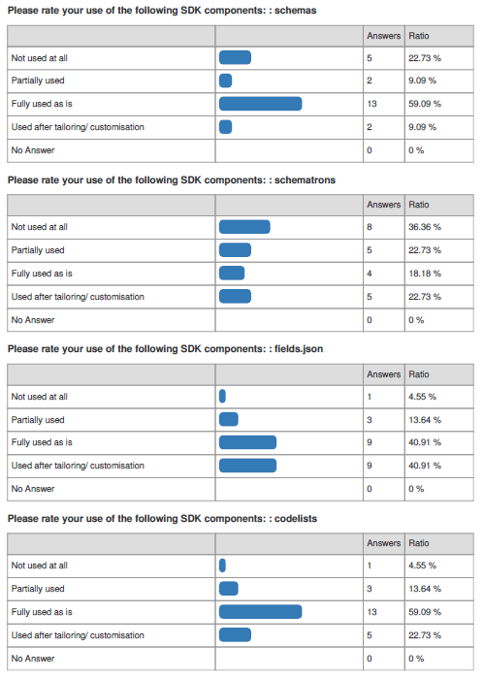
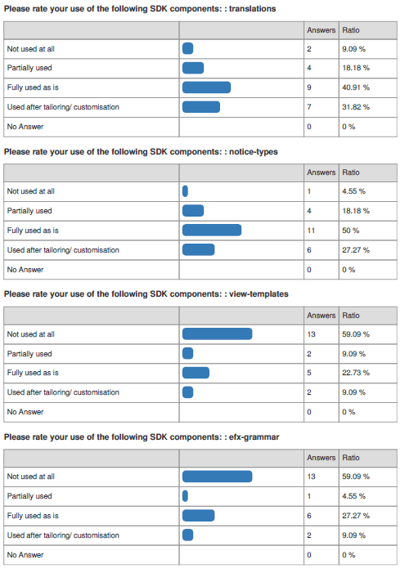
SDK components
Some tailor/customise, especially Public eSenders for fields.json (almost half), then notice-types, codelists, translations, only a couple for other components
Commercial more likely to use as is, or not at all
View-templates and EFX grammar are least used (60% not at all)
Upgrade time: more than half in under 3 months, over 80% in under 6 months

Slide 5
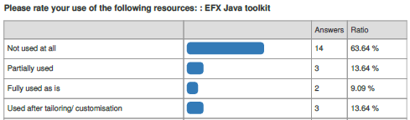
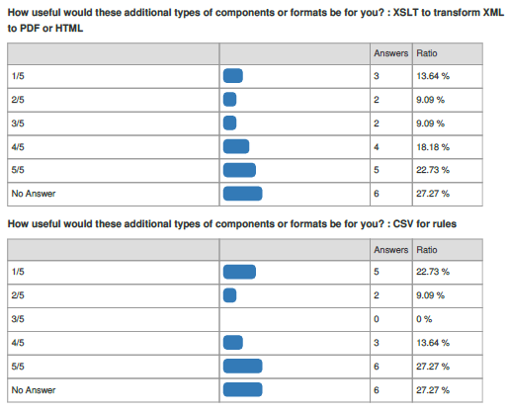
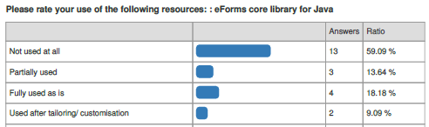
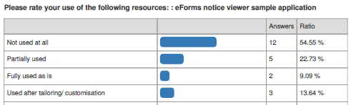
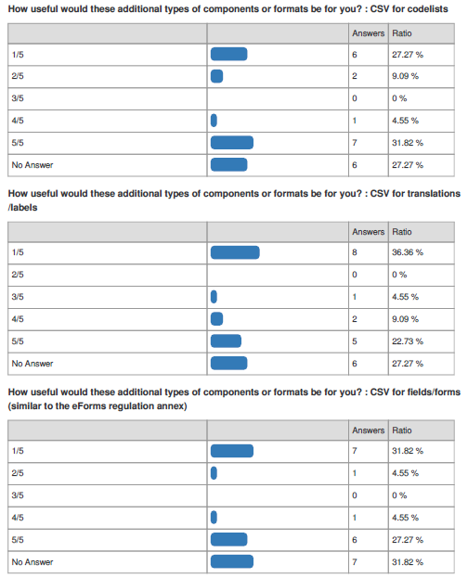
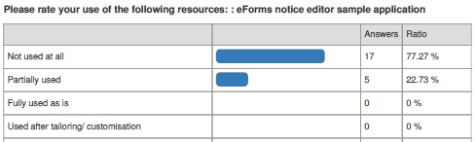
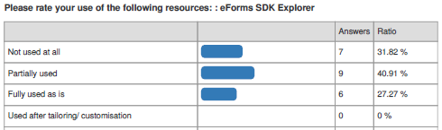
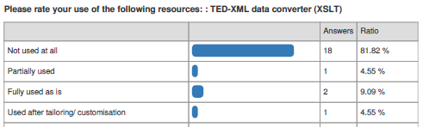
GitHub resources
Relatively low usage
EFX Java toolbox, eForms core library, notice viewer sample app: used by around 40%
Notice editor sample app, XLST converter only used by around 20%
EFX Explorer partially or fully used by over half
Alternative formats
Useful between 31% and 50% (XSLT)
Generally interested in all or none at all
Request for JSON

Slide 6
Use of API functions in Production
Submit 100% (basic eSender function!)
Stop publication over 50%
Query submitted notices 75%
Retrieve validation report 86%
Validation (CVS) 64%
Render: 40% to PDF, 60% to HTML
Search on TED 50%
Only 2 use converter plus 2 as ad-hoc
Active range 50% (all environments)
Use of EFX – impact of SDK2
9 use EFX (40%):
  6 for UI validation
  7 for validation engine
  3 for visualisation engine
Impact of EFX2:
  adapt translations into internal DSL, JEXL or JavaScript
  mix of validation and visualisation adds complexity
  expecting effort for very “breaking” changes but EFX2 also welcome

Slide 7
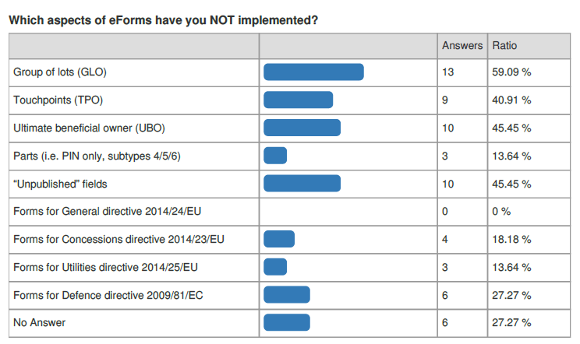
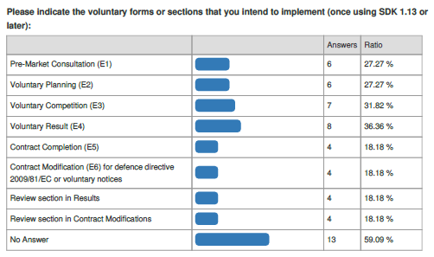
eForms extra features
Over 40% didn’t implement GLO, TPO, UBO or unpublished
Several also skipped different types of Planning
New forms and Review
Mixed but broad interest, from 18% up to 36% for E4 Result

Slide 8
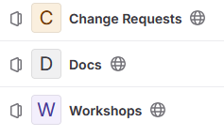



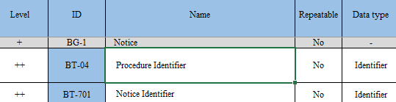
eSenders’ sources of information
Public eSenders more interested in DG GROW information
Commercial eSender more into implementation
TED Developer Docs rated useful (3+) for 90%
  a bit less for schema doc (77%) and metadata doc (68%) and API docs (77%, but check out v3!)
81% find these workshops useful, less so TED-together (45%)
SDK GitHub discussions are useful for 72%

Slide 9
Challenges, improvements needed, what to change
Time: longer SDK lifespans, fewer versions, clearer roadmap, stronger governance framework, earlier consultation
SDK: more stability, limit modifications, backwards compatibility, better documentation, better quality, improve messages, translations and example XMLs, non-Java technologies, fuller test environment, explain source of rules and fields, alternatives to view-templates
Upgrades: finding what really changed, tailoring, adapt existing eProc systems, a single rule can have ramifications, regression testing, plan external contrators, zero commercial benefit
Regulatory: simplify procedures, fields, rules, xPaths, Results, fewer mandatory fields, replace CPV, stop buyers bypassing national platforms

Slide 10
Planned SDK lifespans - timeline
 | 2024 |  |  |  |  |  | 2025 |  |  |  |  |  |  |  |  |  |  |  | 2026 |  |  |  |  |  |  |  |  |  |  |  | 2027
Release | Jul | Aug | Sep | Oct | Nov | Dec | Jan | Feb | Mar | Apr | Mai | Jun | Jul | Aug | Sep | Oct | Nov | Dec | Jan | Feb | Mar | Apr | Mai | Jun | Jul | Aug | Sep | Oct | Nov | Dec | Jan | Feb | Mar | Apr | Mai | Jun | Jul | Aug | Sep | Oct | Nov | Dec
SDK 1.7
SDK 1.8
SDK 1.9
SDK 1.10
SDK 1.11
2nd Amendment
SDK 1.12
SDK 1.13 regulatory
SDK 1.14 intermediate
SDK 2.0 intermediate
3rd Amendment
SDK 2.1 regulatory |  |  |  |  |  |  |  |  |  |  |  |  |  |  |  |  |  |  |  |  |  |  |  |  |  |  |  |  |  |  |  |  |  |  |  |  |  |  |  |  |  | -->
SDK 2.2 intermediate |  |  |  |  |  |  |  |  |  |  |  |  |  |  |  |  |  |  |  |  |  |  |  |  |  |  |  |  |  |  |  |  |  |  |  |  |  |  |  |  |  | -->
Big majority of eSenders moving to SDK 1.13, some moving to SDK 1.12
Stuck for time? Get in touch asap (conditions attached…)
eForms governance https://code.europa.eu/eproc/eforms/docs/-/blob/main/governance/eforms_governance.pdf

Slide 11
Planned SDK lifespans - table
SDK Version | Released | End of standard lifespan 12 months of patches | End of extended lifespan No longer accepted by CVS
1.7 | 11 May 2023 | 11 May 2024 | 30 April 2025
1.8 | 26 July 2023 | 26 July 2024 | 30 April 2025
1.9 | 09 October 2023 | 09 October 2024 | 30 April 2025
1.10 | 01 December 2023 | 01 December 2024 | 31 July 2025
1.11 | 22 April 2024 | 22 April 2025 | 31 July 2025
1.12 | 18 July 2024 | 18 July 2025 | June 2026
1.13 | 28 November 2024 | 28 November 2025 | March 2027*
1.14 | September 2025 | September 2026 | March 2027*
2.0 | September 2025 | September 2026 | March 2027*
2.1 | April 2026* | April 2027* | April 2028…
*Depending on SDK final scope and effort, also assuming 3rd eForms amendment published by end of 2025

Slide 12

SDK 1.14 scope – planned for September 2025
Intermediate/maintenance release, including clarifications and improvements:
  Organisations and roles, e.g. lead buyer, CPB, joint procurement
  Direct award
  Multistage and participant reductions
  Tendering statistics
  Enforce positive monetary amounts and limit to 2 decimals
  Consistent NUTS vs country
  Mandatory eSender role
  New financial regulation for EU institutions (1.13.1 patch soon)
  etc…
  See how to share scope, like an early or rolling release note

Slide 13
Where does SDK2 fit in?
SDK 2.0 aims to provide business equivalence with SDK 1.14
  Same XML schema
  Same business rules but some will be expressed differently in EFX2
    possibly some dynamic rules to prove the concept, e.g. check linked notice has been published
  Improved EFX2 for view-templates
Not using EFX? -> Upgrading to SDK 1.14 or SDK 2.0 should be the same
Using EFX? -> Limited business scope of SDK 1.14 allows to focus on technical upgrade to EFX2
3rd amendment to eForms regulation will be implemented only in SDK 2.1 in 2026

Slide 14

3rd eForms amendment – in SDK 2.1 in 2026
Move fields from lot to procedure
Question need for group of lots (GLO) and touchpoints (TPO)
Rework “unpublished” (non-public) fields
Revisit versioning of notices
Clarify and improve framework agreements (FA) and dynamic purchasing systems (DPS)
Include forms T01 and T02 (passenger transport regulation 1370/2007)
Better registration numbers for organisations
Allow NUTS2
etc…
All depend on DG GROW guides and consultation with Member States via eForms governance
Target: December 2025 to publish 3rd amendment on EUR-Lex

Slide 15
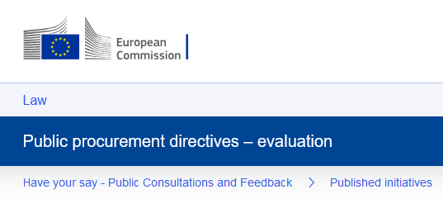
Revision of EU procurement directives
Ongoing evaluation by European Commission
Hundreds of replies to open public consultation and call for evidence
Input from public authorities, business, wide range of stakeholders
Many targeted consultations, meetings, studies
First draft proposal by Q4 2026

Slide 16
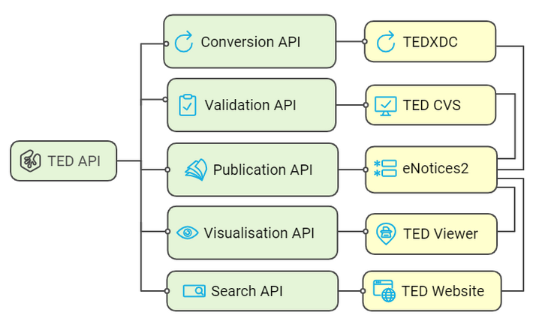
TED API v3
Version 3 of TED API deployed in Preview and Production on 14 March
New consolidated documentation https://docs.ted.europa.eu/api/latest/index.html
Unified gateway, rationalised URLs, single Swagger https://api.ted.europa.eu/swagger-ui/index.html
Includes API to search TED website notices
Current API (v2) will be supported until 30 September 2025
6 months to:
  Update API endpoint URLs
  Change /submit parameter to "noticeAuthorLang"
Unified version for all APIs, always 2 versions available https://docs.ted.europa.eu/api/latest/versioning.html

Slide 17


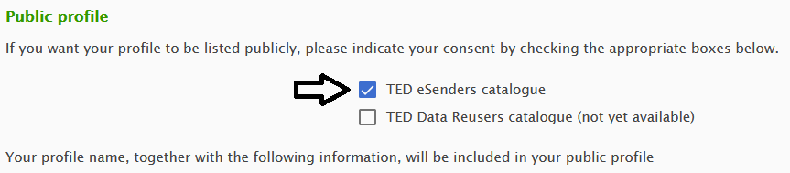
eSender catalogue on TED website
New public list of eSenders published on TED
      https://ted.europa.eu/en/simap/list-of-ted-esenders
22 eSenders opted in to share their public profiles from TED Developer Portal
We encourage the rest of eSenders to be listed so buyers discover your services
List curated by OP to only include active eSenders – let us know when you go live
Plans to improve TED page and Developer Portal profile

Slide 18

OJS publication time on TED
OJS is published on TED every working day (of release calendar)
Published no later than 9:00
  but can be published any time after midnight (often by around 0:15)
Sync job at OP checks TED as from 8:30
  updates notice status to Published
  triggers emails to buyers (noticeAuthorEmail)
  allows eSenders to sync status in own systems
Proposal: start sync earlier in the morning, e.g. from 0:30
  What about buyer expectations if sometimes don’t get notifications until 9:00?
  Other side effects?
Image by PIRO from Pixabay

Slide 19
THANK YOU FOR YOUR ATTENTION
Links​
​https://docs.ted.europa.eu​ - Developer guide, APIs, Preview, FAQ, every SDK version…​
​https://github.com/OP-TED/​ - Components and code for developers, SDK, discussions…​
​https://op.europa.eu/en/web/ted-eforms - OP eSender workshops
Any questions?​
Business TED helpdesk: https://ted.europa.eu/en/contact
  Helpdesk response time down to 3 calendar days on average (peaked at 9 days last year)
Technical: https://github.com/OP-TED/eForms-SDK/discussions/ ​

