Slide 1
eForms SDK – status update
Ioannis Rousochatzakis, Publications Office, 20/03/2024

Slide 2
Agenda
SDK 2 – Quick update
SDK Explorer – Demo
SDK 1.12.0 – Business Entities

Slide 3
SDK 2
Quick update

Slide 4
SDK 2 – what’s the hold up?
Work paused for several months.
  Restarting now.
SDK 2 is about updating EFX.
  To improve notice visualisation (view templates)
  To add support for complex rules
More pre-releases will follow as we progress.
Final release Q1 2025.

Slide 5
SDK EXPLORER
Quick intro & demo

Slide 6
SDK Explorer
New tool – Compares SDK versions
Announced December 2023
Released January 2024
Purpose:
  Help eSenders to migrate from older to newer versions of the SDK
  Improve the visibility and understanding of the SDK contents
Made for both technical and non-technical users

Slide 7
Quick DEMO

Slide 8
SDK Explorer – What’s missing – What’s next
Auto summarise changes
Compare Rules
Your suggestions…

Slide 9
Business entities
To be introduced in SDK 1.12

Slide 10
Business Entities – what are they?
Business Entities tell us how different fields combine to form a business concept.
Introduced to solve current issues
Important the future of the SDK
Wait a minute!
Isn’t that what a Business Group is?
  No; BGs can’t play this role
What about Nodes?
  No; Nodes have a different role
What about Display Groups from Notice Types?
  Still no; Display Groups have a different role

Slide 11
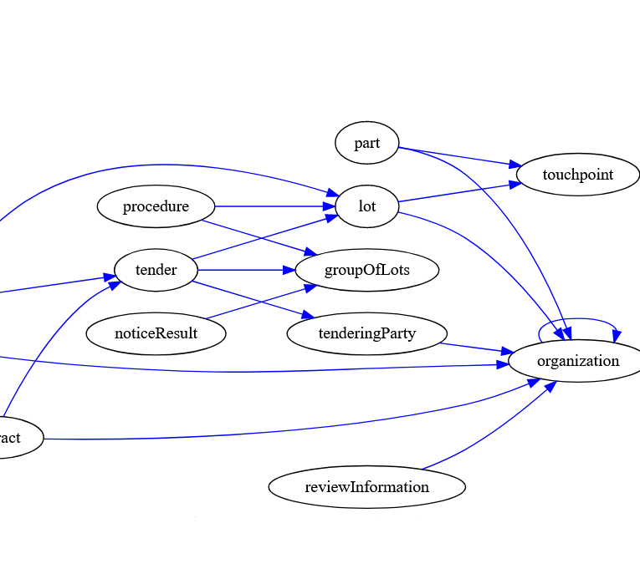
Business Entities – basic facts
They come as a new section in fields.json.
Every field “belongs” to one Business Entity.
Identifiers (id fields) identify Business Entities.
Cross-references (id-ref fields) reference Business Entities.
Business Entities can repeat (of course)
  When they do, they are linked with the Node which they “repeat with”.
Business Entities provide information on
  How to generate and reference instance identifiers for them
  How to reference them in Change Notices

Slide 12
How are Business Entities different from Nodes?
Nodes
Business Entities
How fields combine to form business concepts
Where fields are placed in the XML
Physical model
Logical model

Slide 13
Why “Business Entities” instead of BGs?
Business Entities
Business Groups
Implementation
Regulation
Normalised
Descriptive
Group BTs
Group Fields

Slide 14
Hierarchical structures in the SDK
Physical Model
Nodes
Logical model
Business Entities
Visual Model
Display Groups
Fields
Fields
Fields
XML Generation
Cross-referencing
Forms

Slide 15
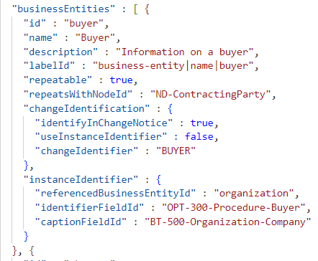
Business Entities – what do they look like?
Linked to a Node when repeating
Provide information for instance identification
Provide information on how to identify them in change notices
Every Field belongs to one Business Entity

Slide 16
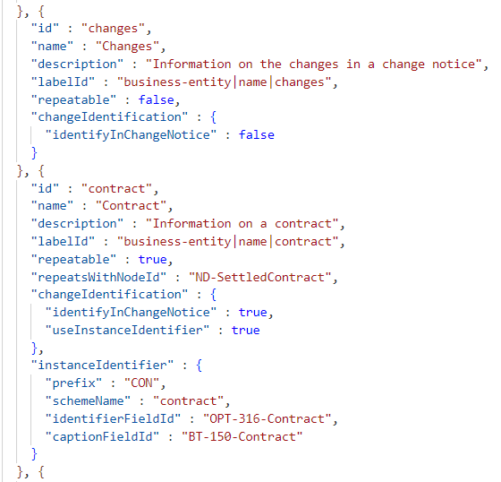
Business Entities – what do they look like?
Linked to a Node when repeating
Provide information for instance identification
Provide information on how to identify them in change notices
Every Field belongs to one Business Entity

Slide 17
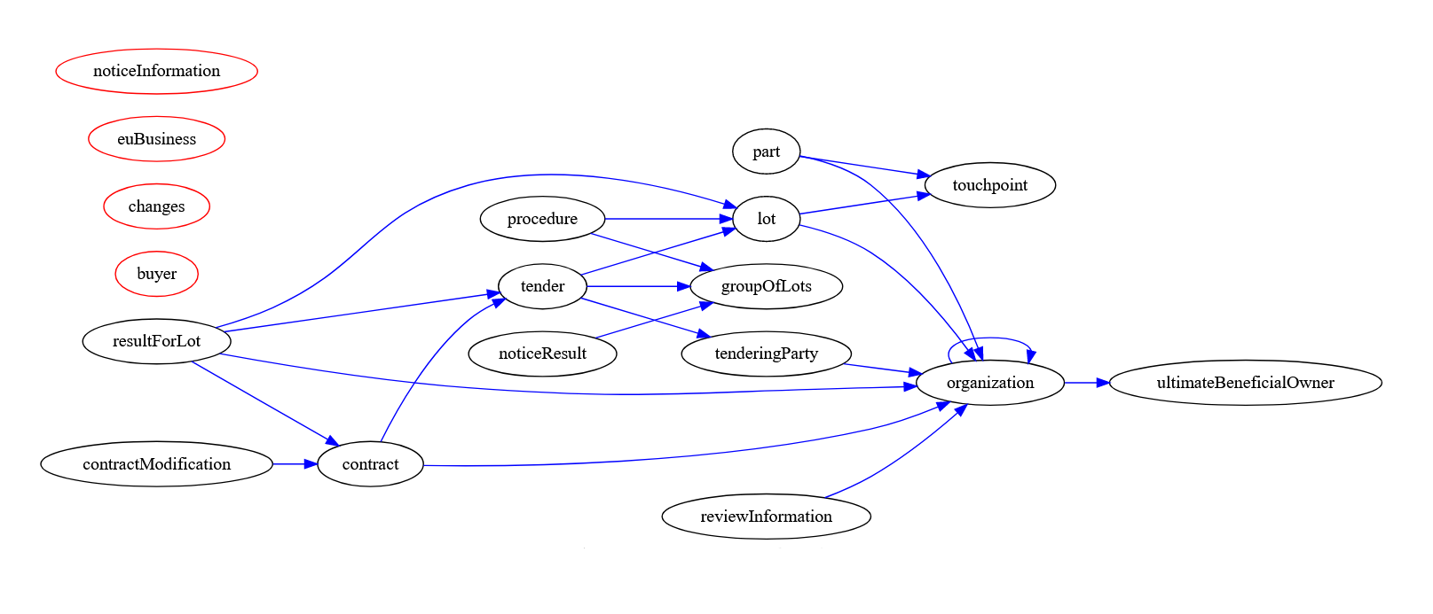
Business Entities in SDK 1.12.0

Slide 18
Business Entities – Current use cases
Generating identifiers
  Replaces the current solution and overcomes its limitations
Cross-referencing
  Linking id-ref fields with identifiers that were not possible in previous versions of the SDK
Change notices
  Simplify/automate filling-in of change section

Slide 19
Business Entities – future evolution
Planned for 2025
  Alignment with the eProcurement Ontology classes
  Composition - “has …” relationships
  Inheritance – “is …” relationships
Possible (but not yet planned)
  Alignment with Business Groups
  (future updates to the regulation)
  To be used by EFX 3 to simplify expressions

Slide 20
Thank you

