Slide 1
What’s up eForms? A policy outlook
TED eSenders annual seminar
DG GROW G4

Slide 2
eForms amendment 2023

Slide 3
eForms amendment 2023
New topics
Foreign Subsidies Regulation (FSR)
International Procurement Instrument (IPI)
Energy Efficiency Directive (EED)
New voluntary forms
Improvements
Exclusion grounds/selection criteria
Other

Slide 4
Foreign Subsidy Regulation
On 12 July 2023, the Foreign Subsidies Regulation (‘FSR’) (EU) 2022/2560 started to apply. This new set of rules enables the Commission to address distortions caused by foreign subsidies allows the EU to ensure a level playing field for all companies operating in the Single Market, while remaining open to trade and investment.
https://eur-lex.europa.eu/eli/reg/2022/2560/oj
Competition notice
BT-681 | Foreign Subsidies Regulation | Indicator | The Foreign Subsidies Regulation (FSR) (EU) 2022/2560, in line with Article 28 thereof, is applicable to this procurement procedure.
Result notice
BT-682 | Foreign Subsidies Measures | Code | Measures applied under the Foreign Subsidies Regulation (EU) 2022/2560.
BG-716 | Review | - | Information about a review request or a review decision.

Slide 5
International Procurement Instrument
On 29 August 2023, the International Procurement Instrument (‘IPI’) Regulation (EU) 2022/1031 entered into force. The IPI introduces measures limiting non-EU companies’ access to the open EU public procurement market if their governments do not offer similar access to public tenders to EU companies seeking business. By fostering reciprocity, this tool aims to open up these protected markets and to end the discrimination against EU companies in third countries.
https://eur-lex.europa.eu/eli/reg/2022/1031/oj
Result notice
BT-684 | International Procurement Instrument Regulation | Indicator | The International Procurement Instrument (IPI) Regulation (EU) 2022/1031 is applicable to this procurement procedure.
BG-681 | Information on IPI Measures | - | The list of IPI Measures that were applied to this tender.
BT-685 | Specific IPI Measure | Code | Information on the IPI Measure applicable to this tender.
BT-686 | Number of tender applications to which this IPI Measure was applied. | Number | Number of requests to participate and tenders to which this IPI Measure was applied, in the case of a public contract; number of requests to participate and projects, in the case of a design contest.
BT-687 | Exception to the application of the IPI Measure | Code | Exception from the application of the IPI Measure.
BT-688 | Overriding reasons relating to the public interest | Text | A description and justification for the application of overriding reasons relating to the public interest.

Slide 6
Energy Efficiency Directive
Energy efficiency helps reduce overall energy consumption and is therefore central to achieving the EU’s climate ambition, while enhancing present and future energy security and affordability. To ensure that the EU’s 2030 target of reducing greenhouse gas emissions by at least 55% (compared to 1990) can be met, the Commission has revised the Energy Efficiency Directive (EU) 2023/1791, together with other energy and climate rules. It will enter into force on the 12 October 2025.
https://eur-lex.europa.eu/eli/dir/2023/1791/oj
Competition notice
BT-810 | Energy Efficiency Directive (EED) | Indicator | The Energy Efficiency Directive (EED) (EU) 2023/1791 is applicable for this procurement procedure.
BT-811 | EED product list | Code | List of products covered by the Energy Labelling Directive, by the Ecodesign Directive, by Union green public procurement criteria, by Regulation 2020/740 and buildings, not being rented or purchased for the purposes listed in EED Annex IV point f) (i), (ii) and (iii).
Result notice
BG-810 | EED information | - | Information on the energy efficiency of the products selected in BT-811.
BT-812 | Energy Efficiency Label | Code | Energy efficiency labels that are provided for the products (A+++, A++, A+, A, B, C, D).
BT-813 | Energy Efficiency Numeric Value | Number | Energy efficiency numeric values for products and services for which no label exist.
BT-814 | Energy Efficiency Unit | Code | The unit of the energy efficiency number, for example, kWh/year.
BT-815 | Energy Efficiency Quantity | Number | The quantity provided or estimated for the product or service.

Slide 7
New voluntary forms
Voluntary forms can be voluntarily be used.
Name | Type
E1 | Pre-market consultation notice
E2 | Prior information notice
E3 | Contract notice
E4 | Award notice
E5 | Completion notice
E6 | Contract modification notice

Slide 8
Exclusion grounds and selection criteria
Simplification of how to apply exclusion grounds and selection criteria.
Competition notice
BG-700 | Exclusion Grounds and Selection Criteria | - | Information about the exclusion grounds and selection criteria used for this procurement procedure.
BT-806 | Exclusion Grounds Source | Code | Where the exclusions grounds are defined, for example, the procurement documents or in ESPD.
BG-701 | Exclusion Grounds | - | The brief description of criteria regarding the personal situation of tenderers that may lead to their exclusion. This shall include a list of all such criteria and indicate required information (e.g. self-declaration, documentation). This may also include specific national exclusion grounds.
BT-67(a) | Exclusion Ground | Code | The criteria (or criterion) of the given type are (is) used, unused, or (in case of prior information notice used as a call for competition or to reduce time limits) the use is not yet known.
BT-67(b) | Exclusion Ground Description | Text | The brief description of the exclusion criteria (or criterion).
BT-821 | Selection Criteria Source | Code | Where the selection criteria are defined, for example, the procurement documents or in ESPD
BG-702 | Selection Criteria | - | Information about the selection criteria (or criterion). All criteria must be listed. This information may differ per lot.
BT-1378 | Selection Lot Identifier | Identifier | An identifier of one or more lots. The information in the selection criteria section refers to this lot or these lots.
BT-809 | Selection Criteria | Code | The criteria (or criterion).
BT-750 | Selection Criteria Description | Text | The brief description of the selection criteria (or criterion), including minimum requirements, required information (e.g. self-declaration, documentation) and how the criteria or criterion will be used to select candidates to be invited for the second stage of the procedure (if a maximum number of candidates was set).

Slide 9
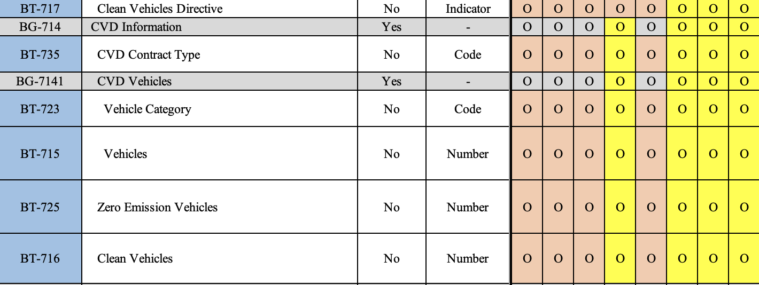
Other improvements
Improvements of descriptions.
Harmonisation of fields for CVD.
With this amendment, there is no difference between the legal annex and the spreadsheet.

Slide 10
Timeline eForms amendment 2023
20 December 2023 Adoption
1 June 2024 FSR and IPI can be used
1 November 2024 optional use
Transition period
28 February 2025 mandatory use

Slide 11
A policy outlook

Slide 12
A policy outlook for 2024
The eForms amendment 2022 was triggered through improving CVD
The eForms amendment 2023 was triggered through the needs of FSR/IPI
Currently (at this point in time) – there is no trigger
We will work on:
Work on guidelines (FSR, IPI and more)
Further harmonize eForms
Understanding the use of eForms through PPDS (Public Procurement Data Space)

Slide 13
eForms and PPDS

Slide 14
Poor exploitation of public procurement data
250.000 Public buyers
Sectors
Numbers
EUR 2 Trillion or 13,6% of GDP
Infrastructure
Education
Social protection
Above thresholds (TED)
Energy
Health
Below
Thresholds (MS)
Waste

Slide 15
Harnessing the power of procurement data
Targeting public funds towards policy priorities
Helping recovery from the pandemic
Increasing transparency and integrity
Ensuring wider uptake of sustainable and social procurement
The PPDS will help e.g. to monitor the RRF
The PPDS helps to fight collusion
Easy access for companies, SMEs, to tenders across the EU
Value for money for public buyers & less red tape
Cutting red tape
Generating key insights for policy-making
The PPDS will support SMEs and data reusers
Plan, buy in bulk & easier reporting
The PPDS will become a strategic asset for policies

Slide 16
The PPDS for reporting
Reporting or monitoring obligations should be as much as possible based on data and not text
It is necessary to define in a collaborative process on how the data can be collected. For public procurement on EU level, this will be done through notices.
The PPDS will provide several dashboards on different aspects like:
Foreign Subsidies Regulation, International Procurement Instrument, Energy Efficiency, Green/Social and Innovative Procurement

Slide 17
The Public Procurement Data Space
Client Layer
User Interface
User rights management: e.g. EC, Member States, research, business, general public
Ensure user-friendliness
Access to open data through data.europa.eu
New Insights
Data-driven decisions
KPIs on priority policy areas
Better data quality due to eForms
Harmonized data through ePO
Collaborative approach
Analytics Layer
Analytics services
Integration Layer
eProcurement ontology
Data quality check
TED data
TED data
TED data
Other public/ private data
Data Sources Layer
TED data
Member State National Publication Portal / Contract register
17

Slide 18
Timeline PPDS in 2024
Connect interested Member States
Summer 2024 go live
Enhance data analytics
Analyse data quality

Slide 19
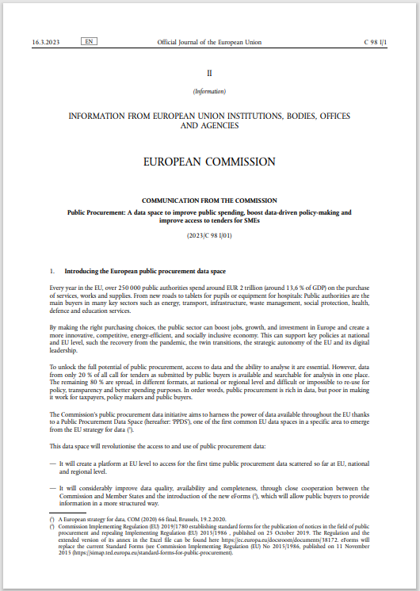
Communication and ECA report
Communication on PPDS
Video on PPDS
Other links on PPDS
https://europa.eu/!qx9WxQ
Report from the European Court of Auditors on less competition in public procurement
https://www.eca.europa.eu/en/publications/SR-2023-28

Slide 20
Open Source Event on 1 February 2024
EC organises a physical event on open source in Brussels on 1 February 2024.
The workshop we will offer discussions about key areas where open source can provide to achieve Digital Autonomy.
There is also a session on data spaces where we will say something on the PPDS.
You can register and check out the preliminary agenda of the upcoming workshop here: https://digital-strategy.ec.europa.eu/en/events/workshop-open-source-key-areas-digital-autonomy

Slide 21
Thank you
© European Union 2023
Unless otherwise noted the reuse of this presentation is authorised under the CC BY 4.0 license. For any use or reproduction of elements that are not owned by the EU, permission may need to be sought directly from the respective right holders.
Notes:
Update/add/delete parts of the copy right notice where appropriate.
More information: https://myintracomm.ec.europa.eu/corp/intellectual-property/Documents/2019_Reuse-guidelines%28CC-BY%29.pdf

