Slide 1
Navigating Reference Data:
Advanced Techniques for Editing, Visualising and Retrieving Reference Datasets
Anikó Gerencsér
Publications Office of the European Union
Team leader – A1 002. Reference Data
Extended Semantic Web Conference
11 May 2026

Slide 2

Schedule
Demos
Introduction (30 minutes)
Break
Exercises
SELEN, Cellar, EU Vocabularies demo (20 minutes)
VocBench demo (30 minutes)
ShowVoc demo (30 minutes)
Hands-on training (1 h 10 minutes)
https://op.europa.eu/en/web/eu-vocabularies/conference-tutorials

Slide 3

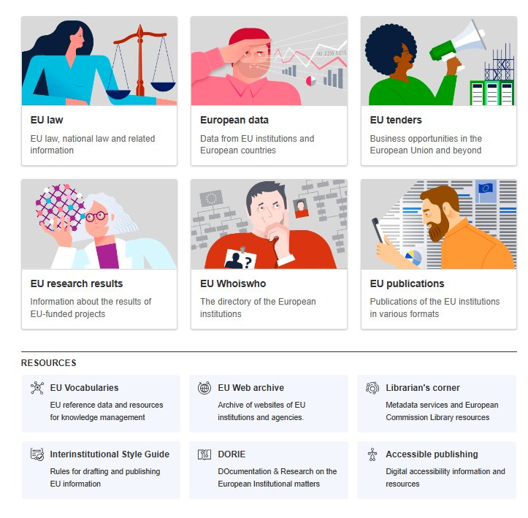
Publications Office of the European Union
Law, data, publications
Support EU policies and provide publishing services to the EU institutions, bodies and agencies
Central point of access to EU law, publications, open data, research results, procurement notices, and other official information
Provides findable, accessible, interoperable and reusable (FAIR) data
Supports transparency, economic activity, the development of modern technologies
Significant role in several of the EU’s political priorities: democracy, the economy, and digital transformation
Reference data team:
Standardisation of reference data, schemas, ontologies and linguistic resources across EU institutions

Slide 4
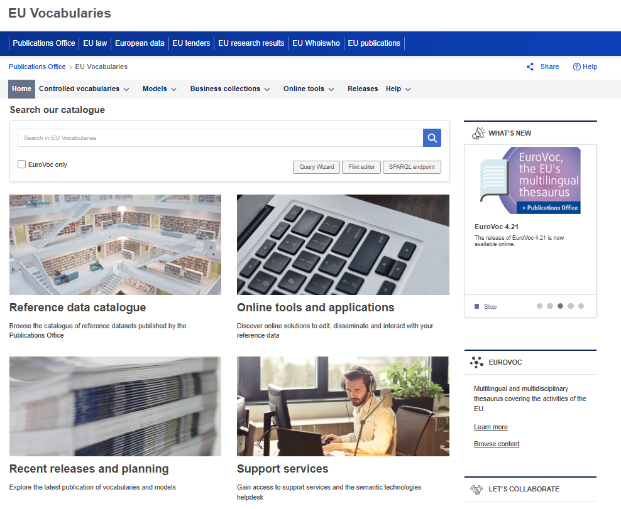
Publications Office of the European Union
EU Vocabularies
Gateway to reference data
Your central point of access to official EU reference data, tools, and services
Set of services
Creation & Update: Helping build new vocabularies and evolve existing ones.
Robust semantic tools
A Rich Catalogue: Home to ~300 actively maintained semantic assets (vocabularies, thesauri, code lists, data models) crucial for EU institutions and beyond
Maintenance: Ensuring quality and consistency.
Publication: Making assets discoverable and accessible (e.g., via Persistent URIs, Cellar, ShowVoc).
Training & Support: Empowering users to leverage these semantic assets effectively.
VocBench: Our collaborative platform for semantic asset creation and management.
ShowVoc: For user-friendly browsing and visualization.
Cellar: The EU's common data repository, providing SPARQL endpoints and machine-readable data.

Slide 5
What we do
Create, enrich, maintain and publish multilingual controlled vocabularies, available online on the EU Vocabularies website​
Provide services to all EU institutions in:
Creation and update of reference data
Semantic modelling
Data conversion and validation
Publication across various platforms
Training and support

Slide 6
Semantic assets
Authority lists
Taxonomies
Harmonised codes and labels used to support metadata exchange between EU institutions and beyond
Corporate bodies, Countries and territories, Currencies, Languages, Places
Eurostat statistical classifications, European Learning Model taxonomies, EuroSciVoc, AI Taxonomy
EuroVoc, Digital Europa Thesaurus, DE-BIAS Vocabulary
Ontologies
ELI ontology, ERA Vocabulary, AKN4EU schema, DE-BIAS ontology, eProcurement ontology
Thesauri
Application profiles
DCAT-AP and its specifications: Mobility DCAT-AP, Health DCAT-AP

Slide 7
Reference data maintenance workflow
Creation
Create or update a vocabulary​
Support in data modelling​
Maintenance
Semantic tools​
Technical support, configurations, data upload​
Publication​
Persistent URIs​
Multiple platforms
Training and support for reference data-related questions

Slide 8
Semantic modelling services
Semantic modelling
Support to EU institutions
Data conversion to semantic formats
Tools
VocBench: reference data editing
Scripts
Semantic models
Reuse of existing standards and models
Widely used ontologies (DCT, FOAF, LEMON)
Open source converting tools
W3C standards (SKOS, OWL)
Euvoc ontology
Excel -> RDF
Interoperability between systems

Slide 9
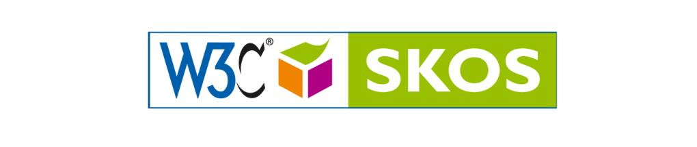
SKOS and modelling
EU Vocabularies are modelled using SKOS
Core modelling principles
One concept = one meaning
One preferred label per language
Multilingual labels attached to the same concept
Semantic structure
Hierarchical relations (broader / narrower)
Associative relations (related)
In practice
Reuse of standards (SKOS, OWL, DC Terms)
Extension of SKOS with domain-specific patterns (e.g. EUVOC, SKOS-XL for labels)
Advanced modelling aspects
Management of notations and codes alongside labels
Handling of lifecycle states (valid, deprecated, replaced concepts)
Versioning and temporal validity of concepts
Interlinking & alignment
Links between vocabularies (cross-domain mappings)

Slide 10
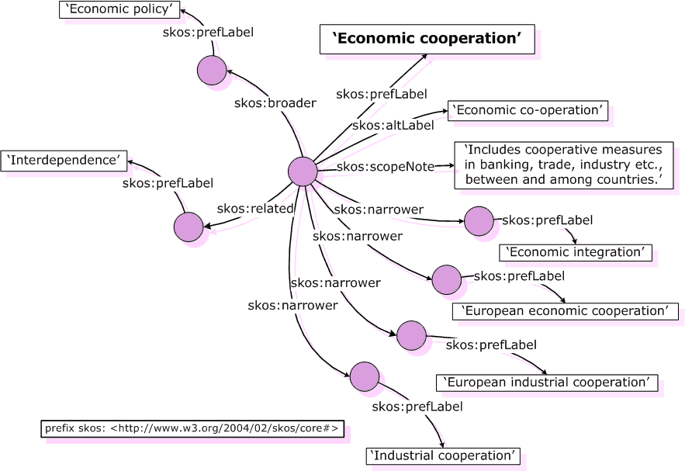

Slide 11
Collaborations
EU institutions
Data spaces
Legal
Public Procurement
Cultural Heritage
Mobility
SEMIC community
Support in the maintenance and publication of reference data
Controlled vocabularies reused in DCAT-AP
Semantic repository of data models
AI factories
Data for AI
Corpus for training AI models

Slide 12
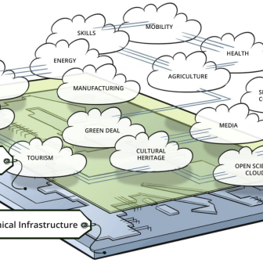
Ongoing collaborations with Data Spaces
EU Vocabularies provides the essential semantic infrastructure necessary for data interoperability across Common European Dataspaces
Health
Reuse of existing vocabularies
Creation and maintenance in VocBench
Reuse of existing vocabularies
Visualisation in ShowVoc and page on EU Vocabularies
Legal
Reuse of existing vocabularies
Creation and maintenance in VocBench
Mobility
Cultural Heritage
DE-BIAS vocabulary: data modelling
Creation and maintenance in VocBench
Structuring of language data (AKN4EU)
Public Procurement
Reuse of existing vocabularies
Creation and maintenance in VocBench
Creation of controlled vocabularies (ERA)
Publication on EU Vocabularies
Publication on EU Vocabularies

Slide 13
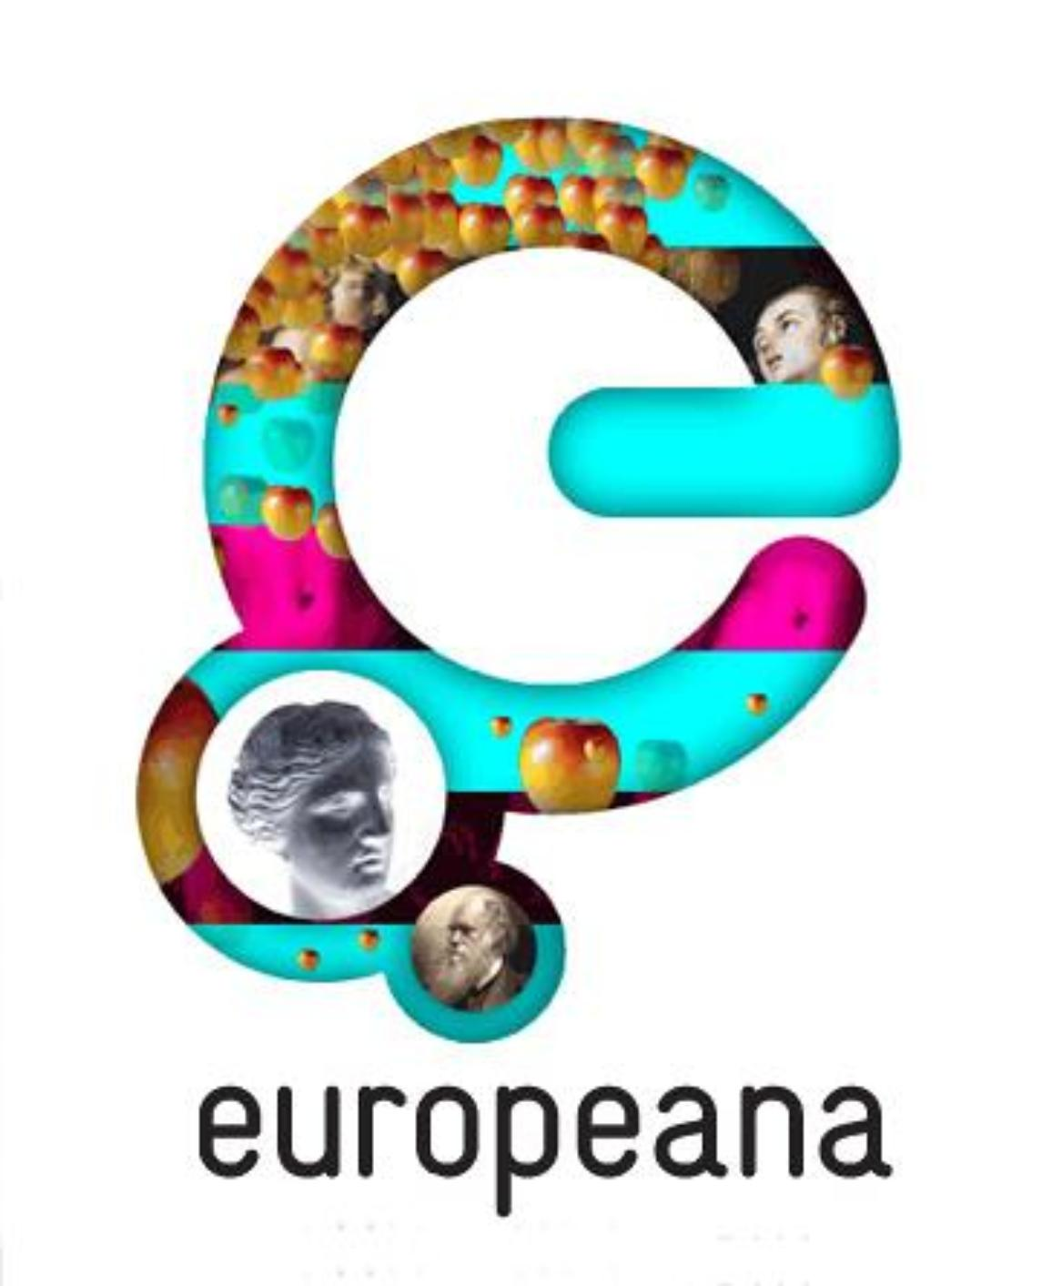
Cultural Heritage Data Space
DE-BIAS vocabulary on EU Vocabularies
The DE-BIAS Vocabulary and its companion Ontology are published as SKOS datasets on the platform, providing ~700 flagged terms (5 languages) with contextual notes and neutral alternatives.
Integrated bias check
During enrichment, the DE-BIAS tool calls those SKOS URIs to detect harmful/derogative descriptors, display explanations to curators, and suggest inclusive replacements—so collections become both interoperable and ethically described before they go live on the Europeana website.

Slide 14
Data for AI: Corpus for automatic semantic tagging
For semantic tagging systems to perform reliably across multilingual, domain-specific European Dataspaces, they must be trained, validated, and benchmarked on high-quality, representative datasets
Selection of representative and diverse raw data
    Collect datasets covering all relevant domains, languages, formats, and types of information
Manual expert annotation (Human-in-the-Loop)
    Domain experts manually annotate data using EuroVoc
Benchmarking and evaluation
    Auto-tagging tools are tested against the golden dataset
https://op.europa.eu/en/web/eu-vocabularies/ai-data

Slide 15
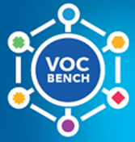
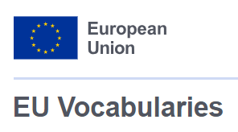

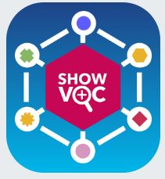

A variety of tools for:
Browsing
Accessing
Editing
Querying

Slide 16
vocbench

Slide 17



What is VocBench?
An open source, collaborative vocabulary management tool based on semantic technologies
Lore Star (University of Rome Tor Vergata) in collaboration with POSIT
Digital Europe Programme of the European Commission
Publications Office of the European Union
Notes:
Introduction:
VB is an onlne collaborative tool for editing and maintaining semantics assets and controlled vocabulary
It is developped by the University of Rome Tor Vergate, ISA², The Publications Office of the EU and Infeurope
The Publications Office provides corporate access for EU institutions, EU Member States and International organisations

Slide 18
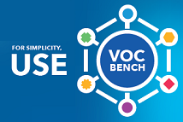
What is VocBench?
Open source and web-based
Use of semantic technologies
Maintenance of controlled vocabularies
Designed for large scale multilingual vocabularies
Collaborative workflow
RDF-based
SKOS, OWL, ONTOLEX
SPARQL
SHACL validator

Slide 19

VocBench: editing tool
Online editing tool of controlled vocabularies
Based on semantic technologies
Designed for large scale multilingual vocabularies
Collaborative features
Enhanced user management
Support of Linked Data functionalities

Slide 20
showvoc

Slide 21
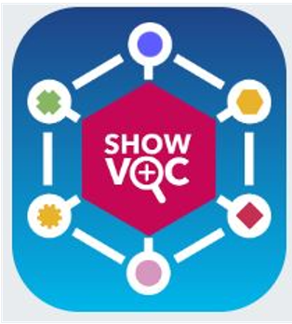
ShowVoc: visualisation tool
User-friendly browsing interface
Support of alignments
Enhanced visualization features
Global search
Dissemination of semantic datasets

Slide 22
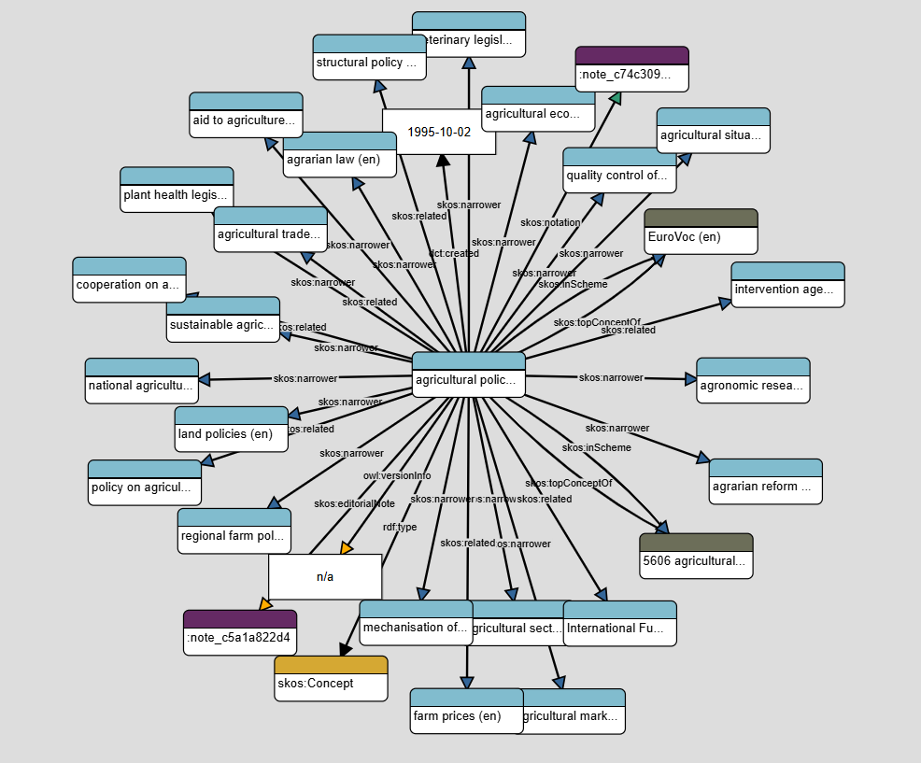
Semantic Alignment
Over 20 alignment files available on EU Vocabularies to support linked data and semantic interoperability
Tools that support the creation, visualisation and publication of alignments: VocBench, ShowVoc, SELEN, Cellar and EU Vocabularies

Slide 23
selen

Slide 24
SELEN: tagging orchestrator
Automatic document tagging
Tagging service based on Annif
Integration with VocBench
Suggestion of keywords based on a reference thesaurus
Review and validation

Slide 25
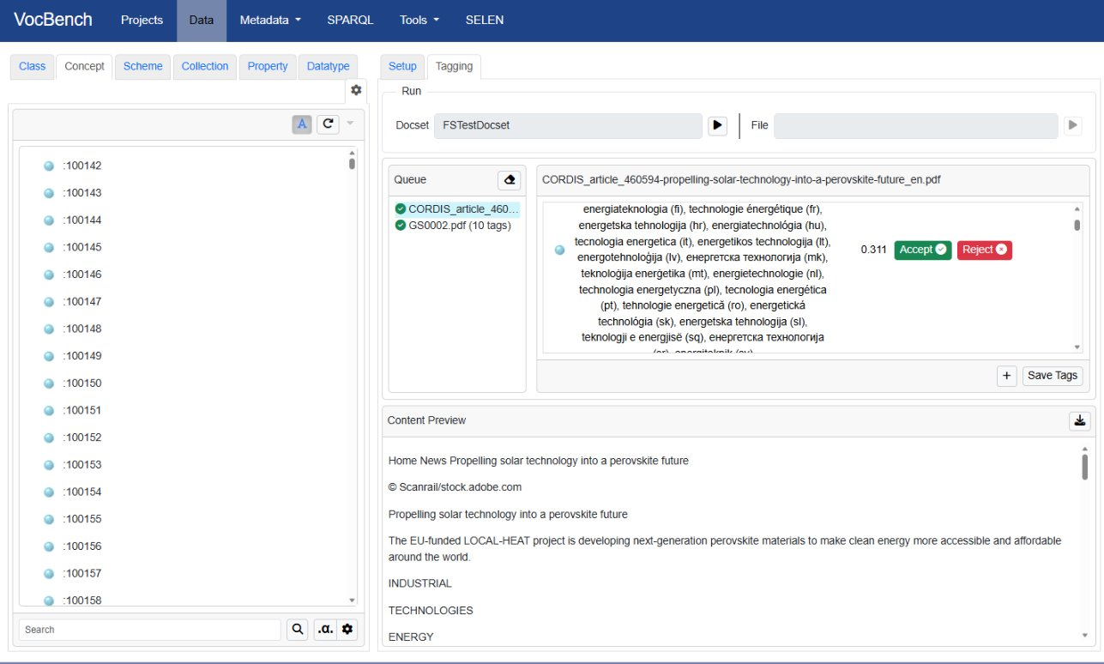

Slide 26
Publication platforms:
Cellar and EU Vocabularies

Slide 27
Publication platforms: Cellar and EU Vocabularies
Semantic data repository
Features: API, SPARQL endpoint, machine-readable data
Access: http://publications.europa.eu/webapi/rdf/sparql
Reference data catalogue
Features: Browsing and searching, multiple display views, human-readable access
Access:
https://op.europa.eu/en/web/eu-vocabularies
Additionally: https://data.europa.eu/ - the central point of access to European open data from international, European Union, national, regional, local and geodata portals

Slide 28

Pilot project on Incremental Publications
Moving from static publication to event-driven updates
Continuous synchronisation of vocabularies
Key concepts
Incremental updates
Versioning and change tracking
Real-time consumption by systems

Slide 29

Contact us
EU VOCABULARIES
https://op.europa.eu/en/web/eu-vocabularies/home
OP-EU-VOCABULARIES@publications.europa.eu
aniko.gerencser@publications.europa.eu

