Slide 1
Navigating Reference Data:
Advanced Techniques for Editing, Visualising and Retrieving Reference Datasets
Anikó Gerencsér
Publications Office of the European Union
Team leader – A1 002. Reference Data
Extended Semantic Web Conference
11 May 2026

Slide 2
Exercises

Slide 3
vocbench

Slide 4

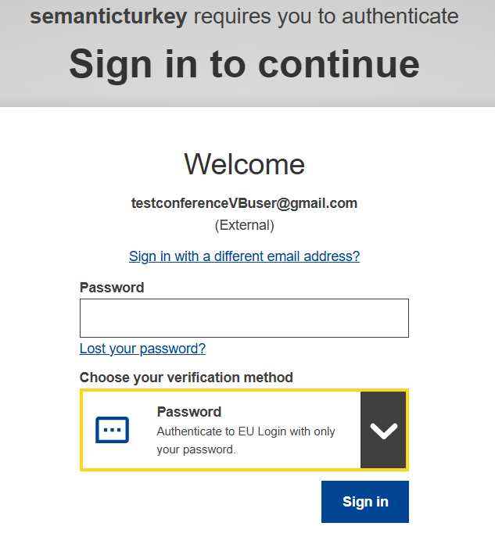

Access and login
Open https://vocbench.op.europa.eu/
Click on SAML Login
The page will be redirected to EU Login
Credentials:
  testconferencevbuser@gmail.com
  Choose authentication method: Password
  conference2026!
Once logged in, click on the top left of the screen: Current project
Choose ESWC_tutorial and click on “access”

Slide 5

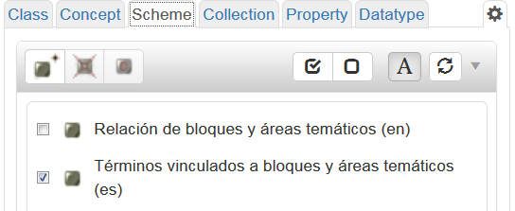
Create a concept scheme
Select the project
Click on Data on the top bar
Click on the Scheme button and then on the Create a concept scheme button
Type the label “scheme_[your initials]” and select the language
Set the URI of the concept scheme: if you leave empty the URI field an URI will be generated by default
Select the concept scheme by clicking on the tick box next to it

Slide 6

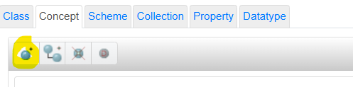

Create a concept
Move to the concept tree by clicking on the “Concepts” button
(Note: the concept scheme has to be selected)
Click on the Create concept button
Create a new concept
  Add a preferred label
  Select the language of the label
  Leave it empty to automatically generate the URI of the concept
Create a narrower (child) concept
  Click on the second button from the left
  Repeat the same operations as above

Slide 7
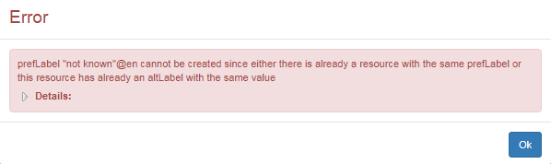
Labels: restrictions and validations
Every concept has to have at least one preferred label
Every concept can have only one preferred label per language
If we create a new label that already exists we have a warning
We can add multiple alternative labels per language
A preferred and an alternative label cannot be the same (warning)

Slide 8
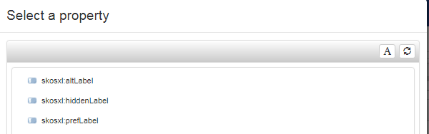
Add labels
skosxl:prefLabel (preferred label)
skosxl:altLabel (acronyms, synonyms)
Lexicalisations
  If there is already a value (one prefLabel) click on “+” next to the type on the right of the screen
  If you want to add a new type (skosxl:altLabel), click on the yellow box next to Lexicalisation and select the type

Slide 9
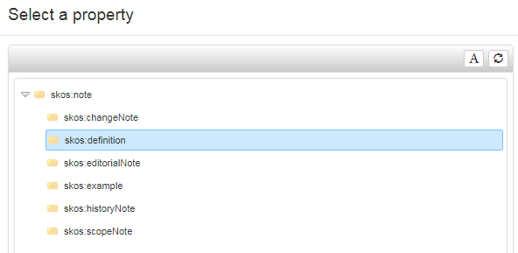
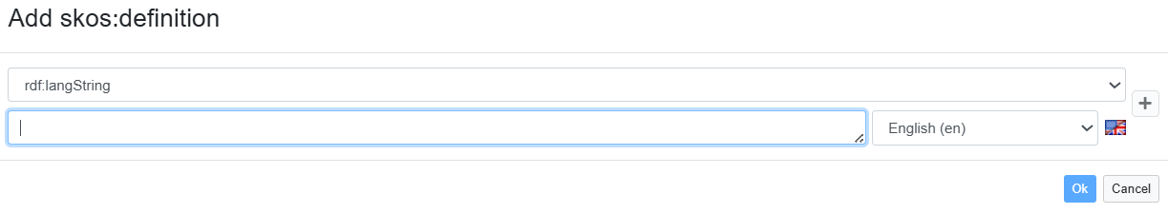
Add notes (definitions / scope notes / history notes)
Add definition
  Notes -> yellow box on the right
  Select skos:definition
  Type: literal
  rdf:langString
  Add the note

Slide 10
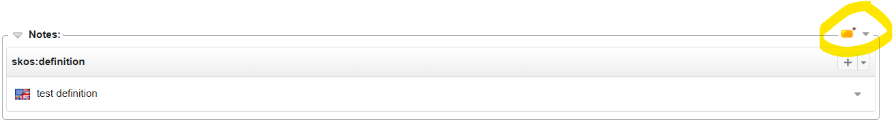
Add notes: if the type already exists
Click on the + button next to the type of note (definition/scope note/history note / editorial note)
Add the note and select the language

Slide 11
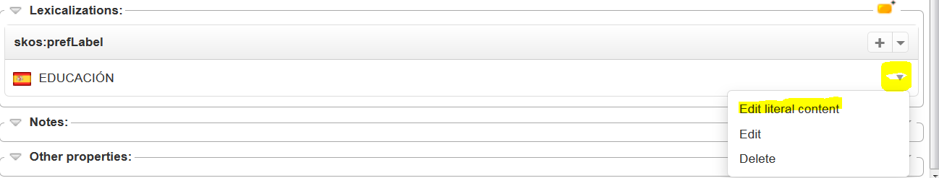
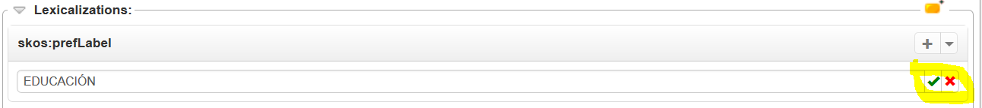
Modify a label / note
Click on the arrow pointing down next to the label to be modified
Select “edit literal content”
Edit the label and press the green check sign

Slide 12

Deprecate a concept
Create a new concept and name it "old concept"
Click on “Deprecate concept”
Add skos:historyNote
  Plain literal
  "This concept was used until 1/03/2019"
Add an end date
  Other properties (note: tick the Show all properties box)
  euvoc:endDate
  Typed literal
  xsd:date: (1/03/2019)

Slide 13
History
Click on “History” (top row)
  Click on the Commit ID to see the details
  Click on the “…” (Other parameters) to open the details of the operation

Slide 14
showvoc

Slide 15
ShowVoc
Search in datasets
Global search, e.g. Germany
Alignments (e.g. Combined Nomenclature)
Translation

Slide 16
ShowVoc – Search in datasets
Look for the EuroVoc thesaurus
How many results are related to climate change?
  Why reduction of gas emission appears in the results?
How can you can only the results that correspond exactly to “climate change”?
  How many results do you get?
  Open one of the result in graph view
  Select only the related concepts
  Save the image

Slide 17
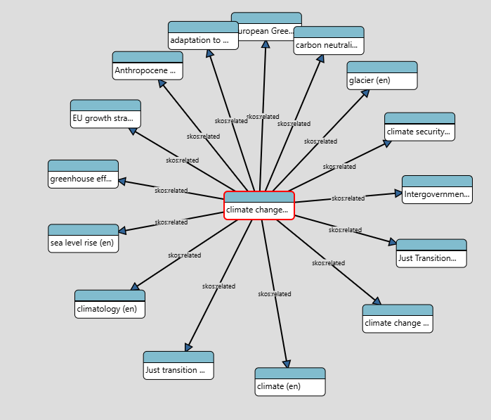
ShowVoc – Search in datasets
Look for the EuroVoc thesaurus
How many results are related to climate change? 9 results.
  Why reduction of gas emission appears in the results? The term climate change appears in the alternative labels.
How can you can only the results that correspond exactly to “climate change”? Advanced search
  How many results do you get? 1 exact match
  Open one of the result in graph view – Select data-oriented graph
  Select only the related concepts
    Unselect all the properties and select only skos:related

Slide 18
ShowVoc – Search through datasets
Use the global search and look for Germany?
  In how many datasets the concept appears?
  How many concepts in Countries and territories?
  Search again using the Exact string match mode, how many results?
Open the Germany in the countries and territories dataset
  Modify the language settings (e.g. try German) and refresh the page

Slide 19
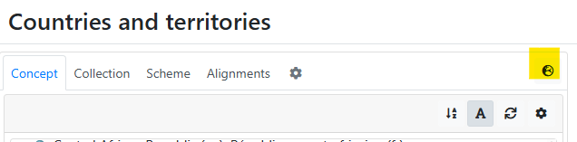
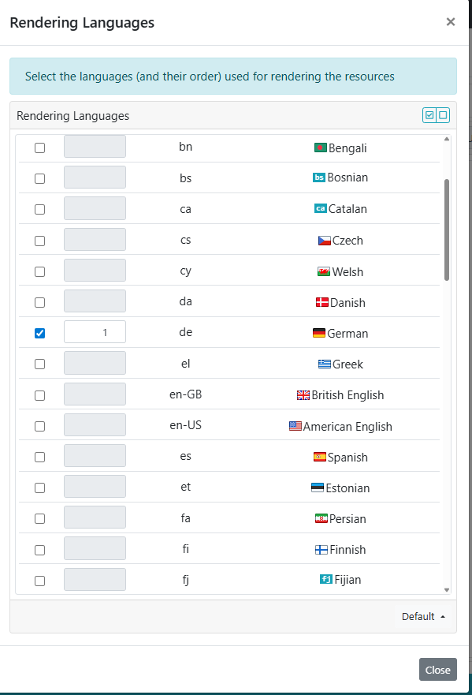
ShowVoc – Search through datasets
Use the global search and look for Germany?
  In how many datasets the concept appears? 17 datasets.
  How many concepts in Countries and territories? 3 concepts containing Germany.
  Search again using the Exact string match mode, how many results? 4 matches in 4 datasets.
Open the Germany in the countries and territories dataset
  Modify the language settings (e.g. try German) and refresh the page

Slide 20
ShowVoc – Translation
What does Det Rådgivende Udvalg for Kontrol med Fusioner og Virksomhedsovertagelser (DA) means in English?
  Tip: you can type in only a part of the label (e.g. Udvalg for Kontrol)
What is the German translation of Audit Board of the European Communities?
  Open the results
  Why the concept appears in grey?
  What is the new concept for Audit Board of the European Communities?

Slide 21
ShowVoc – Translation
What does Det Rådgivende Udvalg for Kontrol med Fusioner og Virksomhedsovertagelser (DA) means in English? Advisory Committee on Concentrations
What is the German translation of Audit Board of the European Communities? Kontrollausschuss der Europäischen Gemeinschaften
  Open the results
  Why the concept appears in grey? Because it is deprecated.
  What is the new concept for Audit Board of the European Communities? Court of Auditors

Slide 22
EU Vocabularies

Slide 23
EU Vocabularies – Search
Search for Germany
  How many results do you get?
  What is the difference between the results?
  What is the country calling code for Germany?
  What is the translation of the Federal Republic of Germany in Gaelic?

Slide 24
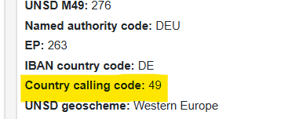
EU Vocabularies – Search
Search for Germany
  How many results do you get? 898 results
  What is the difference between the results? The concepts belong to different datasets.
  What is the country calling code and where can you find this information? 49 (the information appears in the list of codes on the concept page.
  What is the translation of the Federal Republic of Germany in Gaelic? Poblacht Chónaidhme na Gearmáine (you can change the complete webpage in Gaelic or just click on the GA label)

Slide 25
EU Vocabularies
What is the difference between in EuroVoc:
  European Parliament
  ECSC Common Assembly
What is the link between European Parliament and President of the EP in EuroVoc?

Slide 26
EU Vocabularies
What is the difference between in EuroVoc:
  European Parliament -> current concept (replaces ECSC Common Assembly)
  ECSC Common Assembly -> deprecated concept (is replaced by ECSC Common Assembly)
What is the link between European Parliament and President of the EP in EuroVoc?
  European Parliament is the broader term for President of the EP
  President of the EP is the narrower term for European Parliament

Slide 27
EU Vocabularies - Views
How many views are available on the dataset page (in any dataset)?

Slide 28
EU Vocabularies - Views
How many views are available on the dataset page?
Table view
List view
Tree view (hierarchical view)
Bonus: Advanced view (dataset details page)

Slide 29

EU Vocabularies – Search
What are the language(s) spoken in South Africa?
What is the currency of South Africa?
How can you find the concept without using the search bar?

Slide 30
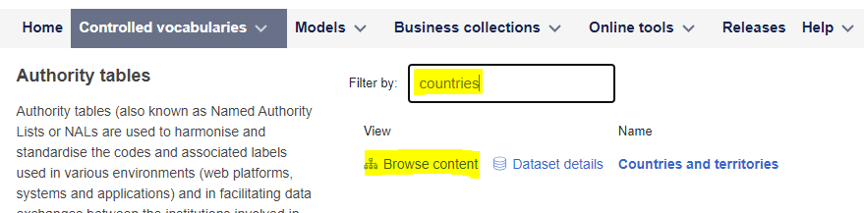
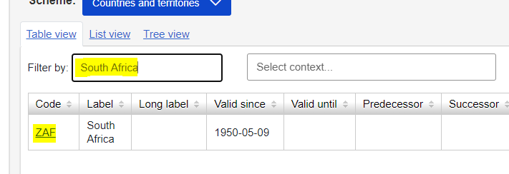
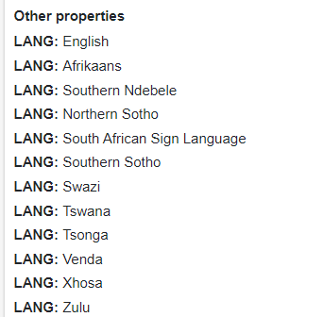
EU Vocabularies – Search
What are the language(s) spoken in South Africa?
  Open the Countries and territories list and click on Browse content
  User the filter option to search for South Africa and open the concept by clicking on the code (ZAF)
  Scroll down to see the list of properties
LANG: language spoken in the country
It is also possible to find the languages in the Language table

Slide 31
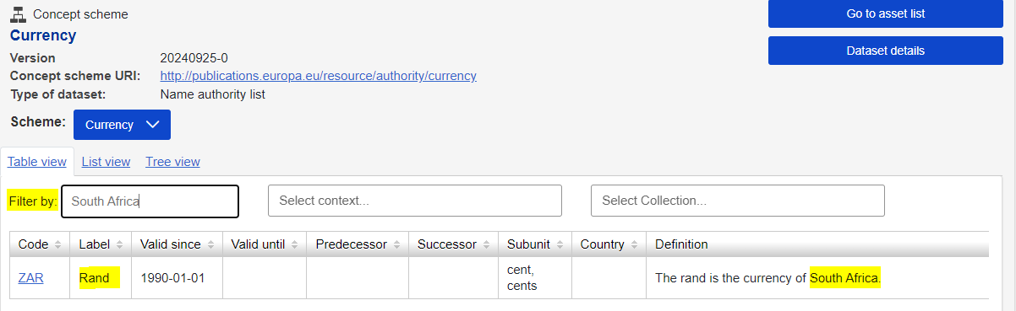
EU Vocabularies – Search
What is the currency of South Africa?
  Open the Currency table
  Use the filter option and search for South Africa

Slide 32
cellar
SPARQL queries
https://publications.europa.eu/webapi/rdf/sparql

Slide 33
Example SPARQL queries
Get all the object properties from the Country authority table
prefix cdm: http://publications.europa.eu/ontology/cdm#
prefix at: http://publications.europa.eu/ontology/authority/
prefix dc: http://purl.org/dc/elements/1.1/
prefix rdf: http://www.w3.org/1999/02/22-rdf-syntax-ns#
prefix rdfs: http://www.w3.org/2000/01/rdf-schema#
prefix owl: http://www.w3.org/2002/07/owl#
select ?objectProperty (COUNT(DISTINCT ?c) AS ?corporateBodiesCount)
from http://publications.europa.eu/resource/authority/country
where {
# Object properties
?c ?objectProperty ?o .
FILTER isIRI(?o) .
}
GROUP BY ?objectProperty

Slide 34
Example SPARQL queries
Get all the datatype properties from the Country authority table
prefix cdm: http://publications.europa.eu/ontology/cdm#
prefix at: http://publications.europa.eu/ontology/authority/
prefix dc: http://purl.org/dc/elements/1.1/
SELECT ?datatypeProperty (COUNT(DISTINCT ?c) AS ?corporateBodiesCount)
FROM http://publications.europa.eu/resource/authority/country
WHERE {
# Datatype properties
?c ?datatypeProperty ?literal .
FILTER isLiteral(?literal) .
}
GROUP BY ?datatypeProperty

Slide 35
Get all the deprecated concepts and their replacements from the Country authority table
prefix cdm: http://publications.europa.eu/ontology/cdm#
prefix at: http://publications.europa.eu/ontology/authority/
prefix dc: http://purl.org/dc/elements/1.1/
prefix rdf: http://www.w3.org/1999/02/22-rdf-syntax-ns#
prefix rdfs: http://www.w3.org/2000/01/rdf-schema#
prefix owl: http://www.w3.org/2002/07/owl#
PREFIX dcterms: http://purl.org/dc/terms/
SELECT ?deprecatedConcept ?replacement
from http://publications.europa.eu/resource/authority/country
WHERE {
?deprecatedConcept at:deprecated 'true' ;
dcterms:isReplacedBy ?replacement .
}

