Slide 1
Wouter van den Berg
TNO - ICT, Strategy & Policy
Practical Experiences with BOMOS, Semantic Treehouse, and GenAI
Building better data spaces

Slide 2


Wouter van den Berg
Self-proclaimed “interoperability geek”
10 years exp with open standardization of data exchange models & formats
Working at TNO
  Independent research & technology org. in the Netherlands
  Department of Data Ecosystems
  Semantic interoperability team

Slide 3
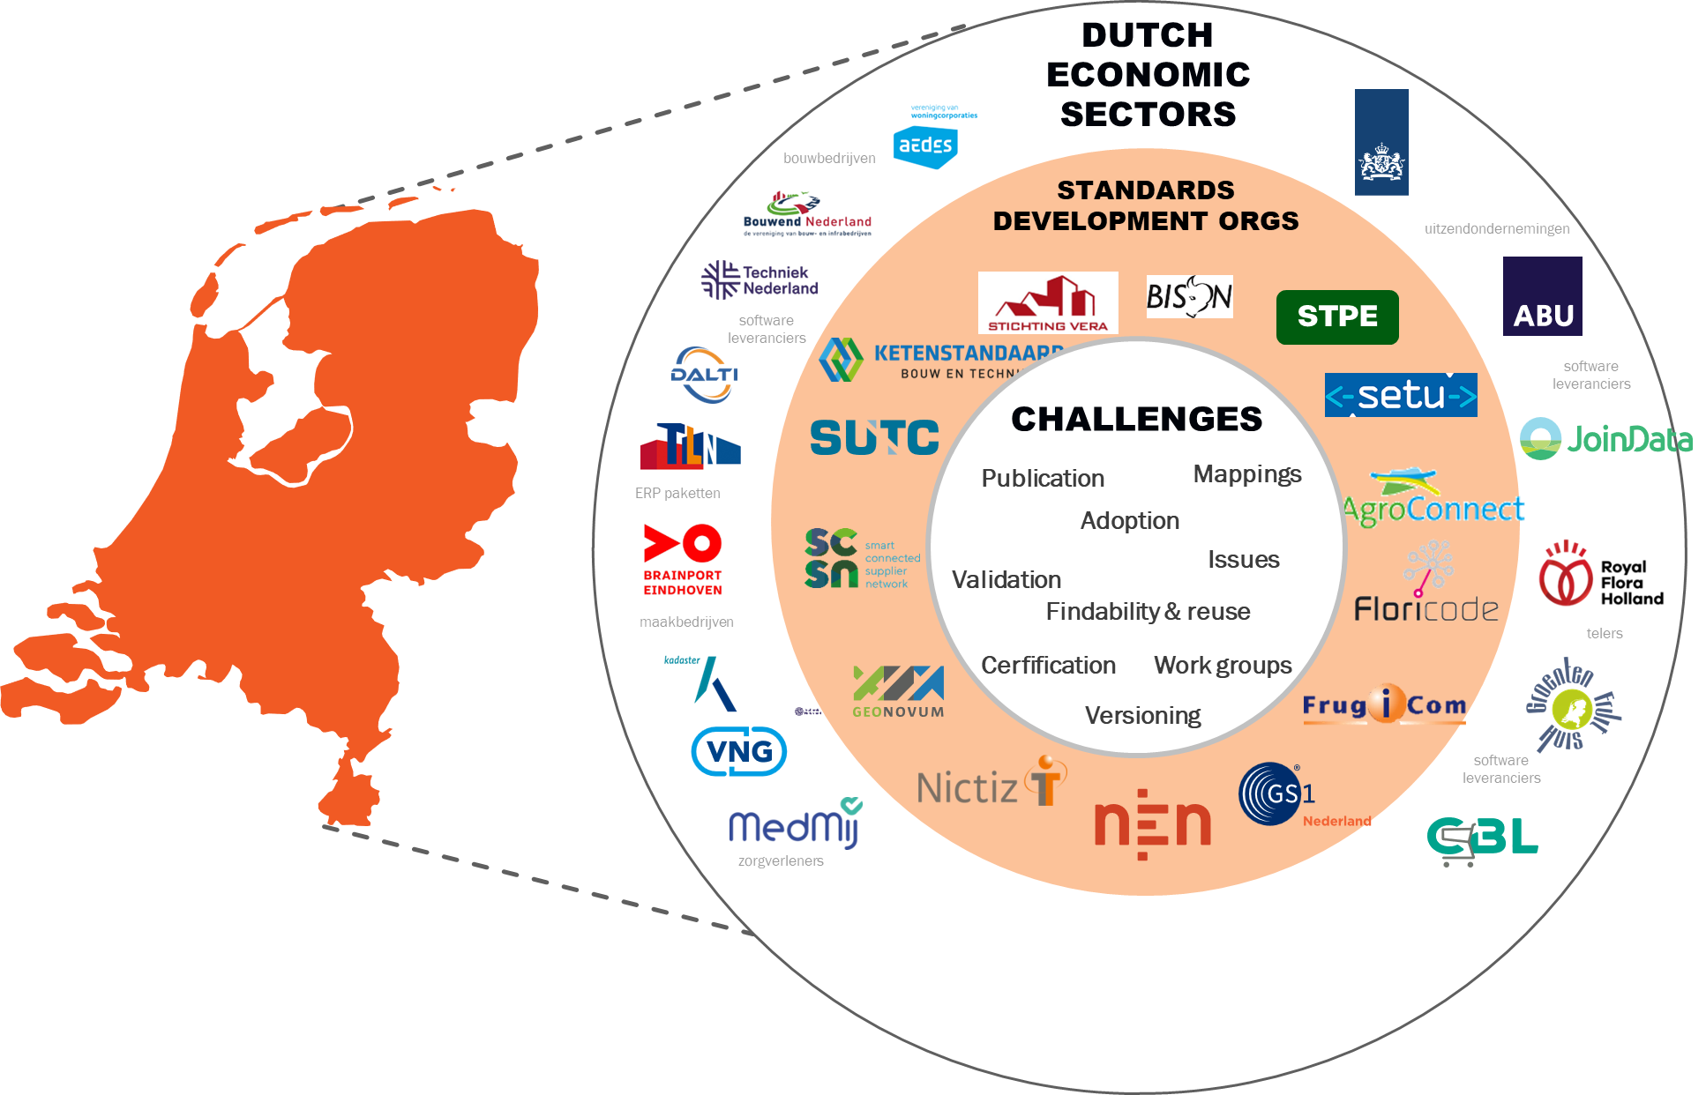
Interoperability is a recurring puzzle

Slide 4





























Dutch
economic sectors
bouwbedrijven
Standards Development Orgs
uitzendondernemingen
software
leveranciers
STPE
challenges
software
leveranciers
Publication
Mappings
ERP paketten
Adoption
Issues
Validation
Findability & reuse
maakbedrijven
telers
Cerfification
Work groups
Versioning
software
leveranciers
zorgverleners

Slide 5
Systems not talking = people not talking
Semantic interoperability is type of ‘commons’ governance problem.
The challenge is creating shared rules and resources (data models) in a community
B.O.M.O.S. is our method
  See BOMOS: The Foundation 3.0.1

Slide 6
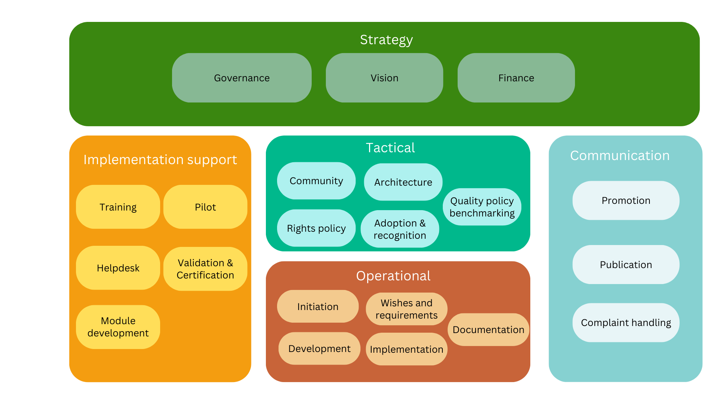
BOMOS activities

Slide 7
BOMOS activities: Operational

Slide 8
BOMOS roles
Activity | primary responsibility for the role | Other roles involved
Strategy | Owner, financier | Authoriser, Functional manager, experts
Tactics | Authoriser | Functional manager, experts
Operational | Functional manager | Technical manager, experts
Implementation support | Functional manager | Technical manager, experts
Communication | Distributor | Functional manager, Technical manager, experts

Slide 9

Semantic Treehouse
Living lab & BOMOS support tool

Slide 10
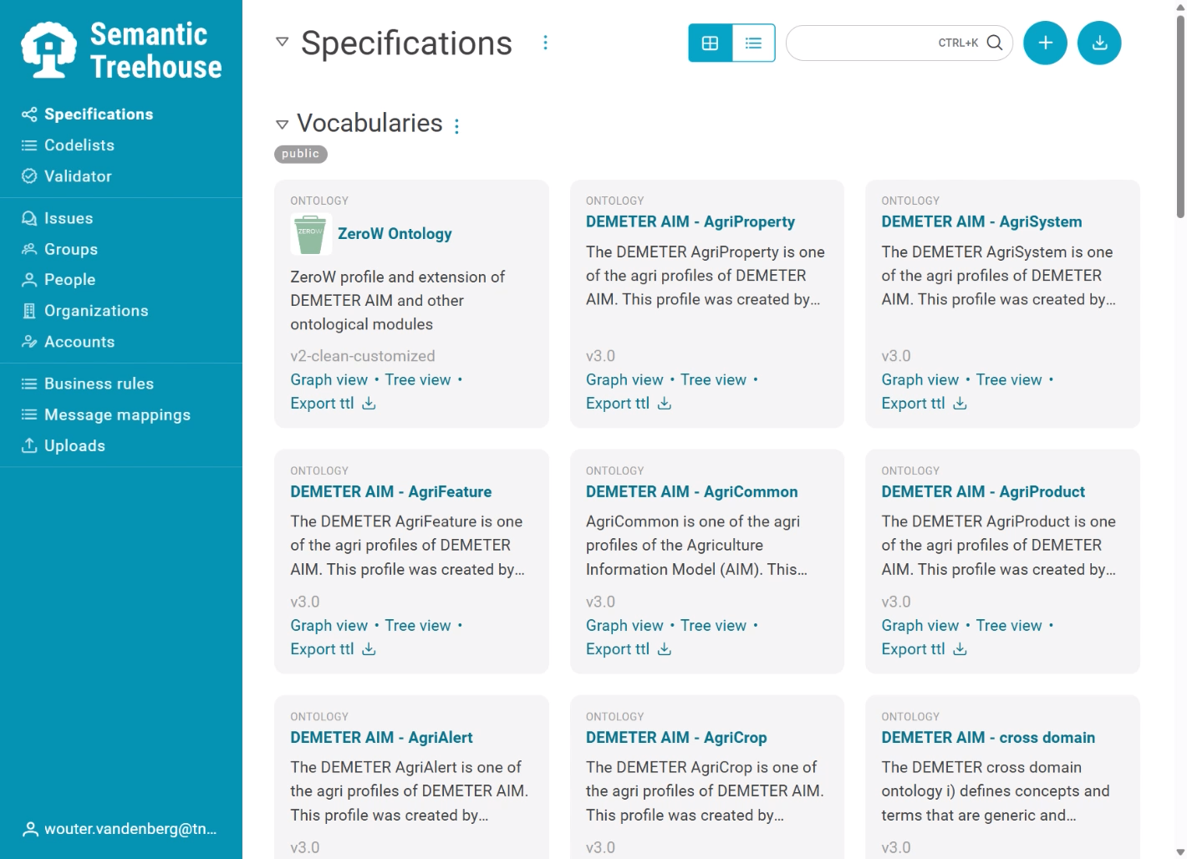
Semantic Treehouse
Browse specifications

Slide 11
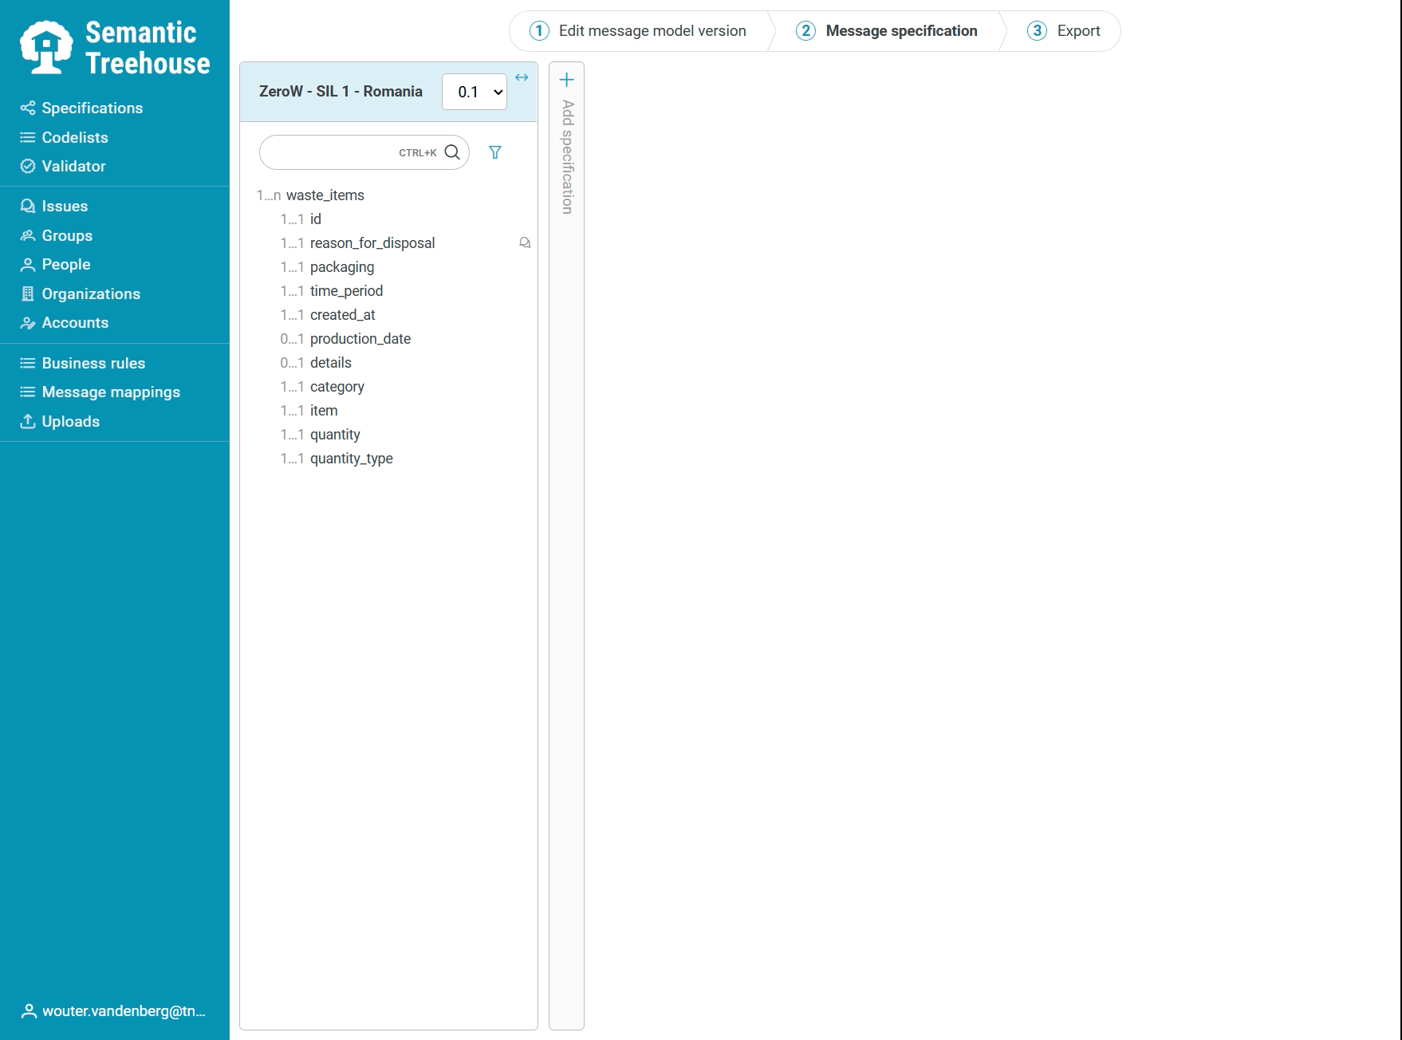
Semantic Treehouse
Browse specifications
Specify semantics

Slide 12
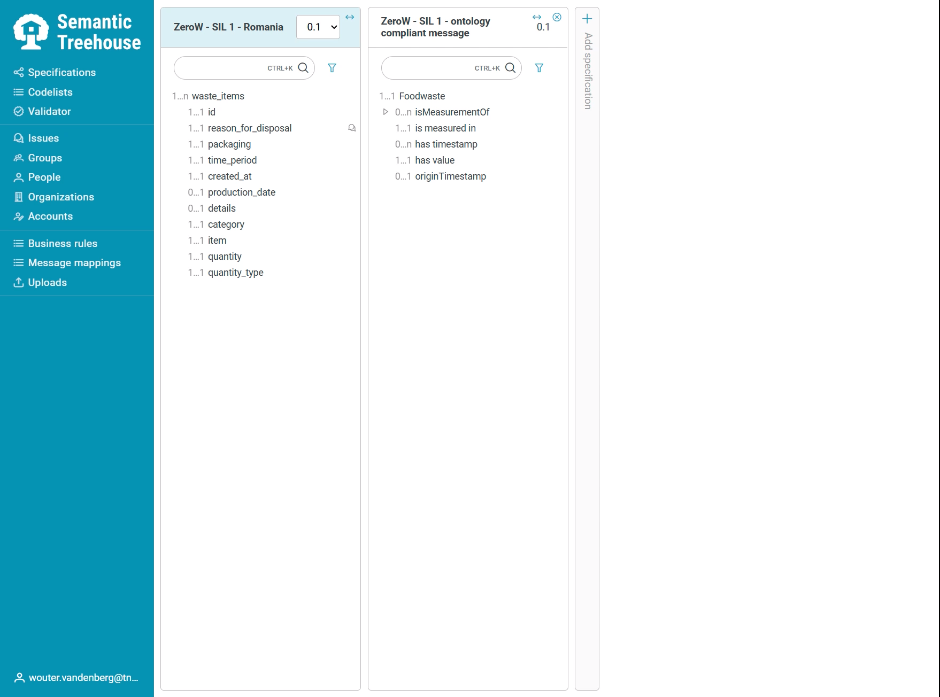
Semantic Treehouse
Browse specifications
Specify semantics
Create alignments

Slide 13
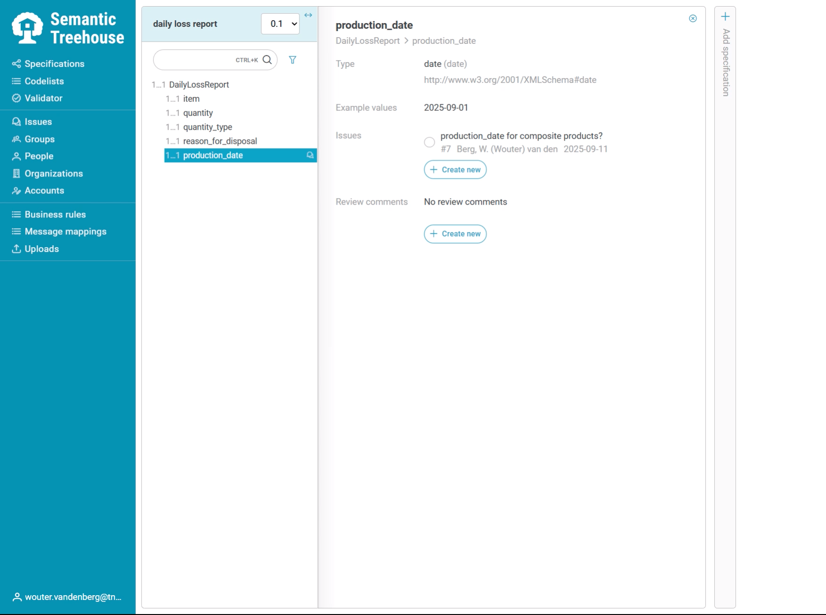
Semantic Treehouse
Browse specifications
Specify semantics
Create alignments
Discuss issues

Slide 14
GenAI for BOMOS operational activities

Slide 15
Demo 1
Data model specification generator

Slide 16
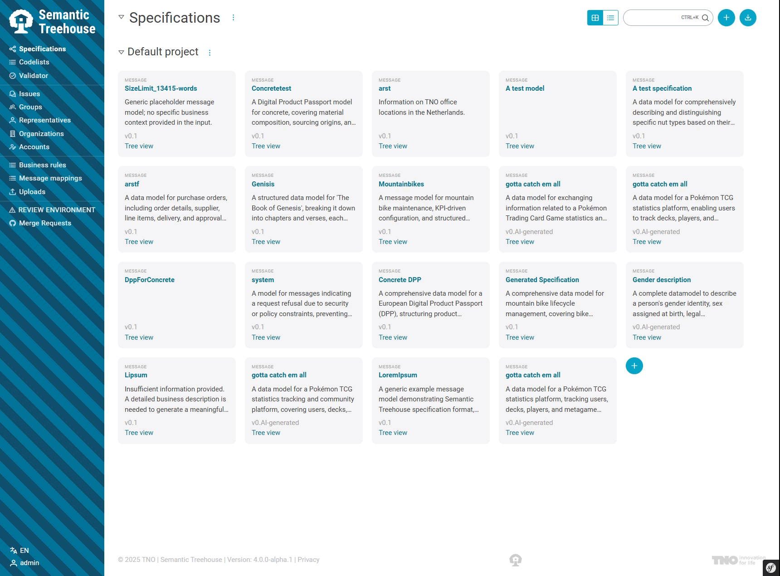
Data model specification generator
Create new spec

Slide 17
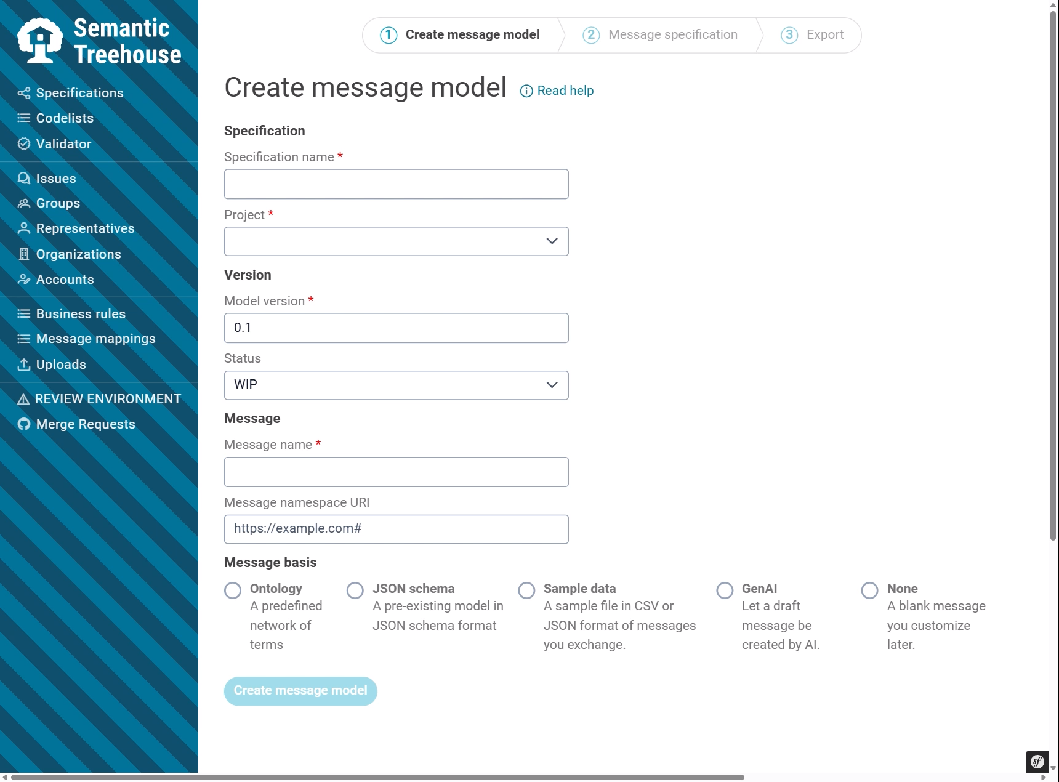
Data model specification generator
Create new spec
Select GenAI

Slide 18
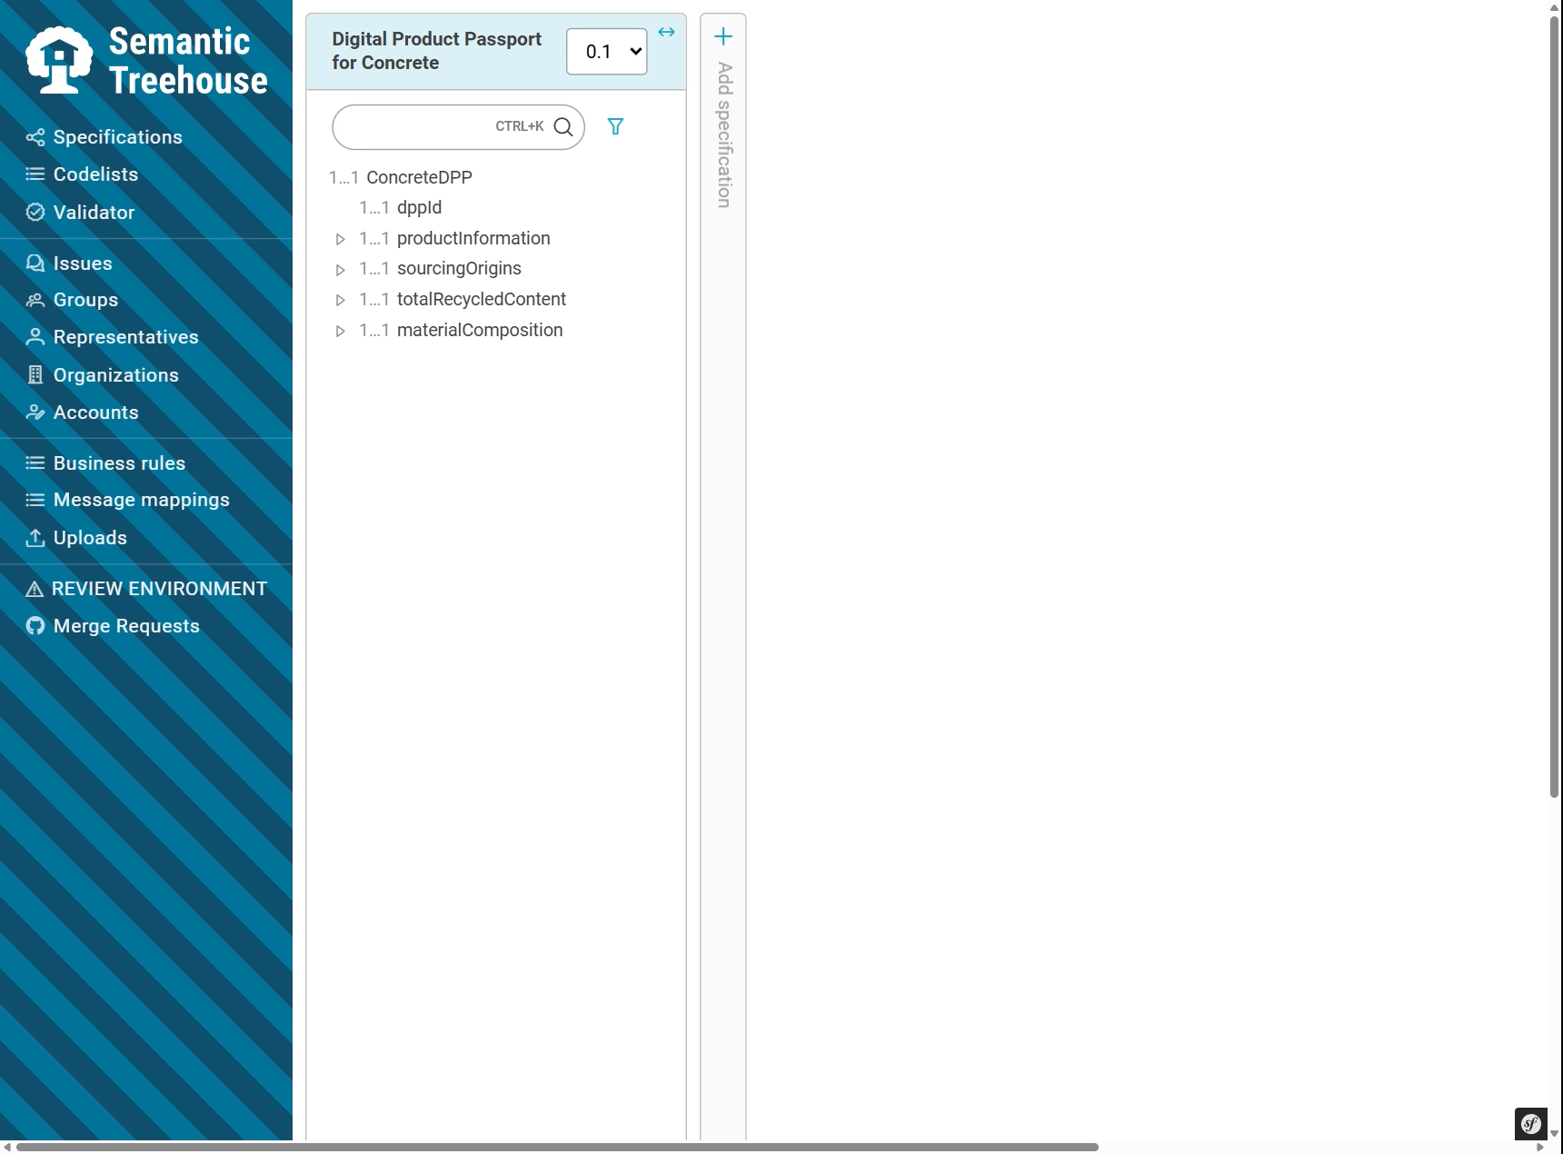
Data model specification generator
Create new spec
Select GenAI
Examine result

Slide 19
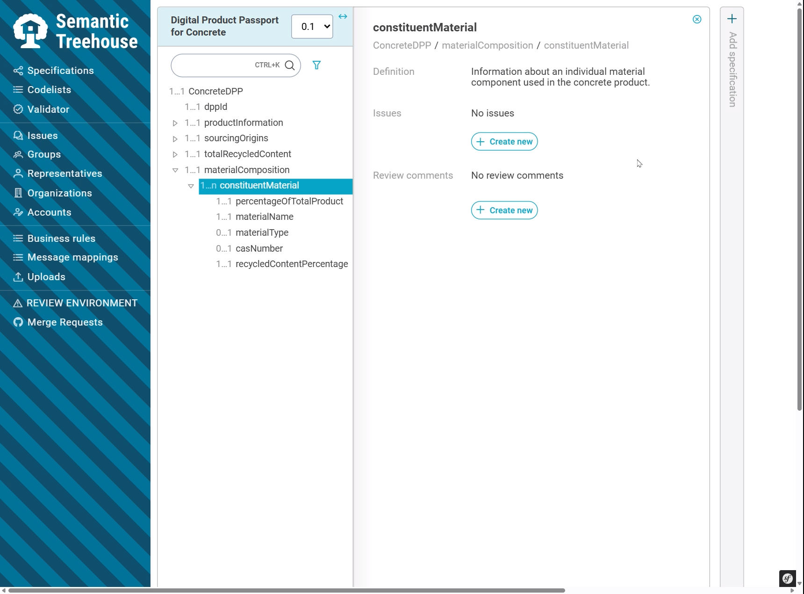
Data model specification generator
Create new spec
Select GenAI
Examine result
Share spec with others

Slide 20
Demo 2
Issue co-pilot

Slide 21
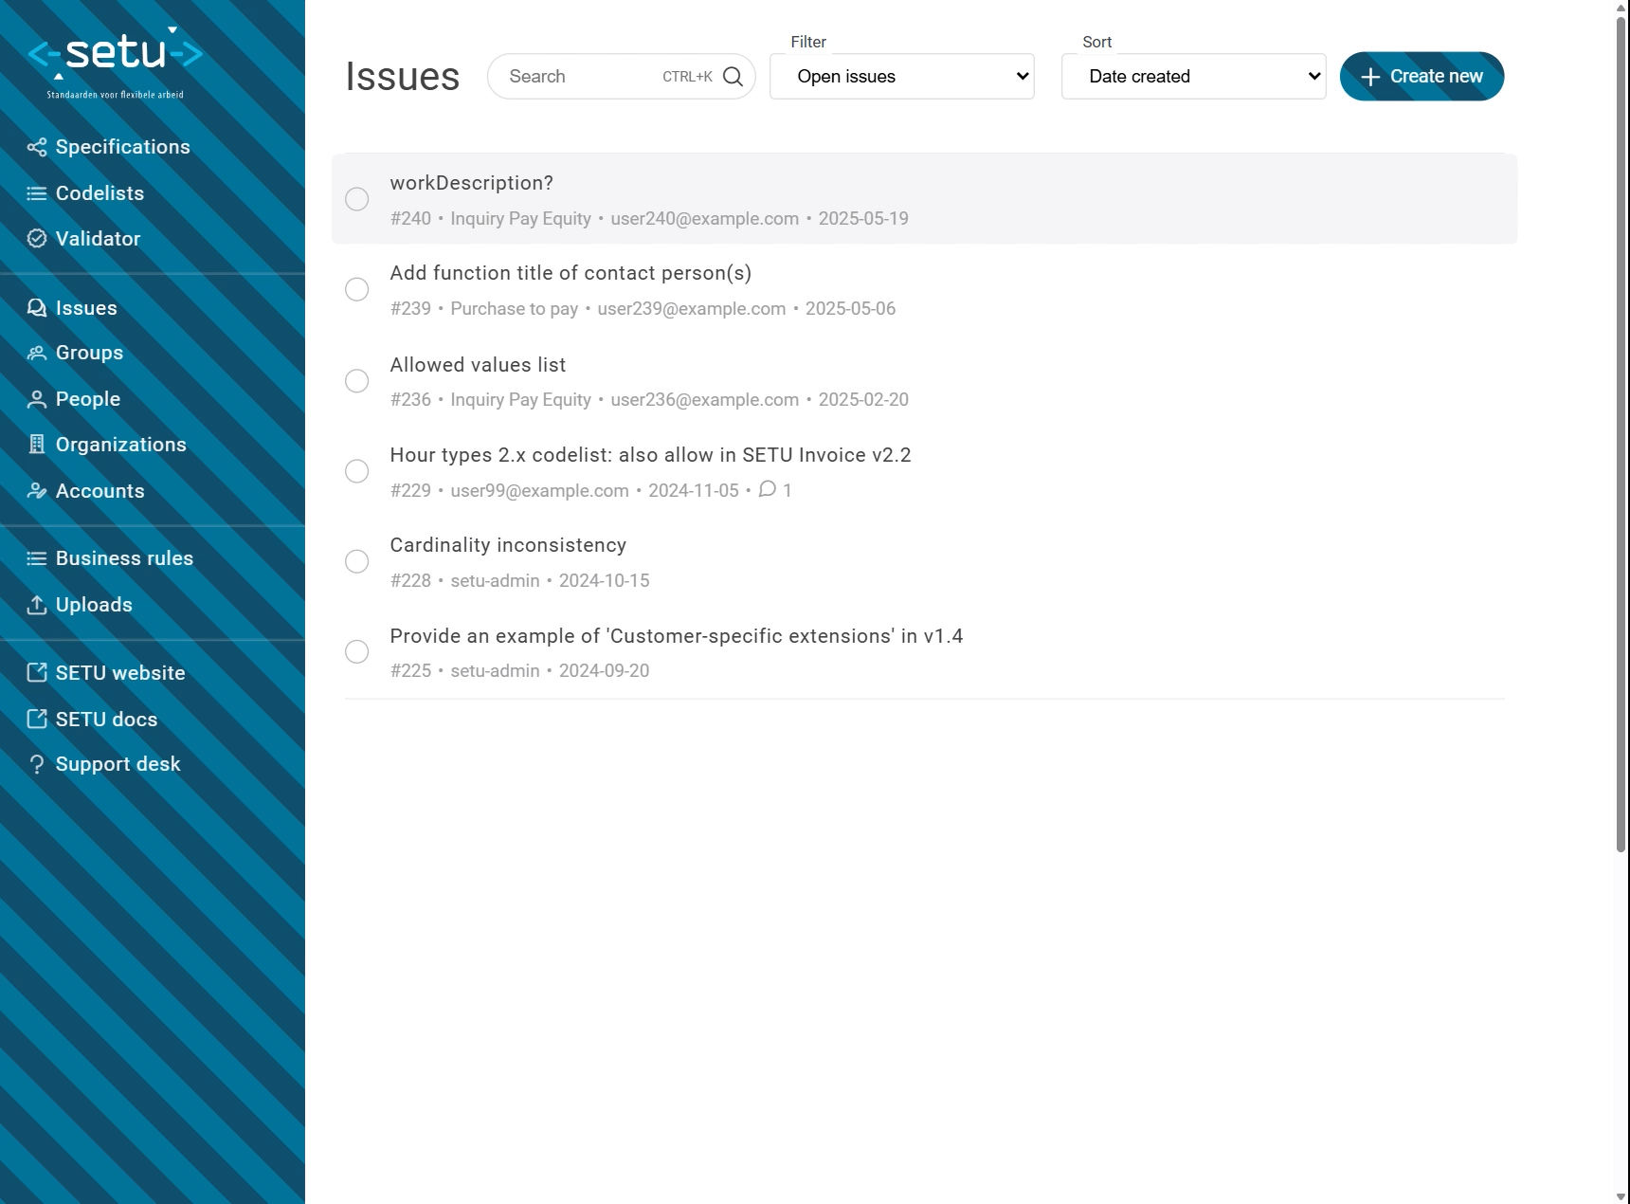
Issue co-pilot
Select issue
Get AI assistance
Feed it context
Dialogue

Slide 23


Issue copilot
Feedback from functional managers
“It’s like having a new junior colleague”
“This saves time”
“Keeps me sharp”
Specification generator

Slide 24
Conclusion

Slide 25
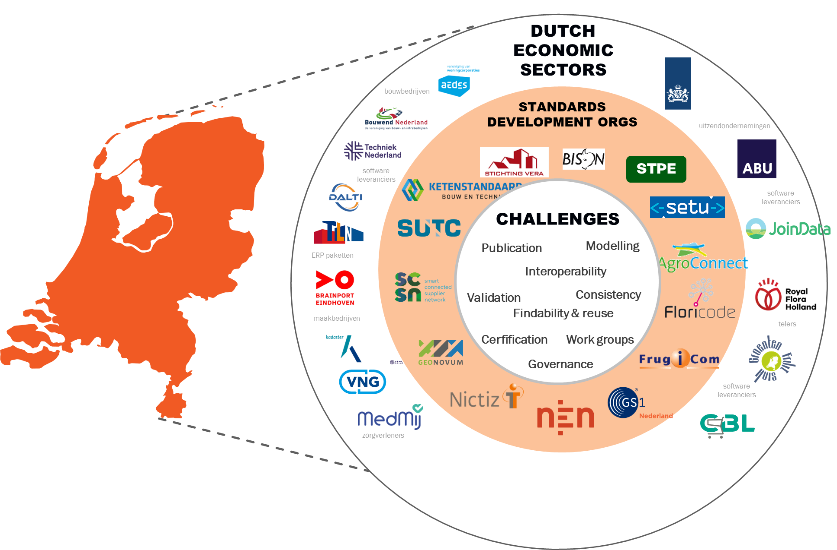
Interoperability is a recurring puzzle

Slide 26
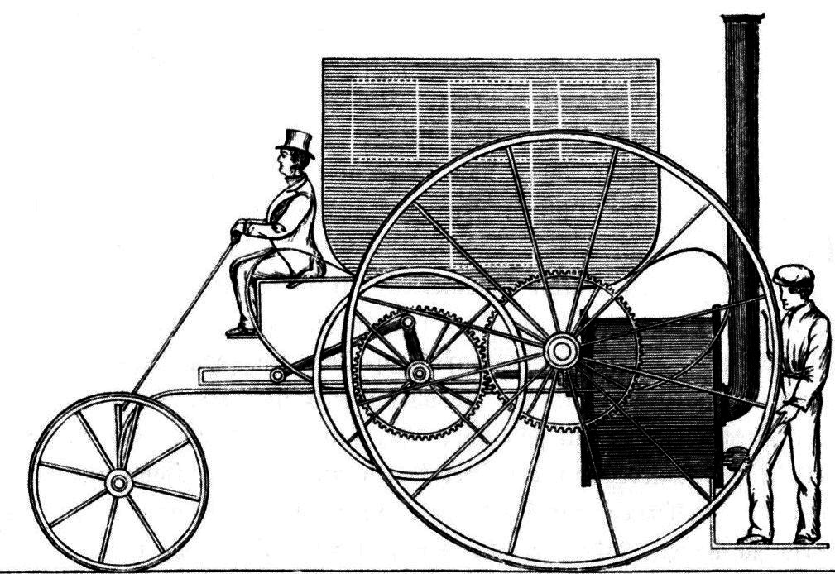
Are we building a horseless carriage?

Slide 27
Research Agenda & collaboration interest
Research directions:
AI-augmented standardization processes
Autonomous data integration/negotiation
Evidence-based standards evolution via observability
We’re looking for collaboration on these topics, e.g., within Horizon Europe or other R&D projects.

Slide 28
Conclusion
Explore Semantic Treehouse:
  https://semantic-treehouse.nl
  https://www.youtube.com/@semantic-treehouse
  https://discord.com/invite/kdrbm9RUu8
  https://gitlab.com/semantic-treehouse
Discuss with us the implications of GenAI for semantic interoperability governance and practice
Connect with us to explore research collaborations
Consider Semantic Treehouse as a mature, open-source Vocabulary Hub solution for your Data Space initiative

Slide 29
Thank you!
wouter.vandenberg@tno.nl
TNO - ICT, Strategy & Policy

