Slide 1
Interoperability
in 1-2-3!

Slide 2

Interoperability in 1-2-3!

Slide 3

Interoperability in 1-2-3!

Slide 4
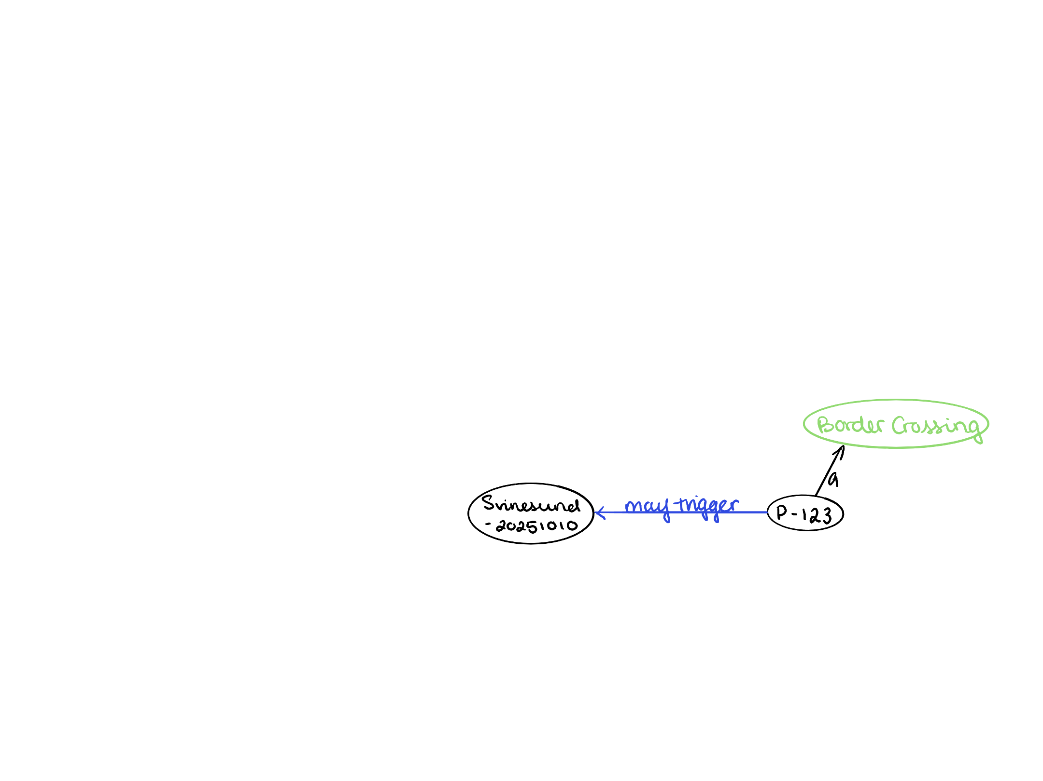
Interoperability in 1-2-3!

Slide 5
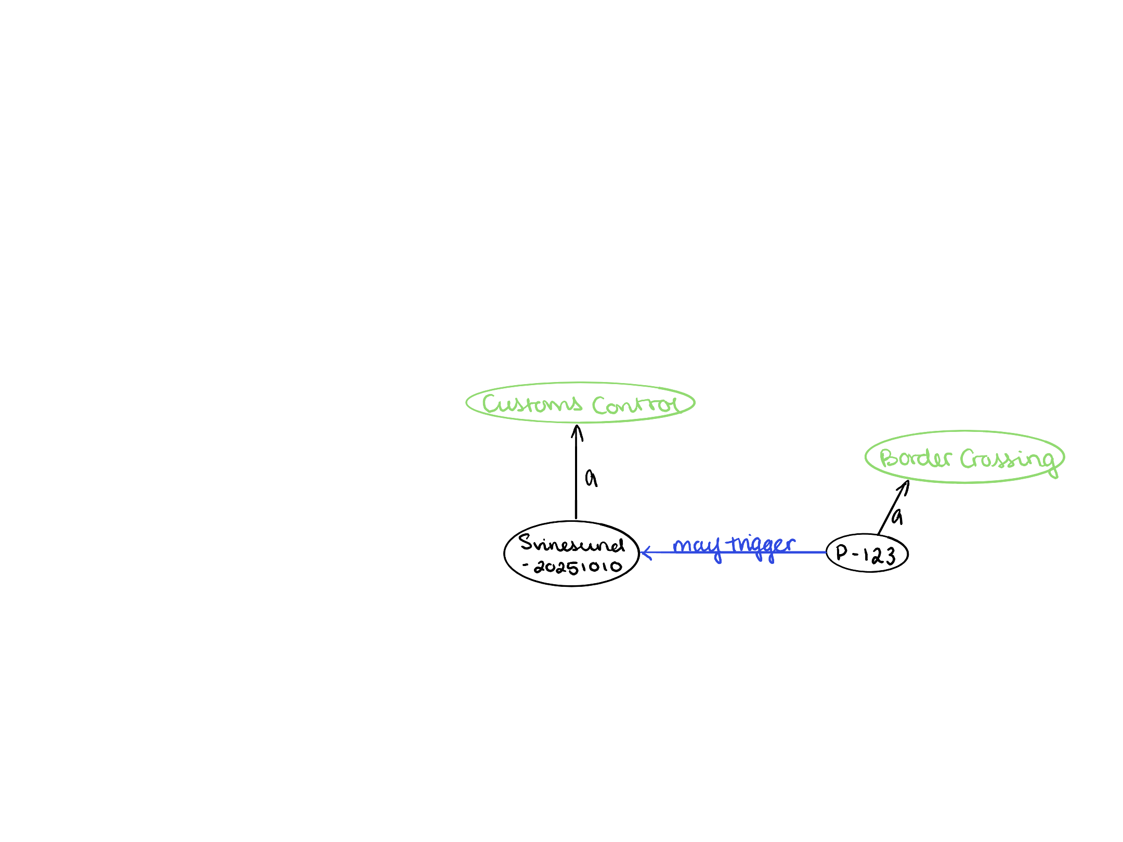
Interoperability in 1-2-3!

Slide 6
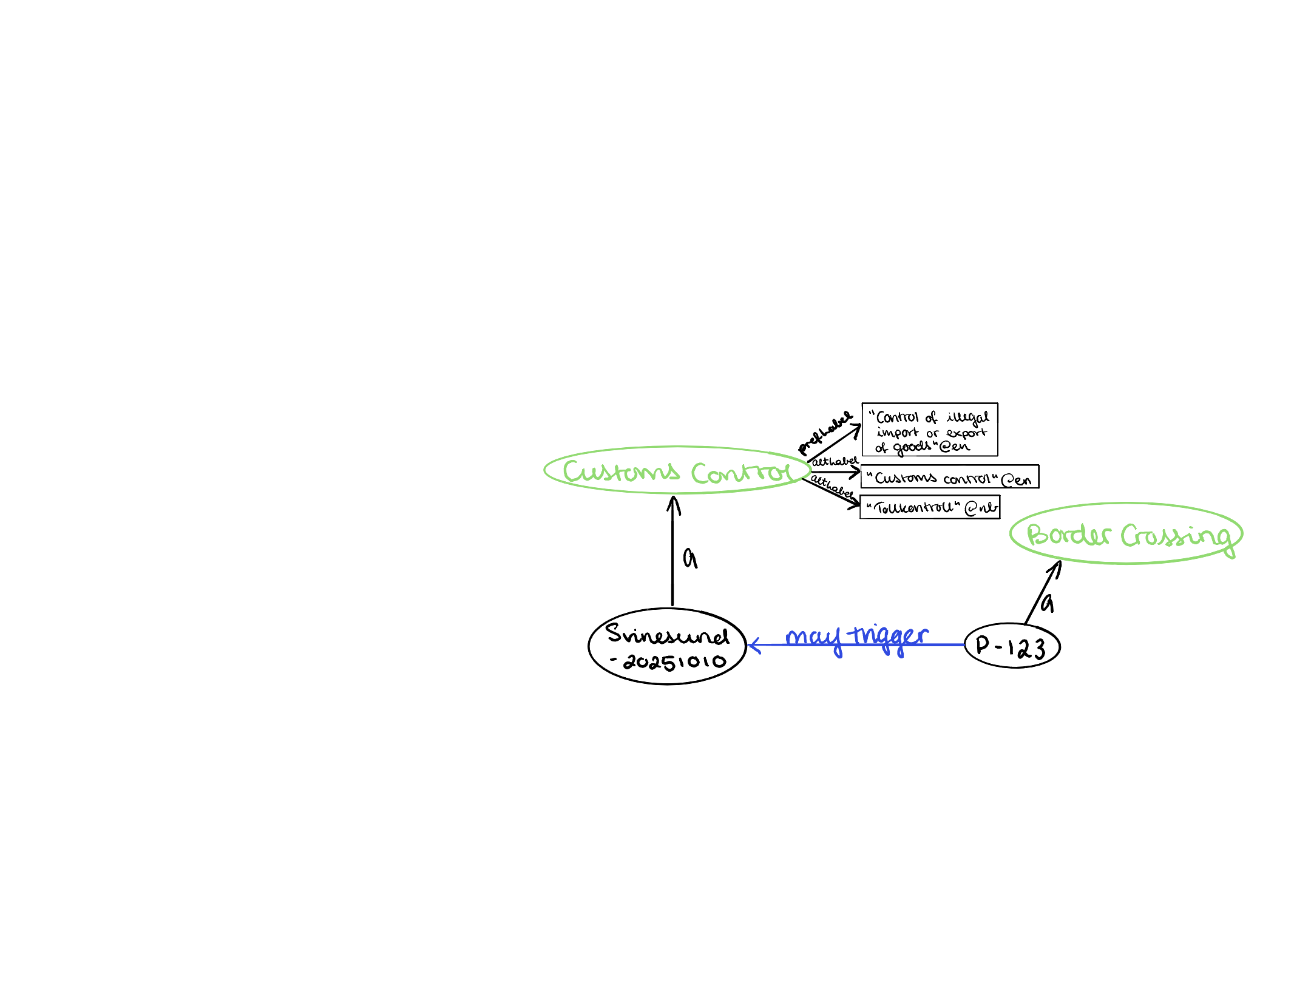
Interoperability in 1-2-3!

Slide 7
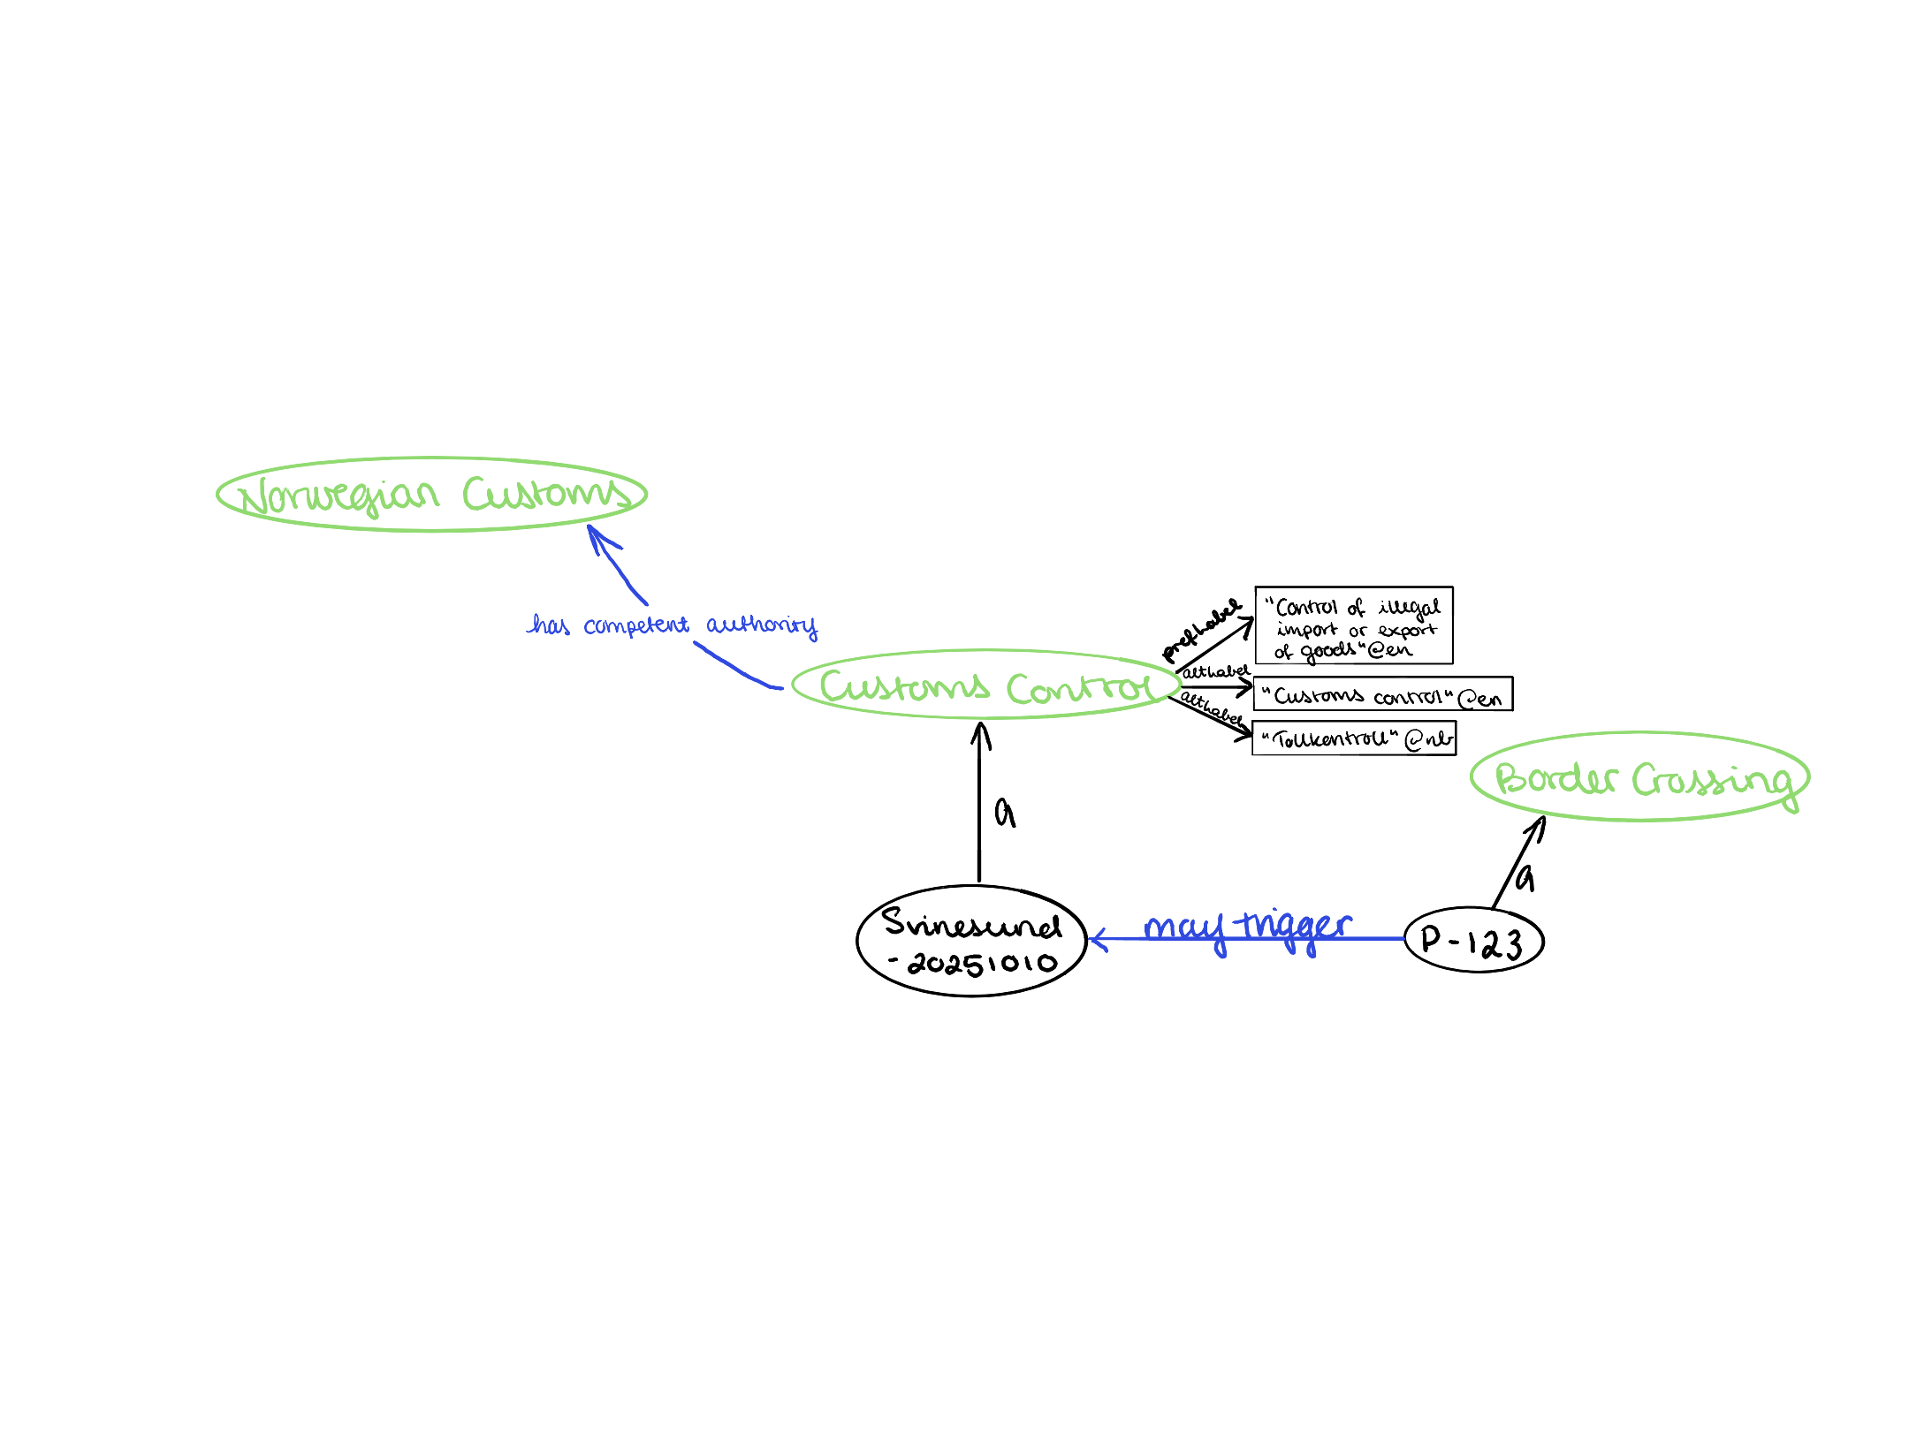
Interoperability in 1-2-3!

Slide 8
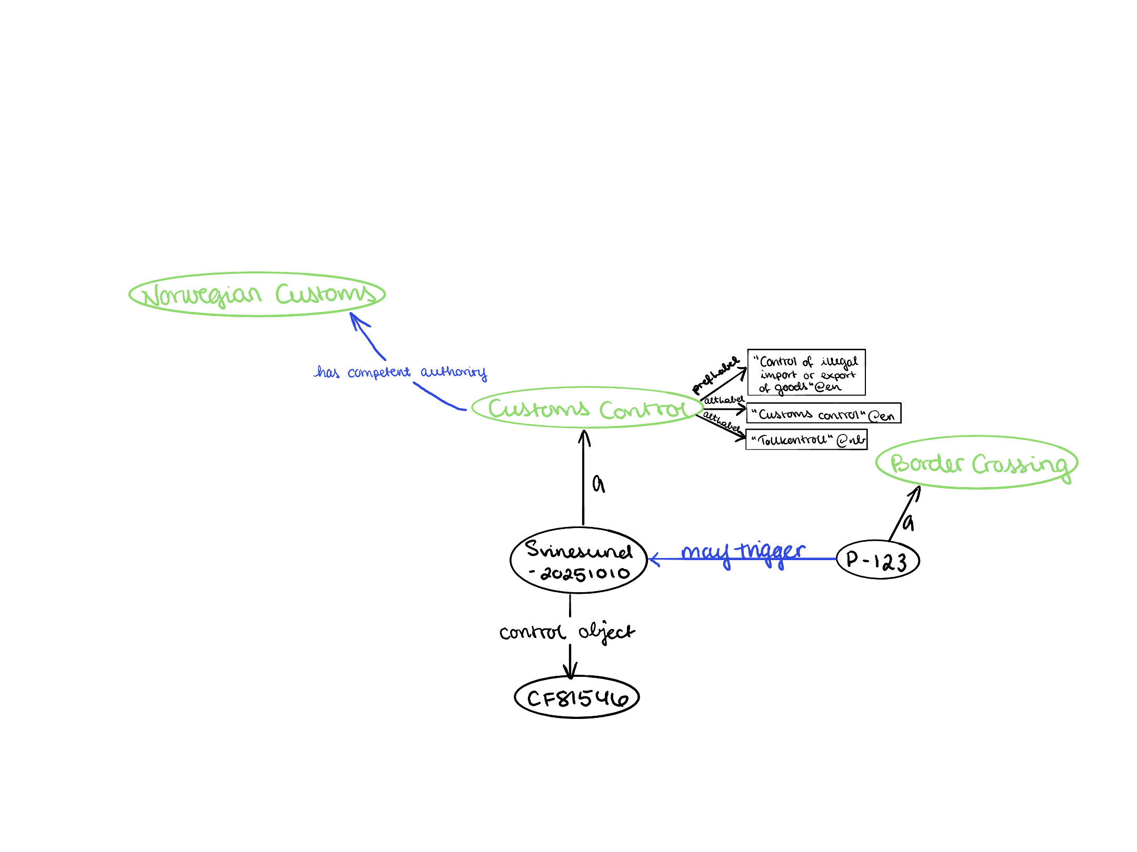
Interoperability in 1-2-3!

Slide 9
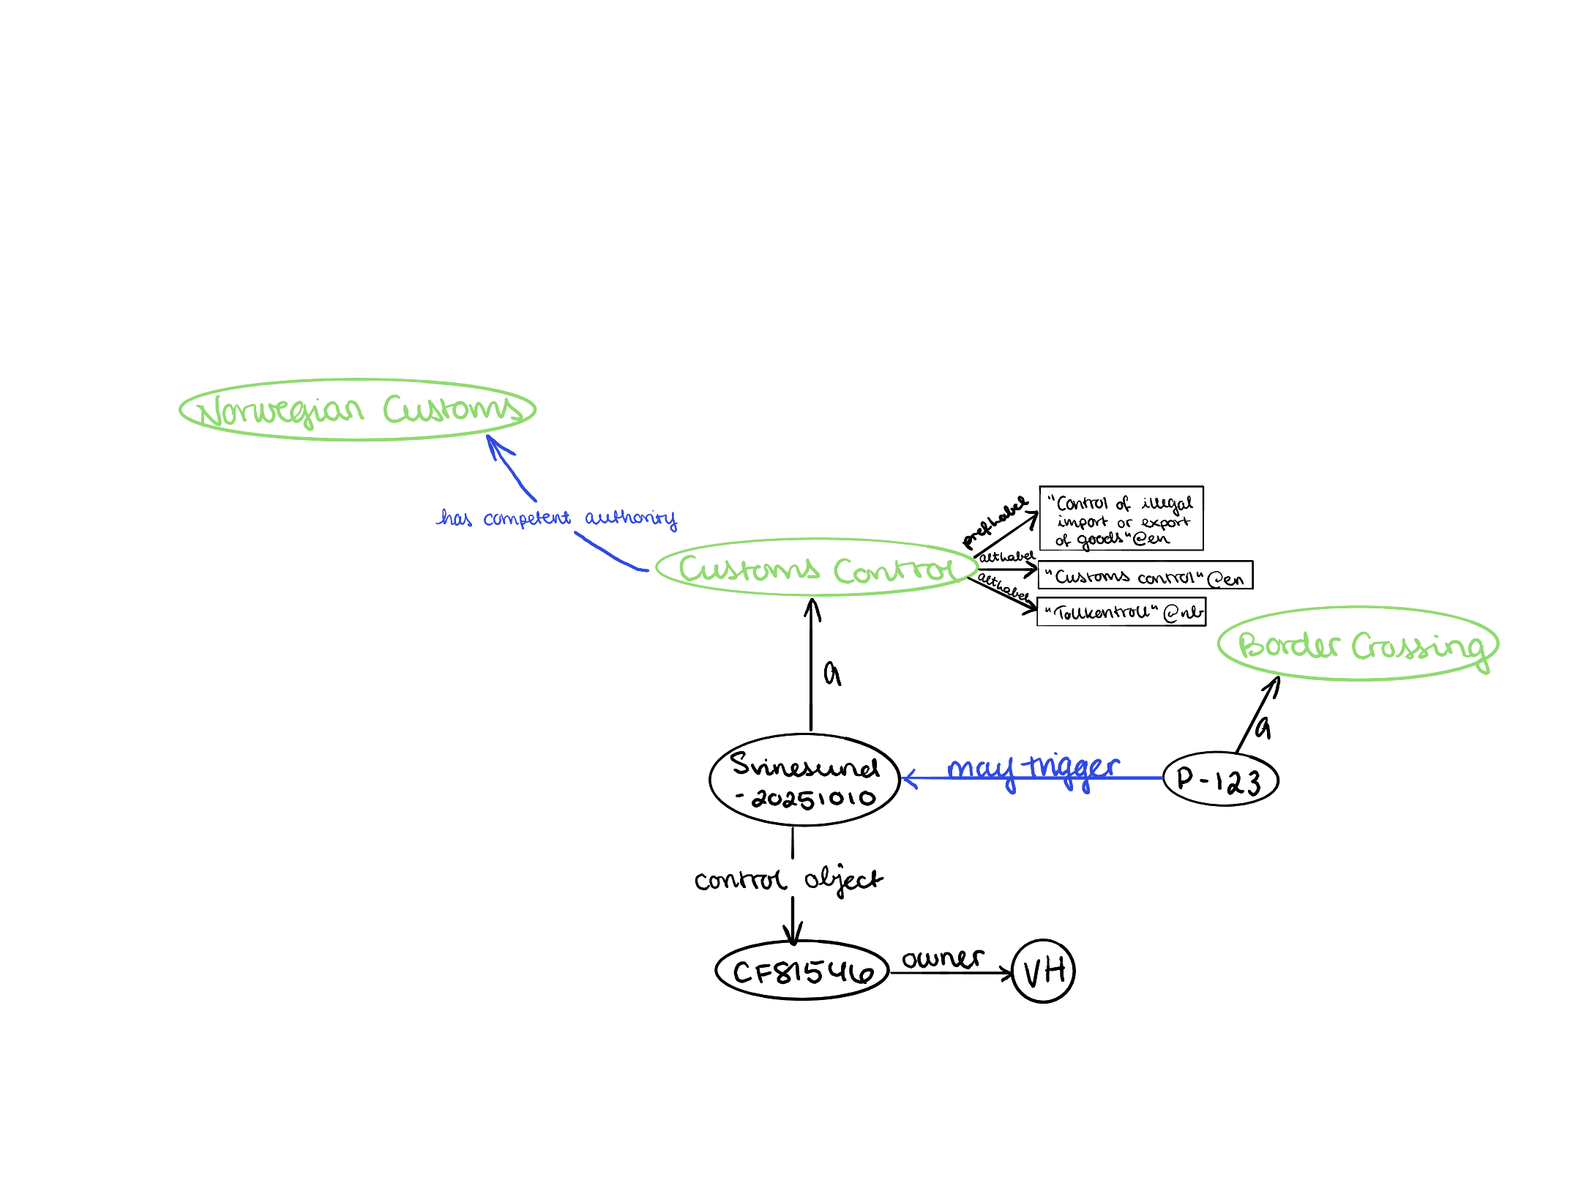
Interoperability in 1-2-3!

Slide 10
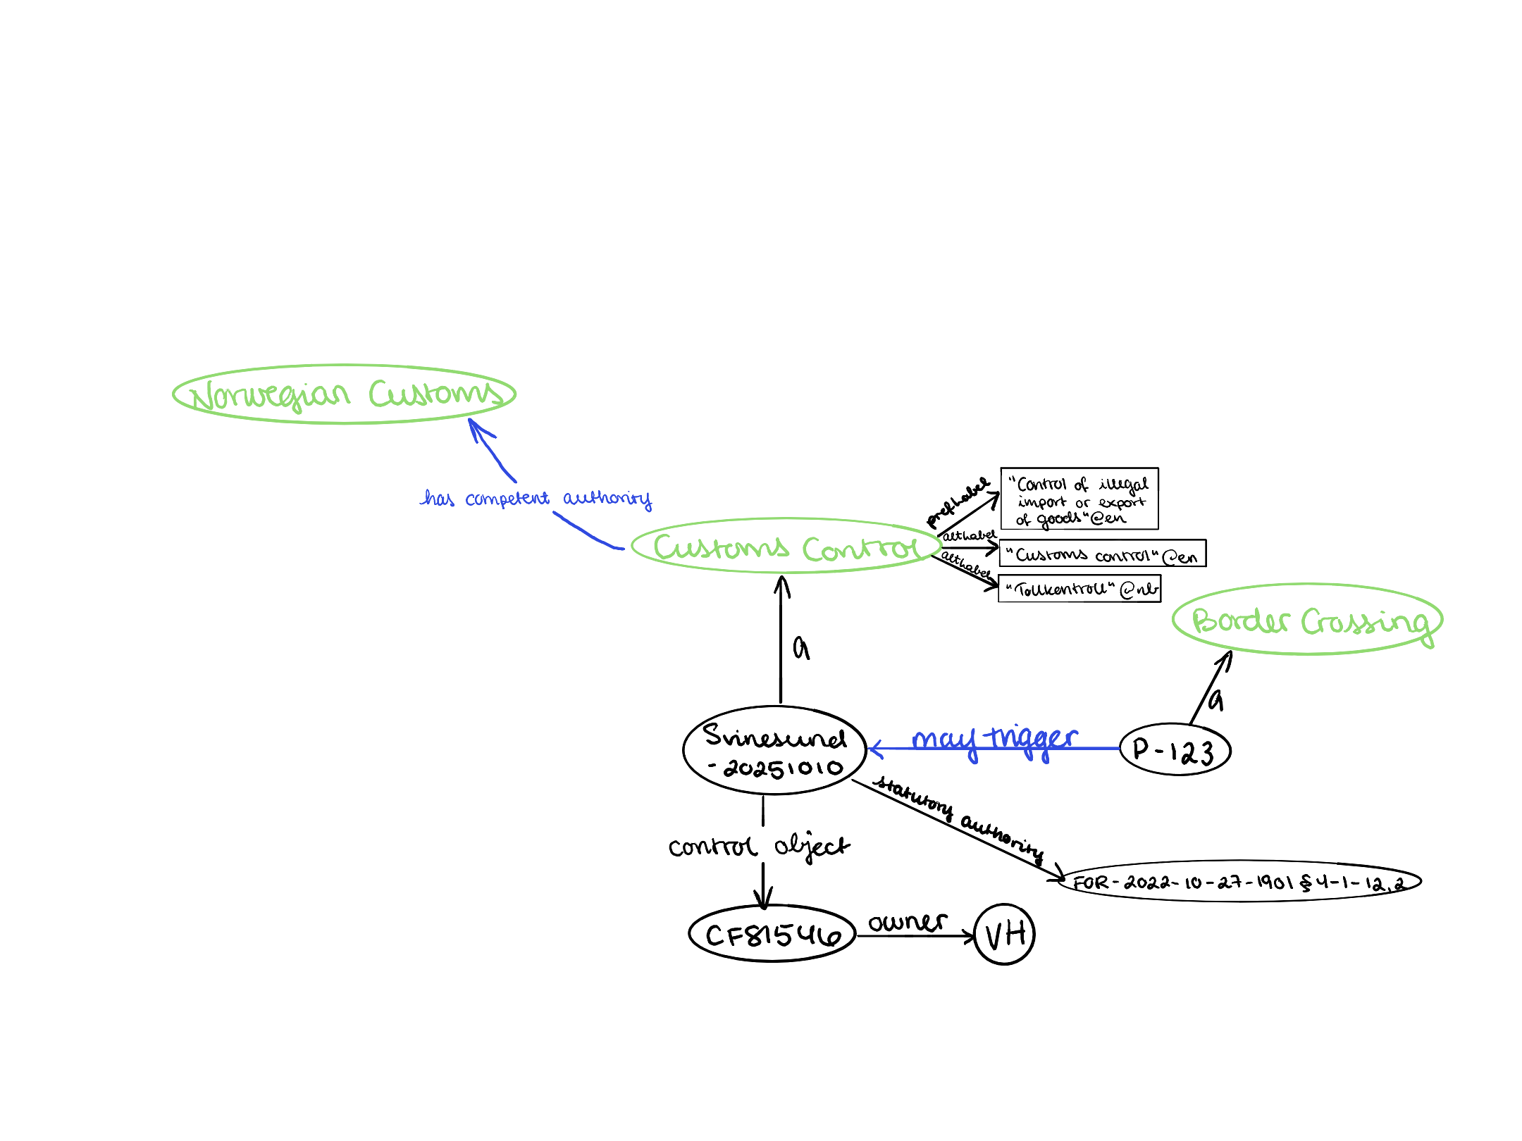
Interoperability in 1-2-3!

Slide 11
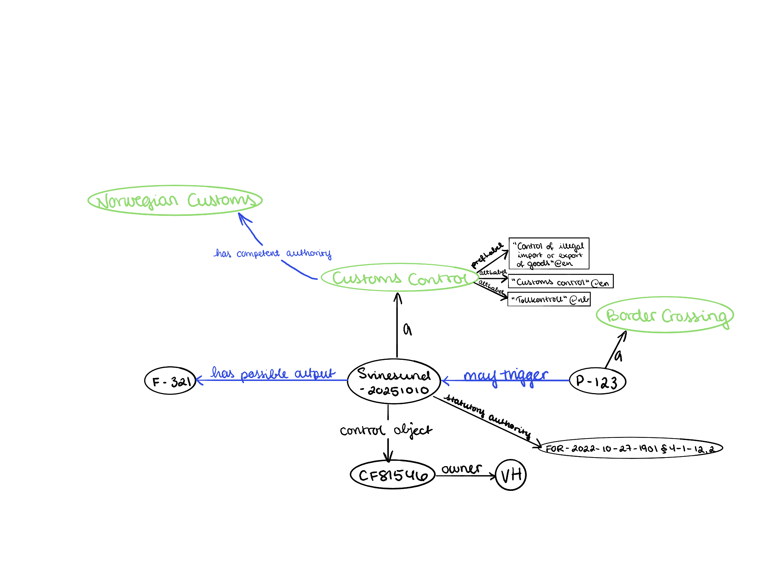
Interoperability in 1-2-3!

Slide 12
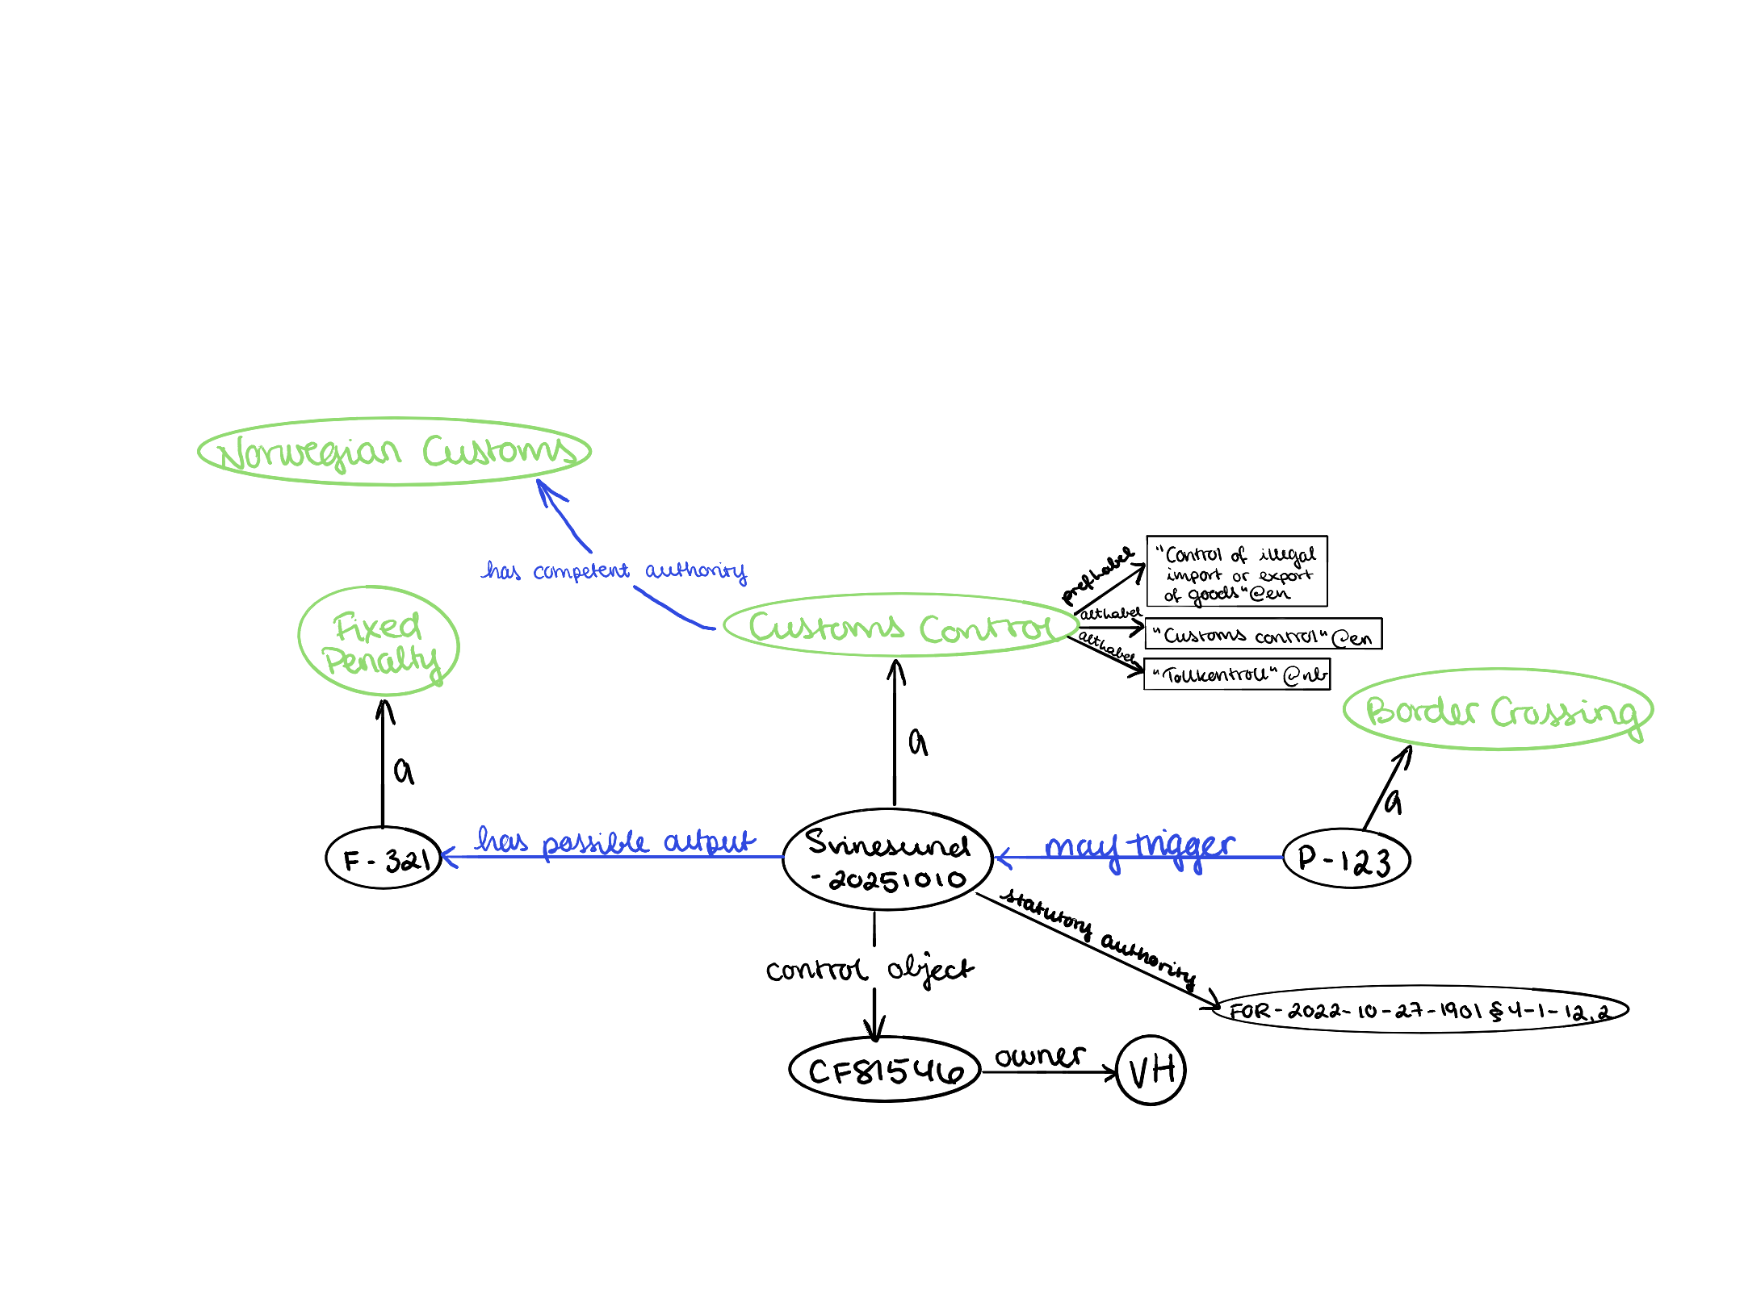
Interoperability in 1-2-3!

Slide 13
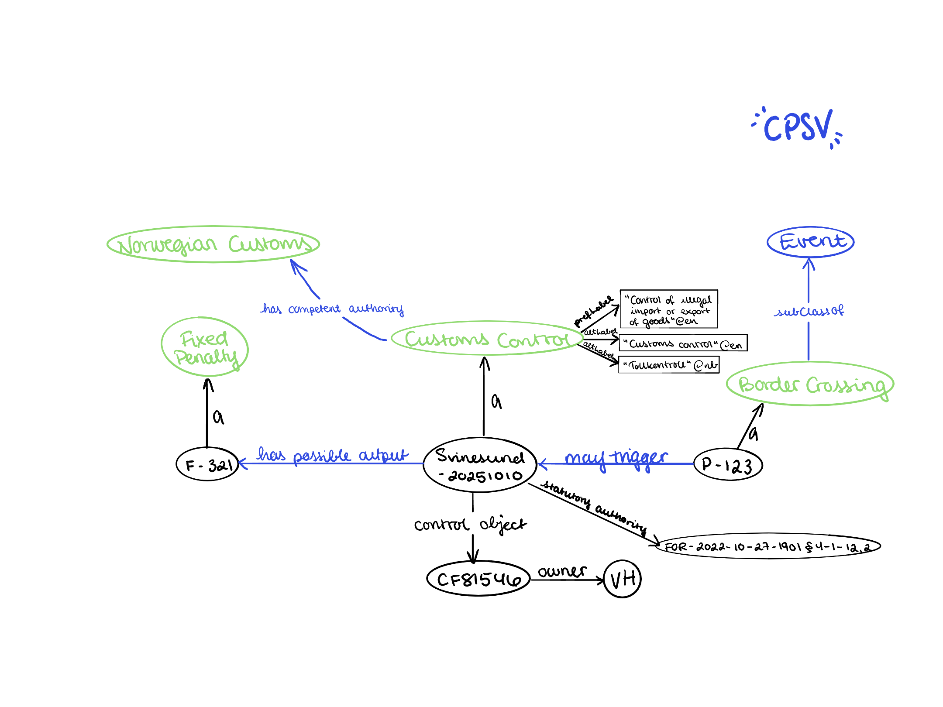
Interoperability in 1-2-3!

Slide 14
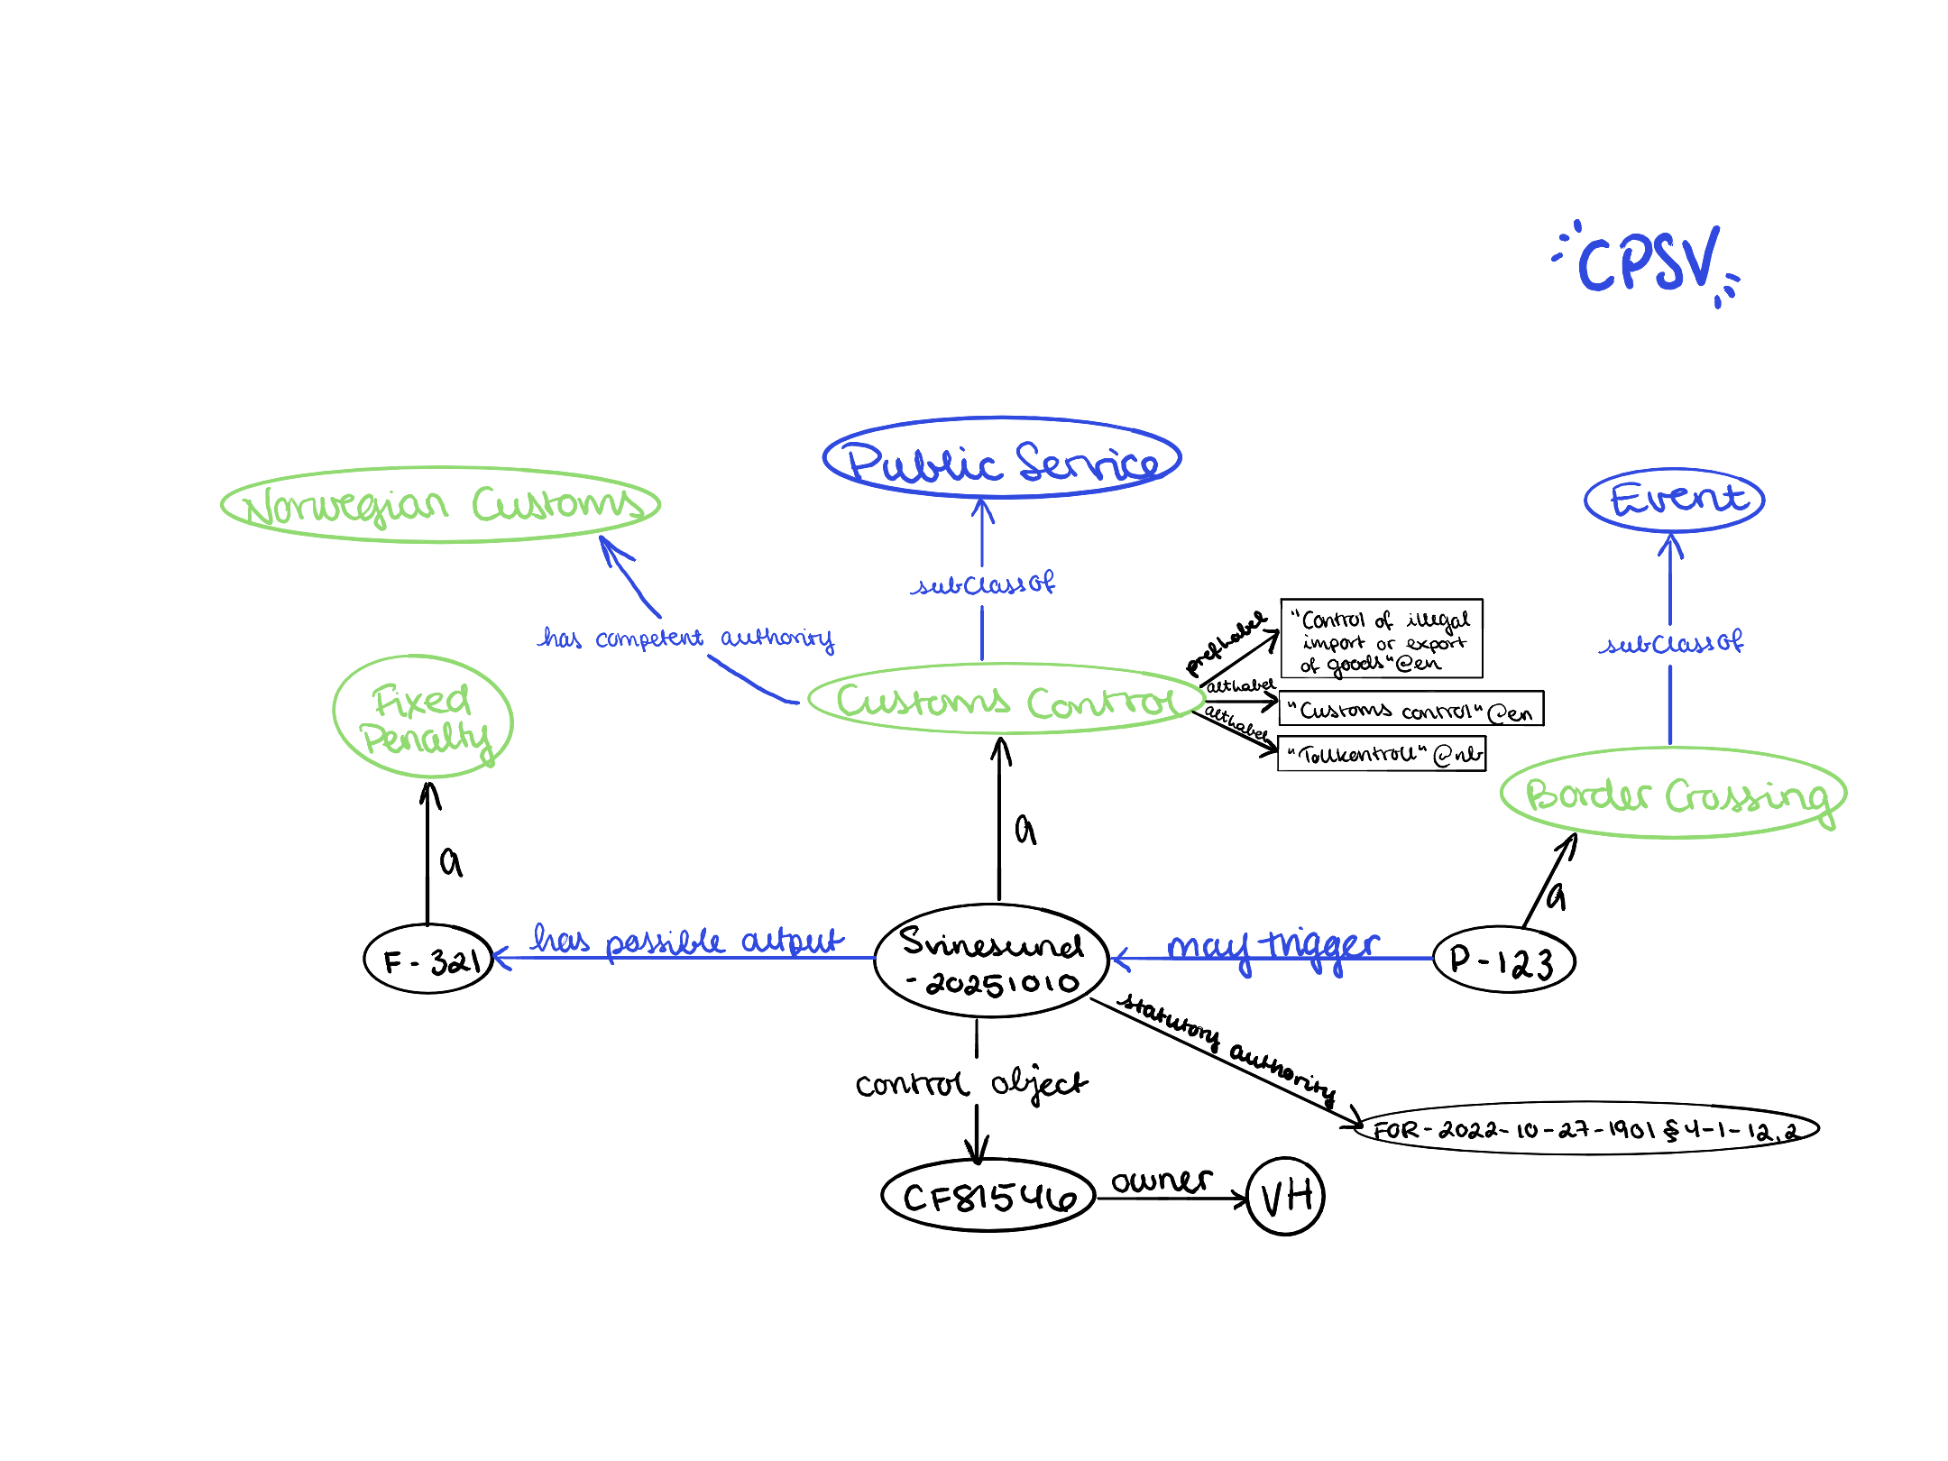
Interoperability in 1-2-3!

Slide 15
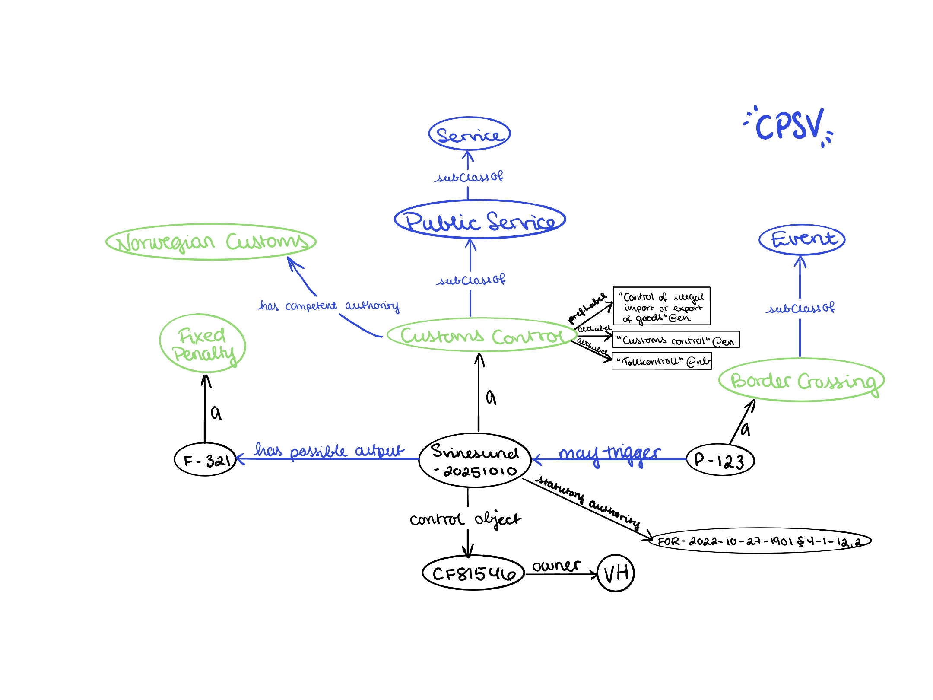
Interoperability in 1-2-3!

Slide 16
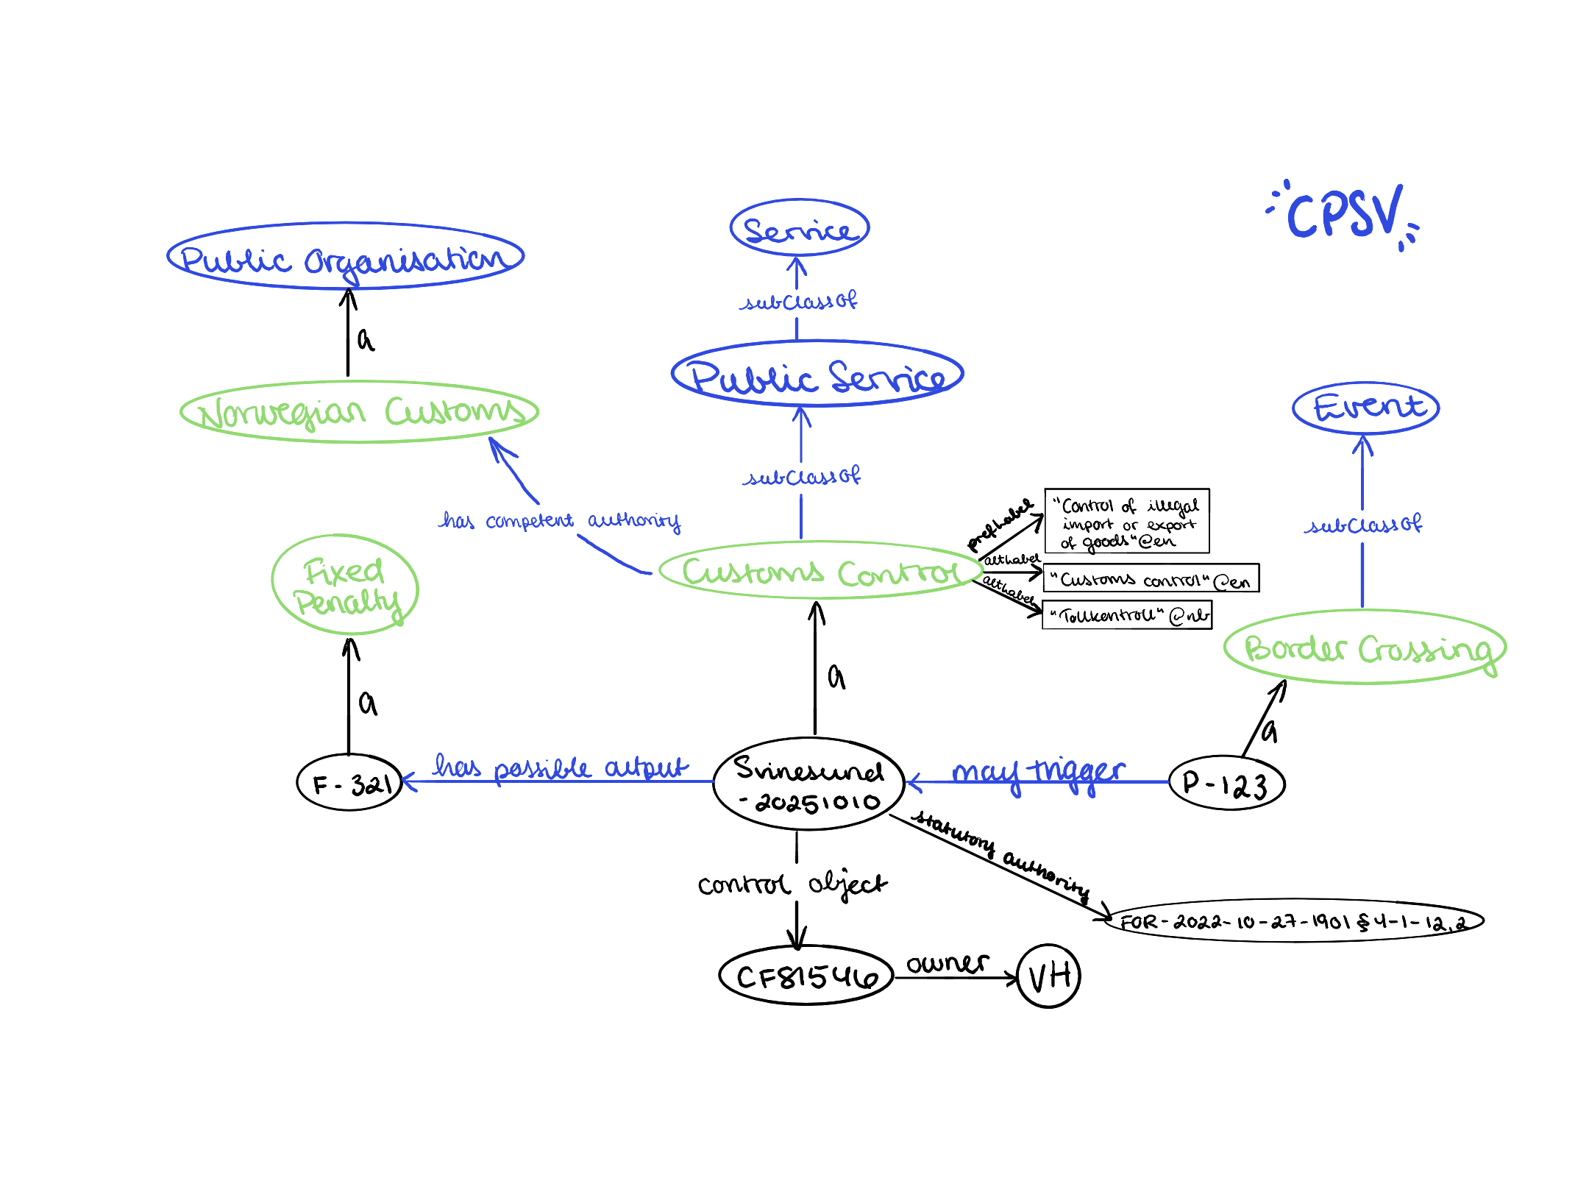
Interoperability in 1-2-3!

Slide 17
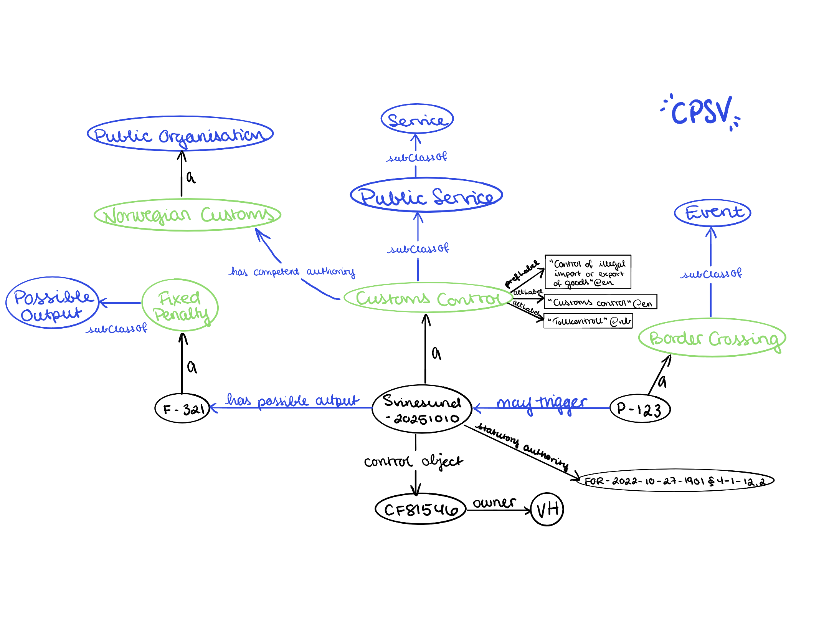
Interoperability in 1-2-3!

Slide 18
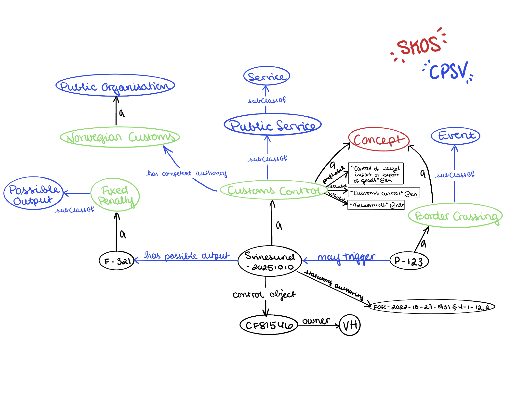
Interoperability in 1-2-3!

Slide 19

Interoperability in 1-2-3!

Slide 20
Thank you!
veronika@data-treehouse.com
Filip.Hansen@toll.no

