Slide 1
Thomas Francart
Sparna – https://www.sparna.fr
Sparnatural: a SPARQL query UI in 15 minutes based on SHACL specifications and controlled vocabularies
Leveraging knowledge graph and machine-readable specifications for improved end-user data access

Slide 2
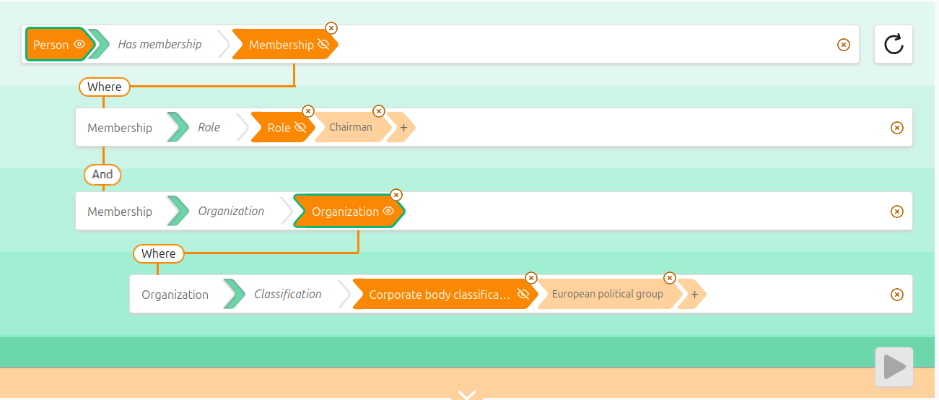
What we will achieve in 15 min
Sparnatural: Open-source end-user oriented knowledge graph exploration UI, querying data from the European Parliament Open Data Portal
Here: « MEPs that are chairs of of political group »
Sparnatural: a SPARQL query UI in 15 minutes based on SHACL specifications and controlled vocabularies

Slide 3
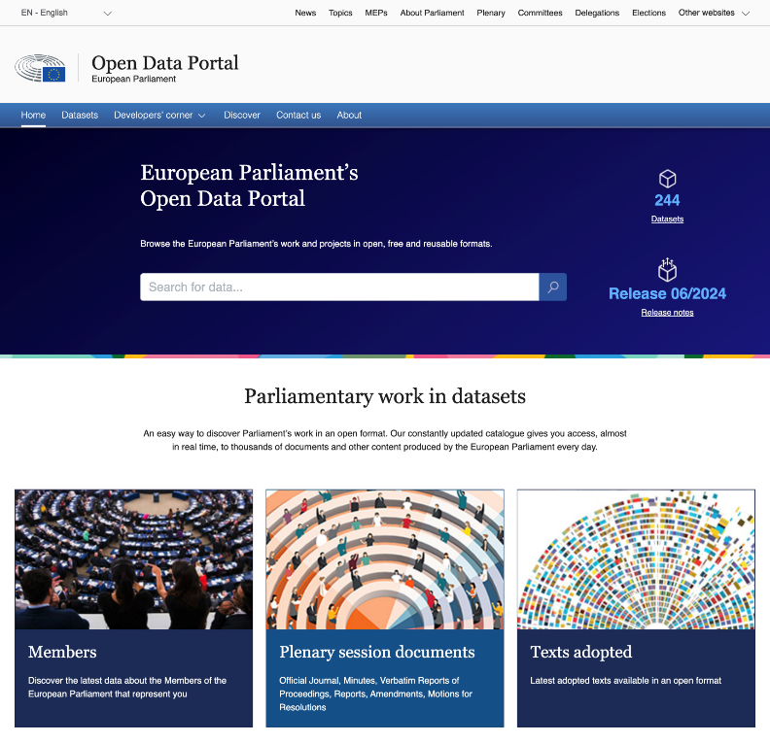
Data comes from the European Parliament Open Data Portal
https://data.europarl.europa.eu
Dataset Catalogue
  Features: DCAT dataset metadata, downloadable dumps (multilingual RDF, monolingual CSV, ...)
  Key users: non-IT users, researchers, data scientists, journalists
Near-real time RESTful APIs & Persistent URIs
  Features: data in multiple formats (RDF, json-ld, ...), Notification (ATOM feed) based on provenance
  Key users: semantic web specialists, web developers (non-RDF)
Based on knowledge graph technologies and standards
Human & machine-readable documentation
Sparnatural: a SPARQL query UI in 15 minutes based on SHACL specifications and controlled vocabularies

Slide 4
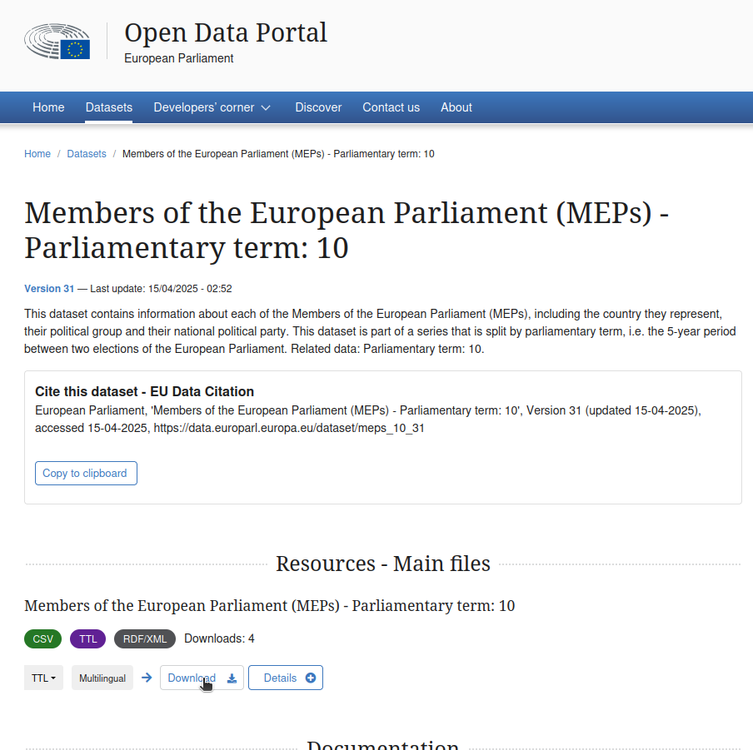
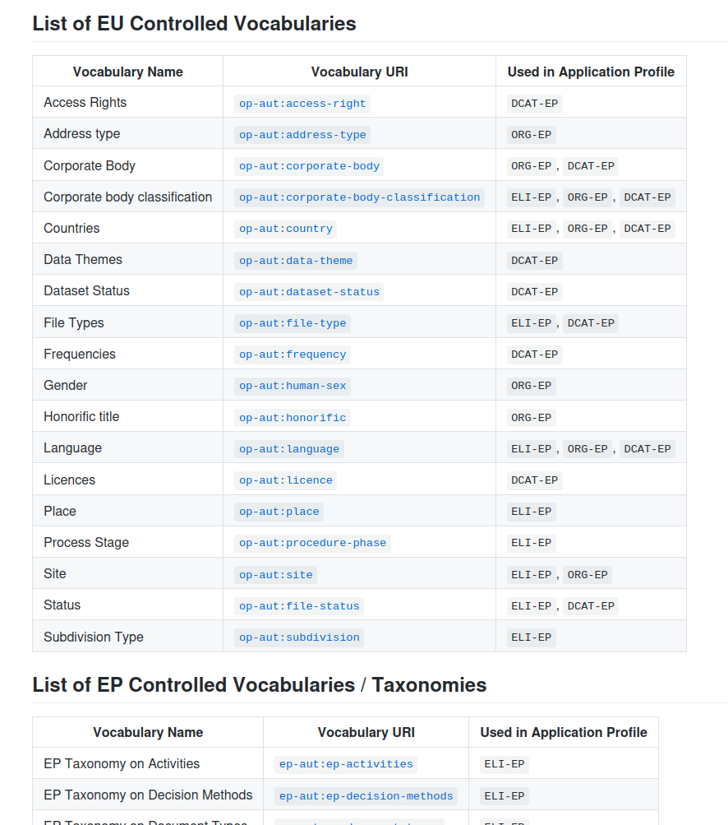
Download data and vocabularies from EP ODP
Dataset download :
  Members of the European Parliament - 10th leg : direct link
  Corporate bodies of the European Parliament : direct link
Controlled vocabularies download : direct link
Sparnatural: a SPARQL query UI in 15 minutes based on SHACL specifications and controlled vocabularies

Slide 5
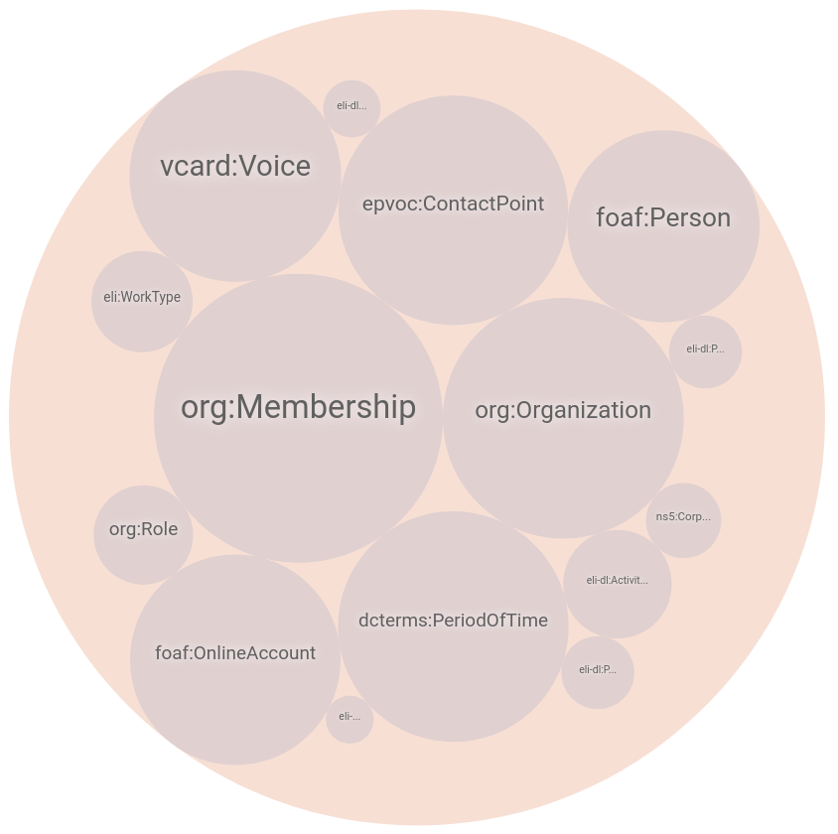
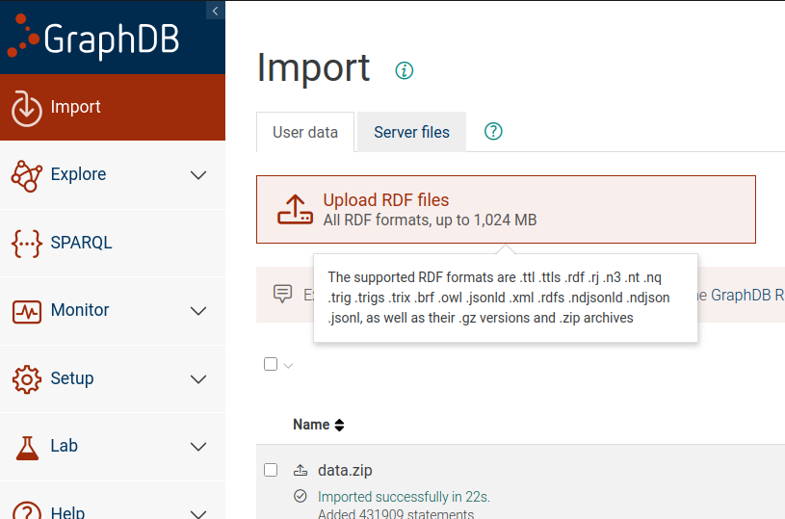
Load all data files into an RDF database
Sparnatural: a SPARQL query UI in 15 minutes based on SHACL specifications and controlled vocabularies

Slide 6
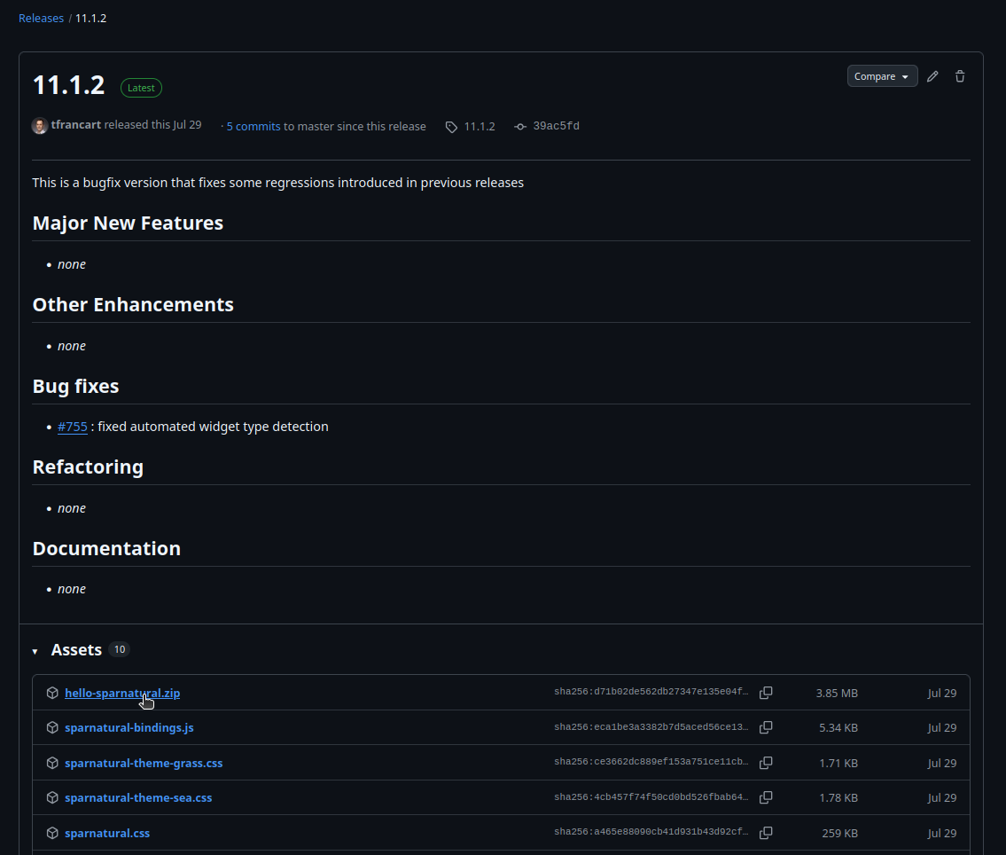
Download and unzip Sparnatural
Sparnatural is a client-side, configurable, SPARQL-based, user oriented, RDF exploration UI
Releases from the Github repository
  https://github.com/sparna-git/Sparnatural
Download « hello-sparnatural.zip » and unzip
Sparnatural: a SPARQL query UI in 15 minutes based on SHACL specifications and controlled vocabularies

Slide 7
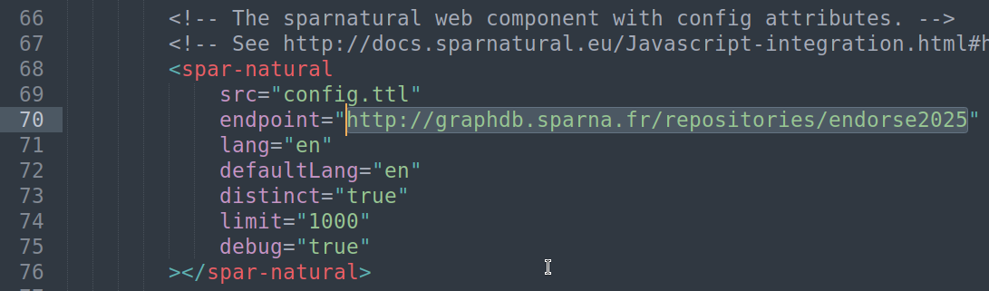
Configure Sparnatural 1/2: SPARQL data service
We follow the Setup documentation « Hello Sparnatural »
Edit index.html from the unzipped files
Point to our RDF database endpoint in the « endpoint » attribute
  Sparnatural can work against any valid SPARQL endpoint
Sparnatural: a SPARQL query UI in 15 minutes based on SHACL specifications and controlled vocabularies

Slide 8
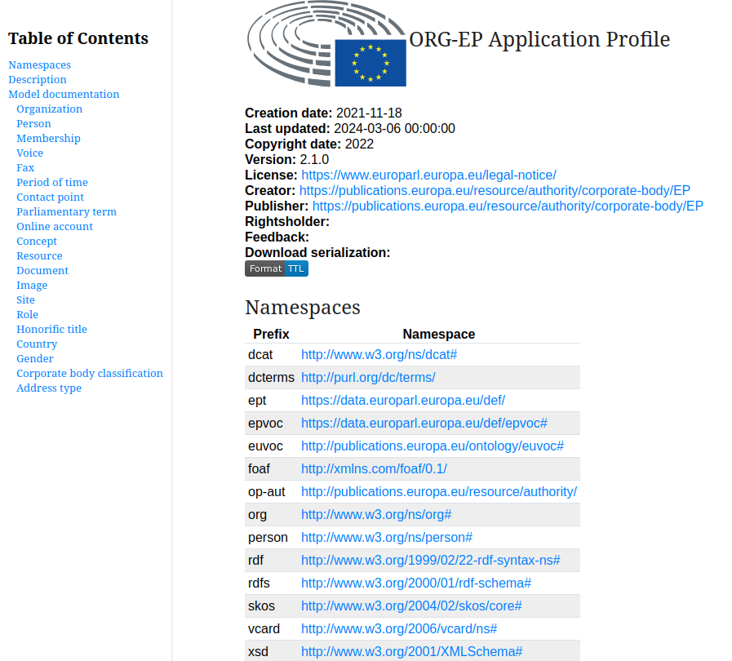
Configure Sparnatural 2/2: data model
Sparnatural is configured using a SHACL specification...
  the online documentation describes the supported subset of SHACL features
... And EP publishes its data model using SHACL
  Human-readable: ORG-EP
  Machine-readable: https://europarl.github.io/org-ep/2.1.0/org-ep.shacl.ttl
Sparnatural: a SPARQL query UI in 15 minutes based on SHACL specifications and controlled vocabularies

Slide 9
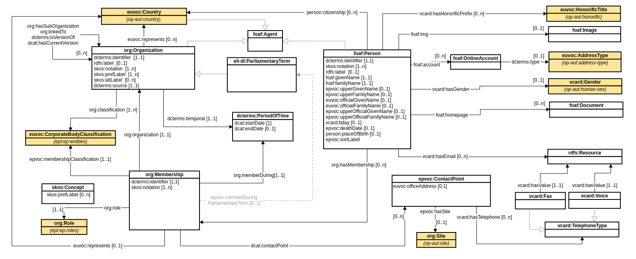
The ORG-EP data model
Sparnatural: a SPARQL query UI in 15 minutes based on SHACL specifications and controlled vocabularies

Slide 10
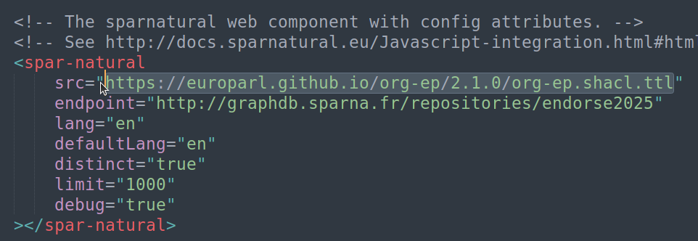
Configure Sparnatural 2/2: the data model
We follow the Setup documentation « Hello Sparnatural »
Edit index.html from the unzipped files
Point to the SHACL specification URL in the « src» attribute
Sparnatural: a SPARQL query UI in 15 minutes based on SHACL specifications and controlled vocabularies

Slide 11
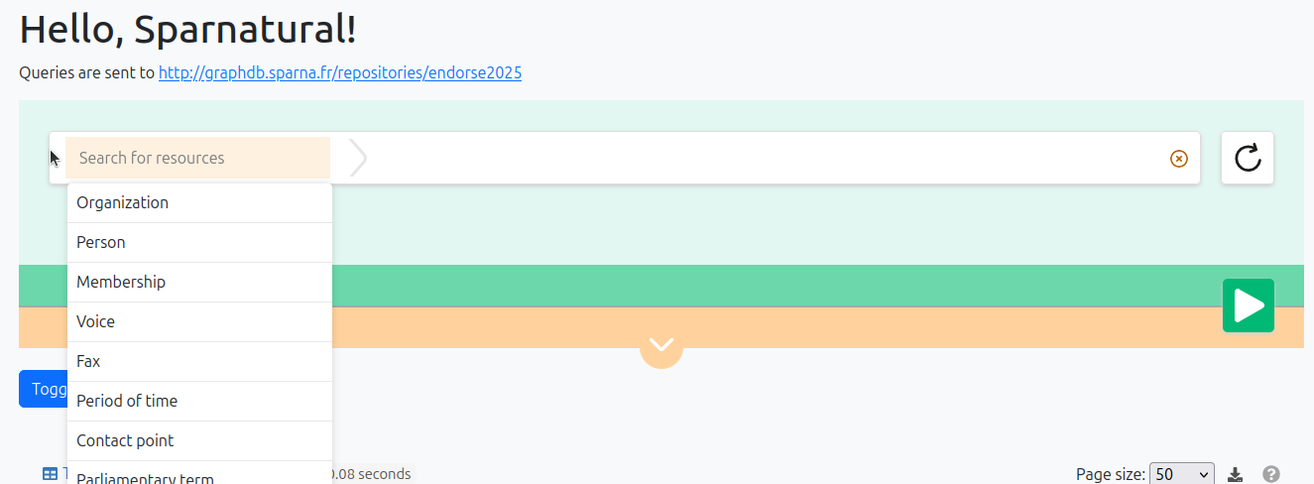
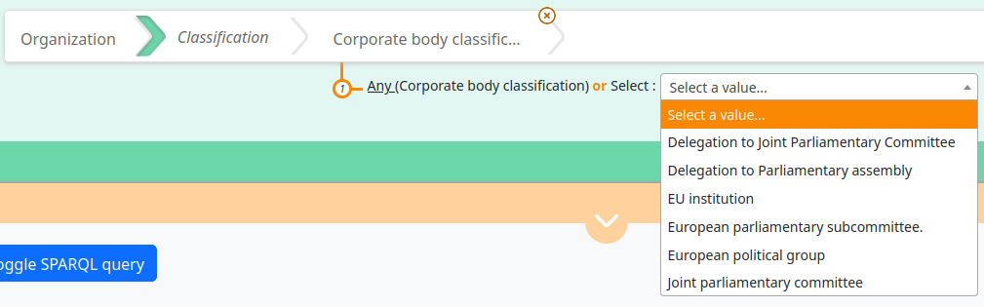
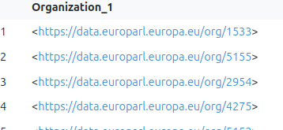
What we have
A working UI! Showing the entities and links from the ORG-EP SHACL spec
Leveraging the controlled vocabularies
But still displaying URI in search results: we want human labels!
Sparnatural: a SPARQL query UI in 15 minutes based on SHACL specifications and controlled vocabularies

Slide 12
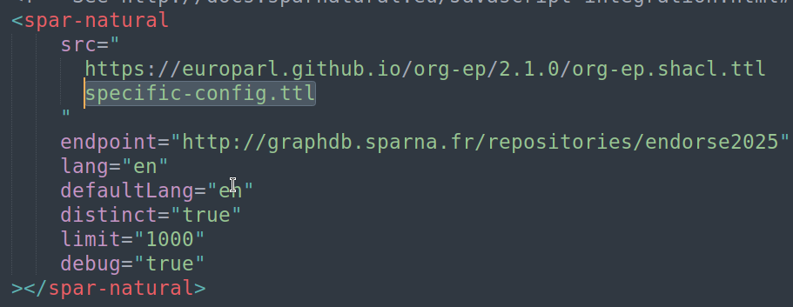
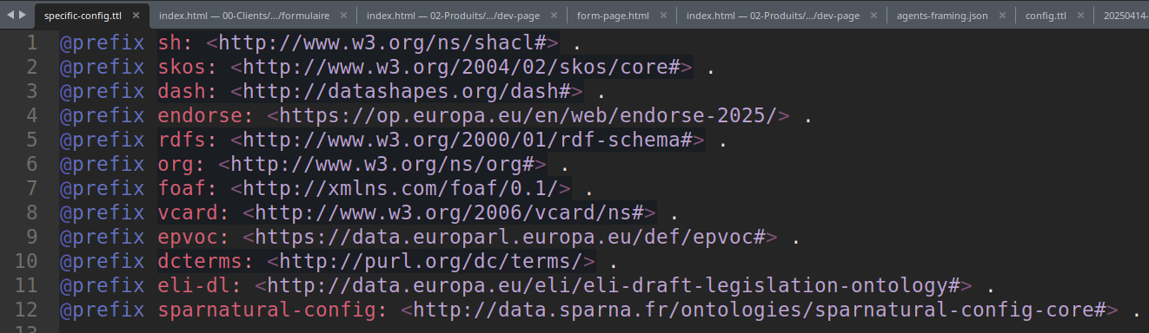
Enhance the UI: an extra configuration layer
Sparnatural can read multiple specification files
We can add our own extra configuration « layer » in addition to ORG-EP
This layer will contain extra configuration annotations
Sparnatural: a SPARQL query UI in 15 minutes based on SHACL specifications and controlled vocabularies

Slide 13
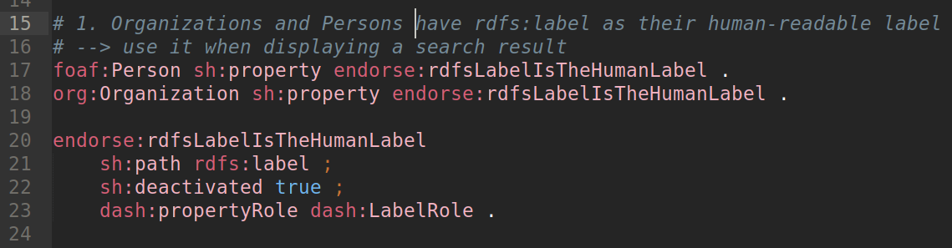
Enhance the UI 1/2: human-readable labels
« When displaying Organizations or Persons, use the rdfs:label property as the human-readable labels of these entities »
We annotate the rdfs:label property with a « dash:propertyRole dash:LabelRole » annotation, meaning : « rdfs:label is the labelling property to use for these entities »
Sparnatural: a SPARQL query UI in 15 minutes based on SHACL specifications and controlled vocabularies

Slide 14
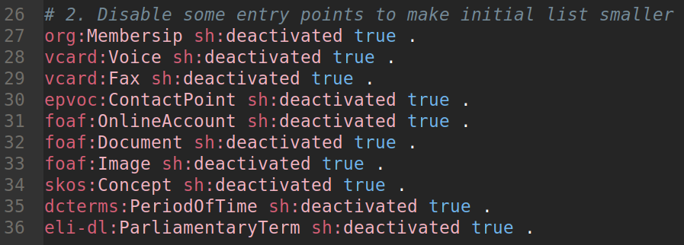
Enhance the UI 2/2: Hide some entry points
« Fax, Voice, PeriodOfTime and others should not be presented as entry points to the graph »
We consider they are just « intermediate entities » for our UI
We annotate the corresponding classes with a « sh:deactivated true » annotation, meaning : « those classes should not be taken into account in the UI »
Sparnatural: a SPARQL query UI in 15 minutes based on SHACL specifications and controlled vocabularies

Slide 15
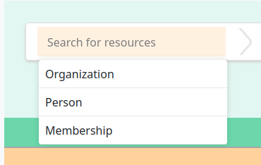
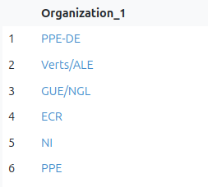
What we have
When choosing an entry point in the graph, the list is restricted to only « meaningful » entry points
When a search is executed, the result lists of persons and organizations will display clickable human-readable labels
Sparnatural: a SPARQL query UI in 15 minutes based on SHACL specifications and controlled vocabularies

Slide 16

Now let’s explore the data !
Sparnatural: a SPARQL query UI in 15 minutes based on SHACL specifications and controlled vocabularies

Slide 17
Key takeaways
RDF efficiently encodes interlinked pieces of a knowlede graph
SHACL machine-readable specifications improves interoperability and reusability of open data
Sparnatural provides a configurable graph exploration UI for end-users
Sparnatural: a SPARQL query UI in 15 minutes based on SHACL specifications and controlled vocabularies

Slide 18
Bonus: Related work SPARQL-based UI
ResearchSpace semantic query UI
  https://documentation.researchspace.org/resource/Help:SemanticSearch
RDFExplorer (2020 – offline)
  Vargas, H., Buil-Aranda, C., Hogan, A., López, C.: RDF Explorer: A Visual SPARQL Query Builder. In: International Joint Conference on Aritificial Intelligence (IJCAI–PRICAI) (2020).
Visual SPARQL builder
  https://leipert.github.io/vsb/#
A-QuB
  https://www.ics.forth.gr/isl/assistive-query-building-semantic-data-qub
Sparnatural: a SPARQL query UI in 15 minutes based on SHACL specifications and controlled vocabularies

Slide 19
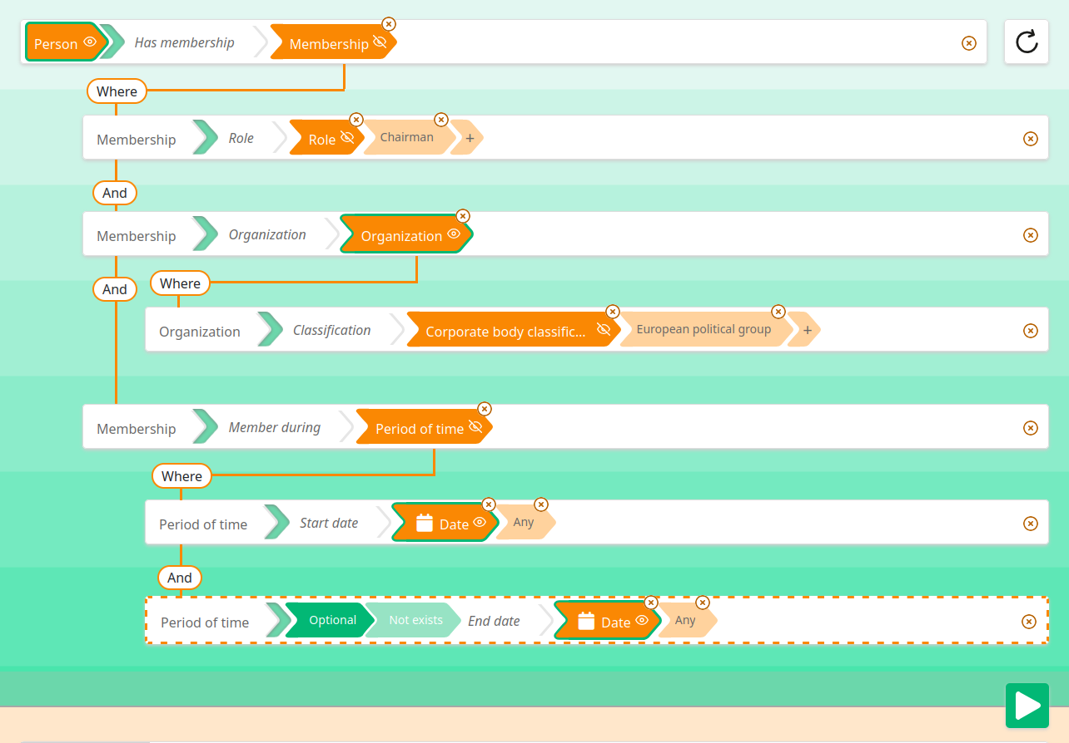
Bonus: screenshot
Sparnatural: a SPARQL query UI in 15 minutes based on SHACL specifications and controlled vocabularies

Slide 20
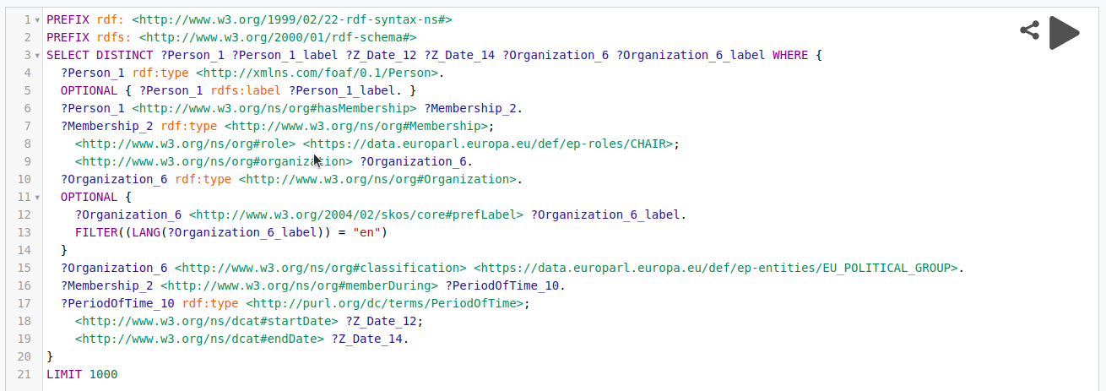
Bonus: The underlying SPARQL query
Sparnatural: a SPARQL query UI in 15 minutes based on SHACL specifications and controlled vocabularies

Slide 21
Thank you !
Sparnatural :
https://github.com/sparna-git/Sparnatural
https://sparnatural.eu/

