Slide 1




The Future of Data Stewardship
Stefaan G. Verhulst
ENDORSE 2025

Slide 2
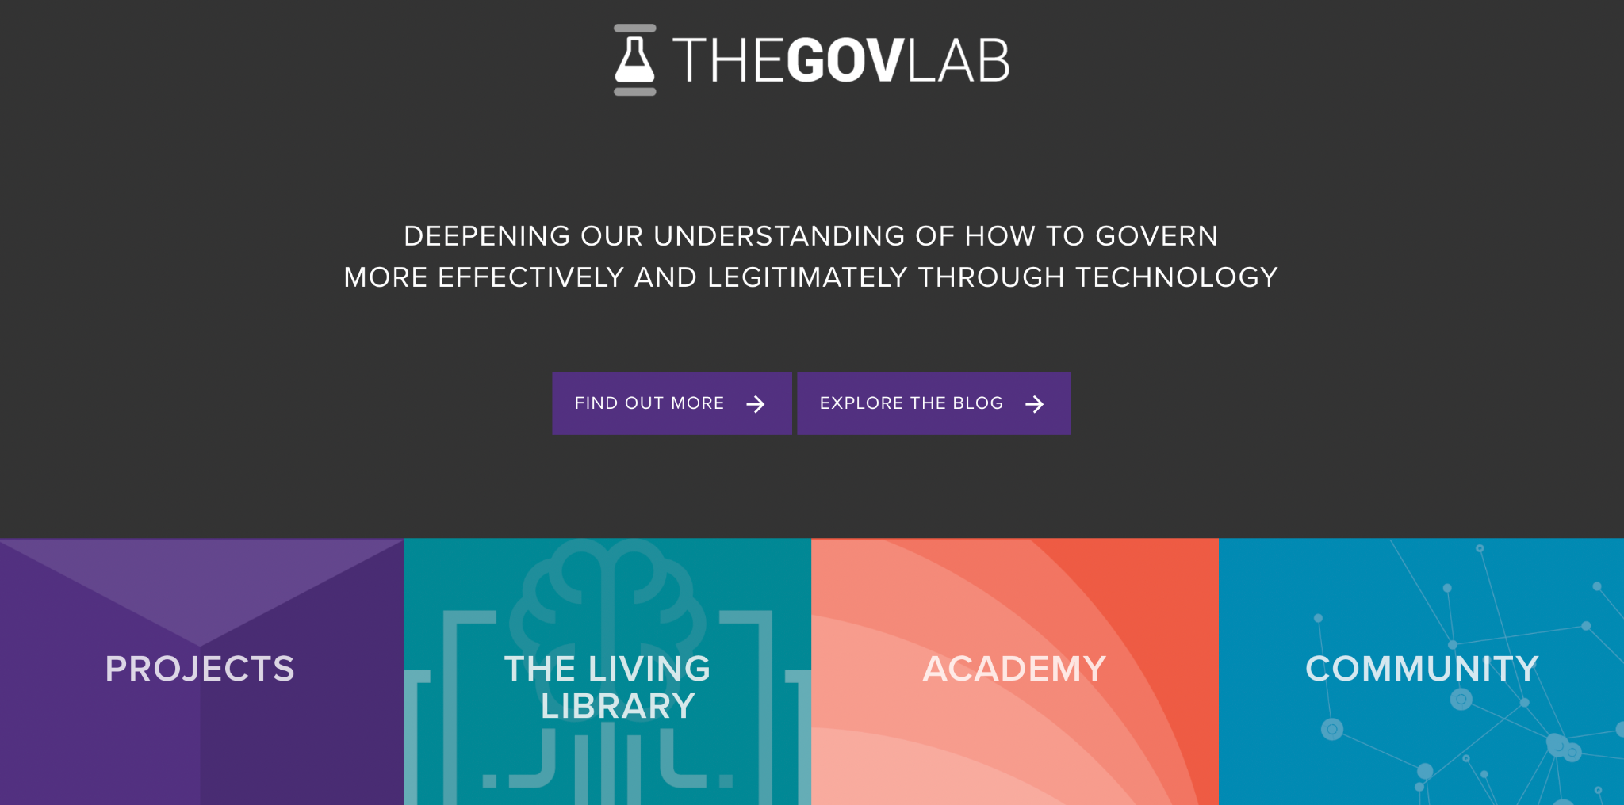
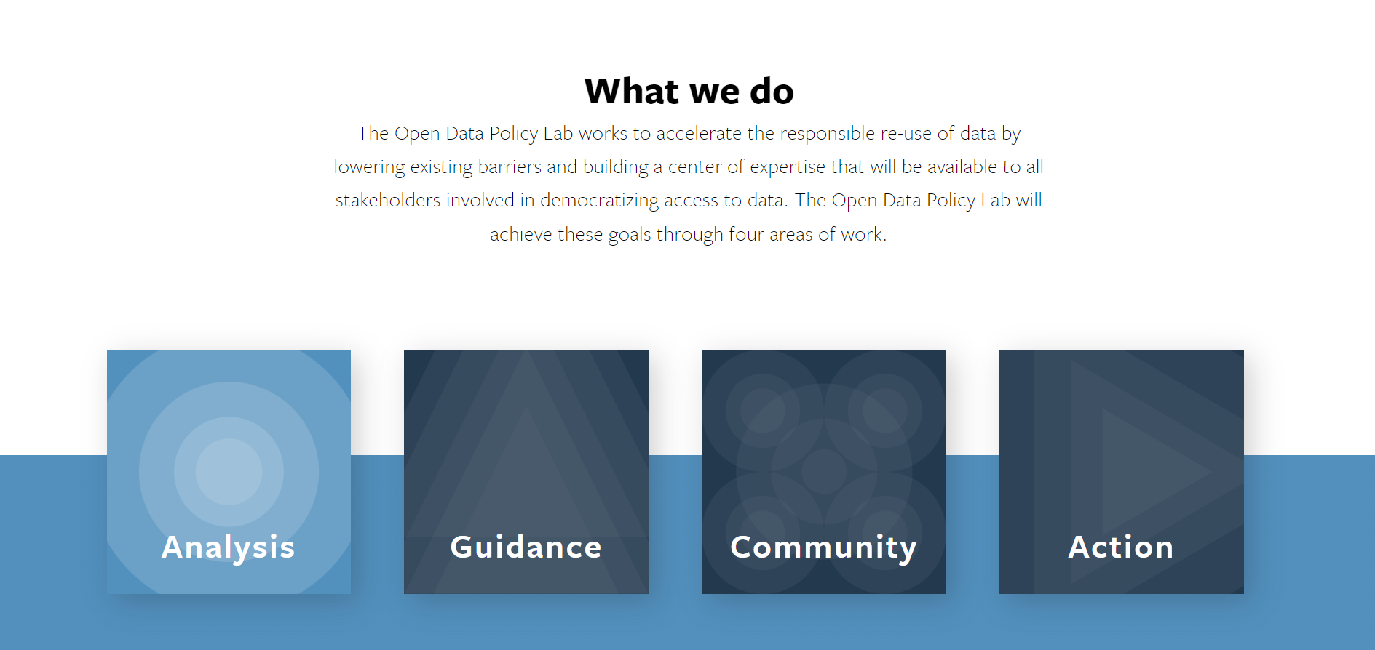
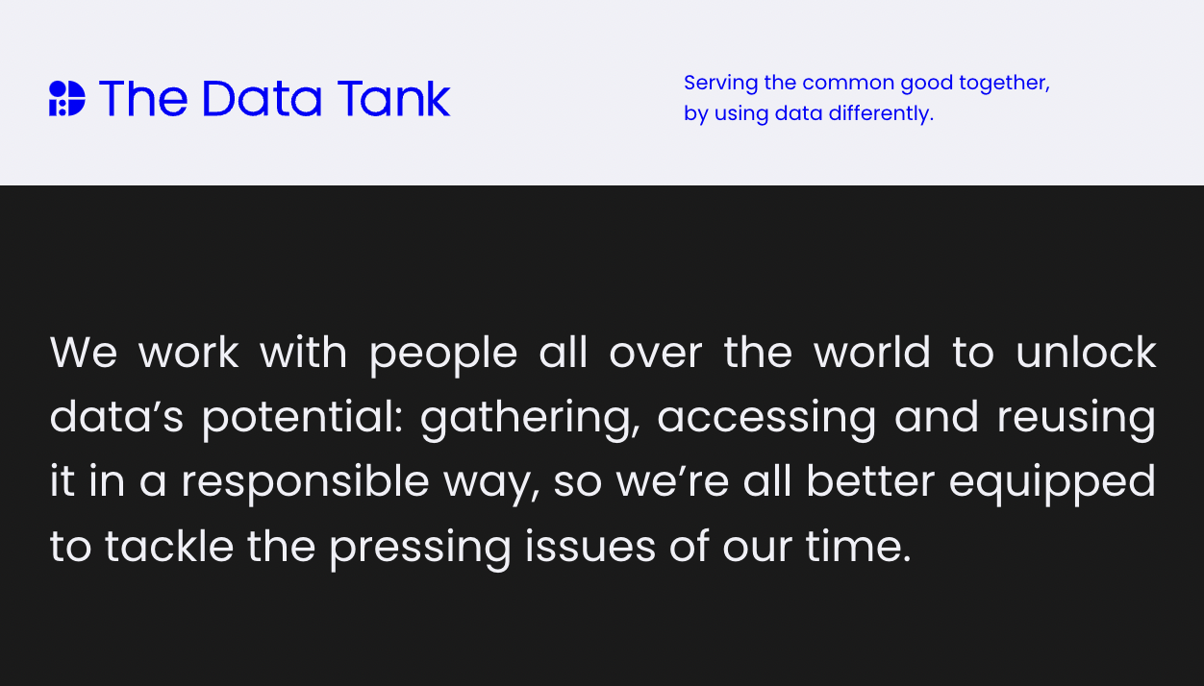
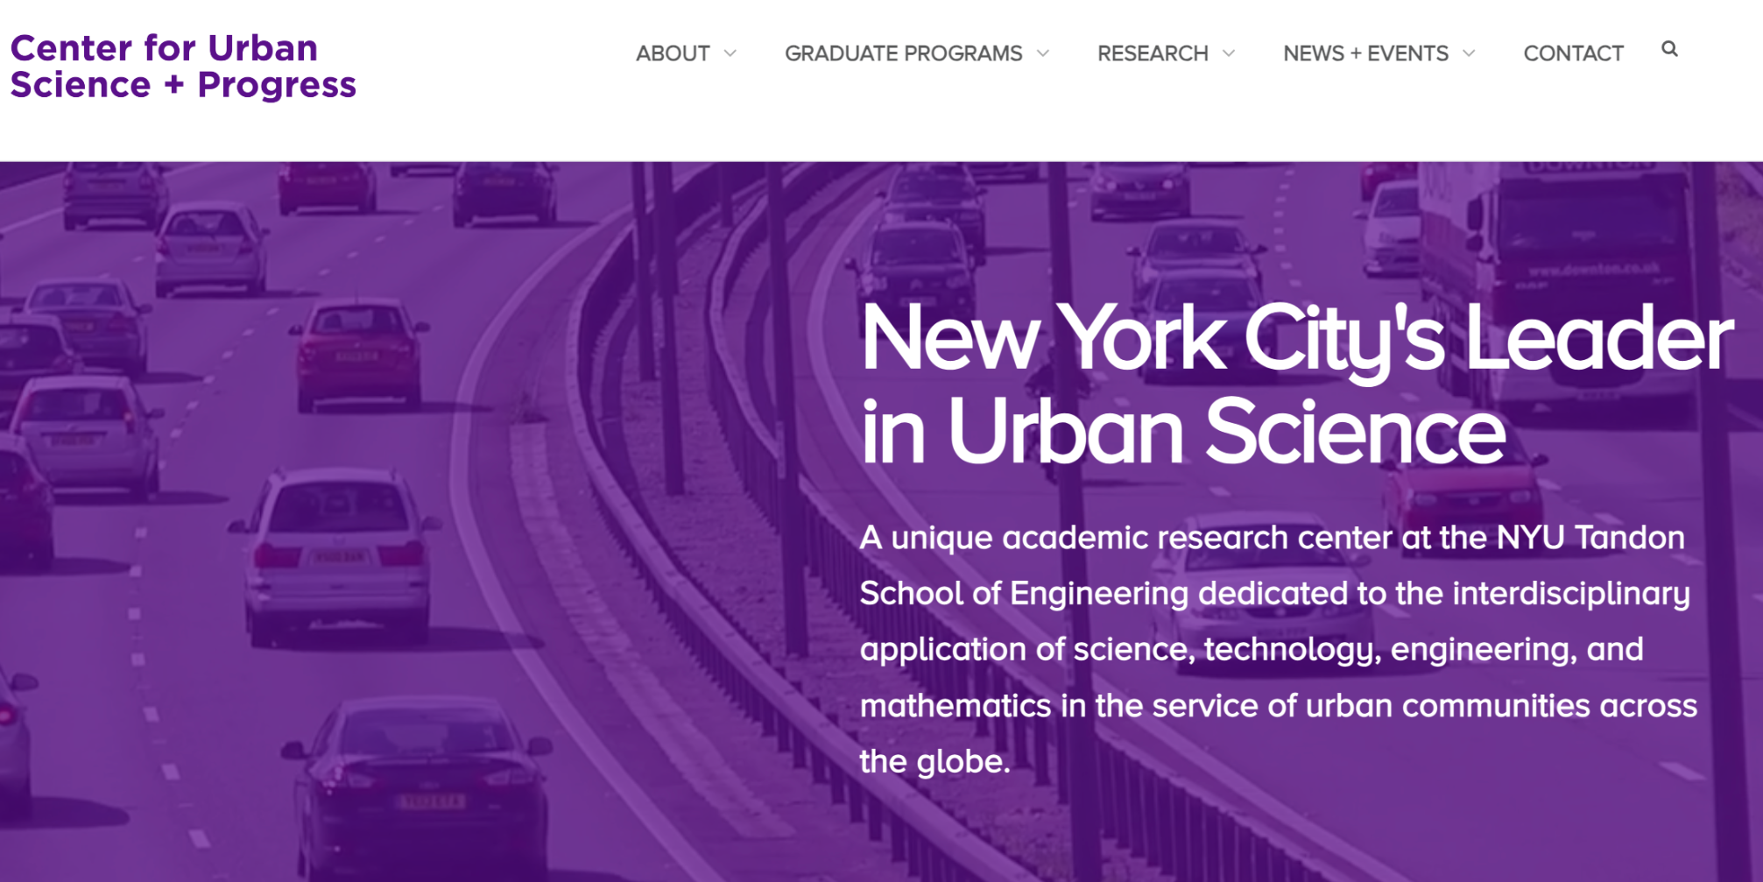

Slide 3
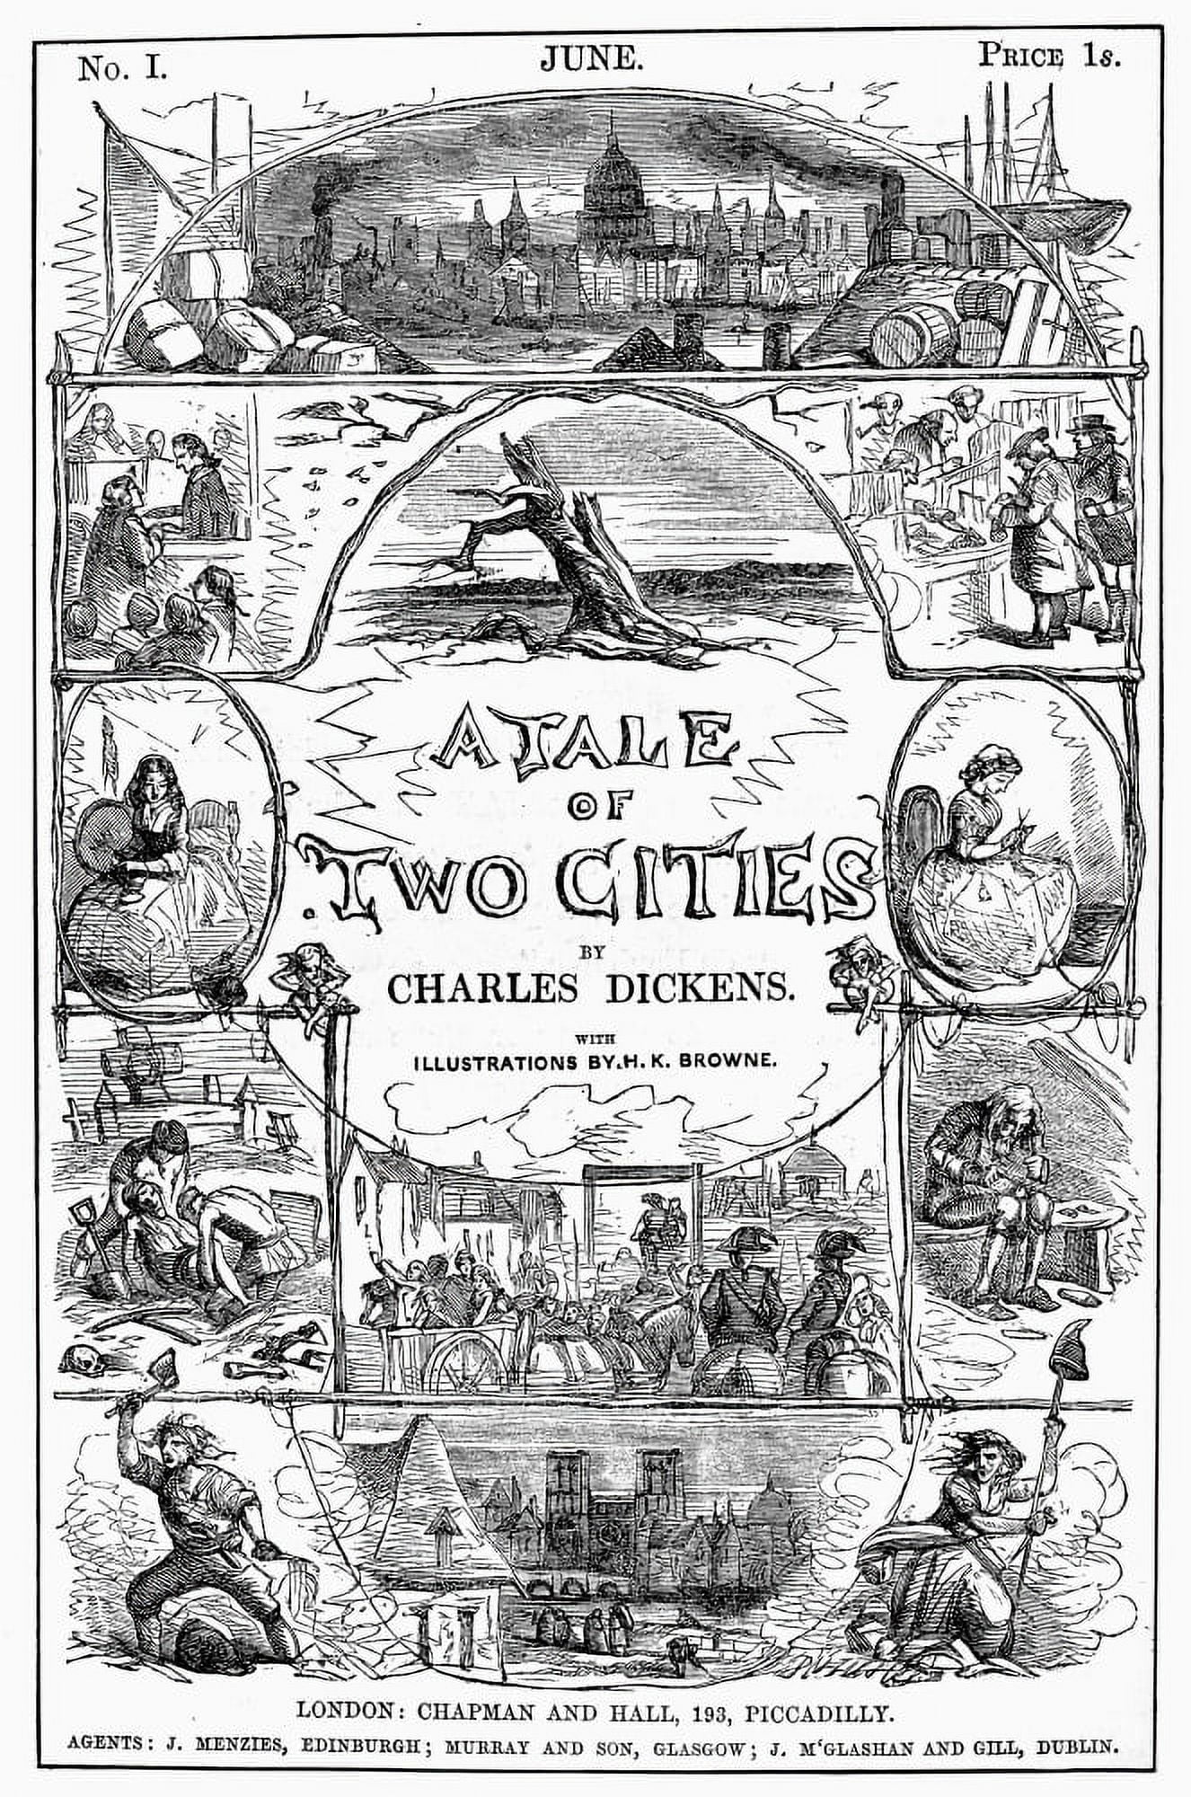

TODAY’S SITUATION
“
It was the best of times, it was the worst of times [...] it was the spring of hope, it was the winter of despair.…
— Charles Dickens
”
`

Slide 4
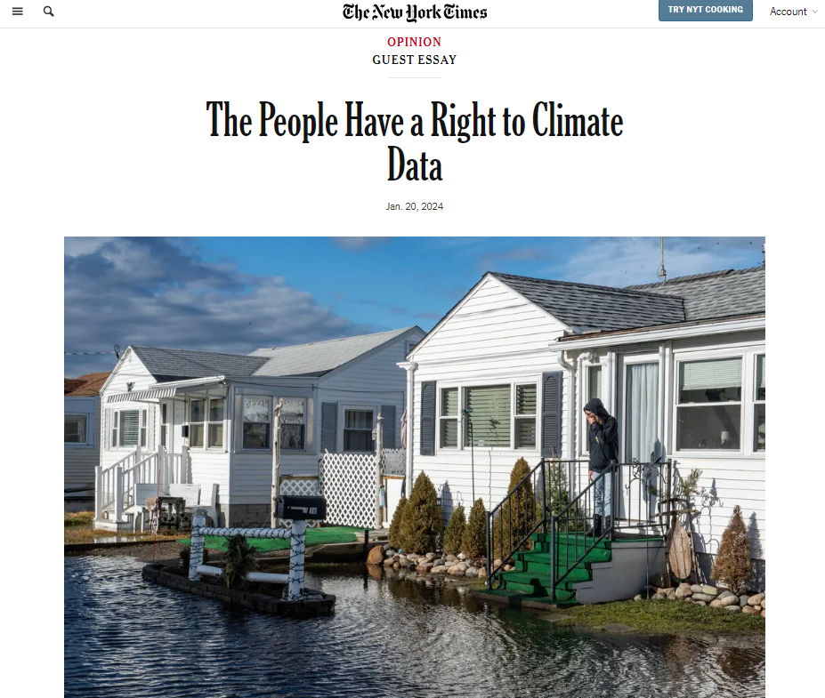
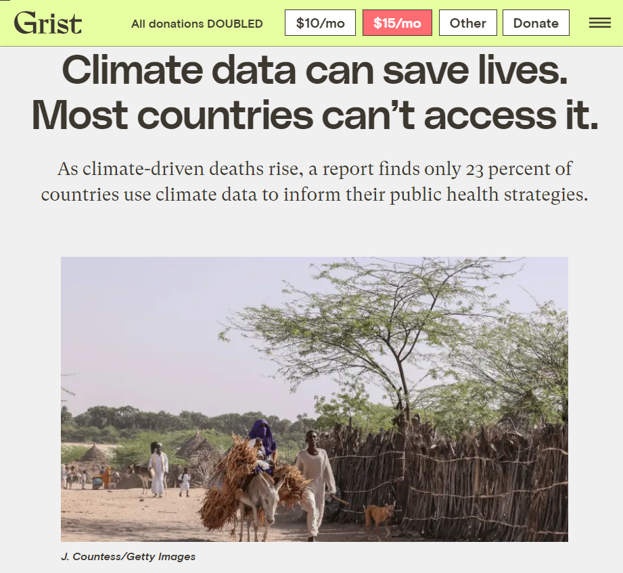
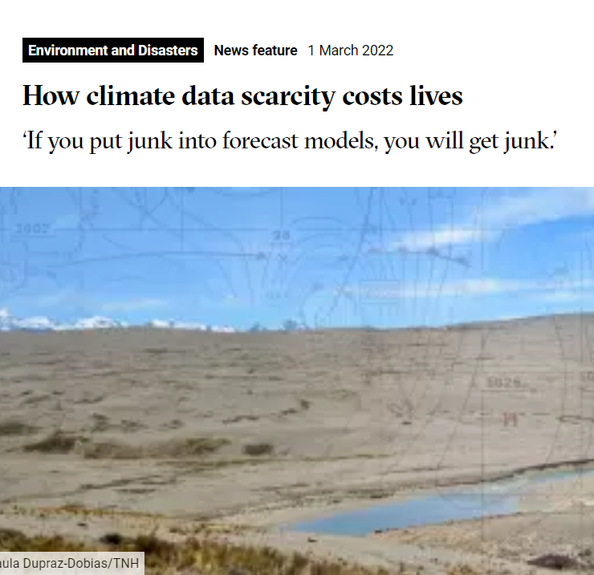
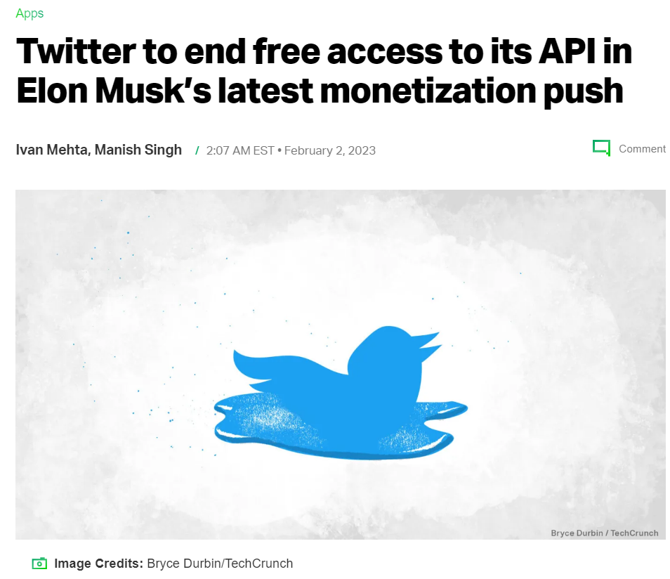
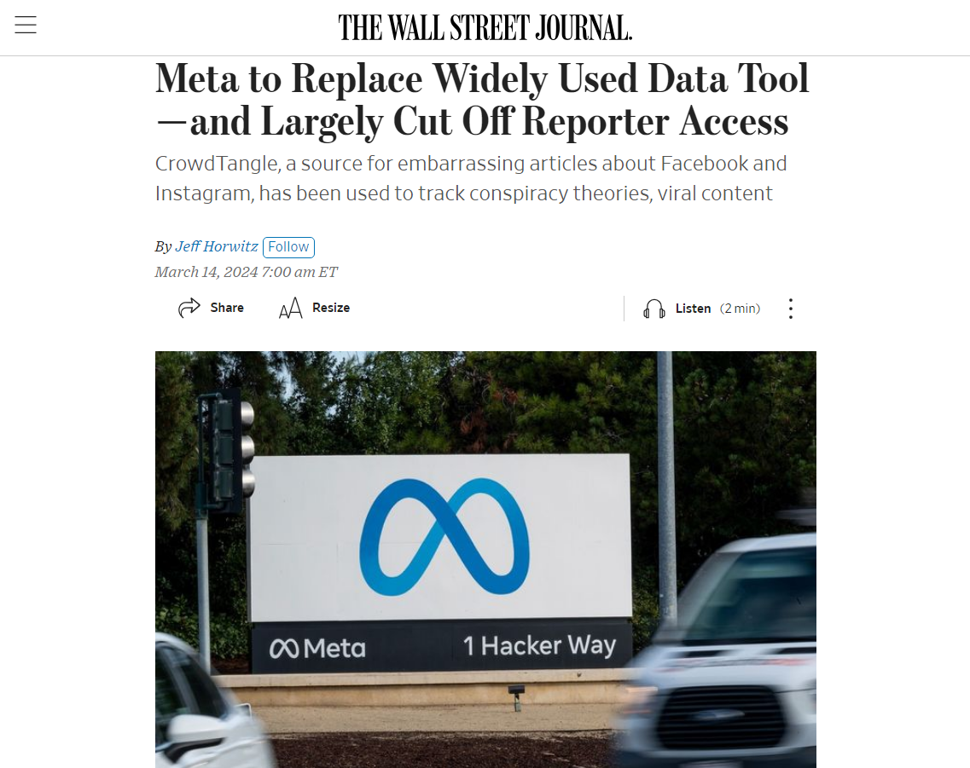
Worst of Times: TOWARDS A DATA WINTER?
bit.ly/4cuzNTK
bit.ly/3KcW3EV
bit.ly/4b85st7

Slide 5
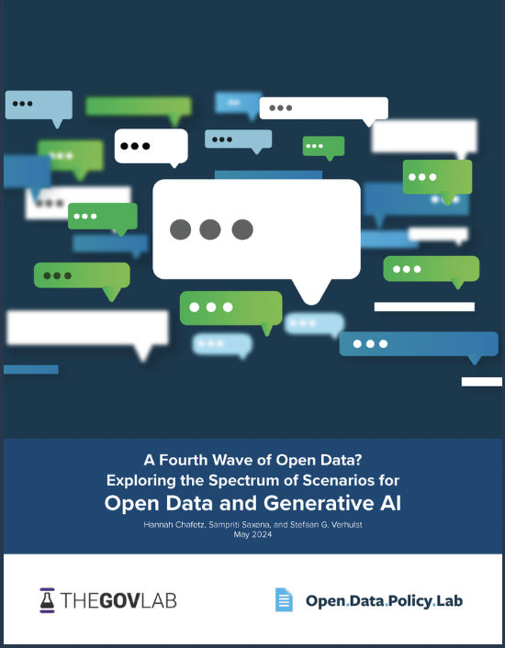
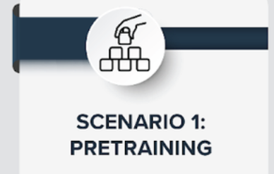
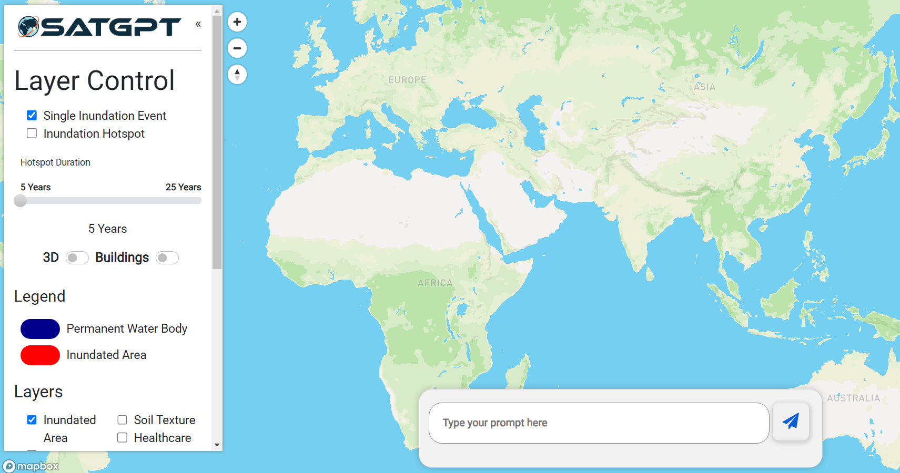

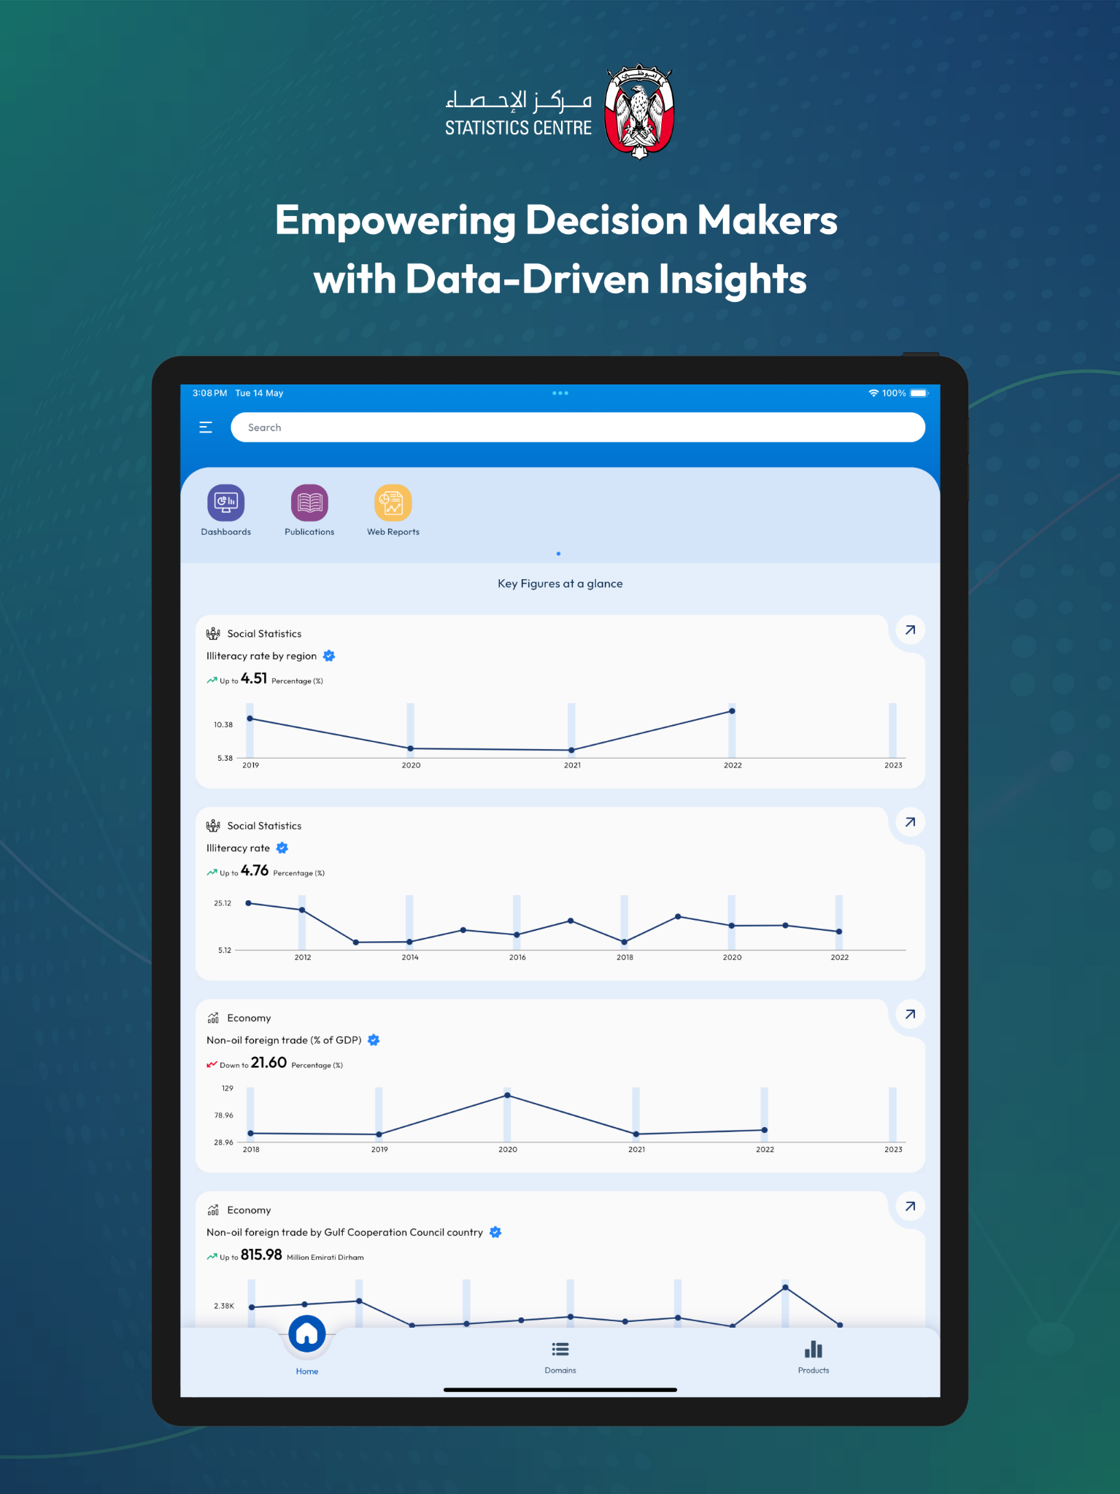
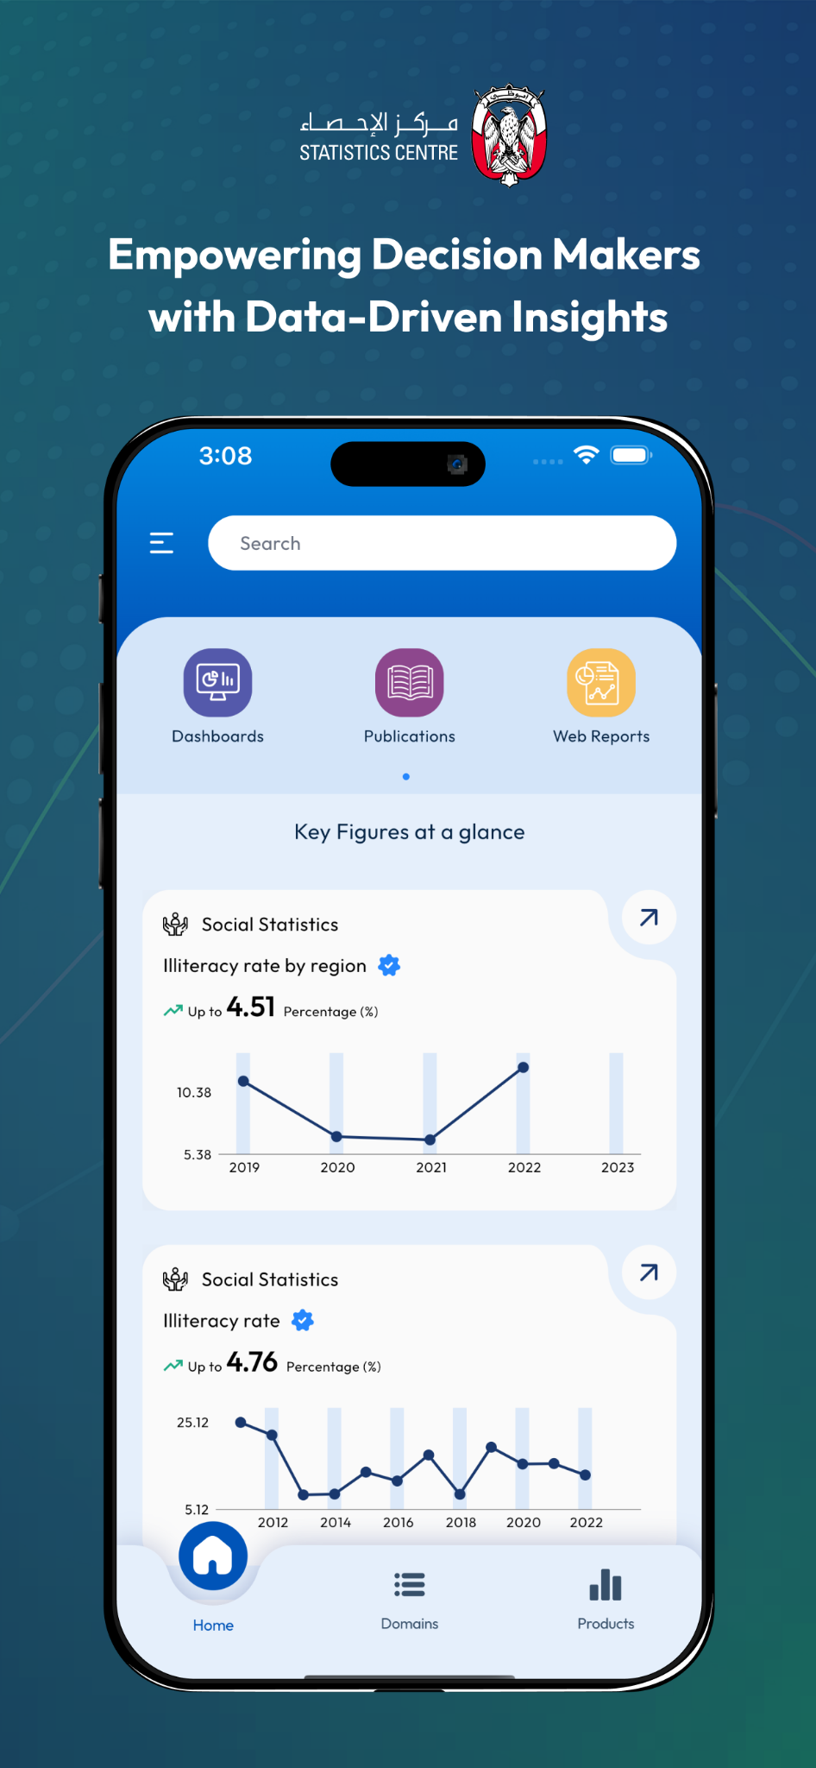
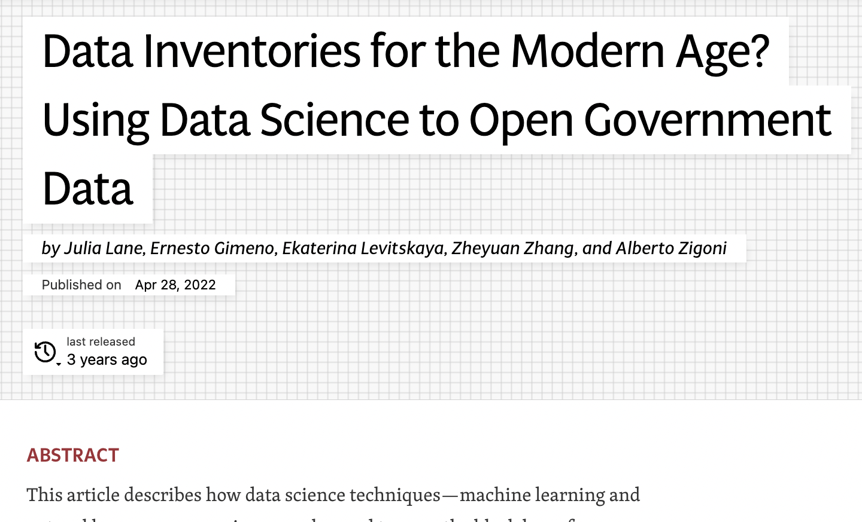
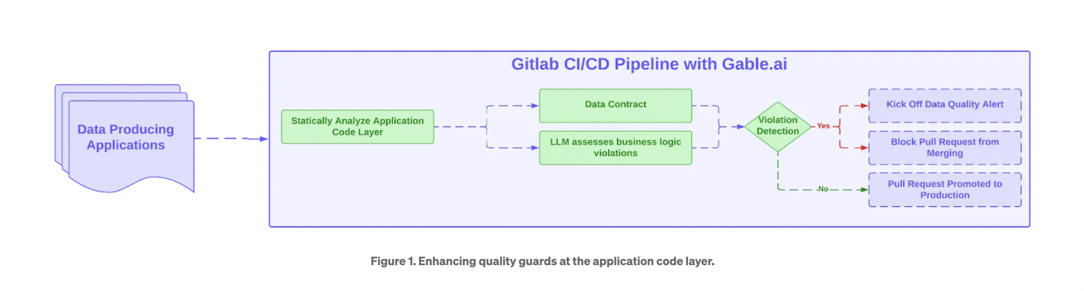
Best of Times: FOURTH WAVE OF OPEN DATA?
Open Data for AI
AI for Open Data
Pre-Training and Fine-Tuning
Augmentation (RAG models)
Factual and Public Interest AI
Conversational Interface
Data Quality and Preparation
Data Discovery
https://arxiv.org/abs/2405.04333
bit.ly/4iml6V0
https://allenai.org/olmo
Bayaan
http://bit.ly/4naaHOl
http://bit.ly/4g8tGXu
https://arxiv.org/abs/2405.04333

Slide 6
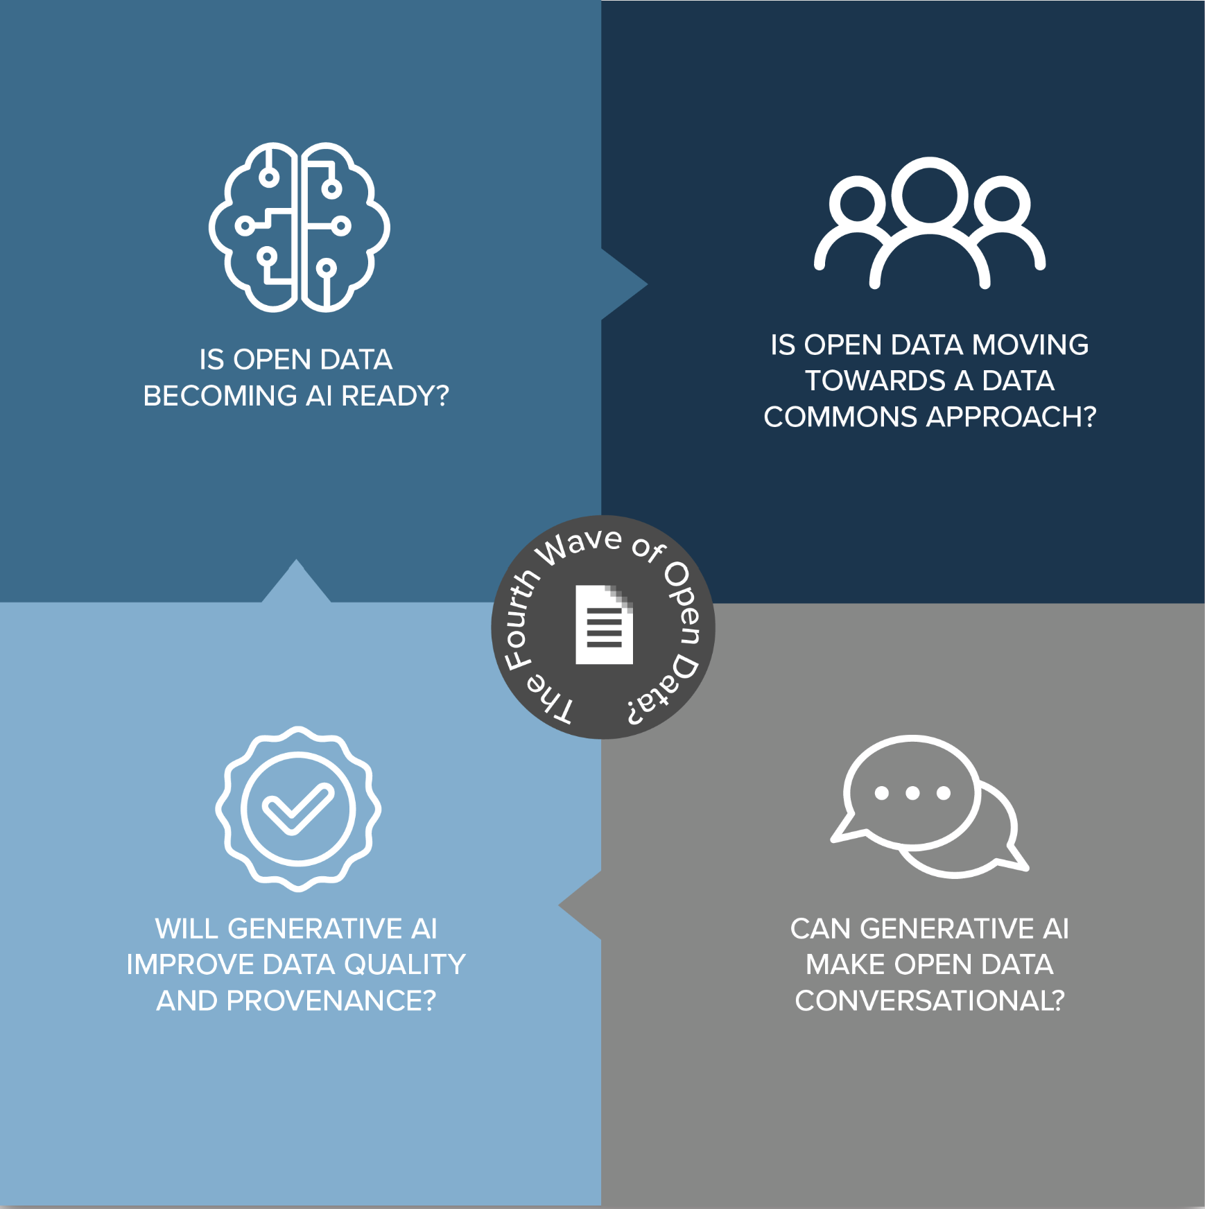
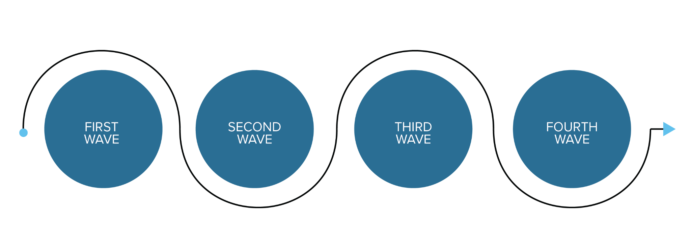
CORE CHALLENGE: RIDING THE FOURTH WAVE
Freedom of Information
Data Collaboratives
Open Government Data
Generative AI
Introduction
https://arxiv.org/pdf/2405.04333

Slide 7
RETHINKING DATA STEWARDSHIP: 6 SHIFTS
Purpose?
SUPPLY
QUESTION
Linkage?
DATA SET
KNOWLEDGE GRAPH
Type?
STRUCTURED
UNSTRUCTURED
Permission?
CONSENT
SOCIAL LICENSE
Principles?
FAIR
FAIR-R
Governance?
OPEN DATA
DATA COMMONS
Rethinking Data Stewardship

Slide 8
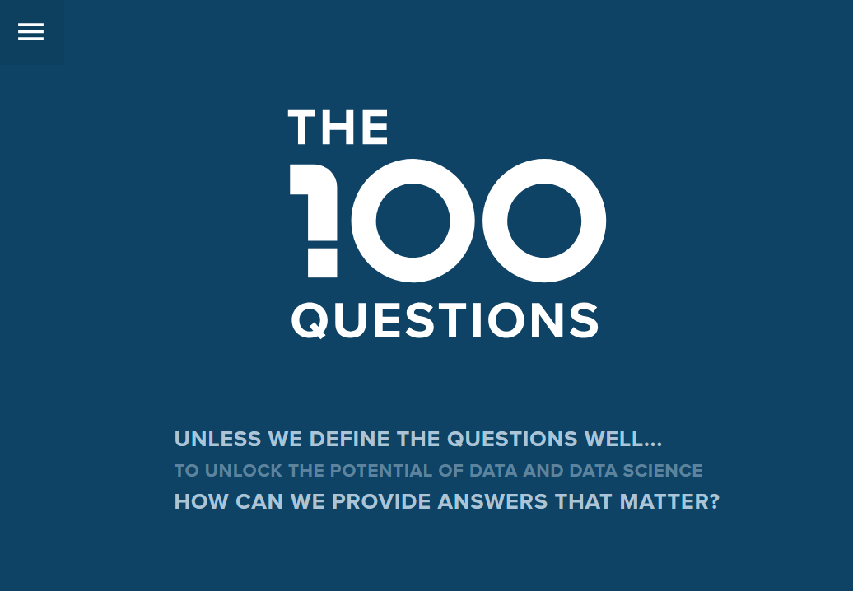
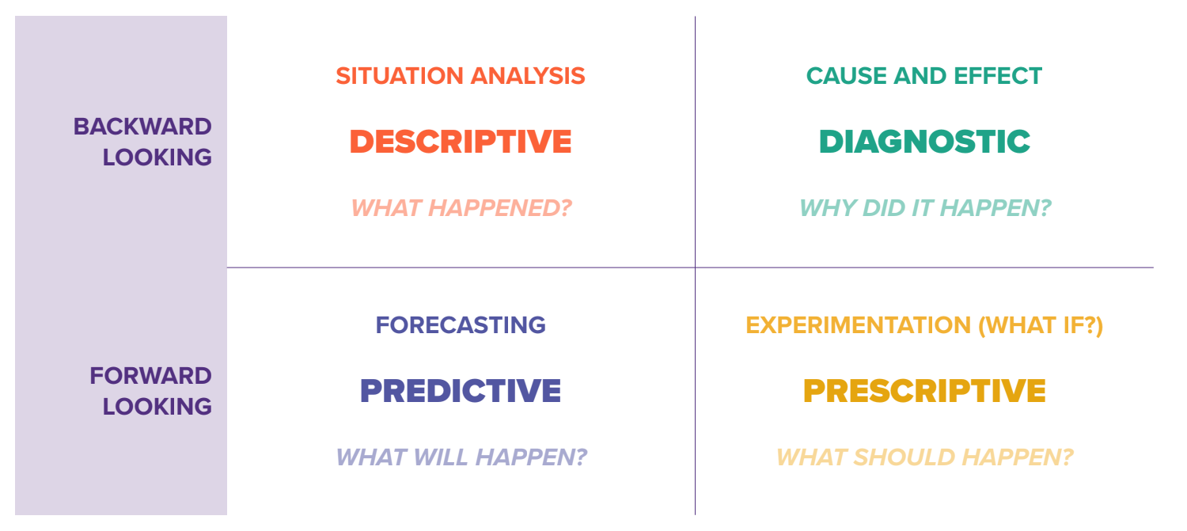
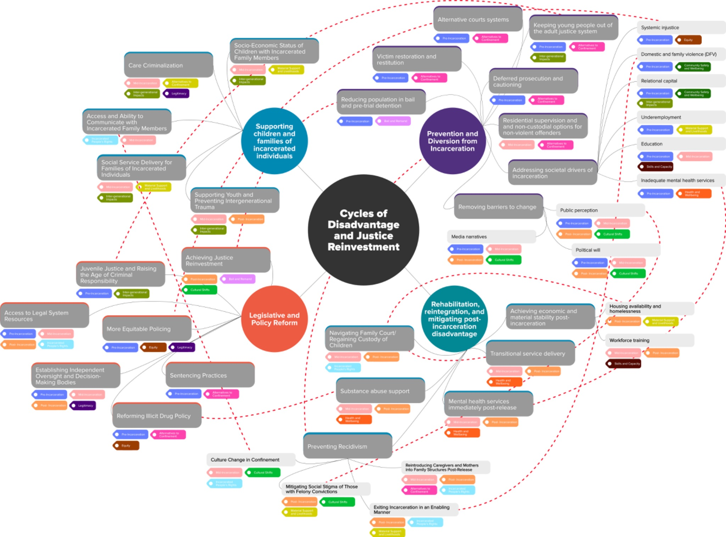
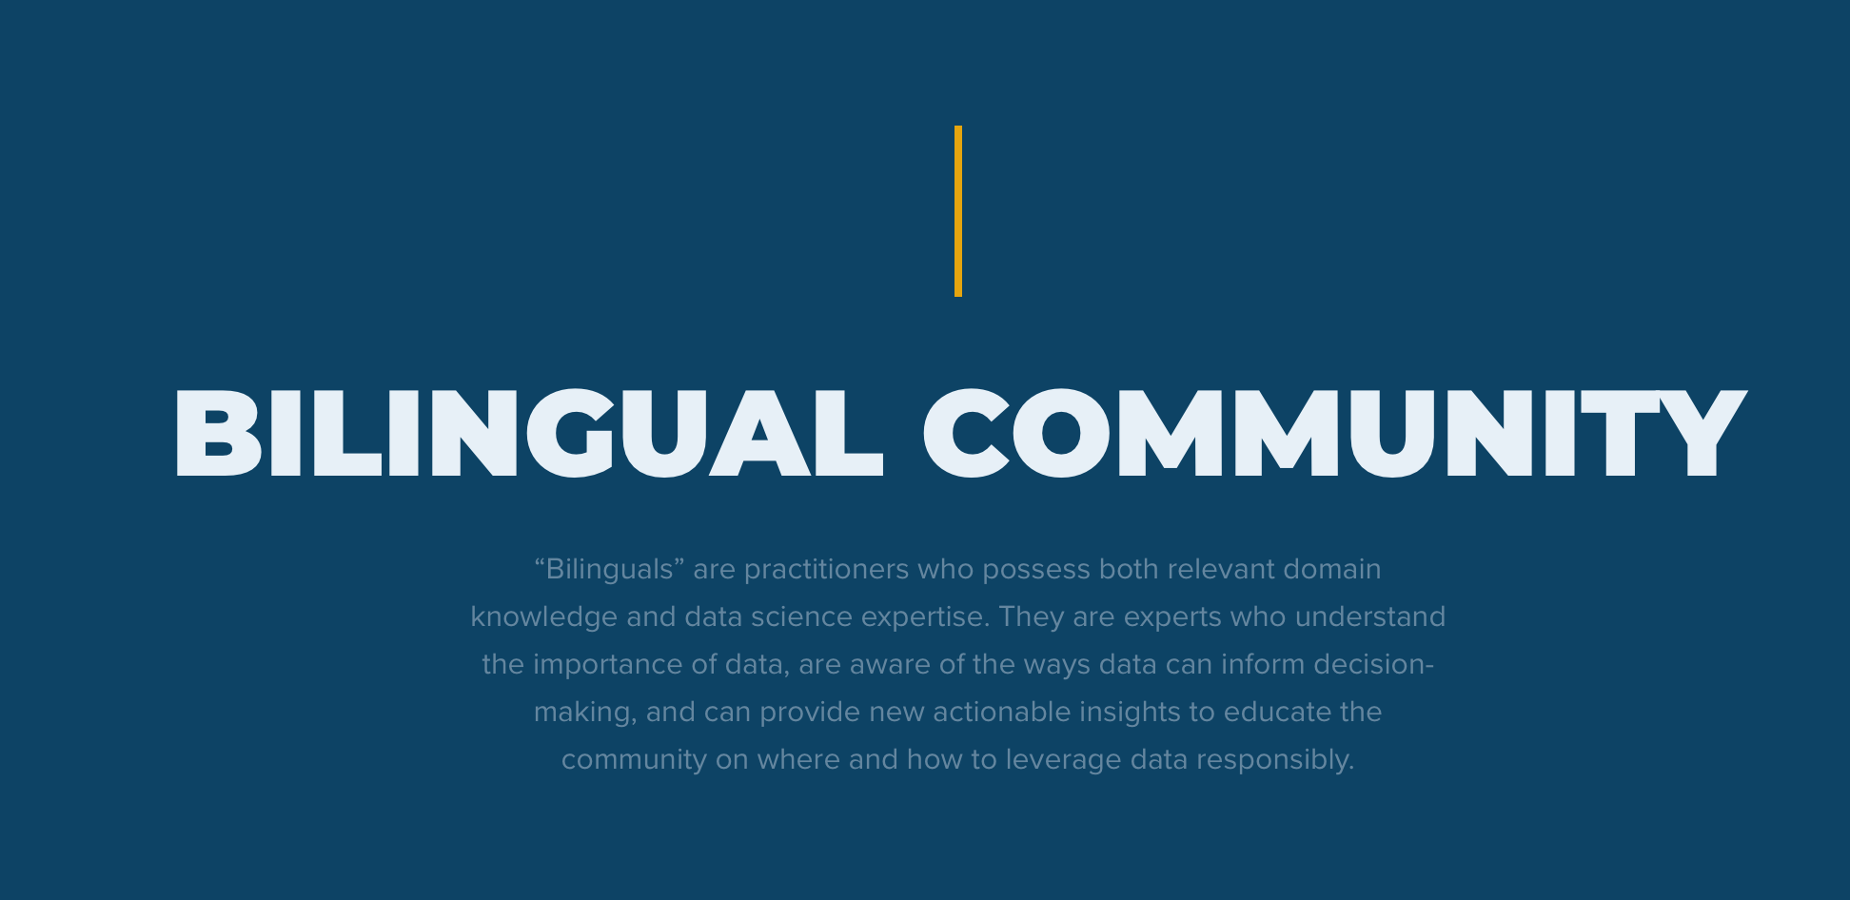
1. Supply-Centric → Question-Centric
Taxonomy of Questions
Topic Mapping
Stewards of Questions
Moving from data dumps to purpose-driven access guided by societal needs
Rethinking Data Stewardship

Slide 9
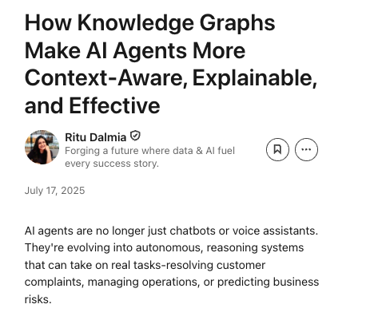
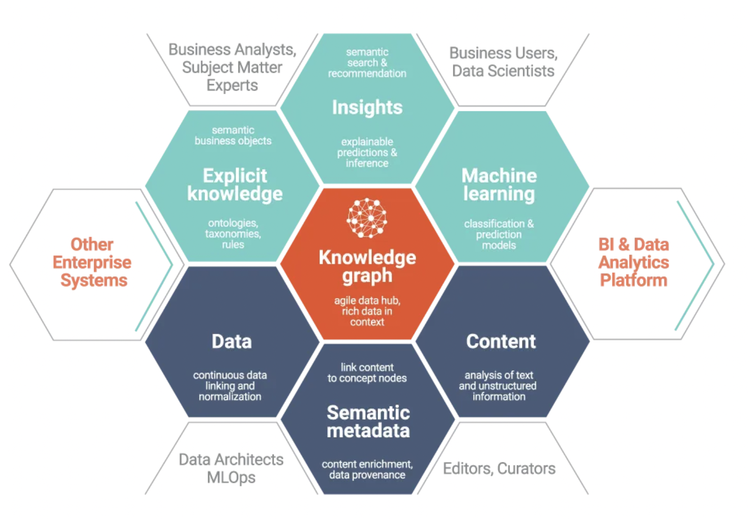
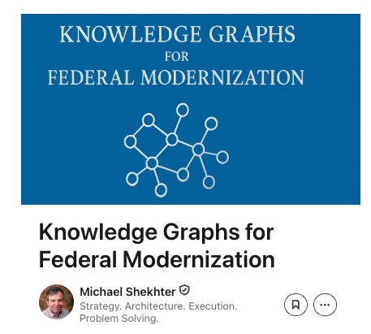
2. Data Sets → Knowledge Graphs
Link Entities and Relationships
Explain Decisions
Provide Vital Context
Enable contextual integrity and linked insights, not just isolated datasets
Rethinking Data Stewardship

Slide 10
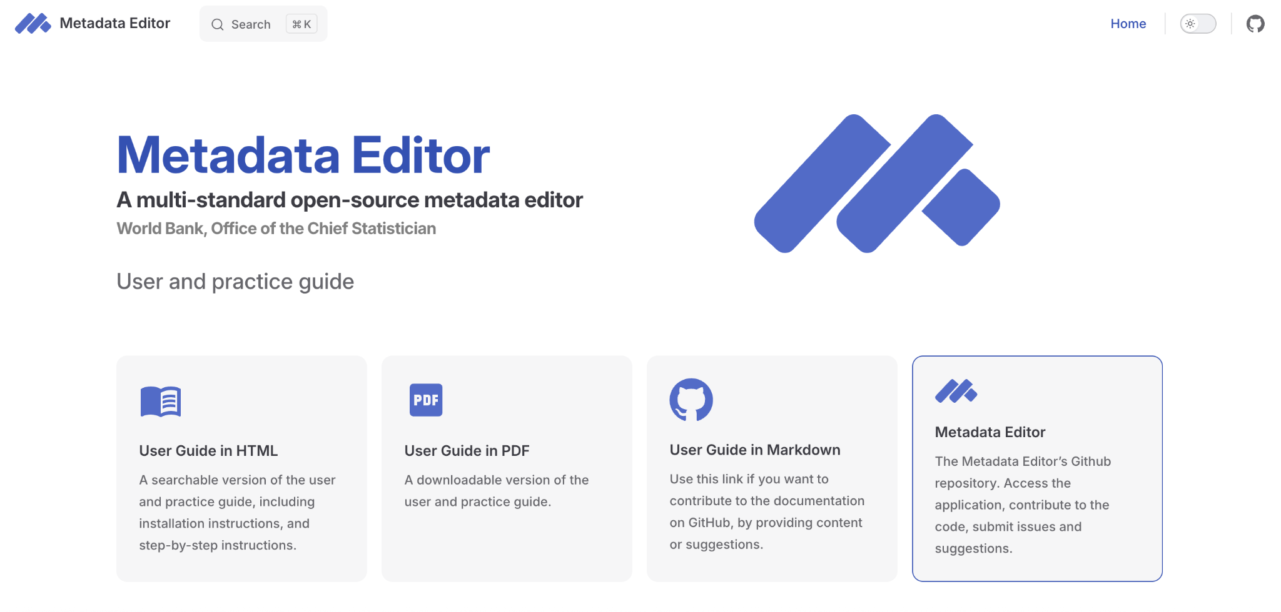
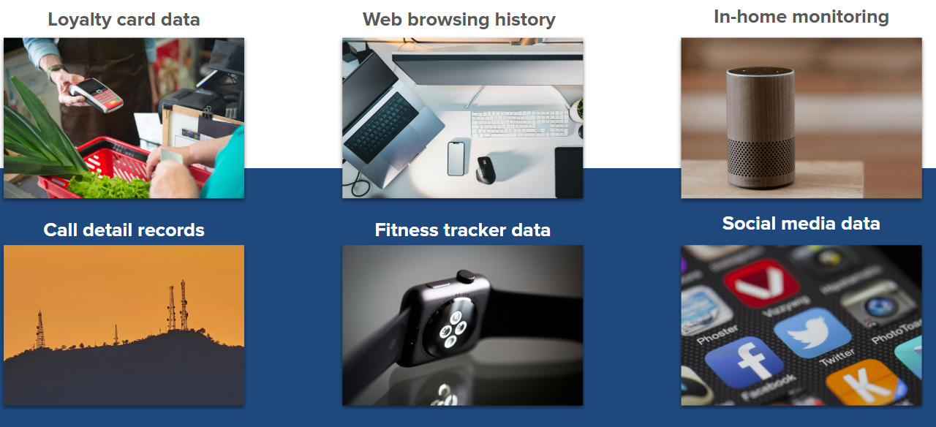
3. Structured Data → Unstructured Data
Opportunity in Non-Traditional Data
Importance of Metadata
Expand stewardship to text, images, audio, video—key for AI readiness
Rethinking Data Stewardship

Slide 11
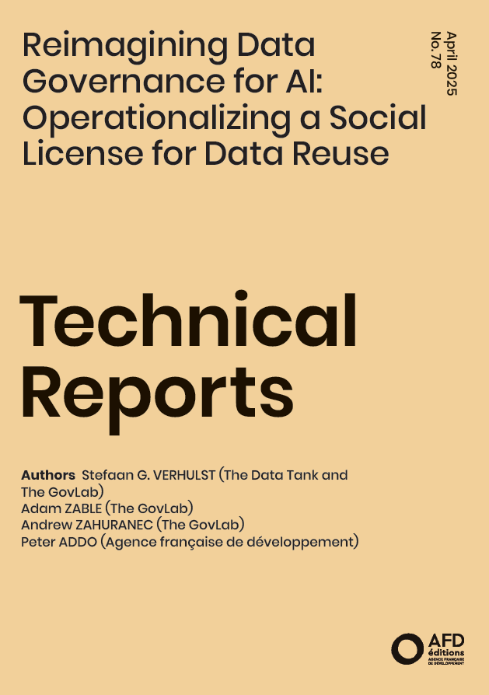
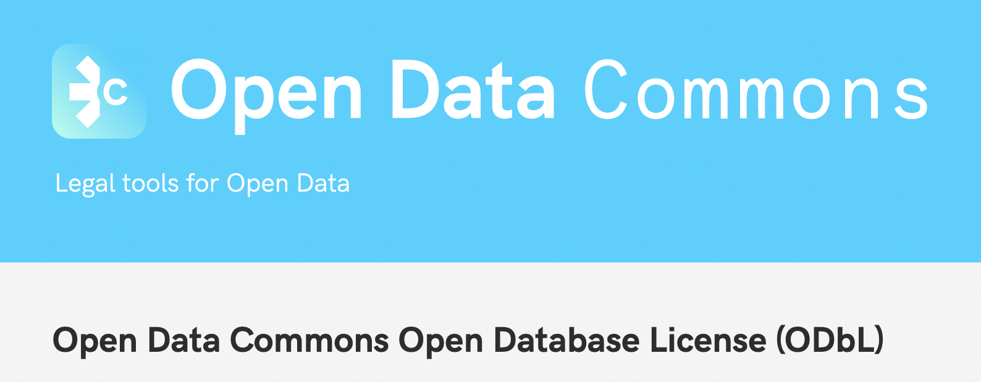


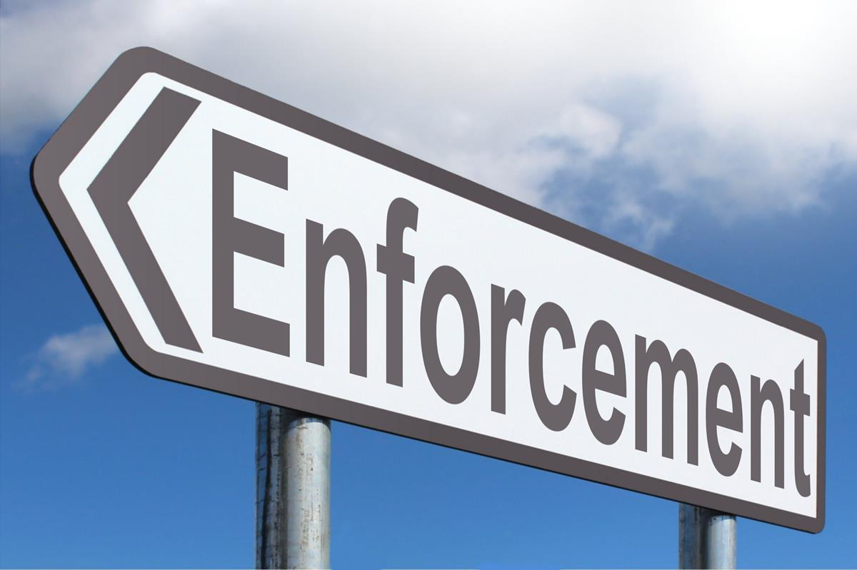

4. Consent → Social License
Establish Preferences
Document
Preferences
Enforce
Preferences
Go beyond individual consent to collective legitimacy and trust-building
Rethinking Data Stewardship

Slide 12
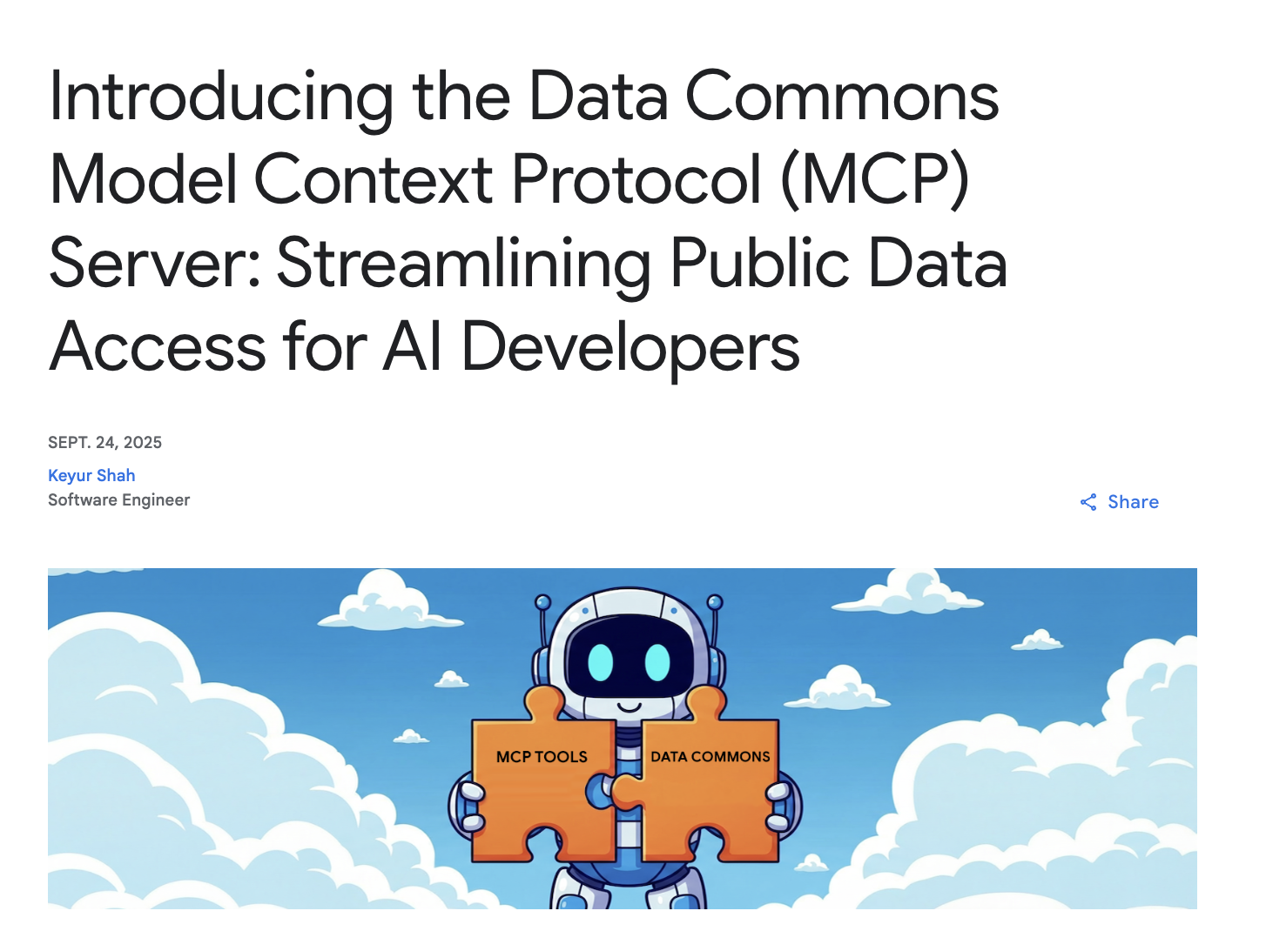
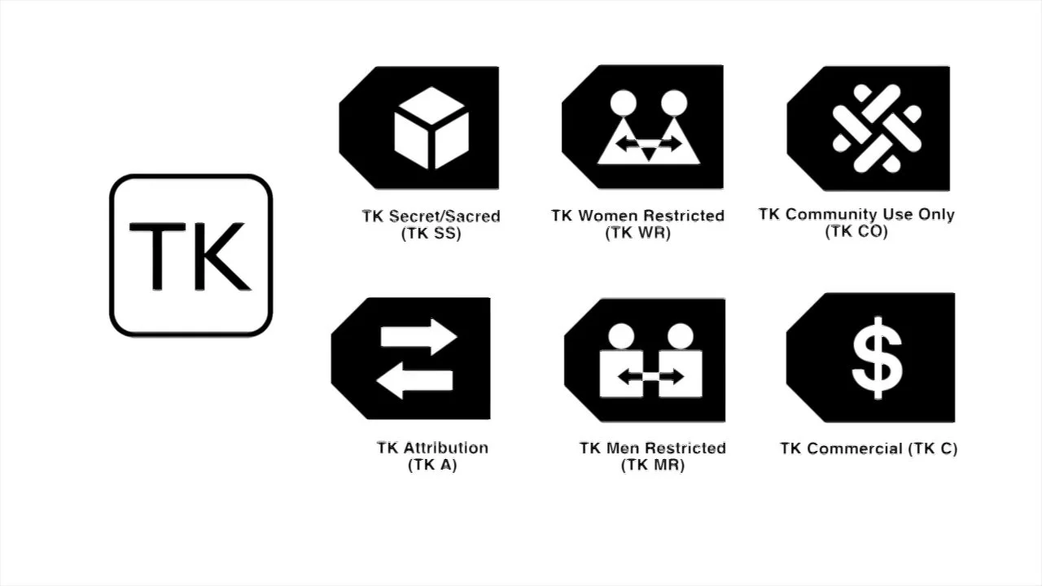
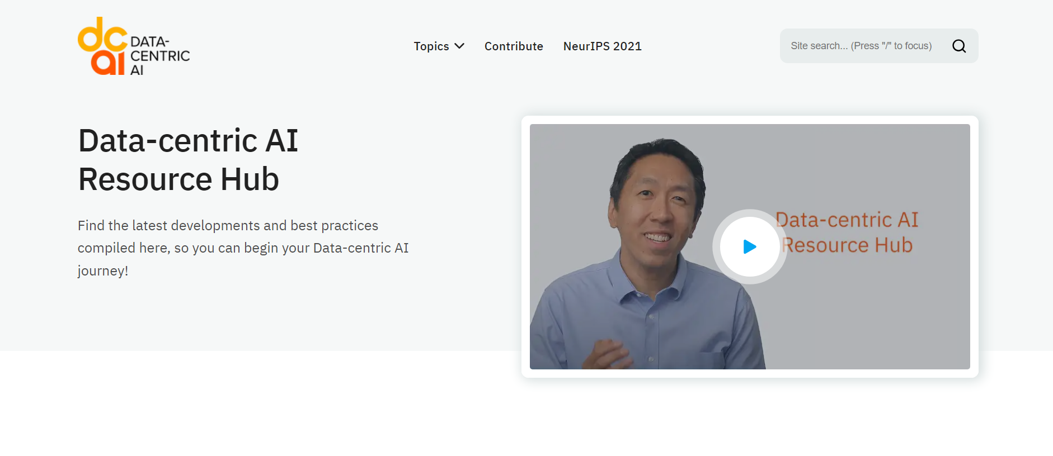
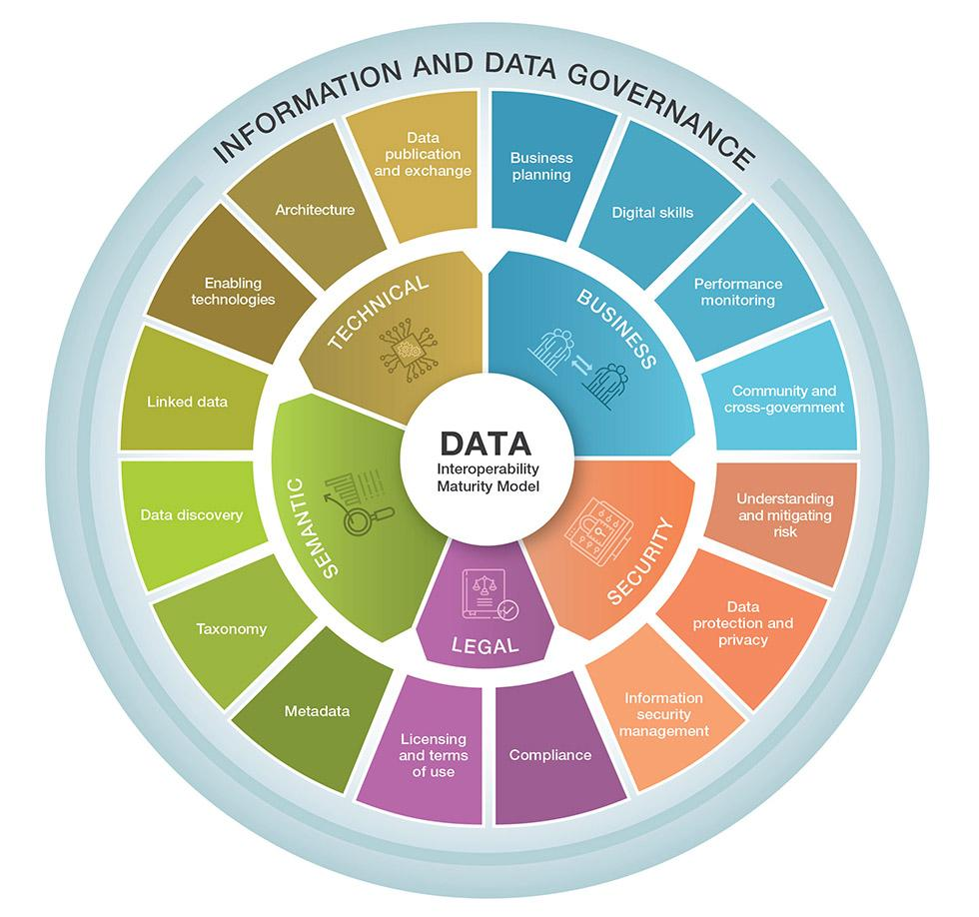
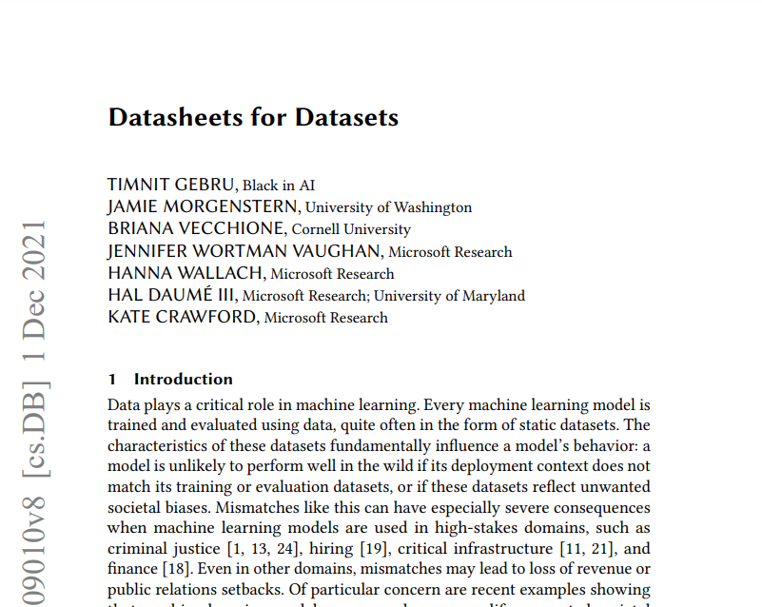
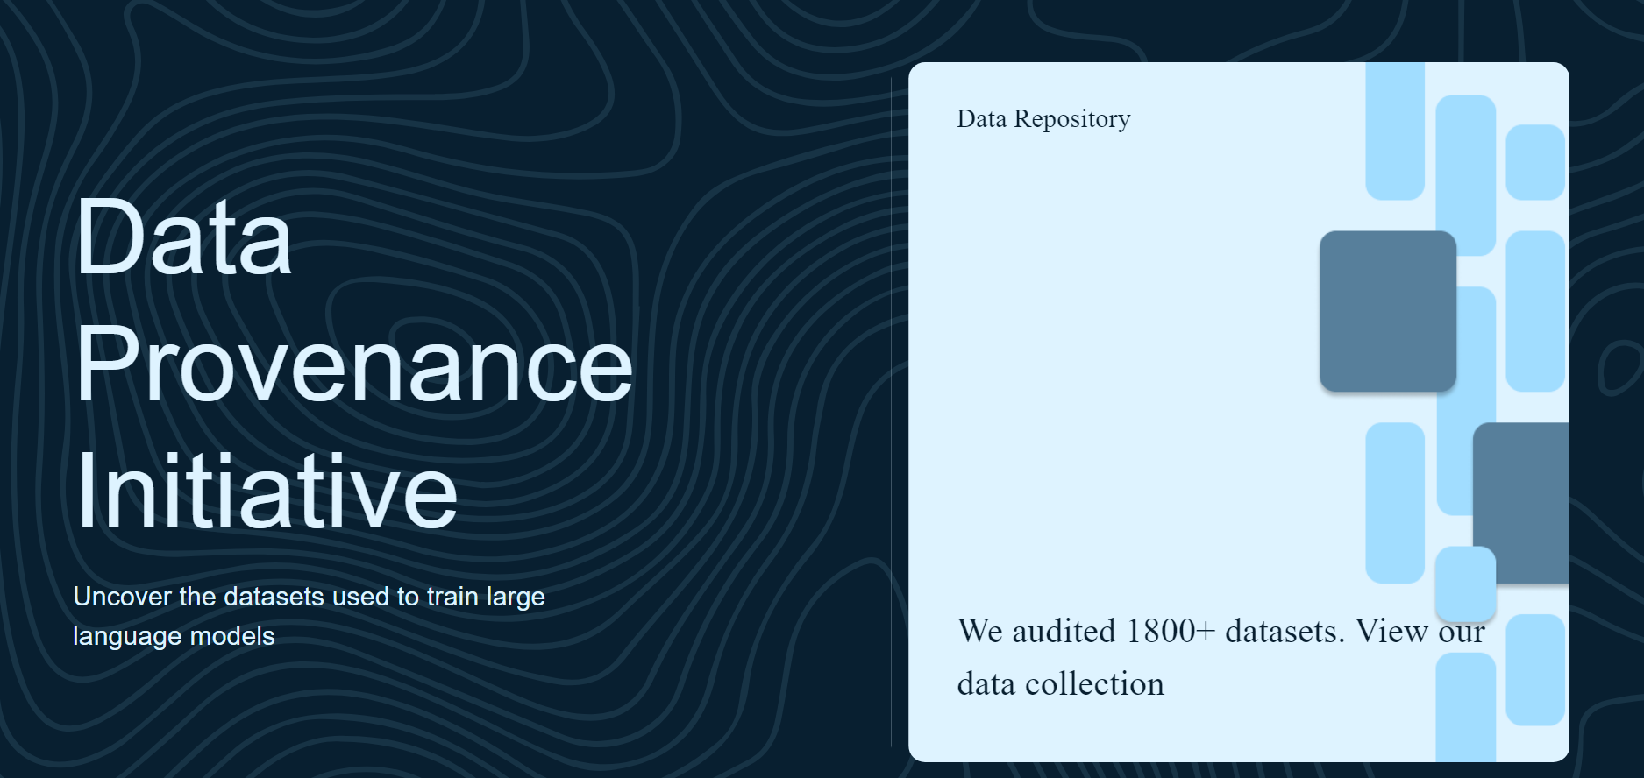
5. FAIR → FAIR-R
Provenance
Quality Assurance
Interoperability
Data Annotation
Ethical/Legal Compliance
“Ready for AI:” provenance, quality, bias mitigation, and ethical metadata.
Rethinking Data Stewardship

Slide 13
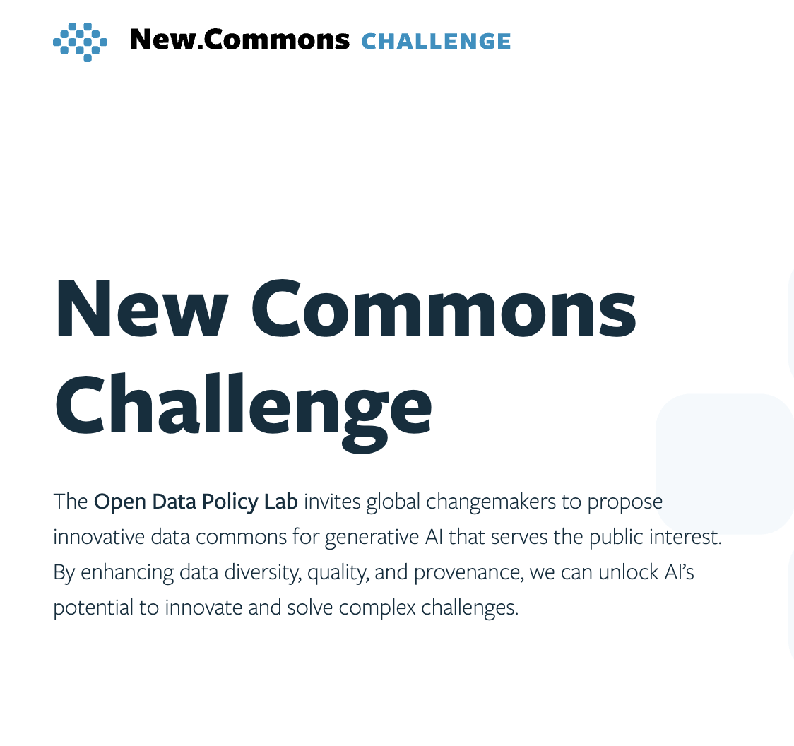
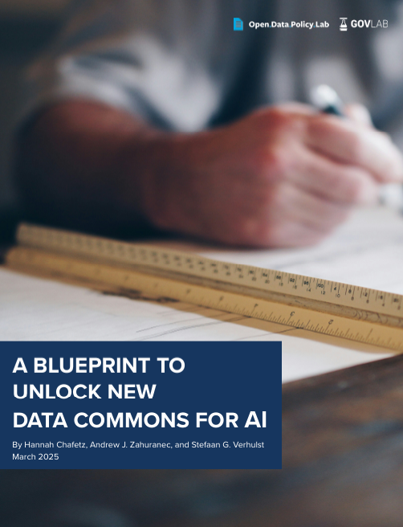
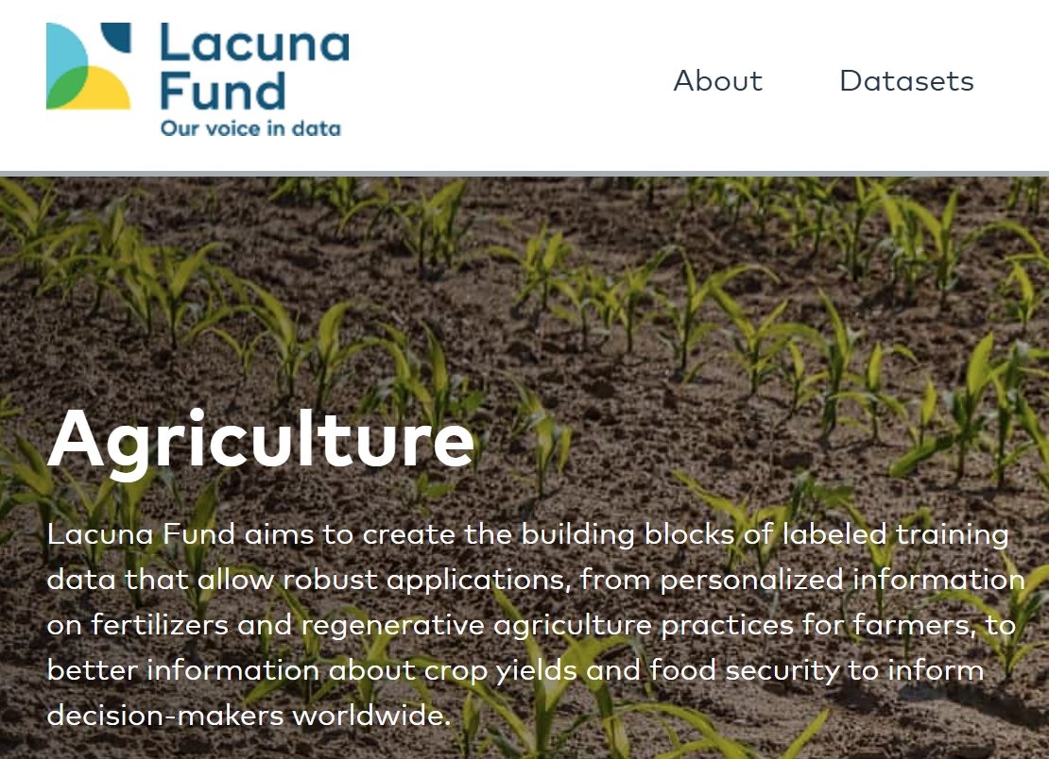
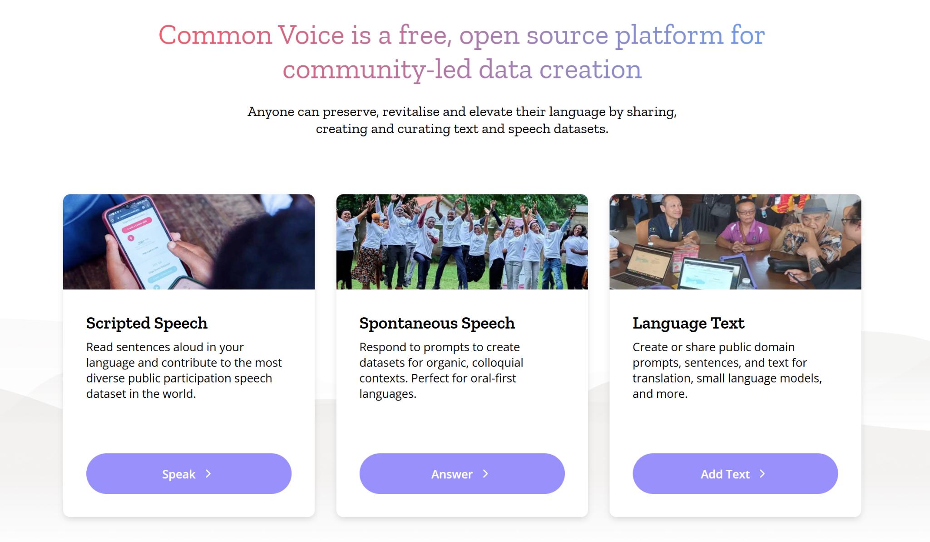
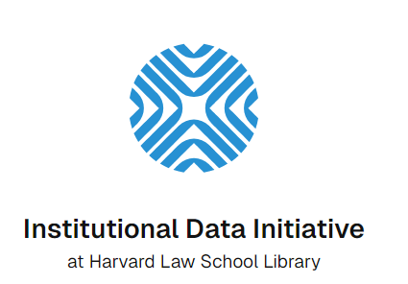
6. Open Data → Data Commons
Lacuna Fund
Common Voice
Institutional Data Initiative
Collaborative governance models balancing openness, responsibility, and value-sharing.
Rethinking Data Stewardship

Slide 14




THE VISION: FAIR-R COMMONS
Data as Public Good and Strategic Resource
Framing conditions for accessibility and responsibility in re-use
Stewards as Bridges
Mediators between competing interests
Building Collective Power
Collectively-established and ongoing social licenses
Question-Centric Supply
Social problems driving the use of technology
Current Data Stewardship
FAIR-R COMMONS
Lack of readiness for AI and collective governance
High-quality data governed collaboratively and responsibly
From Principles to Practice

Slide 15
TOMORROW’S SITUATION
“
It was the best of times, it was the worst of times [...] it was the spring of hope, it was the winter of despair.…
— Charles Dickens
”
`

