Slide 1
Rui Miguel Filipe Ferreira, Laurent Vinesse
European Commission, Legal Service
Ref2Link - Legal text mining
Leveraging the power of the semantic web

Slide 2
Leveraging the power of the semantic web for legal text mining
Introduction
Features of the Ref2Link technology
Use Cases & Benefits of the semantic web
Future Developments
Conclusion
Ref2Link - Legal text mining

Slide 3
What is Ref2Link?
A technology that detects and extract EU legal references or citations from unstructured texts.
Can create versatile outputs like links, footnotes or datasets.
Extracts additional meta-data from semantic repositories to improve user experience and accuracy.
Works on all 24 official EU Languages.
Ref2Link - Legal text mining

Slide 4



Where to find Ref2Link?
Supported by DIGITAL EUROPE PROGRAM
Interactive application for end-users – Linkpad. (Testa network)
Integration through a REST API, JavaScript and Web Content Management Systems snippets.
Open-source distribution on Joinup (core technology).
Ref2Link Add-in for MS Word
Ref2Link - Legal text mining

Slide 5
Features of the Ref2Link technology
Flexible declarative rules, regex macro language, domain based
Supports complex patterns e.g., lists and (list of) subparts
Flexible outputs (multi-target web links, footnotes, endnotes, datasets..)
ELI, ECLI, CELEX implementations
Multilingual (EU 24 languages) with some language specific bundles
Out-of-the box rules for EU Law, some national law extensions
Ref2Link - Legal text mining

Slide 6
Legal Text
(example)
Ref2Link - Legal text mining

Slide 7
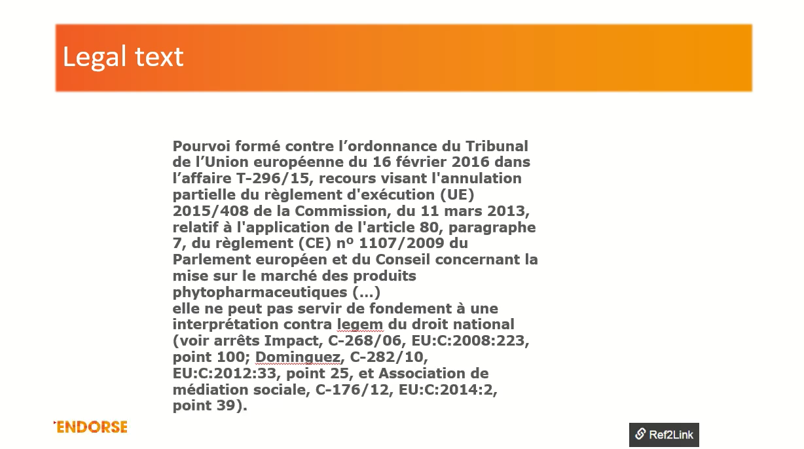

Slide 8
Use Cases & Benefits of the
Semantic Web
Ref2Link - Legal text mining

Slide 9
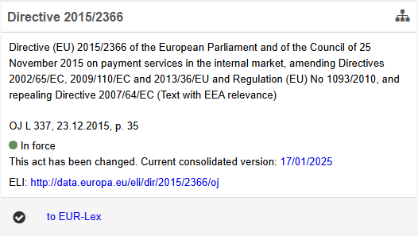
1 - Extracting metadata and additional information
  Queries semantic databases such as Cellar to extract meta data
  Provides additional information.
  Saves time to access information.
  Improves User Experience.

Slide 10


1 - Extracting metadata
  Example: Directive (EU) 2015/2366
  Presenting key information, including:
    The title and subject of the legal text;
    The date of publication in the Official Journal;
    Specifying whether the text is currently in force or not;
    Providing access to the most recent consolidated version;
    Displaying the European Legislation Identifier (ELI);
    Generating links to relevant target repositories.

Slide 11
2 - Resolving ambiguous matches
  Improves accuracy, beyond pattern computing
  Uses SPARQL, to resolve ambiguous matches
    Use of double register
    Existence check (lifecycle, typo error..)
    Missing or duplicate numbering

Slide 12
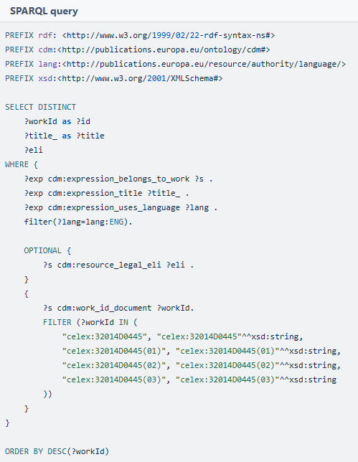
2 - Resolving ambiguous matches
Dual-register issues with acts sharing the same year/number
Decision No 445/2014/EU of the European Parliament and of the Council of 16 April 2014
2014/445/EU: Council Decision of 8 July 2014
Using a SPARQL query we extract CELEX sub-numbers for a specific CELEX id:

Slide 13
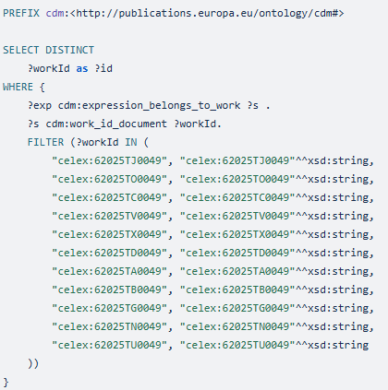
3 - Verifying availability in the target repository
  T-49/25:
  Ongoing legal case, judgement not available
  Only the "Communication: new case" document found:
    https://eur-lex.europa.eu/legal-content/EN/TXT/?uri=CELEX:62025TN0049

Slide 14
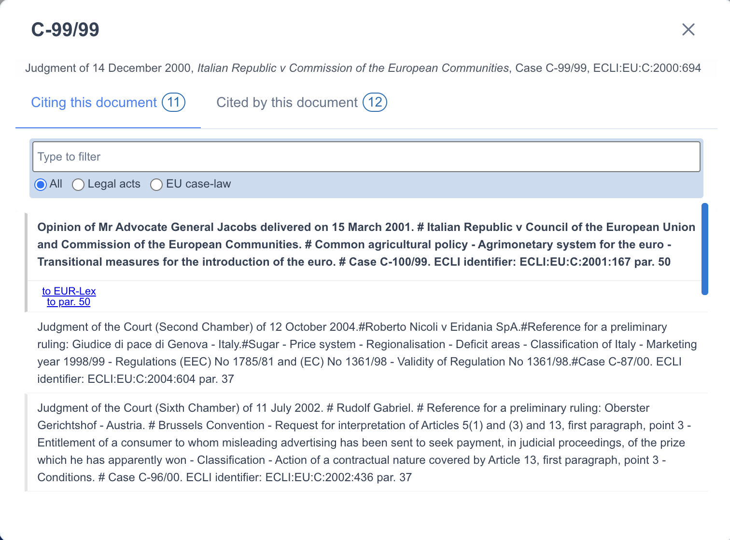
4 - Tailored access to the legal knowledge graph
Display related legal references :
Citing this document
Cited by this document
Acts based on this document
Legal Basis

Slide 15
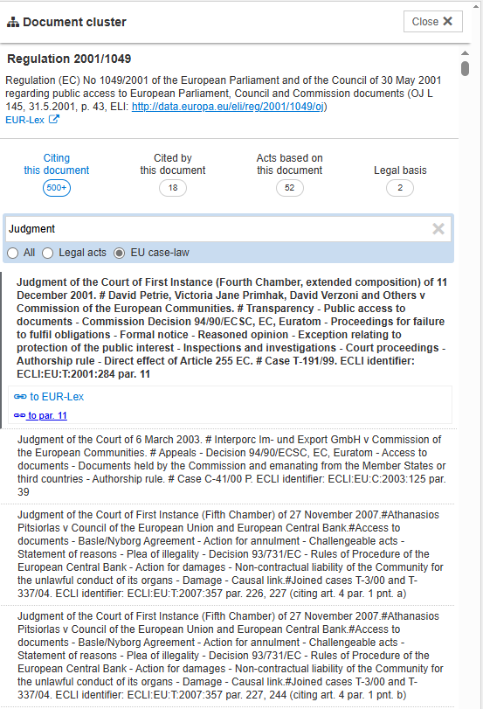
4 - Tailored access to the legal knowledge graph
Multiple Filtering also by:
  Legal Acts
  Case law
Text filtering, more user friendly

Slide 16
Future Developments
Further use cases across the knowledge graph
Connection to other legal semantic repositories across Europe (e.g., MS National)
Artificial Intelligence – Orphan Subdivisions

Slide 17
Conclusion
By using the semantic web, Ref2link contributes to :
  Improving Productivity and user experience:
  Sustainability & interoperability:
    by using available standards.
  Quality and exactness:
    By eliminating ambiguous/duplicate entries.

Slide 18
Thank You for Your Attention
sj-ref2link-support@ec.europa.eu

Slide 19
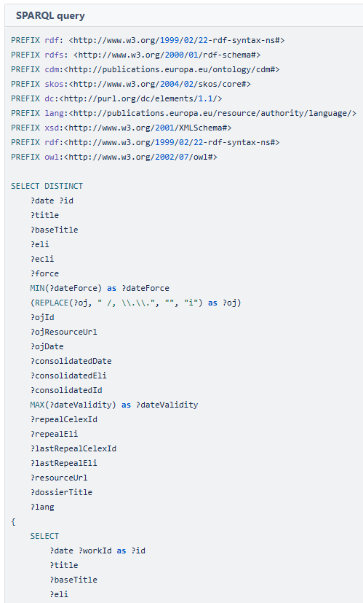
1 - Extracting metadata(from Cellar)

