Slide 1
Pierre-Antoine Champin
W3C/Inria
Semantic Interoperability in Identity & Credentials
Present and future standards at W3C

Slide 2

About myself
Pierre-Antoine Champin
W3C fellow from Inria
Principal Data Strategist @W3C
https://champin.net/
Identity & Credentials ­—PA Champin (W3C/Inria)

Slide 3


What’s in this talk
Identity on the Web (a history)
Controlled and Decentralized Identifiers
Verifiable Credentials
Real world applications
W3C recommendation
W3C future work
Identity & Credentials ­—PA Champin (W3C/Inria)

Slide 4
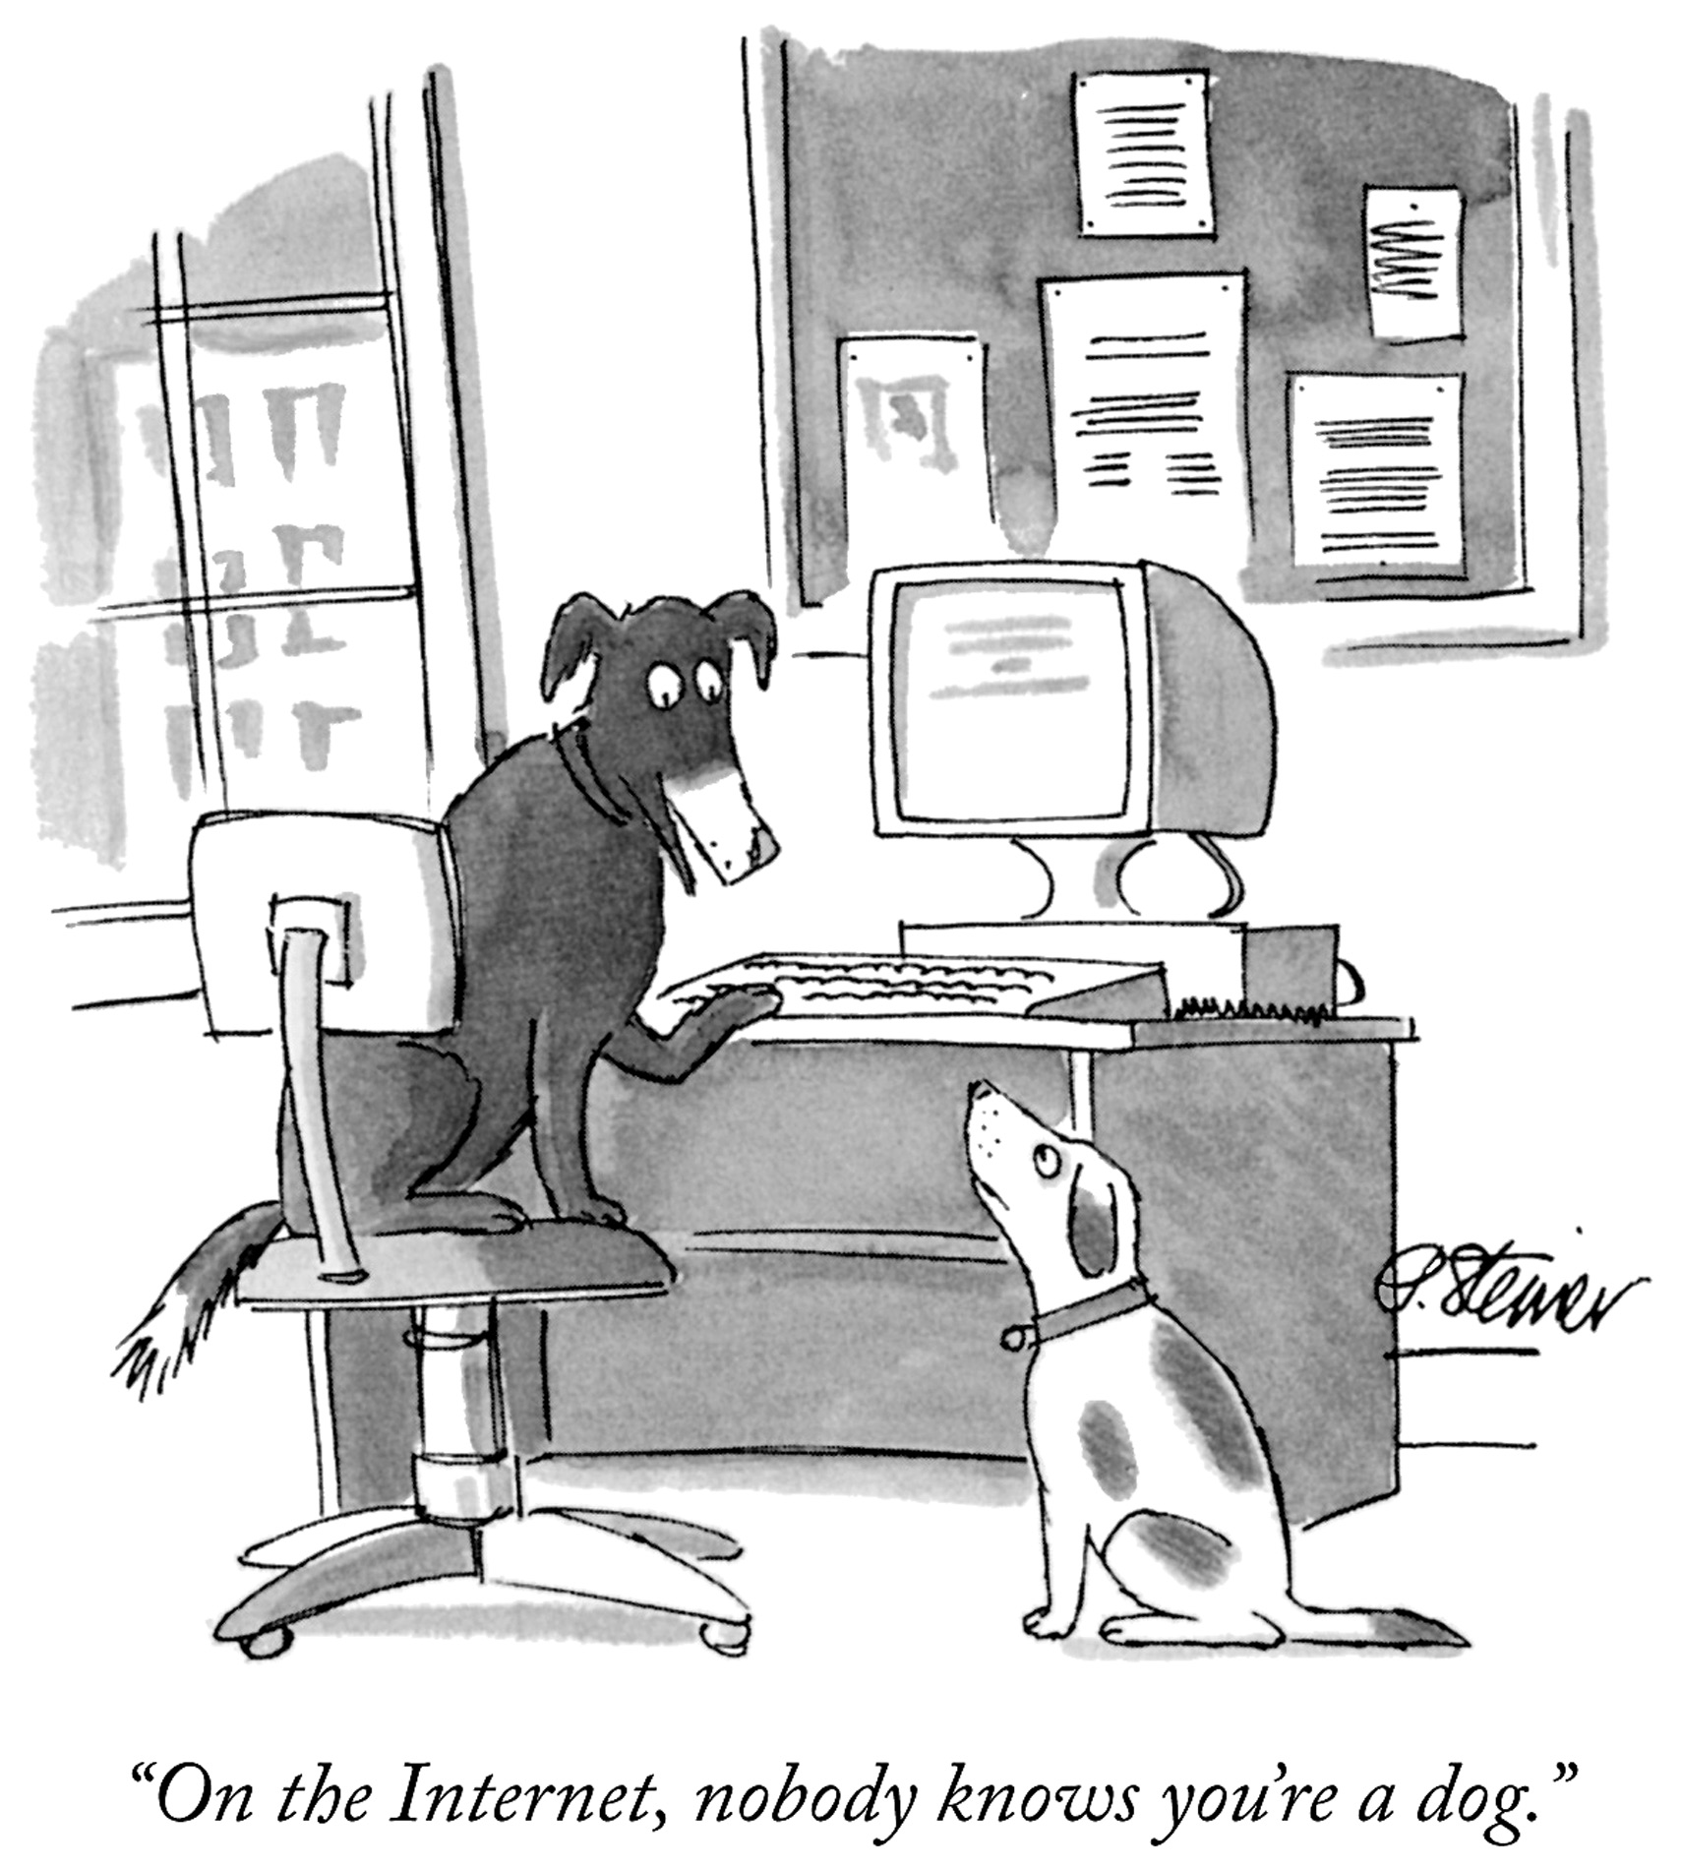
Identity on the Web
(a history)
Identity & Credentials ­—PA Champin (W3C/Inria)

Slide 5
Uniform Resource Identifier (URI)
“the Web makes use of a single global identification system: the URI” (Uniform Resource Identifier)
https://www.w3.org/TR/webarch/#identification
also known as URLs
not just for “web pages” or “web resources”, but for any object of interest (physical, digital, conceptual…)
including persons, organizations
Identity & Credentials ­—PA Champin (W3C/Inria)

Slide 6
Uniform Resource Identifier (URI)
URI
https://champin.net/#pa
identifies
/ refers to
resolves to
Subject
describes
Digital document
Identity & Credentials ­—PA Champin (W3C/Inria)

Slide 7
WebID
WebID (https URL)
https://champin.net/#pa
identifies
/ refers to
resolves to
Subject
describes
WebID profile document
“[A WebID is a URI that refers to an Agent (Person, Organization…); a description of the Agent can be found in the respective WebID Document.]”
https://w3c.github.io/WebID/spec/identity/
Identity & Credentials ­—PA Champin (W3C/Inria)

Slide 8
WebID+TLS (Story ~2008)
WebID (https URL)
https://champin.net/#pa
identifies
/ refers to
resolves to
Subject
describes
WebID profile document
controls
cites
controls
describes
X509 Certificate
https://www.w3.org/2005/Incubator/webid/spec/tls/
Identity & Credentials ­—PA Champin (W3C/Inria)

Slide 9
WebID + Solid Open ID Connect
WebID (https URL)
https://champin.net/#pa
identifies
/ refers to
resolves to
Subject
describes
WebID profile document
controls
authenticates
uses
& trusts
describes
OIDC provider
https://solid.github.io/webid-profile/
Identity & Credentials ­—PA Champin (W3C/Inria)

Slide 10

Controlled and Decentralized Identifiers
Identity & Credentials ­—PA Champin (W3C/Inria)

Slide 11
Controlled Identifiers
W3C Recommendation since 2025-05
https://www.w3.org/TR/cid/
“A controlled identifier document contains cryptographic material and lists service endpoints for the purposes of verifying cryptographic proofs from, and interacting with, the controller of an identifier.”
Narrower focus than WebID → emphasis on privacy
Identity & Credentials ­—PA Champin (W3C/Inria)

Slide 12
Controlled Identifiers
Identifier
https://champin.net/#pa
refers to
resolves to
Subject
Controlled Identifier Document
Controller
controls
controls
describes
Cryptographic material,
Service endpoints
https://www.w3.org/TR/cid/
Identity & Credentials ­—PA Champin (W3C/Inria)

Slide 13
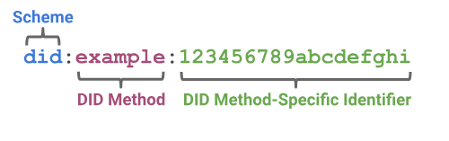
Decentralized Identifier (DID)
W3C Recommendation since 2022
https://www.w3.org/TR/did/
A new kind of URI
Identity & Credentials ­—PA Champin (W3C/Inria)

Slide 14
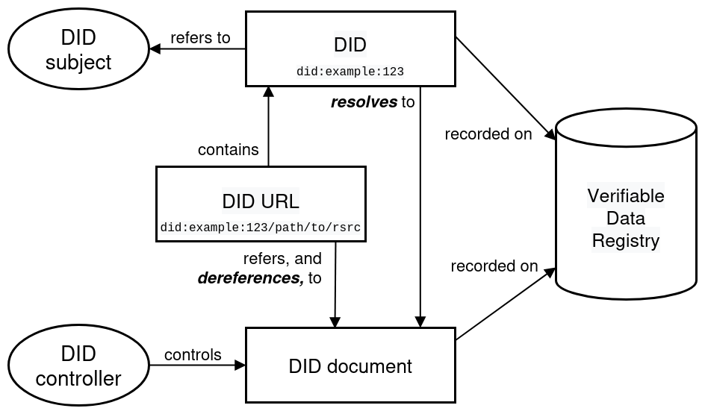
Decentralized Identifier (DID)
https://www.w3.org/TR/did/
Identity & Credentials ­—PA Champin (W3C/Inria)

Slide 15
Decentralized Identifier (DID)
DID
did:example:123
recorded on
Verifiable Data Registry
refers to
resolves to
recorded on
Subject
DID Document
Controller
controls
controls
describes
Cryptographic material,
Service endpoints
https://www.w3.org/TR/did/
Identity & Credentials ­—PA Champin (W3C/Inria)

Slide 16
DID Methods
Determines the “verifiable data registry” to use …
… and how to create/retrieve/update/delete the DID document
https://www.w3.org/TR/did-extensions-methods/
contains 200+ method descriptions
Identity & Credentials ­—PA Champin (W3C/Inria)

Slide 17
Taming the diversity of DID methods
DID Resolution
https://www.w3.org/TR/did-resolution
Defines the notion of DID resolver and a standard way to interact with them.
DID Methods Working Group (in discussion)
https://github.com/w3c/did-methods-wg-charter/
Aims to standardize a few commonly used DID methods.
Identity & Credentials ­—PA Champin (W3C/Inria)

Slide 18

Verifiable credentials
Identity & Credentials ­—PA Champin (W3C/Inria)

Slide 19
Basic terminology
Issuer
Issues VCs
Issue credentials
Holder
Acquires, holds, presents VCs
Presents credentials
Verifier
Verifies VCs
Verifiable Credential
Verifiable Presentation
Credential metadata
Presentation metadata
Claim(s)
Claim(s)
Claim(s)
Credential(s)
Proof(s)
Proof(s)
Identity & Credentials ­—PA Champin (W3C/Inria)

Slide 20
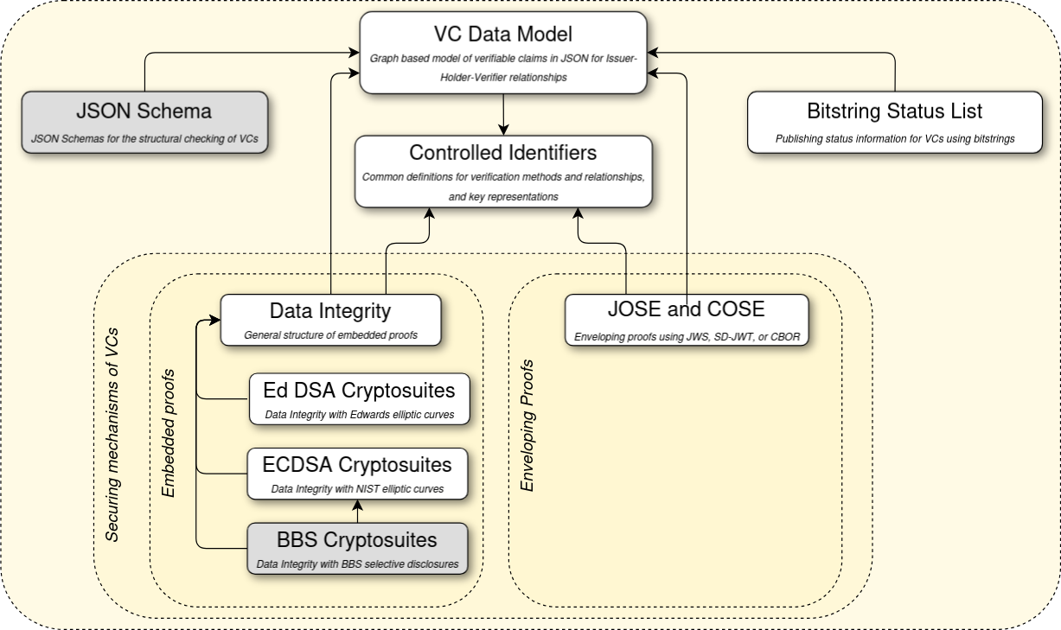
W3C VC Specifications: https://www.w3.org/TR/vc-overview/
Identity & Credentials ­—PA Champin (W3C/Inria)

Slide 21
The VC model: collection of claims
Is a simple model of individual claims (a.k.a. statements):
  subject → predicate → object
By combining such statements, we get a graph
In VC, the graph is serialized in JSON(-LD)
Credential
subject
valid from
Person ID
1978-06-01
alumni of
name
Institution ID
name
Pat
Example university
Identity & Credentials ­—PA Champin (W3C/Inria)

Slide 22
Selective disclosure
Ability to present (disclose) only a subset of the claims, while keeping the proof valid
Example: proving that I am over 18, without disclosing my name, address, or even my full date of birth
Supported by VC via
  ECDSA, BBS (embedded proof)
  JOSE and COSE (enveloping proof)
Identity & Credentials ­—PA Champin (W3C/Inria)

Slide 23
Digital Credentials API
https://w3c-fedid.github.io/digital-credentials/
by the Federated Identity Working Group
“This document specifies an API to enable user agents to mediate presentation and issuance of digital credentials such as a driver's license, government-issued identification card, and/or other types of digital credential.”
“The API design is agnostic to both credential presentation exchange protocols, credential issuance protocols and credential formats
Identity & Credentials ­—PA Champin (W3C/Inria)

Slide 24
Real world applications
Identity & Credentials ­—PA Champin (W3C/Inria)

Slide 25
Privacy-preserving age verification
https://www.mytruage.org/
Program launched in 2021 by the US National Association of Convenience Store, for privacy-preserving age verification
Uses W3C Verifiable Credentials with selective disclosure
Identity & Credentials ­—PA Champin (W3C/Inria)

Slide 26
Mobile drivers’ license
https://www.dmv.ca.gov/portal/ca-dmv-wallet/
Pilot launched in 2023 by California’s Department of Motor Vehicles
Uses W3C Decentralized Identifiers and W3C Verifiable Credentials (and compatible with TruAge)
2,7 millions mDL delivered so far (Aug 2025)
Identity & Credentials ­—PA Champin (W3C/Inria)

Slide 27
UN Transparency Protocol
https://spec-untp-fbb45f.opensource.unicc.org/
“Supporting governments and industry on practical measures to counter greenwashing by implementing supply chain traceability and transparency.”
Uses W3C Decentralized Identifiers and W3C Verifiable Credentials
Identity & Credentials ­—PA Champin (W3C/Inria)

Slide 28
Data Spaces
GAIA-X’s Trust Framework Architecture
uses W3C Verifiable Credentials
The Data Spaces Support Center’s Blueprint
uses W3C Verifiable Credentials and W3C Decentralized Identifiers
Identity & Credentials ­—PA Champin (W3C/Inria)

Slide 29
Thank you
https://champin.net/2025/endorse/

