Slide 1
Monica Palmirani - University of Bologna
Andrea Nuzzolese - CNR-ICST
Alessio Nardin, Cecile Guasch - DG DIGIT.B2
Reporting Requirement Metadata Vocabulary for European Legislation
A Tool for Enhancing the Digital-Ready Policies

Slide 2

Introduction of the problem
“Reporting Requirements” are particular legislative provisions that command some institutions to prepare a report, plan, budget, opinion, or standard to address other institutions for monitoring the quality of the legislation.
The RRs are a tool:
  to implement the Better Regulation
  to monitor the impact of the legislation
  to detect new needs
  to manage Digital-Ready Policies

Slide 3
Example of Reporting Request
Art. 33 - 9. The Commission shall set up an expert stakeholder group by 1 July 2020 to monitor the functioning and success of SME growth markets. By 1 July 2021, the expert stakeholder group shall publish a report on its conclusions.
This text is in English.
It belongs to a specific temporal version 2019-12-31.
http://data.europa.eu/eli/dir/2014/65/2019-12-31
 | Temporal paramenter
 | Agent
 | Action
 | Topic
02014L0065 — EN — 31.12.2019 — 004.001

Slide 4
Introduction of the problem
The number of the RRs in the EU legislation is increased, and the complexity of the linguistic formulations make it difficult to monitor them over time.
60% of EU legislation includes at least one RR with an annual report to submit.
Additionally, the legislation evolves, and to have an updated situation of all the RR mandates is becoming a very time-consuming task.

Slide 5
Research Questions
RQ1: Model the Reporting Requests in RDF (Action, Agent, Role, TemporalEntitySpec)
RQ2: Express the normative references when they are relevant (e.g., temporal deadline depending on another article).
RQ3: Model the temporal parameters of the action (e.g., interval, conditioned deadline).
RQ4: Monitor the evolution over time of the modifications of the RR.
RQ5: Model the execution of the Reporting Request (e.g., the real execution of the RR).

Slide 6
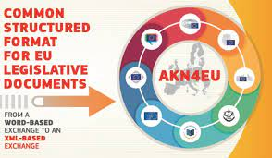

Solution and Methodology
Create a common metadata standard RRMV capable to extract, represent, monitor the RRs
Ontology reused:
  ELI (European Legislation Identifier)
  AKN4EU - FRBR
  Web Annotion Data Model
  UNDO
  CCCEV (analysed but not used)
Legal Analysis of a real dataset (about 100 RRs on thousands of acts)
Legal Analysis of the EU Commission and EU Parliament Reports
Working group with stakeholders evaluation

Slide 7








Extraction and Validation
1. Binary Classification
2. Extraction Entities
EUR-LEX
Tuning
LLM
Reporting Requests Modelling in European Legislation with a Hybrid AI Approach, ACM, 2025
Authors: Corazza, Michele; Palmirani, Monica; Sapienza, Salvatore; Longo, Generoso
Annotated
Dataset of training
RRMV Ontology

Slide 9
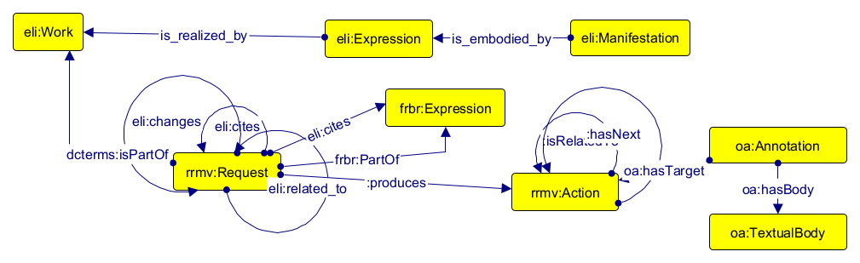
Request, Action, Expression

Slide 10
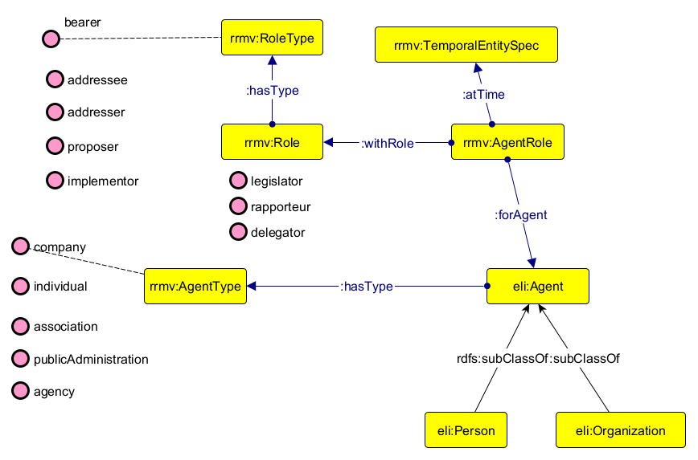
Agent, Role, Temporal Entity

Slide 11
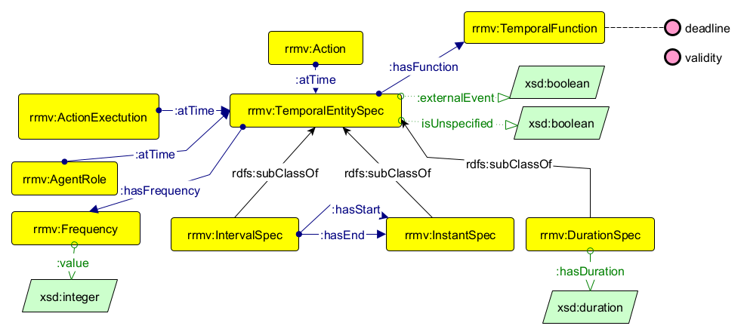
Temporal Entity

Slide 12
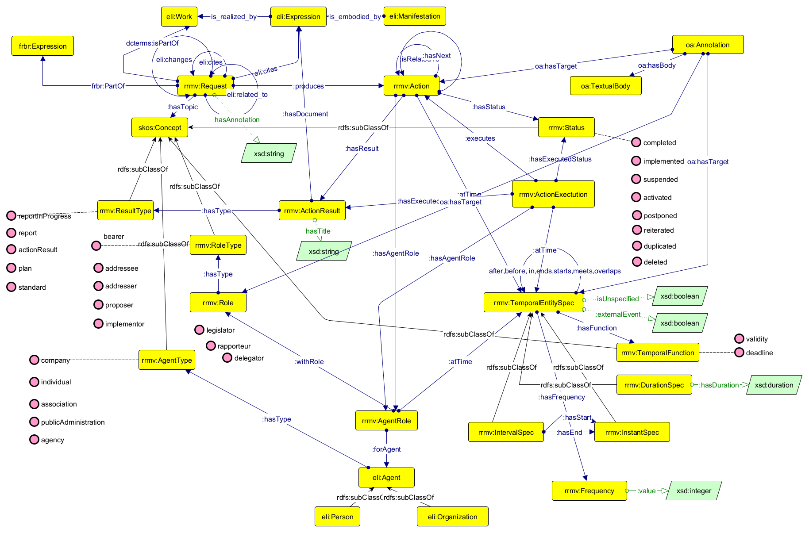

Slide 13
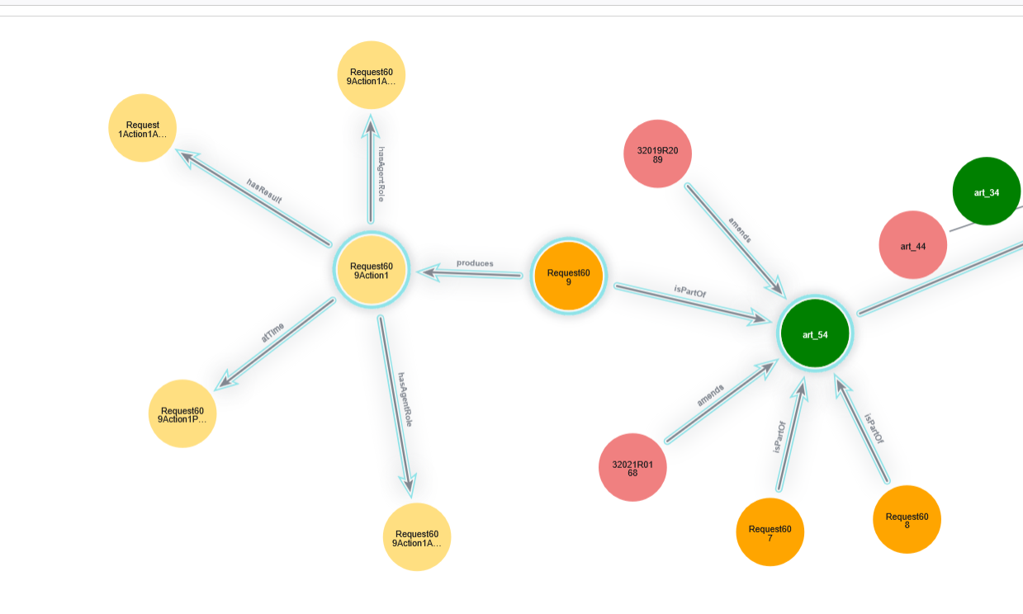

Slide 14

Conclusions
The current version of RRMV is approved by a task force composed by different stakeholders to check if the ontology is completed, sound, and consistent with many use-cases.
The ontology is used to extract information by AI tools in order to validate the effectiveness. EX-POST
The ontology is also integrated in LEOS Editor to model since the beginning the RR during the legal drafting task in order to provide Better Regulation. EX-ANTE
One use-case is also Interoperability of the RR model in Member States considering that a portion of RR involves MSs. INTEROPERABLE ACT

Slide 15
References
[1] “Review clauses in EU legislation adopted during the first half of the ninth parliamentary term (2019-2024 and 2022-2024)”
[2] “Case study analysis of regulatory reporting practices across the European Commission”
[3] “The Importance of Metadata for Regulatory Reporting”, Directorate-General for Informatics, D2 Interoperability
[4] “Objectives of the Better Regulation agenda”
[5] Monica Palmirani, Andrea Giovanni Nuzzolese, Francesco Poggi, Jane Nicholson, and Jorge Estevez. 2024. Tracking WHO reporting requests using hybrid AI. In Proceedings of the 17th International Conference on Theory and Practice of Electronic Governance (ICEGOV '24). Association for Computing Machinery, New York, NY, USA, 139–146. https://doi.org/10.1145/3680127.3680224
[6] Andrea Giovanni Nuzzolese, Francesco Poggi, Luca Bassi and Monica Palmirani Semantic Technologies for Global Governance: A Hybrid AI Approach to Tracking and Monitoring WHO Resolutions, ESWC 2025
[7] Michele Corazza, Monica Palmirani, Salvatore Sapienza, Generoso Longo, Reporting Requests Modelling in European Legislation with a Hybrid AI Approach, ICAIL2025, ACM, 2025

Slide 16
monica.palmirani@unibo.it
https://semiceu.github.io/RRMV/releases/0.1.1/

