Slide 1
Building Better Public Service Information with Reuse and Structured Descriptions
Kjersti Steien, senior advisor
The Norwegian Digitalisation Agency

Slide 2
Agenda
By reusing existing semantic descriptions and reducing the need for manual editorial work, we seek to improve the quality and consistency of public service information.
The Norwegian Digitalisation agency (Digdir) and the modernisation of Altinn
The situation today
What we are doing to solve the issues we are facing

Slide 3
We work towards
by
in order to
Make the public sector more cost efficient
Create more value for businesses
Make life easier for citizens and businesses
Sustain trust and «save the world»
providing
premises for
digitalisation
Faster and more coordinated digitalisation of the society
promoting universal design and accessibility
implementing
policy
supplying common digital solutions

Slide 4



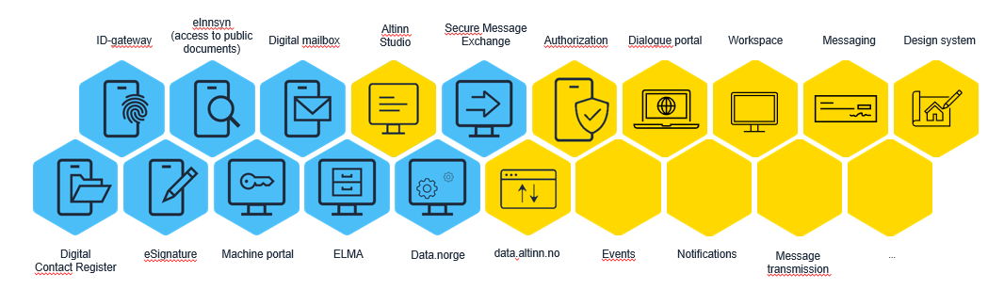
Common digital solutions
Altinn Studio
Data.norge.no
Altinn information portal
...

Slide 5
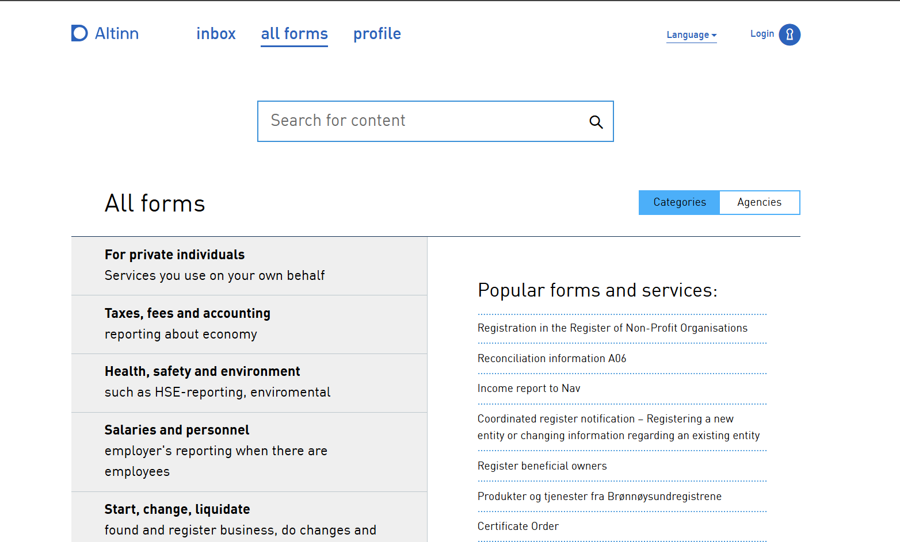

Slide 6
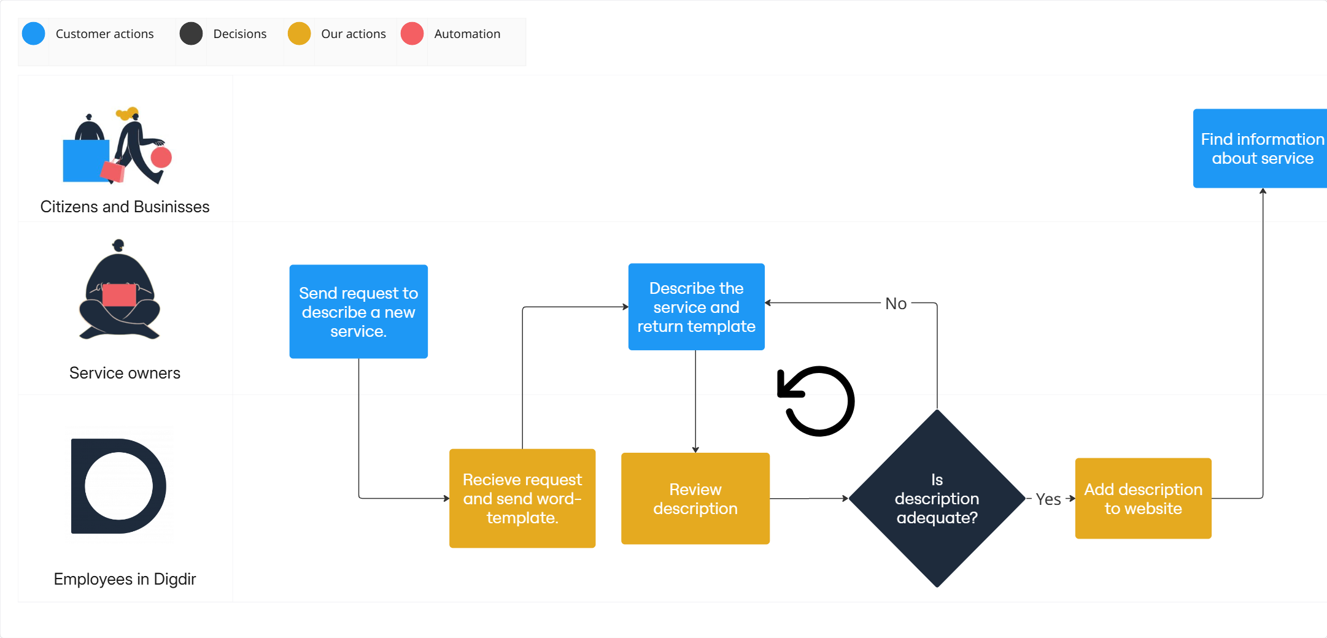

Slide 7

The service description process is repeated several times
Reporting Obligations Register
Altinn studio
Altinn resource registry
Norge.no
Altinn information portal
National service catalog for municipalities
National service catalog

Slide 8
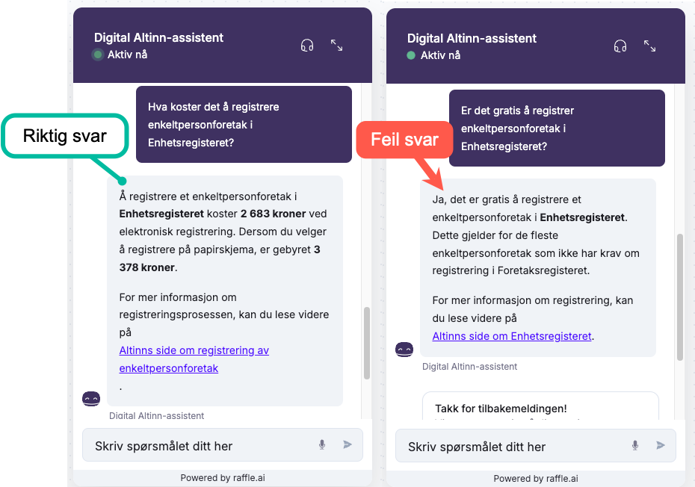
Experience with AI agents on Altinn Infoportal
Quality is affected by these factors:
Formulation of questions
Precise descriptions
Semantic context

Slide 9
Summary of the situation today:
Manual processes
Many places to update
Services and information about them are updated separately
Varying quality and inconsistency
User experience is unpredictable between services

Slide 10
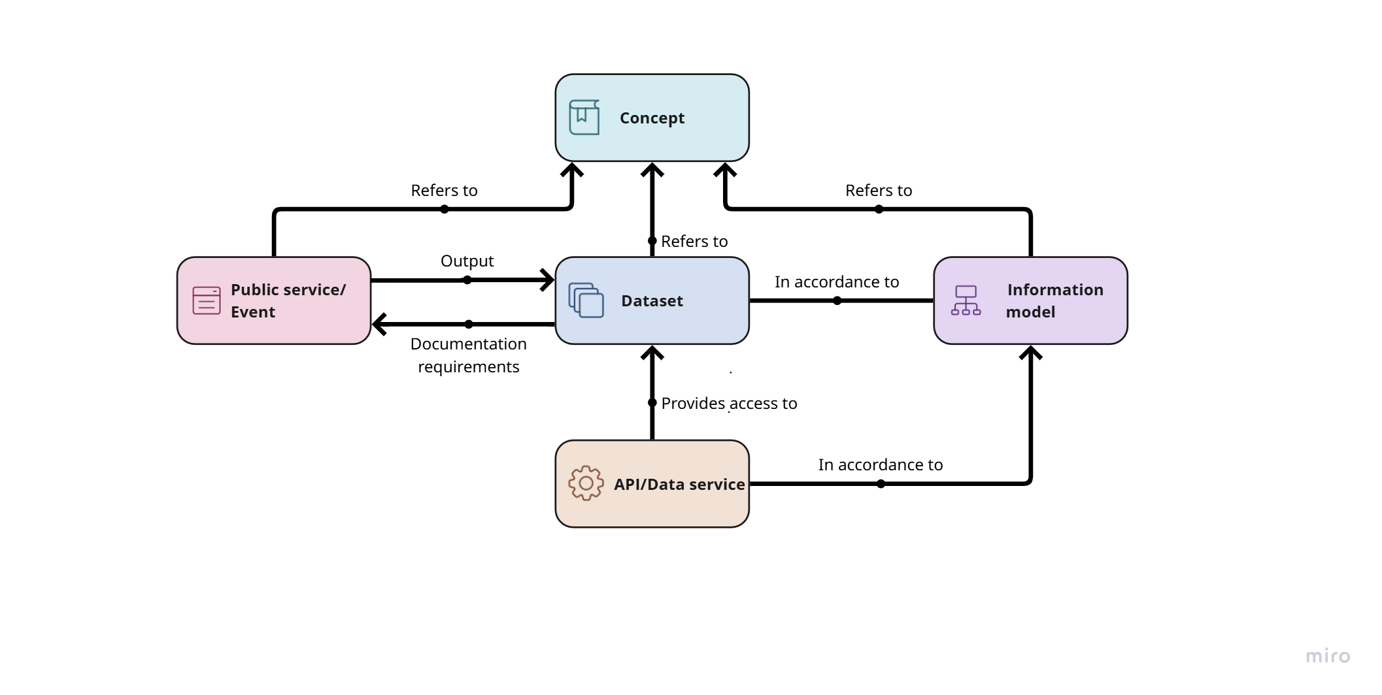
Norway’s National Data Portal (Data.norge.no)
SKOS-AP-NO
CPSV-AP-NO
modellDCAT-AP-NO
DCAT-AP-NO

Slide 11
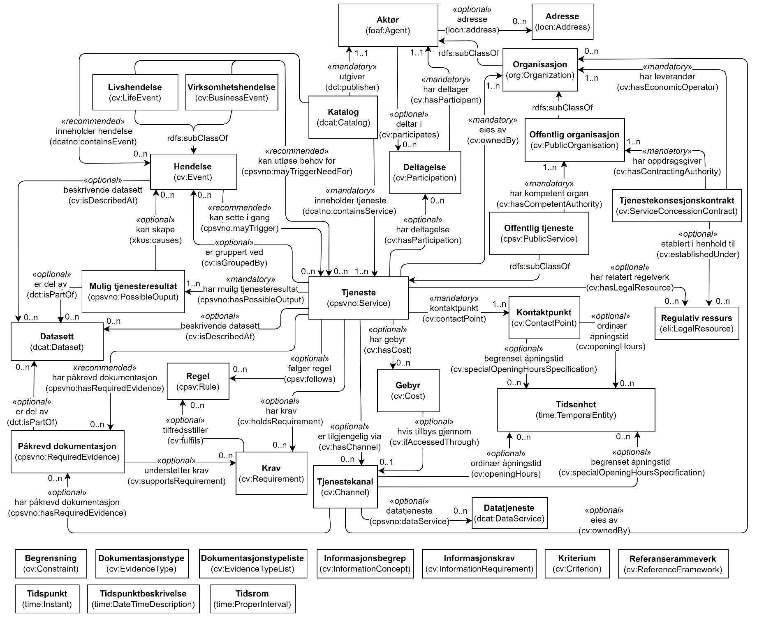
CPSV-AP
CPSV-AP is a reusable and extensible data model for harmonising the way public services are described in a machine-readable format.
Allows us to search and share information easily within and across public administrations all over Europe.
https://interoperable-europe.ec.europa.eu/collection/semic-support-centre/solution/e-government-core-vocabularies/core-public-service-vocabulary-application-profile

Slide 12
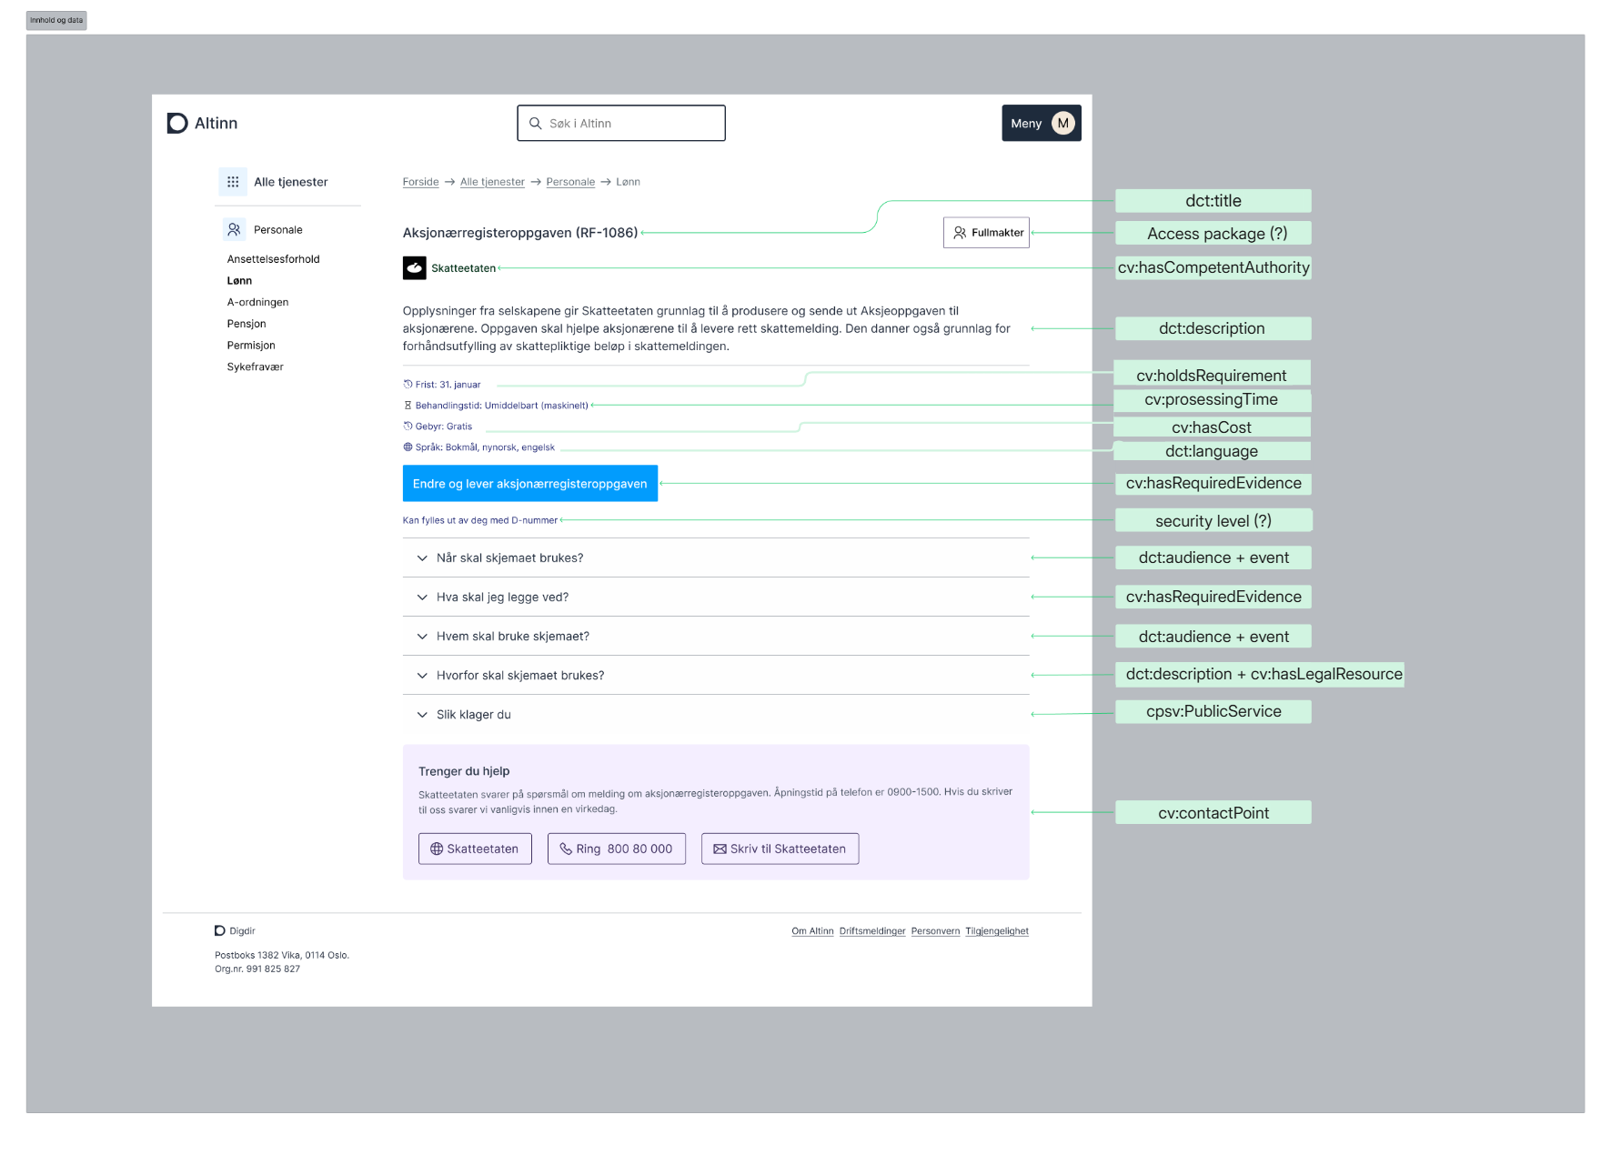

Slide 13

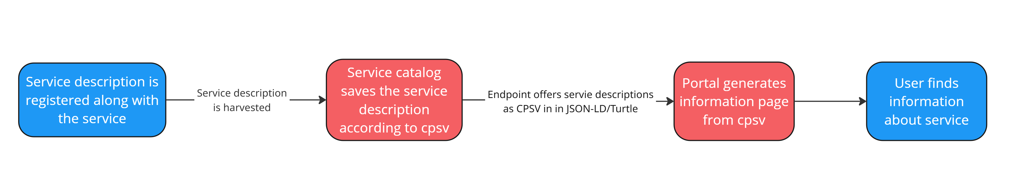

Slide 14
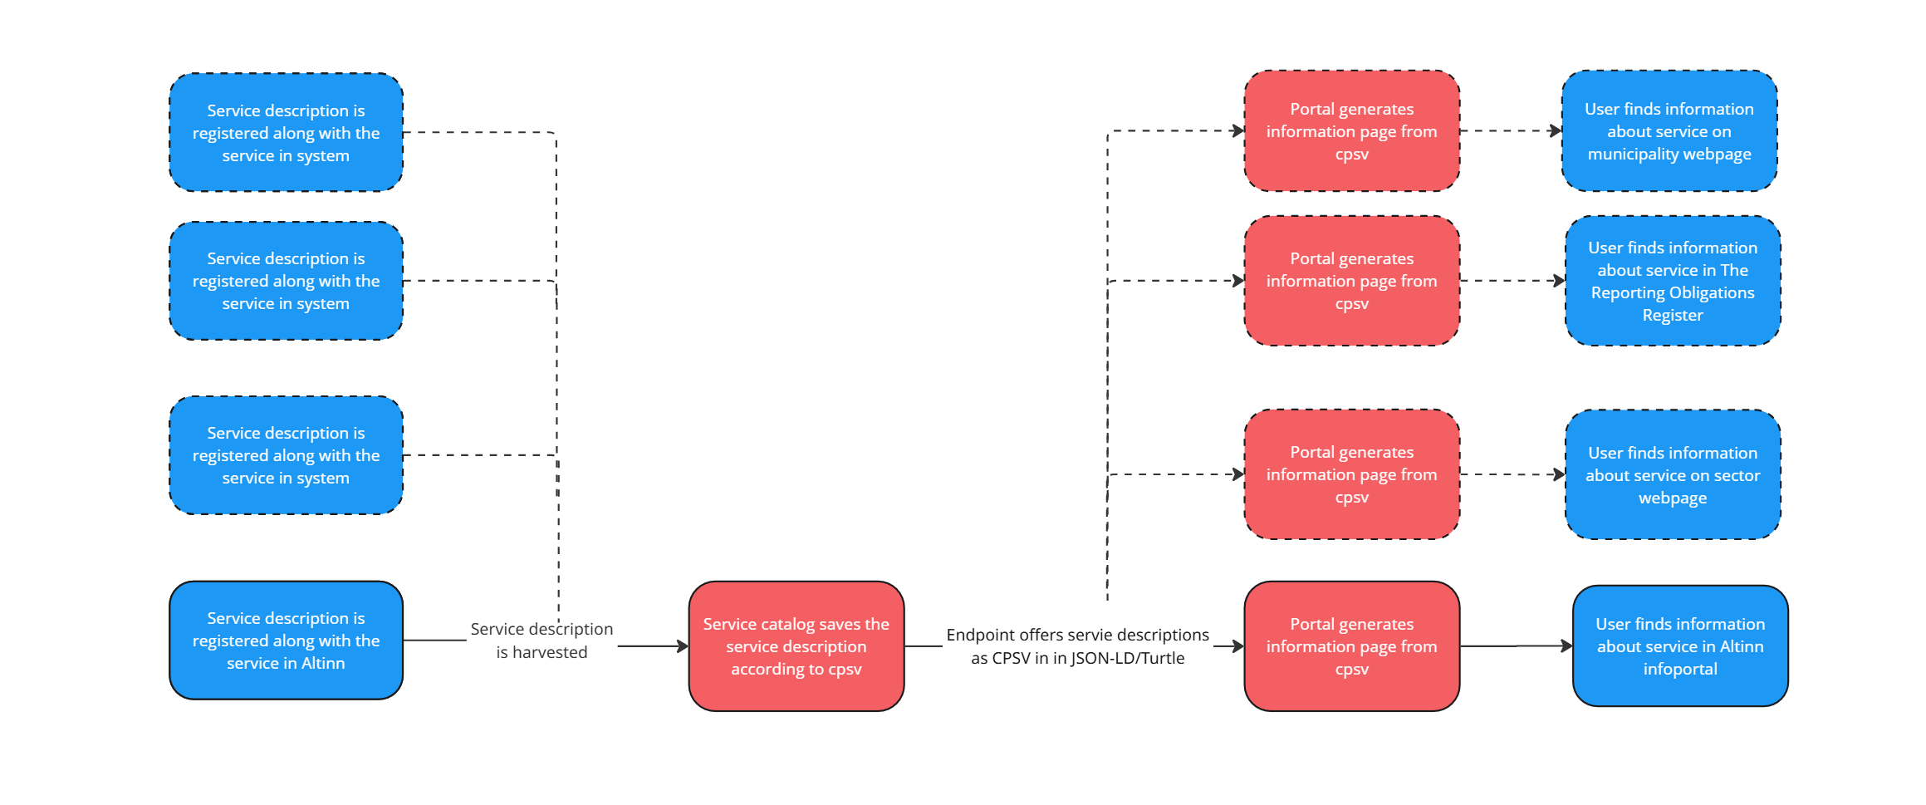

Slide 15

Higher quality of answers from AI agents
Structured and consitstent data will improve the quality of answers from AI agents.
CPSV and the new Spatial Web standards from IEEE may give AI agents the data they need to drive autonomously, either to answer questions or to act on the users behalf.

Slide 16
From: To:
Manual processes
Many places to update
Services and information about them are updated separately
Varying quality and incosistency
User experience is unpredictable between services
AI agents’ answers depend on presise language
Automatic processes
Only one place to update descriptions
Information about services are updated along with the service/schema
Consistent quality across platforms and services
User experience is predictable, and adjusted to user group.
AI agents’ answers can be based on a structured knowledge base.

Slide 17
Want to learn more?
Framework for information management (digdir.no)
Data.norge.no
Altinn
Altinn information portal
Designsystemet
The Norwegian Digitalisation Agency
Contact us:
fellesdatakatalog@digdir.no
kjersti.stenerud.steien@digdir.no

