Slide 1
Jordi Escriu, Hagar Lowenthal
European Commission Joint Research Centre (EC-JRC)
The ISO & GeoDCAT-AP Metadata Implementation Pilot
Paving the way for European (Geospatial) Data Sharing

Slide 2
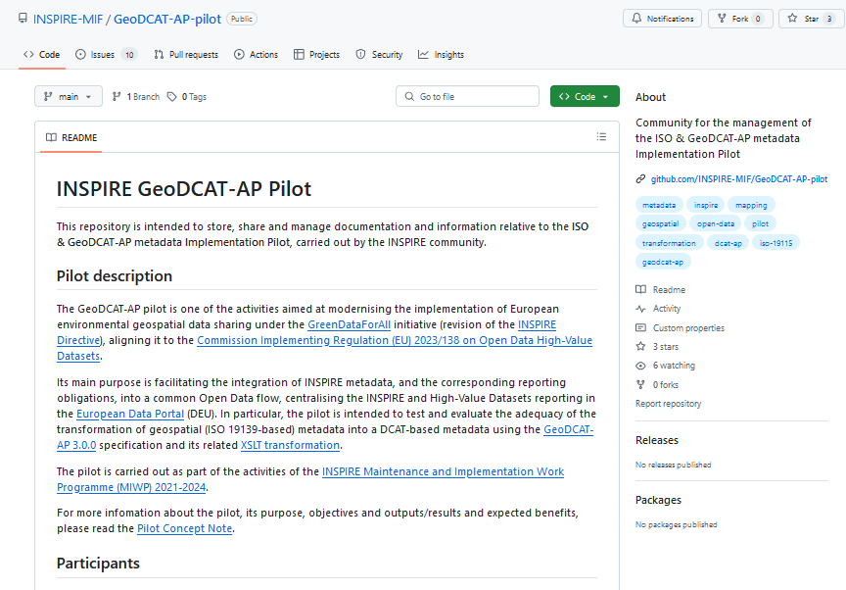
Background & Context
The ISO & GeoDCAT-AP Metadata Implementation Pilot - Paving the way for European (Geospatial) Data Sharing

Slide 3



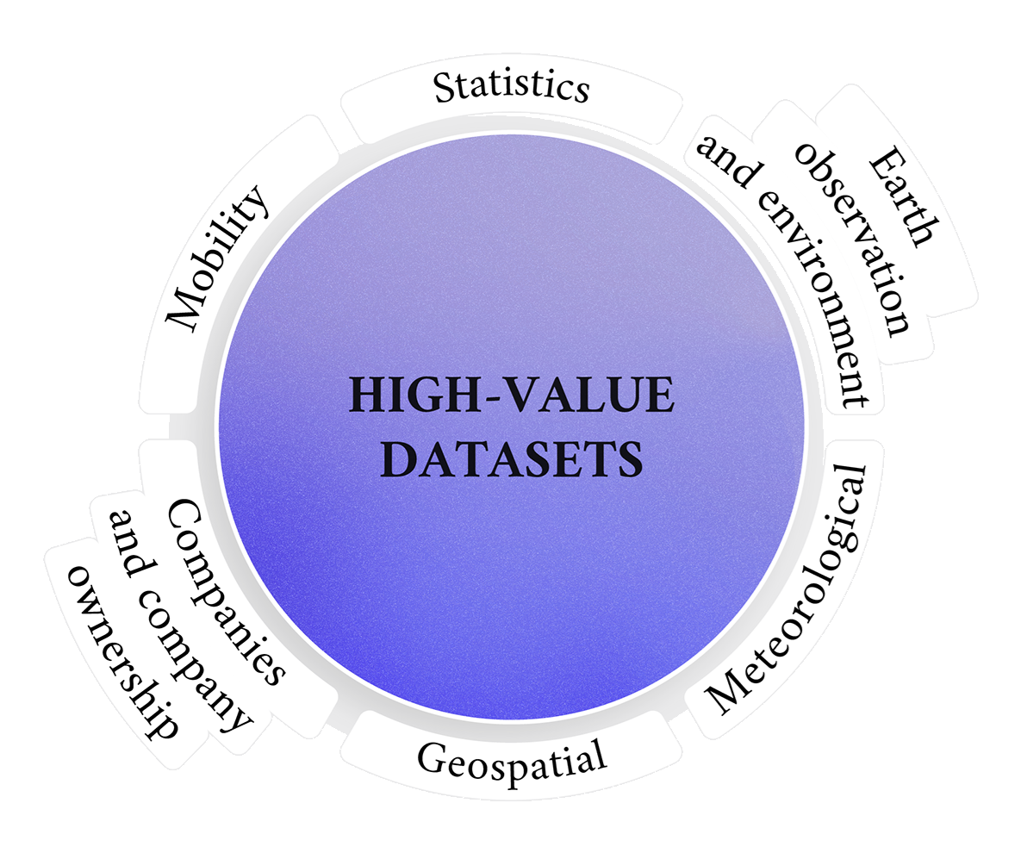

Policy context
INSPIRE - Directive 2007/2/EC
  Making Member States’ (MS) geospatial metadata, data and services available and interoperable across the EU
  Under revision: GreenData4All
Towards a European Data Union
  Directive (EU) 2019/1024 - Open Data Directive (2003 recast of Re-use of Public Sector Information Directive)
  Implementing Regulation (EU) 2023/138 on High-Value Datasets
Priorities 2024-2029
  Simplification and reduction of regulatory burdens, including monitoring and reporting obligations
  Alignment of INSPIRE to Open Data flows
The ISO & GeoDCAT-AP Metadata Implementation Pilot - Paving the way for European (Geospatial) Data Sharing

Slide 4

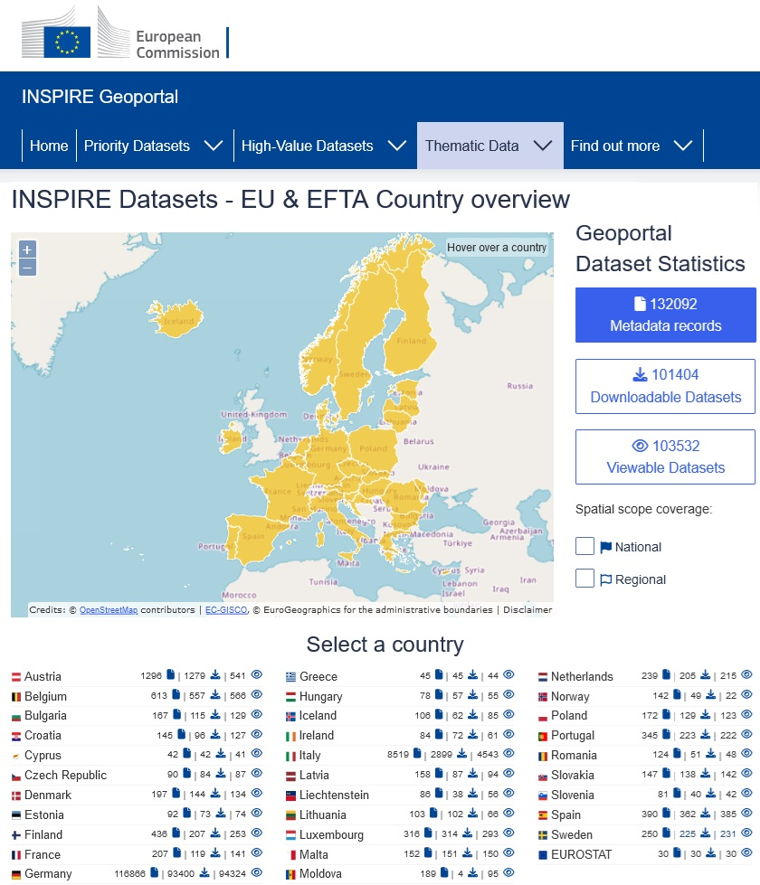
Technical context
INSPIRE: European Spatial Data Infrastructure, based on the infrastructures available in the MS (at source)
Geospatial metadata: Access to MS data & services through the INSPIRE Geoportal
  Interoperable: ISO 19115/19139 standards
  Adopted by INSPIRE: Technical Guidelines on Metadata
  Mapping to the RDF vocabulary: GeoDCAT-AP – v3.0.0
ISO & GeoDCAT-AP Pilot: Supports the INSPIRE community in integrating geospatial metadata into data.europa.eu
The ISO & GeoDCAT-AP Metadata Implementation Pilot - Paving the way for European (Geospatial) Data Sharing

Slide 5
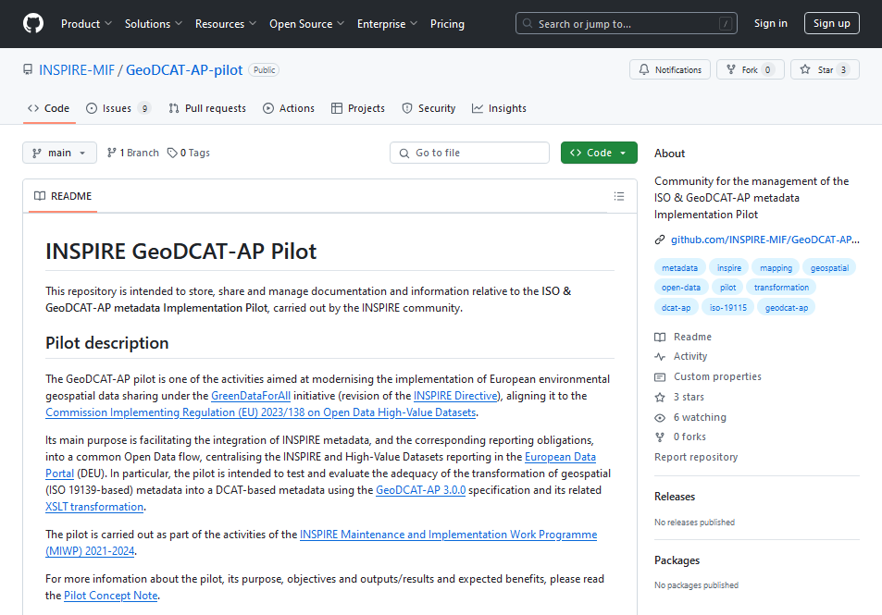
Pilot description. Benefits & results
The ISO & GeoDCAT-AP Metadata Implementation Pilot - Paving the way for European (Geospatial) Data Sharing

Slide 6



Objectives
Evaluating and enhancing the:
  The GeoDCAT-AP 3.0.0 specification
  Its accompanying XSLT transformation
Smooth the integration of geospatial metadata assets within data.europa.eu
  Pragmatic sandboxing approach
  Minimise information loses
  Bring data providers’ experience
Support the SEMIC community to release an improved version of these resources
Reporting of pilot issues:
  https://github.com/SEMICeu/GeoDCAT-AP/issues
  https://github.com/SEMICeu/ iso-19139-to-dcat-ap/issues
  ‘3.0.0 Pilot’ tag
Pilot final report
  Pilot summary. Results achieved
  Evaluation: Extent to which the transformation helps data providers in being compliant to the applicable legal framework
The ISO & GeoDCAT-AP Metadata Implementation Pilot - Paving the way for European (Geospatial) Data Sharing

Slide 7











Participants
Member States
  Contact points for the national geospatial catalogues, as users of GeoDCAT-AP to transform geospatial metadata
  Participants: BE – Flanders, CZ, DK, IT,
  FI , FR, NL, ES, SK
Publications Office of the European Union (OP) / data.europa.eu
  Future receptor of GeoDCAT-AP metadata and transformation re-user
SEMIC group from Directorate-General for Digital Services (DIGIT)
  Point of Contact for resolving issues and contributing to solutions
Directorate-General Joint Research Centre (JRC) / Directorate-General for Environment
  Organiser and managers of the pilot. Provision of scientific & policy knowledge
The ISO & GeoDCAT-AP Metadata Implementation Pilot - Paving the way for European (Geospatial) Data Sharing

Slide 8

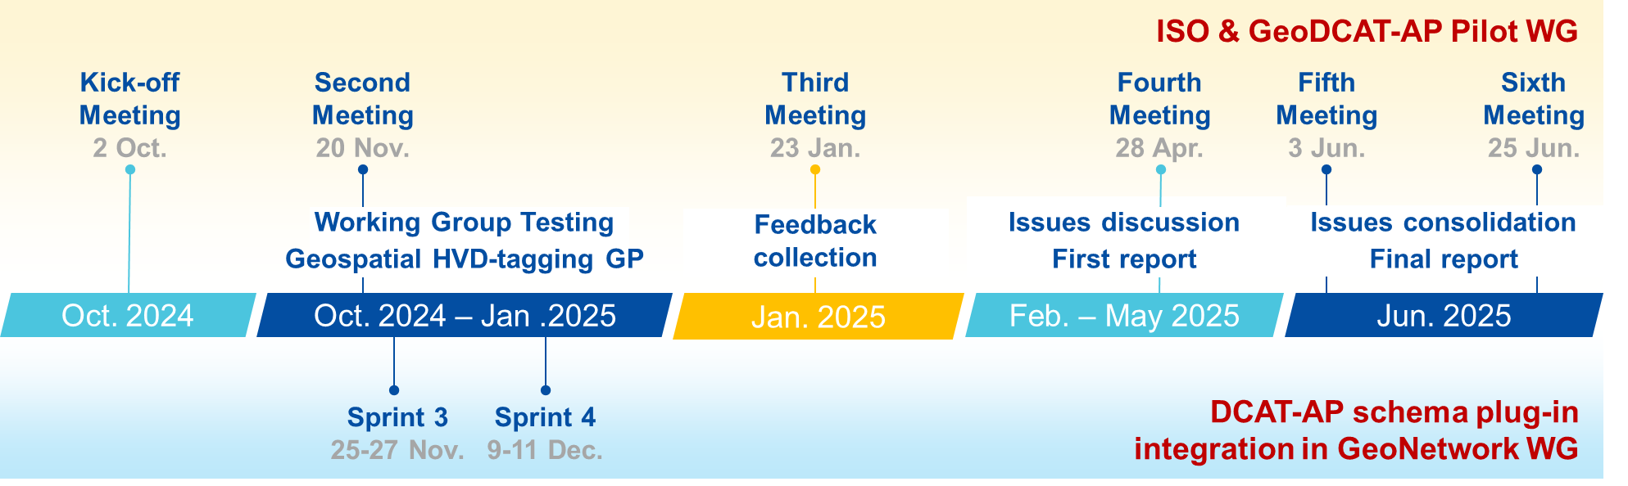
Timeline (Phase 1)
The ISO & GeoDCAT-AP Metadata Implementation Pilot - Paving the way for European (Geospatial) Data Sharing

Slide 9




Benefits
Forum for discussing and identifying ISO/DCAT issues:
  Enhancement and early warning - Example: geospatial HVD tagging
Cross-community collaboration effort & knowledge exchange:
  Implementation examples
  Transformation approaches
  Proposals and new ideas
Pragmatism: sandboxing approach
Implementation freedom: not imposed solutions
The ISO & GeoDCAT-AP Metadata Implementation Pilot - Paving the way for European (Geospatial) Data Sharing

Slide 10
Satisfying geospatial HVD reporting needs
Properly identifying geospatial High-Value Datasets (HVDs)
  Agree on a common approach to tag and classify them
Documenting participants’ testing results, promoting discussion:
  Bunch of issues collected on GitHub
  Issue categories: GeoDCAT-AP 3 / XSLT transformation / SHACL validation
Providing early inputs to SEMIC once any solutions are agreed
Periodically reporting on the results
Continued support:
  Some complex ongoing discussions / New ones
The ISO & GeoDCAT-AP Metadata Implementation Pilot - Paving the way for European (Geospatial) Data Sharing

Slide 11
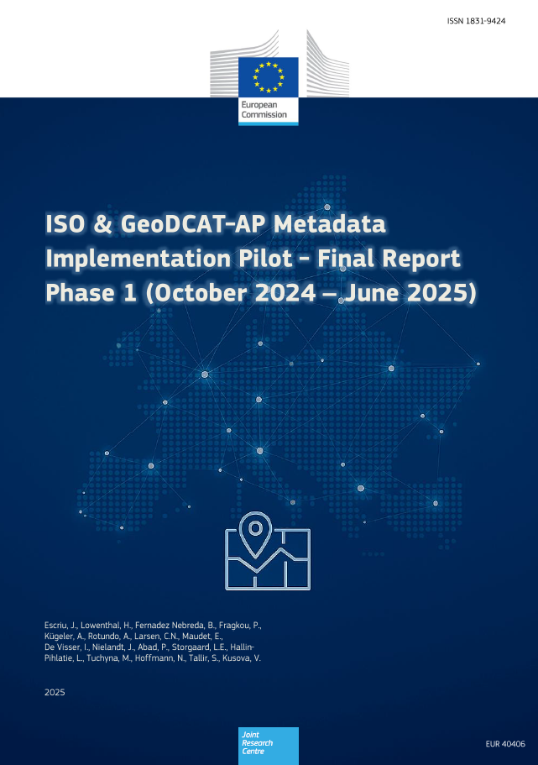

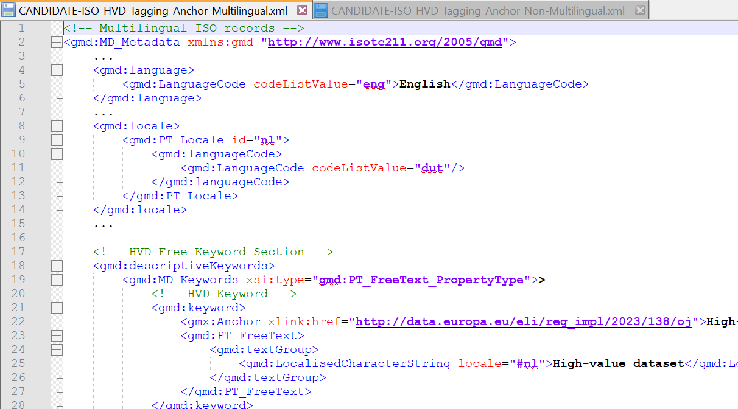
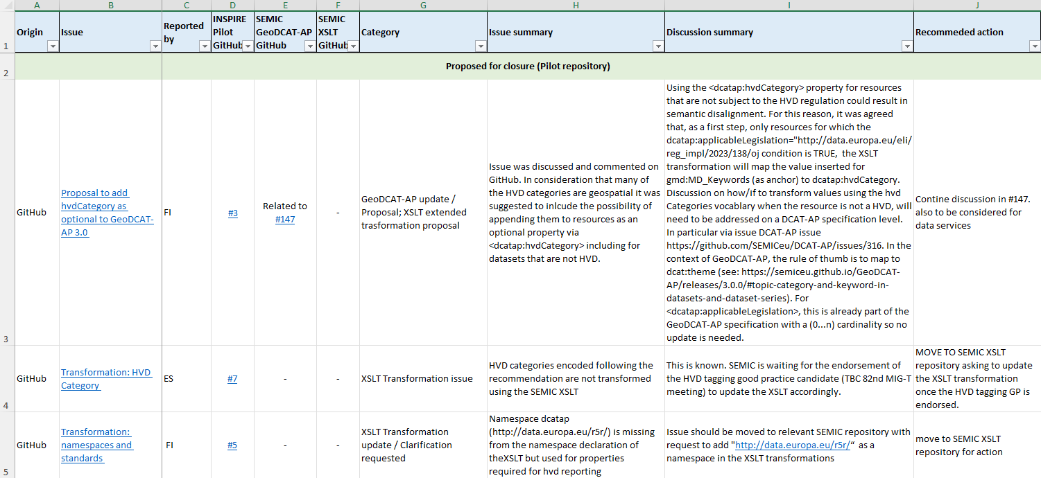
Main results
Continued support to geospatial HVDs reporting: Pilot Phase 2 – until Feb. 2027
Mono-lingual & Multi-lingual examples
Geospatial HVDs tagging good practice
Agreed way to identify and classify HVDs (category and subcategory)
Final Report - Pilot Phase 1
Expectations, testing approaches, issues identified and conclusions
Bunch of issues collected on GitHub
Issues-summary spreadsheet available, including issue classification and status
The ISO & GeoDCAT-AP Metadata Implementation Pilot - Paving the way for European (Geospatial) Data Sharing

Slide 12
Issues
Type of issues:
GeoDCAT-AP specification: SEMIC GeoDCAT-AP GitHub
XSLT transformation: SEMIC XSLT GitHub
Other Issues & discussions: ISO & GeoDCAT-AP Pilot GitHub
The ISO & GeoDCAT-AP Metadata Implementation Pilot - Paving the way for European (Geospatial) Data Sharing

Slide 13
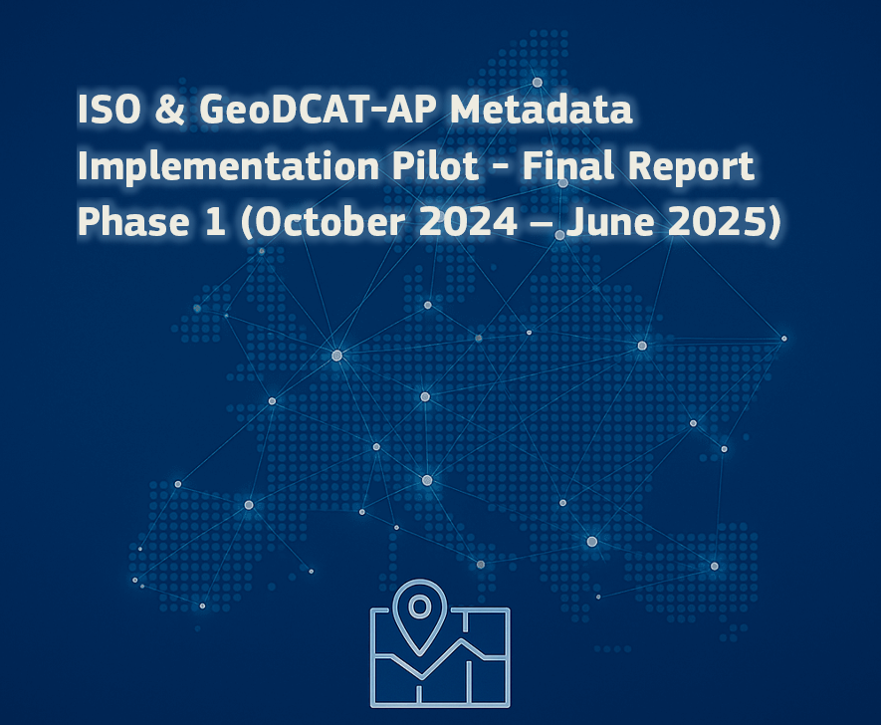
Conclusions
The ISO & GeoDCAT-AP Metadata Implementation Pilot - Paving the way for European (Geospatial) Data Sharing

Slide 14


Conclusions
Successful collaborative experience – Timeliness
Tangible results: Encoding of geospatial High-Value Datasets (HVDs)
Several mappings and transformations to GeoDCAT-AP (SEMIC / national and software solutions) - Coordination and documentation necessary
Approach for describing Data Services & API endpoints remains a challenge
Evaluation of possible information loss for INSPIRE-compliant metadata records transformed to GeoDCAT format still ongoing
Wish: Quick update of the SEMIC XSLT and validation SHACL shapes
Pilot Phase 2 starting in Sept. 2025!
The ISO & GeoDCAT-AP Metadata Implementation Pilot - Paving the way for European (Geospatial) Data Sharing

Slide 15
Thanks!
Jordi Escriu – Jordi.ESCRIU@ec.europa.eu
Hagar Lowenthal – Hagar-Isabel.LOWENTHAL1@ec.europa.eu

