Slide 1
Miroslav Líška, Honza Förster
Cognizone
A Knowledge Graph RAG Chatbot: An Evaluation of the DCAT Metadata Querying
Querying DCAT Open Data Portals with Natural Language

Slide 2

Table of Content
1. Problem: SPARQL Complexity
2. Solution: DCAT RAG Chatbot
3. Challenges
4. Implementation

Slide 3
1. Problem
Currently: Querying Open Data Catalogues (DCAT) requires SPARQL expertise.
Gap: Non-experts struggle to run complex queries or comparisons.
Standard LLMs fail to map correct semantics from natural language.

Slide 4
1. Problem: Why Does This Matter?
European open data portals (e.g., data.europe.eu) use DCAT-AP.
Adoption may be limited if only SPARQL experts can query.
Increasing demand for natural-language access.

Slide 5
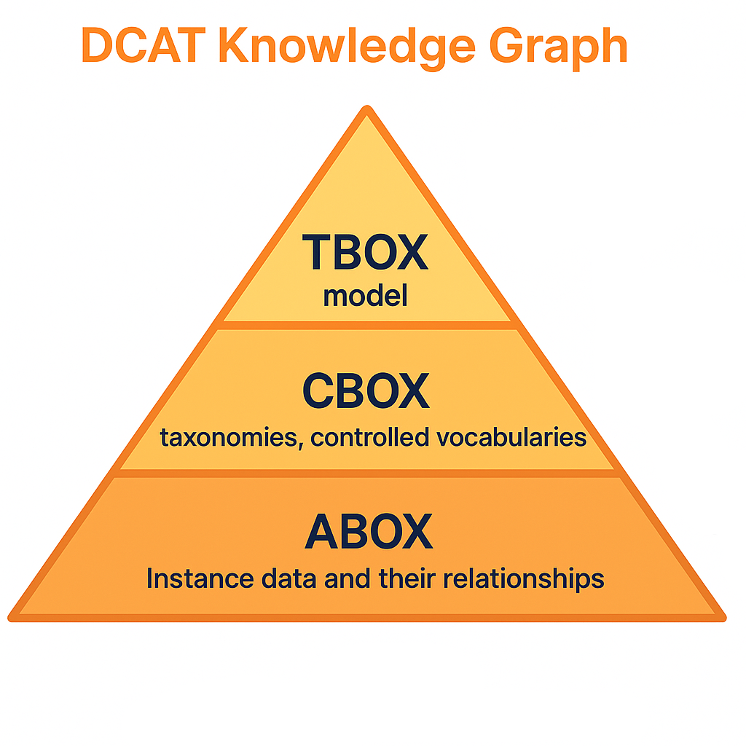
2. Solution: DCAT RAG Chatbot
DCAT, DCAT-AP, DCAT-AP-HVD
EU Controlled Lists, EuroVoc
catalogs, datasets, distributions, data services, publishers
(*McComb, D.:TBOX, CBOX, ABOX)

Slide 6
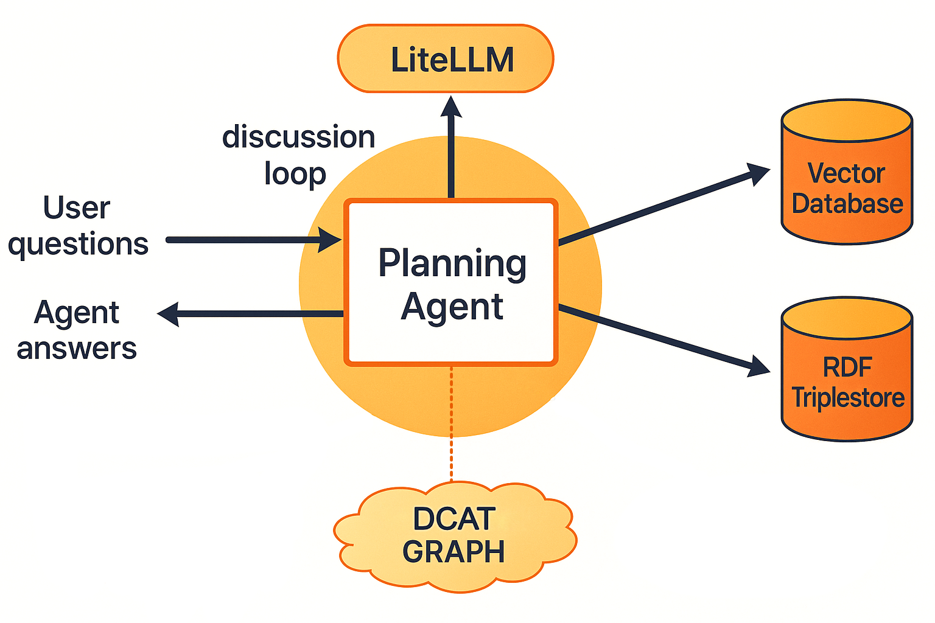
2. Solution: DCAT RAG Chatbot

Slide 7
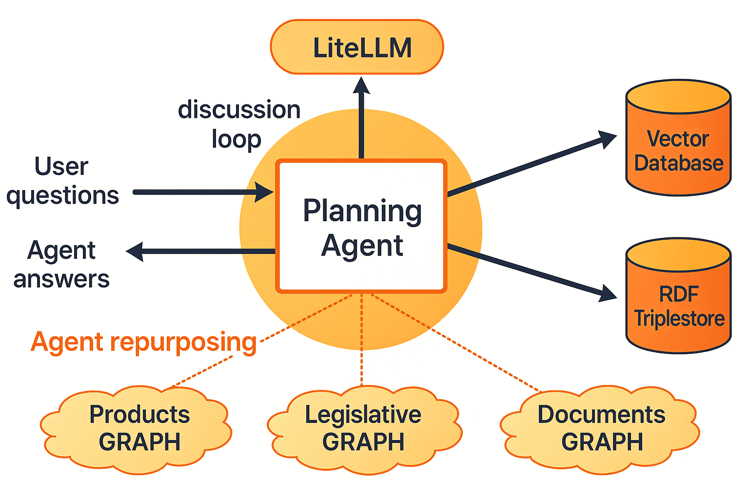
2. Solution: Generalisation
Configurable semantics domain

Slide 8
3. Challenges
Generating valid SPARQL queries aligned with DCAT.
Correctly using URIs from EU vocabularies.
Coping with logical interpretation of a query.
Handling multilingual metadata.
Ranking/filtering results (titles, licences, formats).

Slide 9
4. Implementation: Use Cases
Search, compare, and analyse open datasets without knowing SPARQL.
Example queries:
  “Show all transport datasets available in CSV updated after 2023.”
  “Find datasets to compare CO₂ emissions by country.”
Value: Democratise access to open data → usability beyond specialists.
Explainable AI: Transparent SPARQL queries

Slide 10
4. Implementation: Meta-Analysis of Tools
Custom RAG prototype: Python + Flask, Configurable access to LLM, triplestore and a vector db (ChatGPT, GraphDB, Milvus).
GraphDB Talk-to-Your-Graph: part of GraphDB database.
Key findings:
  Getting correct semantics challenging for all tools
  Customisation and fine-tuning needed

Slide 11
4. Implementation: Demonstration
RAG chatbot in action - example prompts → SPARQL → answer
GraphDB Talk-to-Your-Graph interface

Slide 12
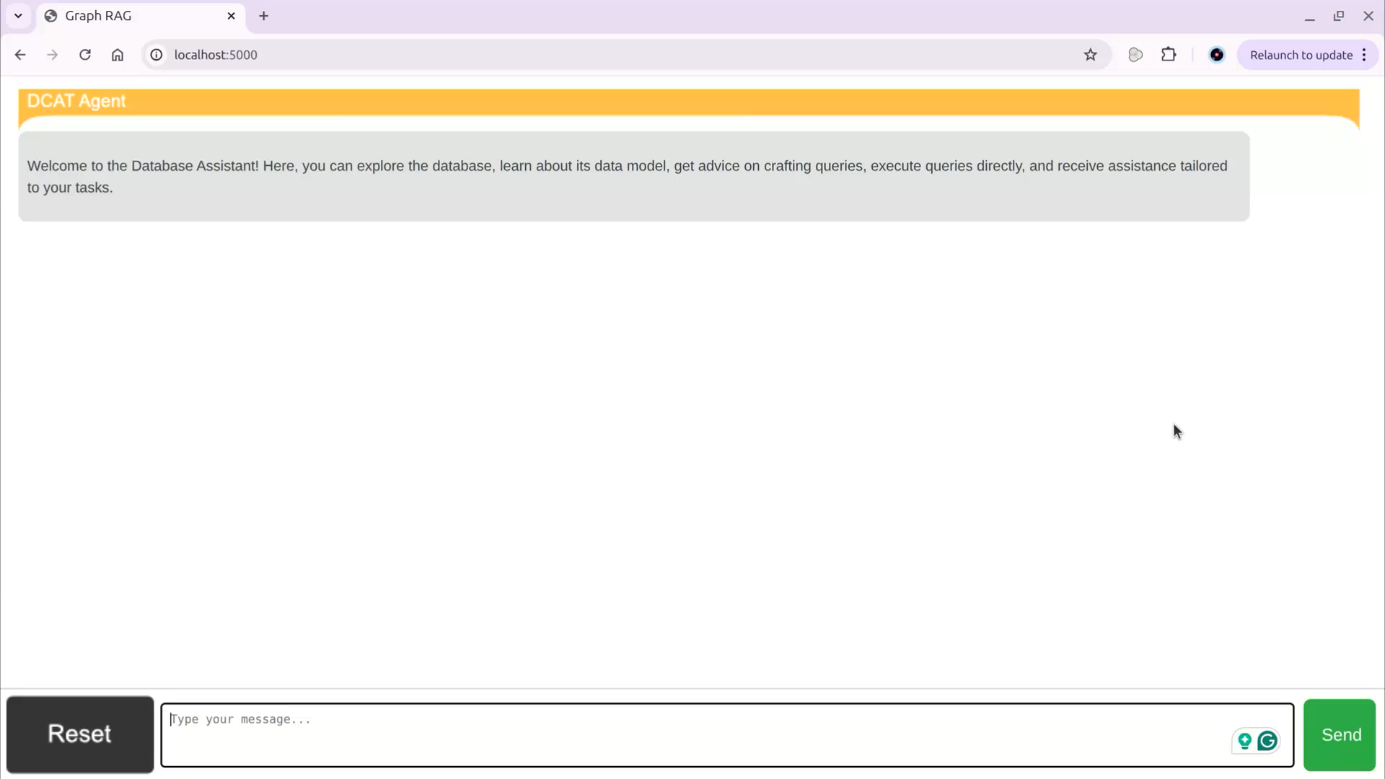
4. Implementation: Demonstration

Slide 13
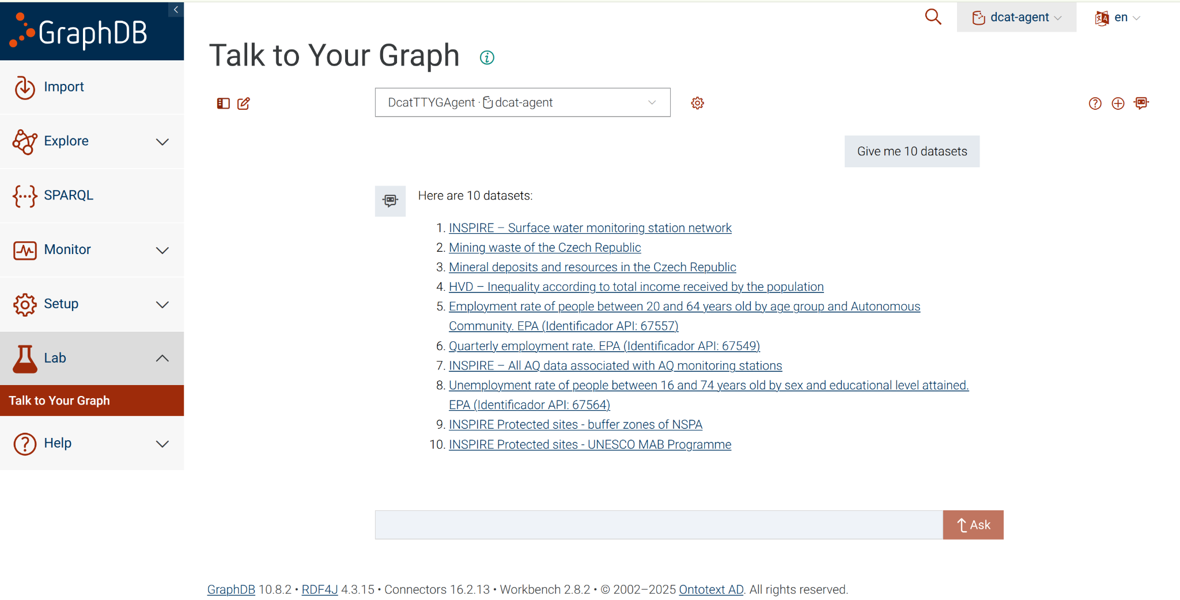
4. Implementation: Demonstration

Slide 14
Thank you for your attention!
liska@semantickyweb.sk
honza.forster@cogni.zone

