Slide 1
Helen Lippell
Taxonomy consultant
How taxonomies and reference data underpin good data quality - and how to convince people about this!

Slide 2

Agenda
Who am I?
Setting the scene
Where semantic thinking comes in
What it enables
How to persuade people about all this!

Slide 3
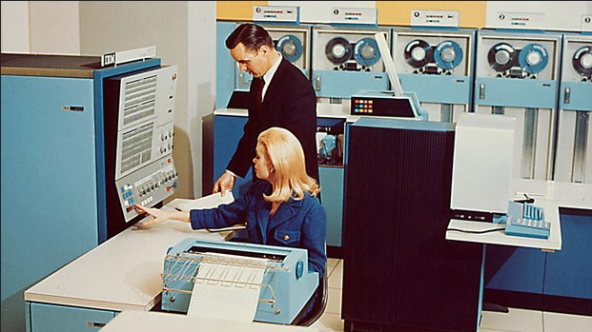
Setting the scene
Legacy systems
Huge volumes of data
Lots and lots of systems
‘Grey IT’
Decentralised operations
Barriers between frontline staff and data experts

Slide 4

Where semantic thinking comes in
Naming conventions
Code lists
Language control
Definitions and disambiguation
Categorisation
Metadata and domain modelling
Ontologies and other semantic models

Slide 5

What it enables
Good data quality
Data sharing and interoperability
Increased confidence in analytics, reporting and MI
Compliance, standards adherence and reputational protection
Process efficiency

Slide 6

How to persuade people
Be visible (even if you’re in a team of one)
Demystify your language and use of jargon
Be explicit on benefits (even if it seems obvious to you)
Find tactical wins or pilots (even if they seem small)
Build up a library of examples and use cases
Link key benefits to organisational goals
Be flexible – change is a constant

Slide 7

Thanks!
LinkedIn - www.linkedin.com/in/helenlippell
X and Bluesky - @octodude
Book - Taxonomies https://tinyurl.com/mwche4k4

