Slide 1
Héctor Rico Lorenzo – Senior Public Sector Consultant
NTT DATA
CAMSS and ELIS: Assessing Reference Data

Slide 2
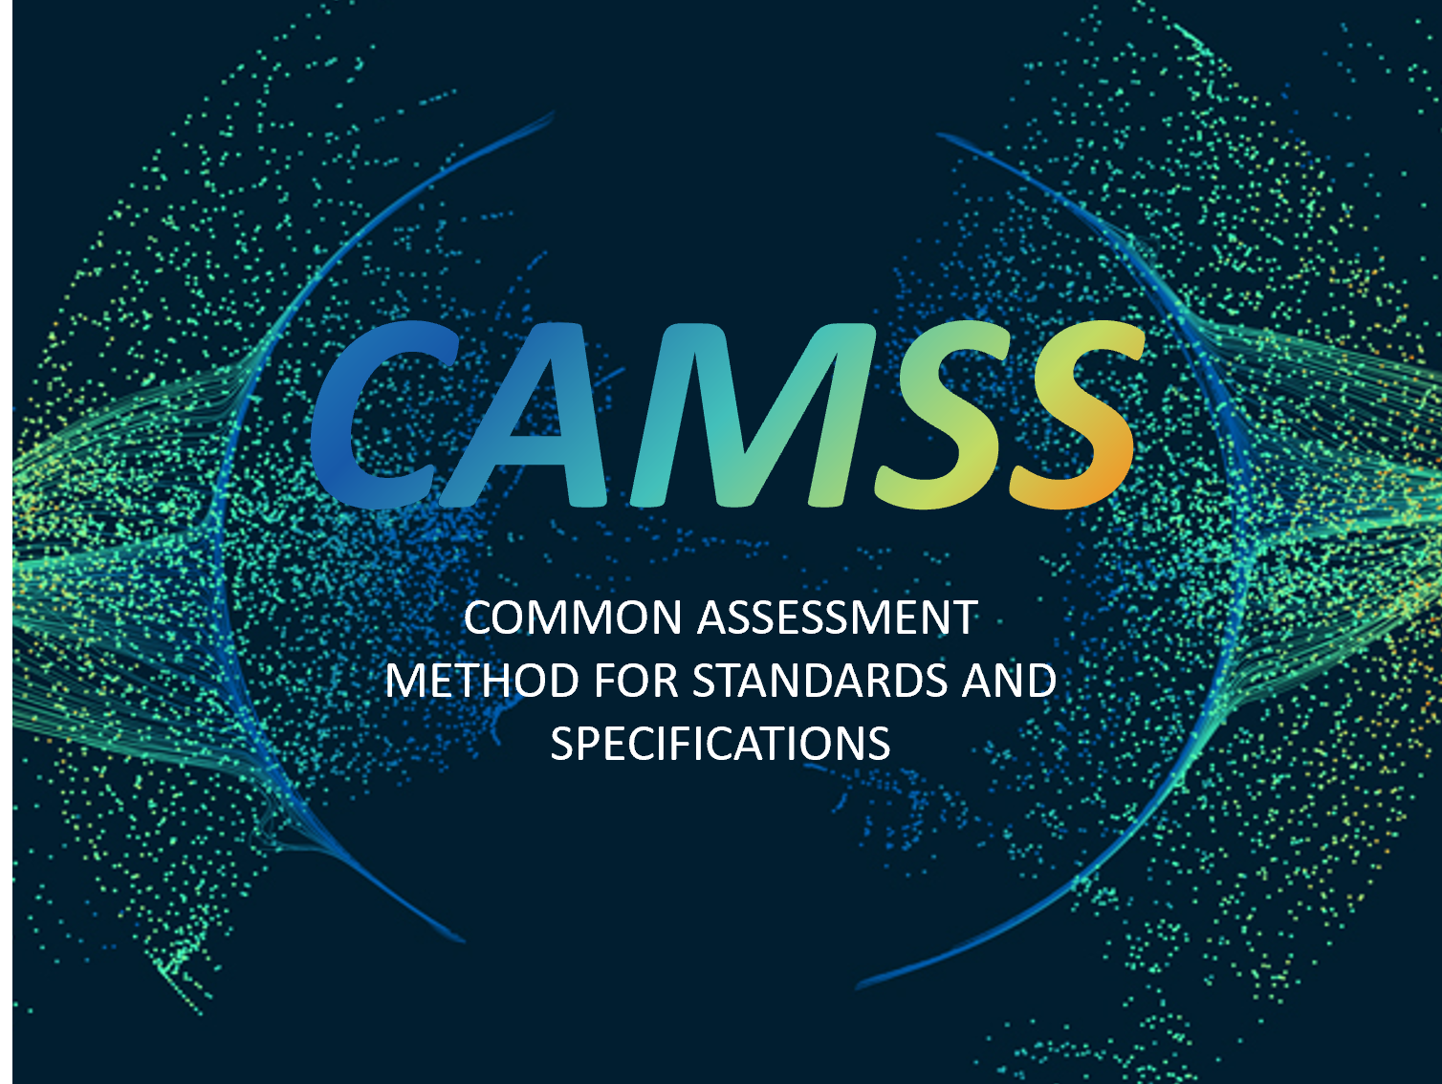
What is CAMSS?
CAMSS ELIS: Assessing Reference Data

Slide 3
What is CAMSS? - The context
CAMSS is the European guide for assessing and selecting standards and specifications for an eGovernment project, a reference when building an architecture and an enabler for justifying the choice of standards and specifications in terms of interoperability needs and requirements.
The context
The needs
EIF
(European Interoperability Framework)
1
Ease cross-border services interaction and avoid the creation of digital barriers
DEP (Digital Europe Programme)
2
Interoperability architecture planning
EIRA©
3
Avoid vendor lock-in when choosing solutions in e-government services
ISA2 Programme
CAMSS is provided as a best practice method for Member States, public administrations and digital service providers to support them in addressing their interoperability needs and requirements.
CAMSS ELIS: Assessing Reference Data

Slide 4
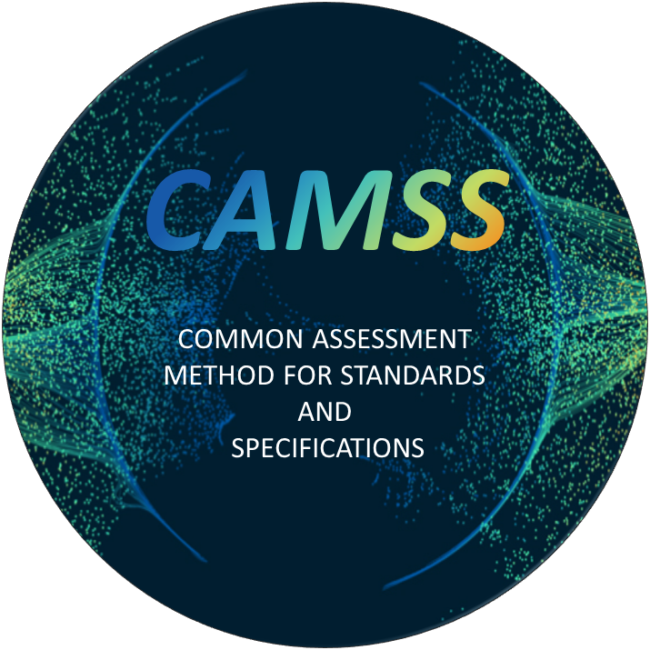
What is CAMSS? – The definition
The Common Assessment Method for Standards and Specifications
European guide for assessing, selecting, and justifying standards and specifications in eGovernment projects, specifically references when building an ICT architecture.
Widespread adopted specification, agreed upon by a recognised authority
Precise requirement(s) needed for implementing a solution
CAMSS offers a set of solutions, assets and specifications that respond to interoperability needs and requirements:
1
For public administrations and digital service providers to avoid vendor lock-in situations and engage in public procurement of interoperable ICT solutions
2
For cross-administration and cross-border digital services to easily interact with one another without having electronic barriers
For public administration and digital service providers to assess technical specifications and standards and ensure their conformance with the EIF interoperability views (semantic and technical)
3
CAMSS ELIS: Assessing Reference Data

Slide 5

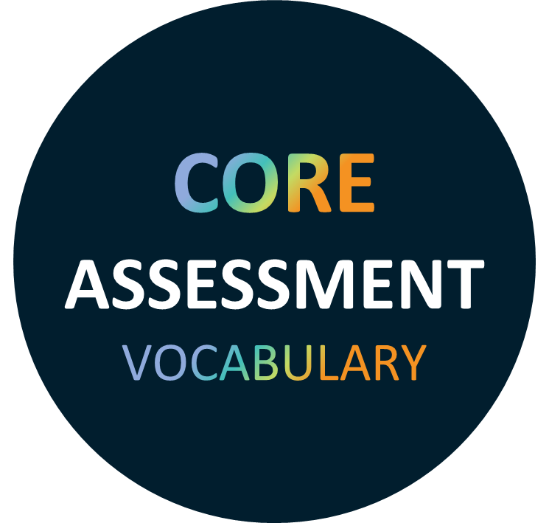
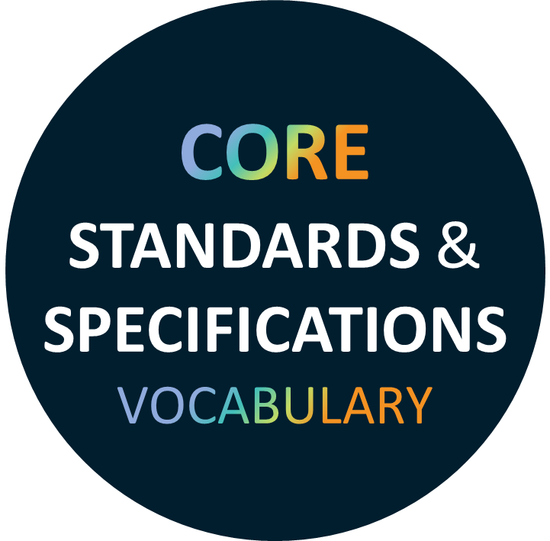

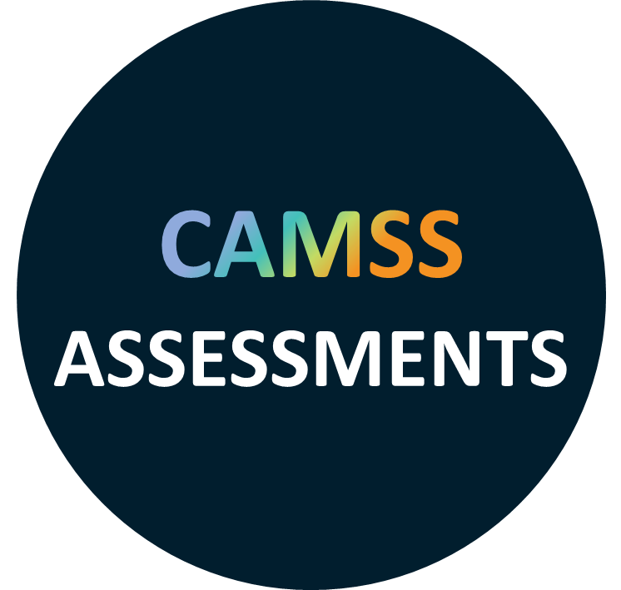

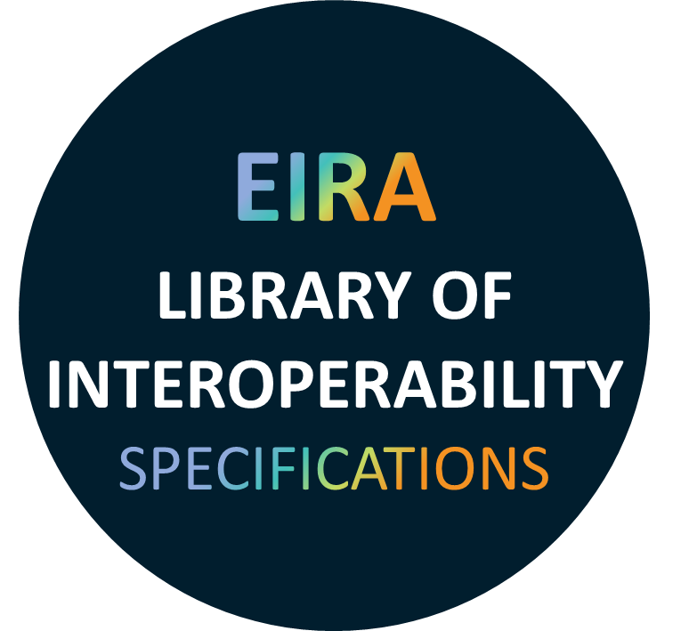
The ELIS – The definition
The EIRA© Library of Interoperability Specifications is a library containing the standards and specifications defining the interoperability requirements of the architectural building blocks (ABBs) contained in the European Interoperability Reference Architecture (EIRA©).
Specifications
Solutions
Based on
Interoperable ICT Standards and Specifications
link the EIRA© architectural building blocks (ABBs) to the standards and specifications that can be used to implement Solution Building Blocks based on those EIRA© ABBs.
Candidate standards and specifications to cover EIRA© ABB requirements
Provide
Provides
In conformance with
European Interoperability Framework (EIF)
Defines basic interoperability guidelines in the form of common principles, models and recommendations.
CAMSS ELIS: Assessing Reference Data
5

Slide 6

The ELIS – Characteristics
It aims to support architects in the modelling of solutions based on EIRA©.
It includes specifications and standards evaluated with the CAMSS Assessment EIF Scenario.
It is also available via a SPARQL endpoint, from where to launch the query and retrieve the data.
It contains and extensively documents each standards and specification by describing their interoperability requirements associated to the different EIRA© architecture building blocks.
The main criterion to include a specification and consequently its assessment in ELIS is that the score range of the assessment results (%) is higher than 75%.
Metrics | Total
Total number of Specification in ELIS | 761
Total number of specifications assessed in ELIS | 109
Assessments Score average in EIF scenario (v6.0.0) assessments | 86
All figures in the ELIS Online Dashboard
0-64% → Not acceptable fit for purpose
65-74% → Minimal acceptable fit for purpose, candidate to be deprecated by a better alternative
75-89% → Strong fit for purpose
90-100% → Full fit for purpose
CAMSS ELIS: Assessing Reference Data

Slide 7
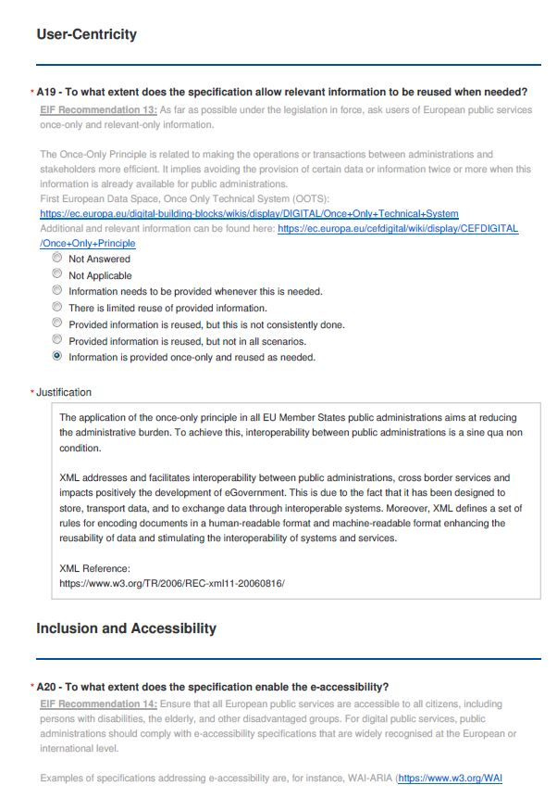
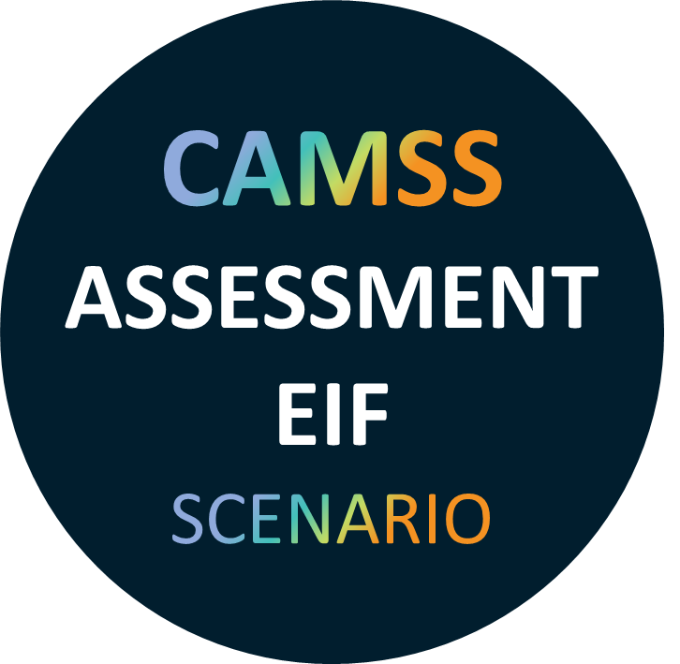

The CAMSS EIF Assessment Scenario
The CAMSS Assessment EIF Scenario allows to assess the compliance of interoperability specifications with the EIF, hence determining which specifications suit better to a specific purpose when designing public services.
CAMSS Assessment EIF Scenario:
Builds upon the 12 main EIF principles
Consists of a total of 45 criteria
The CAMSS methodology proposes a standardised way for the performance of the different criteria answers
EIF Scenario sections:
Principles setting the context for EU actions on interoperability
Core interoperability principles of the EIF
EIF principles addressing generic user needs and expectations
Fundamental EIF principles for cooperation between public administrations
EIF interoperability layers
UP1-Subsidiarity and proportionality
UP2-Openness, UP3-Transparency, UP4-Reusability, UP5-Technological neutrality and data portability
UP6-User-centricity, UP7-Inclusion and accessibility, UP8- Security and Privacy, UP9 - Multilingualism
UP10-Simplification, UP11-Preservation of information, UP12-Assessment of effectiveness and efficiency
CAMSS ELIS: Assessing Reference Data
Fundamental Interoperability layers: Legal, Organisational, Semantic, Technical

Slide 8
EIRA©
EUROPEAN
INTEROPERABILTY
REFERENCE
ARCHITECTURE
European Interoperability Reference Architecture (EIRA©)
CAMSS ELIS: Assessing Reference Data

Slide 9

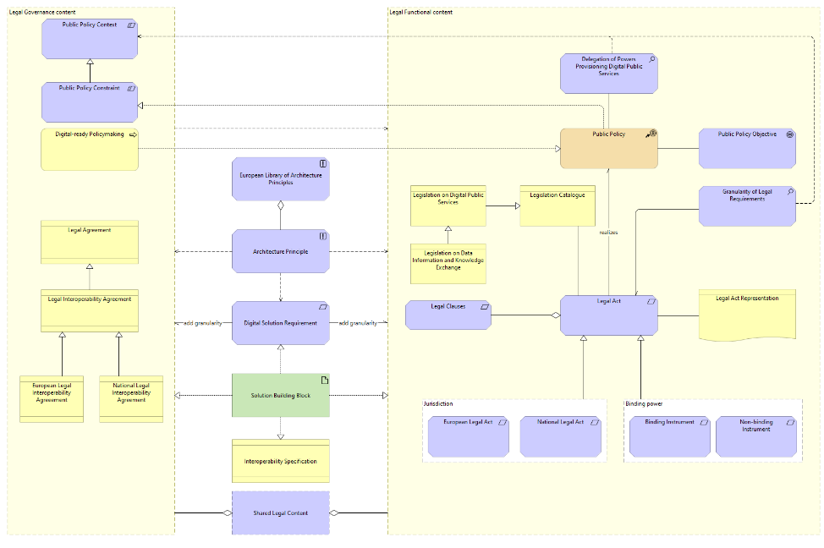
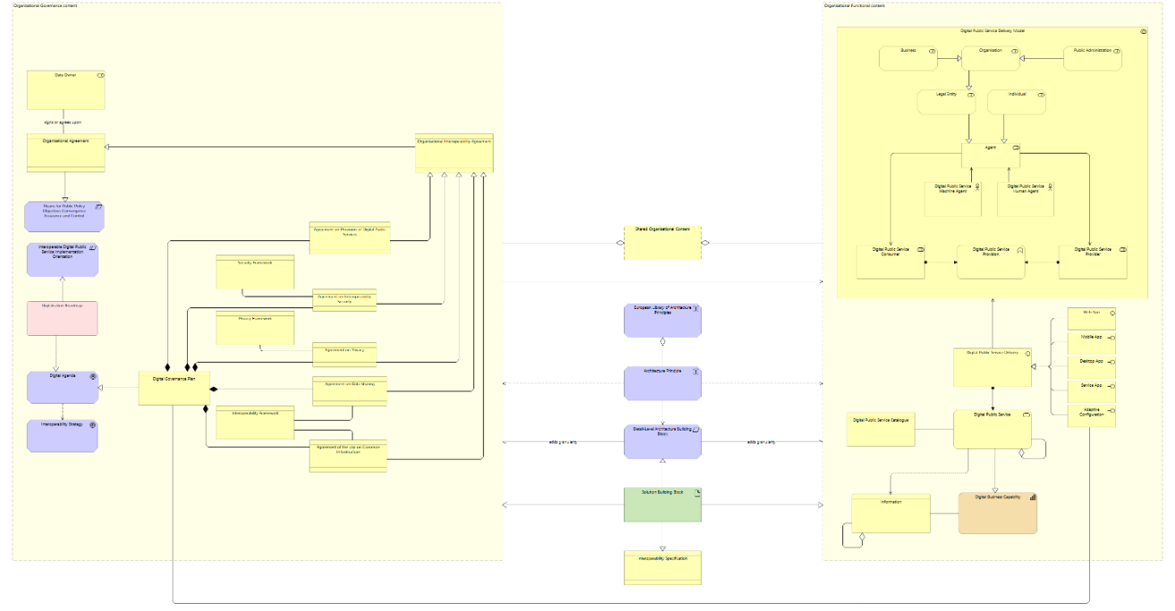
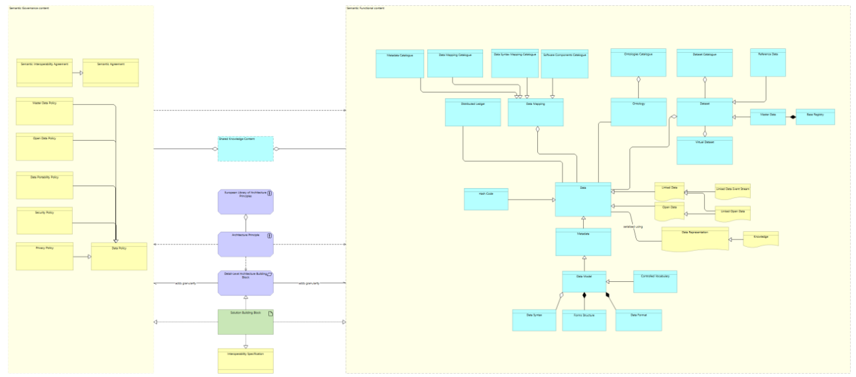
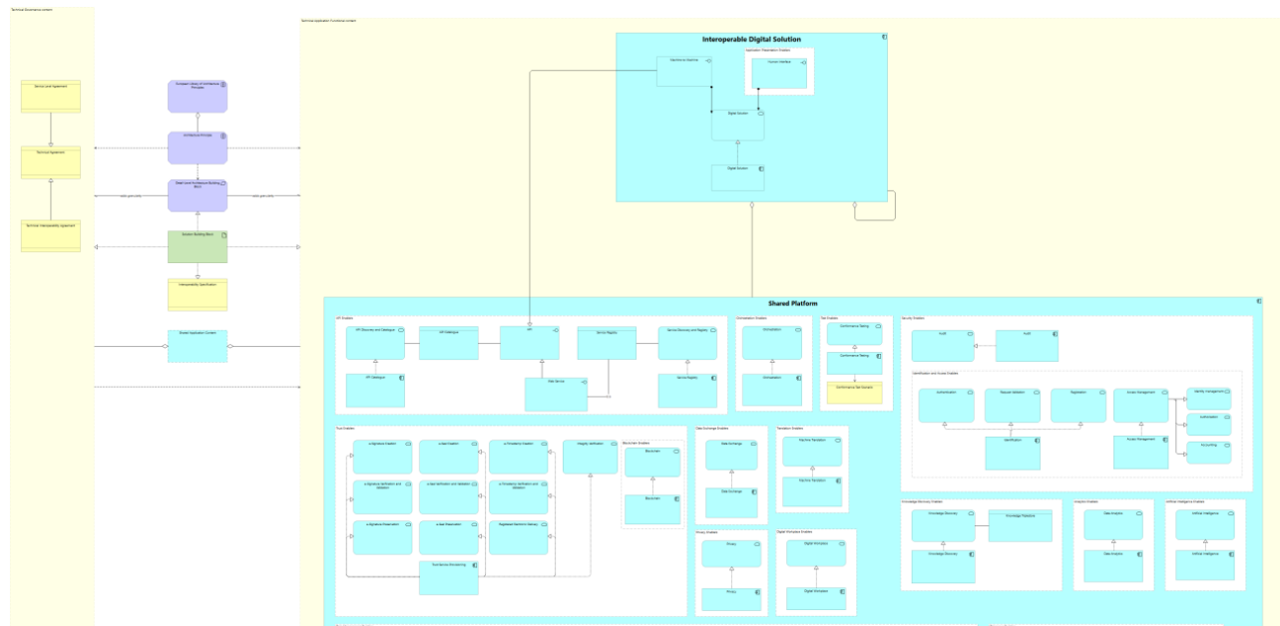
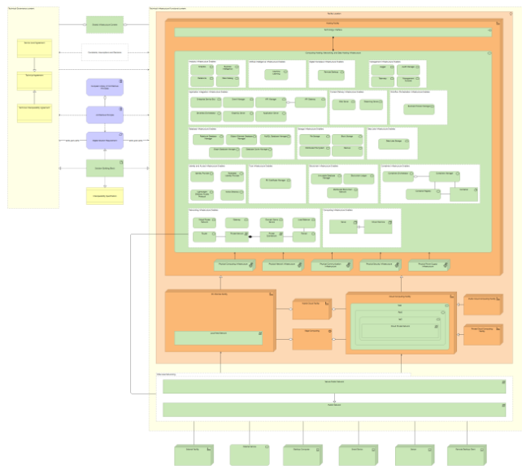
EIRA©
EIRA© is a reference architecture for the 1) analysis of requirements and 2) design of a target solution use cases across borders and sectors. It defines the required capabilities for promoting interoperability
EIRA© views and building blocks
What is a reference architecture?
Legal view
Defines the legal governance and functional content
Organisational view
Defines the organisational governance and functional content
Blueprint/template that provides a recommended framework for designing and implementing systems
Guide for creating solutions that meet specific needs or objectives
Best practices, standards, and guidelines to create systems that are efficient, scalable, and interoperable
A common language and approach for technology development and deployment that reduces complexity and costs
Semantic view
Defines the semantic governance and functional content
Technical view (Application & Infrastructure)
Defines the technical governance and functional content
EIRA© operates as a checklist for Quality Assurance: Ensuring quality during the analysis and solution design stages.
CAMSS ELIS: Assessing Reference Data

Slide 10

Assessing Reference Data
CAMSS ELIS: Assessing Reference Data

Slide 11







CAMSS for Assessing Reference Data – How?
Identification of reference data or semantic specifications that are relevant for their reuse and development of digital public services.
Use of the CAMSSS Methodology to assess the identified reference data (or semantic artefacts) by performing an assessment using the CAMSS EIF Scenario (i.e., Openness, Market Acceptance, Licensing issues, vendor lock-in, etc).
Association of a reference data with a positive evaluation (at least a score of ≥ 75%) with EIRA© Architecture Building Blocks in ELIS, supporting the development of Interoperable Digital Public Services.
Positive outcome
Addition to ELIS
Support the design of Interoperable Digital Public Services
Reference Data (or any other semantic artefacts)
EIF Assessment
Provide report
Negative outcome
CAMSS ELIS: Assessing Reference Data
Notes:
This is the process that would be followed when assessing Reference Data:
Assessing domain specific reference data using the EIF scenario can provide insights on how these code lists are supporting Interoperability.
If the outcome is positive, these will be added to ELIS to support Interoperable Digital Public Services development.
If the outcome is negative, a report can be provided with recommendations on pain points and what is missing to be aligned with the EIF.

Slide 12





CAMSS for Assessing Reference Data – Why?
Bring value
The identification, assessment, and link of relevant reference data to EIRA© ABBs through ELIS bring value to digital transformation of public administrations by supporting the implementation of semantic interoperability
Ensure semantic interoperability
Reusing and selecting reference data with a positive interoperability assessment can play a crucial role on establishing and implementing semantic interoperability in digital public services at cross-border level
Reduce technical risks
By utilising pre-assessed reference data, public administrations minimise the risk of implementing solutions that subsequently prove non-interoperable
Investment scalability
Once positively resulting from the assessment, reference data and semantic assets can be reused extensively, multiplying the return on initial investment in their development
Interoperability Governance
Governance is assessed while using CAMSS Solutions, ensuring that reference data and semantic assets are managed consistently and evolve following aligned governance frameworks
CAMSS ELIS: Assessing Reference Data

Slide 13
Thank you!
Contact us at digit-camss@ec.europa.eu
Check out our CAMSS Collection on the Interoperable Europe Portal

