Slide 1
Georges Lobo, Emidio Stani, Ine Weyts
PwC Technology Consulting – SEMIC, DIGIT
MLDCAT-AP: An application profile to describe machine learning models

Slide 2
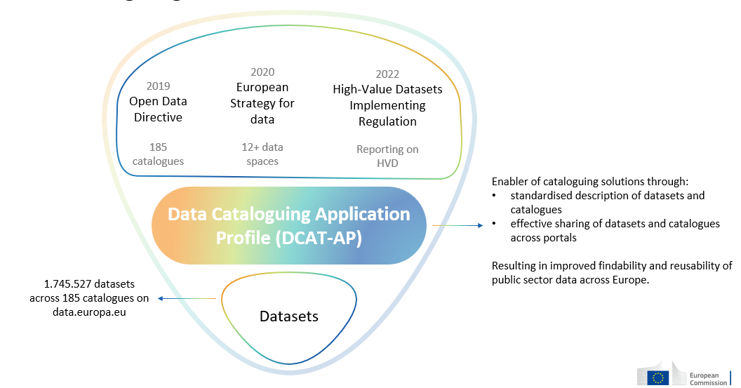
Dataset cataloguing and DCAT-AP
MLDCAT-AP: An application profile to describe machine learning models

Slide 3
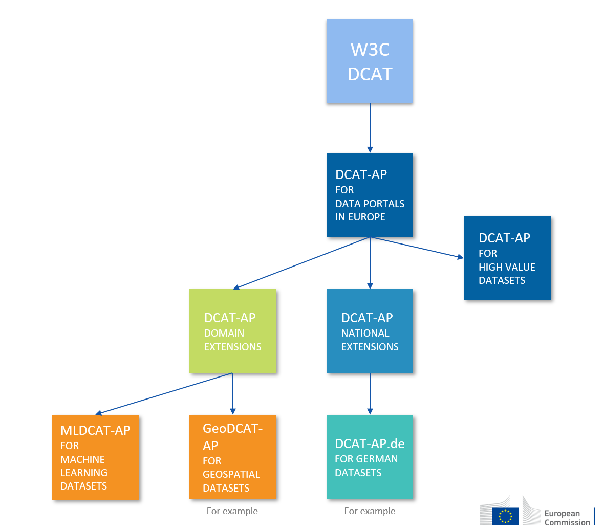
DCAT-AP ecosystem and MLDCAT-AP
Problem statement
Lack of semantic interoperability forbids assets (including machine learning models) to be easily exchanged with other platforms.
Strategy
Define a common data model and enrich existing API with semantics.
Compatible with DCAT-AP 3.0.0
MLDCAT-AP: An application profile to describe machine learning models

Slide 4
The need for MLDCAT-AP
MLDCAT-AP: An application profile to describe machine learning models

Slide 5

Dataset cataloguing and DCAT-AP
Findability
Publishing
Platforms
Reproducibility
Provider
User
Quality
Transparency
AI Act
Official publication: 12/07/2024
Application: 02/08/2025
Risk
MLDCAT-AP: An application profile to describe machine learning models

Slide 6
History of MLDCAT-AP releases
13/01/2023
25/06/2024
18/02/2025
01/09/2025
MLDCAT-AP 1.0.0
            Initial release
            Pilot in collaboration with OpenML
            Reusing DCAT-AP 2.1.1 concepts
MLDCAT-AP 2.0.0
Comparative analysis between repositories of machine learning models
Aligned with DCAT-AP 3.0.0
Inclusion of Paper, Algorithm, Data Quality and Risk in view of the AI Office and AI Act
MLDCAT-AP 2.1.0
Updates to align with AI act annexes XI – XIII
Inclusion of Benchmark, Computer Infrastructure, Hardware, Environmental Impact, ...
MLDCAT-AP 3.0.0
Aligned with DCAT-AP 3.0.1
Adding elements to align with the AI Code of Practice, including modality
MLDCAT-AP: An application profile to describe machine learning models

Slide 7
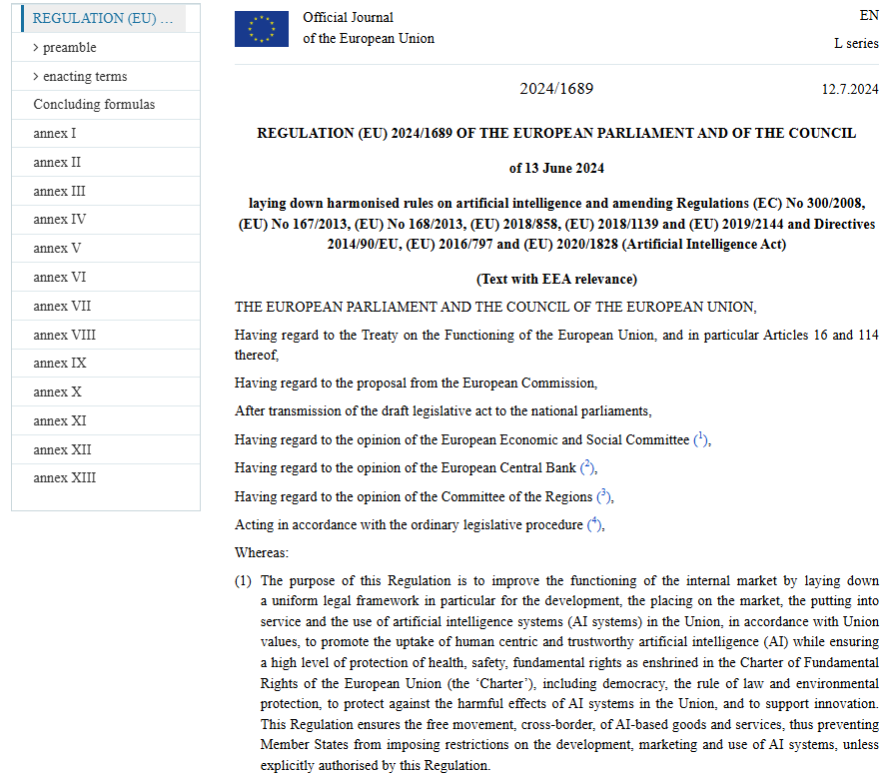
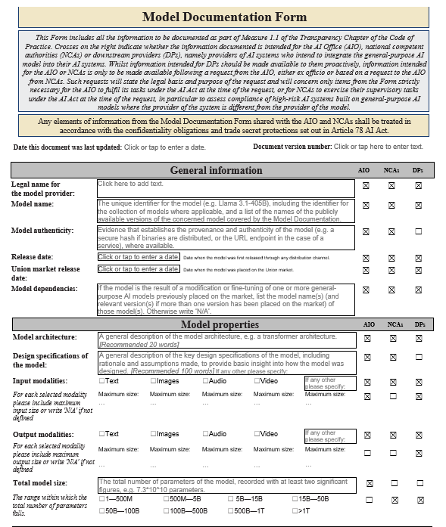
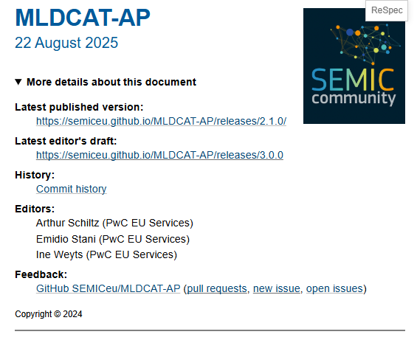
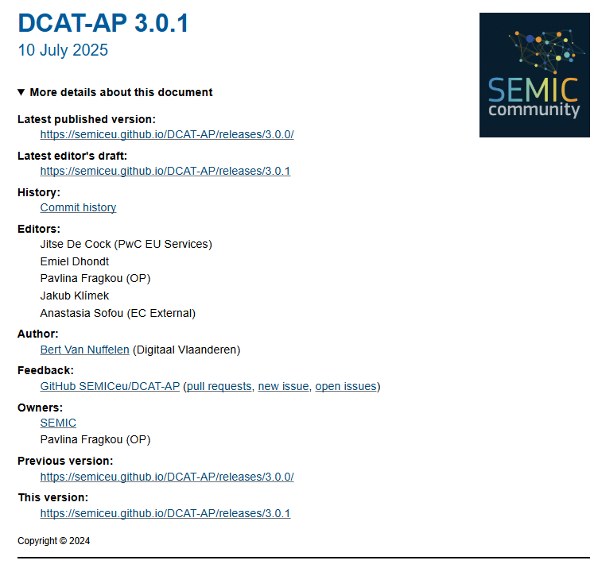
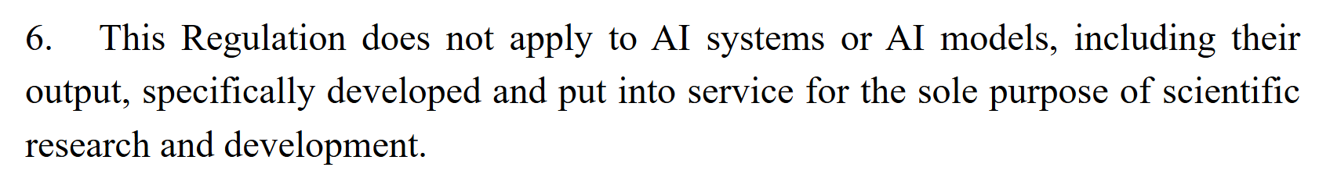
Sources for MLDCAT-AP 3.0.0
Legal
AI Act
Policy
AI Code of Practice
Data model
DCAT-AP 3.0.1
Data models
MLS, LPWC, DPV
MLDCAT-AP: An application profile to describe machine learning models

Slide 8
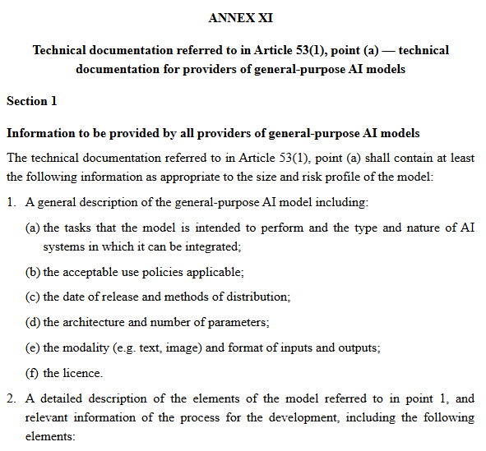

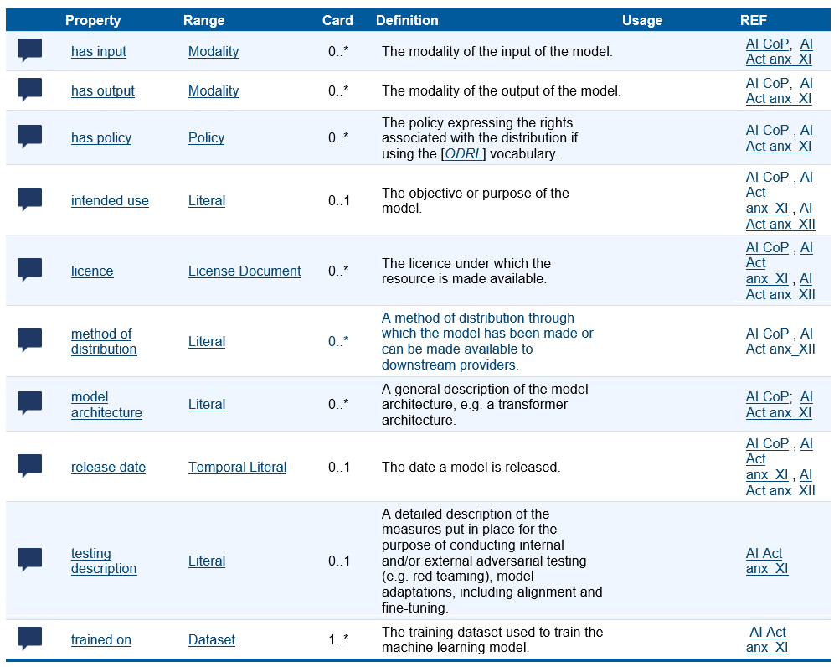
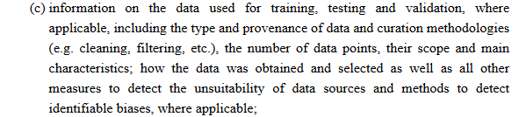
The AI Act: Relevant Annexes XI - XIII
1(e)
1(e)
1(b)
1(f)
1(c)
1(d)
1(d)
2(c)
2(c)
MLDCAT-AP: An application profile to describe machine learning models

Slide 9

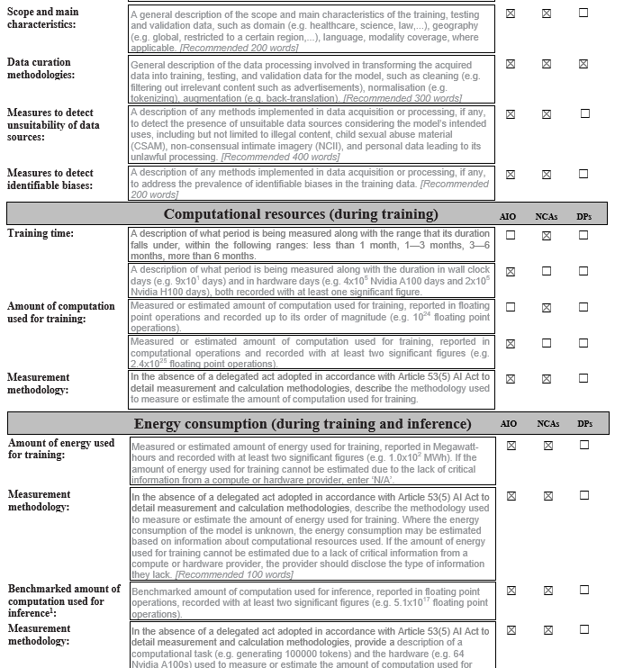
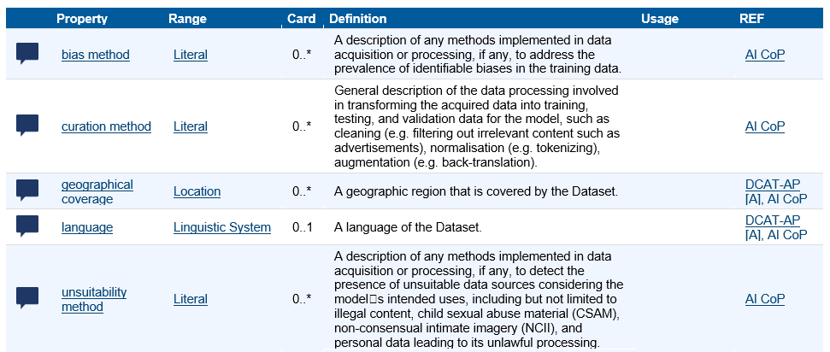
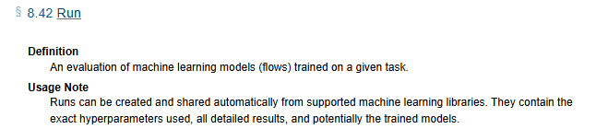
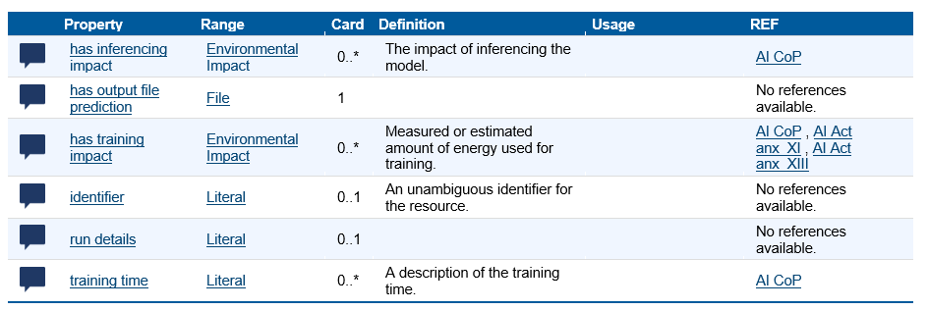
The AI Code of Practice
1.
2.
4.
3.
2.
4.
1.
1.
5.
3.
6.
7.
6.
7.
MLDCAT-AP: An application profile to describe machine learning models
5.

Slide 10
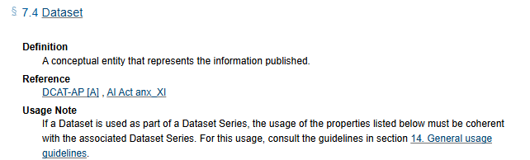
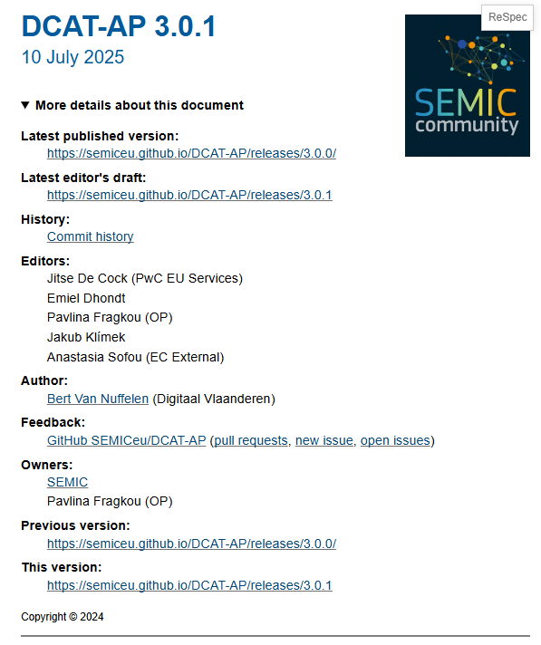
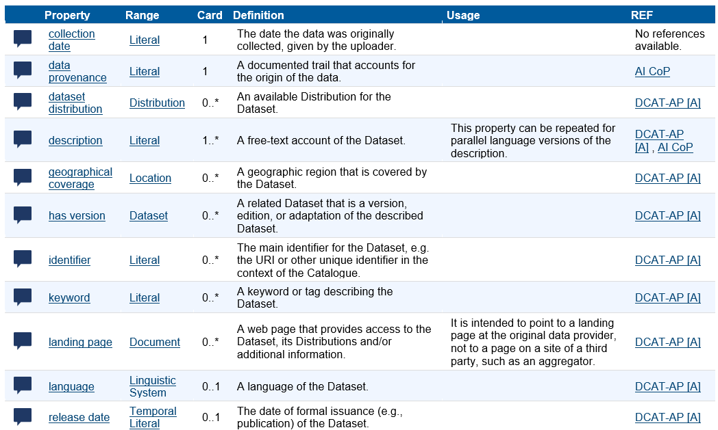
DCAT-AP 3.0.1
MLDCAT-AP: An application profile to describe machine learning models

Slide 11
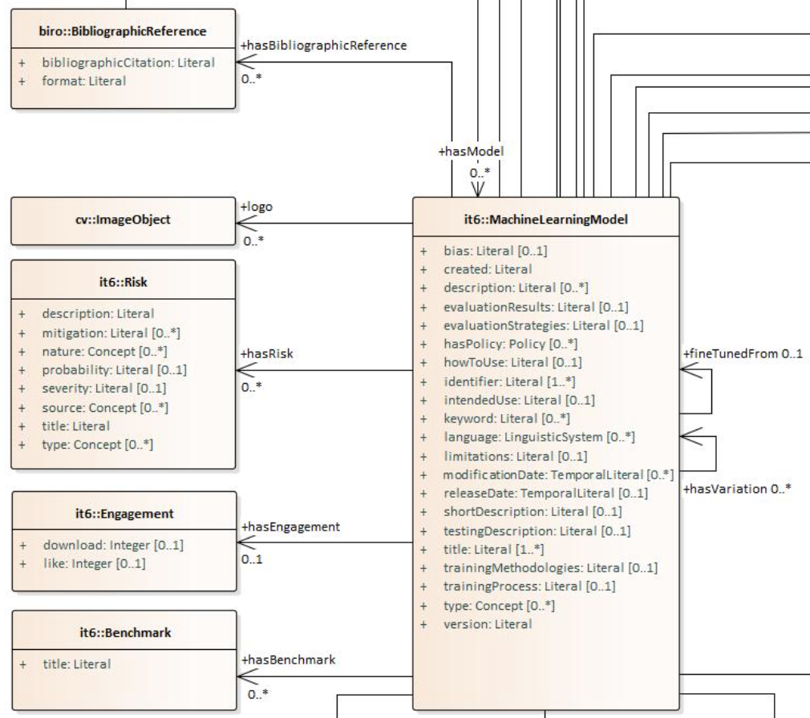
Platforms analysis
Common Properties | Hugging Face 1,5 M+ models | Kaggle -TensorFlow 278-2 K | Pytorch 55 | AzureAI 100+ (in org)
Language | X | X | X | X
References to Paper/Code | X | X | X
How to use | X | X | X
Logo | X | X | X
Files | X | X |  | X
Likes | X | X | X (GitHub stars)
Downloads | X | X
Relation | X (fine tuned from) | X (variation)
Created date | X |  |  | X
Checksum | X |  |  | X

Slide 12
MLDCAT-AP as a solution
MLDCAT-AP: An application profile to describe machine learning models

Slide 13
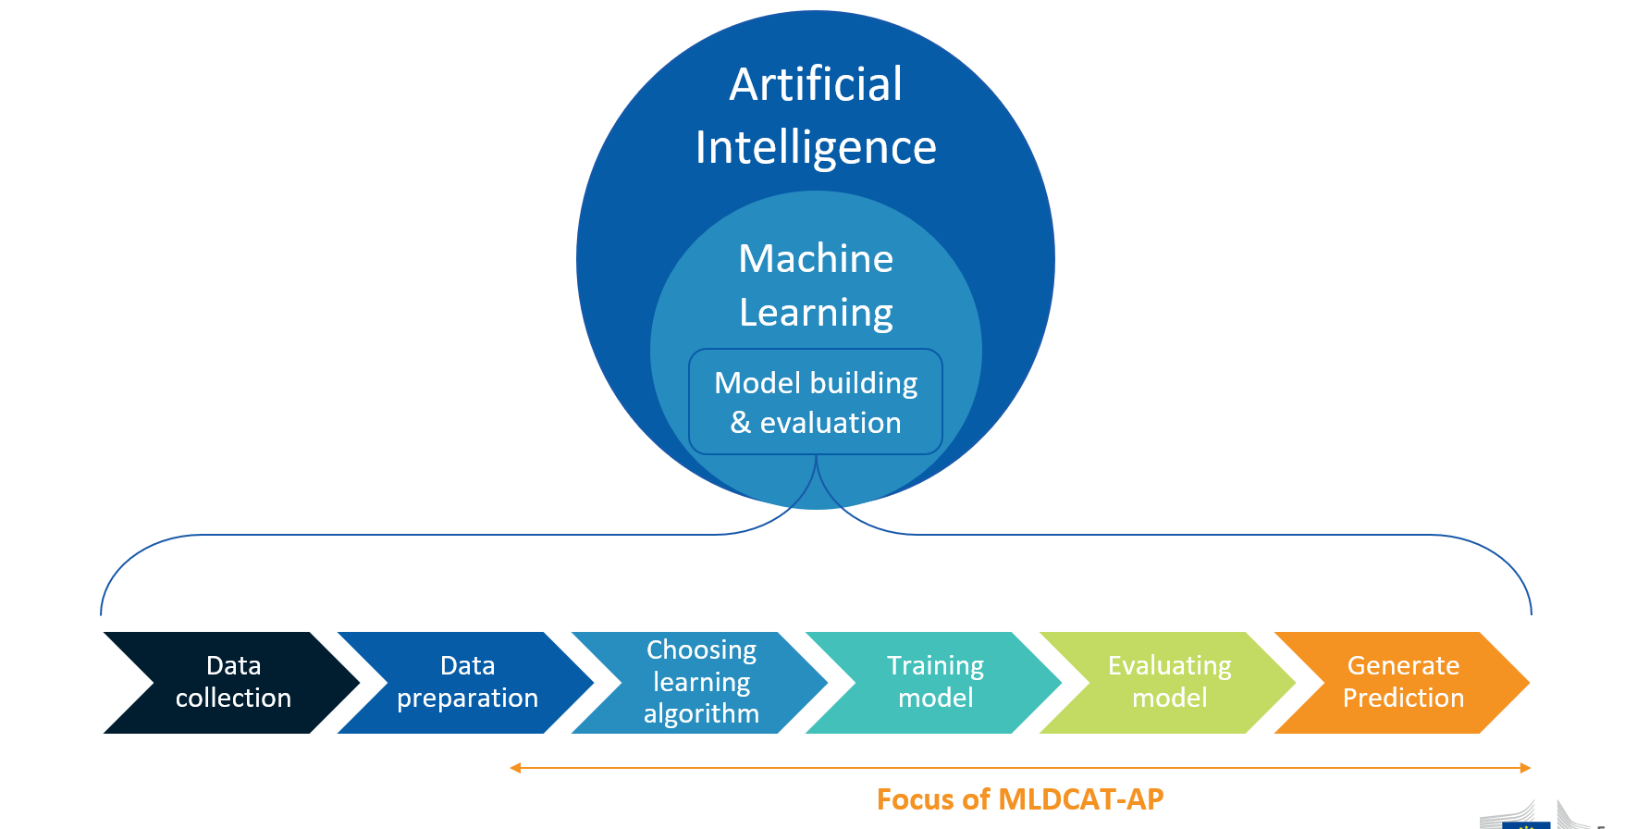
Domain of MLDCAT-AP
MLDCAT-AP: An application profile to describe machine learning models

Slide 14
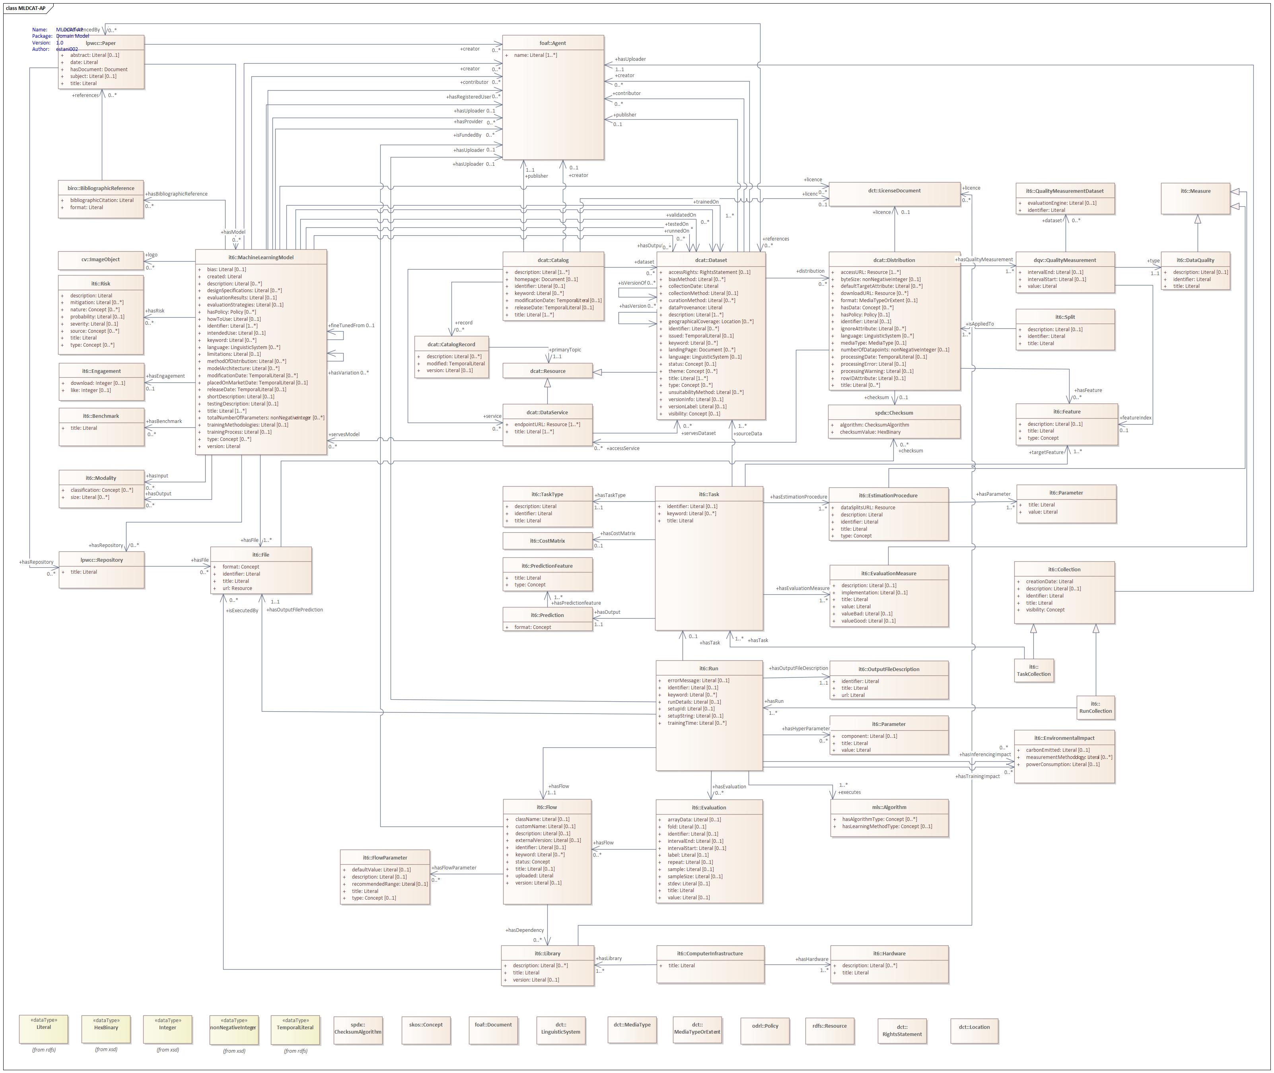
MLDCAT-AP 3.0.0
Concepts reused from DCAT-AP
Classes describing the quality of the data (cf. AI Act)
Algorithm class (cf. AI Act)
Machine Learning Model, Computer Infrastructure, Hardware and Library classes (cf. AI Act, AI CoP)
Benchmarks and Risks of the model (cf. AI Act)
Dataset class as output of a Machine Learning Model
Data preparation
Choosing learning algorithm
Training model
Evaluating model
Generate Prediction
MLDCAT-AP: An application profile to describe machine learning models

Slide 15
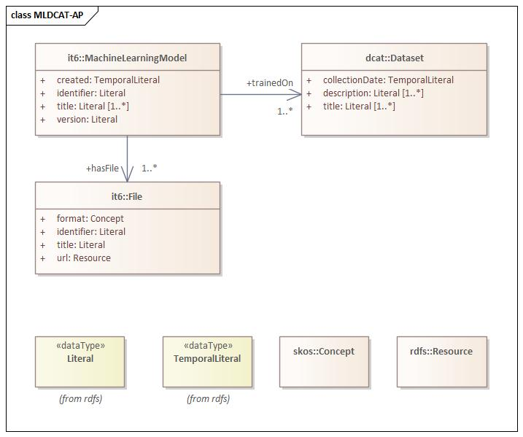
MLDCAT-AP – Machine Learning Model
Simplified view of mandatory properties for Machine Learning Model class.
MLDCAT-AP: An application profile to describe machine learning models

Slide 16
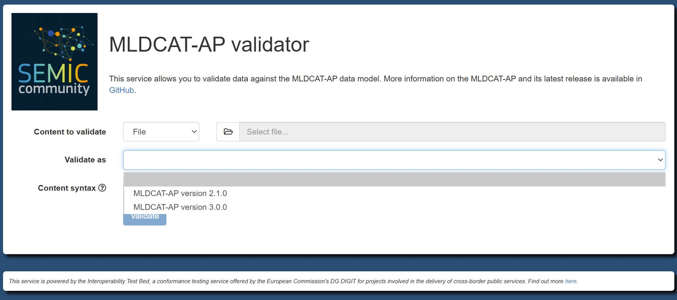
MLDCAT-AP – Validator
https://www.itb.ec.europa.eu/shacl/mldcat-ap/upload
MLDCAT-AP: An application profile to describe machine learning models

Slide 17
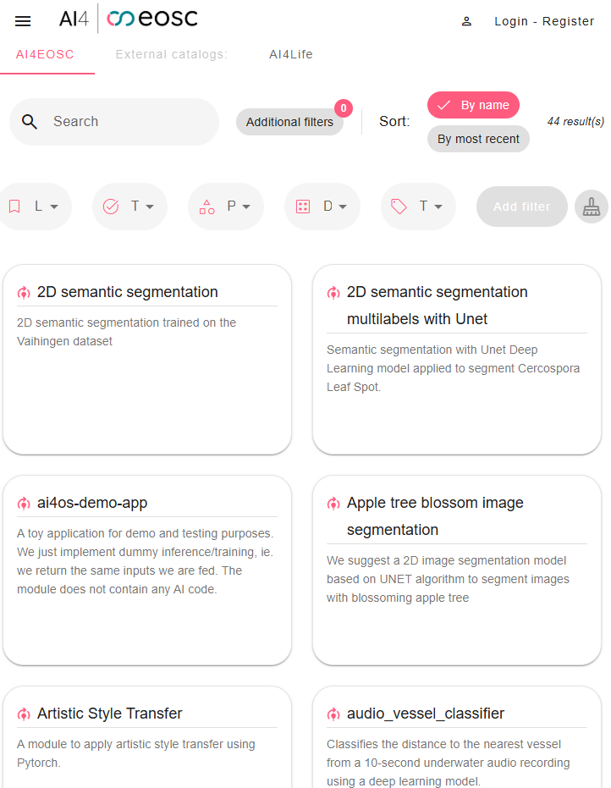
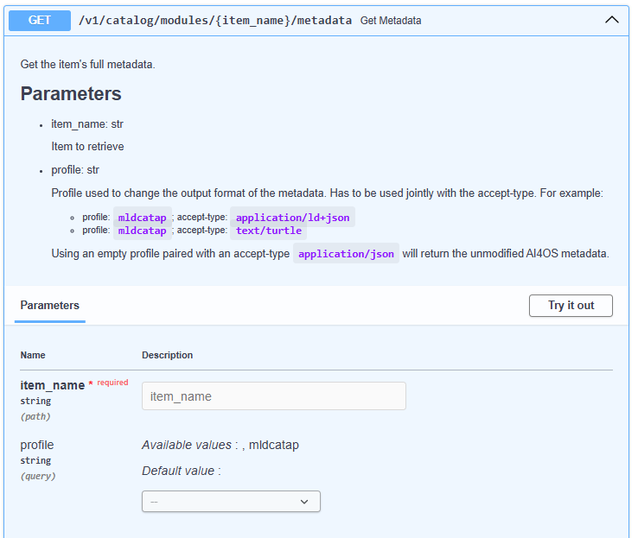

MLDCAT-AP pilot with AI4EOSC
https://api.cloud.ai4eosc.eu/docs#/Catalog%20(modules)/get_metadata_v1_catalog_modules__item_name__metadata_get
https://dashboard.cloud.ai4eosc.eu/catalog/modules
https://api.cloud.ai4eosc.eu/docs#/Catalog%20(modules)/get_metadata_v1_catalog_modules__item_name__metadata_get
https://api.cloud.ai4eosc.eu/docs#/Catalog%20(modules)/get_metadata_v1_catalog_modules__item_name__metadata_get

Slide 18
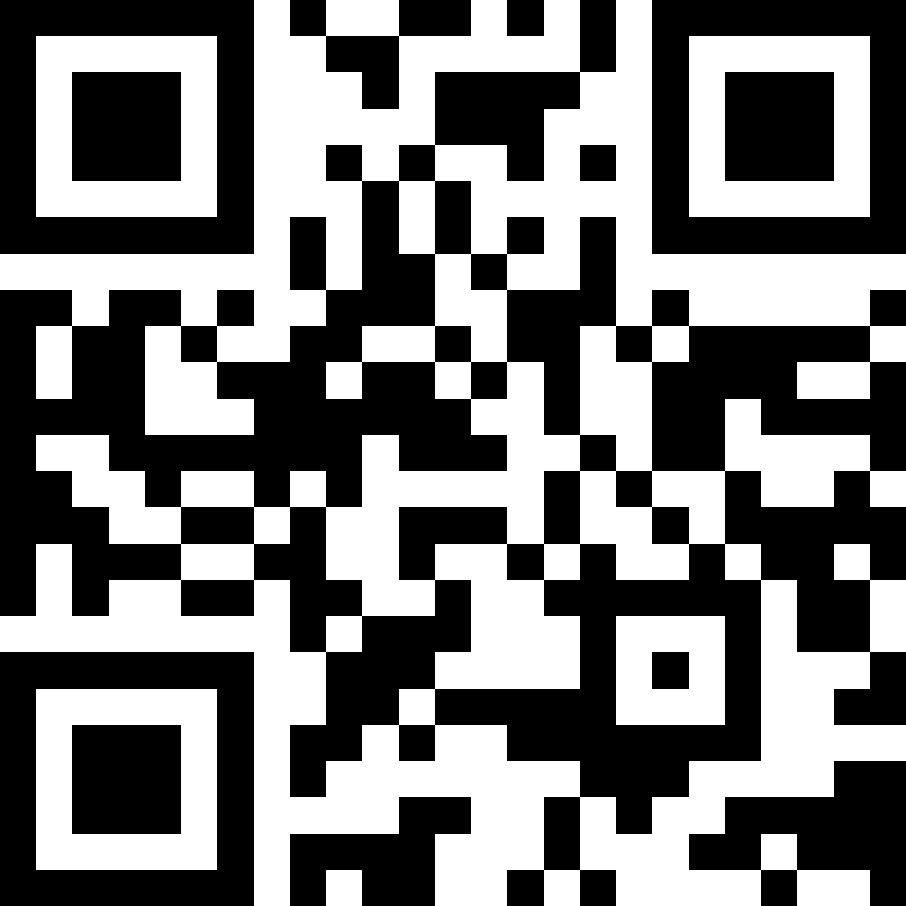
Next steps
    Please contact us to discuss pilot opportunities if interested.
    DIGIT-SEMIC-TEAM@ec.europa.eu
    Please provide your additional feedback on GitHub.
    https://github.com/SEMICeu/MLDCAT-AP/issues
    Join the MLDCAT-AP community on the SEMIC Support Centre.
Stay in touch by subscribing to our mailing list!
\
MLDCAT-AP: An application profile to describe machine learning models

Slide 19
Thanks
Georges Lobo, Emidio Stani, Ine Weyts – SEMIC
DIGIT-SEMIC-TEAM@ec.europa.eu

