Slide 1
Jakub Piskorski, Guillaume Jacquet, Xavier Chapelant, Dominik Skotarczak
Publications Office of the European Union
Directorate A: Data, Information and Knowledge Management Services and Artificial Intelligence Exploitation
NERDLE:
Named-Entity Recognition for the Domain of EU LEgislation
Crafting a Modular Hybrid Framework for Information Extraction

Slide 2
Overview
Named Entity Recognition (NER)
NEs in Legal Domain
NERDLE

Slide 3
Overview
Named Entity Recognition (NER): task of identifying and classifying named mentions of entities in unstructured text.
Named Entity Recognition (NER)
NEs in Legal Domain
NERDLE

Slide 4
Overview
Named Entity Recognition (NER)
NEs in Legal Domain
NERDLE
NEs in Legal domain: organisations, references to legislation, geo-political entities, temporal and numerical expressions, events, identifiers, products, and other artifacts

Slide 5
Overview
Named Entity Recognition (NER)
NEs in Legal Domain
NERDLE
NERDLE: Text processing component developed at the Publications Office to recognize Named Entities in legal texts in the EU Acquis and (later) for Caselaw.

Slide 6
Overview
Named Entity Recognition (NER)
NEs in Legal Domain
NERDLE
NERDLE: Text processing component developed at the Publications Office to recognize Named Entities in legal texts in the EU Acquis and (later) for Caselaw.
NERDLE: Combination of knowledge-based, machine learning, and generative AI techniques.
NERDLE: Benchmark corpus of EU-Acquis documents
NERDLE: Evaluating NERDLE techniques ranging from lexica- to generative AI-based extractions

Slide 7
Context: Acquis Management Programme
🏛️
Publications Office, in collaboration
with the Secretariat General of the EC and DG DIGIT
⚖️
Build a comprehensive digital ecosystem to support the management of the EU legal acquis.​
​
🗂️
Provide complete, updated, and granular information
for better search and analysis of the EU acquis.
✅
Simplify compliance for Member States, businesses,
and SMEs.
🤖 AI-driven information extraction

Slide 8
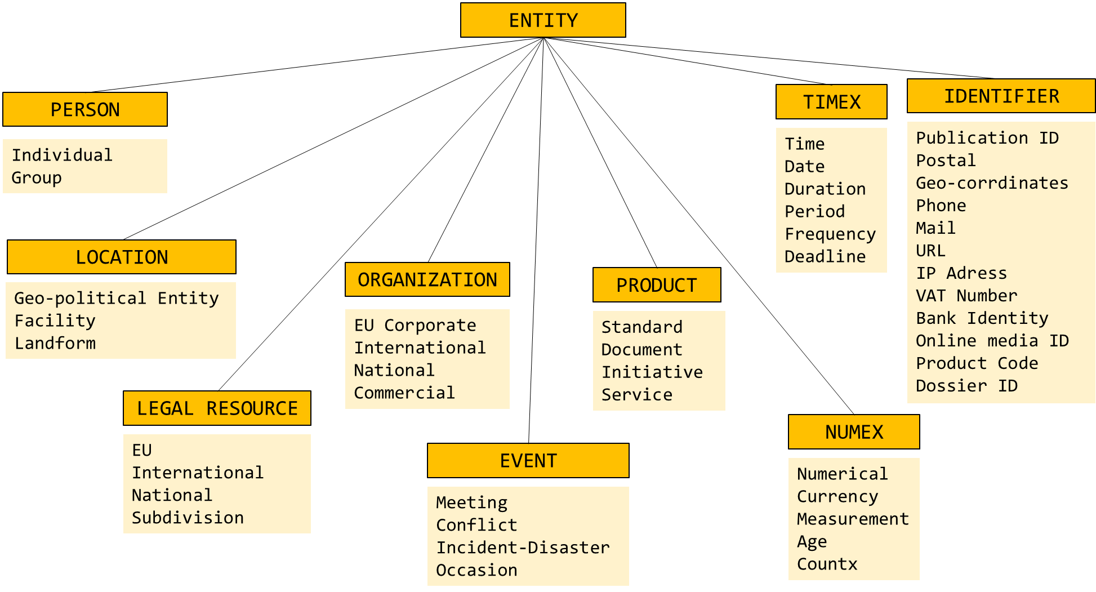
NERDLE’s Taxonomy
❓
❓

Slide 9
Incremental Hybrid Approach
Gen AI
Machine Learning
Patterns
Lexica

Slide 10
Incremental Hybrid Approach
Gen AI
Machine Learning
Patterns
Lexica
... [European External Action Service]_{ORGANIZATION} ...

Slide 11
Incremental Hybrid Approach
Gen AI
Machine Learning
Patterns
Lexica
... [by 30 June 2025]_{DEADLINE} ...

Slide 12
Incremental Hybrid Approach
Gen AI
Machine Learning
Patterns
Lexica
... Article 6 of the [1971 Fund Convention]_{LEGAL-REF} is amended as follows ...
  ❓

Slide 13
Incremental Hybrid Approach
Gen AI
Machine Learning
Patterns
Lexica
... [Competent GOVSATCOM Authorities] _{ORG-NAT} are entities designated by each...
  ❓

Slide 14
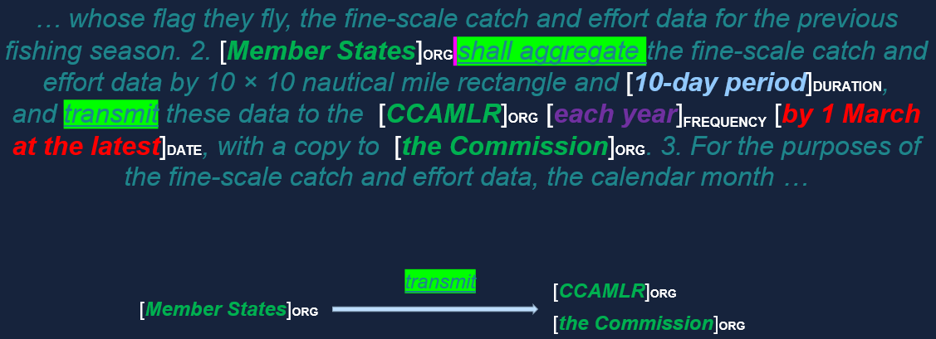
NERDLE in action: Extraction of Reporting Requirements

Slide 15
NERDLE’s Lexica*
....
Francia [TYPE:Geopolitical Entity, LANG:it, CATEGORY:country, BASEFORM:France, CONCEPT:coun-FRA]
Franciaország [TYPE:Geopolitical Entity, LANG:hu, CATEGORY:country, BASEFORM:France, CONCEPT:coun-FRA]
Franţa [TYPE: Geopolitical Entity, LANG:ro, CATEGORY:country, BASEFORM:France, CONCEPT:coun-FRA]
Francija [TYPE: Geopolitical Entity, LANG:sl, CATEGORY:country, BASEFORM:France, CONCEPT:coun-FRA]
France [TYPE: Geopolitical Entity, LANG:fr, CATEGORY:country, BASEFORM:France, CONCEPT:coun-FRA]
Фpaнция [TYPE:Geopolitical Entity, LANG:bg, CATEGORY:country, BASEFORM:France, CONCEPT:coun-FRA]
Frankreich [TYPE:Geopolitical Entity, LANG:de, CATEGORY:country, BASEFORM:France, CONCEPT:coun-FRA]
França [TYPE: Geopolitical Entity, LANG:pt, CATEGORY:country, BASEFORM:France, CONCEPT:coun-FRA]
....
*compiled from various sources

Slide 16
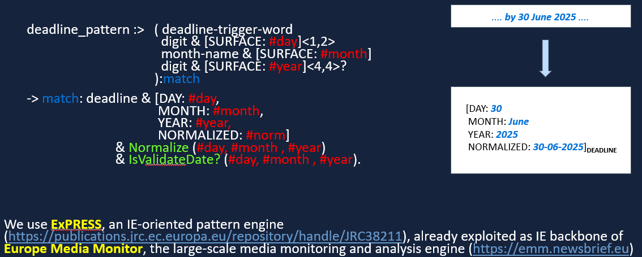
NERDLE’s Patterns

Slide 17




















Classical Machine Learning for NERDLE
Tools
Corpora
🧰
  NLTK

Slide 18
Classical Machine Learning for NERDLE
🧰
Tools
Corpora
❓
performance depends on the modelling approach
❓
EU-acquis targeted evaluation
performance improvement at
a relatively low computational cost
❓
⚠️
scarcity of legal NER corpora
⚠️
lack of training data for EU acquis

Slide 19
Generative AI for NERDLE
❓ potential recall boost
⚠️ risk of quality loss
⚠️ potentially lower precision
⚠️ computational overhead
🛠️
Generative AI requires engineering
for robustness and optimal performance

Slide 20





Generative AI for NERDLE 🛠️
❓
❓
pre-process
post-process
⚠️
⚠️

Slide 21
What is the Benchmark Corpus for?
❓ and ⚠️
agreement between humans on the task
evaluation of NERDLE, its components and other tools for NER
quantification of possible adverse effects in the industrial setting of IE from EU-acquis
training and/or instructing models
facilitation of structuring business needs on the task of Named-Entity recognition for the legal domain and tuning the taxonomy accordingly
better positioning the Publications Office in the Legal NLP domain

Slide 22
Benchmark corpus creation
40 documents
from EU Acquis (English)
📱
📖
INCEpTION
annotation web app
NERDLE Codebook
for onboarding annotators
🧑‍💼👩‍💼
2 annotators
per document

Slide 23
🧠
1 curator
per document
🏷️
~35 000
entity mentions
annotated
❓⚠️ covered

Slide 24
Benchmark corpus statistics
25/40
documents
18 524
entities annotated
77 000
average doc length (in characters)

Slide 25

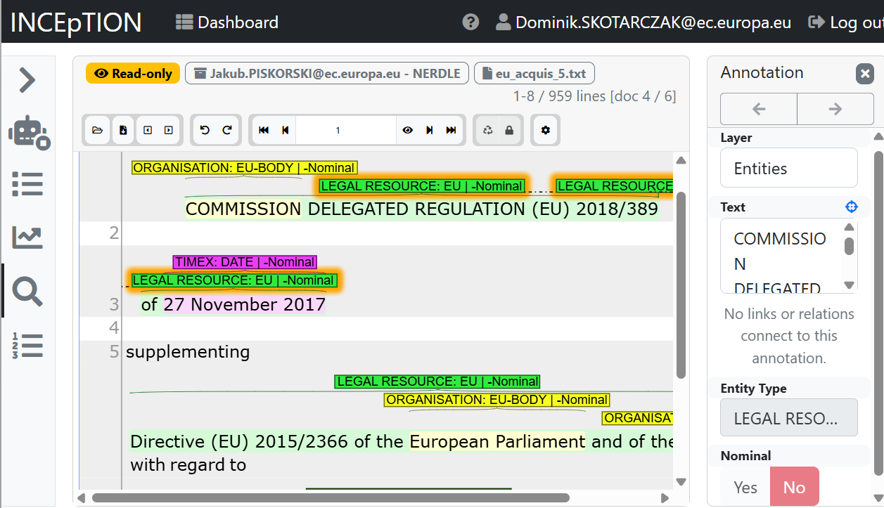
Inception Web App
📱

Slide 26
Our Framework
Evaluation
Classical ML & Generative AI
🏗️
Codebook
Tools
Lexica & Patterns
New business needs
Data
25 annotated & curated documents
+15 annotated & curated documents

Slide 27
Annotators
Oceane Abrard (OP A.1)
Iwona Serdynska (OP C.2)
Despoina Karipidi (OP A.2)
Juraj Kuba (OP C.2)
🧑‍💼👩‍💼
Xavier Chapelant (OP A.2)
Avraam Markianidis (OP A.2)
Jakub Piskorski (OP A.3)
Dominik Skotarczak (OP A.2)
Guillaume Jacquet (OP A.1)

Slide 28
Thank you!
Jakub.Piskorski@ec.europa.eu
Xavier.Chapelant@ext.publications.europa.eu
Guillaume.Jacquet@ec.europa.eu
Dominik.Skotarczak@ec.europa.eu

Slide 29
Backup

Slide 30
Benchmark corpus statistics (fine-grained)

Slide 31
Benchmark corpus statistics (fine-grained) ctd.

Slide 32
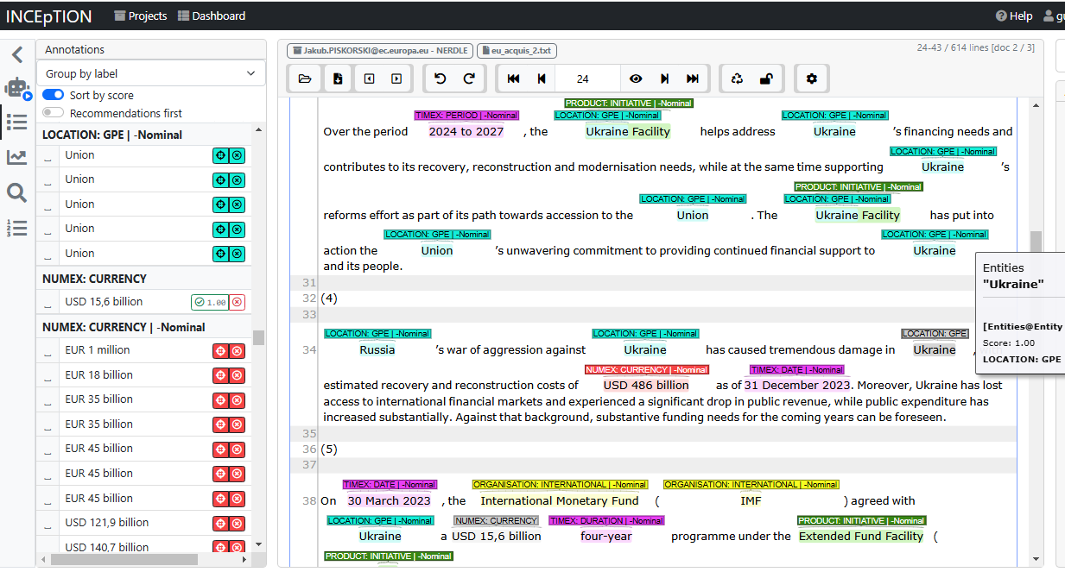
Inception : annotation recommendation example

Slide 33
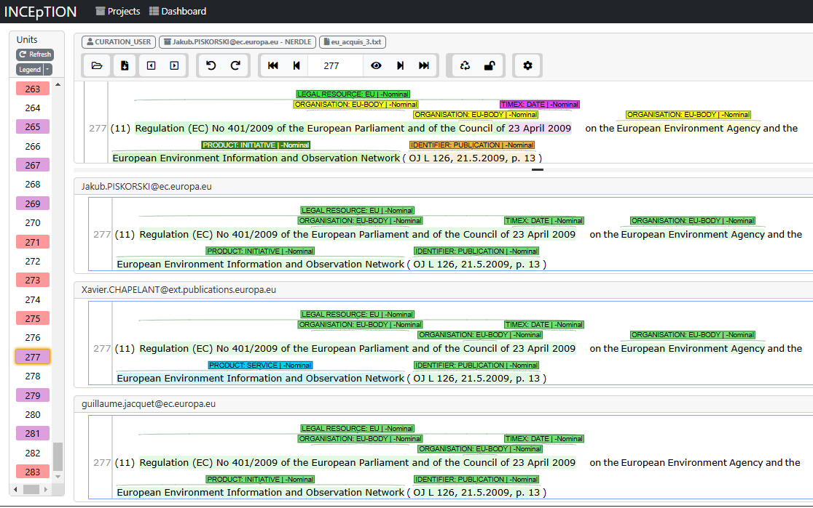
Inception : annotation curation
Curated annotations
Annotator 1
Annotator 2
Annotator 3

Slide 34
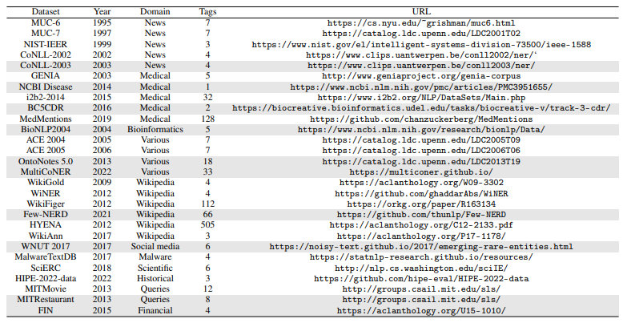
Popular NER Corpora
Corpora
Legal Domain
EDGAR-NER https://aclanthology.org/2022.nllp-1.22.pdf
LER https://link.springer.com/content/pdf/10.1007/978-3-030-33220-4_20.pdf

