Slide 1
Jakub Piskorski & Dominik Skotarczak
Publications Office of the European Union
Directorate A: Data, Information and Knowledge Management Services and Artificial Intelligence Exploitation
Extracting Structured Information from EU acquis on Information Provision Activity Requirements
How much CO2 do you need to get the job done?

Slide 2
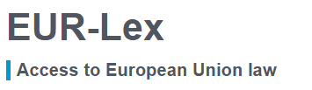
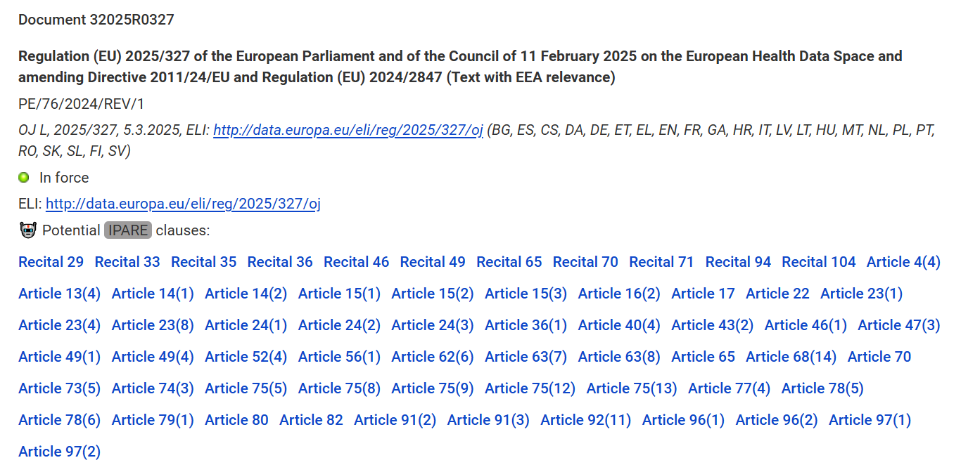
IPARE

Slide 3
IPARE

Slide 4
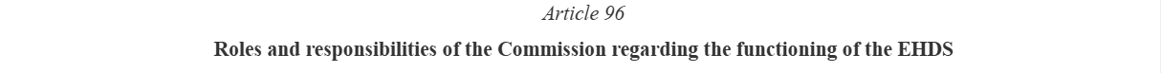
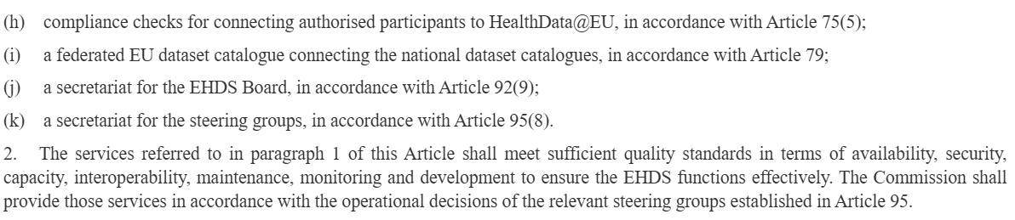
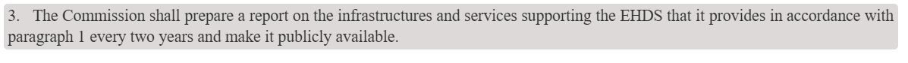
IPARE
[…]

Slide 5
IPARE
[…]

Slide 6
What is IPARE?
. . . or any evidence considered by the said authorities to be equivalent thereto. 3. The competent authorities of the Member States shall notify the Commission before 15 January each year of the total quantities, per
category and third country, which are allocated to beneficiaries . . .

Slide 7
What is IPARE?
. . . or any evidence considered by the said authorities to be equivalent thereto. 3. The competent authorities of the Member States shall notify the Commission before 15 January each year of the total quantities, per category and third country, which are allocated to beneficiaries . . .

Slide 8








What is IPARE?
. . . or any evidence considered by the said authorities to be equivalent thereto. 3. The competent authorities of the Member States shall notify the Commission before 15 January each year of the total quantities, per category and third country, which are allocated to beneficiaries . . .
PROVIDING ENTITY: the competent authorities of the Member States
TARGET ENTITY: the Commission
DEADLINE: 15-01-?
FREQUENCY: annually

Slide 9





What is IPARE?
Information provision activity is how a PROVIDING ENTITY communicates or provides information to a TARGET ENTITY. The PROVIDING ENTITY is (or may be) obliged to perform an information-providing activity, which involves systematic or one-time actions such as reporting, disclosing, notifying, providing, certifying, publishing or transferring information. We distinguish between primary and secondary information, where the former includes information on the key actors involved, information/activity type, and activity-related DEADLINE and FREQUENCY, whereas the latter encompasses details such as language and format of information, information process-related technicalities, detailed descriptions of the to-be-provided information that go beyond primary information, etc.

Slide 10





How do you run an IPARE?
Detection (subtask 1)
Given a text fragment, determine whether it contains a mention of information provision activity, and more precisely mentions of primary information.
Extraction (subtask 2)
Given a text fragment mentioning information provision activity, extract primary information on the providing and target entities, frequency, and deadline if present in the text.

Slide 11
What is the benchmark for IPARE?
1212
sentences
~40
average sentence length
(in words)
90%
annotator
agreement
43.2%
keyword + deadline/frequency
19.7%
no keyword

Slide 12
What is the benchmark for IPARE?

Slide 13

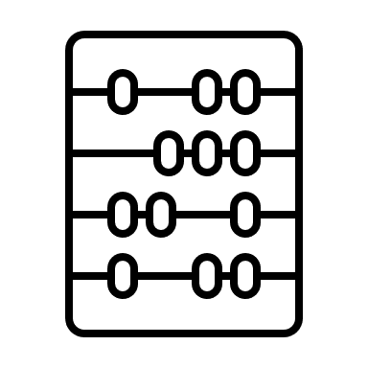



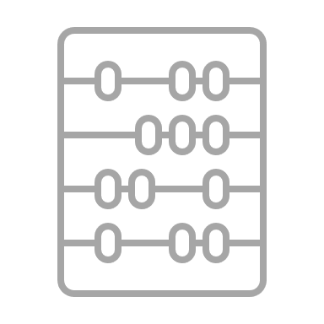

Which technologies did we compare for IPARE?
Detection
Extraction
Baseline
Classical ML
Knowledge-based
LLMs
Transformers
LLMs
Classical ML
Transformers

Slide 14

Which technology might be the most suitable for detection?
classical ML was a close runner-up in terms of performance (F1-score 0.93 vs best LLM 0.95)
faster and easier to maintain
can be improved with more annotated data
can also be improved with more sophisticated features
can be hosted locally
Classical ML

Slide 15
Which technology is the most suitable for extraction?
+
Knowledge-based
LLMs

Slide 16
Why the hybrid technology for extraction?
The knowledge-based approach is more precise in judgment
but might miss some fields.
LLMs might struggle with standardization/formatting which is crucial for interoperability (e.g., no later than 15 January -> 15-01-?).
There should be a combination of the two.
Alternatively, the approach can be selected based on the use case, after considering the desired metric, speed, cost, environmental footprint etc.
+
Knowledge-based
LLMs

Slide 17



How much energy do LLMs consume?
Luccioni et al. also reported that generating an average of 10 tokens (~7 words) 1000 times across 6 tasks consumed ~0.047-0.049 kWh, on average. An equivalent of (over) two average, fully charged smartphones [1].
.
.
.
.
x 1000
≈

Slide 18
How much energy do LLMs consume?
Very difficult to estimate (training + inference consumption) [1][2][3]
More aspects of LLM consumption (additional 15% for Mistral Large 2) [3]
Generative tasks require more energy than discriminative tasks (e.g., IPARE detection) [1].
Multi-purpose models require more energy than single-task models
(30 times more for text classification per 1000 queries) [1][2].

Slide 19





What about energy consumption for IPARE?
Observation 1
Detection
<
Extraction
Observation 2
≈
≈
<
<
Baseline
Knowledge-based
Classical ML
Transformers
LLMs

Slide 20


How can we minimize IPARE inference costs?
A hybrid solution can lower the financial cost, speed, and carbon footprint* in production
costs* in production
LLM inference is expensive but requires less annotated data
+
Classic ML is cheaper and consumes less power in production but requires more data annotation
Annotation takes time
annotated data

Slide 21
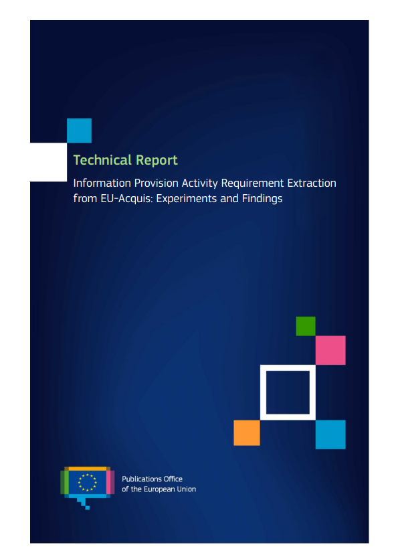
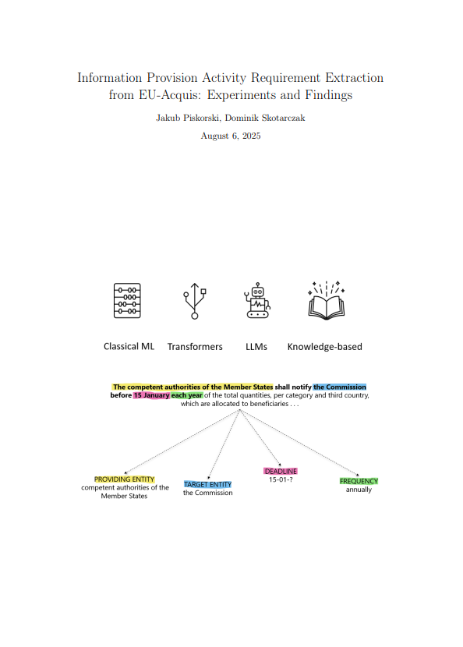
Full Technical Report

Slide 22
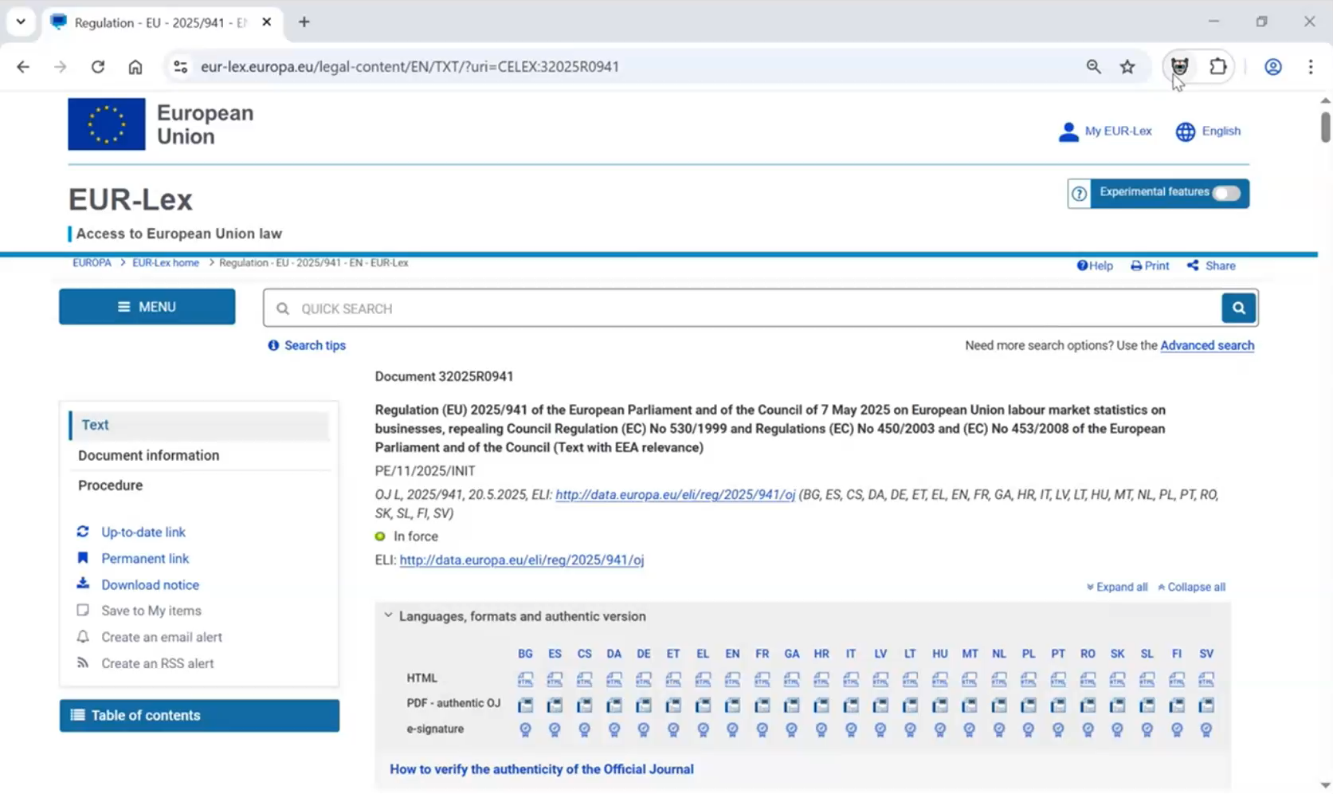
Use Case Demo

Slide 23
Sources
[1] Luccioni, S. and Jernite, Y. and Strubell, E. Power Hungry Processing: Watts Driving the Cost of AI Deployment?. Association for Computing Machines. 2024.
[2] S. Luccioni, B. Gamazaychikov, S. Hooker, R. Pierrard, E. Strubell, Y. Jernite & C.-J. Wu. Light bulbs have energy ratings — so why can’t AI chatbots? Nature, 2024.
[3] Mistral AI. Our contribution to a global environmental standard for AI. 2025. Retrieved from https://mistral.ai/news/our-contribution-to-a-global-environmental-standard-for-ai on 3 September 2025.

Slide 24

Thank you!
Full Technical Report
Jakub.Piskorski@ec.europa.eu
Dominik.Skotarczak@ec.europa.eu

