Slide 1
Zornitsa Manolova – Head of Data Quality Management & Data Science
Dominik Jany – Senior Data Scientist
Global Legal Entity Identifier Foundation (GLEIF)
Training a legal form classifier on LEI reference data

Slide 2

Who is GLEIF?
GLEIF is a not-for-profit Swiss foundation, founded by the Financial Stability Board (FSB).
GLEIF is overseen by the Regulatory Oversight Committee (ROC) with
  65 regulators and
  19 observers
  from 50 countries
GLEIF Board has 15 independent directors.
GLEIF makes available the LEI data free of charge.
Partners for LEI Issuing (LOUs)
38
and growing
Issued LEIs to date
> 3 millions
Training a legal form classifier on LEI reference data

Slide 3
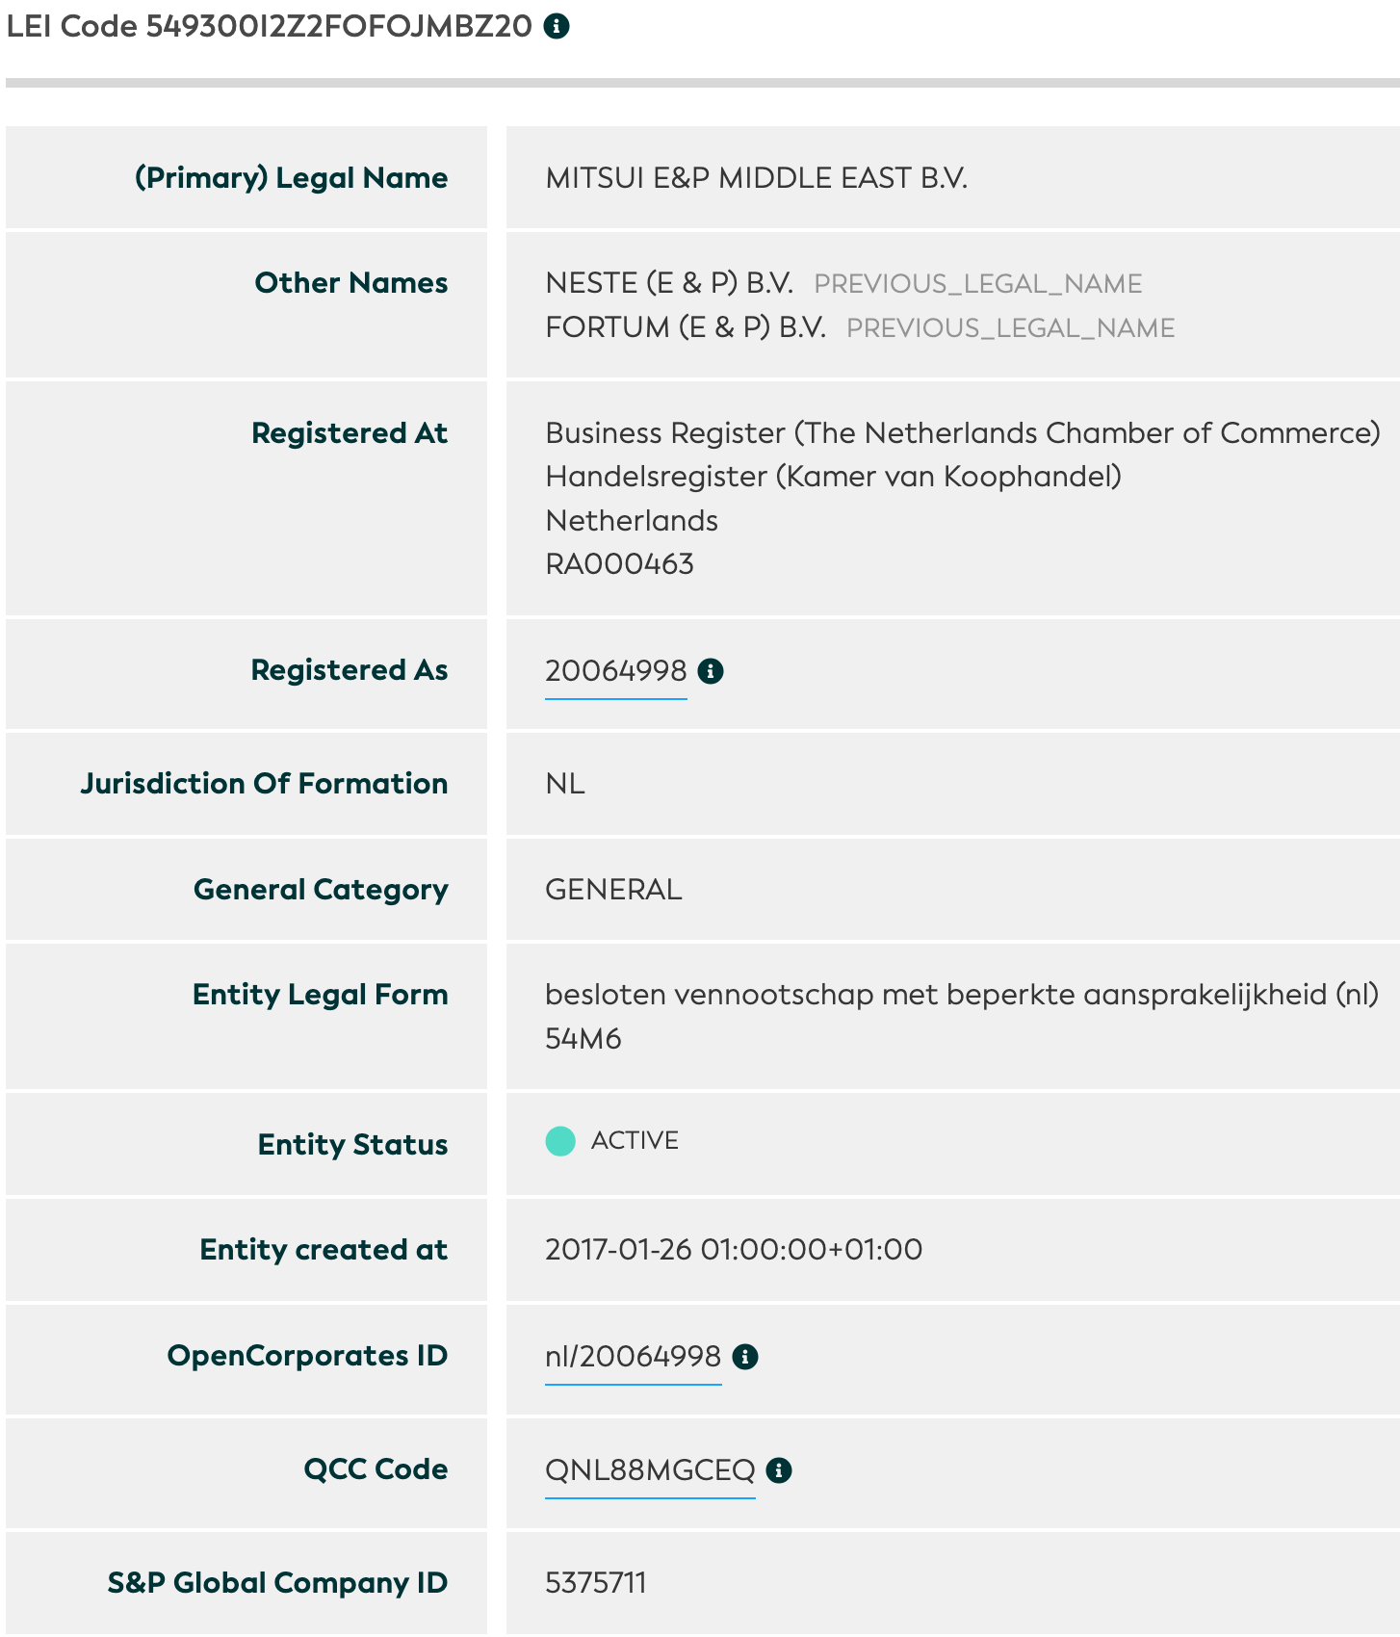
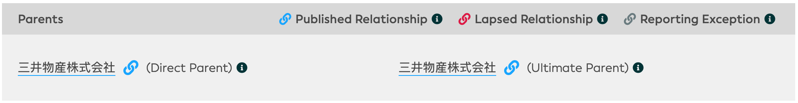
Legal Entity Identifier (LEI) Reference Data
"Level 1"
"Level 2": Direct & ultimate parents & fund relationships
Who is who? Who owns whom?
LEI Data is available free of charge in various formats:
GLEIF API: https://api.gleif.org/docs
LEI Search: https://search.gleif.org
Golden Copy: https://www.gleif.org/en/lei-data/gleif-golden-copy
Training a legal form classifier on LEI reference data

Slide 4
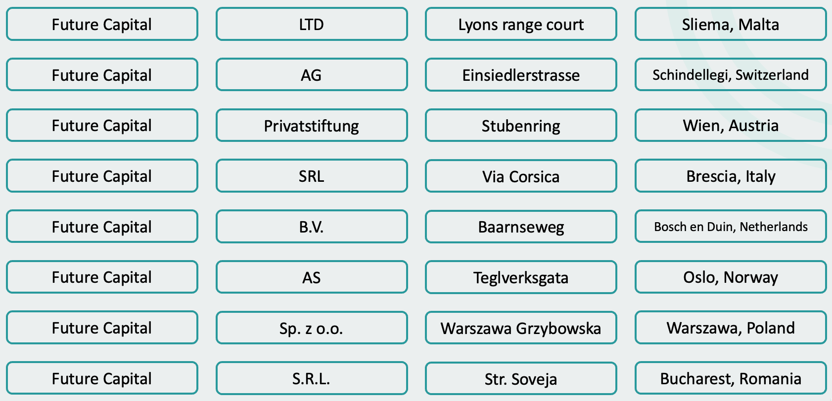
Entity Legal Forms
Why are they important?
What is the challenge?
What is the ELF Code List?
Training a legal form classifier on LEI reference data

Slide 5
Identifying Legal Forms – Easy …right?
Finland – Same Legal Form?
Asunto-osakeyhtiö Puistoranta
Asunto Oy Keskiyöntie 22
“Asunto-osakeyhtiö” = “Asunto Oy”
→ ELF Code: V0TJ
Asunto-osakeyhtiö = Housing company
ELF Code to the rescue!
Training a legal form classifier on LEI reference data

Slide 6
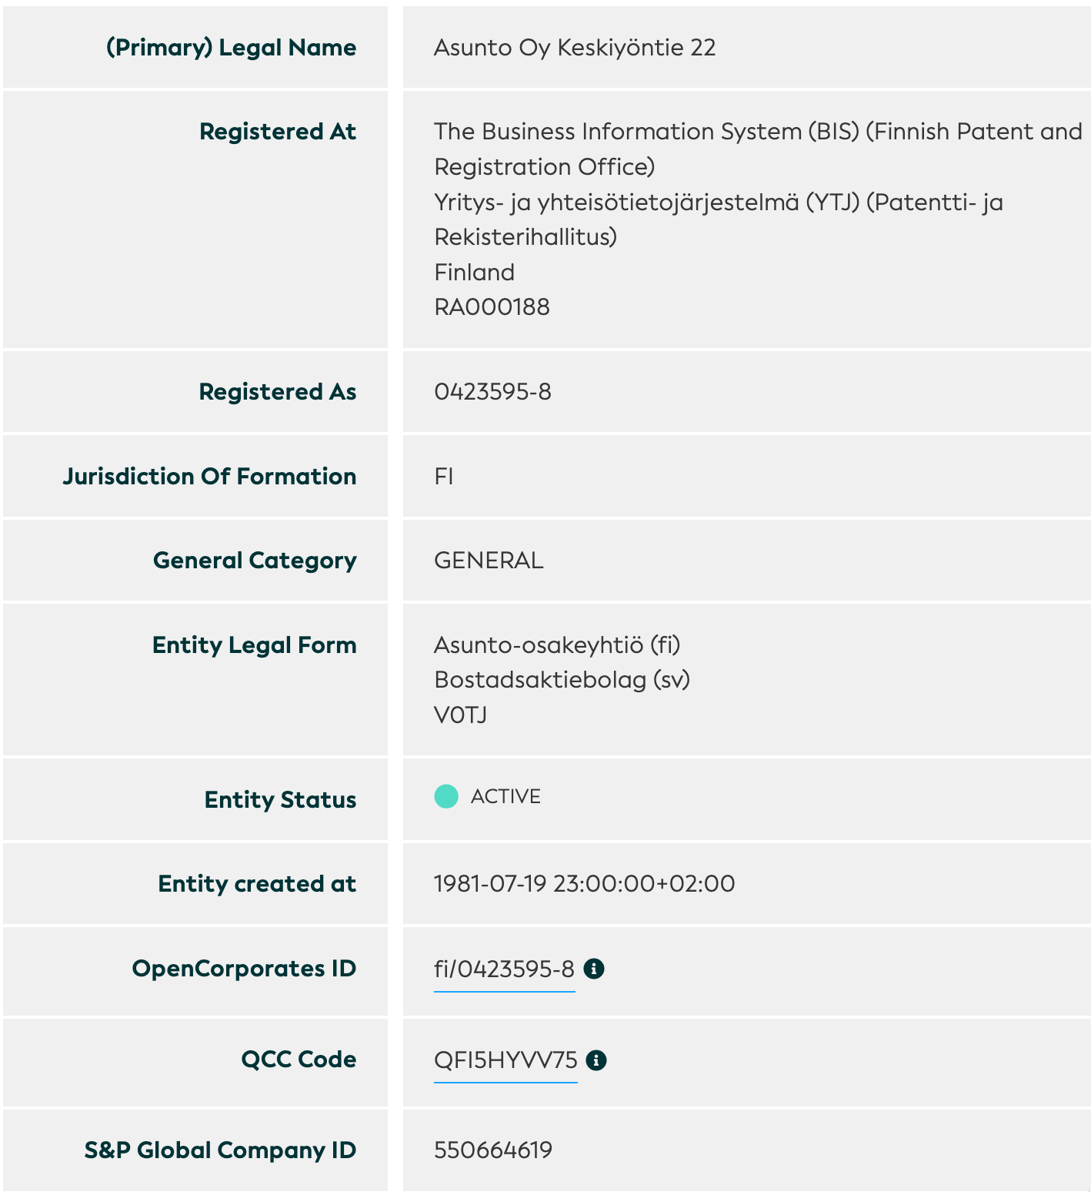
Identifying Legal Forms – Easy …right?
Finland – Same Legal Form?
Asunto-osakeyhtiö Puistoranta
Asunto Oy Keskiyöntie 22
“Asunto-osakeyhtiö” = “Asunto Oy” → ELF Code: V0TJ
Asunto-osakeyhtiö = Housing company
ELF Code to the rescue!
Training a legal form classifier on LEI reference data

Slide 7
ISO 20275 Entity Legal Form Code
A list of all legal forms – in all countries
ELF Codes identify the distinct entity legal forms in a given jurisdiction
  Introduced in November 2017
  Currently 3,297 legal forms in 117 countries (192 jurisdictions)
  GLEIF acts as maintenance agency
  Leveraged local expertise of 38 LEI Issuers
ELF Code | Country of Formation | Jurisidiction of Formation | Entity Legal Form Local Name | Abbreviations Local Language
LNBY | Canada | British Columbia | Limited Liability Partnership | LLP;SRL;SENCRL
JDX6 | Cayman Islands | Cayman Islands | special economic zone company | SEZC
B5UZ | China | China | 事业单位
QRZJ | Italy | Italy | Società Cooperativa | S.C.;soc. coop.
M886 | United States of America | Alaska | Limited Liability Partnership | L.L.P.;LLP
Training a legal form classifier on LEI reference data

Slide 8
Machine Learning Pipeline
Feature Extraction
Train Classifier
Evaluation
Name harmonization
Tokenizing
Legal Form Abbreviations
10-fold Cross-Validation
Stratified shuffling
train-test 70% - 30%
Naive Bayes
Decision Tree
Rule Based
Neural Network
Per jurisdiction:
Technology: python, scikit-learn, pandas
Training a legal form classifier on LEI reference data

Slide 9
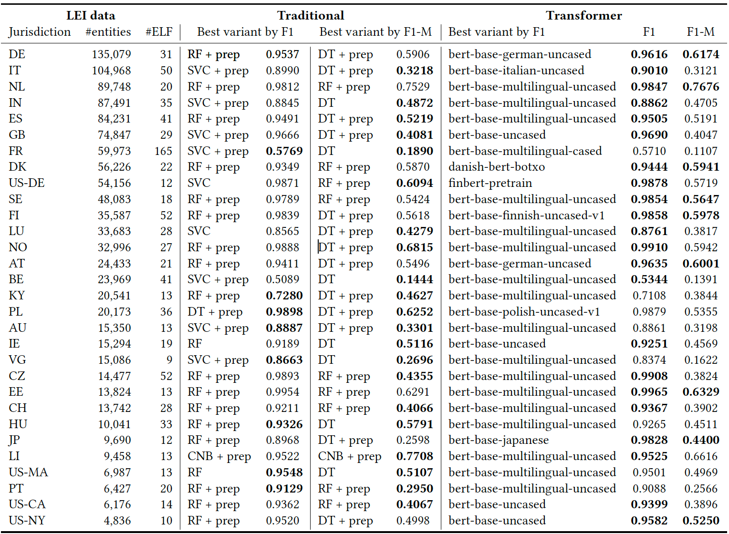
Traditional Machine Learning vs Deep Learning
Paper available at: https://arxiv.org/abs/2310.12766
Models available at: https://huggingface.co/Sociovestix
Training a legal form classifier on LEI reference data

Slide 10
Some examples where the Transformer shines…
Counter example:
Volksbank Odenwald eG
[CLS] 0.00
volksbank 0.09
oden 0.06
##wald 0.17
eg 0.98
[SEP] 0.00
Word attribution calculated by transformers-interpret
Unsere Kinder, unsere Zukunft –
Stiftung der Volksbank Odenwald eG
[CLS] 0.00
unsere 0.11
kinder 0.12
, 0.05
unsere 0.10
zukunft 0.17
- 0.08
stiftung 0.82
der 0.43
volksbank 0.01
oden 0.06
##wald 0.18
eg 0.18
[SEP] 0.00
These show how the Transformer is taking the sequential statistics into account.
Training a legal form classifier on LEI reference data

Slide 11
Traditional Machine Learning vs Deep Learning
Scikit-Learn – Naïve Bayes
Explicit preprocessing necessary
  Name harmonization
  Tokenizing
  Special character handling
→Good results, but limitations regarding:
  Balanced accuracy
  Legal names with non-Latin characters
BERT – Transformer Models
Leverage pre-trained language-specific models
  From the start, the model ”understands” context and tokens within legal names
  No language proficiency necessary
  Fine-tuned on LEI data
→Improvement of balanced accuracy
→Better performance for non-Latin characters
Jurisdiction | F1 Score sklearn | Balanced Acc. sklearn | F1 Score Transformer | Balanced Acc. Transformer | Comments
ES | 0.9429 | 0.4671 | 0.9505 | 0.5044 | Uncased BERT works best, as >90% of ES entities are uppercase
JP | 0.2746 | 0.1828 | 0.9826 | 0.4293 | Massive improvement with transformer models
GB | 0.9424 | 0.2716 | 0.9686 | 0.4089 | Transformer improves balanced accuracy
Training a legal form classifier on LEI reference data

Slide 12
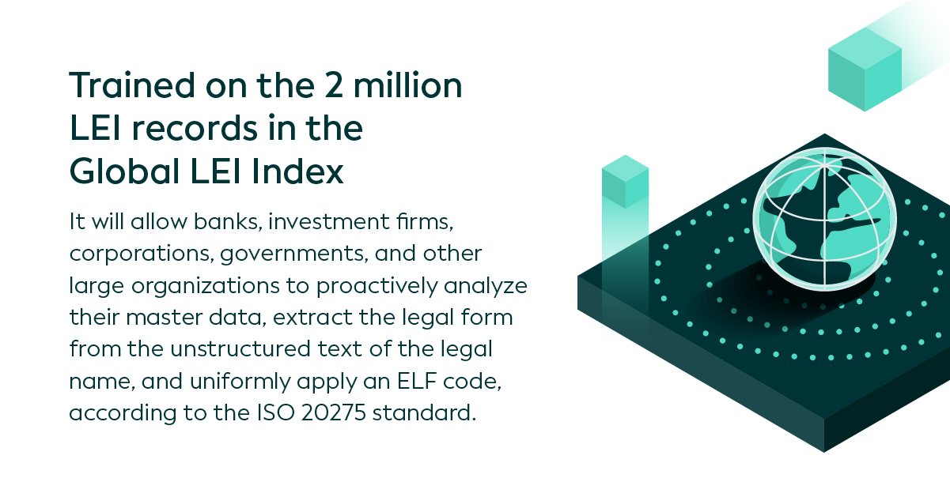

LENU – Legal Entity Name Understanding
Enables Organizations Everywhere to Automatically Detect and Standardize Legal Forms
Developed by GLEIF and Sociovestix Labs
https://github.com/Sociovestix/lenu
Training a legal form classifier on LEI reference data

Slide 13
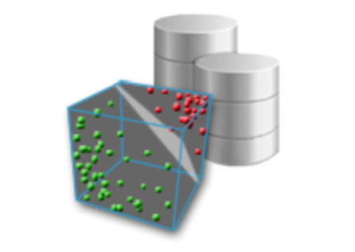
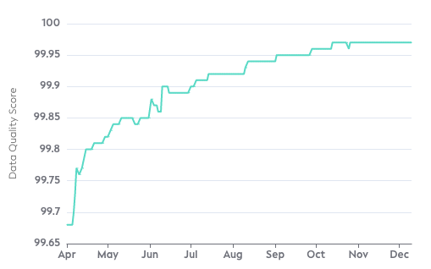

Data Quality Loop
Train and Test Classifier
Inspect Confusion Matrix
Identify
LEI data Challenges
Improve Data Quality
Data Quality Loop
T
F
Records challenged | 7,256
Records updated | 6,088
Overall acceptance rate | 83.9%
T
F
Training a legal form classifier on LEI reference data

Slide 14
Thanks!
LEI Search: https://search.gleif.org
GLEIF API: https://api.gleif.org/docs
Golden Copy: https://www.gleif.org/en/lei-data/gleif-golden-copy
Open Source Tool LENU: https://github.com/Sociovestix/lenu
Models: https://huggingface.co/Sociovestix
Research paper: https://arxiv.org/abs/2310.12766
Questions?

