Slide 1
Nasredine Cheniki¹, Mauro Colavincenzo², Abdelfettah Feliachi³, Didier Hardy⁴, Marc Kuster⁵, Valerio Miceli⁶, David Dowey⁷, Monica Palmirani⁸, Michele Corazza⁹
1-7: Publications Office of the European Union, Luxembourg
8-9: University of Bologna, CIRSFID-ALMA AI, Bologna, Italy
Leveraging LLMS to convert unstructured documents to a structured format

Slide 2
Outline
Introduction: Objectives of the AI4XML project.
Problem Statement
The challenge
LLM-based approach
LLM-based approach - LLM programs
Experiments
Discussion
Conclusion & Future Work
Leveraging LLMS to convert unstructured documents to a structured format

Slide 3


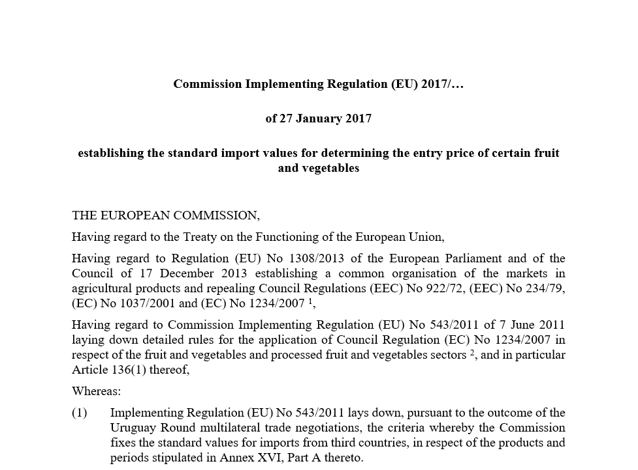
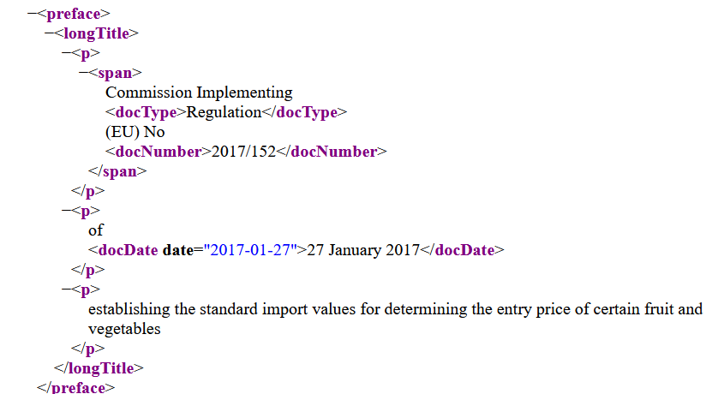
Introduction: Objectives of the AI4XML project
proofreaders
OJ signed PDF
OJ XML (formex)
OJ XHTML
OJ metadata
OJ signed PDF
OJ XML (AKN4EU)
OJ XHTML
OJ metadata
Production agents
Publication & validation
Metadata
EURLEX
OP Portal
External clients
Cellar
SeTA
Internal repository
EU
Institutions
OJ publication systems
OJ manuscript
SeTA
Internal repository
Data
AI4XML project
Printer
External contractor
OJ XML
(AKN4EU)
OJ final
manuscript
OJ PDF
OJ XML (formex)
OJ final
manuscript
AI4XML project Objective :
  Usage of AI, particularly Generative LLMs models,
  to automate the XML (AKN4EU) generation.
Objectives :
  Usage of AI, particularly Generative LLMs models, to automate the XML (AKN4EU) generation.

Slide 4



Introduction - The Challenge
Problem: Effective document structuring is vital for interoperability.
  Important for inter-institution communication at EC
Traditional Limitation: Rule-based methods (e.g., regex) struggle with flexibility and evolving standards, and struggle with multilingual support.
Opportunity: Large Language Models (LLMs) offer advanced capabilities like contextual understanding and semantic parsing.
Leveraging LLMS to convert unstructured documents to a structured format

Slide 5
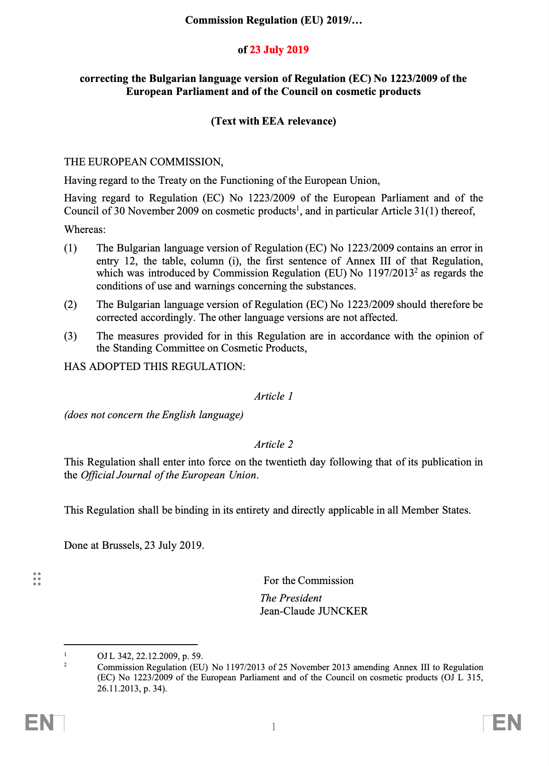
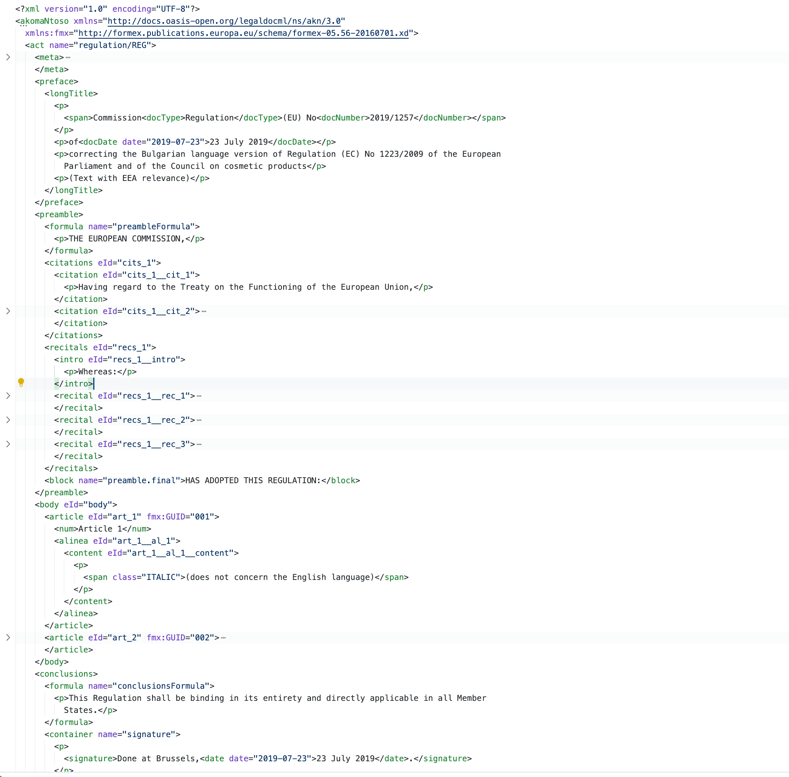
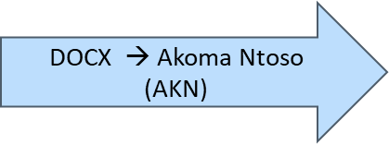
Introduction - The Challenge
<preface>
preface
</preface>
<preamble>
preamble
Body (articles)
</preamble >
<body>
conclusion
</body>
<conclusion>

Slide 6
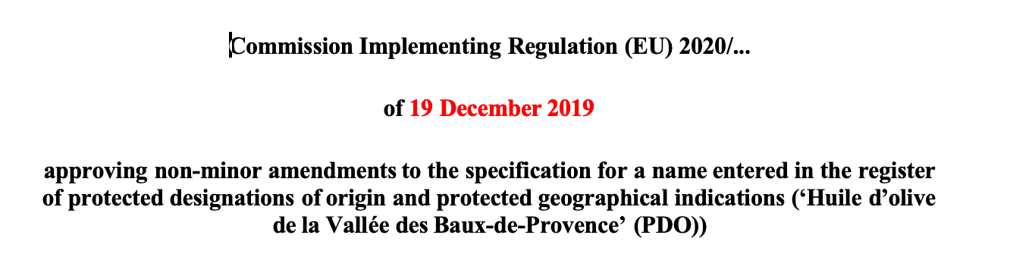
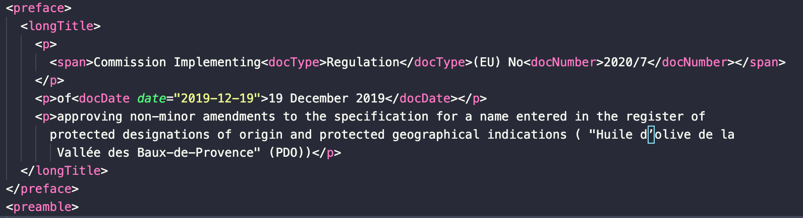
Introduction - The Challenge
Preface example
DOCX
AKN
Leveraging LLMS to convert unstructured documents to a structured format

Slide 7
LLM-based Approach
Objective:
  Enable intelligent, scalable structuring of complex documents—particularly in the legal domain—using LLMs.
Key Challenges:
  Complex DOCX Structures: Legal documents often include deeply nested elements, inconsistent formatting, and mixed content types.
  Context Limitations: Processing documents that span hundreds of pages exceeds typical context windows of LLMs.
Our Approach:
  Modular Decomposition: Break large documents into semantically coherent, manageable components.
  LLM-Orchestrated Structuring: Each component is processed using a tailored LLM prompt pipeline.
  Few-Shot, In-Context Learning: Dynamically adapts to new document styles without retraining.
  Schema Compliance: Ensures output consistency through integrated XML schema validation.
Leveraging LLMS to convert unstructured documents to a structured format

Slide 8
LLM-based Approach - LLM Programs
Leveraging LLMS to convert unstructured documents to a structured format

Slide 9
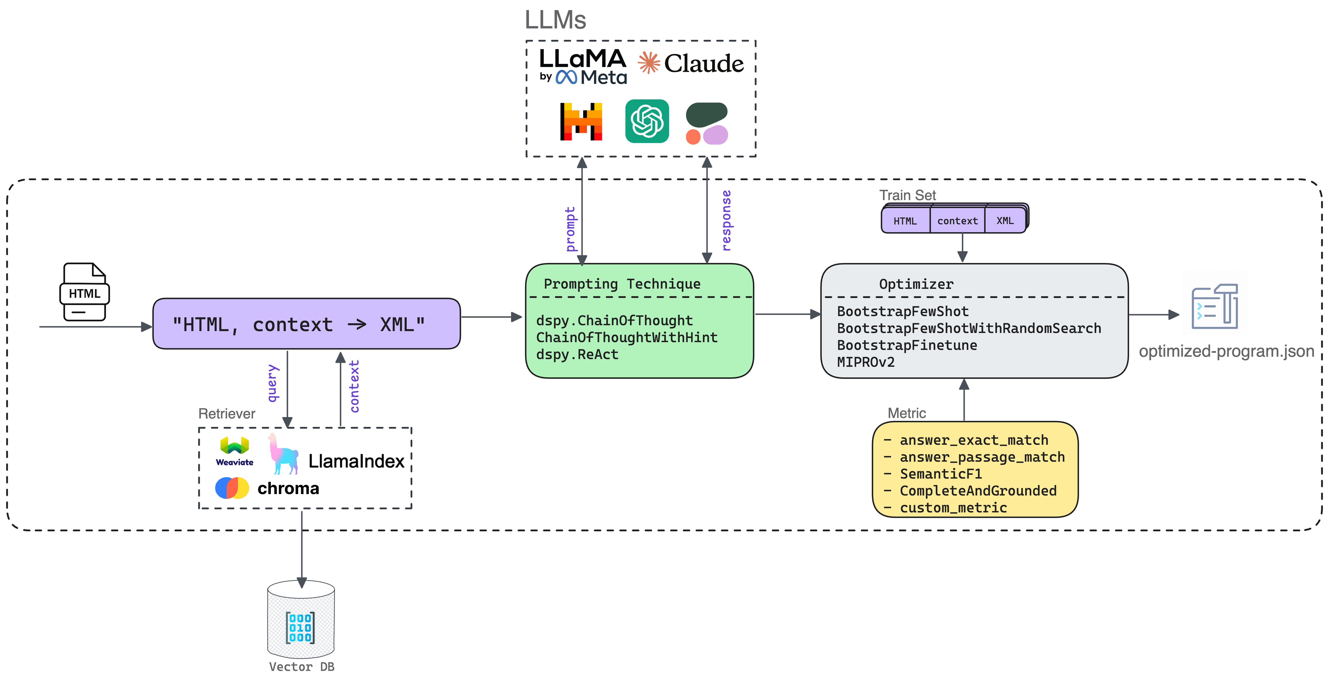
LLM-based Approach - LLM Programs
Leveraging LLMS to convert unstructured documents to a structured format

Slide 10
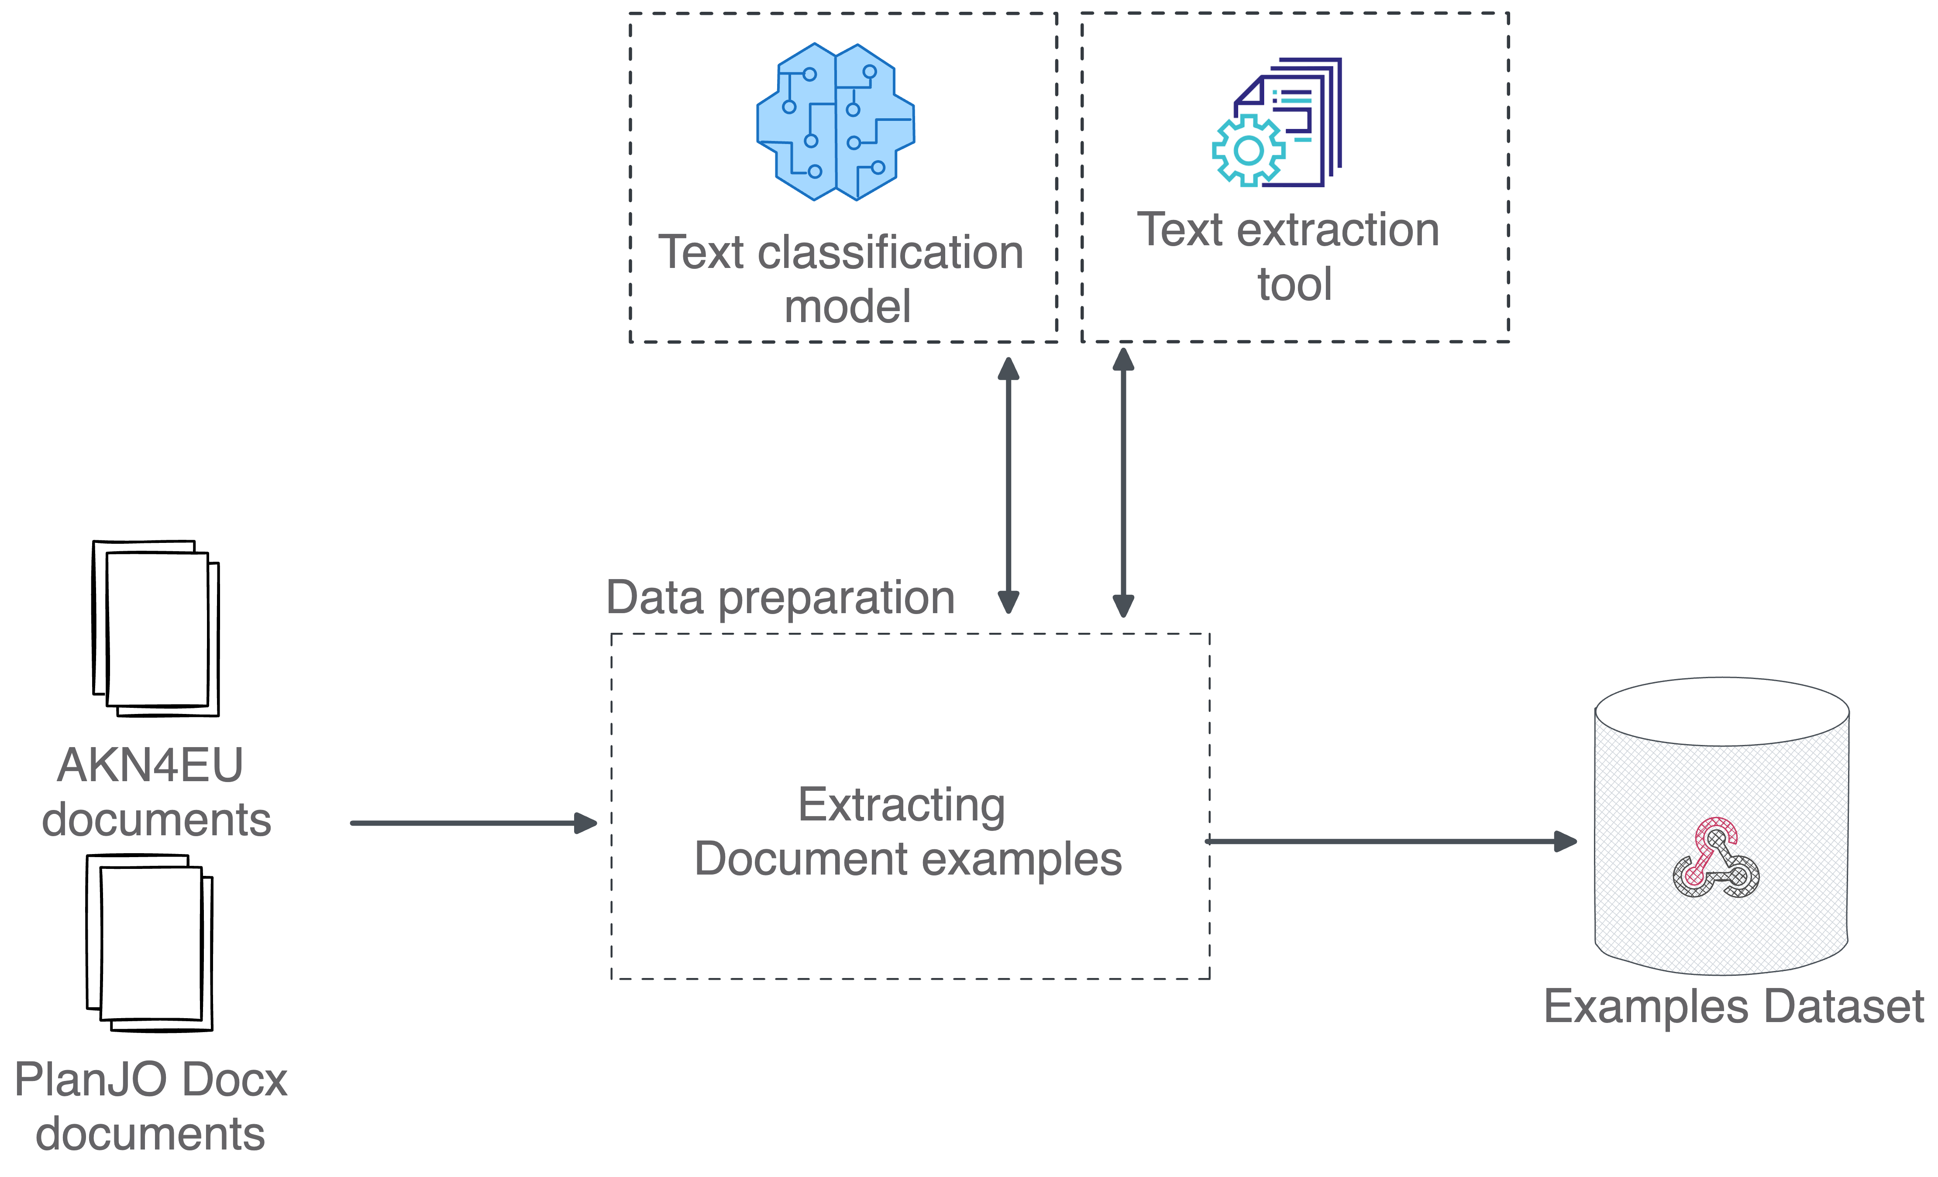
Experiments - Setup
Dataset : Paired Legal Document Collection
  PlanJO : Original Word documents
  GenAI4Lex dataset : Corresponding Akoma Ntoso (AKN) XML versions
LLMs
  4 Mistral models
  3 LLAMA models
Optimizers
  Bootstrap Few Shot with Random Search
    max_labeled_demos= 8 (shots)
    num_candidate_programs = 5
  MiproV2
    minibatch_size= 35
    num_trials = 30
Context:
  No context provided to the model (for upcoming experiments)
Metric: Custom Composite Metric:
  XML Validation: Ensures structural integrity
  AKN Schema Validation: Confirms compliance with Akoma Ntoso standard
  ROUGE-L Scoring: Measures sequence-based similarity
Leveraging LLMS to convert unstructured documents to a structured format

Slide 11
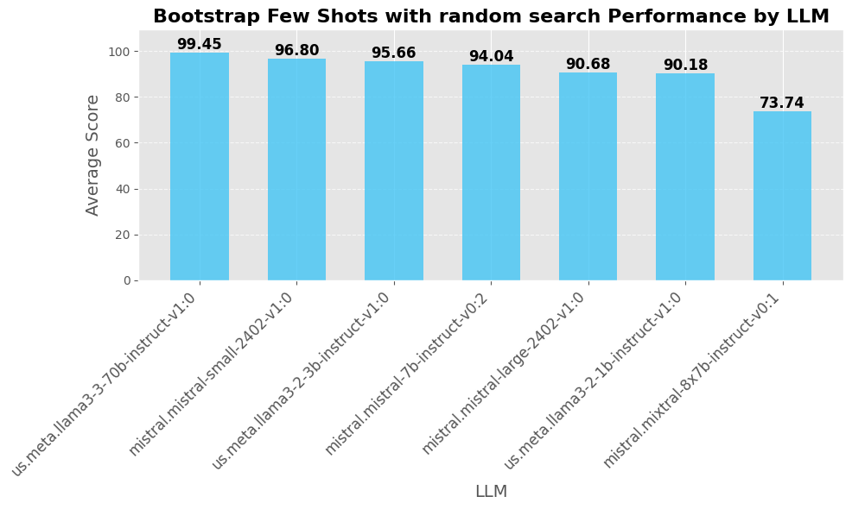
Experiments - Results (Preface)
Leveraging LLMS to convert unstructured documents to a structured format

Slide 12
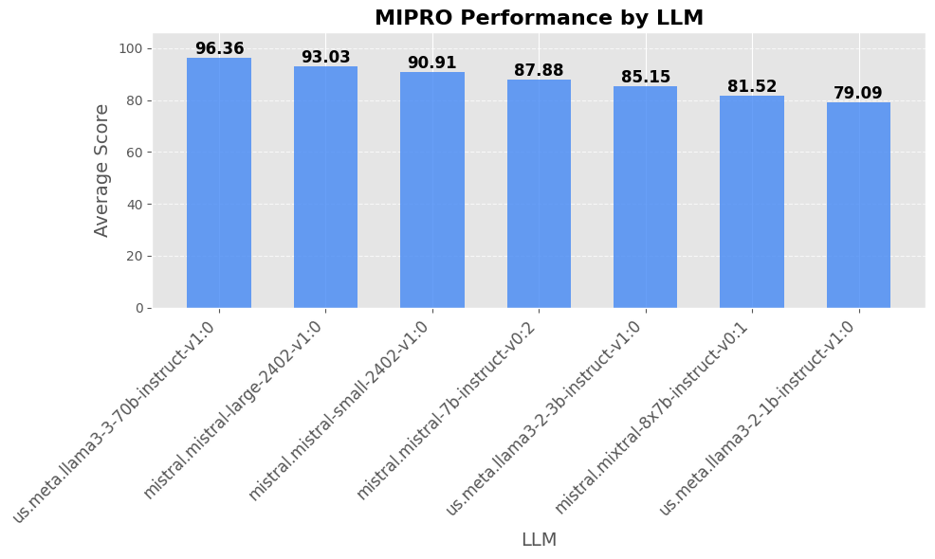
Experiments - Results (Preface)
Leveraging LLMS to convert unstructured documents to a structured format

Slide 13
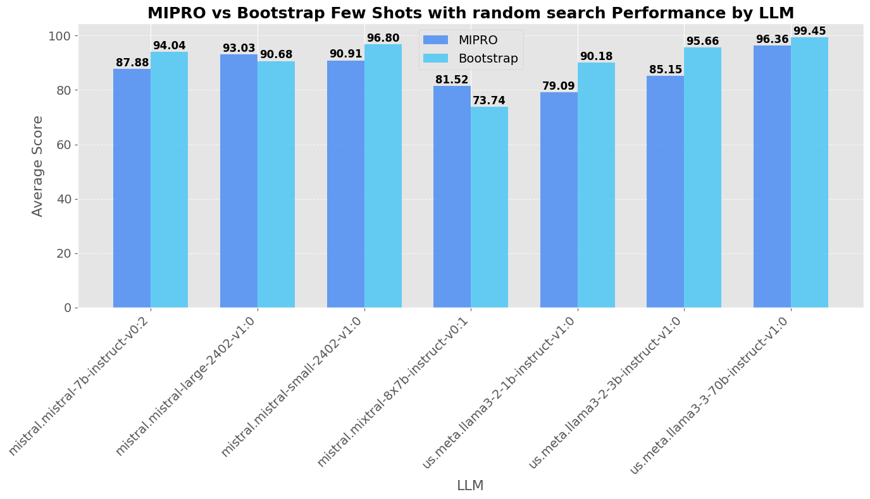
Experiments - Results (Preface)
Leveraging LLMS to convert unstructured documents to a structured format

Slide 14
Experiments - Results Discussion
Can LLMs be used to structure document in AKN format?
  Yes, they can be optimized to generate a valid structured format
Bootstrap outperforms MIPRO on most models (best: 99.45% with Llama3-70B)
Model size impact varies by task complexity
  Larger models perform better overall
  Smaller models remain surprisingly competitive
  Use small models for simple conversion tasks, large models for complex tasks (use LLMs routing)
Optimization approach matters more than model size in some cases
  Bootstrap with Mistral-small (96.8%) outperforms MIPRO with Llama3-70B (96.36%)
Leveraging LLMS to convert unstructured documents to a structured format

Slide 15
Conclusion
Current Achievements (as of today)
  We perform documents conversion with schema validation
    Full prefaces, and preambles,
    Articles with simple lists
    Conclusions part
  We adopted an advanced programmable prompting approach
    Advanced prompt generation
    Modular pipeline allows quick switching to any other dataset, model or schema
Leveraging LLMS to convert unstructured documents to a structured format

Slide 16
Future Work
Objective to the end of the year
    Switch to AKN4EU
    Convert document with complex structures and tags (nested lists, math formulas)
    Include Schematron validation
    Metadata and cross reference support
    Full conversion of simple OJ manuscripts
    Perform experiments with additional LLMs
      Use GPT@EC
      Other providers (from OpenRouter)
Leveraging LLMS to convert unstructured documents to a structured format

Slide 17
Thanks!
Questions ?
Keep in touch via:
  Dr KUSTER Marc Marc.KUSTER@ec.europa.eu
  Head of Unit – OP.D.4 – “Interinstitutional Relations, Innovation, Programming and Compliance”

