Slide 1
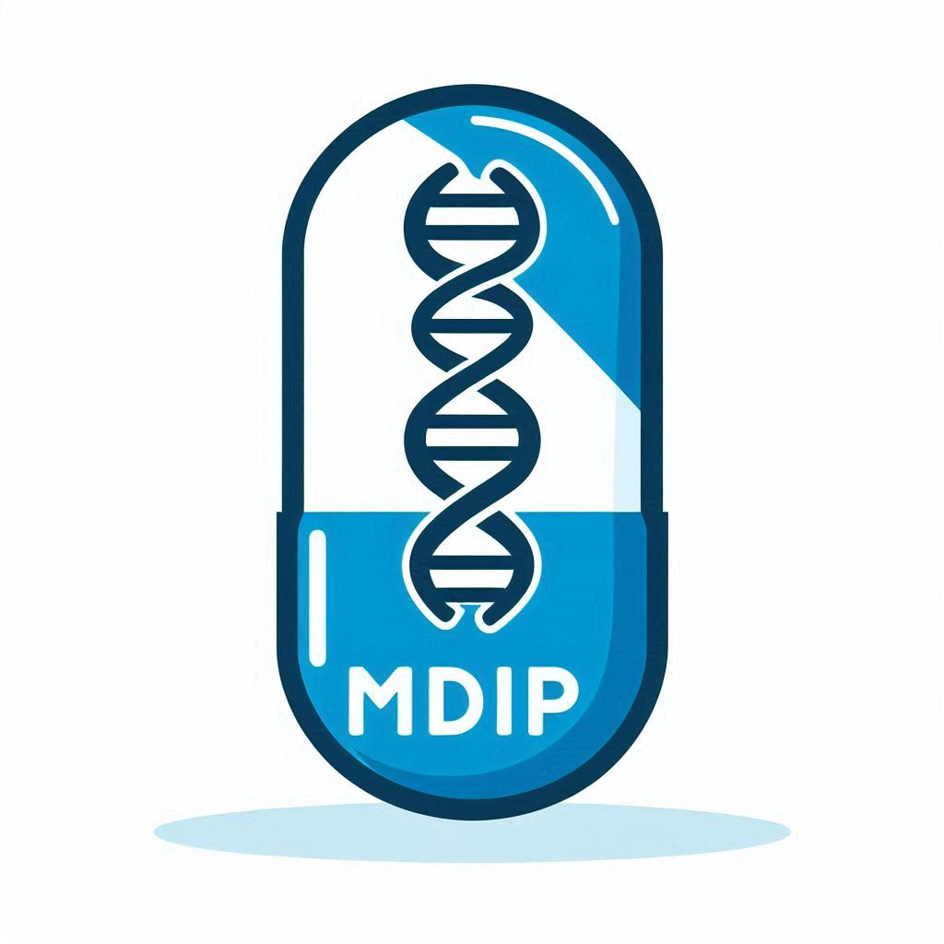
Dermot Doyle
CEO, Dynaccurate
Medications Data Interoperability Project
Combining medications data into a single-source-of-truth

Slide 2






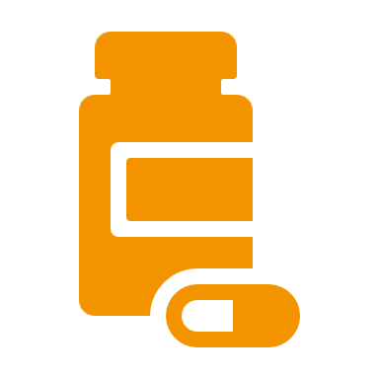
‘Unique Identifiers’ are not unique…
Multiple Stakeholders providing duplicate and different information for exactly the same item…per country
Software, Data & Terminology Vendors
Pharma Companies
Health Providers & Agencies
Regulators
One package of drugs gets…
Stock Code
Clinical Code
ATC Code
Barcode
ATC code
Track & Trace
Formulary Code, Clinical Code, ATC
Regulatory Code, ATC Code
Medications Data Interoperability Project

Slide 3
This is reality, but can we improve on it?
It’s normal for each stakeholder to have own identifiers, formats etc.
We cannot suddenly overwrite legacy information as this breaks data links in pre-existing value chains
However, by gradually promoting and adopting core identifiers, best practice data models and file formats, interoperability is achieved for the long-term.
Unfortunately, current fragmentation is impossible to consolidate.
Medications Data Interoperability Project

Slide 4
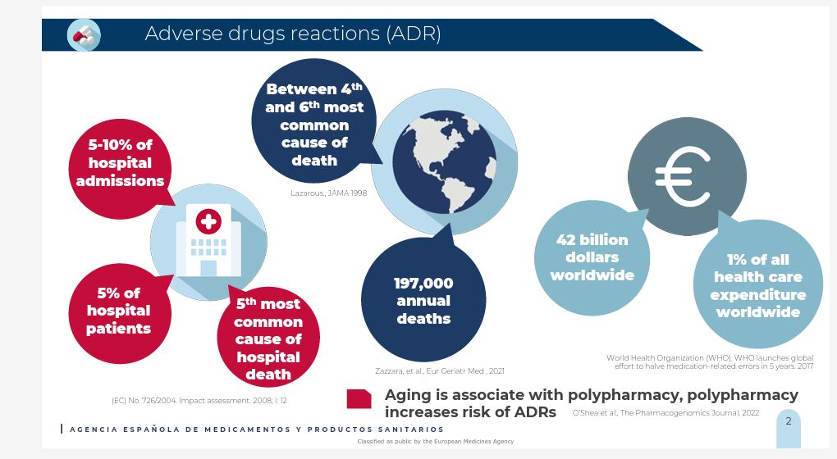
Why so important?
Medications Data Interoperability Project

Slide 5
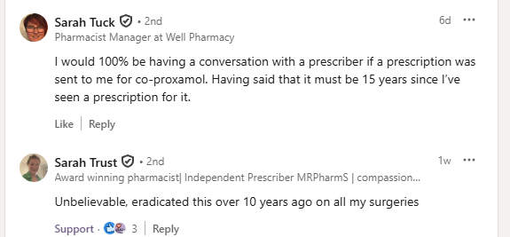
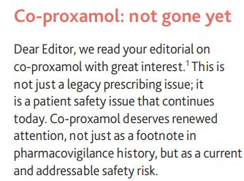
Dangerous drugs still prescribed…
The cost of non-linked data in health - Since its withdrawal, over 200 people have died in the UK due to co-proxamol poisoning and new initiations of co-proxamol are occurring. In 2024 alone, the UK NHS spending on co-proxamol was approximately £2 million before regulatory action. By connecting to a proper database, this would be avoided.
Medications Data Interoperability Project

Slide 6









The vision…
A single, centralised, comprehensive and trustworthy medications index for Europe. For doctors and patients…
Safe Drug Info
National Drug Regulators or Public Database Holders
Medications Data Interoperability Project

Slide 7





Methodology
We used web search, legal instruments, semantic interoperability methods and AI to deliver our project.
Web search
Legal Requests
Data Cleaning
Data Parsing
Artificial Intelligence
Quality Checking
Medications Data Interoperability Project

Slide 8







Specific Barriers faced
Poor Data Formats
Evasiveness
No direct download
(Lot) of time spent on parsers and scripts…
Time spent enforcing Directives…
Workarounds
31 parsers + 5 cleaning scripts + 1 mapping script
3 refusals to share (better) data
Medications Data Interoperability Project

Slide 9
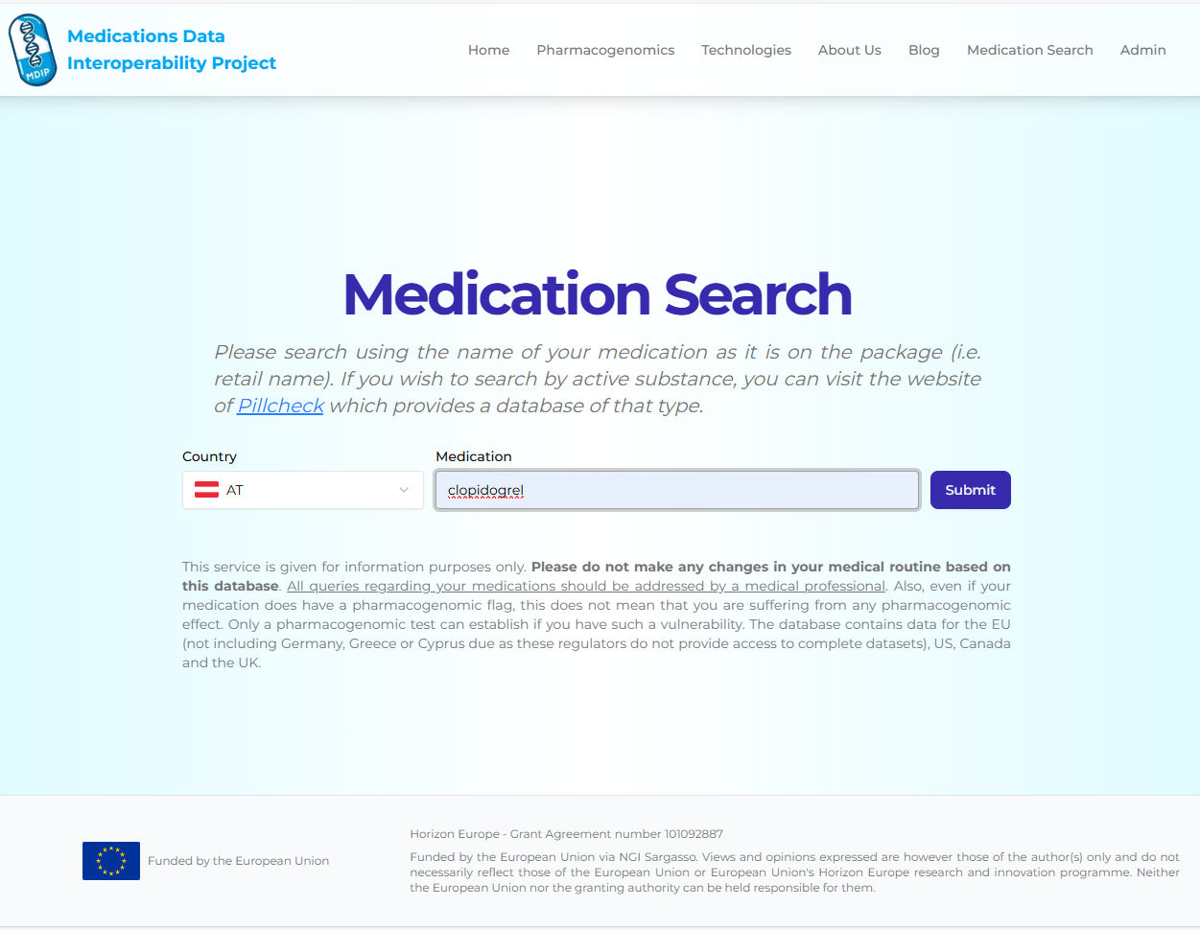
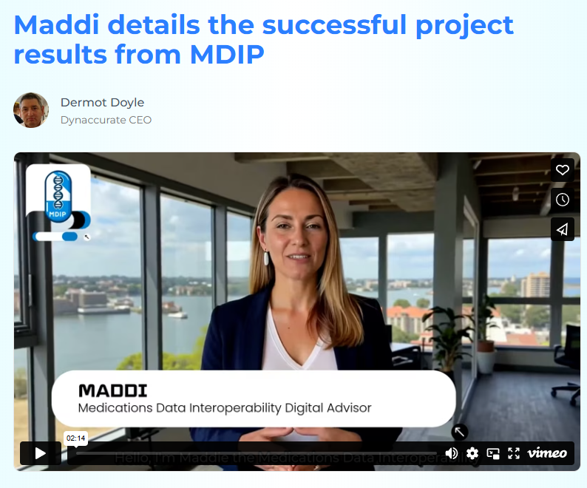
PoC = www.mdip.eu
Effort | Result
Regions in Scope | EU, Cn, UK, US
Records gathered | 950,197
Usable | 930,871
Unusable | 20,115
PGx flag number | 223,152
PGx Percentage | 24%
Searchable DB | Yes
Blockchain | Yes
Open Source | Yes
Completely replicable for larger DB
Medications Data Interoperability Project

Slide 10
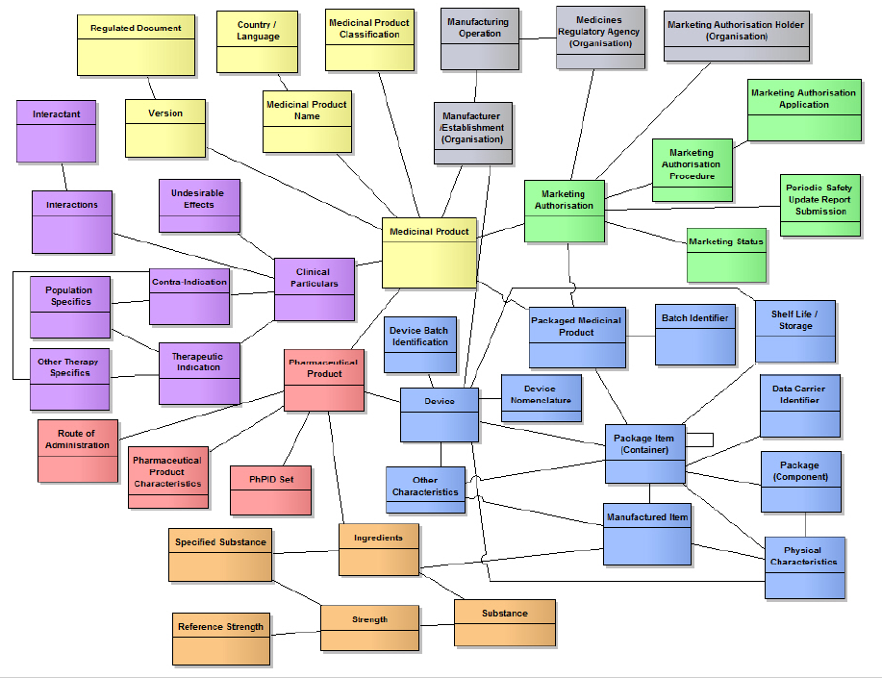
Data universe for medication be like…
Identification of Medicinal Products (IDMP) from the ISO gives us a view of the universe for medications data. There are five different ISO standards involved.
However, not everyone has to supply all data immediately. Accurate data under a few correct headings is enough.
Medications Data Interoperability Project

Slide 11
One good EU DB for medications is completely possible…
Each stakeholder can contribute
Clinical Codes – SNOMED & ICDATC Codes – WHO
Regulatory Codes – Regulators
Barcodes – Manufacturer/Distributor
Packet Info – Manufacturer/Distributor
Dosing Info - Manufacturer/Distributor
Extant Data can be given using ISO IDMP data model headers.
Best practice formats/content
‘Many-to-Many’ data systems cannot work…
‘Many-to-One/Few’ data systems work very well.
Can be offered via the EHDSI Terminology Server. EUR-Lex was a success – this is no different!
Medications Data Interoperability Project

Slide 12
Thanks!
Dermot Doyle, Dynaccurate
Website – www.mdip.eu

