Slide 1
Denis Dechandon, Anikó Gerencsér, Vassilis Tzouvaras
Publications Office of the European Union
EU Vocabularies:
Enhancing Data Management and Interoperability for
EU Institutions and Data Spaces

Slide 2
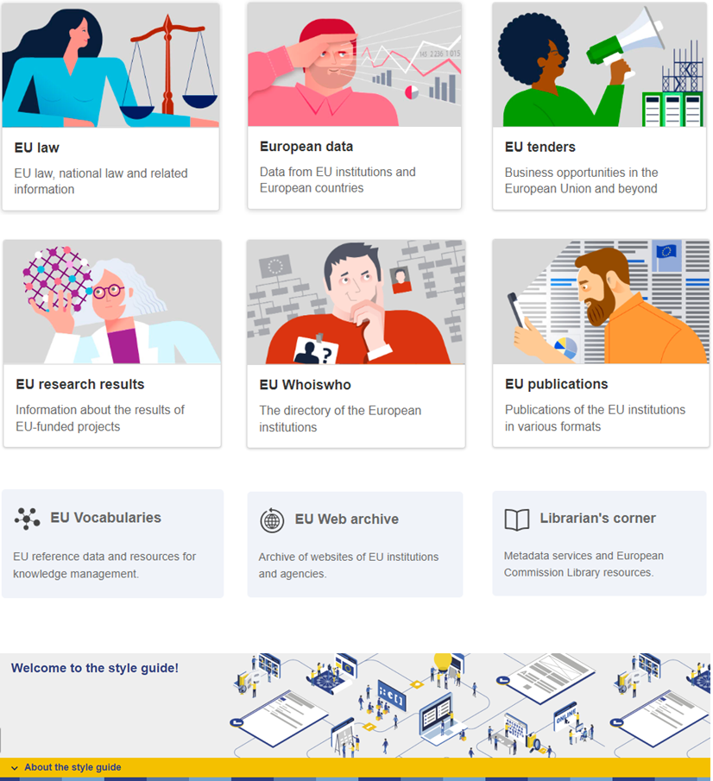

Who we are
The Publications Office of the European Union (OP)
The official publisher for all EU institutions, bodies and agencies
Multilingual expertise
Based in Luxembourg, working across all 24 official EU languages
EU Vocabularies: Enhancing Data Management and Interoperability for EU Institutions and Data Spaces

Slide 3
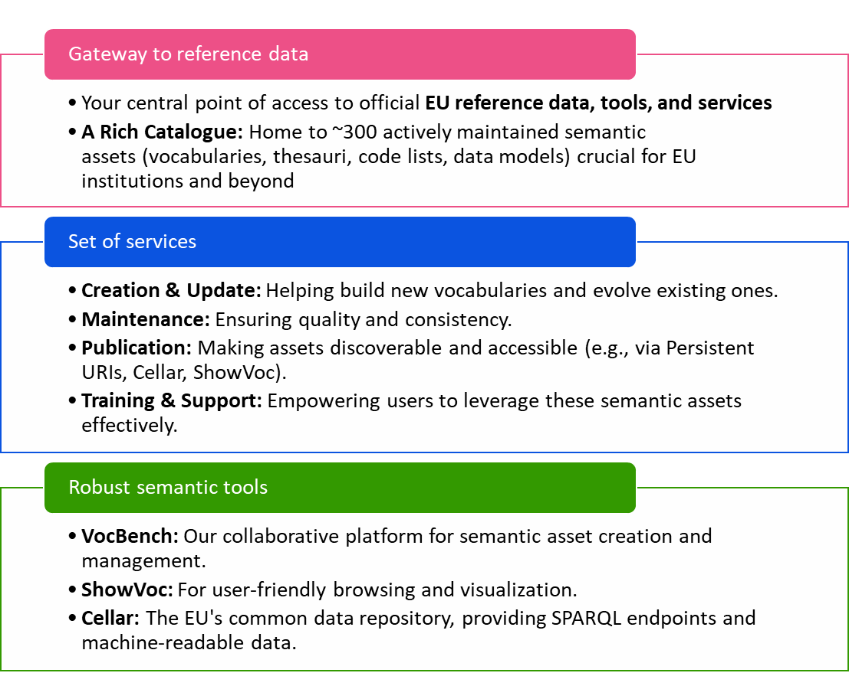
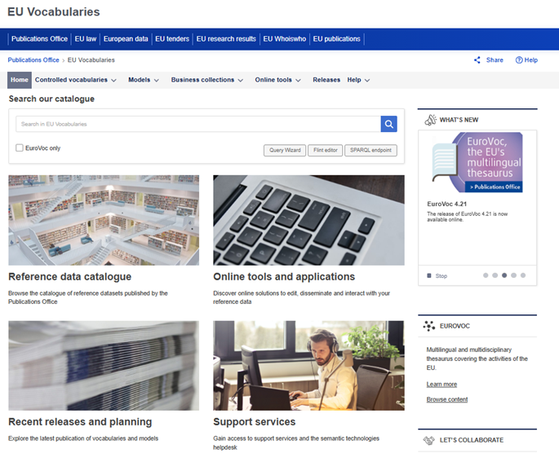
Publications Office of the European Union
EU Vocabularies
EU Vocabularies: Enhancing Data Management and Interoperability for EU Institutions and Data Spaces

Slide 4
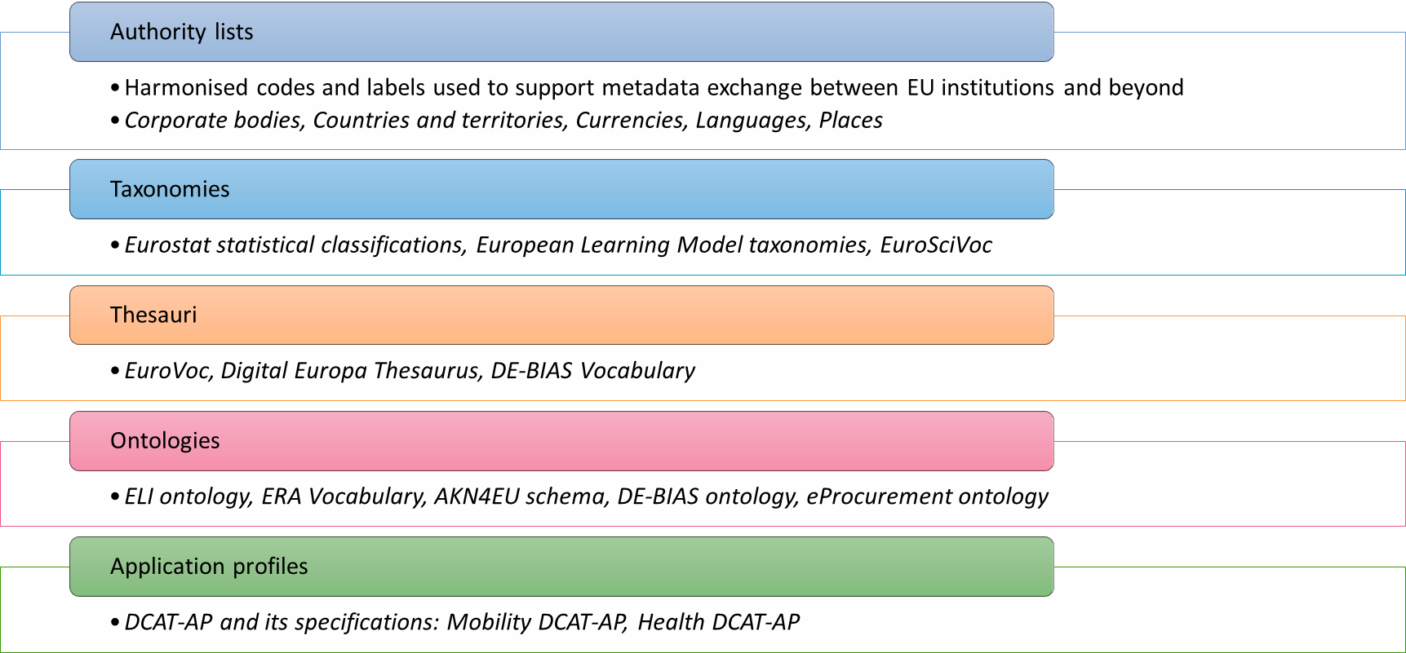
Semantic assets
EU Vocabularies: Enhancing Data Management and Interoperability for EU Institutions and Data Spaces

Slide 5
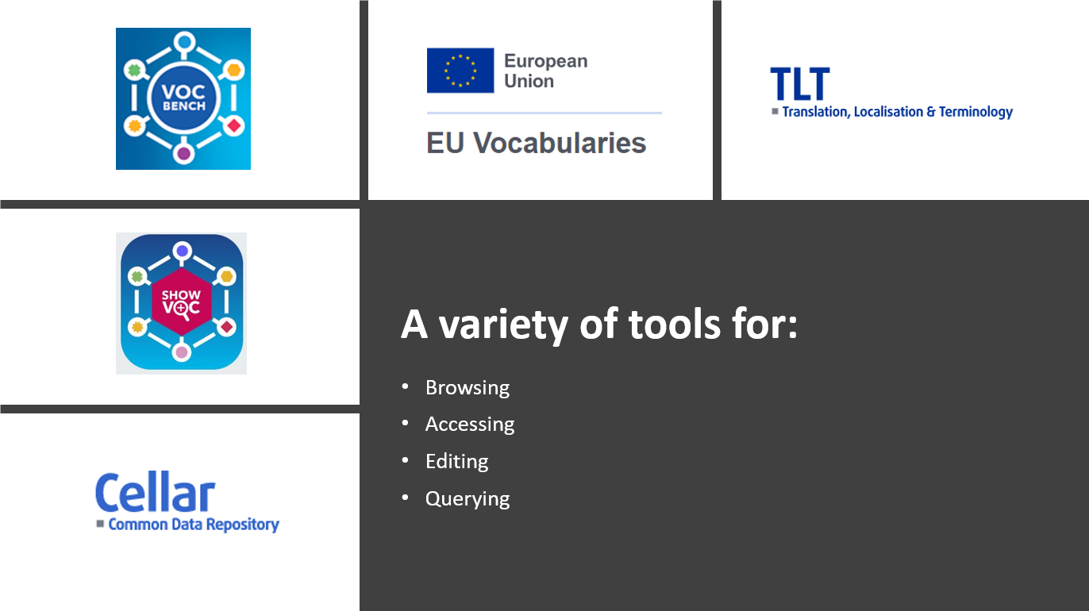
EU Vocabularies: Enhancing Data Management and Interoperability for EU Institutions and Data Spaces

Slide 6

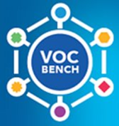
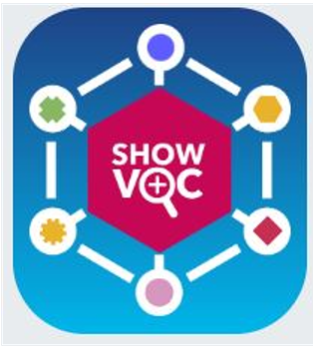
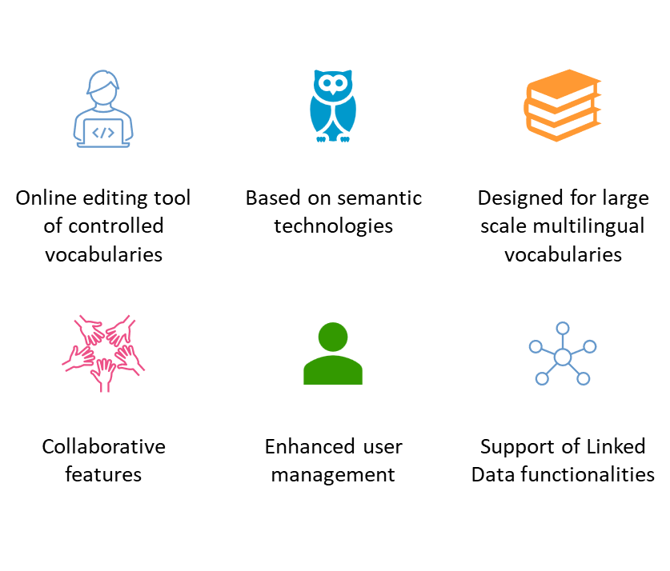
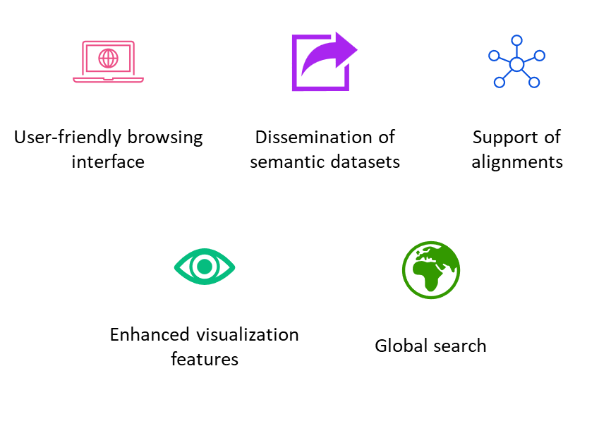
Maintenance and visualisation tools
EU Vocabularies: Enhancing Data Management and Interoperability for EU Institutions and Data Spaces

Slide 7
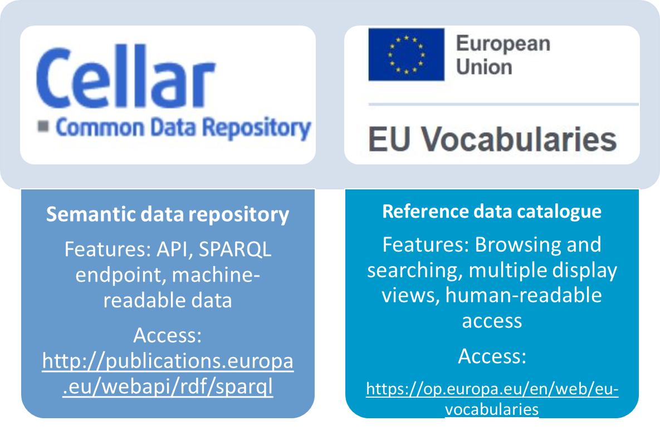
Publication platforms: Cellar and EU Vocabularies
Additionally: https://data.europa.eu/ - the central point of access to European open data from international, European Union, national, regional, local and geodata portals
EU Vocabularies: Enhancing Data Management and Interoperability for EU Institutions and Data Spaces

Slide 8
EU Vocabularies and Data Spaces
EU Vocabularies provides the essential semantic infrastructure necessary for data interoperability across European Data Spaces.
The controlled vocabularies standardise terms and meanings, facilitating smooth communication, integration, and reuse of reference data. Here is the specific value of reference data to selected Data Spaces:
    Legal
    Public Procurement
    Cultural Heritage
    Mobility
    Health
EU Vocabularies: Enhancing Data Management and Interoperability for EU Institutions and Data Spaces

Slide 9
Legal Data Space
ELI & Euvoc Ontologies
The Legal Data Space relies on multiple ontologies (ELI Ontology, ELI Impact Ontology, ELI Draft Legislation Ontology, Euvoc Ontology) published on the EU Vocabularies platform and on data.europa.eu to model legislation and case-law metadata
Controlled reference data
Publication of AKN4EU schema on EU Vocabularies
Reuse of authoritative code-lists for places, corporate bodies, resource types, modification types and subdivisions ensure consistent classification across Member States.
EU Vocabularies: Enhancing Data Management and Interoperability for EU Institutions and Data Spaces

Slide 10
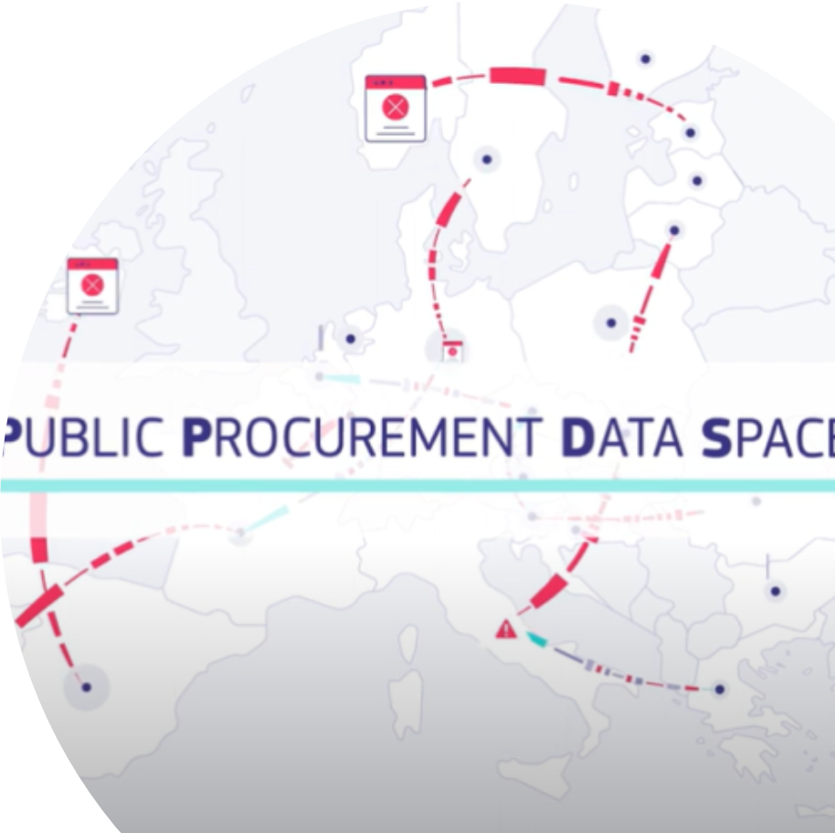
Public Procurement Data Space
eProcurement Ontology (ePO)
All PPDS data is mapped to the eProcurement Ontology URIs managed by the Publications Office, providing a shared model for procurement metadata
Rich controlled vocabularies
Over 60 code-lists (CPV, NUTS, ISO country/currency codes, notice types, etc.) are published on the
EU Vocabularies platform and used in TED notices to ensure consistency across Member States.
Business collection page: https://op.europa.eu/en/web/eu-vocabularies/e-procurement
Creation of new controlled vocabularies: entity status (ongoing)
EU Vocabularies: Enhancing Data Management and Interoperability for EU Institutions and Data Spaces

Slide 11
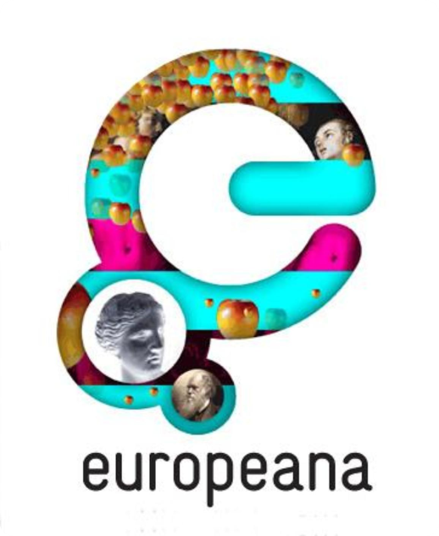
Cultural Heritage Data Space
DE-BIAS vocabulary on EU Vocabularies
The DE-BIAS Vocabulary and its companion Ontology are published as SKOS datasets on the platform, providing ~700 flagged terms (5 languages) with contextual notes and neutral alternatives.
Integrated bias check
During enrichment, the DE-BIAS tool calls those SKOS URIs to detect harmful/derogative descriptors, display explanations to curators, and suggest inclusive replacements—so collections become both interoperable and ethically described before they go live on the Europeana website.
EU Vocabularies: Enhancing Data Management and Interoperability for EU Institutions and Data Spaces

Slide 12

Mobility Data Space
ERA Vocabulary: The Mobility Data Space leverages the ERA ontology - published on EU Vocabularies - to model transport entities (rail networks, infrastructure, services) https://op.europa.eu/en/web/eu-vocabularies/era
Mobility DCAT-AP: Datasets in the Mobility Data Space conform to a specialised DCAT-AP profile (Mobility DCAT-AP) hosted on data.europa.eu, ensuring consistent metadata structures across modes and jurisdictions
The Frequency Authority Table is used by the mobility DCAT-AP and has been adapted appropriately to meet the needs of the Data Space - so “hourly,” “every 15 min” and similar terms are linked to standardised URIs for unambiguous interpretation. Frequency - EU Vocabularies - Publications Office of the EU
EU Vocabularies: Enhancing Data Management and Interoperability for EU Institutions and Data Spaces

Slide 13

Health Data Space
Health DCAT-AP
A specialised DCAT-AP profile adds new health-specific properties and controlled vocabularies (e.g., data permit categories, access-body registry, provenance, lineage). Published as SKOS datasets on data.europa.eu (Health DCAT-AP)
eHDSI Central Terminology System
Controlled vocabularies underpin the Central Terminology System (eHDSI) and the HealthData@EU platform, ensuring semantic consistency across medical records, prescriptions, and health datasets.
EU Vocabularies: Enhancing Data Management and Interoperability for EU Institutions and Data Spaces

Slide 14
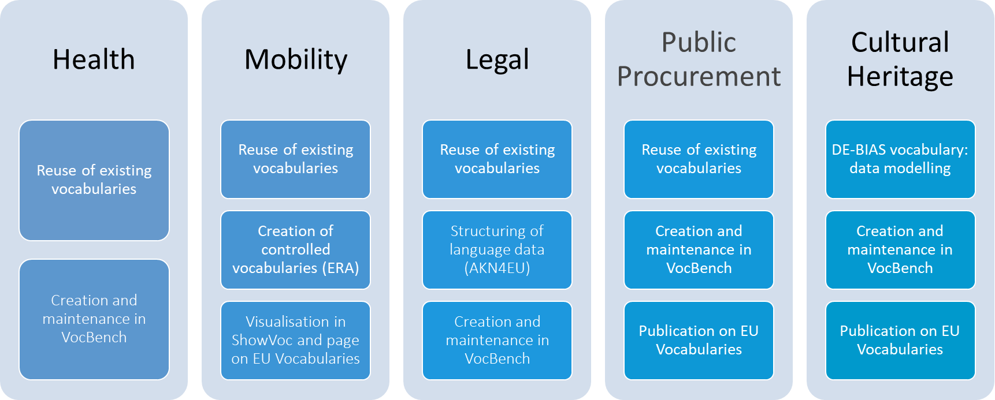
Ongoing collaboration with Dataspaces
EU Vocabularies: Enhancing Data Management and Interoperability for EU Institutions and Data Spaces

Slide 15
The role of AI in Enhancing EU vocabularies
AI significantly enriches and optimises the use, maintenance, and scalability of reference data, acting as a powerful enabler for semantic interoperability and effective data sharing across European Data Spaces
Semantic tagging: facilitates automatic tagging of EU documents with authority tables and EuroVoc from the EU Vocabularies platform
Semantic alignment: AI algorithms automate the alignment and harmonisation of multilingual controlled vocabularies
EU Vocabularies: Enhancing Data Management and Interoperability for EU Institutions and Data Spaces

Slide 16
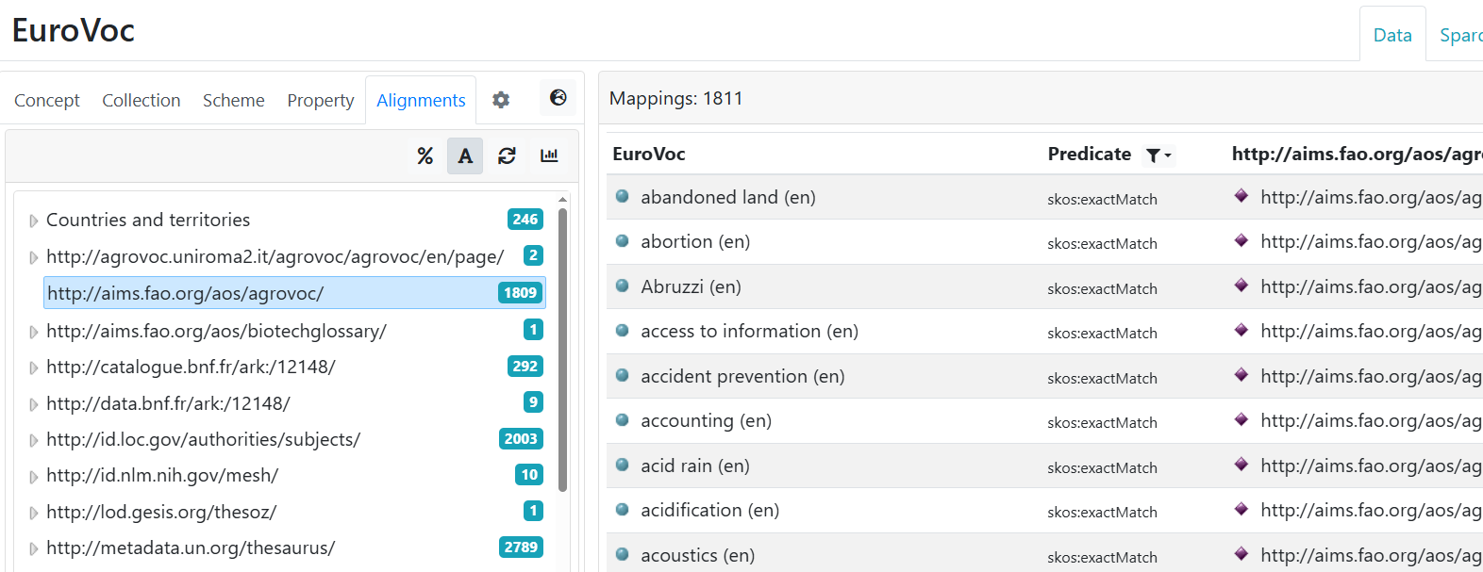
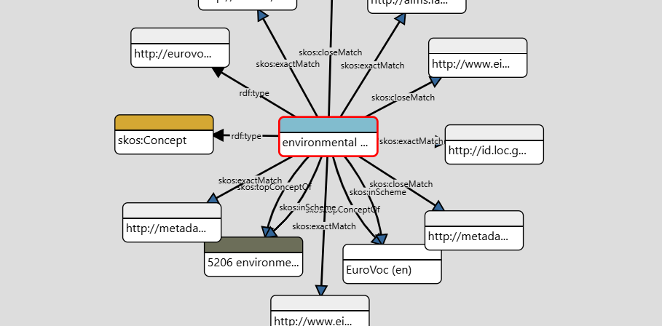
Semantic alignments
Over 20 alignment files available on
EU Vocabularies to support linked data and semantic interoperability
Tools that support the creation, visualisation and publication of alignments: VocBench, ShowVoc, Cellar and EU Vocabularies
Challenges:
  Vocabularies evolve independently
  Volume and velocity of vocabularies emerging from diverse Data Spaces
  Potential new AI-driven or community-sourced alignment mechanisms
EU Vocabularies: Enhancing Data Management and Interoperability for EU Institutions and Data Spaces

Slide 17
Building high quality training datasets
For semantic tagging systems to perform reliably across multilingual, domain-specific European Dataspaces, they must be trained, validated, and benchmarked on high-quality, representative datasets
Selection of representative and diverse raw data
    Collect datasets covering all relevant domains, languages, formats, and types of information
Manual expert annotation (Human-in-the-Loop)
    Domain experts manually annotate data using EU Vocabularies
Benchmarking and evaluation
    Auto-tagging tools are tested against the golden dataset
EU Vocabularies: Enhancing Data Management and Interoperability for EU Institutions and Data Spaces

Slide 18


Support infrastructures for Data Spaces:
Simpl and Data Spaces Support Centre
Simpl is an open source, smart and secure middleware platform that supports data access and interoperability among European Dataspaces
  Ensure that different Dataspaces exchange data with shared meanings through controlled vocabularies to standardise the metadata of datasets
Data Spaces Support Centre: contributes to the creation of common Dataspaces, that collectively create a sovereign, interoperable and trustworthy data sharing environment, to enable data reuse within and across sectors
  Semantic interoperability: DSSC encourages Dataspaces to embed vocabularies and EU ontologies in data models and metadata
  Blueprint evolution: EU Vocabularies aligns with updates to the DSSC’s evolving blueprint versions to remain future-proof
EU Vocabularies: Enhancing Data Management and Interoperability for EU Institutions and Data Spaces

Slide 19
Thanks!
Website: https://op.europa.eu/en/web/eu-vocabularies/home
Functional mailbox: OP-EU-VOCABULARIES@publications.europa.eu
aniko.gerencser@publications.europa.eu
denis.dechandon@publications.europa.eu
vassilis.tzouvaras@ext.publications.europa.eu

