Slide 1

Claudio Baldassarre, Emidio Stani, Emiel Dhondt and Arthur Schiltz
SEMIC Team
The Semantic Registry
A collaborative approach to semantic models

Slide 2
The objectives of SEMIC
The objectives of the SEMIC action are to promote Semantic Interoperability amongst the EU Member States by:
Promoting the share and reuse of semantic assets, experience and tools and facilitating agreements in key areas.
Identifying opportunities for alignment on semantic definitions, metadata and reference data sources with special focus on identification and definitions of Core Concepts / Vocabularies.
Raising awareness on the importance of data and metadata management.
The Semantic Registry for Data Models

Slide 3
The objective of the Semantic Registry
The Semantic Registry aims to record a critical mass of evidences on data models to promote interoperability across sectors, such as:
Health
Business
Employment
Tax
Mobility
Language
Tourism
Enabling knowledge workers to search and retrieve data models to achieve:
greater semantic interoperability through consistent data model selection
The Semantic Registry for Data Models

Slide 4
The objective of the Semantic Registry (cont.)
How does one choose a semantic model, from the many available options, that will maximize interoperability?
Fundamental question
Evidences such as reuse by countries or organisations
Connecting to authoritative sources of data models
Enablers
Convergence of design and adoption
Outcome
The Semantic Registry for Data Models

Slide 5
What is missing?
data models
Dispersion of semantic models hampers discoverability.
At their authoritative sources semantic assets do not display consistent information on reusability or adoption.
Member States
Portal A
End user
(GUI)
data models
Portal B
Directorate Generals
data models
Portal C
Agencies
End user
(API)
The Semantic Registry for Data Models

Slide 6
The Semantic Registry & its outcomes
A hub where metadata on models from various sources can be discovered.
Improved findability & reusability.
Understand interoperability between ontologies.
Gauge adoption of models.
Member States
metadata
End user
(GUI)
metadata
Directorate Generals
The Semantic Registry
metadata
End user
(API)
Agencies
The Semantic Registry for Data Models

Slide 7
Metrics support recommendations
Metrics that are based on the centrality of the model in the graph support ordering of search results.
Reuse: by counting links with other models.
Implementations: by looking at datasets using the model.
Aggregation: aggregating these metrics across publishers, member states, themes, and between models.
The Semantic Registry for Data Models

Slide 8
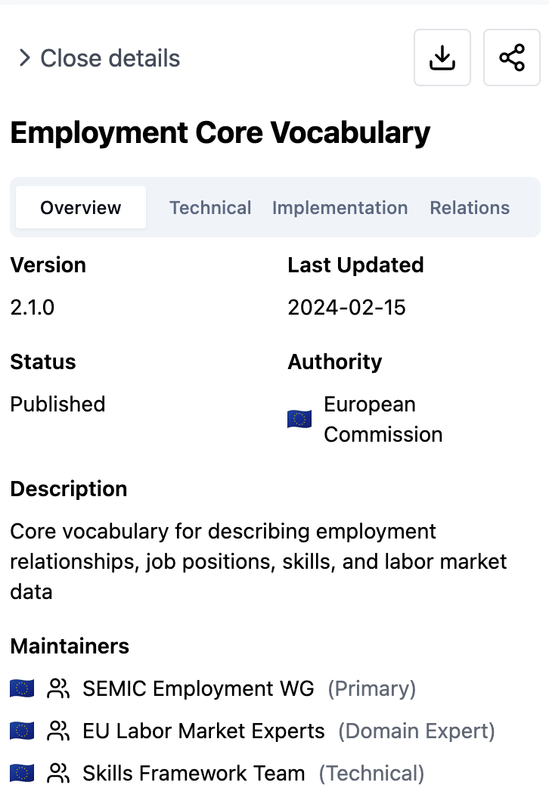
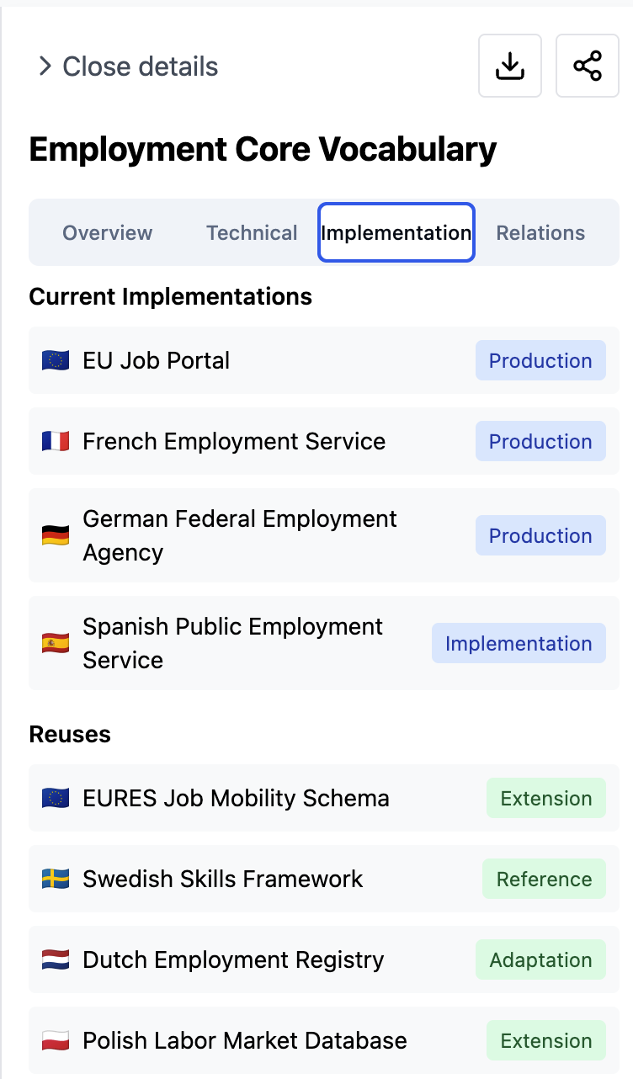
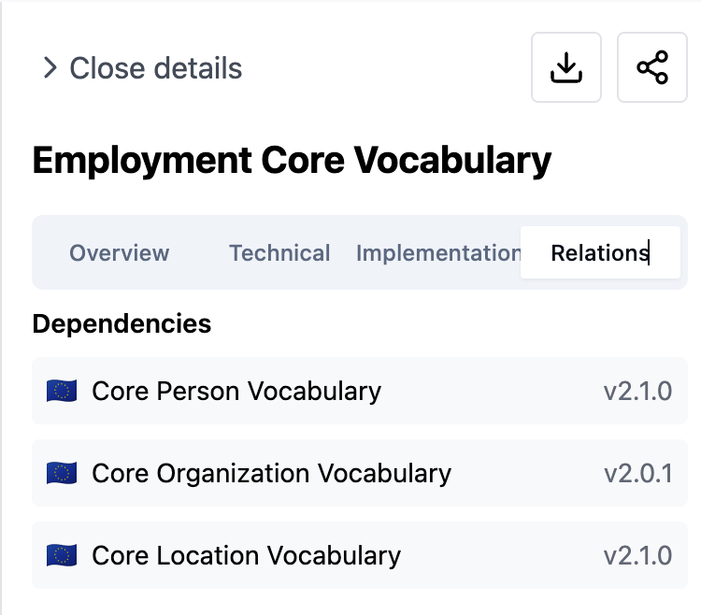
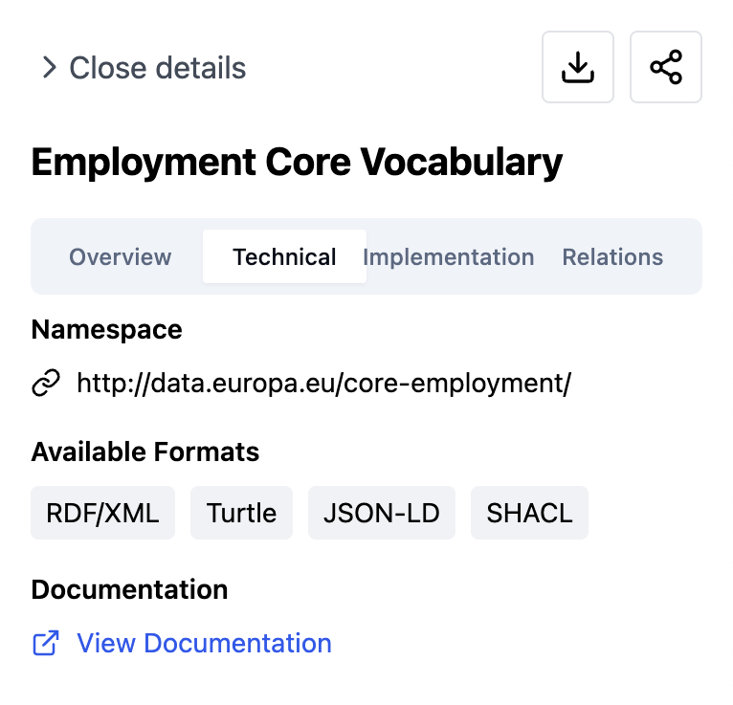
A first look at the Semantic Registry
The Semantic Registry for Data Models

Slide 9
Development of the Semantic Registry
Feasibility and scalability analysis, development of metrics and indicators.
Building a front-end web interface to interact with the Semantic Registry and build an access API to connect programmatically.
Pilot the Semantic Registry with Member States and EU agencies/DGs to develop a Proof-of-Concept.
Creating a common model to harmonise the Semantic Registry metadata.
Build a harvester to collect, transform and validate the data according to the data model.
The Semantic Registry for Data Models

Slide 10
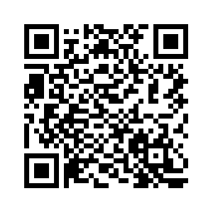
Semantic Registry Pilot: Call for action
SEMIC is looking for:
Authoritative sources within the Member States and within EU institutions
Individuals that are interested in testing the Semantic Registry and influence development
Scan the QR code to apply!
The Semantic Registry for Data Models

Slide 11

Claudio Baldassarre, Emidio Stani, Emiel Dhondt and Arthur Schiltz
SEMIC Team
Thank you!
digit-semic-team@ec.europa.eu

