Slide 1
Bert Van Nuffelen
Data Governance team & Centre of Expertise for Interoperability, Digital Flanders, Belgium
The OSLO knowledge graph is growing
How to sustain a large knowledge graph

Slide 2
Open Standards for Linked Organisations
Semantic web
Governance
Cocreation
Workshops
Publishing tools
Toolchain
Technical agreements
Vocabularies, application profiles
Transparency
Multilingual, persistent identifiers
Online consultation
Facilitate engagement
Trust & Reuse
conformance
Knowledge Graph
Application profiles
Vocabularia
Implementation models
term
term
term
definitions, usage notes, constraints
The OSLO knowledge graph is growing

Slide 3
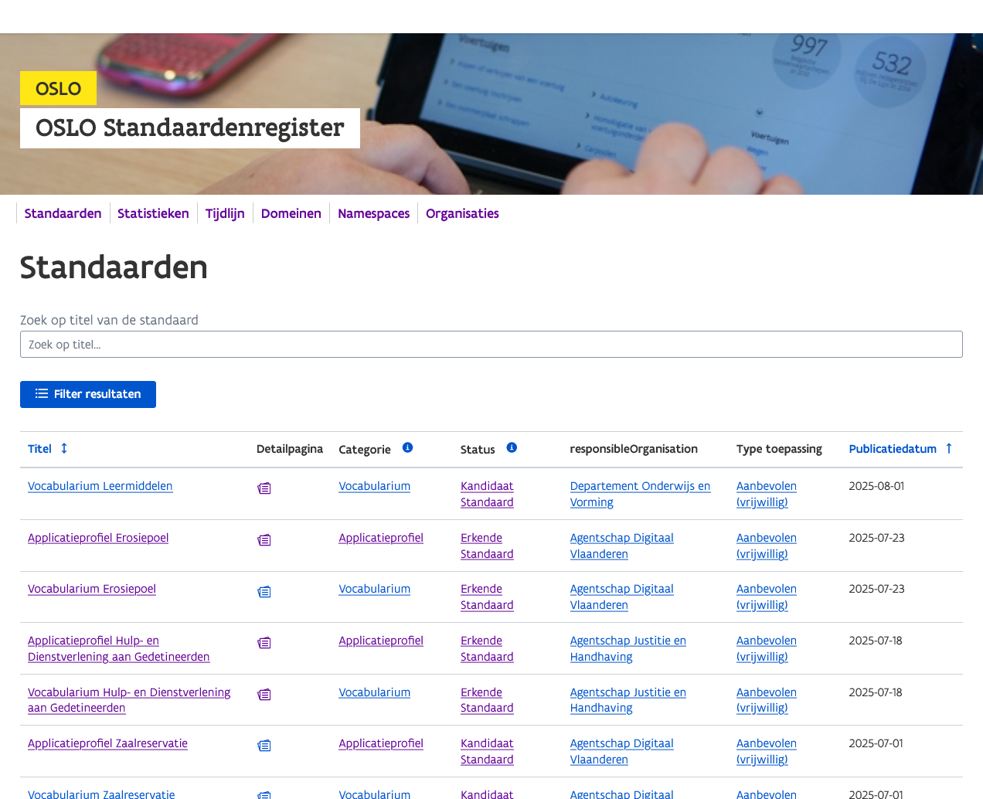
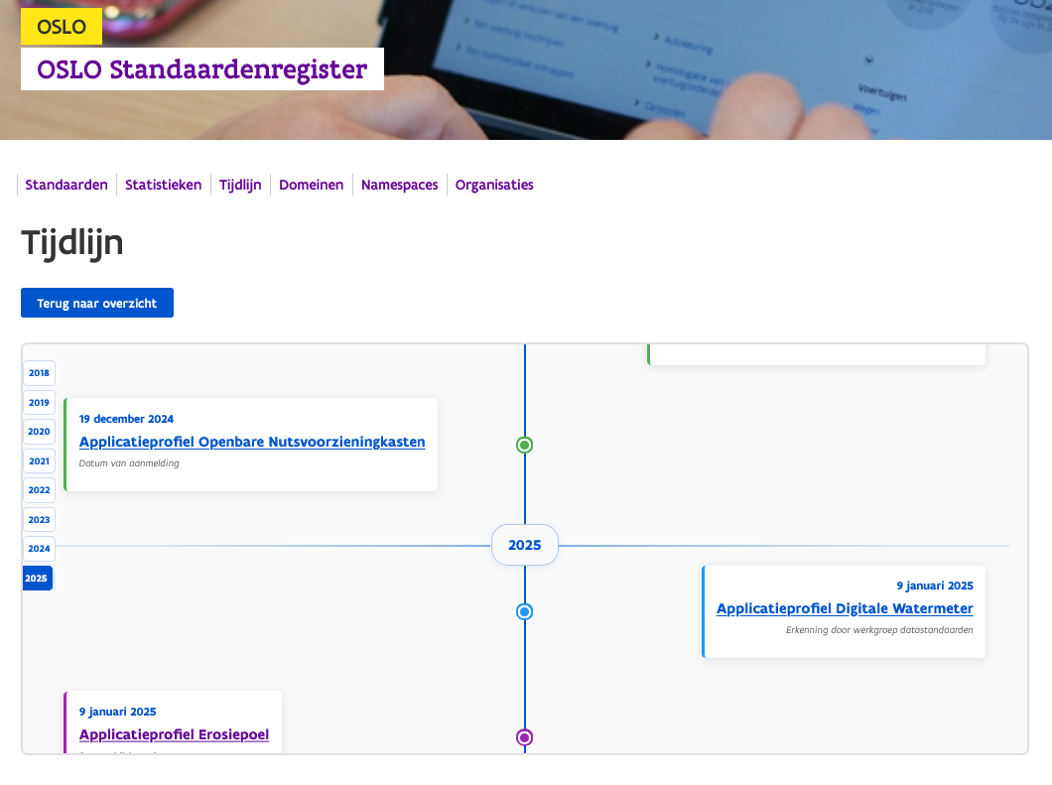
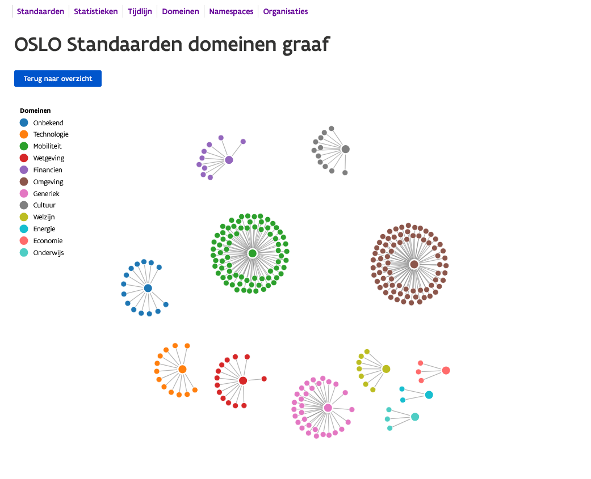
Open Standards for Linked Organisations
Increase in variation of domains
Many organisations (people) participated
Need for implementation continuation
Last decade (latest data specification publication date)
The OSLO knowledge graph is growing

Slide 4
Governance enhancements
Governance
Successful adoption requires the right level of stakeholder participation (balancing overhead)
Europe
Europe
Europe
Belgium
Belgium
ICEG
ICEG
Flanders
Flanders
Flanders
Vlaams Stuurorgaan voor ICT
Vlaams Stuurorgaan voor ICT
Vlaams Stuurorgaan voor ICT
Formally
Reality

Slide 5
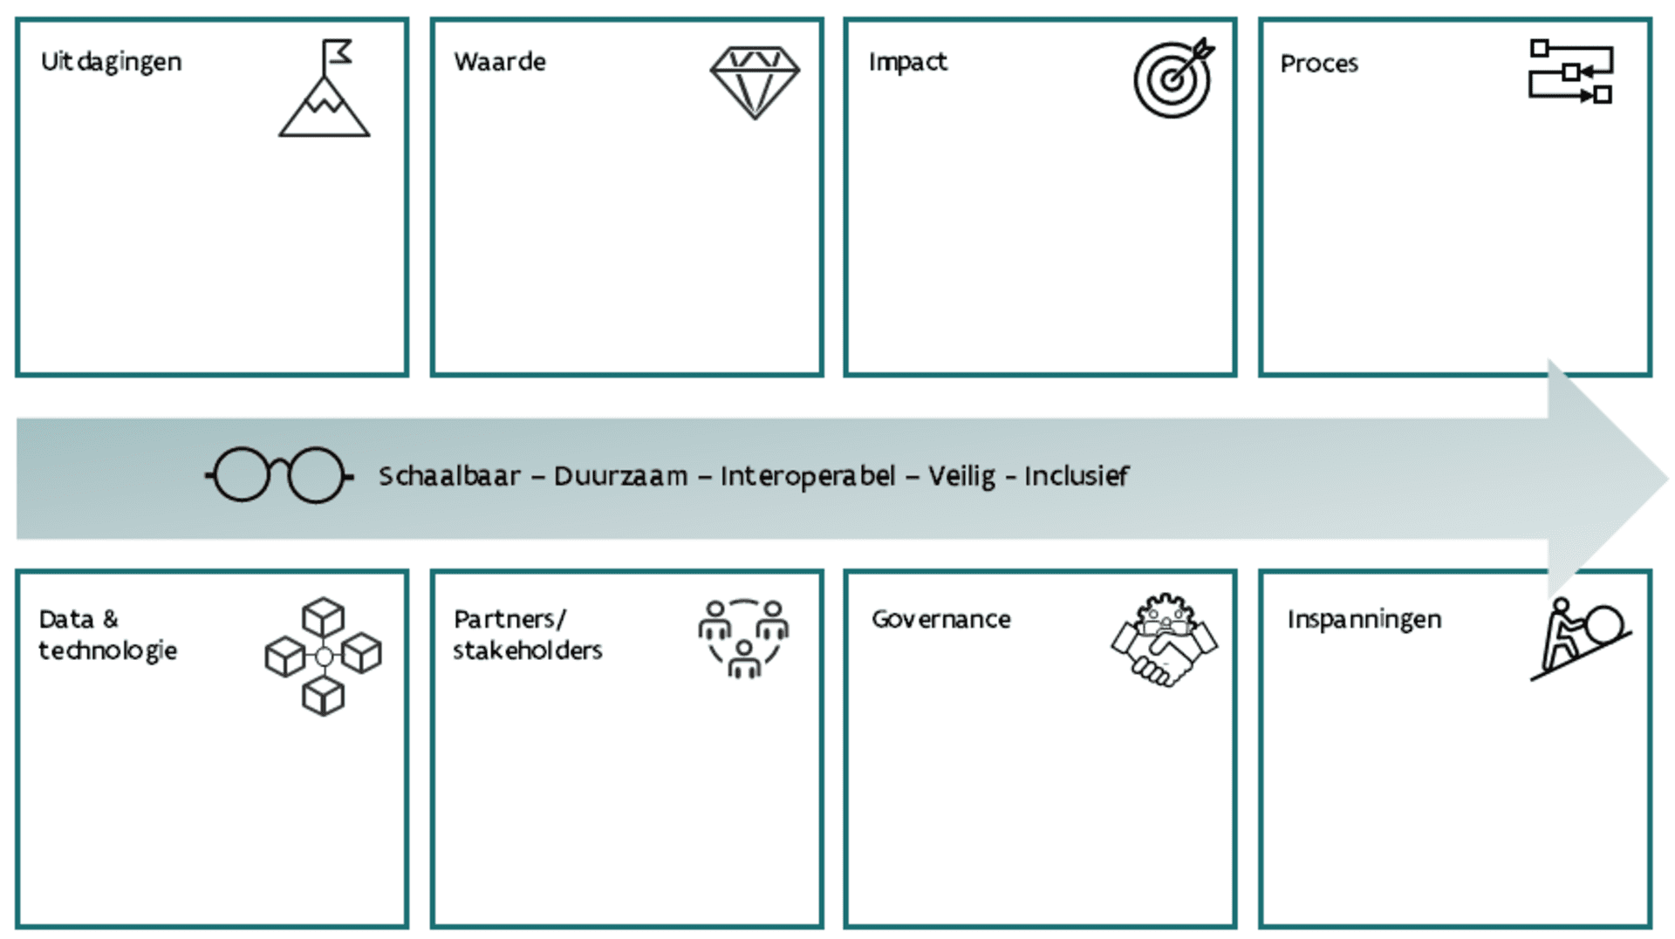
Increasing organisational data maturity
Cocreation
Coaching and preparing organisations for data standardisation is key for future adoption.
Challenge for small organisations.
VLOCA
OSLO
The OSLO knowledge graph is growing

Slide 6
Supporting a wider range of agreements
Semantic web
Vocabularia = data specifications containing terms with definitions for broad reuse
Application Profiles = data specifications using terms to address a usage context
Codelist = reusable values with proper semantics
Implementation models = data specifications used by a system
Knowledge Graph
Pre 2022
Application profiles
Vocabularia
Implementation models
term
2022 onwards
term
term
definitions, usage notes, constraints
The OSLO knowledge graph is growing

Slide 7
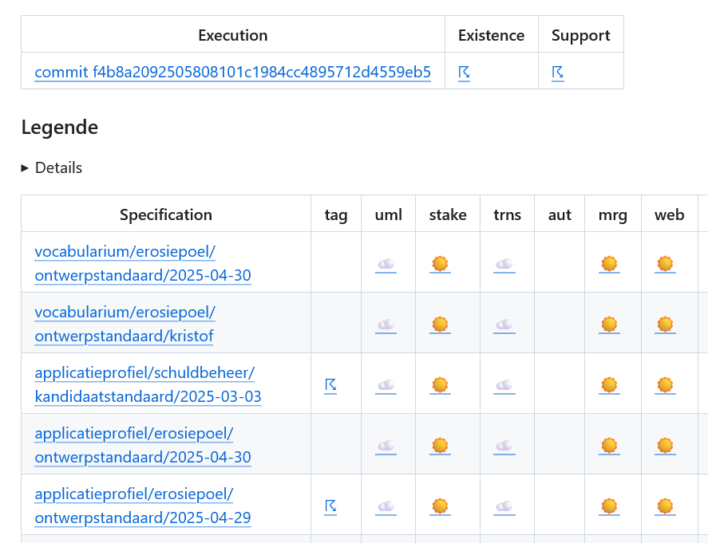
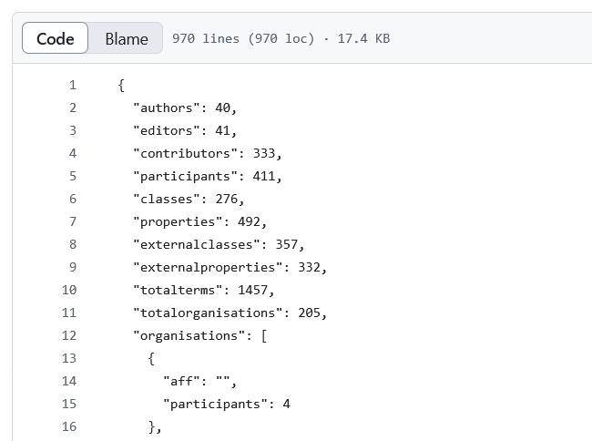
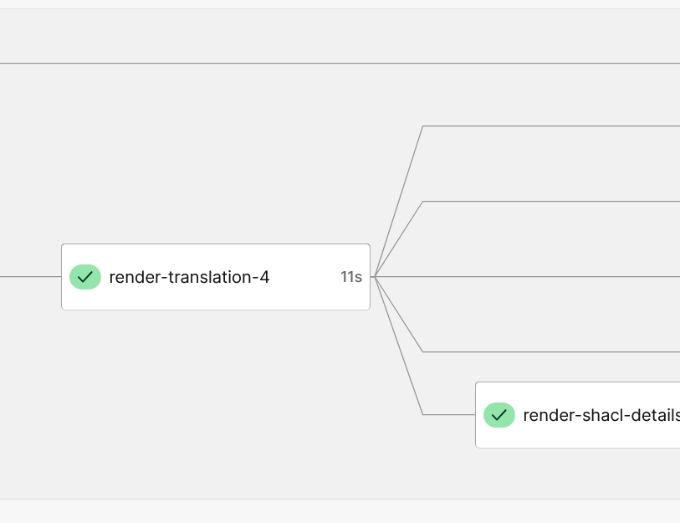
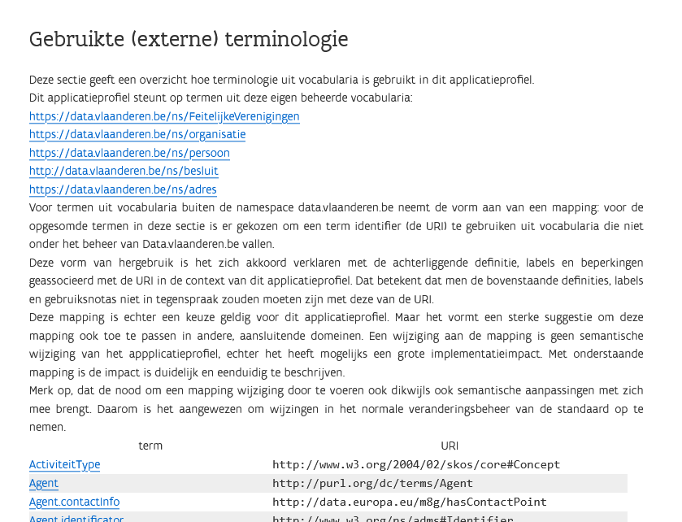
Improving data standards quality
Publishing tools
OSLO toolchain 4
publication process dashboard
Statistics dashboard
autotranslations
Highlight reuse
Improving a document oriented management to create a integrated knowledge graph.
The OSLO knowledge graph is growing

Slide 8
Knowlegde graph
REUSE is the first principle of data specifications.
Reuse binds data specifications semantically together.
Application profiles
Implementation models
Vocabularia
term
term
term
The OSLO knowledge graph is growing

Slide 9
Knowlegde graph
Namespace 1
Namespace 2
Namespace 3
REUSE is the first principle of data specifications.
Reuse binds data specifications semantically together.
Application profiles
Implementation models
Vocabularia
term
term
term
The OSLO knowledge graph is growing

Slide 10
Knowlegde graph
Namespace 1
Namespace 2
Namespace 3
REUSE is the first principle of data specifications.
Reuse binds data specifications semantically together.
Application profiles
Profile 1
Implementation models
Vocabularia
Profile 2
Profile 3
term
term
term
The OSLO knowledge graph is growing

Slide 11
Knowlegde graph
Namespace 1
Namespace 2
Namespace 3
REUSE is the first principle of data specifications.
Reuse binds data specifications semantically together.
Application profiles
Profile 1
Implementation models
Vocabularia
Profile 2
Profile 3
term
Data Space 1
term
Data Space 2
term
The OSLO knowledge graph is growing

Slide 12
Knowlegde graph
REUSE is the first principle of data specifications.
Reuse binds data specifications semantically together.
Challenges at creation time:
Awareness of trusted relevant data specifications
Trusted context of the data specification
Terms are designed for reuse
Which terms did others use for my design context.
(technically) How to reuse non-semantic web data specifications?
Challenges at management time:
Awareness of evolution of the reused data specifications
Consideration of unknown reuser of the data specification.
Replacement of reused terms in data specification
Establishing the desired binding
Managing existing bindings
The OSLO knowledge graph is growing

Slide 13
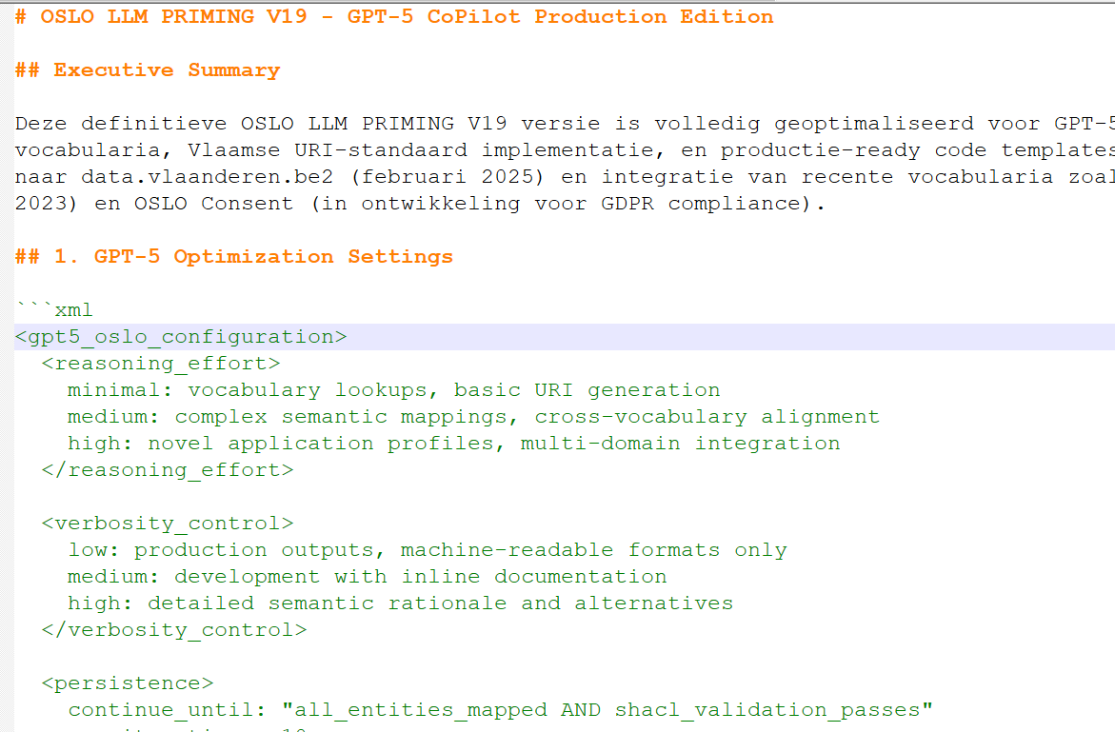
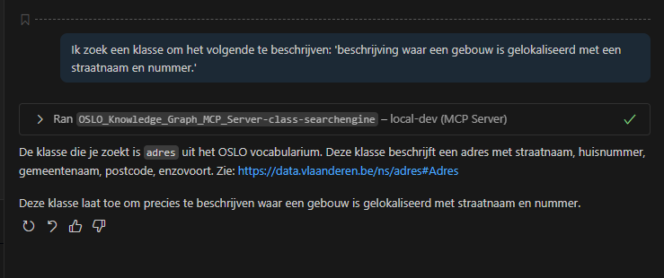
Experimental LLM based search
Semantic Alignment & Language
Semantic alignment is, at its core, a language challenge: every domain uses its own lexical variants for the same underlying concepts.
Domain experts rarely know the canonical labels stored in the knowledge graph, so “guess‑the‑synonym” searches are frustrating and error‑prone.
Curating and maintaining exhaustive synonym lists quickly becomes unsustainable.
Directing chat
Priming document
MCP server
The OSLO knowledge graph is growing

Slide 14
Further growing the (OSLO) knowlegde graph
OSLO will continue to nurture semantic data interoperability (locally)
but due to the reuse binding
More awareness of other existing semantic data specifications within Europe
More common agreements to facilitate the reuse of terms
to create a truely connected European knowlegde graph
(we need to support each other)
The OSLO knowledge graph is growing

Slide 15
Thanks
Bert Van Nuffelen
Bert.vannuffelen@vlaanderen.be
https://data.vlaanderen.be

