Slide 1
Davide Audrito, Alessio Nardin, Cecile Guasch
DIGIT B.2 - Digital-ready Policy making Team
The Legislative Financial and Digital Statement Vocabulary
A semantic approach to digital-ready policymaking

Slide 2
Agenda
Introduction: the Interoperable Europe Act
The digital dimensions chapter of the Legislative Financial and Digital Statement (LFDS)
The Legislative Financial and Digital Statement Vocabulary (LFDSV)
AI-based completion of the LFDS
The Legislative Financial and Digital Statement: A semantic approach to digital-ready policymaking

Slide 3
The Interoperable Europe Act
The Interoperable Europe Act entered into force on 11 April 2024.
According to Article 1, the Act promotes the cross-border interoperability of network and information systems which are used to provide or manage public services in the Union.
The Act proposes to introduce a structured and co-owned EU cooperation framework for public administrations.
The Legislative Financial and Digital Statement: A semantic approach to digital-ready policymaking

Slide 4
The Interoperable Europe Act
The cooperation framework codified in the Interoperable Europe Act is composed of the following four pillars:
The Interoperable Europe Board;
Mandatory interoperability assessments;
The Interoperable Europe Portal;
Innovation and support measures, including regulatory sandboxes and GovTech cooperation
The Legislative Financial and Digital Statement: A semantic approach to digital-ready policymaking

Slide 5
The LFDS
The EU Commission, as an EU institution, is required to perform the LFDS, which serves as the interoperability assessment.
This information, which accompanies most of EU legally-binding acts, is to be incorporated in a new chapter dedicated to the interoperability and digital dimensions of legislative proposals.
The Legislative Financial and Digital Statement: A semantic approach to digital-ready policymaking

Slide 6
The LFDS
The digital dimensions chapter is composed of the following five sections:
  Requirements of digital relevance
  Data
  Digital Solutions
  Interoperability assessment
  Measures to support digital implementation
The Legislative Financial and Digital Statement: A semantic approach to digital-ready policymaking

Slide 7
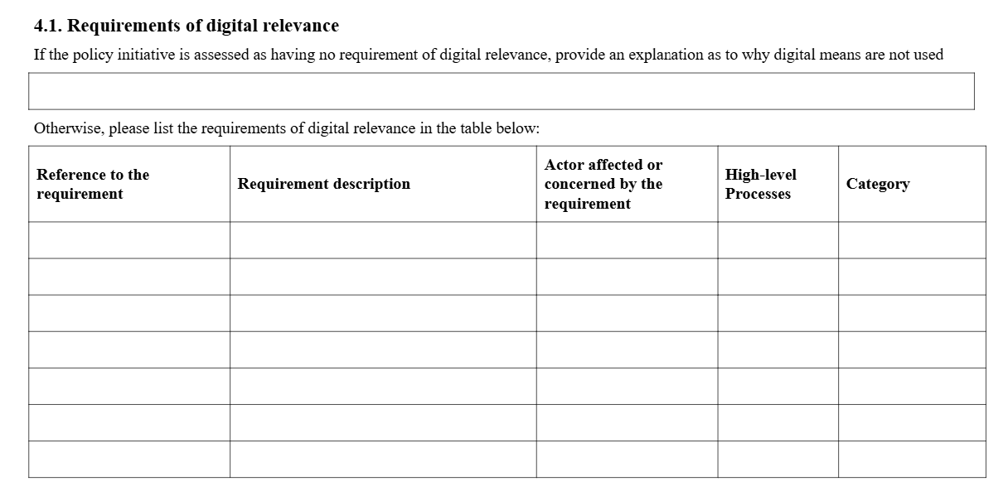
Section 1: Requirements of digital relevance
The Legislative Financial and Digital Statement: A semantic approach to digital-ready policymaking

Slide 8
From the LFDS to the LFDSV
The LFDSV is used to represent the digital dimensions chapter of the LFDS in a "queryable" and machine-readable format (RDF, JSON, SHACL).
The LFDS data model aims to support the following use-cases:
  UC1: Complete the LFDS digital dimensions' chapter in a semi-automated way.
  UC2: Draft requirements of digital relevance in legal texts using a streamlined and digital-ready approach.
  UC3: Convert the LFDS digital dimensions' chapter into an interoperability assessment report.
The Legislative Financial and Digital Statement: A semantic approach to digital-ready policymaking

Slide 9
Section 4.1: Requirements of digital relevance
The Legislative Financial and Digital Statement: A semantic approach to digital-ready policymaking

Slide 10
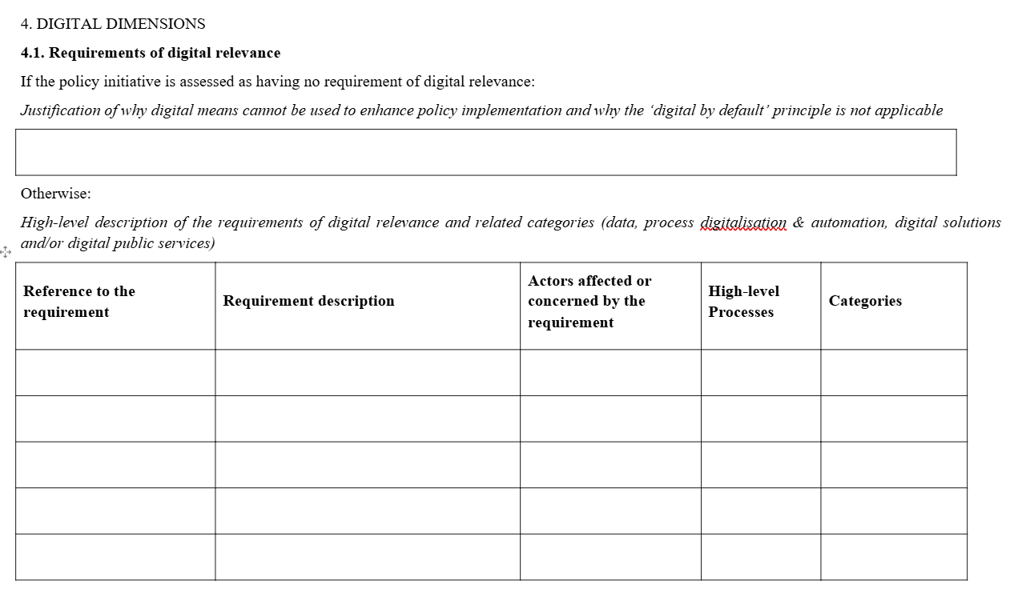
The Legislative Financial and Digital Statement: A semantic approach to digital-ready policymaking

Slide 11
eli:LegalExpression
dct:isPartOf
rrmv:Requirement
rrmv:hasTopic
rrmv:hasURI
rrmv:Action
rrmv:produces
rrmv:hasAgentRole
rdfs:subClassOf
rrmv:AgentRole
RequirementDigitalRelevance
Category: Code [0…*]
rrmv:forAgent
rrmv:Agent
This is a draft: datatypes are not final, typos may exist, for simplicity the IOPA elements have not been fully included

Slide 12
Section 4.2: Data
The Legislative Financial and Digital Statement: A semantic approach to digital-ready policymaking

Slide 13
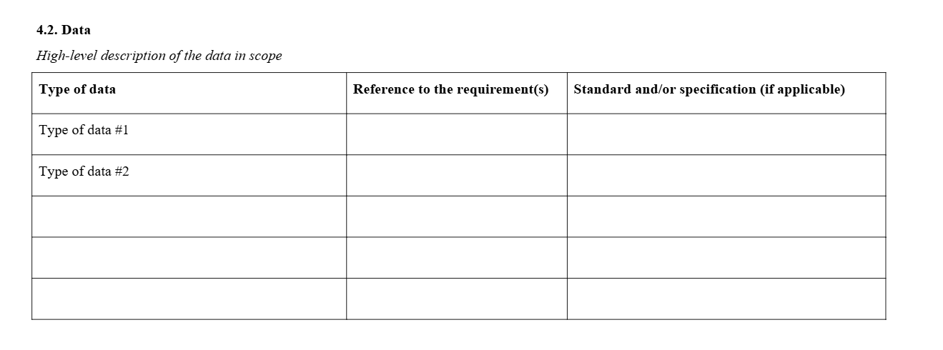
The Legislative Financial and Digital Statement: A semantic approach to digital-ready policymaking

Slide 14
eli:LegalExpression
dct:isPartOf
rrmv:Requirement
rrmv:hasTopic
rrmv:hasURI
annotation: xsd:string[…]
dcat:Resource
description:Literal
dct:requires
rdfs:subClassOf
dcat:Dataset
RequirementDigitalRelevance
Category: Code [0…*]
cssv:Specification
This is a draft: datatypes are not final, typos may exist, for simplicity the IOPA elements have not been fully included

Slide 15
Section 4.2: Policy alignment
The Legislative Financial and Digital Statement: A semantic approach to digital-ready policymaking

Slide 16
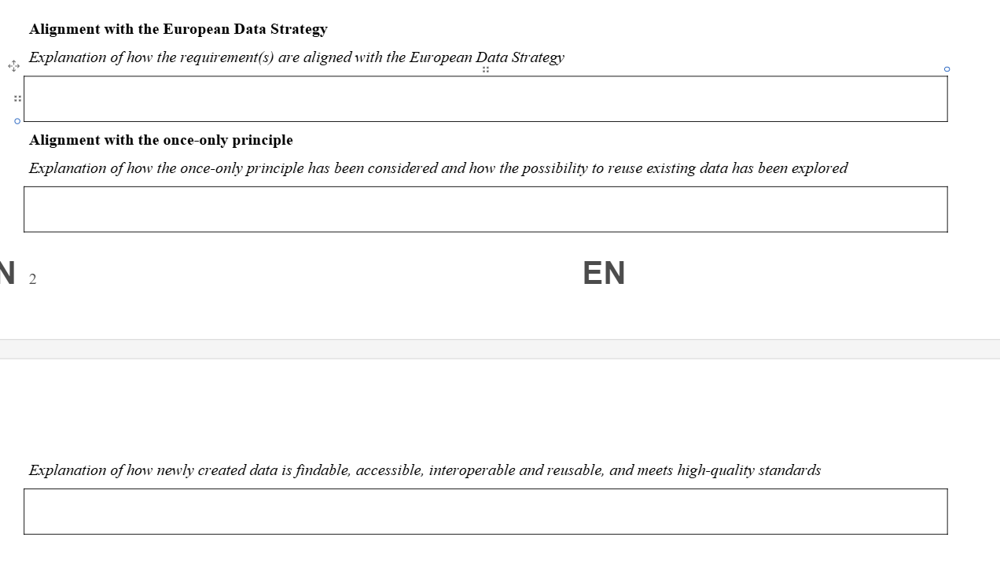
The Legislative Financial and Digital Statement: A semantic approach to digital-ready policymaking

Slide 17
cav:Assessment
documentedIn: URI
rdfs:subClassOf
cav:resultsIn
lfds:PolicyAlignment
dct:description:Literal
policy:URI
cav:Statement
interpretation: Code [0…*]
judgment: Text [0…*]
type: Code [0...*]
This is a draft: datatypes are not final, typos may exist, for simplicity the IOPA elements have not been fully included

Slide 18
Section 4.2: Data flows
The Legislative Financial and Digital Statement: A semantic approach to digital-ready policymaking

Slide 19
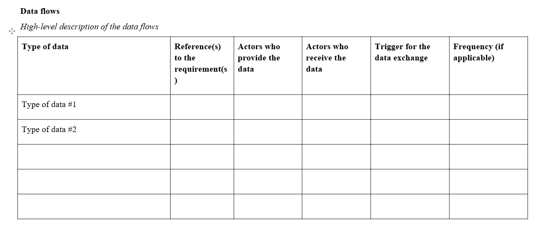
The Legislative Financial and Digital Statement: A semantic approach to digital-ready policymaking

Slide 20
eli:LegalExpression
lfds:DataFlow
lfds:trigger:Literal
dct:isPartOf
rrmv:hasAgentRole
rrmv:Requirement
rrmv:hasTopic
rrmv:hasURI
annotation: xsd:string[…]
rrmv:Action
hasannotation: LangString
rrmv:AgentRole
rrmv:Role
rrmv:hasResult
rrmv:forAgent
rrmv:hasFrequency
rrmv:Agent
rrmv:Role
rrmv:Frequency
This is a draft: datatypes are not final, typos may exist, for simplicity the IOPA elements have not been fully included

Slide 21
Section 4.3: Digital Solutions
The Legislative Financial and Digital Statement: A semantic approach to digital-ready policymaking

Slide 22
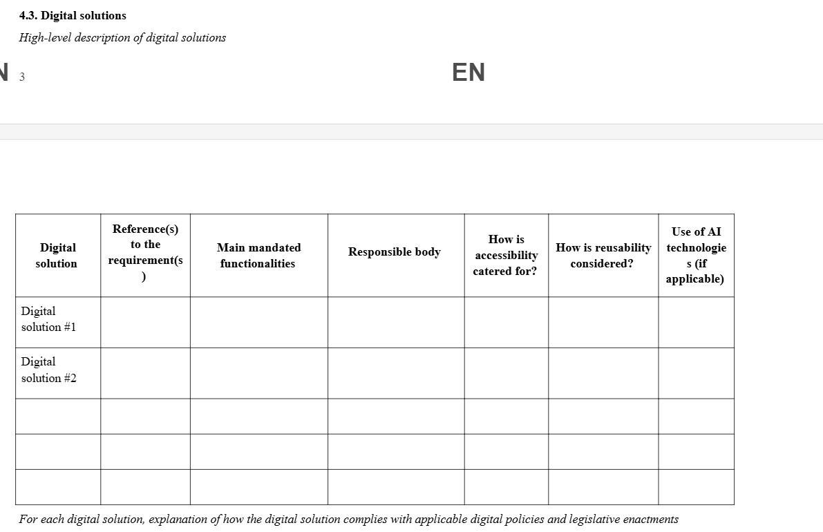
A semantic approach to digital-ready policymaking: the Legislative Digital Statement

Slide 23
rrmv:hasResult
rrmv:hasAgentRole
rrmv:Requirement
rrmv:hasTopic
rrmv:hasURI
annotation: xsd:string[…]
rrmv:Action
hasannotation: LangString
rrmv:AgentRole
dct:creator
cav:Assessment
documentedIn: URI
cav:assesses
cav:resultsIn
lfds:SolutionAssessment
question: code
cav:Statement
interpretation: Code [0…*]
judgment: Text [0…*]
type: Code [0...*]
adms:Asset
rdfs:label:Literal [0...*]
This is a draft: datatypes are not final, typos may exist, for simplicity the IOPA elements have not been fully included

Slide 24
Section 4.3: Digital Solution Policy Alignment
The Legislative Financial and Digital Statement: A semantic approach to digital-ready policymaking

Slide 25
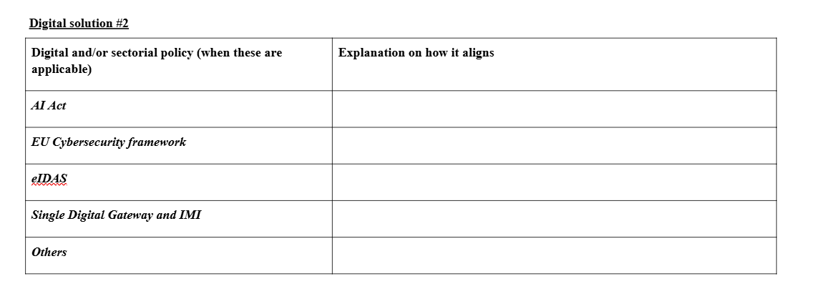
The Legislative Financial and Digital Statement: A semantic approach to digital-ready policymaking

Slide 26
cav:Assessment
documentedIn: URI
cav:resultsIn
cav:assesses
cav:Statement
interpretation: Code [0…*]
judgment: Text [0…*]
type: Code [0...*]
lfds:PolicyAlignment
dct: description: Literal
Policy:URI
adms:Asset
rdfs:label:Literal [0...*]
This is a draft: datatypes are not final, typos may exist, for simplicity the IOPA elements have not been fully included

Slide 27
Section 4.4: Interoperability Assessment
The Legislative Financial and Digital Statement: A semantic approach to digital-ready policymaking

Slide 28
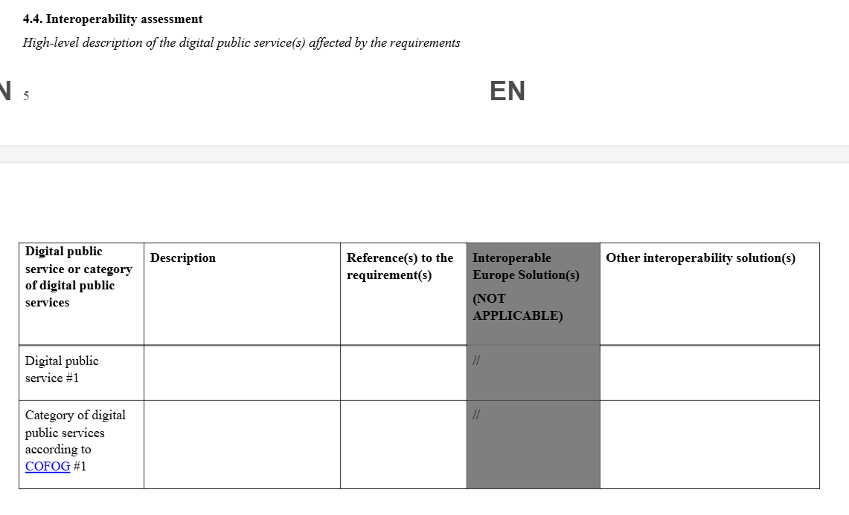
A semantic approach to digital-ready policymaking: the Legislative Digital Statement

Slide 29
rrmv:hasResult
rrmv:Requirement
rrmv:hasTopic
rrmv:hasURI
annotation: xsd:string[…]
rrmv:Action
hasannotation: LangString
cav:assesses
cav:Assessment
documentedIn: URI
cpsv:PublicService
description:Literal
hasIOPsolution:Literal
hasintsolution:Literal
cav:resultsIn
cav:Statement
interpretation: Code [0…*]
judgment: Text [0…*]
type: Code [0...*]
IOPAssessment
lfds:describes
This is a draft: datatypes are not final, typos may exist, for simplicity the IOPA elements have not been fully included

Slide 30
Section 4.4: Digital Public Service Interoperability
The Legislative Financial and Digital Statement: A semantic approach to digital-ready policymaking

Slide 31
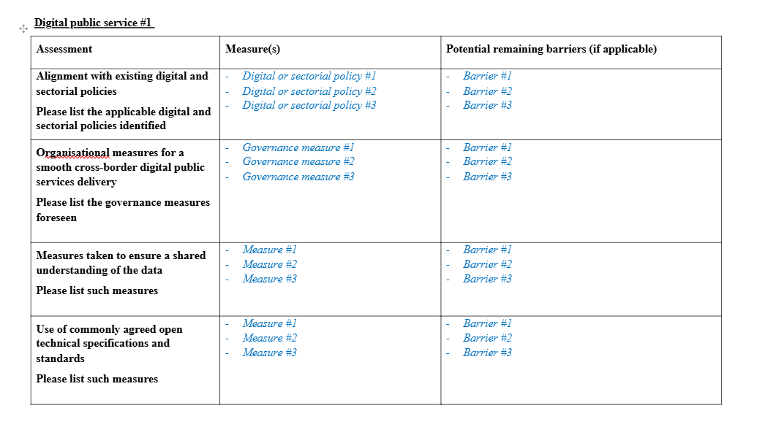
A semantic approach to digital-ready policymaking: the Legislative Digital Statement

Slide 32
rrmv:Requirement
rrmv:hasTopic
rrmv:hasURI
annotation: xsd:string[…]
rrmv:hasResult
rrmv:Action
hasannotation: LangString
cav:assesses
cav:Assessment
documentedIn: URI
cpsv:PublicService
description:Literal
hasIOPsolution:Literal
hasintsolution:Literal
cav:resultsIn
IOPAssessment
alignment: Text
measure: Text [0…*]
remainingbarriers: Text [0...*]
cav:Statement
interpretation: Code [0…*]
judgment: Text [0…*]
type: Code [0...*]
This is a draft: datatypes are not final, typos may exist, for simplicity the IOPA elements have not been fully included
lfds:describes

Slide 33
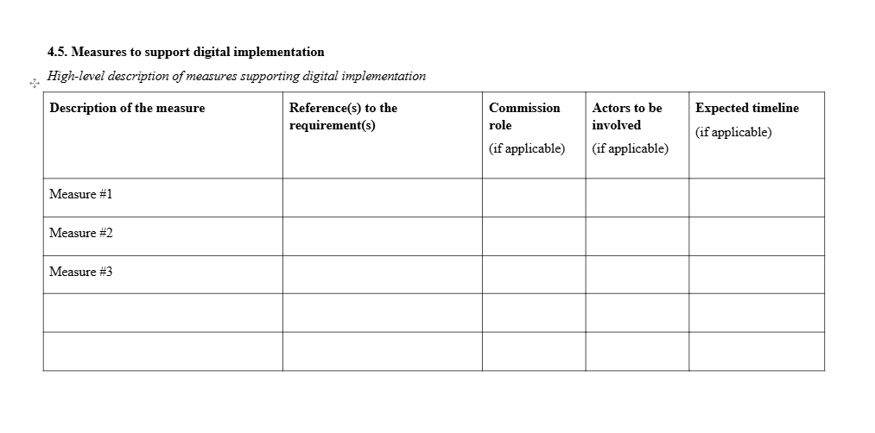
Section 4.5: Measures to support digital implementation
The Legislative Financial and Digital Statement: A semantic approach to digital-ready policymaking

Slide 34
AI4DRPM Prototype – Layered architecture view
Presentation layer
Frontend
eUI 19 (based on Angular)
Other consumer applications
Business logic layer
Data acquisition
TULIT package
REST API
FastAPI
AI Orchestrator
LLM interfaces
GPT@EC
ML
Data integration
In the roadmap
Task Queue
Celery + Redis
Knowledge-based approaches
Other AI-based approaches
Persistence layer
ORM
SQLAlchemy
Data layer
Relational DB
PostgreSQL
Triple Store
In the roadmap

Slide 35
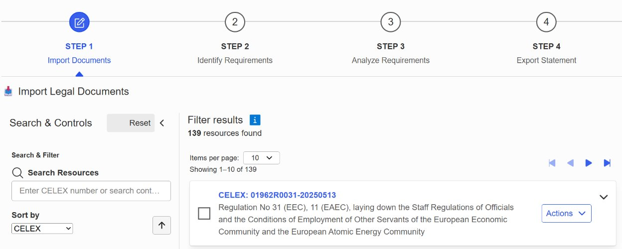
AI4DRPM functionalities
The Legislative Financial and Digital Statement: A semantic approach to digital-ready policymaking

Slide 36
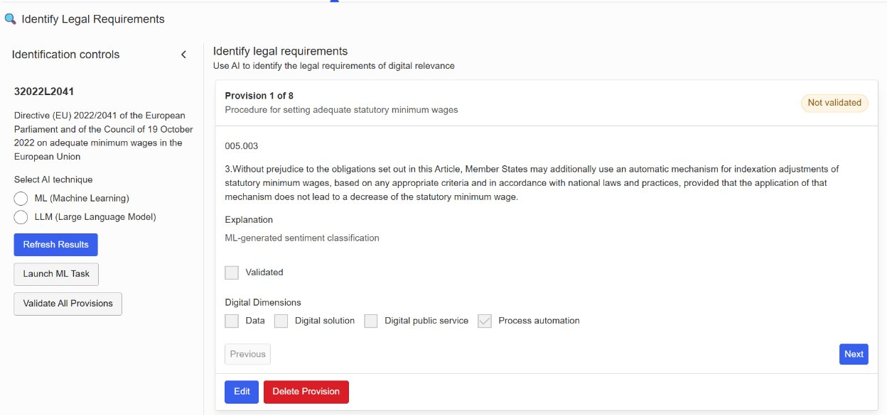
AI4DRPM functionalities
The Legislative Financial and Digital Statement: A semantic approach to digital-ready policymaking

Slide 37
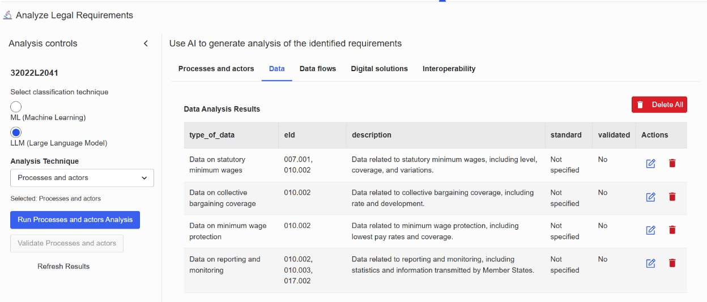
AI4DRPM functionalities
The Legislative Financial and Digital Statement: A semantic approach to digital-ready policymaking

Slide 38
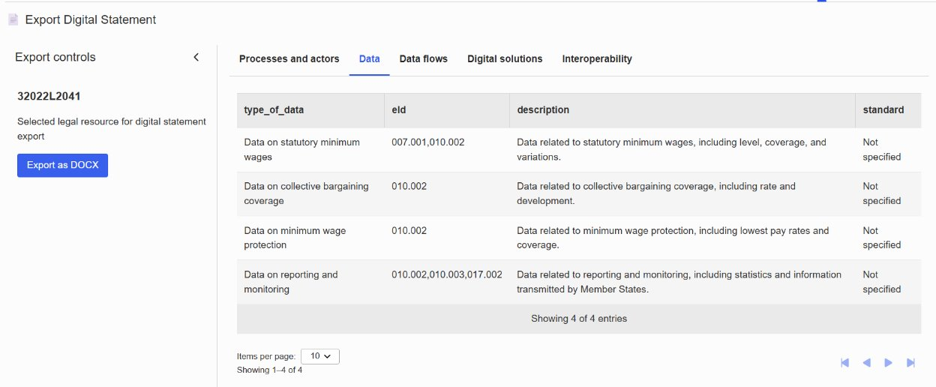
AI4DRPM
The Legislative Financial and Digital Statement: A semantic approach to digital-ready policymaking

Slide 39
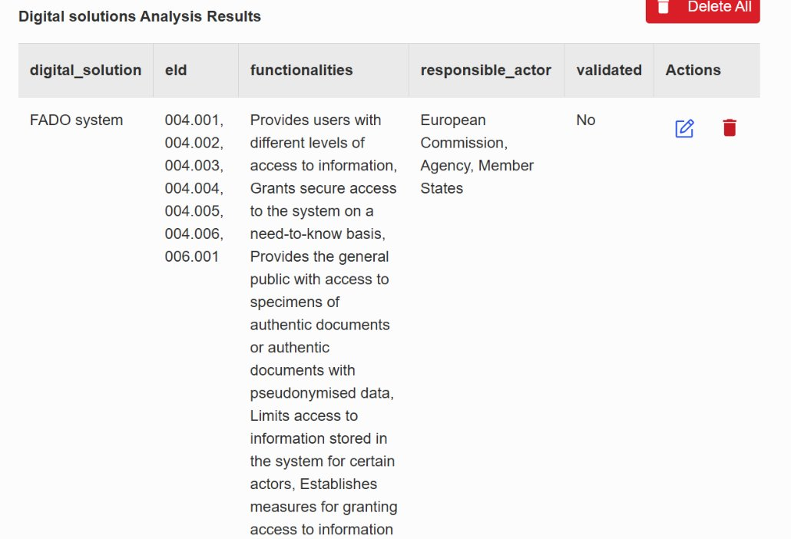
AI4DRPM
The Legislative Financial and Digital Statement: A semantic approach to digital-ready policymaking

Slide 40
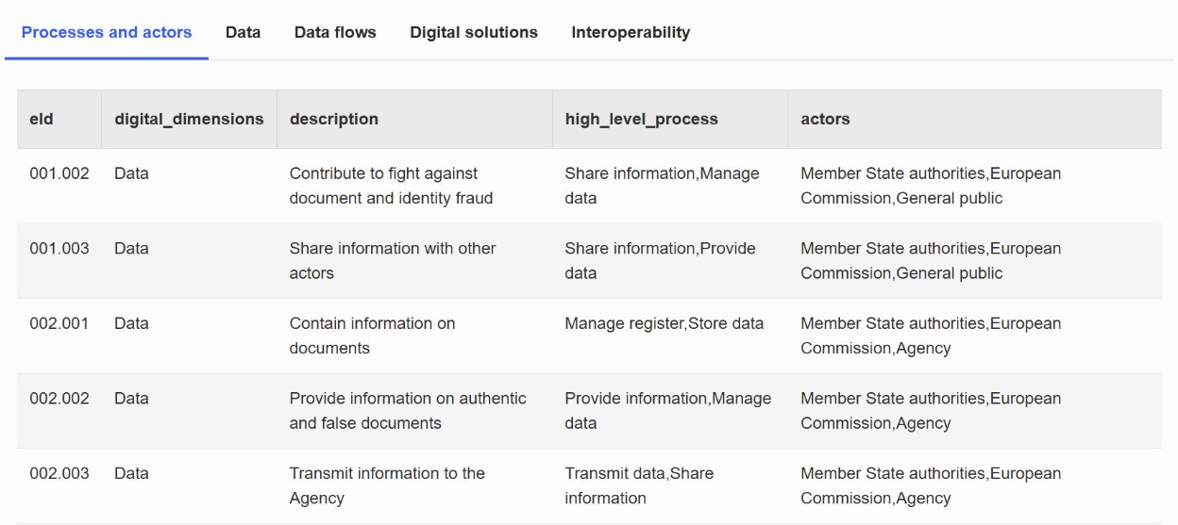
AI4DRPM
The Legislative Financial and Digital Statement: A semantic approach to digital-ready policymaking

Slide 41
AI4DRPM
The Legislative Financial and Digital Statement: A semantic approach to digital-ready policymaking

Slide 42
Thanks!
Contact us!
eu-digital-ready-policymaking@ec.europa.eu

