Slide 1
ENOTICES2
API services
Enrico Campanella : Publications Office of the EU

Slide 2
Agenda
How to access
Swagger documentation
Curls
Service responses
Q&A
2

Slide 3
How to Access
→Have an EU Login Account
→Create a TED eNotices2 account
→Retrieve your API Key
That’s it!
3

Slide 4
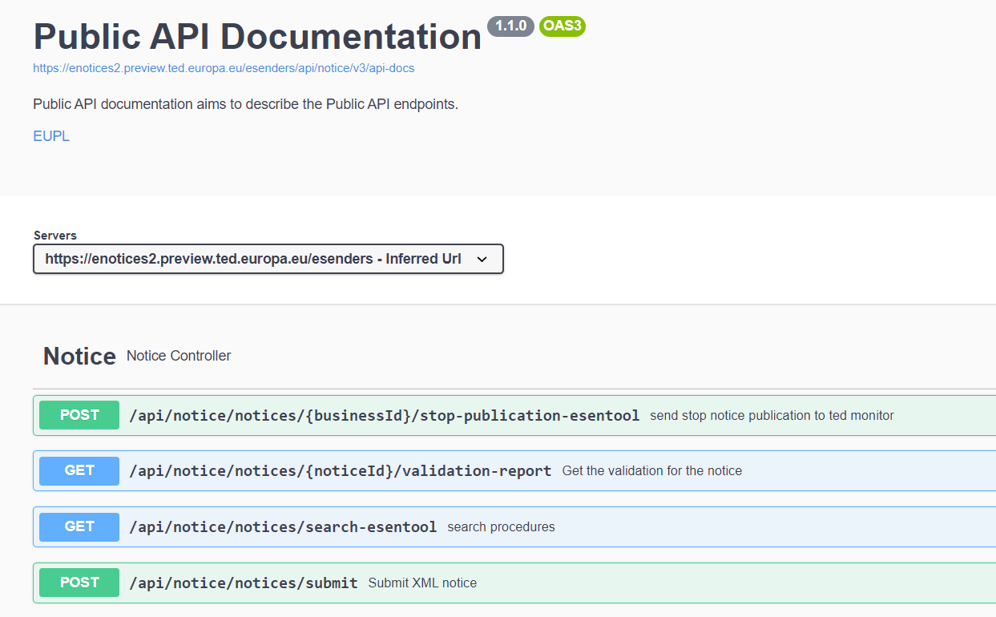
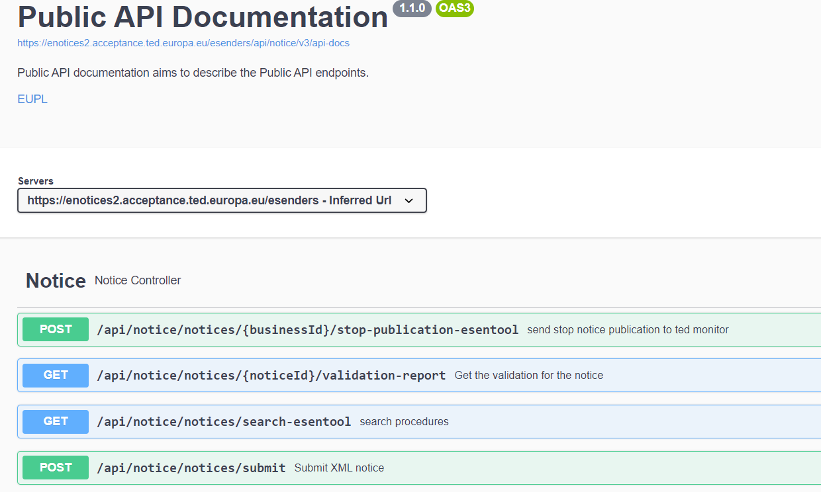
Swagger
https://enotices2.preview.ted.europa.eu/esenders/swagger-ui/#/Notice
4

Slide 5
Curls
Submit xml notice:
curl --location --request POST 'https://enotices2.preview.ted.europa.eu/esenders/api/notice/notices/submit' \
--header 'Content-Type: multipart/form-data' \
--header 'Accept: */*' \
--header 'Authorization: Bearer apikeyapikey' \
--form 'metadata="{\"noticeAuthorEmail\":\“email@abc.com\", \"noticeAuthorLocale\":\"en\"}\""' \
--form 'notice=@"/C:/Users/camenr/Downloads/COMPETITION1105.xml"'
5

Slide 6
Curls
Search notice:
curl --location --request GET 'https://enotices2.preview.ted.europa.eu/esenders/api/notice/notices/search-esentool?statuses=SEARCH PARAMETER' \
--header 'Accept: */*' \
--header 'Authorization: Bearer apikeyapikey’
Search parameters:
Notice Id
Status
Submission date
Publication Date
Sorting options
6

Slide 7
Curls
Stop Publication:
curl --location --request POST 'https://enotices2.preview.ted.europa.eu/esenders/api/notice/notices/NOTICE_UUID/stop-publication-esentool' \
--header 'Accept: */*' \
--header 'Authorization: Bearer apikeyapikey'
7

Slide 8
Curls
Get Validation Report:
curl --location --request GET 'https://enotices2.preview.ted.europa.eu/esenders/api/notice/notices/NOTICE_UU ID/validation-report' \
--header 'Accept: */*' \
--header 'Authorization: Bearer apikeyapikey'
8

Slide 9
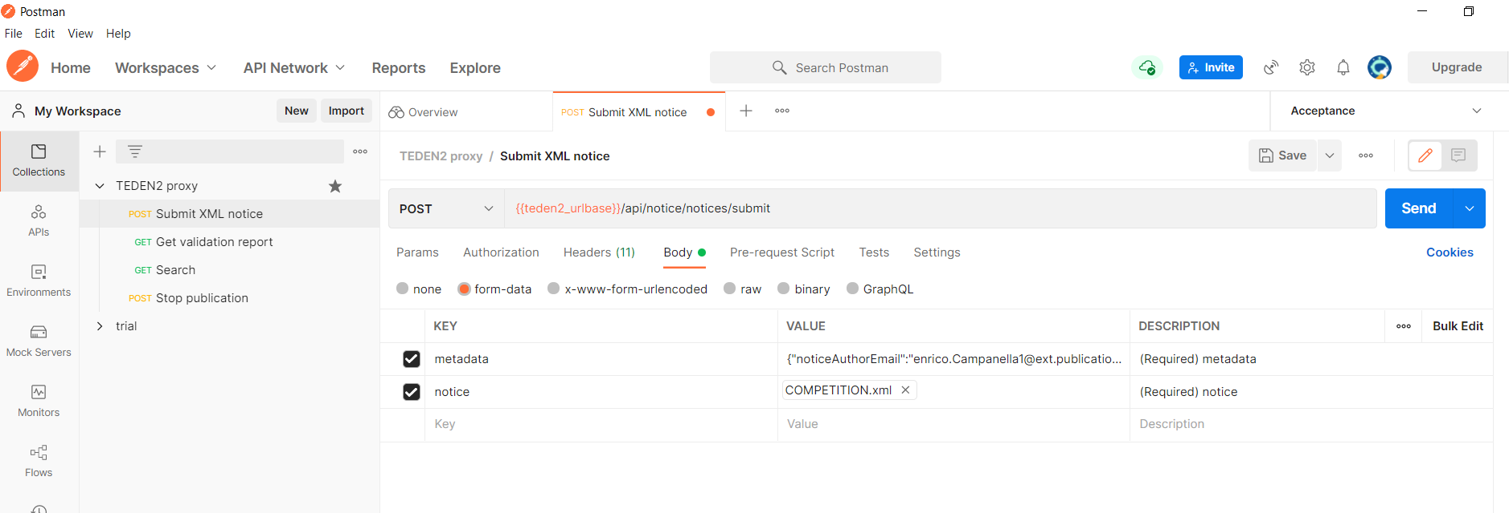
Submit xml notice
9

Slide 10
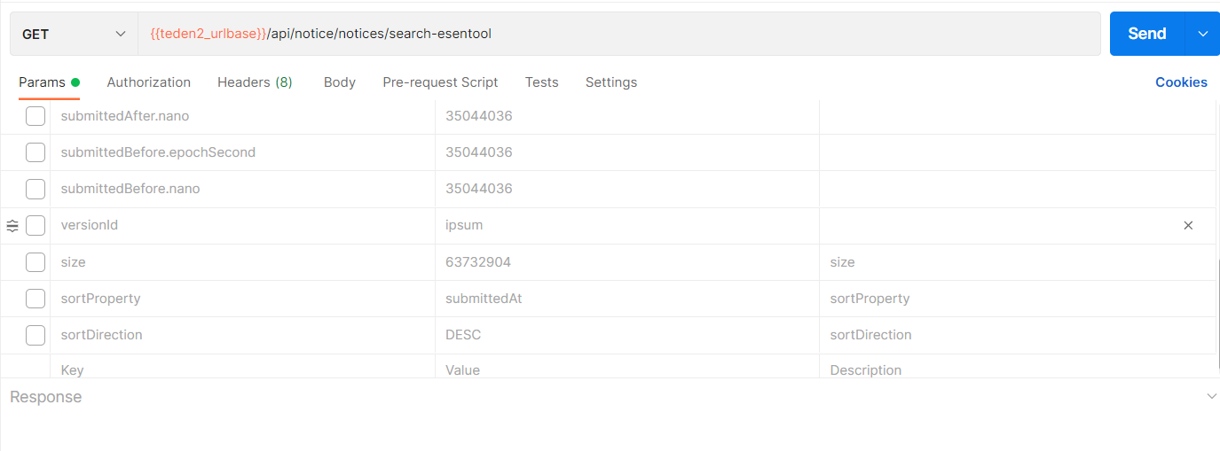
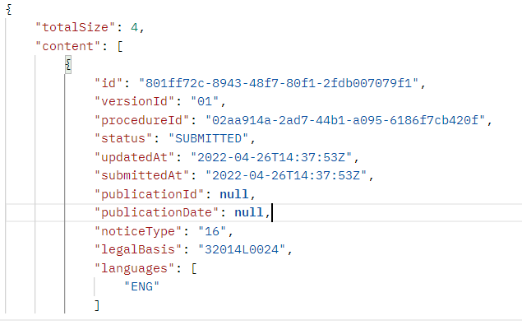
Search
10

Slide 11
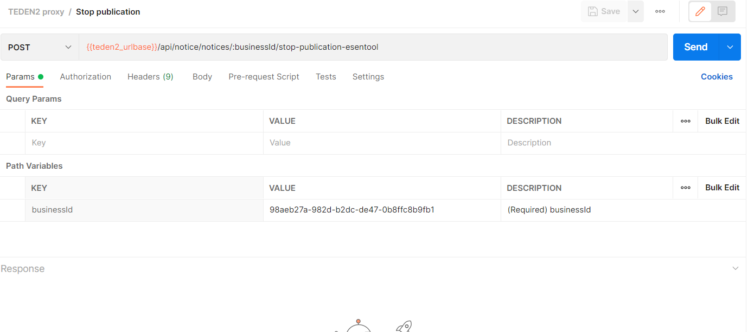
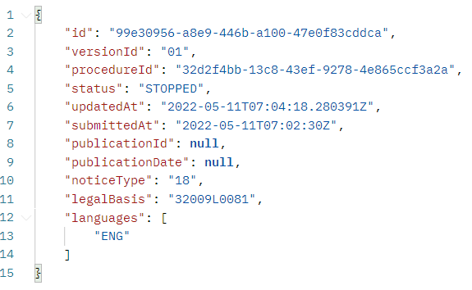
Stop Publication
11

Slide 12
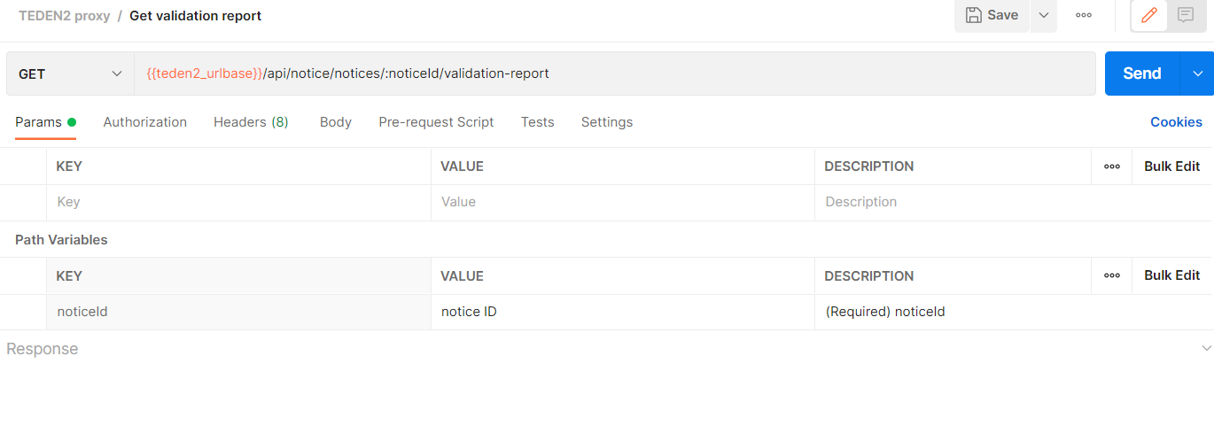
Get Validation report
12

Slide 13

Thank you for your Attention
Any questions?
Please ask your question in the Webex chat
13

