Slide 1
Overview of eforms
eForms technical workshop – 11 May 2022
Karl Ferrand – TED unit - Publications Office of the EU

Slide 2
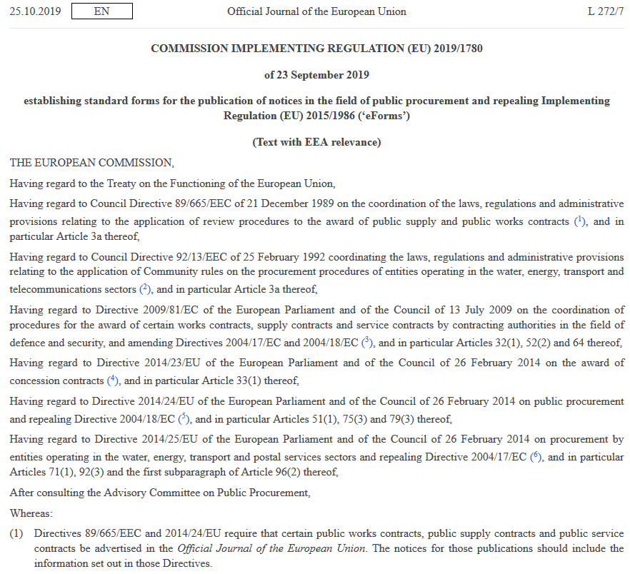
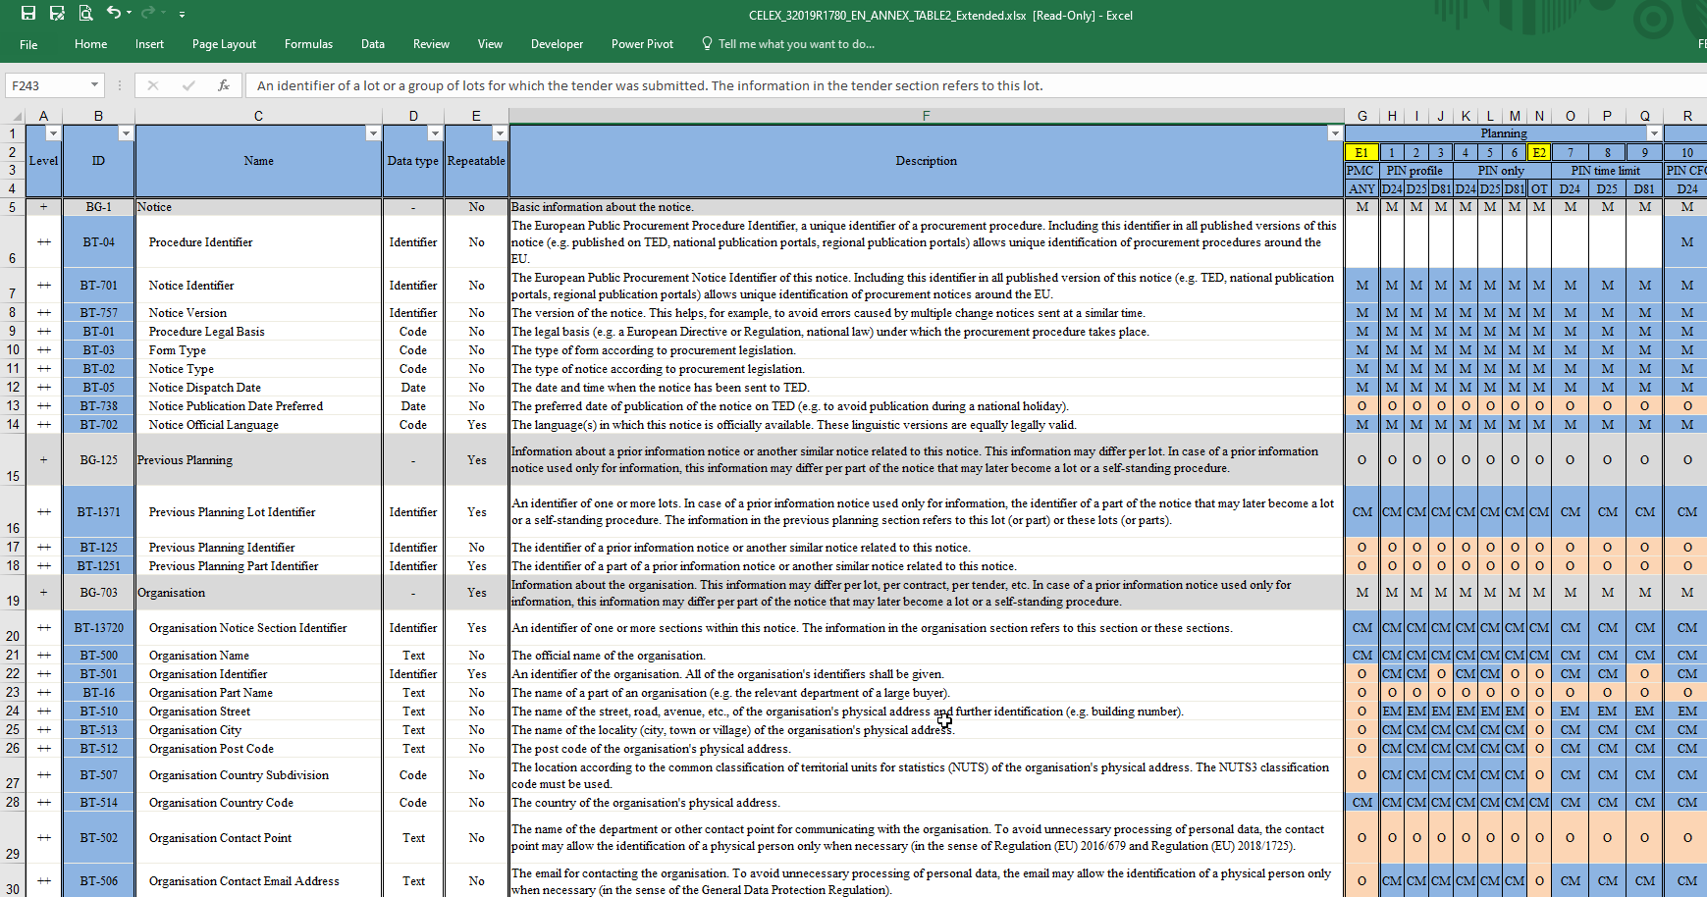
An overview of eForms implementation
How did we get here and where are we now?
Schema and rules
OP applications and Preview environment
Notice workflow
2022 amendment to the eForms regulation
Next steps
eNotices2 demo
Using APIs
Overview of SDK and developer docs

Slide 3
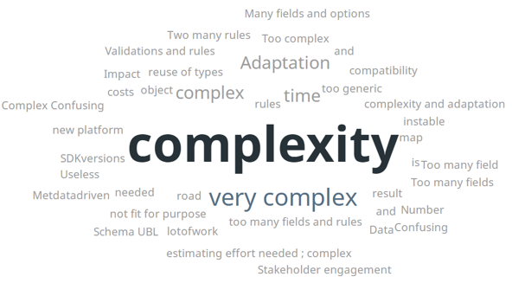
eForms so far
09/2019:
  eForms implementing regulation: annex table 2 of almost 300 Business Terms, 40 forms, Optional/Mandatory
  “Extended annex” Excel: added Conditional Mandatory, E1-E5 voluntary forms, technical BTs
12/2019: first eForms schema end of 2019, close to final by end 2020
05/2020: provisional mapping with BTs and provisional identifiers
12/2020: eSenders seminar
03/2021: first Software Development Kit
07/2021: sample PDF visualisation of all forms
09/2021: developer documentation at docs.ted.europa.eu
10/2021: eForms FAQ
11/2021: eSenders seminar
04/2022: Excel mapping of current TED-XML to eForms XML

Slide 4
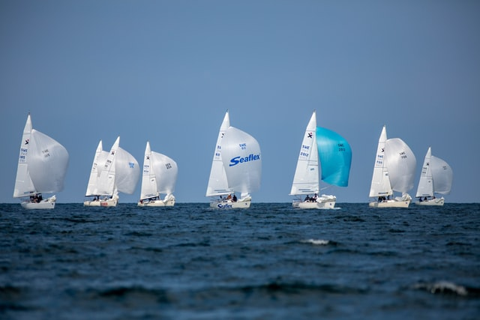
Where are we today?
SDK 0.6.0
eForms expression language and translator
Viewer templates and sample application
TED-XML data converter
Updated FAQ
“Preview” test environment
A lot is happening, a lot still needs to be done
and we have 6 months to go…
A workshop to share our progress, exchange information and tackle eForms complexity together
Photo by Daniel Stenholm on Unsplash

Slide 5
eForms schema
Uses Universal Business Language v2.3 (latest OASIS standard)
UBL also used for eInvoicing, ESPD, PEPPOL
No empty elements, no formatting
Use UBL common components (cac, cbc), add extensions for eForms-specific elements (efac, efbc)
Scope: 40 eForms for 2014 public procurement directives, plus 5 other forms
  T01, T02: regulation 1370/2007 (public passenger transport by rail and by road)
  X01, X02: business registration (European economic interest grouping and company/cooperative)
  CEI: call for expression of interest (by EU institutions)
Business Terms can exist as more than one field, depending on the context
Fields are prefixed with BT number or with OPP (OP business fields) or OPT (OP technical)

Slide 6
eForms rules
Many flavours of rules:
  Allowed for form, optional, mandatory, conditional mandatory
  Repeatable, language, text length, pattern, codelist
  Well-formed XML and schema compliance
  Business workflows and consistency
Central Validation System as single point of truth, used by all applications
If a notice is valid for CVS, it’s valid for publication on TED (except for lawfulness check)
Rules generated from SDK into Schematron
CVS returns report in Schematron Validation Report Language (SVRL)
Public API to call CVS at any stage of notice lifecycle

Slide 7
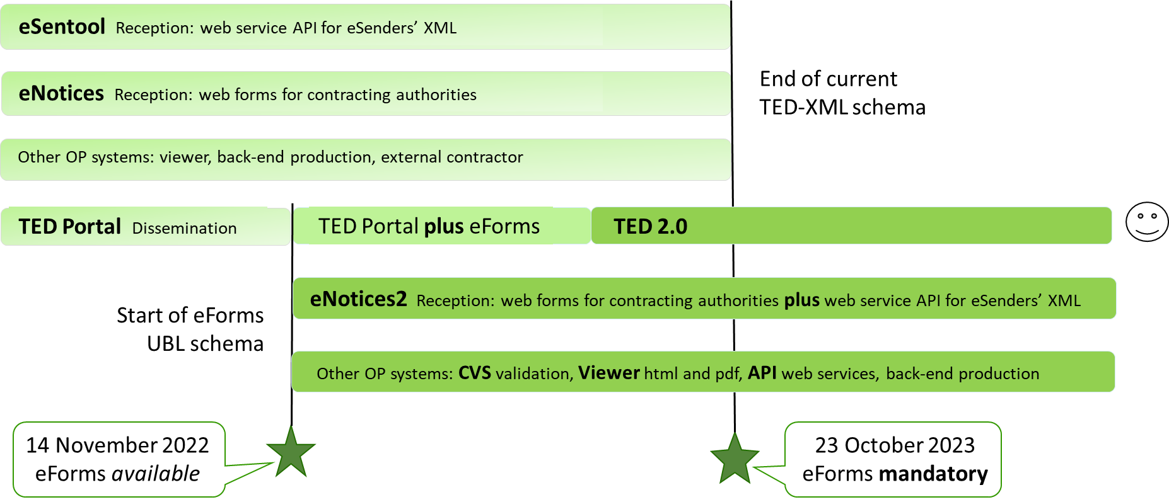
eForms transition

Slide 8
Future TED systems at EU Publications Office
Buyers
eNotices2
TED
Monitor2022
TED 2.0
Suppliers/users/reusers
eSenders
TED
Viewer2022
Central
Validation
Service
Software
Development
Kit
TED API
Reception
Production
Dissemination

Slide 9
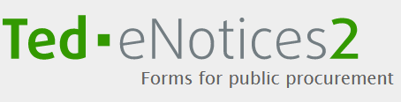
eNotices2
Website: replaces current eNotices
  Form-filling tool for 45 forms
  Manage notices: submit, continue procedure, change notice
  Workgroups, user organisations, roles, address book
  Form settings and default values
API: replaces current eSentool
  Functions: submit notice, get validation report, search, stop publication
  No qualification process, register to get API key from TED API website
Finalised by November 2022

Slide 10
CVS and TED Viewer
CVS:
  Public API to validate notices at any moment
  Technical, Schematron, also lawfulness warning
  Checks using the SDK of the notice
  Finalised in July 2022
TED Viewer 2022
  Public API to render notices XML in HTML or PDF
  Organised in sections, used by eNotices, TED Monitor and TED
  Finalised in August 2022

Slide 11

TED API, TED Monitor and TED
TED API
  Log into website with EU Login to get and manage API key – no qualification process
  Document available APIs
  Final version in acceptance testing
TED Monitor 2022 - internal to OP
  Manual check of lawfulness warnings
  Mask unpublished fields
  Generate daily export files to publish on TED
TED
  Adapt current TED to handle eForms
  Spring 2023: new TED 2.0 website, merged with SIMAP, new search and functionality

Slide 12
Notice status
Draft, Locked, Validated: working within eNotices2
Submitted: validated and sent to OP (received by TED Monitor)
Publishing: included in export for TED, cannot be stopped
Published: notice online on TED
Stopped: user request to stop notice before publication
Not published: notice received but not published on TED

Slide 13
New Preview environment
Test environment was planned for Q2 2022
« Preview » follows the OP’s internal acceptance environment
Allows for testing of applications and functions
Make systems available progressively as soon as ready
Currently: eNotices2 website and Swagger UI for API
Next: TED API website (need API key) and APIs for eNotices2, CVS and TED Viewer
Aim to have all applications available by end of June
  but not all finished, integrated or using latest SDK
  New documentation page with URLs and status of each application:
  https://docs.ted.europa.eu/home/eforms/preview/

Slide 14

2022 amendment to eForms regulation
DG GROW is consolidating and consulting the planned changes to annex table 2 (business terms and forms)
Aim to publish in autumn, to apply from 14 November 2022 !
Changes for Clean Vehicles Directive, green procurement, innovative procurement, errors, corrections, clarifications
Annex changes: 8 new fields, 2 new codelists, changes to several BT names, description and O/M in forms.
Impact on schema, field metadata, rules, labels
OP will start implementing before amendment is published
Timing still to be assessed

Slide 15
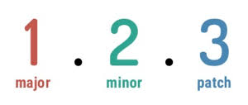
Next steps and issues
Add more services to Preview environment and document the APIs
SDK web documentation: more readable metadata reference for codelists, fields, rules
  Also update schema documentation (e.g. organisations, OPP/OPT)
Start building a converter service (API) from TED-XML to eForms schema
Version 1 of SDK by July 2022
Finish all applications and lots of testing, integrating, checking…

Slide 16

Thank you for your Attention
Any questions?
  ted@publications.europa.eu

