Slide 1
Overview of SDK & docs.TED.EUROPA.EU
eForms technical workshop – 11 May 2022
Karl Ferrand – TED unit - Publications Office of the EU

Slide 2
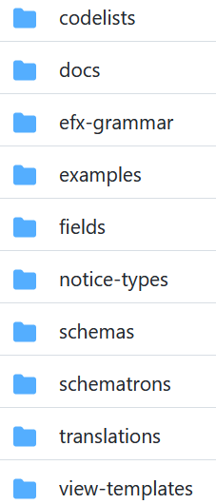
Software Development Kit
github.com/OP-TED/eForms-SDK
SDK 0.6.0
New eForms Expression Language (EFX), replaces SpEL, allows more rules
New view-templates
Updated fields, rules, notice types, codelists, examples
New code in https://github.com/OP-TED
efx-toolkit-java: Java EFX expression translator to Xpath, used for Schematron
eforms-notice-viewer: sample application, uses EFX and view-templates for HTML
ted-xml-data-converter: XSLT to convert TED-XML to eForms XML

Slide 3
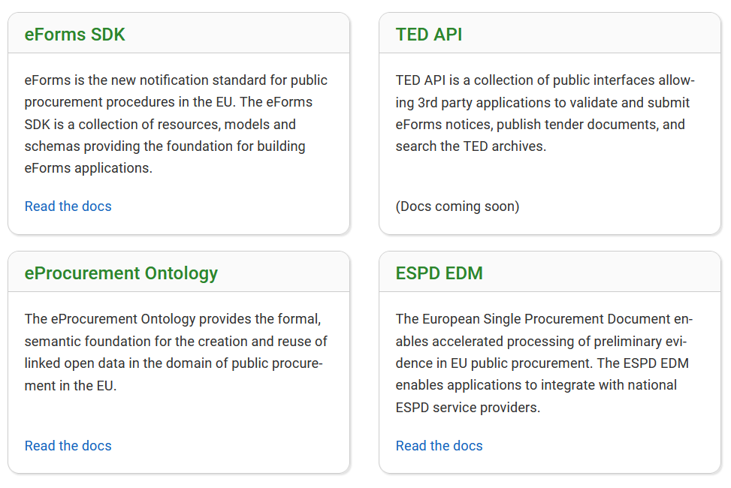
TED developer docs
docs.ted.europa.eu
FAQs
Versioned with SDK
Documentation for each SDK component: schema, field metadata, codelists, etc
SDK roadmap: docs.ted.europa.eu/home/eforms/roadmap/
Building metadata-driven applications
More documentation to come…
Also documents ESPD and eProcurement ontology

Slide 4
Thank you for your Attention Any questions?
ted@publications.europa.eu

