Slide 1
Developing eForms Applications
eForms technical workshop – 12 May 2022
Ioannis Rousochatzakis – TED unit - Publications Office of the EU

Slide 2
Agenda
What’s new
What’s next
Challenges: your perspective
Challenges: our perspective

Slide 3
What’s new
SDK 0.5.0 released in January
  Added XML Structure info
  Added Codelists
  Added Notice Type definitions
  Improved Field metadata file format
  Latest metadata (rules, translations etc.)
SDK 0.6.0 released two days ago
  eForms Expression Language (EFX)
  Notice View Templates
  Latest metadata (rules, translations etc.)
Also just released
  EFX Toolkit for Java
  Notice Viewer sample application
Coming in in a few days
  Metadata Reference Documentation

Slide 4
What’s next?
SDK 0.7.0
  Revision of Notice type definitions
  Completing EFX features
  (for loops, quantified expressions)
SDK 1.0.0
  Final revision
What comes after SDK 1.0.0
  Metadata updates

Slide 5
Takeaways from day #1
When asked about your main challenges you said:
  Integration / Tailoring
  Complexity
  Deadline / timeline
  SDK and docs have mistakes & are “not final”
  How to work with metadata and metadata driven apps
  It’s just too much, don’t know where to start

Slide 6
Working with metadata driven apps
Challenge #1

Slide 7
Metadata driven architecture
It’s not rocket science
The idea is:
  Let your developers focus only on the technical details
  Abstract away all business details
  like “when this field is mandatory” or “which codes are applicable for that field” etc.
The SDK is supposed to contain all the metadata you will ever need.
If something is wrong or missing just let us know and we will address it in a subsequent release.
Read this: https://docs.ted.europa.eu/eforms/latest/metadata-driven-applications.html

Slide 8
To hardcode or not to hardcode?
Hardcoding is not practical because
  It does not require less analysis
  It does not require less effort
  It does not require less time
eForms is too big to hardcode anyway
Starting a new development cycle for every change in eForms is not sustainable

Slide 9
SDK, docs not final + have mistakes
Challenge #2

Slide 10
The need for a “stable version”
What is a stable version?
  Major (a.k.a. “breaking “) changes = changes that require developer intervention.
  Minor changes = changes that affect notice validation (i.e. new fields, new schema, new rules, codelists, etc.).
  Revisions (a.k.a. patch releases) = every other type of change (i.e. fixing mistakes, typos, etc.).
First stable version will be 1.0.0.
  Target date for 1.0.0 = end of July.
  That does not mean that there will be no other releases before November.
Read: https://docs.ted.europa.eu/eforms/latest/versioning.html

Slide 11
Integration / Tailoring
Challenge #3

Slide 12
Integration / Tailoring
Bottom line:
  We cannot get involved in national tailoring and integration.
However:
  We will do all we can so that:
    The SDK is not an impediment (to your integration and tailoring efforts)
    If possible, the SDK is friendly (to your integration and tailoring efforts)
Examples of challenges that could be addressed by using the SDK
  Simple things like
    an optional field becoming mandatory at MS level
    reusing the SDK model for your tailoring needs
  More complex things like
    using EFX to tailor some rules

Slide 13
Complexity, Deadline, “too much work”
Challenges #4 #5 and #6

Slide 14
I think we just covered these
A metadata driven application using the SDK will save you time.
  All the time we have spent already consolidating the metadata
  (every rule, every field, every codeliist, translations etc.).
  All the time we will spend maintaining and updating the metadata
  (as eForms inevitably evolves in the future)
  All the time that you will need to spend together with your development team to maintain and update a hardcoded application (after every little change in the SDK)
Working with the SDK will also reduce complexity
  Why read understand and code every single business rule or every single field? Why even care how many there are?
  (All your application needs to know is what types of fields and rules exist and where to find them)

Slide 15
Challenges as we see them

Slide 16
Challenges addressed by the SDK
How to create a form for filling a notice → Notice type deffinitions + Field metadata (in fields.json)
How to create the XML → Field metadata + XML structure (in fields.json)
How to find the proper codelist to use for a specific notice → codelists in the SDK
How to validate on the server side → Schematron
How to validate on the client-side → validation rules in fields.json
How to have the same validation rules run in Schematron and JavaScript → EFX expressions
How to visualise any notice → EFX templates
How to translate EFX in other languages → EFX Toolkit
Internationalisation → Procurement labels in the SDK (in translations)
How to convert a TED XML notice to eForms → TED XML Data Converter
How to publish detailed metadata reference documentation → docs.ted.europa.eu
How to maintain documentation of several versions of the SDK in parallel → docs.ted.europa.eu

Slide 17
Metadata driven applications – Challenges
How to load/consume the SDK
  Use eForms SDK data directly from a local copy?
  Load SDK data to a repository to combine them with MS tailoring/integration data?
Working with only one SDK version at a time?
    Possible if your app only creates new notices.
Working with multiple SDK versions in parallel?
    Necessary if your app needs to manipulate notices created with an older version of eForms.
Handling dependencies
  Import dependencies
  Runtime dependencies

Slide 18
Understanding parallel versions
Every new version of the SDK that is published remains active indefinitely
(it is not replaced by the subsequent versions)
The OP will accept notices created using any version of the SDK that was active the day they were submitted. There will be a range of versions that are active. (e.g. from 1.2.x to 2.4.x)
There may be more than one major versions active at the same time.
There may be more than one minor versions active at the same time.
Every patch release is meant to replace the previous patch.
Using the latest patch of a versions is always recommended.
When your application creates a notice then it is the application that dictates the version of the SDK to be used.
When your application reads a notice, then it is the notice that dictates the version of the SDK to be used. (see cbc:CustomizationID)
A version of the SDK becomes outdated and will be discontinued only when the notices it creates are no longer acceptable as valid by the active regulation.
The OP will maintain with patches and minor releases of the SDK all active major versions.

Slide 19
Working together
Our goal is to create the conditions for eSenders to be able to perform their function/business in a sustainable and efficient manner.
Our focus is to solve the underlying problems.
Building the eSender applications and business processes is the responsibility of each eSender
We are interested in knowing the individual problems eSenders are facing but we can only focus on solving the underlying issues that can be addressed through updates of the SDK.
Should we open the Github discussions for technical feedback?
Is another channel preferable like Teams, or Slack or Zulip?
Whatever we do to improve our communication will have wait for SDK 1.0.0 to be released.

Slide 20
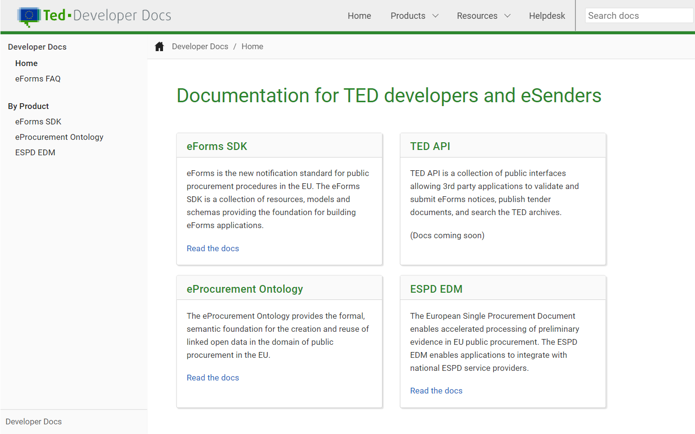
Thank you
Documentation available at:
http://docs.ted.europa.eu
I am ready to answer your questions

Slide 21
Questions
If there are any eSenders in the audience that evaluated the option of using the SDK but rejected it, I would like to hear from you what was the deciding factor.
Michaël De Winne from Belgium asked:
  How do other member states plan to integrate eForms in their existing platforms?
  Will they sync data between the forms and the platform and if so how?
  Do they plan to maintain the agnostic / dynamic approach of the SDK or will they rather hardcode the eForms in their platform?

