Slide 1
Visualisation of eFoRms notices
eSenders webinar – 10 November 2021
Karl Ferrand - Publications Office of the EU

Slide 2
Agenda
The challenge to display eForms
TED Viewer 2022
Principles applied to visualise eForms notices
Description of sections and subsections
Useful links
Q&A.

Slide 3
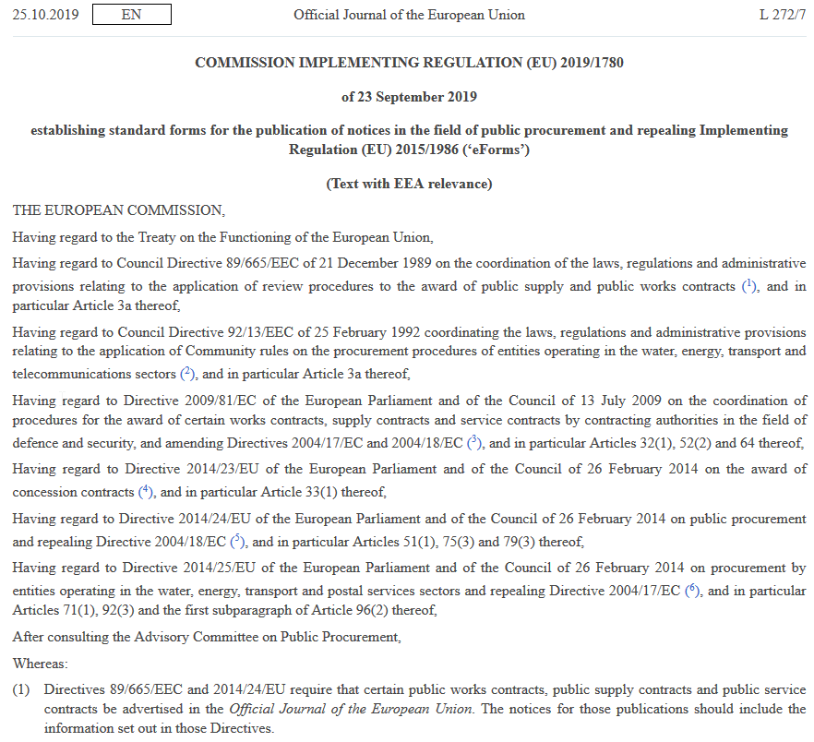
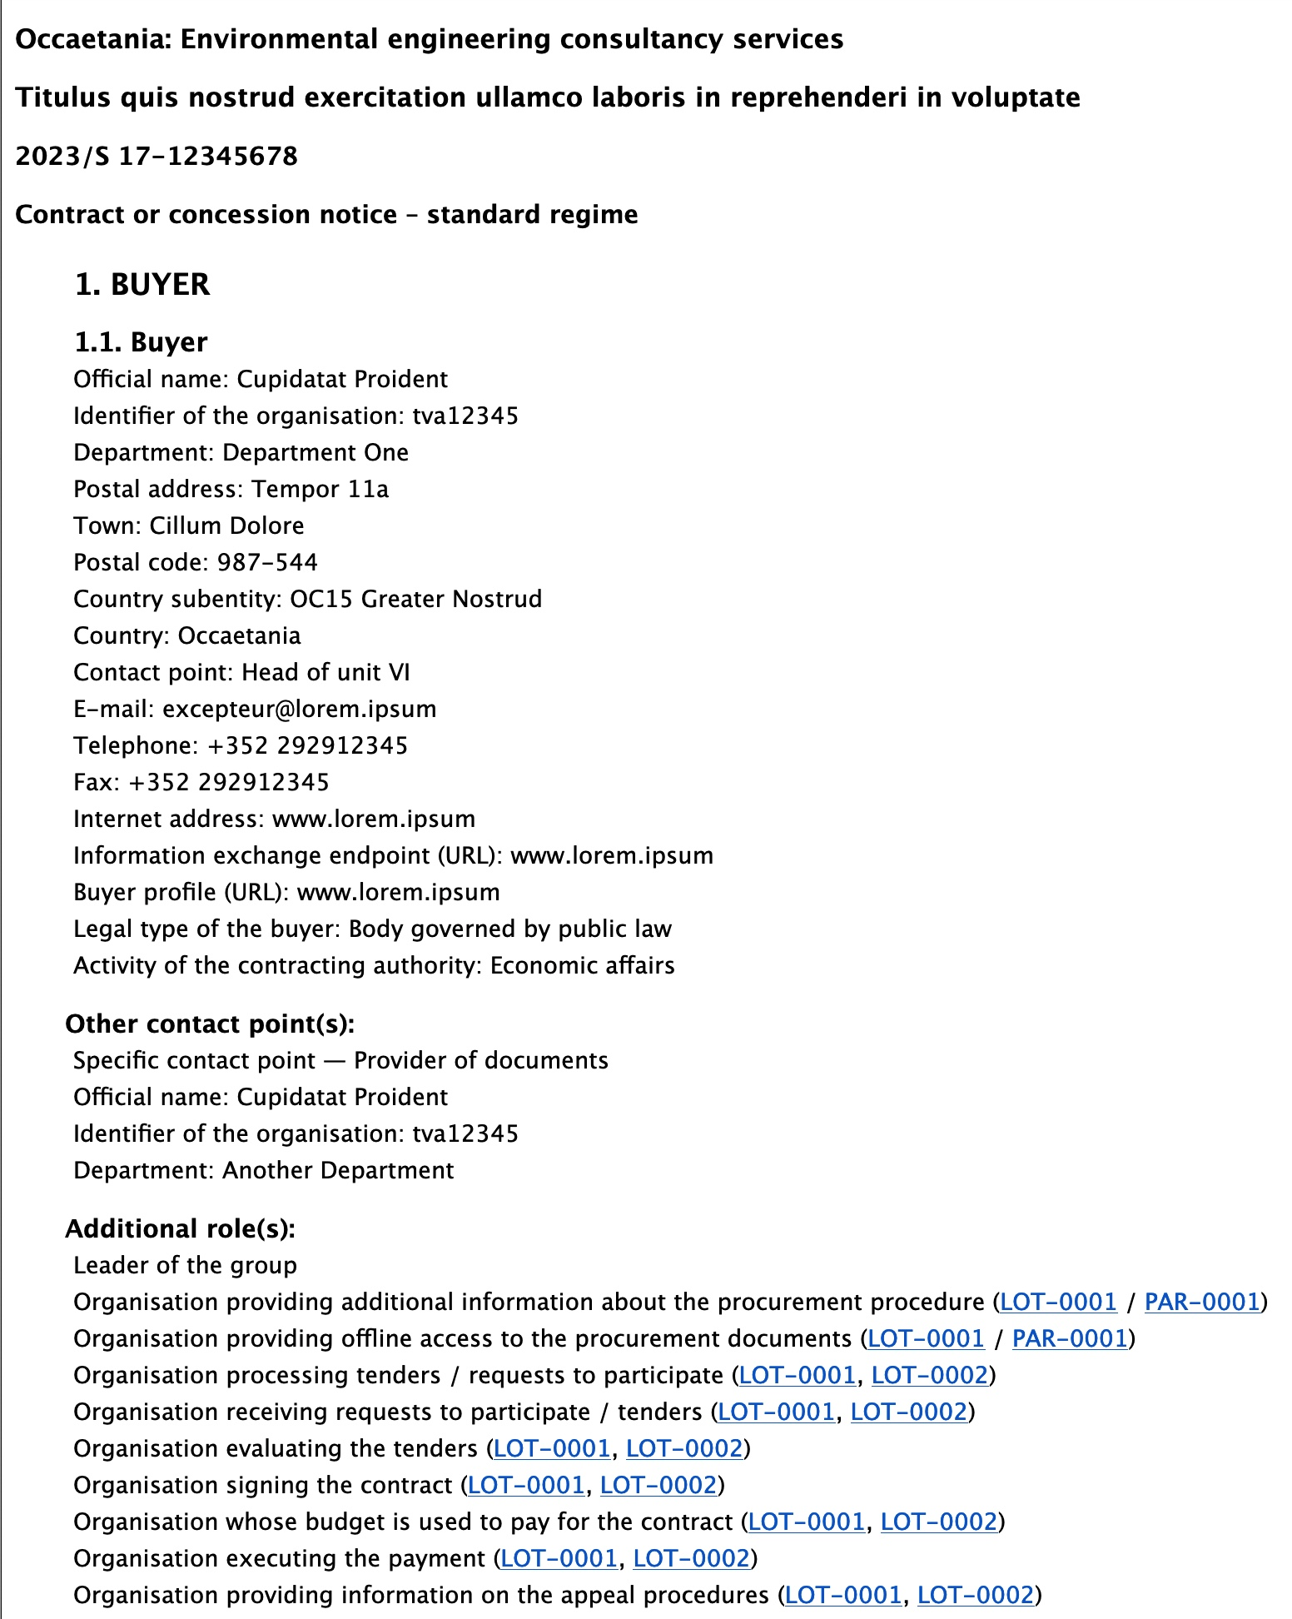
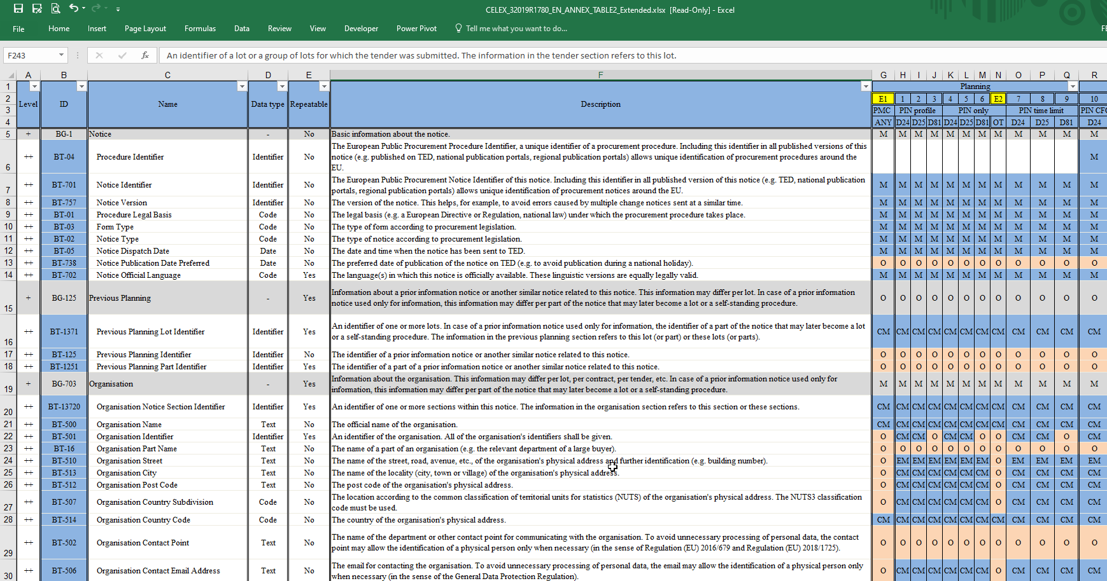
New forms, new display
How to get from these tables…
…to a more user-friendly view of information?

Slide 4
TED Viewer 2022
Common module for external and internal systems at Publications Office
Receives eForms XML and returns PDF or HTML
Development started, ready by Q2 2022
Current TED Viewer will continue to display current TED-XML notices
Buyers
eNotices2
TED
Monitor 2022
TED
(until TED 2.0)
End users
eSenders
TED Viewer 2022
TED Viewer 2022

Slide 5
Principles applied to visualise eForms notices
Define a single structure allowing to visualise all types of eForms notices
Organise the information into sections and subsections
Number the sections and subsections
Where needed, adapt BT names to be meaningful for the reader
eForm information structure
1. BUYER
2. PROCEDURE
3. PART
4. GROUP OF LOTS
5. LOTS
6. RESULTS
7. MODIFICATION
8. ORGANISATION
9. CHANGE
10. NOTICE INFORMATION

Slide 6
Section 1. BUYER
1. BUYER
1.1. Buyer
The section BUYER contains:
  Information related to its organisation (e.g. Official name (BT-500); Organisation identifier (BT-501), etc.) ;
  Information of the buyer (e.g. Buyer profile (BT-508); Buyer legal type (BT-11); Buyer contracting entity (BT-740); Contracting authority activity (BT-10); Contracting entity activity (BT-610));
  The section buyer can contain several buyers (e.g. in case of a joint procurement)
  A buyer can have several roles (e.g. Central purchasing body acquiring supplies and/or services intended for other buyers )
  A buyer can have several subroles (e.g. Group leader, Organisation executing the payment) assigned to specific lots (e.g. Document provider organisation for LOT-0001 and LOT-0003)

Slide 7
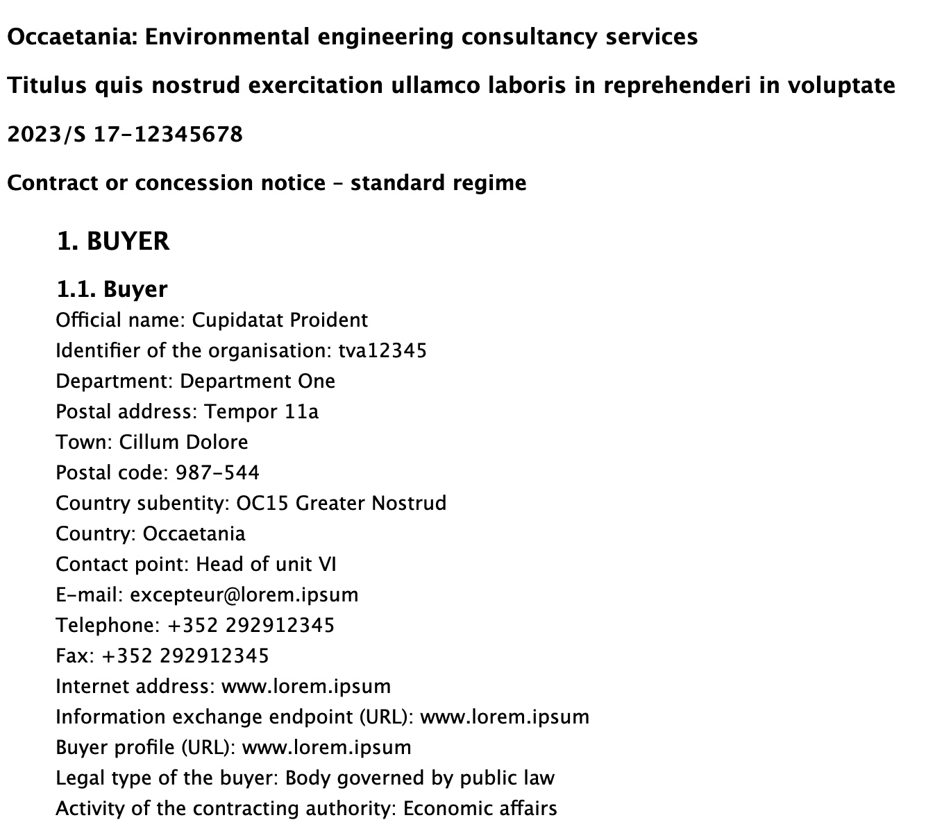
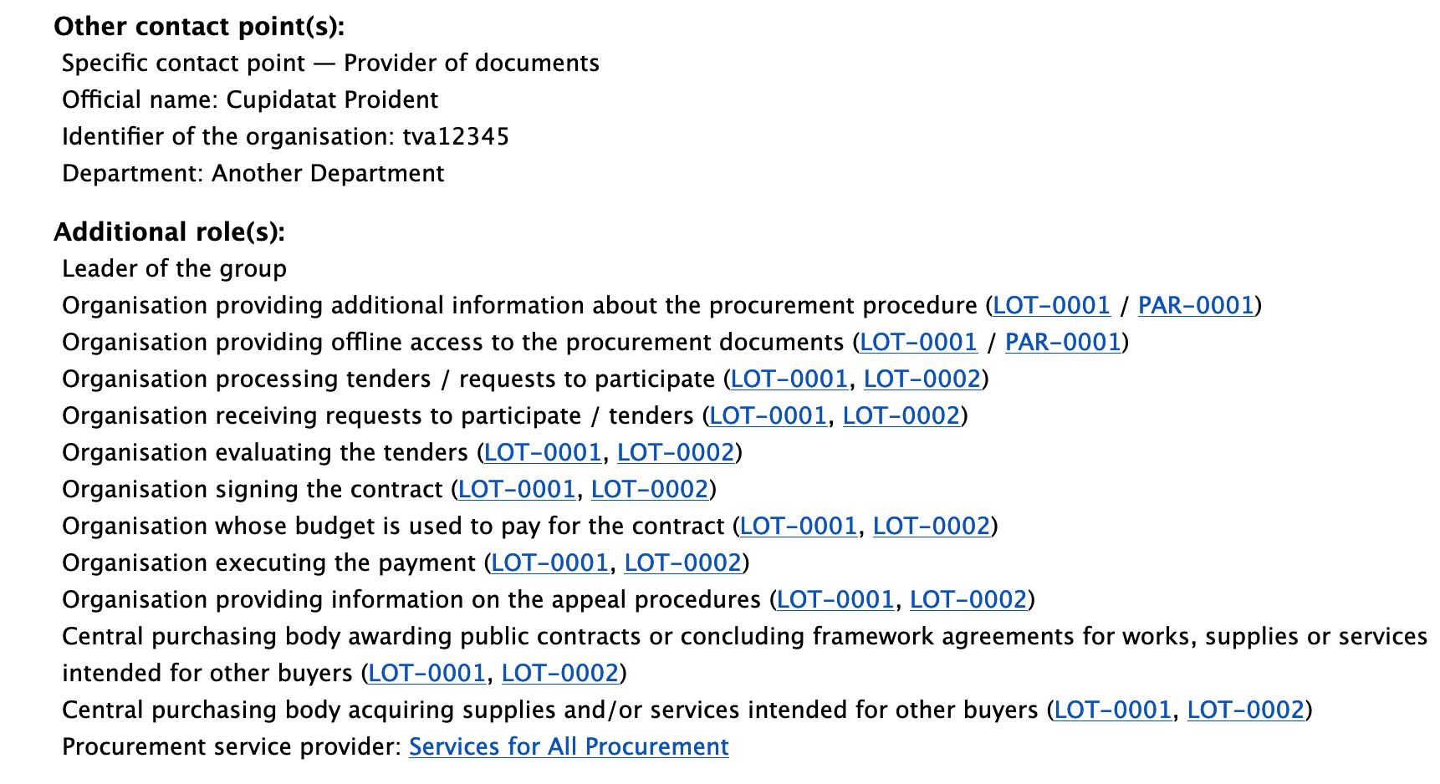
Section 1. BUYER

Slide 8
Section 2. PROCEDURE (1/2)
2. PROCEDURE | Section content
2.1. Procedure
2.1.1. Purpose | Description of the procurement (BT-24); Procedure Identifier (BT-04); Internal identifier (BT-22); etc.
2.1.2. Place of performance | Title (BT-21); Description of the procurement (BT-24); Procedure Identifier (BT-04); Internal identifier (BT-22); etc.
2.1.3. Value | Estimated value excluding VAT (BT-27)
2.1.4. General information | Call for competition is terminated (BT-756); Additional information (BT-300); Legal basis (BT-01); etc.

Slide 9
Section 2. PROCEDURE (2/2)
2. PROCEDURE | Section content
…
2.1.5. Procurement terms | Submission terms (BT-31, BT-763); Contract terms (BT-33).
2.1.6. Exclusion grounds | Exclusion Grounds (BT-67)

Slide 10
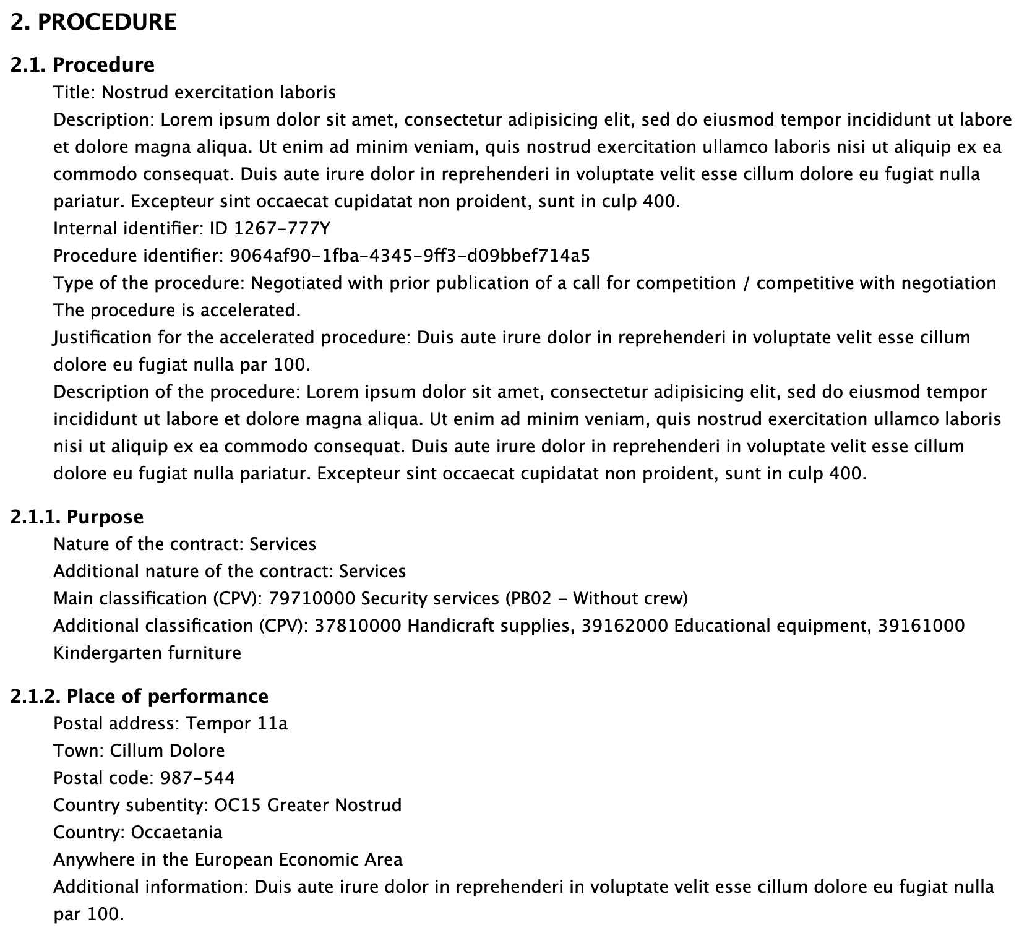
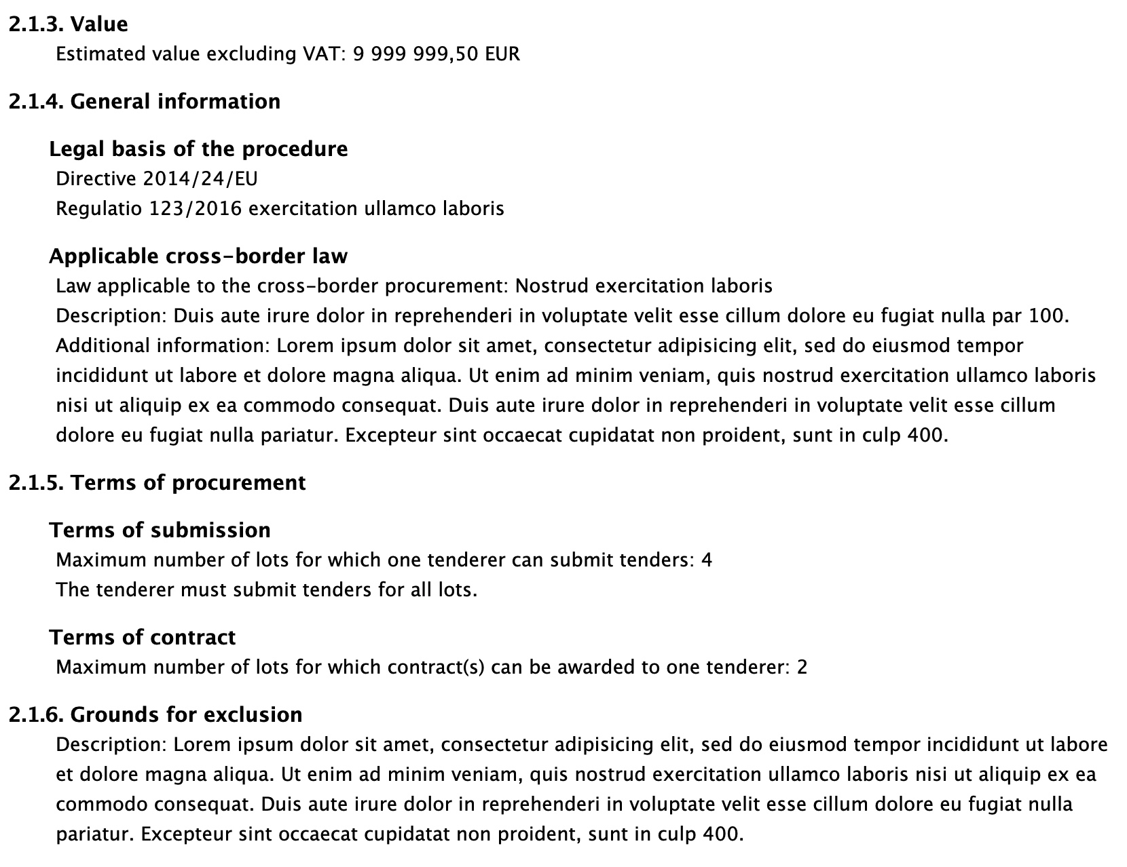
Section 2. PROCEDURE

Slide 11
Section 3. PART (1/2)
3. PART | Section content
3.1. PAR-0001 | Part identifier (BT-137); Title (BT-21); Description of the part (BT-24); Internal identifier (BT-22).
3.1.1. Purpose | Main nature (BT-23); Additional nature (BT-531); Main Classification (BT-262); etc.
3.1.2. Place of performance | Place Performance Street (BT-5101); Place Performance City (BT-5131); Place Performance Post Code (BT-5121); etc.
3.1.3. Duration (Planned period) | Duration Start Date (BT-536); Duration End Date (BT-537); Duration Period, Duration Other (BT-36, BT-538)
3.1.4. Value | Estimated value (BT-27); Group Framework Estimated Maximum Value (BT-157)
The section PART is only used for the notices where the notice type is ‘Prior information notice' or ‘Periodic indicative notice used only for information’

Slide 12
Section 3. PART (2/2)
3. PART | Section content
…
3.1.5. General information | GPA Coverage (BT-115); Suitable for SMEs (BT-726); Previous Planning Identifier (BT-125, BT-1251); etc.
3.1.6. Procurement Documents | Documents URL (BT-15); Additional information deadline (BT-13); etc.
3.1.7. Techniques | Framework Agreement (BT-765).
3.1.8. Organisations | Organisations and associated subroles

Slide 13
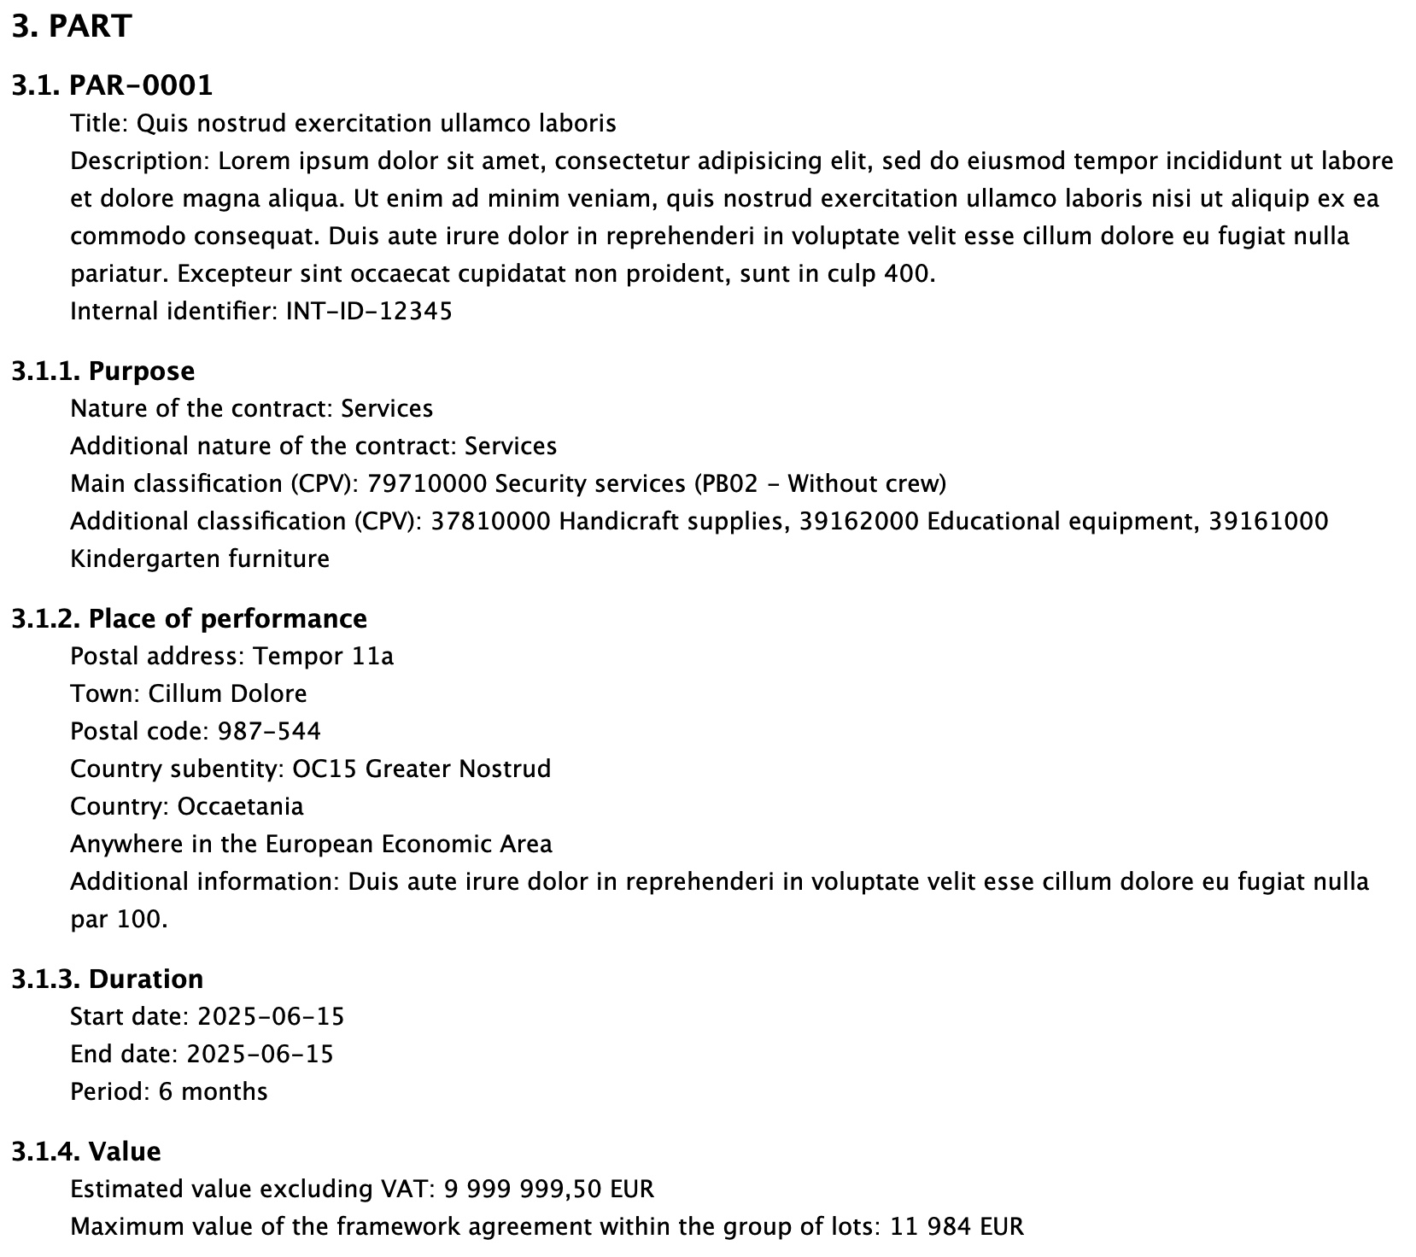
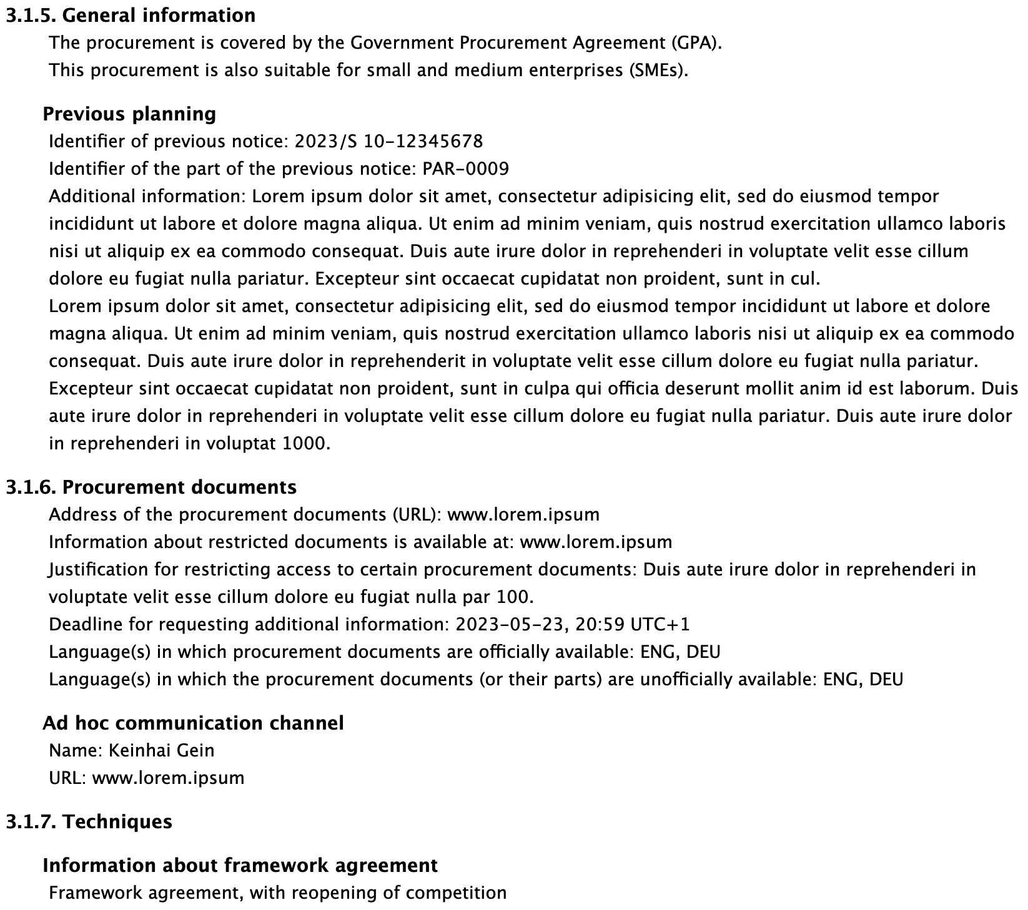
Section 3. PART

Slide 14
Section 4. Group of lots
4. GROUP OF LOTS | Section content
4.1. GLO-0001 | Group of lots identifier (BT-137); Lots included (BT-1375); Title (BT-21); Description (BT-24); Internal identifier (BT-22)
4.1.1. Value | Estimated value (BT-27); Group Framework Estimated Maximum Value (BT-157)
4.1.2. General information | Additional information (BT-300)
4.1.3. Award criteria | Criterion number; Type (BT-539); Name (BT-734); Description (BT-540); Weight (BT-5421, BT-541); etc.

Slide 15
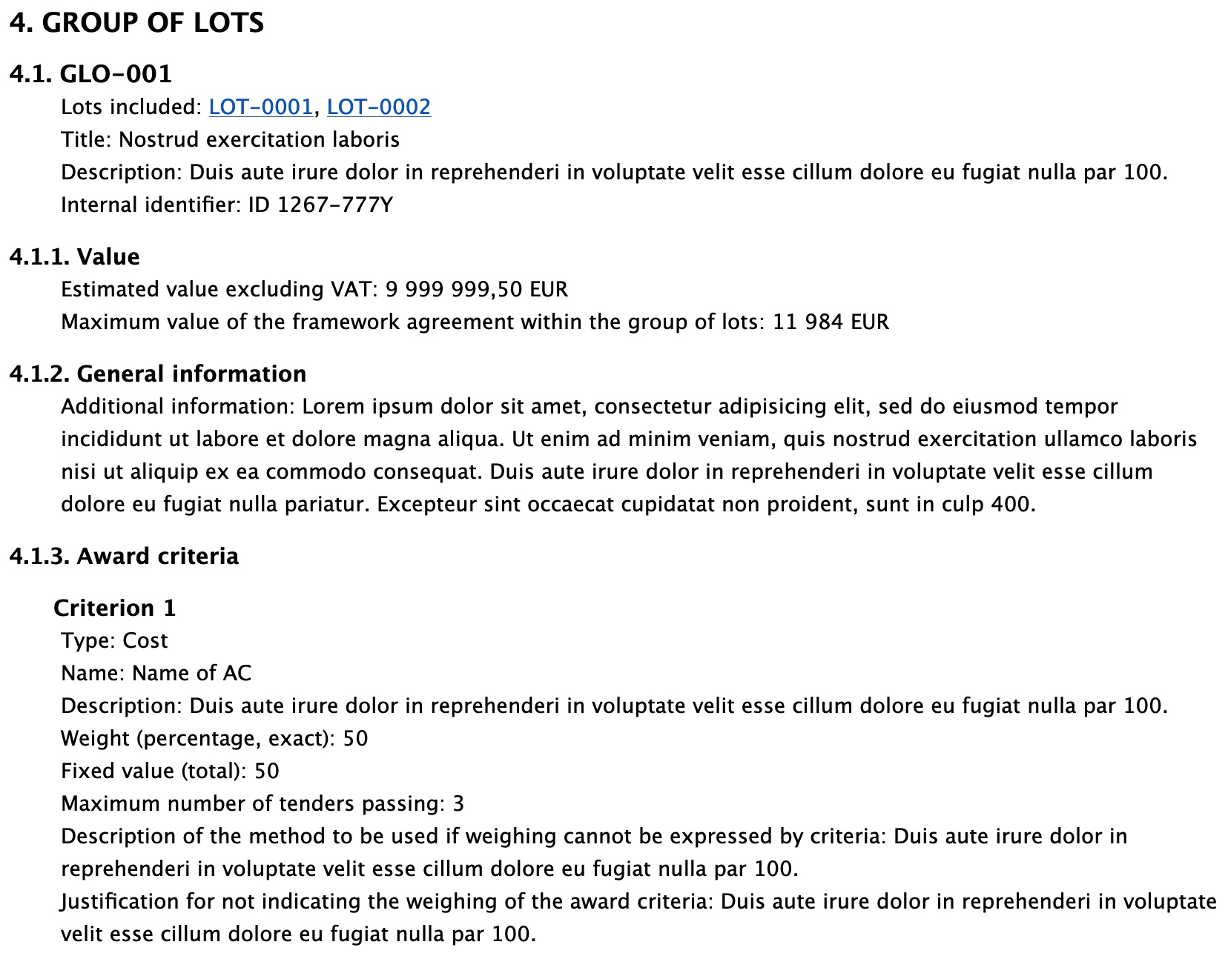
Section 4. Group of lots

Slide 16
Section 5. LOT (1/4)
5. LOT | Section content
5.1. LOT-0001 | Lot identifier (BT-137); Title (BT-21); Description (BT-24); Internal identifier (BT-22).
5.1.1. Purpose | Main nature (BT-23); Additional nature (BT-531); Main Classification (BT-262); etc.
5.1.2. Place of performance | Place Performance Street (BT-5101); Place Performance City (BT-5131); Place Performance Post Code (BT-5121); etc.
5.1.3. Duration (planned period) | Duration Start Date (BT-536); Duration End Date (BT-537); Duration Period, Duration Other (BT-36, BT-538)
5.1.4. Renewal | Renewal Maximum(BT-58); Renewal Description (BT-57).

Slide 17
Section 5. LOT (2/4)
5. LOT | Section content
…
5.1.5. Value | Estimated value (BT-27); Group Framework Estimated Maximum Value (BT-157)
5.1.6. General information | Procurement Relaunch (BT-634); Recurrence (BT-94); Recurrence description(BT-95); etc.
5.1.7. Strategic procurement | Strategic Procurement (BT-06), Strategic Procurement Description (BT-777), Green Procurement (BT-774); etc.
5.1.8. Accessibility criteria | Accessibility (BT-754); Accessibility Justification (BT-755)

Slide 18
Section 5. LOT (3/4)
5. LOT | Section content
…
5.1.9. Selection criteria | Criteria number; Selection Criteria Type (BT-747); Selection Criteria Name (BT-749); etc.
5.1.10. Award criteria | Criteria number; Award Criterion Type (BT-539); Award Criterion Name (BT-734); etc.
5.1.11. Procurement documents | Documents URL (BT-15), Documents Restricted (BT-14), Documents Restricted URL (BT-615); etc.
5.1.12. Procurement terms | Dispatch Invitation Interest (BT-631); Dispatch Invitation Tender (BT-130); Security Clearance (BT-578); etc.

Slide 19
Section 5. LOT (4/4)
5. LOT | Section content
…
5.1.13. Techniques | Framework Agreement (BT-765); Framework Maximum Participants Number (BT-113); etc.
5.1.14. Organisations | Organisations and associated subroles

Slide 20
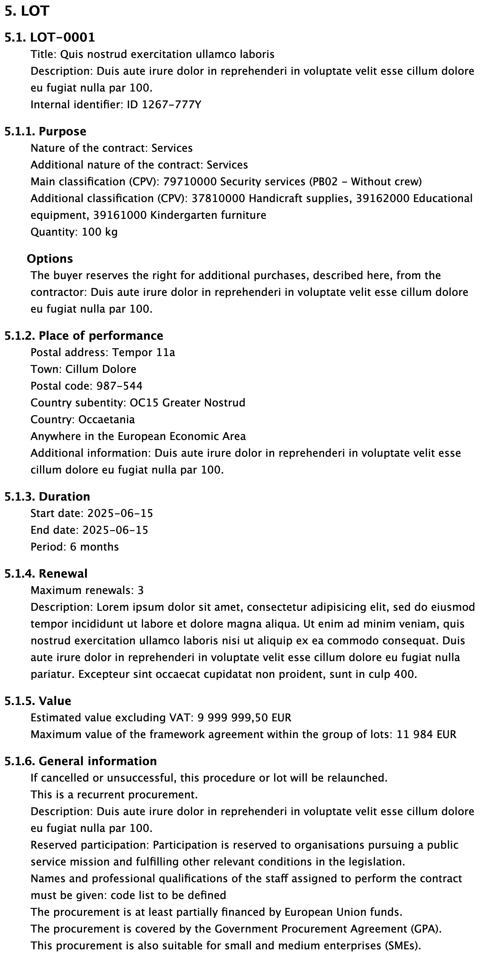
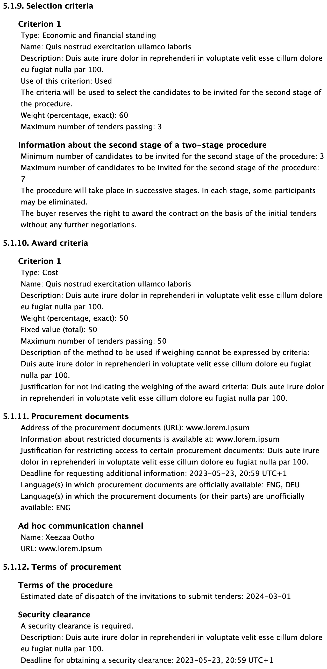
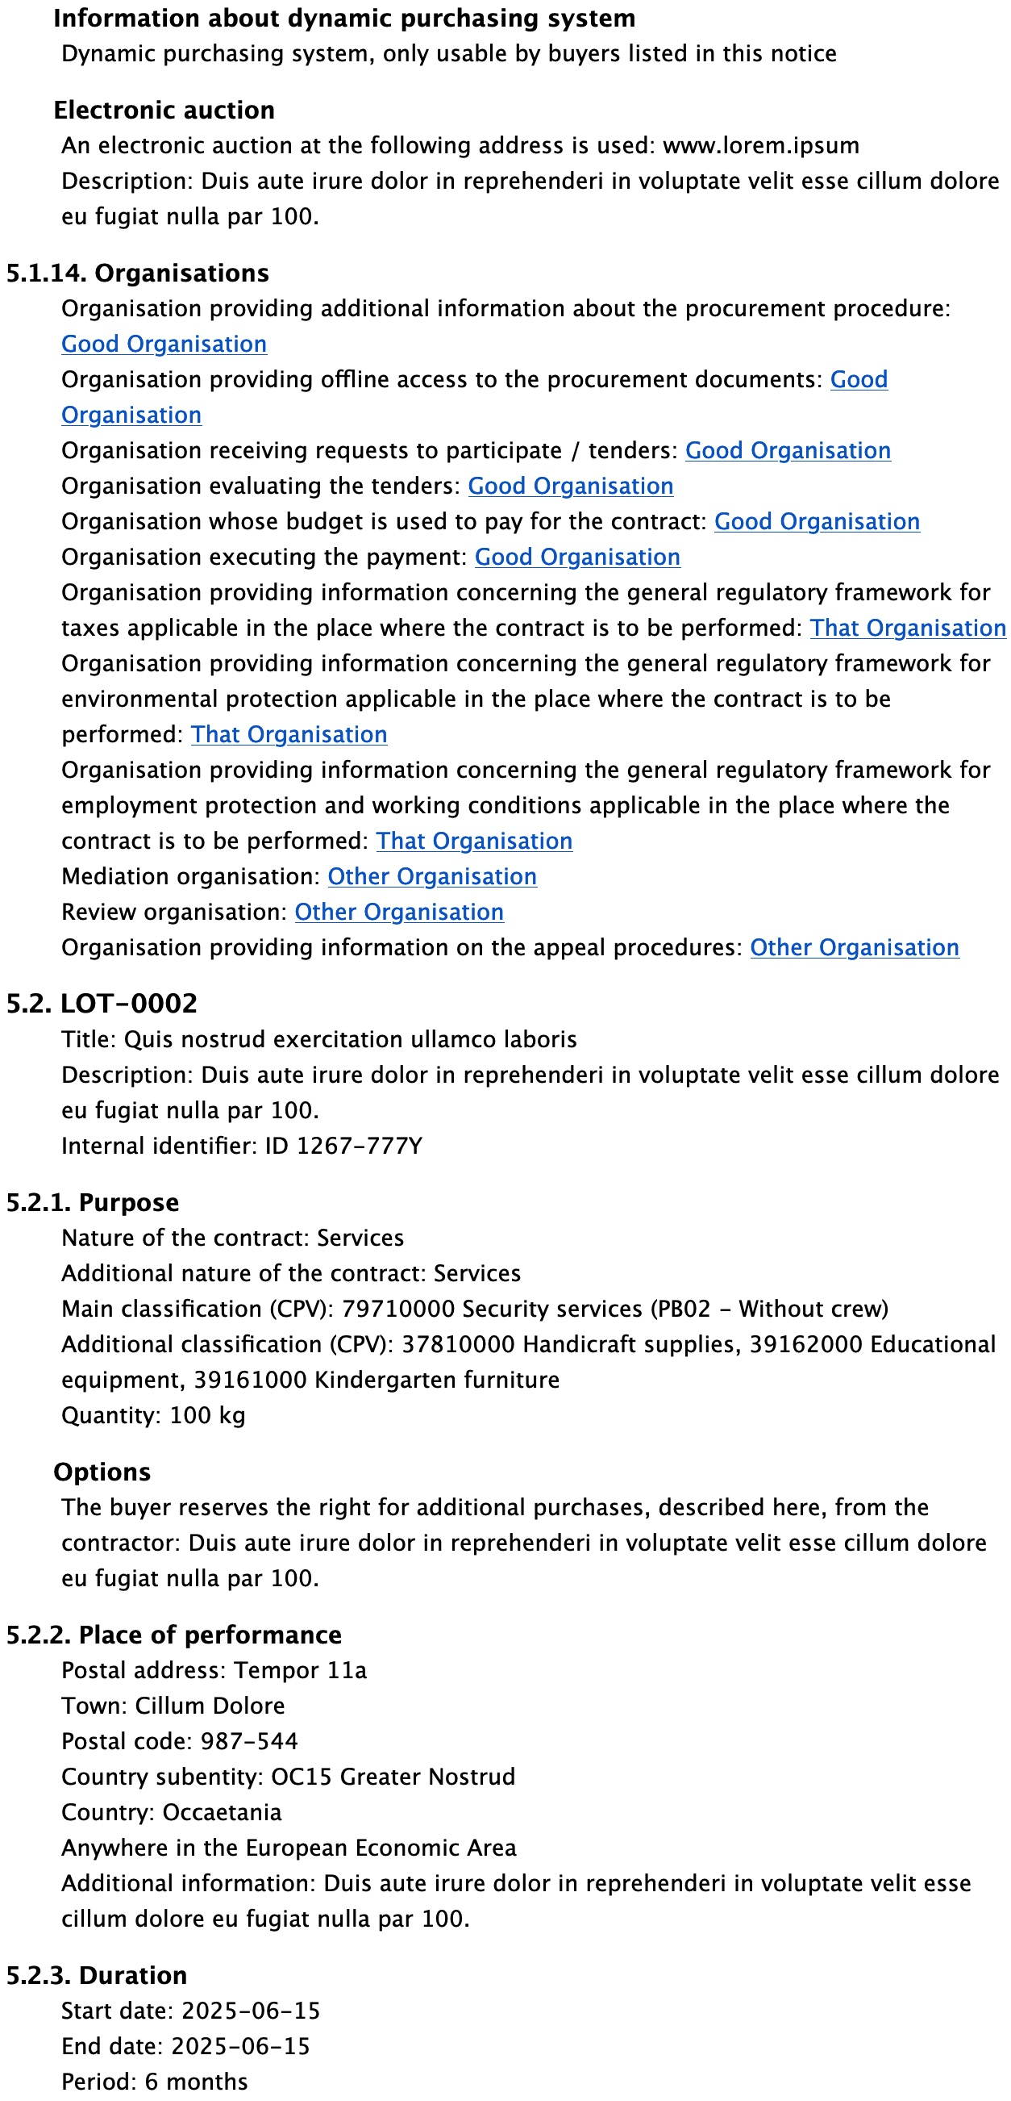
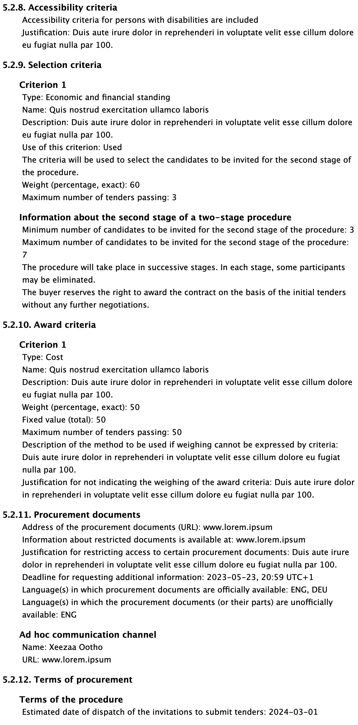
Section 5. LOT

Slide 21
Section 6. RESULTS
6. RESULTS | Section content
6.1. Results | Notice Value (BT-161); Notice Framework Value (BT-118); Group Lot Identifier (BT-1375); etc.
6.2 Results LOT-0001 | Winner Chosen (BT-142); Not Awarded Reason (BT-144); Framework Maximum Value (BT-709); etc.
6.2.1. Winning tender(s) | Tender number; Tender Identifier (BT-3201); Tender Lot Identifier (BT-13714); Tender Value (BT-720); etc.
6.2.2. Non-winning tender(s) | Non-winning Tender number; Tender Identifier (BT-3201); Tender Lot Identifier (BT-13714); etc.
6.2.3. Statistical information | Buyer Review Complainants (BT-712); Buyer Review Requests Irregularity Type (BT-636); etc.

Slide 22
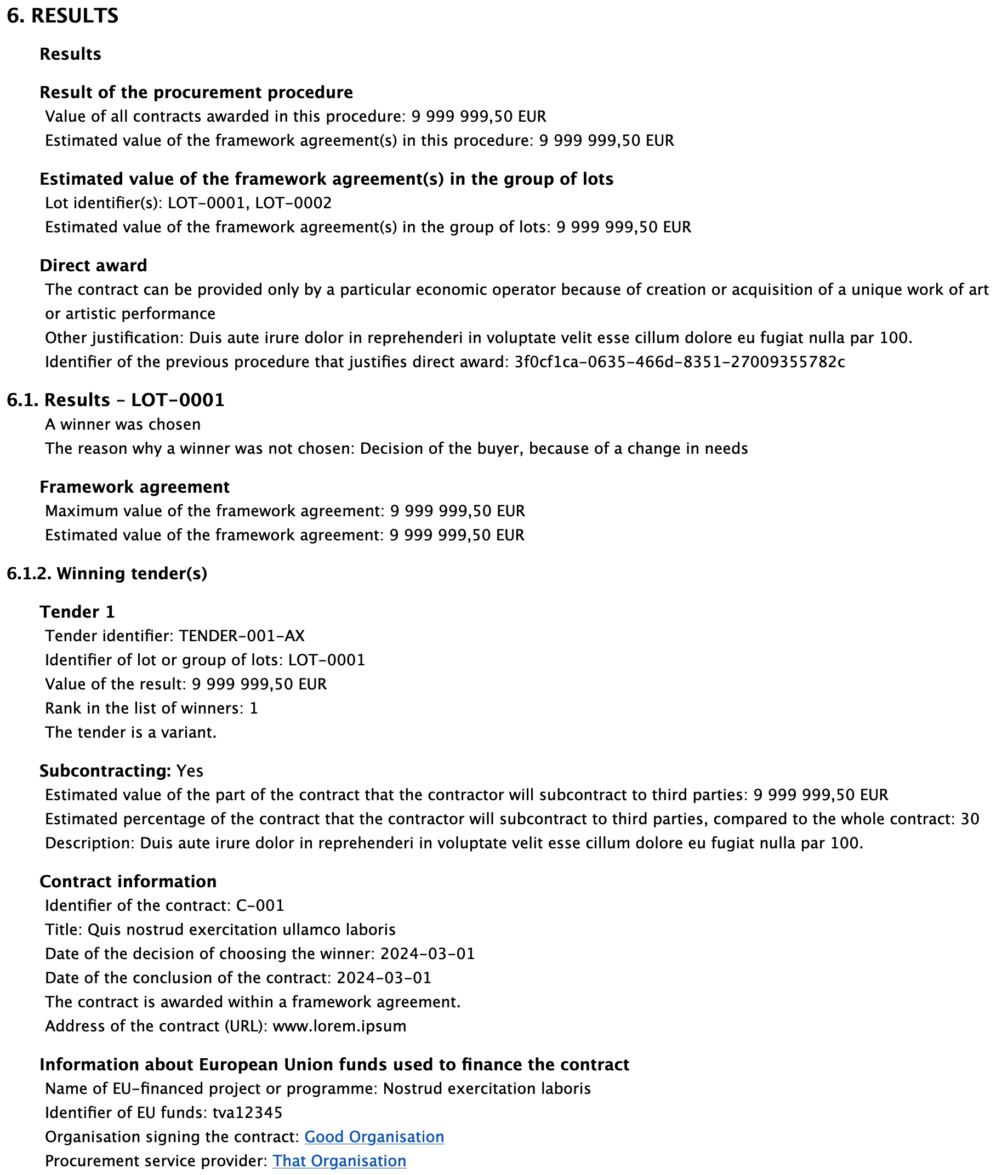
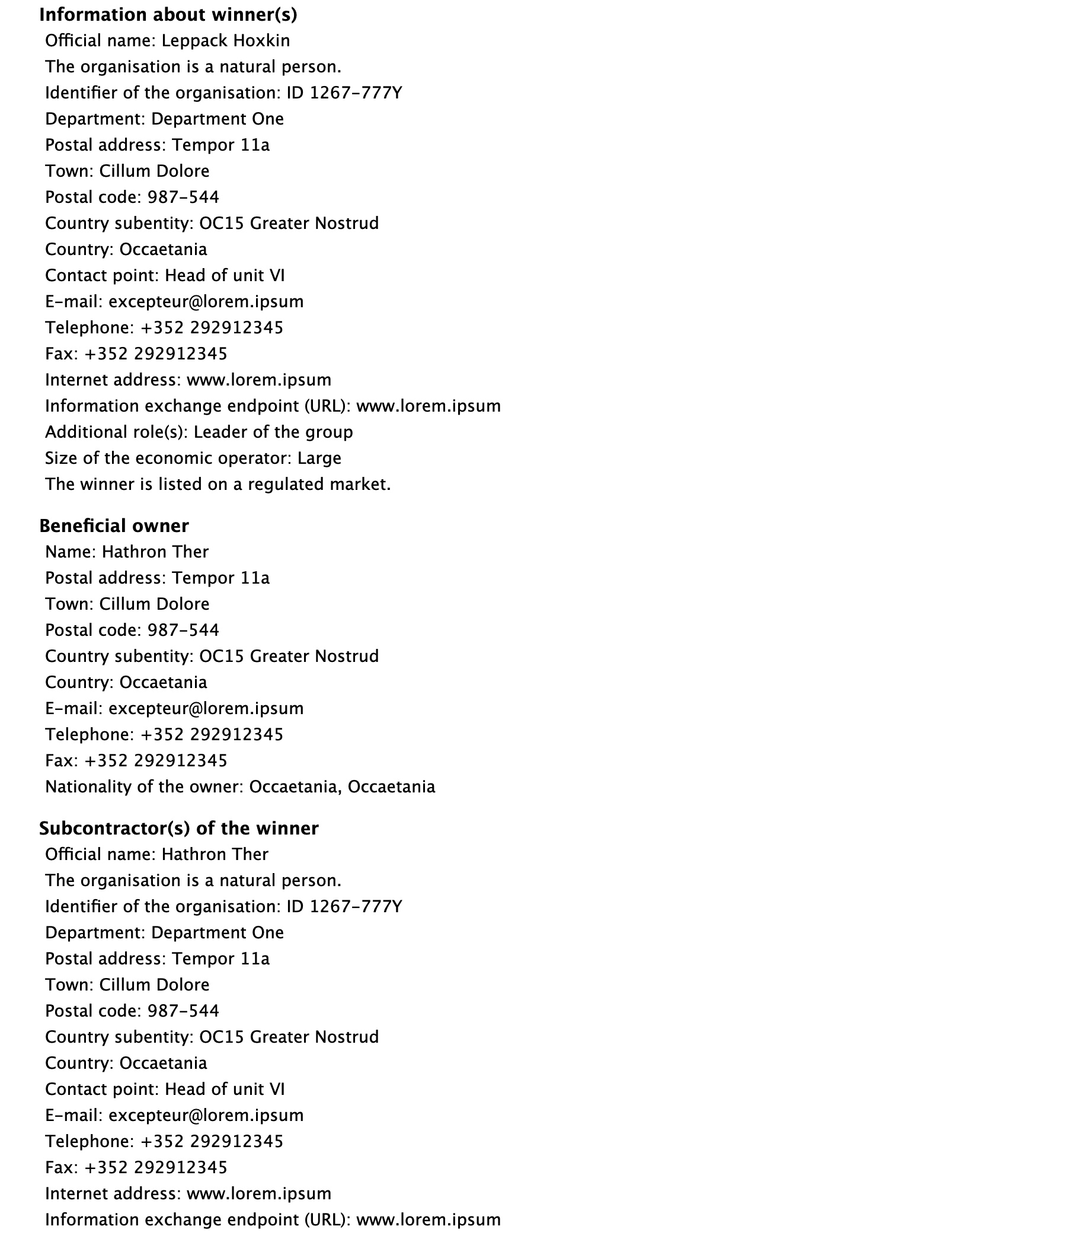
Section 6. RESULTS

Slide 23
Section 7. (CONTRACT) MODIFICATION
7. MODIFICATION | Section content
7.1. Modification | Modification Previous Notice Section Identifier (BT-1501); Modification Description (BT-202); Modification Reason Code (BT-200); Modification Reason Description (BT-201)
The section MODIFICATION is only used for notices where the form type is ‘Contract modification’

Slide 24
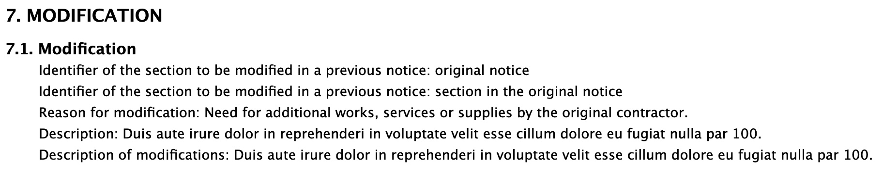
Section 7. (CONTRACT) MODIFICATION

Slide 25
Section 8. ORGANISATIONS
8. ORGANISATIONS | Section content
8.1. Organisations
8.1.1. Procurement service provider
8.1.2. Tax legislation information provider
8.1.3. Environment legislation information provider
8.1.4. Employment legislation information provider
8.1.5. Review organisation
8.1.6. Mediation organisation
8.1.7. eSender

Slide 26
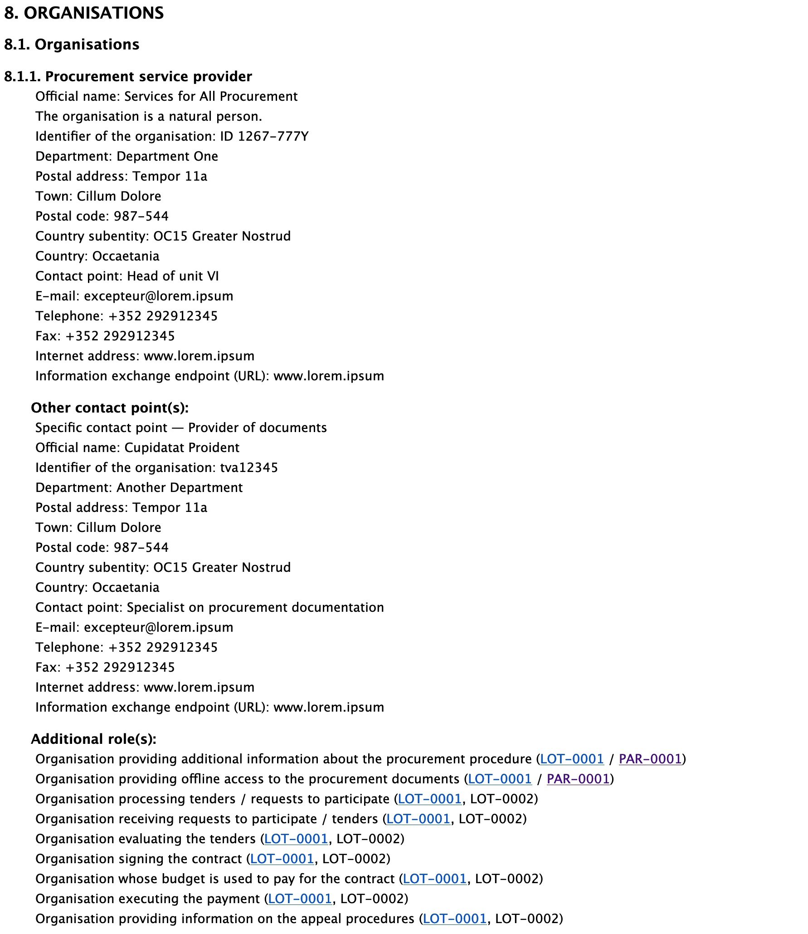
Section 8. ORGANISATIONS
Same organisation can have more than one role
Display the information only once, e.g. same buyer for many lots
List additional roles and link to specific organisations

Slide 27
Section 9. CHANGE
9. CHANGE | Section content
9.1. Change
The section CHANGE is only used for notices where the notice type is ‘Change notice’

Slide 28
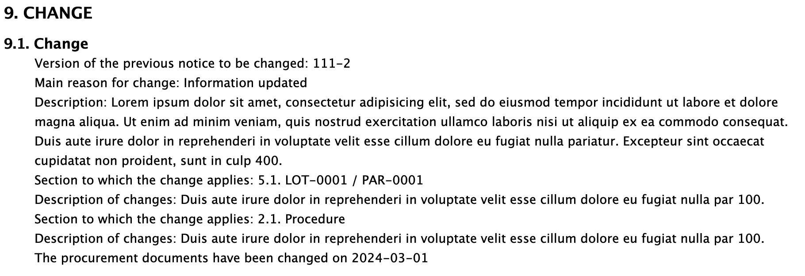
Section 9. CHANGE

Slide 29
Section 10. NOTICE INFORMATION
10. NOTICE INFORMATION | Section content
10.1. Notice information | Notice Identifier (BT-701): Notice Version (BT-757); Form Type (BT-03); Notice Type (BT-02); Notice Dispatch Date (BT-05); Notice Official Language (BT-702)
10.2. Publication information | Publication date; OJ S issue number; notice publication number

Slide 30
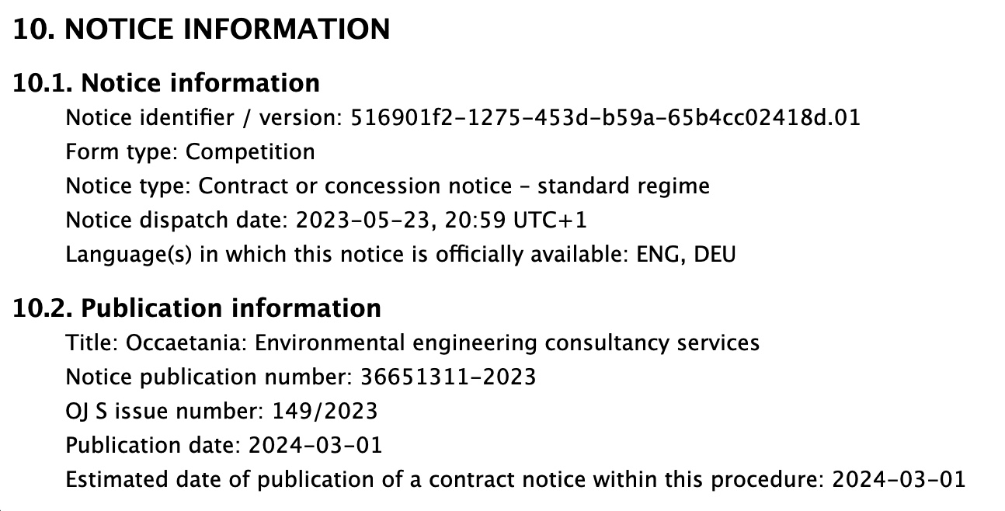
Section 10. NOTICE INFORMATION

Slide 31
“Not immediately published” data
ID | Name | Data type | Name of the codelist
BT-195 | Unpublished Identifier | Identifier
BT-197 | Unpublished Justification Code | Code | non-publication-justification
BT-196 | Unpublished Justification Description | Text
BT-198 | Unpublished Accessibility Date | Date
For information that cannot be published yet, a section will list “non-public information”
It will display the justification for not publishing and the date the information will be available

Slide 32
Useful links
eForms https://ec.europa.eu/growth/single-market/public-procurement/digital/eforms_en
TED developer documents and FAQs https://docs.ted.europa.eu/
eForms Software Development Kit https://github.com/OP-TED/eForms-SDK/
Sample PDFs on SIMAP (July 2021 version): https://simap.ted.europa.eu/documents/10184/320101/eForms+notice+PDF+samples+2021-07-22/c6785da3-8907-4071-9980-bb670b8ae9b8

Slide 33

Thank you for your Attention
Any questions?
Please ask your question in the Webex chat

