Slide 1
eForms in TED and the future TED 2.0
eSenders seminar, Cécilia Charlier, Luxembourg, 10/11/21

Slide 2
Timeline
Adaptation of the current TED website ongoing
Development of TED 2.0 shall start during Q4 2021
TED Portal Dissemination
TED Portal plus eForms
TED 2.0
TED publishes both current standard forms and eForms notices
End of publication of current standard forms
notices. TED publishes only eForms notices
14 November 2022
eForms available
March 2023
23 October 2023
eForms mandatory

Slide 3
eFORMS in TED

Slide 4
Adaptation of the current TED website to eForms
Minimal changes to support eForms (full adaptations to be done in TED 2.0)
TED users will be able to:
  visualise and download both current standard forms and eForms notices in different formats (html, PDF, XML) and in different languages
    eForms notices will be displayed via TED Viewer 2022, while TED schema notices will be displayed via the current TED Viewer
    Sections will differ between current standard forms and eForms notices
    The ‘Data’ tab will not be available for eForms notices
    eForms notices will have a detailed table of contents
  search in both current standard forms and eForms notices
  get automatic translation both for current standard forms and eForms notices (eTranslation service)

Slide 5
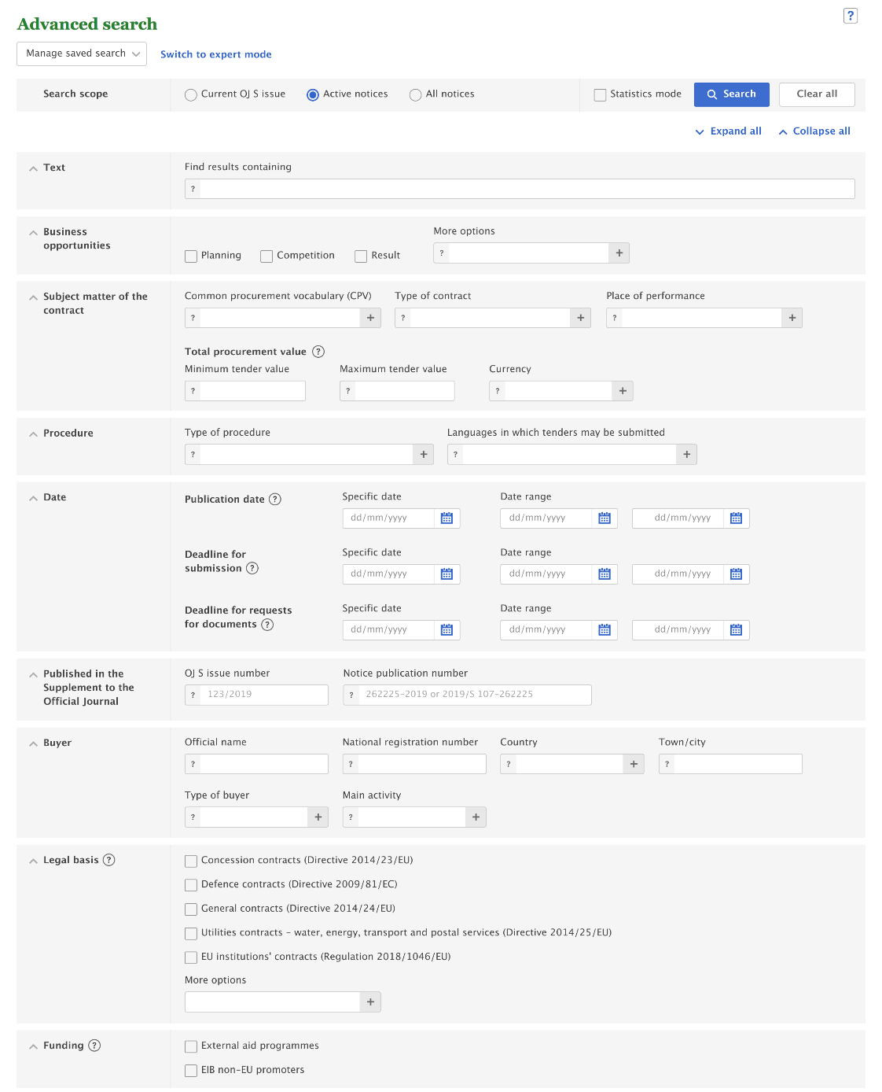
Changes in the advanced search
By default, search will be imited to the current search fields
Search codes will be based on the authority tables used for eForms
(e.g. notice type, legal basis, buyer legal type, etc.)
eForms values will be added in appropriate fields
For Business opportunities, the search field “notice type” will be used
instead of the field “document type”. Values will be those of the
authority table notice-type on EU vocabularies.
‘Country’ and ‘Languages in which tenders may be submitted’: use of 3-letter code
instead of 2-letter code to align with EU Vocabularies authority table
Place of performance values displayed in a new tree
Type of buyer tree enhanced with eForms values and list of international organisations
New “Funding” section to search for “External aid programmes” and “EIB non-EU
promoters”
Saved advanced searches will be migrated
        Anywhere
        Anywhere in the EEA
        In a specific country
            Country
              NUTS1
                - NUTS2
                - NUTS 3
            More countries
                Continents
                - Country

Slide 6
Expert search
All current expert search fields will still be usable -> saved user queries will be maintained
Some codes will allow to find current standard form notices only, e.g.:
  Type of document - TD
  Regulation (applicable regulation of the document) - RP
eForms notices will be searchable with the new search codes

Slide 7
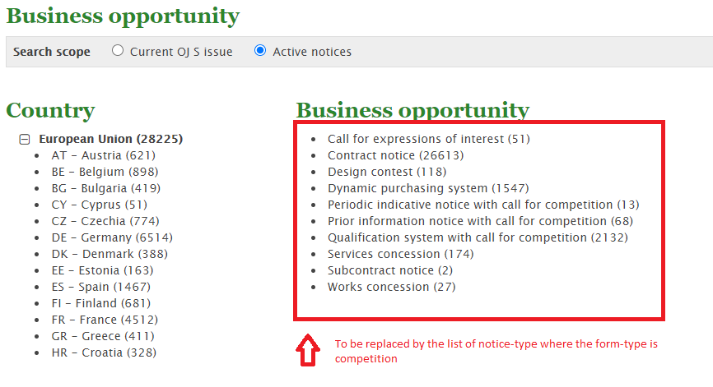
Browse by subject
Adapted to include both current standard forms and eForms notices
Update of the Browse by Business opportunity with competition form types:

Slide 8
APIs
The current TED Website API will be discontinued and replaced by a new search API to provide operations to search and retrieve both TED schema notices and eForms notices.
TED Notice Viewer API will still provide operations to render TED schema notices in various formats.
A new TED Notice Viewer 2022 API will provide operations to render eForms notices in various formats

Slide 9
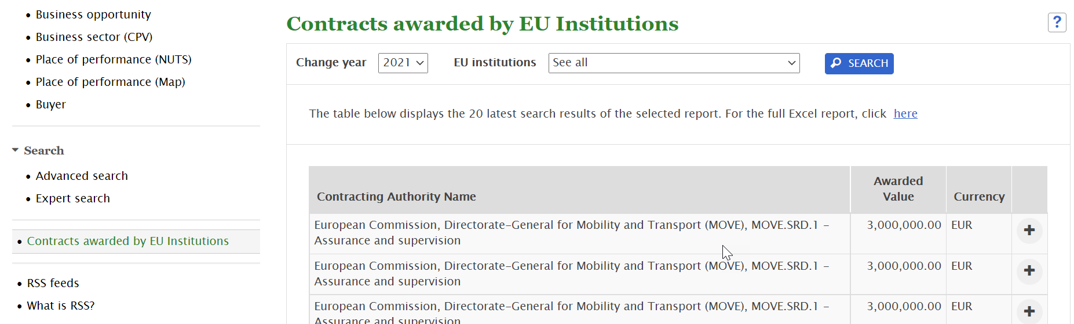
Adaptation of the page on contracts awarded by EU Institutions
Both current standard forms and eForms notices will be visible in the table

Slide 10
But … the current TED website has its limitations
Ageing technology
Currently, not all notice fields are indexed by the search engine
-> limitations to the introduction of new search fields in the user interface
-> limitations to the data that can be displayed
Limited number of facets, no facets for non-active notices and expert search results

Slide 11
THE FUTURE TED 2.0

Slide 12
Timeline
Development of TED 2.0
Start:
Q4 2021
End:
Q1 2023

Slide 13
Benefits of a new TED website
Merge of TED and SIMAP websites into a single point of reference
    TED -> gives access to the online version of the 'Supplement to the Official Journal' of the EU, dedicated to European public procurement
    SIMAP -> website gives information about European public procurement
Revamped user interface
    New look and feel
    Improved navigation
    Full responsiveness for mobile and tablet
New search engine
Added functionalities
All notice fields will be indexed -> possibility to add new search fields easily in the user interface at any time
Increased use of code lists
Setting email alerts will be made easier

Slide 14
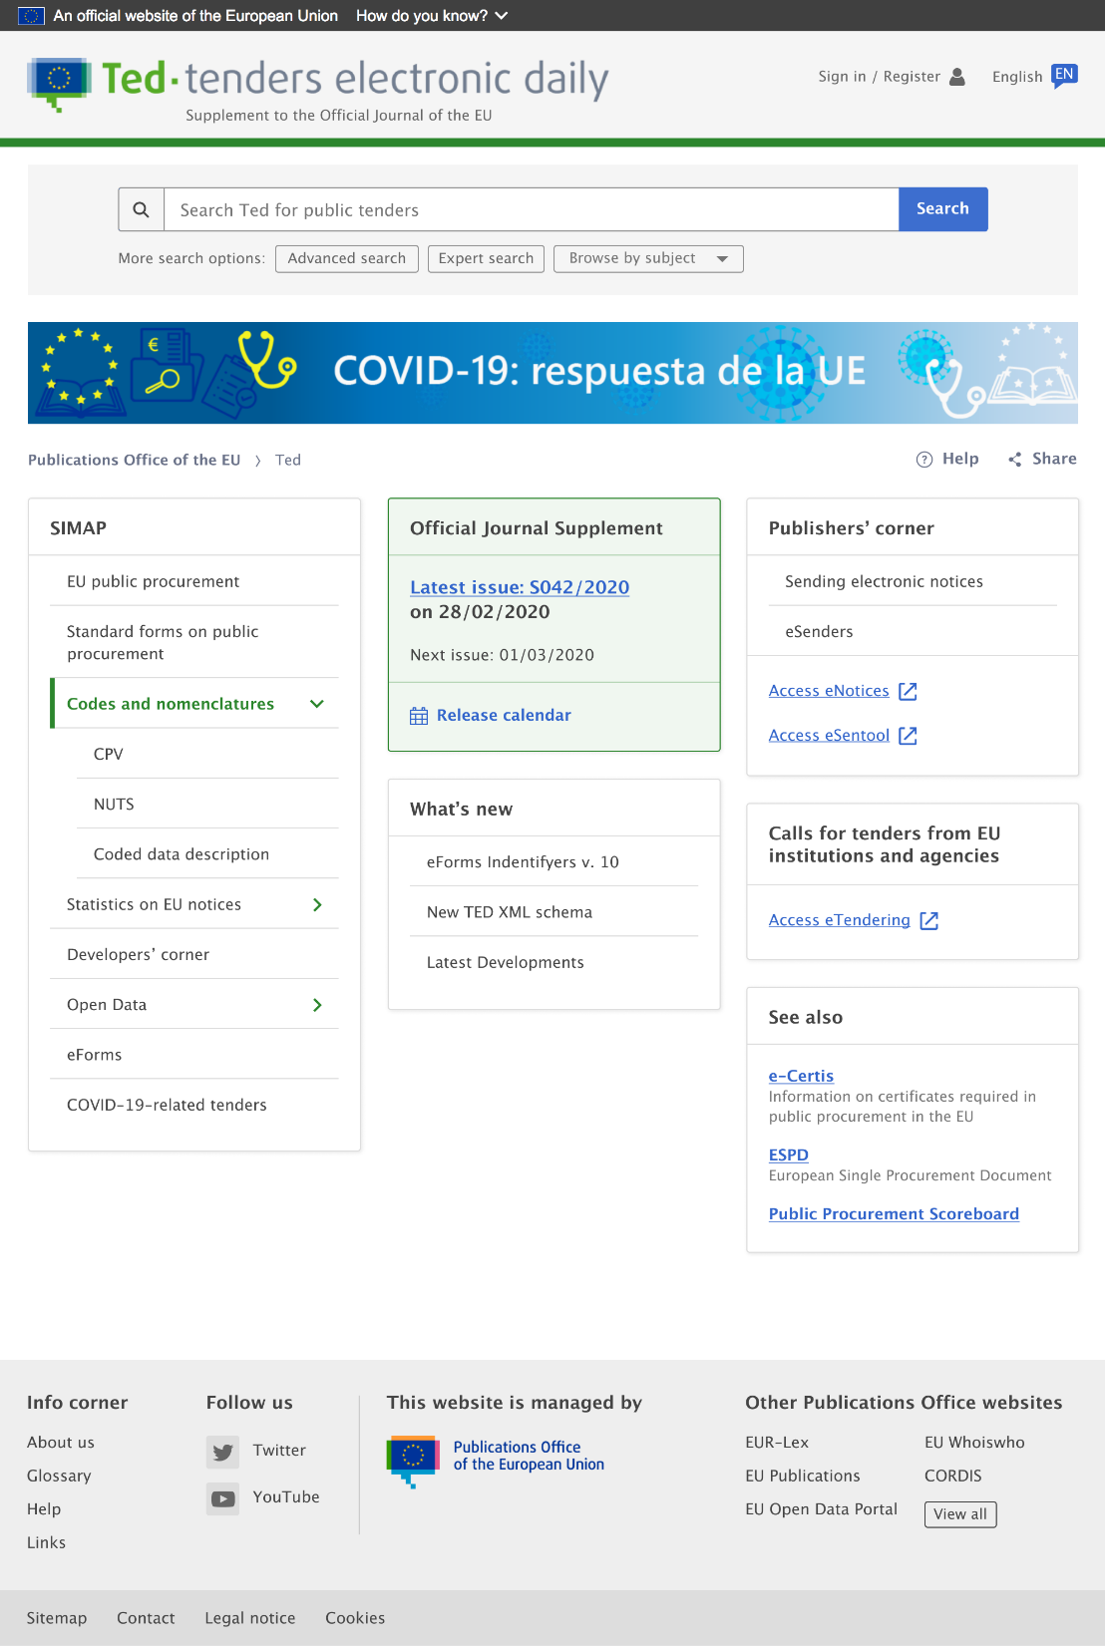
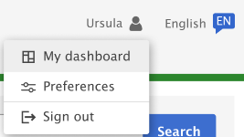
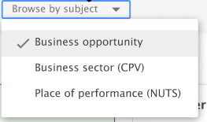
Homepage

Slide 15
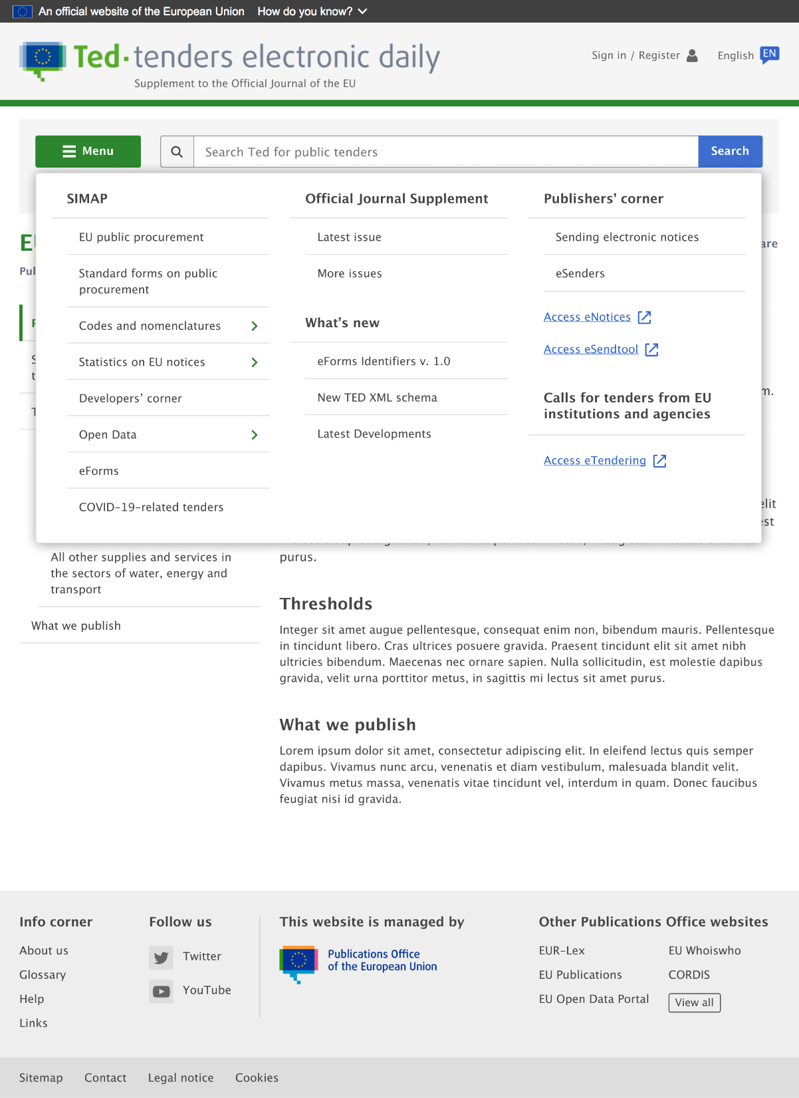

Navigation menu on other pages

Slide 16
Navigation menu on other pages

Slide 17
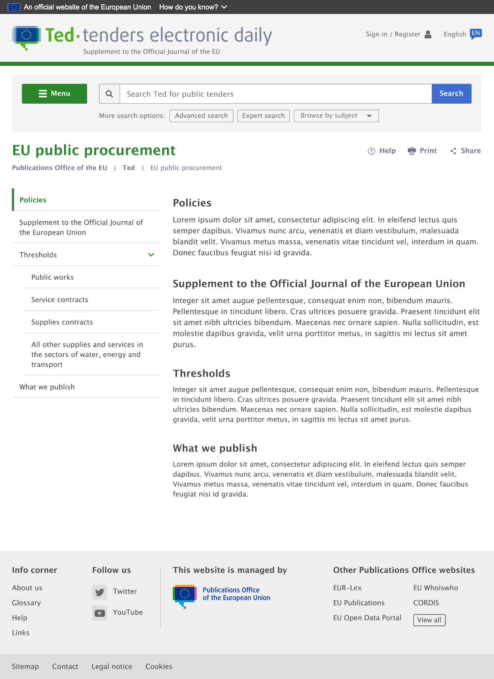
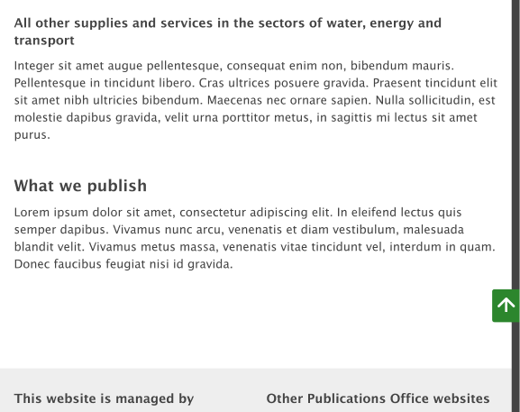
Editorial pages

Slide 18
Browse by subject
By business opportunity
By business sector (CPV)
By place of performance (NUTS)
    Merge of pages ‘Browse by place of performance (NUTS)’ and ‘Browse by place of performance (Map)’

Slide 19
Advanced search
Initially, same fields as on the current TED after adaptation to eForms, except for:
  New free text field “Other legal basis” in Legal basis section
Addition of new fields will be easily manageable at any stage as eForms notices will be fully indexed
  Updated fields:
  Business opportunities: values displayed in a new tree with form and notice types

Slide 20
More user-friendly expert search
Definitions and examples for all search codes
All searchable data will be listed
Help to input dates
Check for query validity

Slide 21
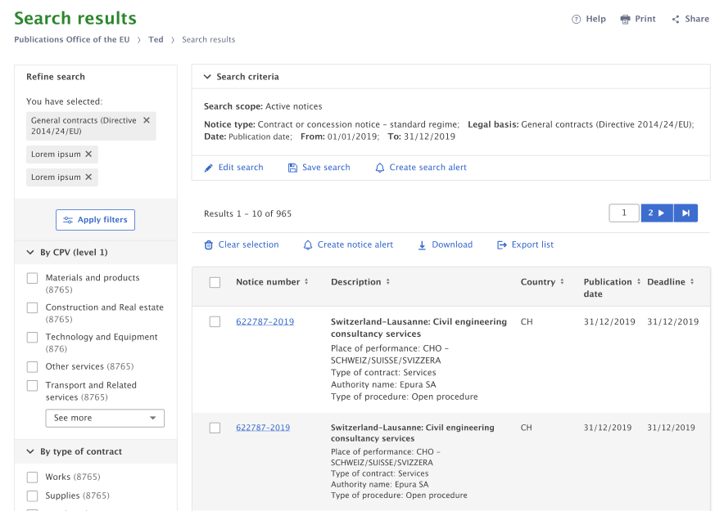
Search results
Update of metadata displayed
for each result
New export functionality:
-> possibility to export full
results lists in various formats
and with chosen metadata
New facets added allowing
multiple selection
Creating email alerts made easier

Slide 22
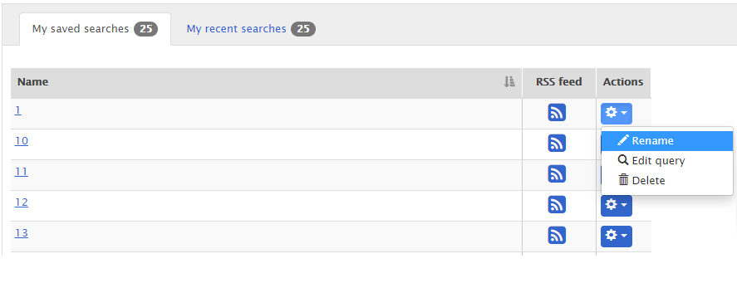
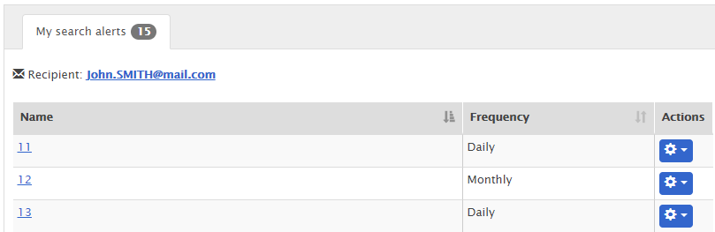
Changes to My Dashboard
Separation between saved searches and search alerts -> separate section for search alerts

Slide 23
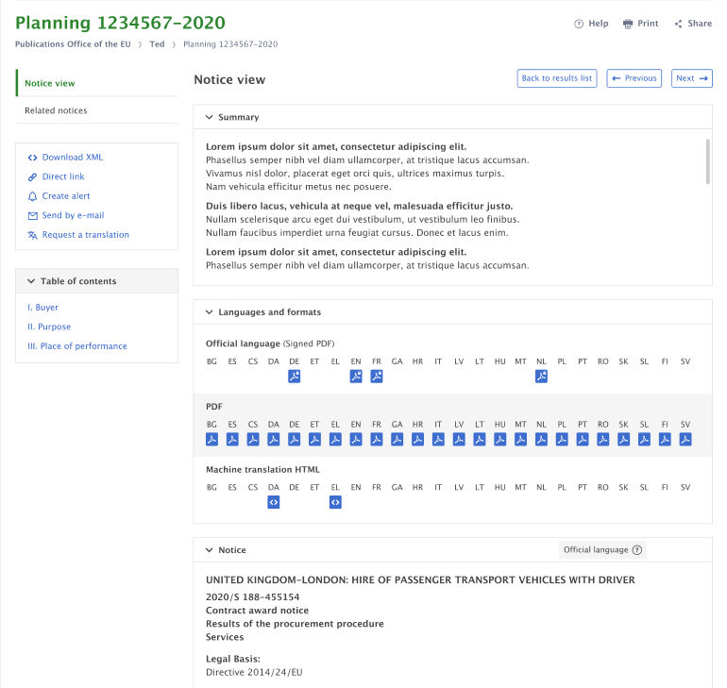
Notice view page – notice view section
More user-friendly display of notice
options and table of contents

Slide 24
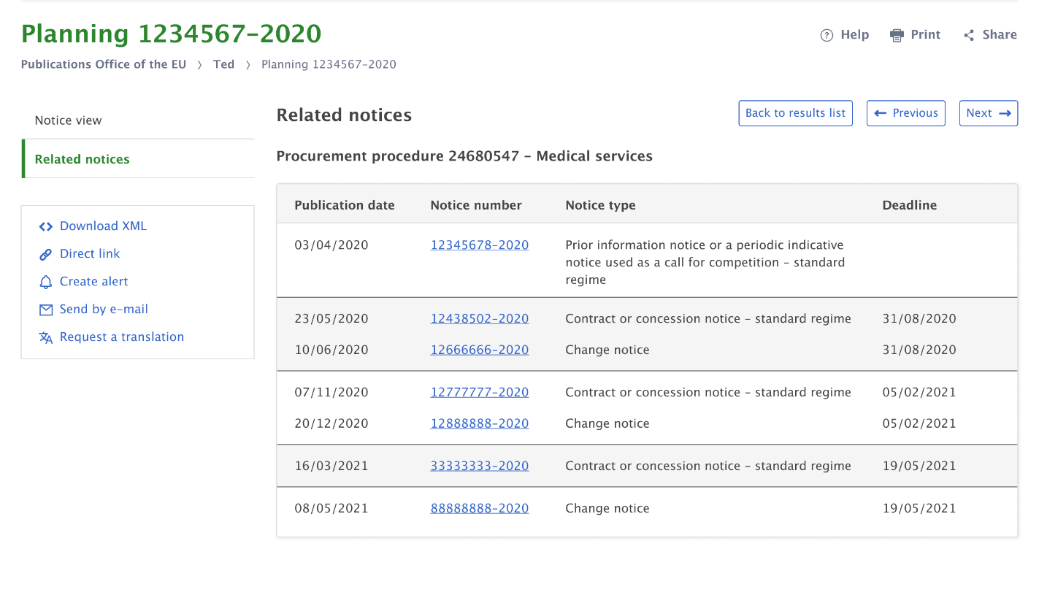
Notice view page – related notices section

Slide 25
URLs
Search results pages will be bookmarkable and their URL will include the search criteria for all searches except expert searches
This will allow users to:
  directly specify a quick search and advanced search from the URL;
  view and modify the current search criteria from the URL;
  save or exchange search criteria by saving or sharing these URLs.
https://ted.europa.eu/TED/search/.../cpv=30000000&Text=fish

Slide 26

Thank you for your Attention
Any questions?
Please ask your question in the Webex chat

