Slide 1
eForms developments and implementation in MS
eSender webinar
8 November 2021
Carmen Ciciriello
Directorate-General for Internal Market, Industry, Entrepreneurship and SMEs

Slide 2
Agenda
Overview of change requests received
eForms developments in Member States

Slide 3
1. Change requests

Slide 4
Requests for change – current status
ID # | Change Request - Context
1 | Clean Vehicles Directive
2 | Innovative Procurement
3 | Green Procurement
4 | Estimated value in FA
5 | Variants
6 | Name of Jury
7 | Errors

Slide 5
2. Developments in MS

Slide 6
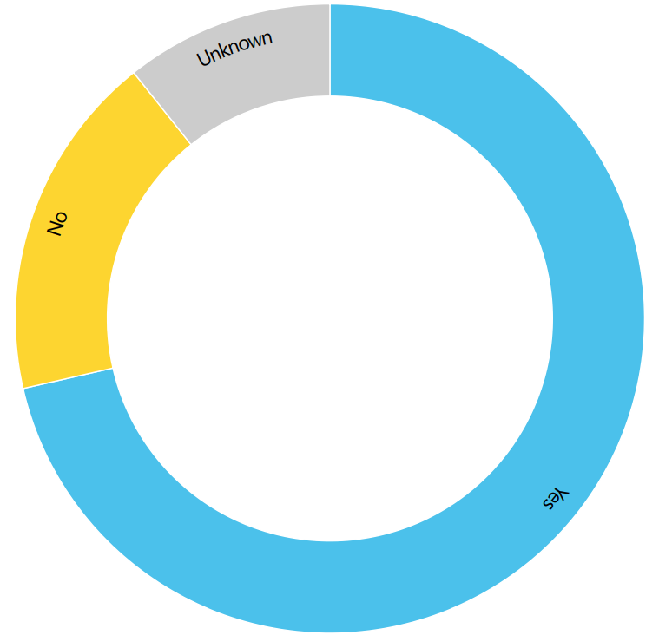
Using eForms for below thresholds contracts

Slide 7
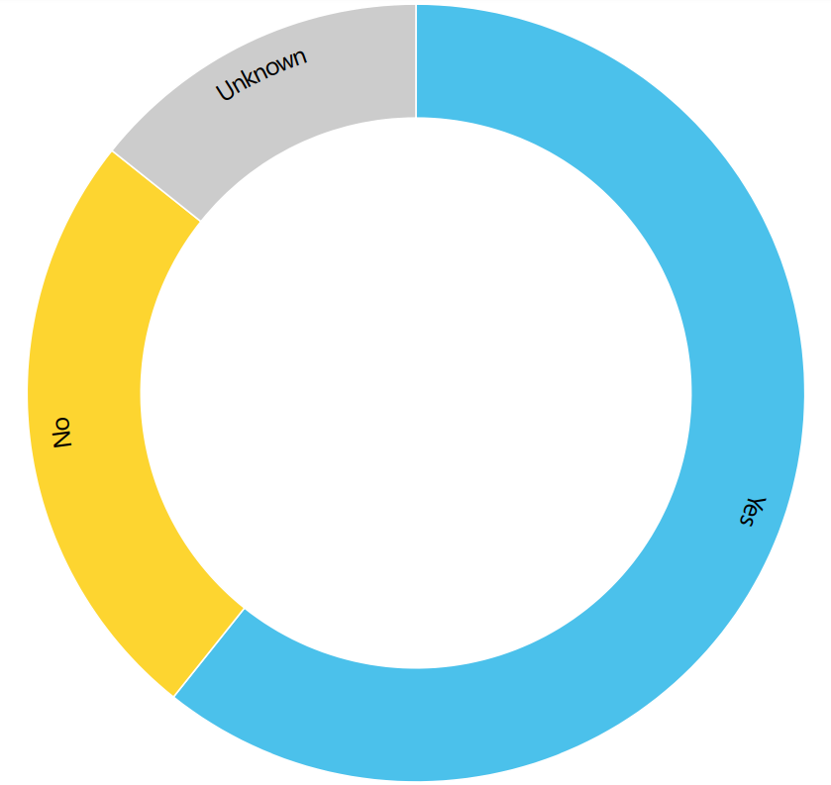
Using eForms for the publication of contract award notices for individual contracts within a framework agreement.

Slide 8
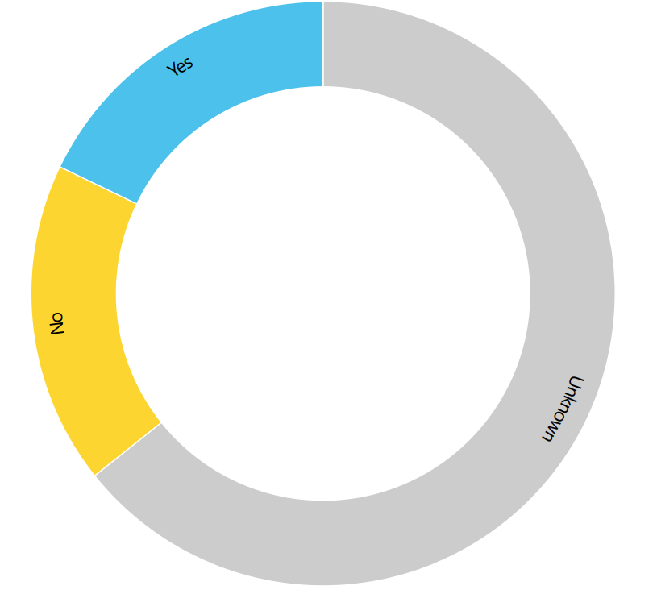
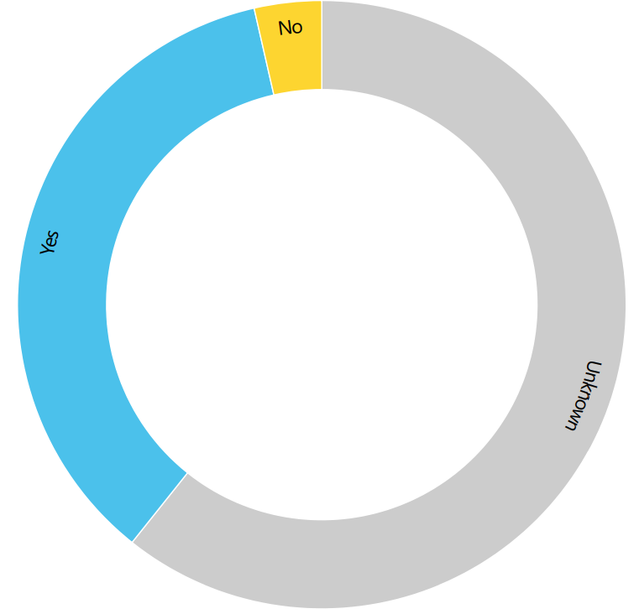
Using individual contract award notices in framework agreements – National Guidelines
National Guidelines
Mandatory use

Slide 9
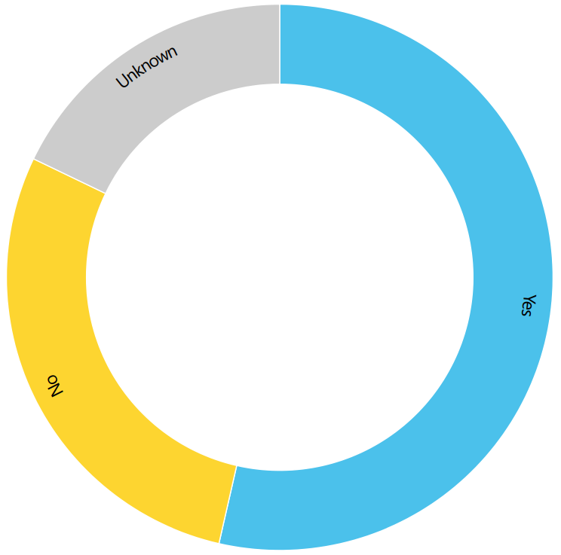
Using eForms to publish minor notices modifications

Slide 10
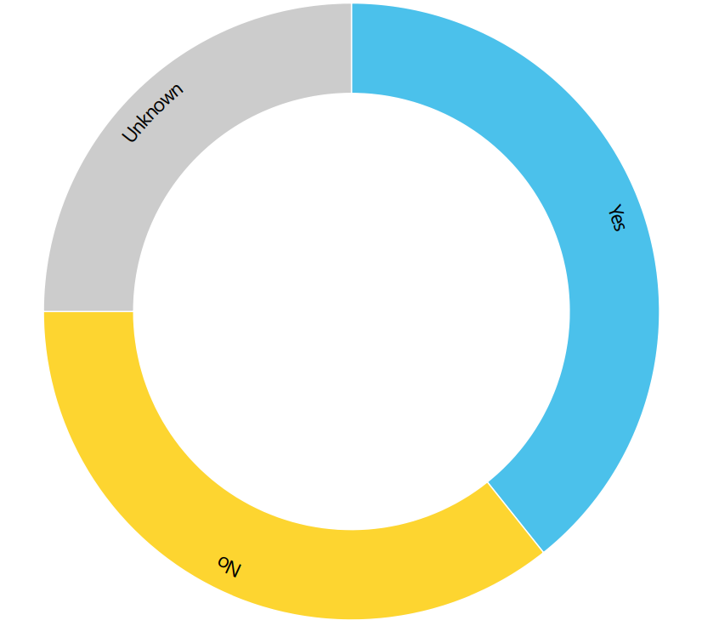
Using eForms to publish information on all bids received

Slide 11
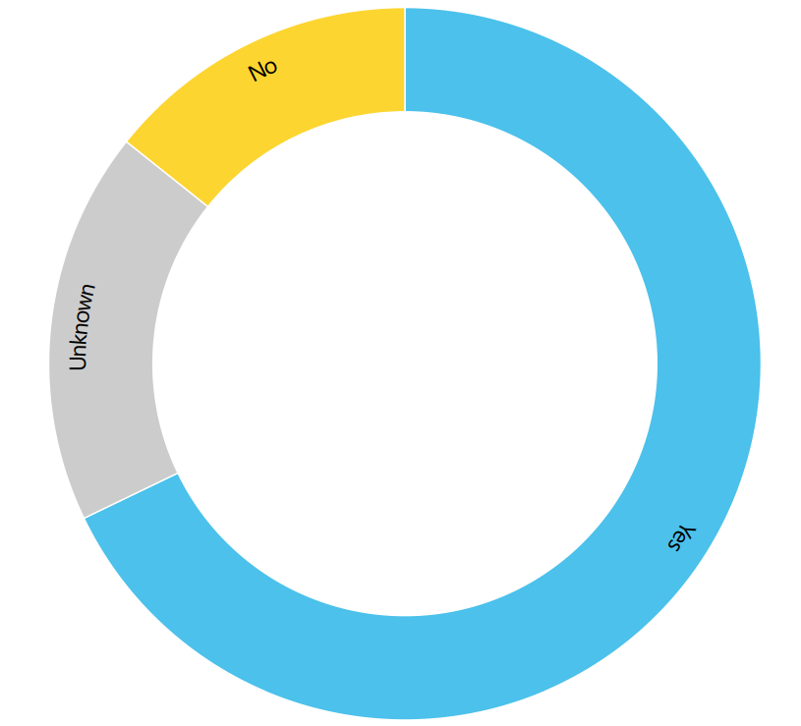
Using eForms to publish voluntary notices -

Slide 12
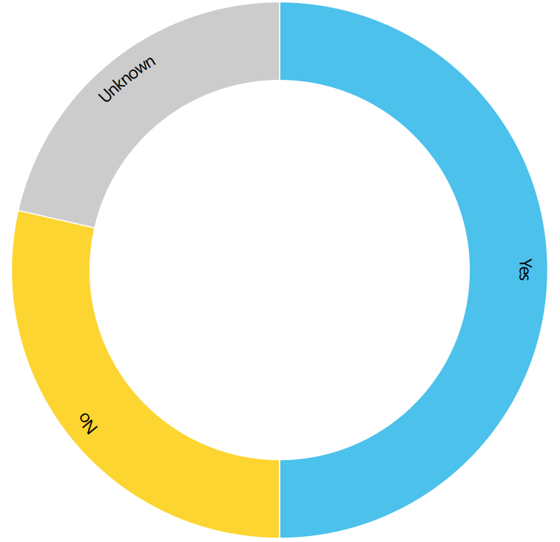
Implementing ESPD request into eForms -

Slide 13
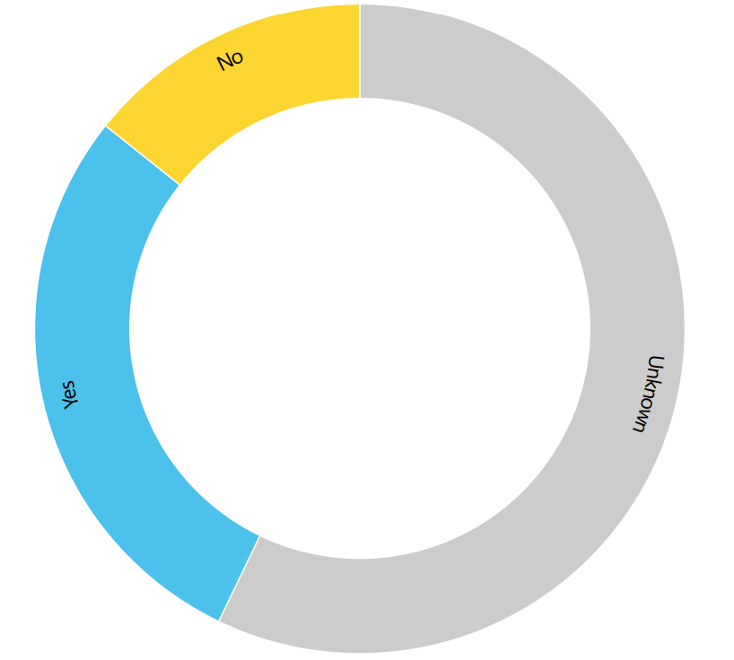
Tailoring codelists

Slide 14
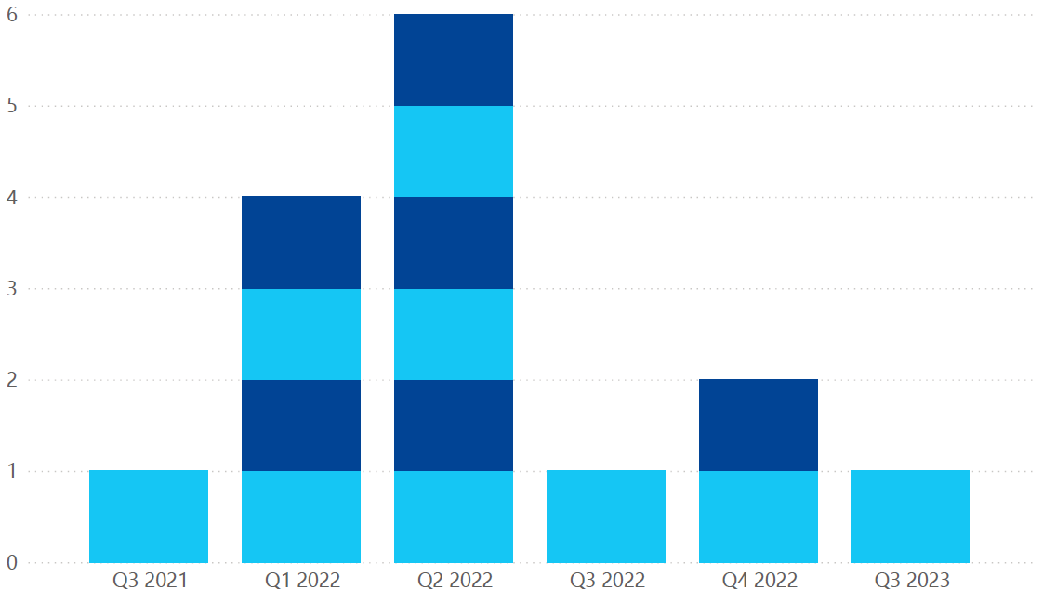
Tailoring policy - Timelines

Slide 15
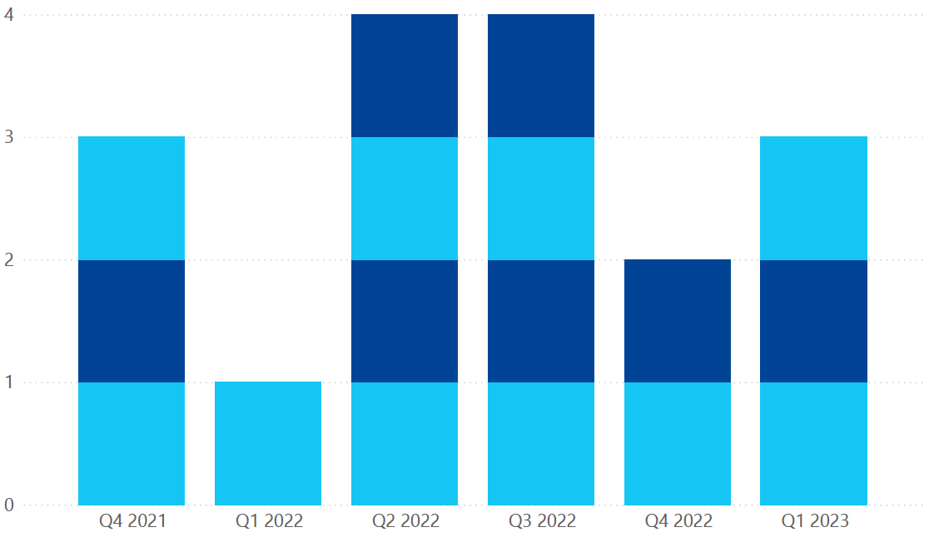
Technical implementation - Timelines

Slide 16
Thank you.

