Slide 1
eForms - General overview
TED eSENDERS SEMINAR
Manuela Cruz
08/11/2021

Slide 2
Summary
Legal timeline
Implementation components
Status

Slide 3
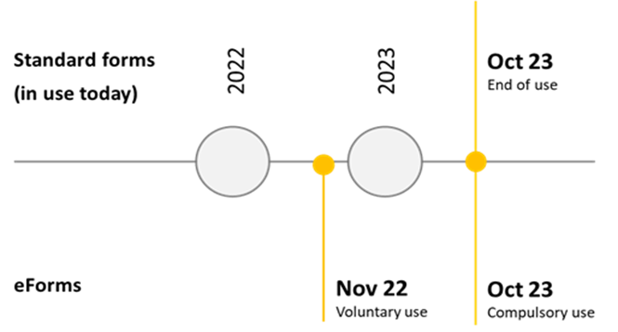
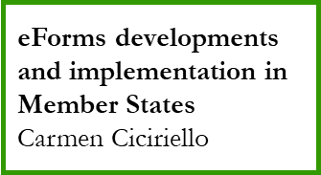
Legal timeline
23 September 2019: adoption of eForms Regulation
14 November 2022: eForms Regulation applies
Publications Office must be able to receive, process and publish eForms AND current standard forms
25 October 2023: use of eForms is mandatory
Publications Office will only receive, process and publish eForms

Slide 4
Implementation components
UBL Schema and related information
(Code lists, Rules, etc.)
eForms schema
Yves Jordan
Reception
Validation
Processing
Publishing
eNotices2
[eSentool]
CVS
[TED Monitor]
TED Website
eForms visualisation
Karl Ferrand
eNotices2 overview
Enrico Campanella
eForms validation
Bertrand Lorentz
eForms in TED and the future TED 2.0
Cécilia Charlier
Developing eForms applications +TEDAPI
Ioannis Rousochatzakis
Machine to machine services

Slide 5
Implementation status
UBL Schema and related information
(Code lists, Rules, etc.)
Information: last update 14/10/2021
SIMAP
TED developers documentation site
eForms Software Development Kit
Reception
Validation
Processing
Publishing
eNotices2: development launched, to be ready by 11/2022
eSentool: features to be integrated in eNotices2, to be ready by 11/2022
CVS: development launched, to be ready by 08/2022
TED Monitor: development launched, to be ready by 07/2022
Current TED: to be adapted to display eForms by 11/2022
New TED: Contract signed, to be ready by 03/2023
TED Viewer 22
development launched, to be ready by 08/2022
TED API
development to be launched, to be ready by 01/2022
Machine to machine services

Slide 6
Implementation roadmap
01/2022
07/2022
08/2022
11/2022
03/2023
TEDAPI
TED Monitor
CVS
TED Website
TED 2.0
TED Viewer
eNotices2

Slide 7
Thank you for your Attention Any questions?
Please ask your question in the Webex chat

