Slide 1
Current status of esentool & data quality
eSenders webinar – 8 November 2021
Karl Ferrand - Publications Office of the EU

Slide 2
Agenda
Current status of the eSentool
Releases of the eSentool web application
Overview of the evolution of eSentool in 2021
TED schema and rule changes planned for November 2021
Data quality
eSenders requests to TED Helpdesk
Statistics on most common quality issues and errors
Quality of Notices
Production figures
Useful links
Q & A

Slide 3
Current status of the eSentool
Releases of the eSentool web application
Overview of the evolution of eSentool in 2021
TED Schema and rule changes planned for 30 November 2021

Slide 4
Releases of the eSentool web application
Release 2.12.0: for the application of NUTS 2021 (December 2020)
Release 2.12.1: technical patch and migration (September 2021)
Release 2.13: new TED XML package for the implementation of a new procedures for T01 form and XSLT validation rule changes (as from 30 November 2021)

Slide 5
Overview of the evolution of eSentool in 2021
Current versions of the TED XML package including NUTS-2021:
schema R2.0.8.S05 (F16, F17, F18 and F19 forms)
schema R2.0.9.S04 (all other forms) with the
corresponding XSLT validation tool version 0.39
Live in production on 26 February 2021, with a transitional period until 27 April 2021.
New versions of the TED XML package to go live on 30 November 2021 in qualification, simulation and production environments:
schema R2.0.9.S05 and XSLT package version 0.40. Transitional period until 31 January 2022, after which R2.0.9.S04 will be rejected.
schema R2.0.8.S05 and XSLT package version 0.40. No transition period.
As of 30 November, all eSenders will be automatically qualified for the new schema.
All details are available in section 3.5 on the eSenders workspace wiki

Slide 6
TED schema changes in November 2021
The new version (S05) of the R.2.0.9 schema will be released to allow for the additional type of procedures for form T01 (Regulation 1370/2007 "public passenger transport services by rail and by road" amended by Regulation 2016/2338).
4 elements have been added to R2.0.9.S05:
PT_REQUEST_EXPRESSION_INTEREST : Request for expression of interest - only for rail (art. 5(3b) of 1370/2007)
PT_DA_EXCEPTIONAL_CIRCUMSTANCE_RAIL : Direct award, if justified by exceptional circumstances - only for rail (art. 5(3a) of 1370/2007
PT_DA_MARKET_NETWORK_RAIL : Direct award, if justified by relevant structural and geographical characteristics of the market and the network - only for rail (art. 5(4a) of 1370/2007)
PT_DA_OPERATOR_MANAGER_RAIL : Direct award, to an operator which manages simultaneously the entire or the major part of the railway infrastructure on which the services are provided - only for rail (art. 5(4b) of 1370/2007)

Slide 7
TED rule changes in November 2021
XSLT package version 0.40 will tighten 4 validation rules:
Increase severity from “Warning” to “Error” for rule R619 (both R2.0.8.S05 and R2.0.9.S05)
Enforcement of rule R197 for Defence forms (R2.0.8.S05) with severity “Error”
Reminder: these two rules apply directly for Defence forms (R2.0.8.S05) on 30 November with no transition.

Slide 8
TED rule changes in November 2021
XSLT package version 0.40 will tighten 4 validation rules:
Restriction of valid legal bases for rule R118 (only R2.0.9.S05)
Rule R118 will be updated to validate the consistency between the type of form and the legal basis provided. For F20 forms (modification notice), only directive 2014/23/EU, directive 2014/24/EU and directive 2014/25/EU are allowed.
Increase severity from “Info” to “Error” for R556 (only R2.0.9.S05)
Rule R556 concerns the year from the OJS notice number on section IV.2.1 "Previous publication concerning this procedure"

Slide 9
Data quality
eSenders requests to TED Helpdesk
Information
Technical
Statistics on most common quality issues and errors
Quality of Notices: Issues by validation rule and form in eSentool
Quality of Notices: Rejected Notices by rule and form in eSentool
Production figures: Low quality notices in Production by reason
Production figures: Rejected notices in Production by reason

Slide 10
eSenders requests to TED Helpdesk: 11/2020 - 09/2021

Slide 11
eSenders requests to TED Helpdesk: 11/2020 - 09/2021

Slide 12
Statistics on most common quality issues and errors: 10/2020 – 09/2021

Slide 13
Quality of Notices: 10/2020 – 09/2021 The four most common validation rules triggered

Slide 14
Quality of Notices: 10/2020 – 09/2021

Slide 15
Quality of Notices: 10/2020 – 09/2021 Most common rules to reject notices
T002 - XML file is not valid against XSD.
T001 - Metadata could not be retrieved from the XML file.
R299 - As of 1 January 2021, procurement notices from the UK will not be published anymore on TED as the EU rules on public procurement will cease to apply to and in the United Kingdom.
R560 - S4-02-01: Please fill in the previous publication which is mandatory according to the given procedure.
R127 - The country code and the NUTS code are not compatible.
R390 - Section II.5/II.1.6/II.1.5: Main CPV code inconsistent with the type of contract: Supplies corresponds to CPV code starting from 0 to 44 and with 48, Works with 45, Services from 49 to 98.
R013 - Duplicate NO_DOC_EXT, a notice with the same identifier has already been received.
R008 - NOTICE_DISPATCH_DATE element must contain the real sending date of XML notice.
R332 - S2-01-07: Total value of the procurement: mandatory if at least one contract has been awarded.

Slide 16
Quality of Notices 10/2020 – 09/2021

Slide 17
Production figures: 10/2020 – 09/2021 Low quality notices in Production by reason

Slide 18
Most common warnings by reason: Examples
SECTION | Example of text | Issue identified
SECTION IV.2.2) / IV.2.7) | IV.2.2) and IV.2.7). The date from section IV.2.2) “Time limit for receipt of tenders or requests to participate” will be published as received in this notice, but please note that the date for opening of tenders (section IV.2.7) will be prior to the time limit for receipt of tenders in section IV.2.2). | Incoherent Dates
SECTION V.2.4 )/ II.1.7) | The notice has been published as received; however please note that the Total value of the contract/lot in section V.4 is higher than the Total value of the procurement in section II.2.1. | Wrong Value
SECTION VII | "Notice of modification" (NF20), but note that the information indicated in section VII, field VII.1.7) "Name and address of the contractor / dealer" differs from the information indicated in section V, field V .2.3) "Name and address of the contractor / dealer". | Incomplete Text
SECTION I | In section I.1 Contracting authority: the Official name field, and in section VI.4.1 Body responsible for appeal procedures: the fields Official name, Postal address, City, Country are not correctly filled in. In the future, please fill them in with the information requested. | No Coherent Text

Slide 19
Production figures: 10/2020 – 09/2021 Rejected notices in Production by reason

Slide 20
Reporting
New monthly reporting on errors and warnings in last 12 months
Will start to send by email, specific to each eSender
Plans to end current daily reports
API can be used for ad-hoc or custom reporting:
Use “/notice/search” operation and parameters like status, publishedFrom and publishedTo

Slide 21
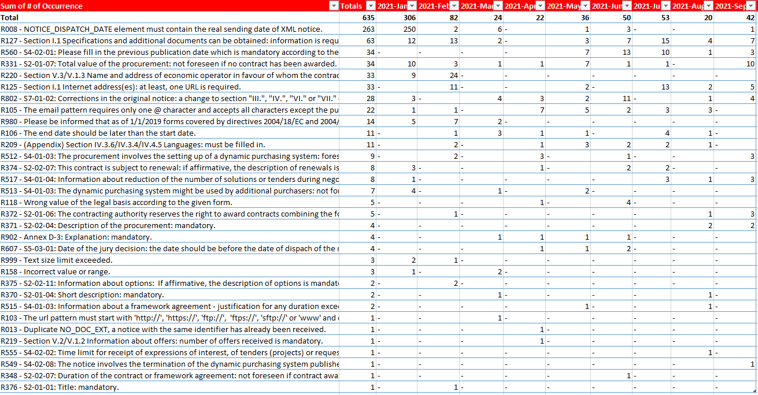
Example of monthly reporting

Slide 22
Other issues
Ensure your customers are informed, e.g. guidelines for using form 14 corrigendum
Avoid mixing languages in the same notice – see updated FAQ
OP contractor no longer corrects notices since 1 August 2021 – only accepts or rejects
Upgrade to TLS 1.2+ by 30 November 2021 – TLS 1.0 and 1.1 are deprecated and not secure
No changes planned in 2022 for current TED schema or rules – unless essential

Slide 23
Useful links
Main points of contact:
TED Helpdesk: ted@publications.europa.eu
eSentool contact form: https://esentool.ted.europa.eu/contact
TED eSenders Workspace: https://webgate.ec.europa.eu/fpfis/wikis/display/TEDeSender
TED schemas – EU vocabularies: https://op.europa.eu/en/web/eu-vocabularies/e-procurement
General Conditions of Use of eSentool: https://esentool.ted.europa.eu/generalConditionsOfUse

Slide 24
Thank you for your Attention Any questions?
Please ask your question in the Webex chat

