Slide 1
ENDORSE follow-up event
Statistical Classifications
Christine Laaboudi, Eurostat B.1

Slide 2
Table of contents
1 Statistical classifications
Integrated System
Ramon
2 Migration as LOD
Migration strategy
Dissemination
3 Uses Cases
Combined nomenclature
Units of measure
Correspondence tables

Slide 3
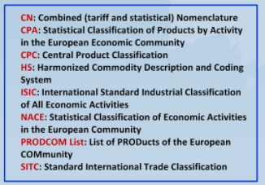
Integrated System of Statistical Classifications

Slide 4
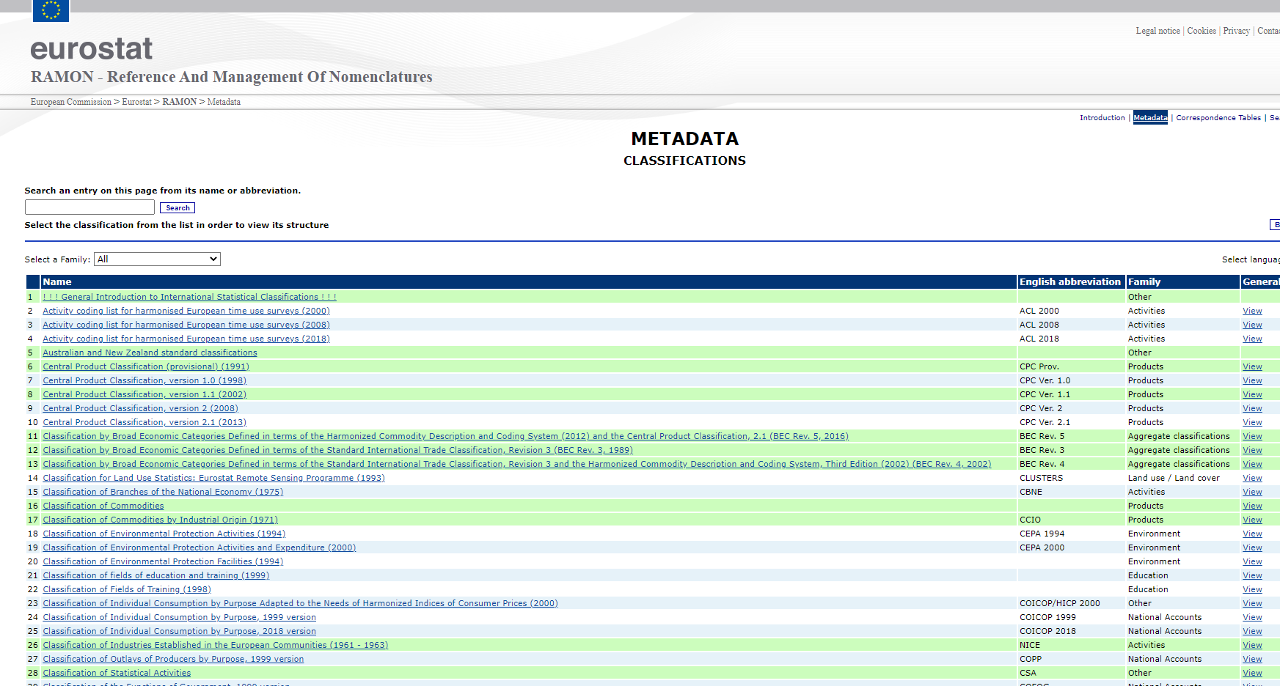
Statistical classifications in RAMON
RAMON (Reference And Management Of Nomenclatures)
Dissemination of Classifications
Managed by Eurostat (EU Level)
Not managed by Eurostat (World Level)
Linked to a third party website
Stored in RAMON itself, with a disclaimer that the official version is available elsewhere
Structured but not standardised
Content is partially findable
The description of the classification is Accessible (HTML) but not Findable
For many classifications there are additional files attached (Open, Proprietary formats)

Slide 5
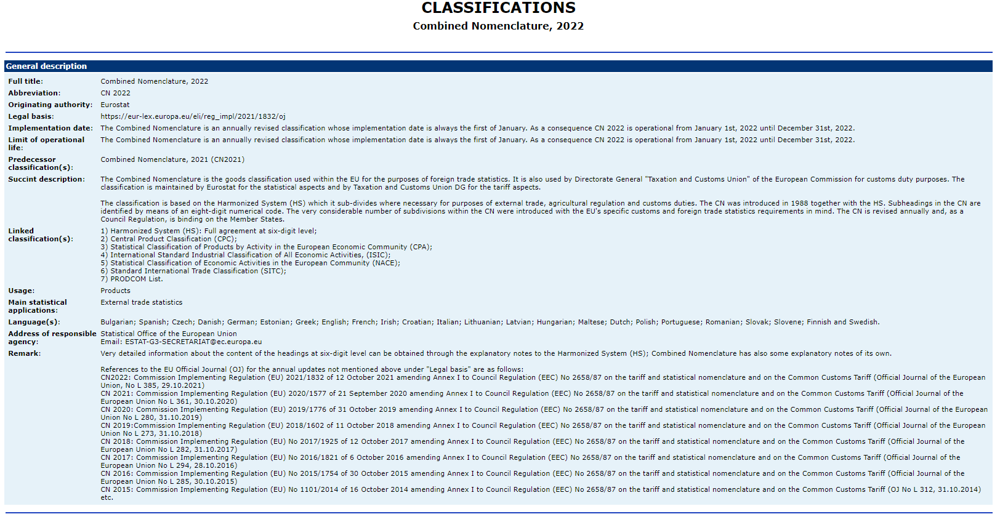
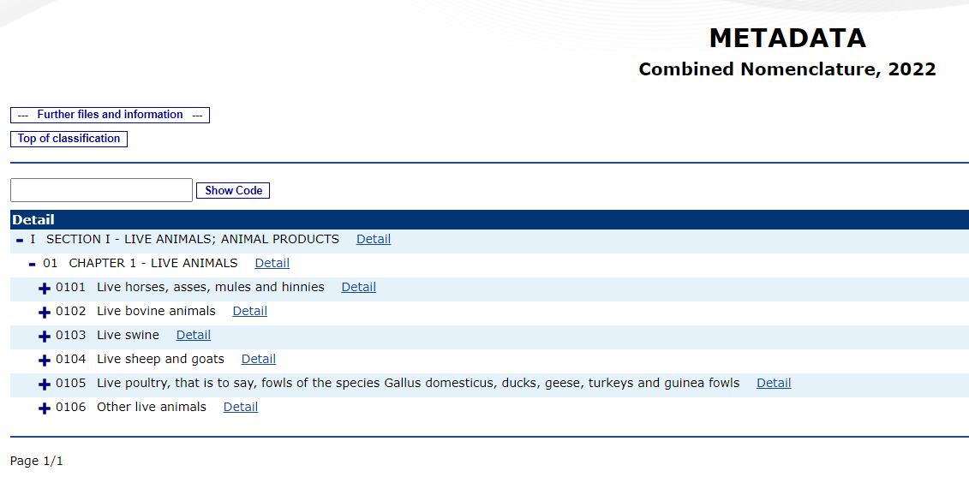
Statistical classifications in RAMON

Slide 6
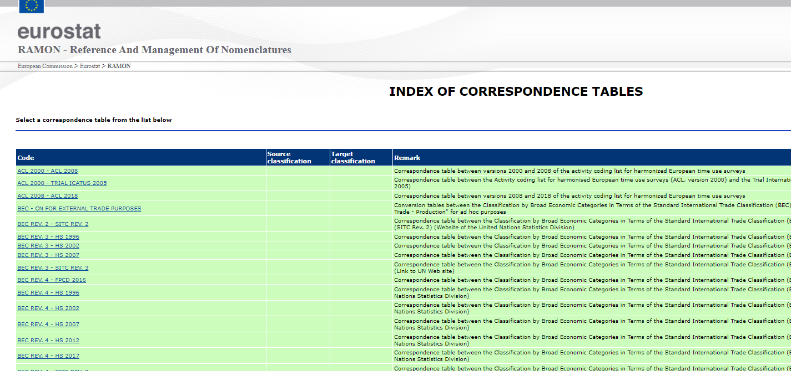
Statistical classifications in RAMON
RAMON also contains many correspondence tables
Downloadable, not Findable
Different formats (Excel, CSV, ZIP )
Sometimes Links to third party websites
Classifications and Correspondences are not Interoperable
Mapping based on the classification code, sometimes different from the classification item ID
Code 12.4 ←→ ID 124
In the correspondence, the semantic context of the source/target is not Accessible
In the classification item, the correspondence(s) are not Accessible
RAMON being phased out at the end of 2022

Slide 7
Migration Strategy
Make this information to be more easily FAIR (Findable, Accessible and Reusable and Interoperable)
Follow Open Standards and formats
SDMX Statistical Data and Metadata Exchange
RDF as LOD
What?
All the classifications managed by Eurostat + correspondence tables
Expose our classification as Linked Open Data (LOD)
Requires more modelling flexibility
Less integration with our production systems
Offer Semantic Interoperability with classifications (world, national) exposed as LOD
EC Corporate Collaborative tools
VocBench (Uploading of our classifications)
ShowVoc (Visualisation of VocBench content)
EU Vocabularies (Dissemination as LOD)

Slide 8
Migration to VocBench
Statistical classifications
Catalogues
Combined Nomenclature
CN2022, CN2021, CN2020, CN2019
PRODCOM 2019, 2021
NACE Rev. 1.2
CPA 2.1
ECOICOP/HICP
LUCAS 2022
NST 2007
Units of measurement
NUTS 2021 + Statistical Regions
ESTAT-Legis
STAT-Manuals
ESS-Standards
CS
odW
Code lists
Statistical organisations
ECOICOP European Classification of Individual Consumption according to Purpose
LUCAS Land Use, Land Cover Classification
NUTS Classification of Territorial Units
NST Standard Goods Classification for Transport Statistics

Slide 9
Migration to Vocbench
Data Model
SKOS: Simple Knowledge Organization System (W3C)
XKOS: An SKOS extension for representing statistical classifications (DDI - Data Documentation Initiative)
Extension of the Data Model
Transformation in RDF
By Eurostat
Tools in Vocbench
Converting structured content (XLS, CSV) into triples (RDF)
Workflow validation (Accept or Reject an action)
Integrity Constraint Validator
Interoperability between our projects
Enable to reuse the resources between different projects
Use case: Units of measure
SKOS, XKOS
COOS
Core Ontology for Official Statistics
ELI (EU Legislation)
Dublin Core
Org Ontology

Slide 10
Dissemination
European Statistics Code of Practice
Principle 7.4 Detailed concordance exists between national classifications systems and the corresponding European systems
Expose our statistical classifications as LOD
Make our statistical classifications Interoperable
Persistent URI (PURI)
One namespace by Classification Family
http://data.europa.eu/xsp/cn2020 http://data.europa.eu/xsp/cn2021
http://data.europa.eu/qw1/prodcom2019
One suffix for the classification
A Permanent URI by Resource
http://data.europa.eu/xsp/cn2021/440100000080 (a code item in the Combined Nomenclature)
http://data.europa.eu/xsp/cn2022/CN2022_CN2021 (a Correspondence Table)
http://data.europa.eu/xsp/cn2022/CN2022_CN2021_030910000080 (a Concept Association in a Correspondence Table)

Slide 11
Use Cases

Slide 12
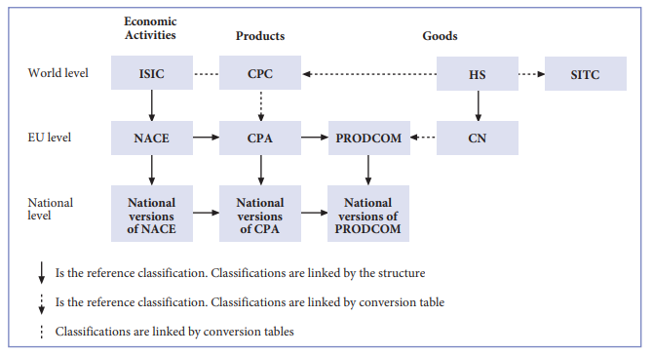
Combined Nomenclature
Two representations
Select a Scheme
Visualise the full classification (CN) or a subset (HS)
Breakdown by Classification Level
Visualise/extract the codes by Level
Use for collecting statistical data on trade in goods
Update: Yearly (Eurostat), legal basis
Derived from the Harmonised Commodity Description and Coding System (HS)
Custodian: World Customs Organisation
Major update in 2022
Levels
HS: 2-digit, 4-digit, 6-digit levels
CN: subdivided, further breakdown at 8-digit level

Slide 13
Combined Nomenclature
Search the code 1515 90 91 (part of CN)

Slide 14
Combined Nomenclature

Slide 15
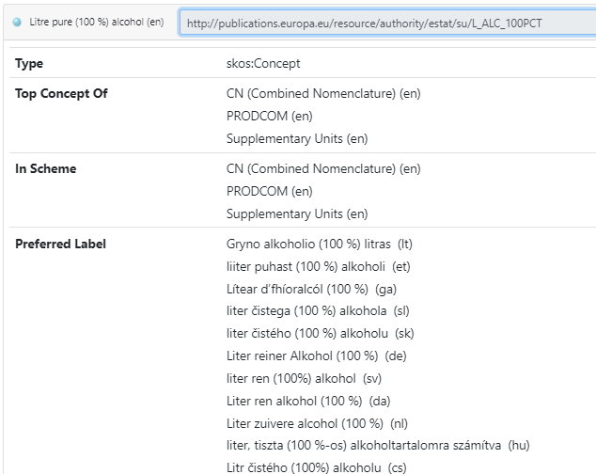
Units of measure
Interoperability
Maintained in one Code List
Referenced in 2 Classifications
Combined Nomenclature
Prodcom Classification
Reuse
Extracted (CSV format) via a SPARQL-query from VocBench
Collection of saved queries
Injected in the Eurostat SDMX Registry (Reused)
In Combined Nomenclature, volume of goods is expressed in a Unit
2208 20 19 Spirits obtained by distilling grape wine, in containers holding <= 2 l (excl. Cognac, Armagnac and Brandy/Weinbrand)
SU (Supplementary Unit): Litre pure (100 %) alcohol

Slide 16
Correspondence tables
Two representations
skos:mapping
a property of skos:Concept
Directly accessible in ShowVoc
xkos:Correspondence (a Class)
xkos:ConceptAssociation (a Class)
<sourceConcept>, <targetConcept>
In ShowVoc, available via a SPARQL query
Concordance tables
CN 2021 – CN 2022 (Transition between two versions)
Conversion tables
NACE – ISIC 4 (remote)
CPA 2.1 – CN 2021
NACE Rev 2 – CPA 2.1
Generated by Eurostat
Validated by Eurostat and the ESS Members
Imported in VocBench

Slide 17
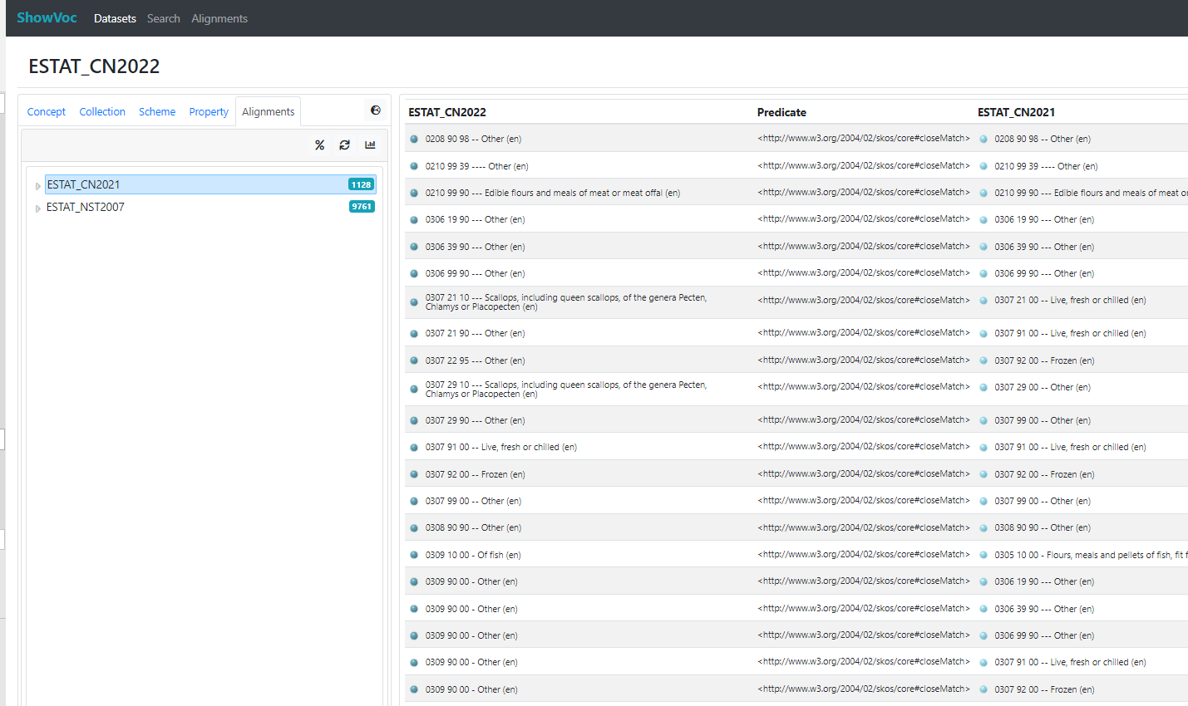
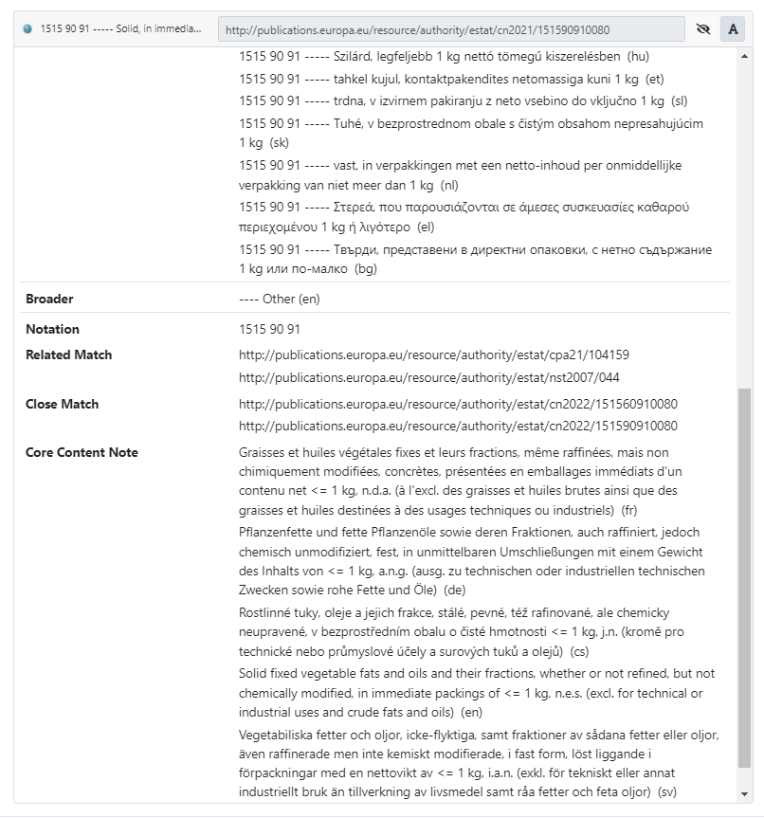
Correspondence tables (skos:mapping)
skos:mapping

Slide 18
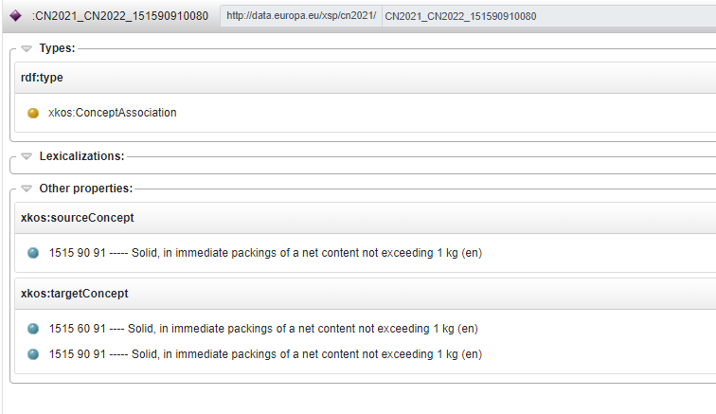
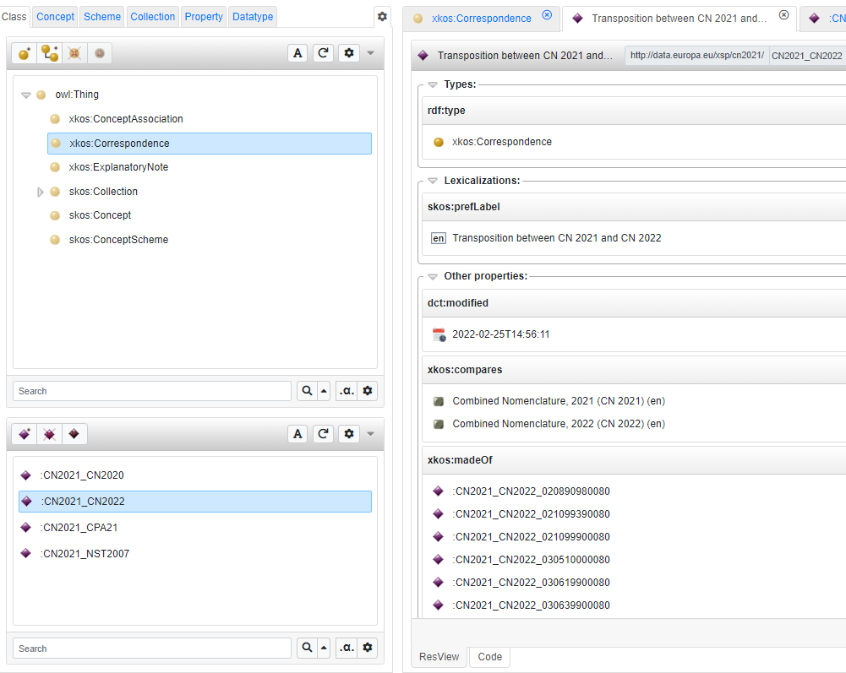
Correspondence tables (xkos:Correspondence)

Slide 19
Query with SPARQL
Customised data extraction
Save your templates (in VocBench)
Query Classifications or Correspondences
Export in CSV, TSV, JSON, XLSX
Export the full dataset
RDF, TTL, JSON
Display the Correspondence tables for a Classification
?s a xkos:Correspondence .
Display the Associations of a Correspondence Table
:CN2021_CN2022 xkos:madeOf ?Associations .
Display a concept Association (Source, Target)
:CN2021_CN2022_151590910080 ?p ?o .

Slide 20
Thank you
© European Union 2020
Unless otherwise noted the reuse of this presentation is authorised under the CC BY 4.0 license. For any use or reproduction of elements that are not owned by the EU, permission may need to be sought directly from the respective right holders.
Slide xx: element concerned, source: e.g. Fotolia.com; Slide xx: element concerned, source: e.g. iStock.com
Notes:
Update/add/delete parts of the copy right notice where appropriate.
More information: https://myintracomm.ec.europa.eu/corp/intellectual-property/Documents/2019_Reuse-guidelines%28CC-BY%29.pdf

