Slide 1

OntoLex-Lemon and the
Prêt-à-LLOD & ELEXIS Projects
John P. McCrae
DSI/Insight, NUI Galway

Slide 2
The Prêt-à-LLOD Project

Slide 3
Objective 1 - Multilingual cross-sectoral data access
Data discovery tools aggregated from multiple sources
Digital Single Market
Deduce probable licenses from complex pipelines

Slide 4
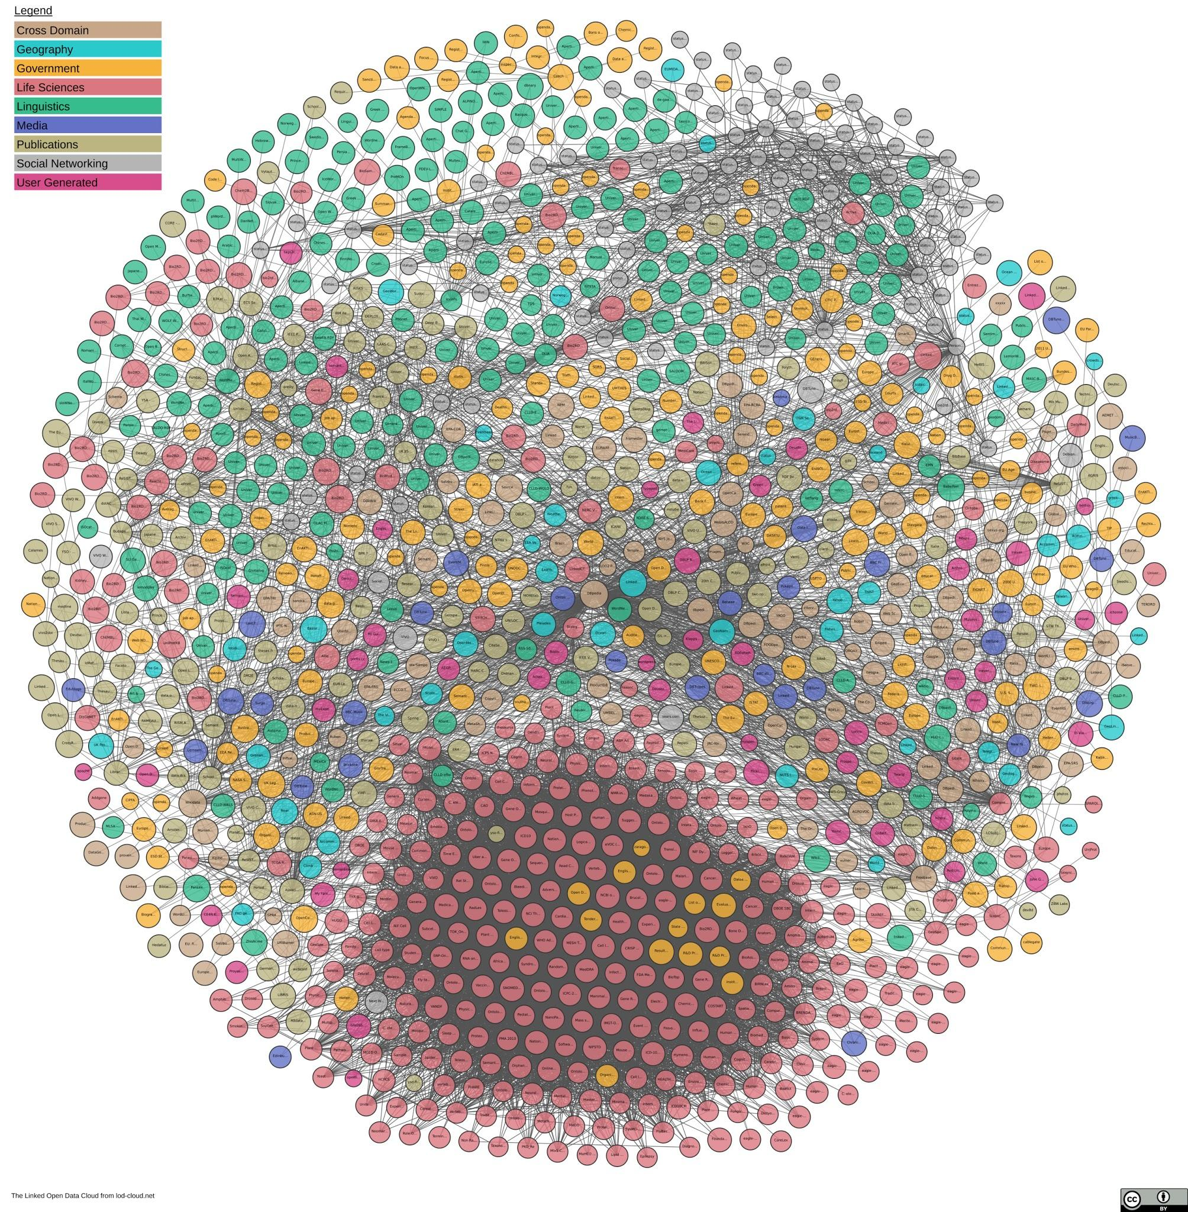


Objective 2 - Interoperable language technology
European Language
Grid
Linked Open Data

Slide 5
Objective 3 - Sustainability of language technologies/resources
Services as Data
Data as
Services
Licensing
Long-term archiving
Minority Languages

Slide 6
Pilots
Pilot I: Multilingual Knowledge Graphs for Knowledge Management across Sectors
Pilot II: Linking lexical knowledge to facilitate rapid integration and wider application of lexicographic resources for technology companies
Pilot III: Supporting the development of cross-border public services in open government
Pilot IV: Multilingual Text Analytics for Extracting Real-World Evidence in the Pharma Sector

Slide 7

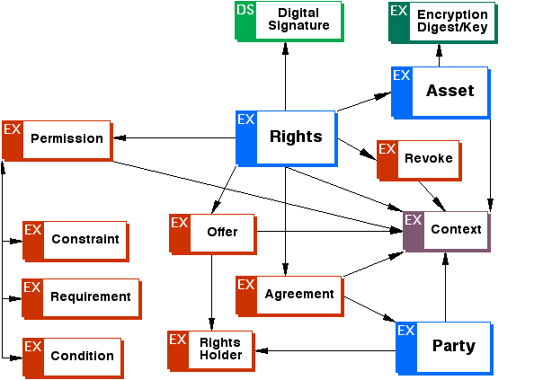


Tools
Discovery
Search and discovery of datasets by aggregating multiple sources
Transform
Transformation of non-RDF sources to RDF standards
OLiA
Data Manager
Smart contracts for composing licenses
Link
Semi-automatic linking of datasets
Workflows
Workflows for portable and scalable technologies using containerization

Slide 8
The ELEXIS project

Slide 9



Dictionaries
The Virtuous Cycle of eLexicography
Artificial Intelligence
Lexicographers
Linked Data
banque
Ufer
bank
銀行
ตลิ่ง

Slide 10
Lexicographic Data and Workflow
Objectives:
Support needs of lexicographic community
Robust guidelines and best practices for workflows in lexicography
New methods for retro-digitisation of lexicographic content

Slide 11
Interoperability and Linked (Open) Data
Objectives:
Interoperability of existing lexical resources
Establish cross-lingual links between dictionaries
Validate the quality of dictionaries

Slide 12
Lexicographic Data for NLP
Objectives:
Show impact of quality lexicographic data on NLP
  Word Sense Disambiguation
  Entity Linking
  Semantic Parsing
Address “knowledge acquisition bottleneck” in AI

Slide 13
NLP for Lexicography
Objectives:
Automatic acquisition of lexicographic data
Crowdsourcing and gamification
Enrich dictionaries with multi-modal data

Slide 14
ELEXIS Technologies

Slide 15
The ELEXIS Infrastructure
Observers’
Dictionaries
Continuous Quality Evaluation
Linking Tool (Naisc)
Retro-digitisation
REST
Interface
Dictionary Matrix
TEI-Lex0 / OntoLex-Lemon
Dictionaries
NLP Tools
Sketch Engine
Dictionary Authoring (Lexonomy)
Crowdsourcing

Slide 16
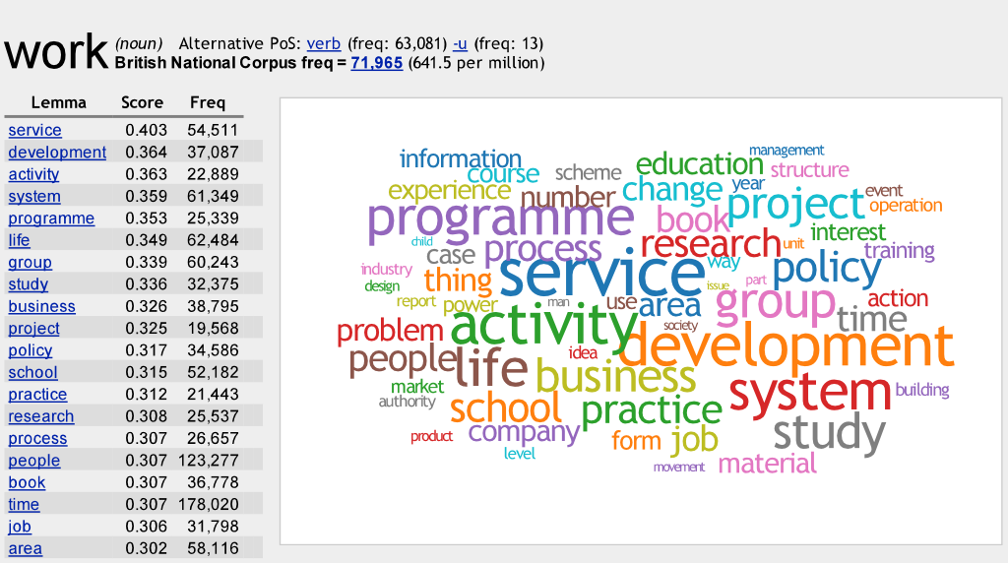
Sketch Engine
Free to academic users in the EU until 2022 - thanks to ELEXIS

Slide 17
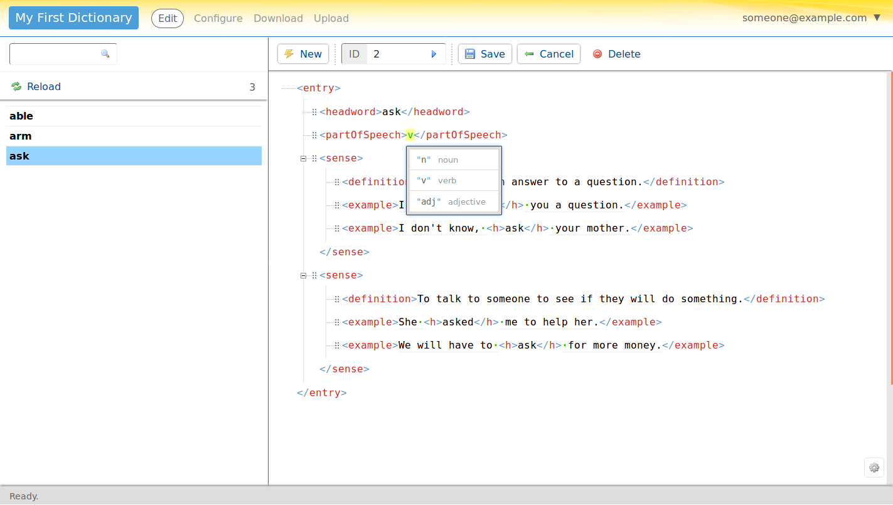
Lexonomy
Integrated development environment for lexicography
Also free and integrated with Sketch Engine and other ELEXIS tools

Slide 18



The Dictionary Matrix
Search
Bank
Search Results
Bank (English Noun)
“The land alongside or sloping down to a river or lake.” - From Oxford Dictionaries
“sloping land (especially the slope beside a body of water);” -
From Princeton WordNet
“A bank is a financial institution that accepts deposits from the public and creates credit” - From Wikipedia

Slide 19

Naisc
Dictionary
Naisc
Dictionary
Links
(‘naisc’ in Irish)

Slide 20
The OntoLex-Lemon Model

Slide 21
History of the Model
LingInfo (Buitelaar, 2006)
Monnet
Lemon
(2011)
Linguistic Information Repository (Montiel-Ponsoda, 2008)
OntoLex
Use Cases
(2014)
Lexicography Module
(2019)
LexInfo
(2010)
OntoLex Lemon Final Specification (2016)
LexOnto (Cimiano, 2007)
OntoLex
CG Founded
(2012)

Slide 22
OntoLex or Lemon?
The Ontolex Community Group’s primary result is the Lexicon Model for Ontologies (Lemon), which consists of the following modules:
(OntoLex) Core
  http://www.w3.org/ns/lemon/ontolex
Syntax and Semantics
  http://www.w3.org/ns/lemon/synsem
Decomposition
  http://www.w3.org/ns/lemon/decomp
Variation and Translation
  http://www.w3.org/ns/lemon/vartrans
Metadata (Lime)
  http://www.w3.org/ns/lemon/lime

Slide 23
Requirements on the Model
R1. OWL and RDF
R2. Multilinguality
R3. Semantics by Reference
R4. Openness
R5. Reuse relevant standards

Slide 24

Community Group - Please Join!
http://www.w3.org/community/ontolex

Slide 25

RDF and OWL
RDF models are labelled directed graphs
  Representation
Each entry has a URI
Reuse of lexicon data
Reasoning

Slide 26
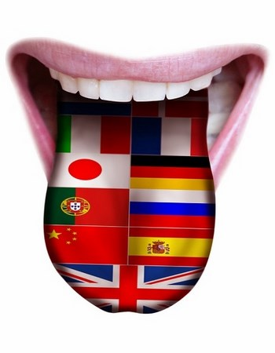
Multilinguality
Support any language
Do not make language-specific assumptions
  Part-of-speech values
  Gender
Translation and variation

Slide 27
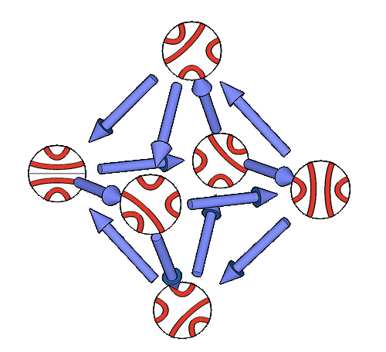
Semantics by Reference
Meaning of a word given by reference
Reference captures semantic information
Disambiguation is performed relative to the ontology
No (traditional) word senses

Slide 28
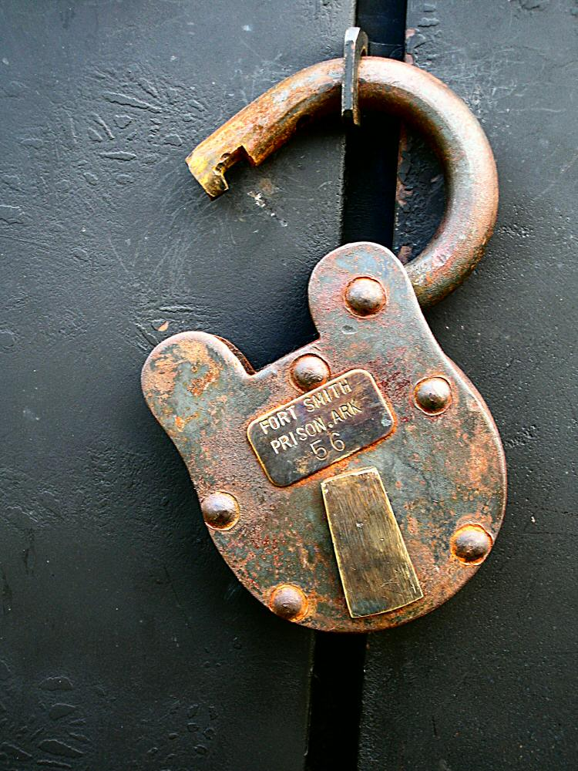
Openness
Extensible with new models
No unnecessary choices of linguistic categories
No payment or restrictions in using the model
All discussion is public

Slide 29

Reuse standards
Reuse as many standards as possible
OWL
RDF
SKOS
Dublin Core
LMF
TMF
TEI

Slide 30
A (very) brief introduction to OntoLex-Lemon

Slide 31
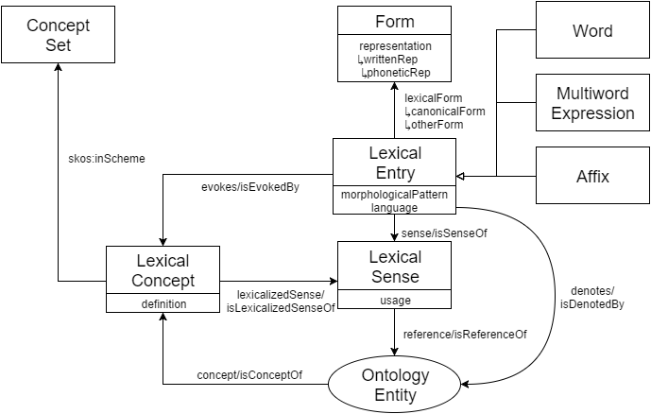

Slide 32
Simple Entry
OntoLex Namespace
@prefix ontolex: <http://www.w3.org/ns/lemon/ontolex#> .
@prefix skos: <http://www.w3.org/2004/02/skos/core#> .
<#cat> a ontolex:Word ;
ontolex:canonicalForm [
ontolex:writtenRep “cat”@en ] ;
ontolex:denotes [
skos:definition “A four-legged, furry animal”@en ] .
Lemma
Sense

Slide 33
Grammatical Information
@prefix ontolex: <http://www.w3.org/ns/lemon/ontolex#> .
@prefix skos: <http://www.w3.org/2004/02/skos/core#> .
@prefix lexinfo: <http://www.lexinfo.net/ontology/2.0/lexinfo#> .
<#cat> a ontolex:Word ;
lexinfo:partOfSpeech lexinfo:noun
ontolex:canonicalForm [
ontolex:writtenRep “cat”@en ;
lexinfo:number lexinfo:singular ] ;
ontolex:otherForm [
ontolex:writtenRep “cats”@en ;
lexinfo:number lexinfo:plural ] ;
ontolex:denotes [
skos:definition “A four-legged, furry animal”@en ] .
LexInfo Ontology
Part of Speech
Inflected Form

Slide 34
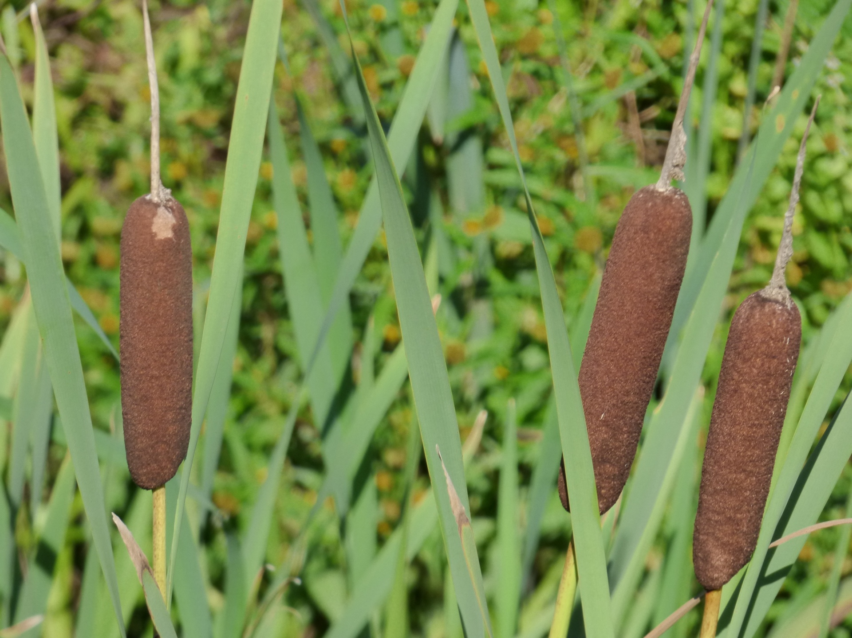
Lexical Senses
@prefix ontolex: <http://www.w3.org/ns/lemon/ontolex#> .
@prefix dbpedia: <http://dbpedia.org/resource/> .
@prefix dbo: <http://dbpedia.org/ontology/> .
<#bulrush> a ontolex:Word ;
ontolex:sense [
ontolex:reference dbpedia:Typha ;
ontolex:usage [ rdf:value “British English” ] ] ;
ontolex:denotes dbpedia:Typha .
<#cattail> a ontolex:Word ;
ontolex:sense [
ontolex:reference dbpedia:Typha ;
ontolex:usage [ rdf:value “American English” ] ] ;
ontolex:denotes dbpedia:Typha .
sense ⚬ reference
=
denotes
Restriction on Lexical Sense

Slide 35
Syntax and Semantics
John knows Jorge
<http://john.mccr.ae> foaf:knows uzar:jogracia

Slide 36
Decomposition
Qualitätsmanagement-System
Qualität Management System

Slide 37

Variation and Translation
Cultural
Translation
“もち”@ja
“Japanese Rice Cake”@en

Slide 38



LIME - Linguistic Metadata
Magic Ontology
Jace the Wizard
Thanks, Armando!
Erhnam the Djinn

Slide 39
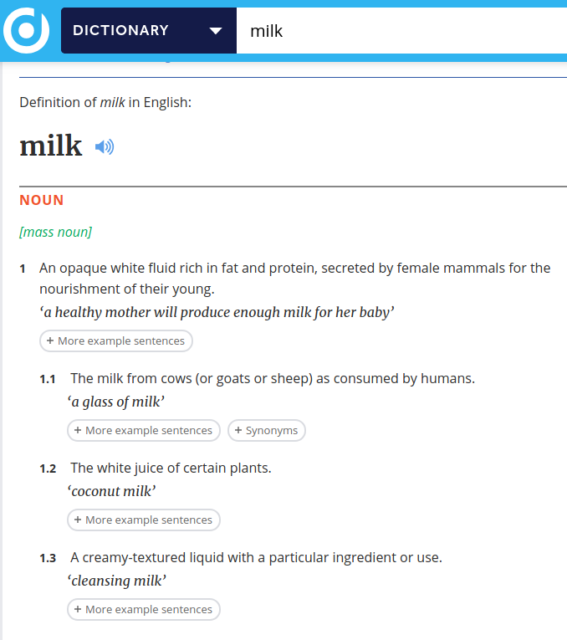
Lexicography
Multi-POS Entries
Usage Examples
Sense Hierarchy
Form Restrictions

Slide 40

Morphology
na mBeoracha
Simulfix
Eclipsis
Stem
Beoir (beer)
Simulfix
Broadening
Plural Suffix
-acha

Slide 41
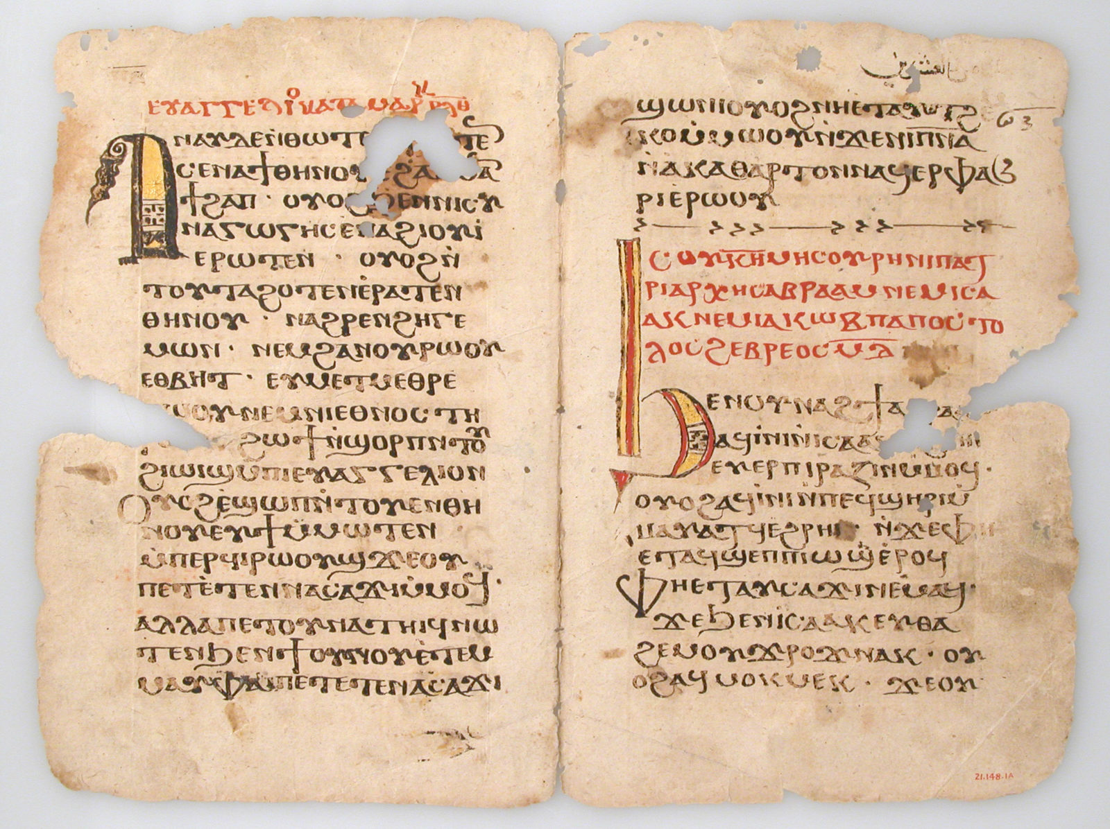
FRAC - Frequency, Attestation & Corpus Information
Where?
How often?
First usage?

Slide 42
OntoLex in Prêt-à-LLOD and ELEXIS

Slide 43
OntoLex in Prêt-à-LLOD
Development of new modules
Lexicalization for Linking
Common translation format
Supports Multilinguality

Slide 44
OntoLex in ELEXIS
Observers’
Dictionaries
Continuous Quality Evaluation
Linking Tool (Naisc)
Retro-digitisation
REST
Interface
Dictionary Matrix
TEI-Lex0 / OntoLex-Lemon
Dictionaries
NLP Tools
Sketch Engine
Dictionary Authoring (Lexonomy)
Crowdsourcing

Slide 45
Conclusion
Prêt-à-LLOD aims to make linguistic data more available
  Through 5 practical tools
ELEXIS will improve lexicography
  As an infrastructure that supports the virtuous cycle
OntoLex-Lemon is a glue that holds this together
  Widely-used model for lexicography
  Simple, clean
  Extensible

Slide 46
Questions?

