Slide 1
Limits of automatic alignment: the GACS experience
Tom Baker
Workshop on
Semantic interoperability
for the multilingual web
Luxembourg, 4 June 2019

Slide 2

AGROVOC
CAB Thesaurus
NAL Thesaurus
32,000
concepts,
>1.2M labels
140,000
concepts,
>1.4M labels
53,000
concepts,
>200k labels
English, Spanish, Portuguese, German, Czech, Persian, Polish, Hindi, French, Italian, Russian, Japanese, Hungarian, Chinese, Slovak, Thai, Lao, Turkish, Korean, Arabic, Telugu ...
English, Spanish, Portuguese, Dutch
+ many languages with
lower coverage
English, Spanish
Starting point

Slide 3
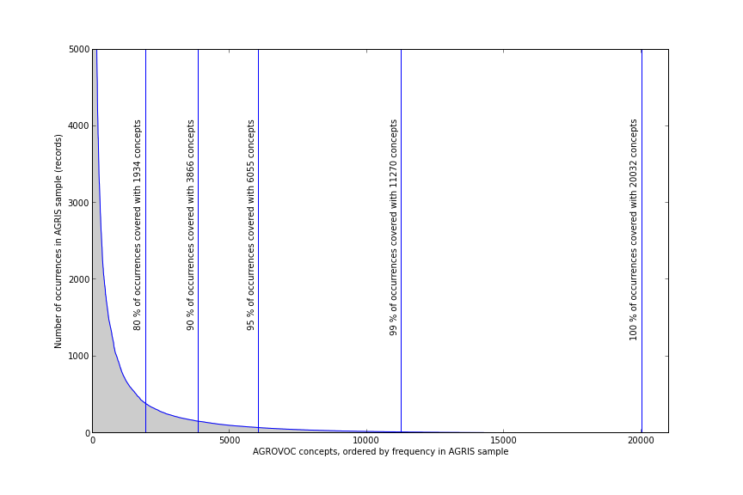
GACS Phase Two steps
Decide approximate size
of GACS Core
Select important concepts
from source thesauri
Generate mappings
Create mapping tables
with candidates
Evaluate mappings
Reconcile mappings
Expand mapping tables
Evaluate added mappings
Form GACS Core concepts
Assign GACS URIs
Complete GACS Core with
additional information
Select preferred labels
for display purposes
Reconcile structure
Publish GACS Core
Algorithm + human review

Slide 4
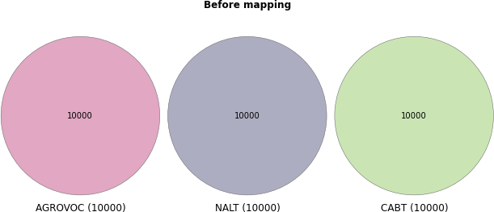

Slide 5
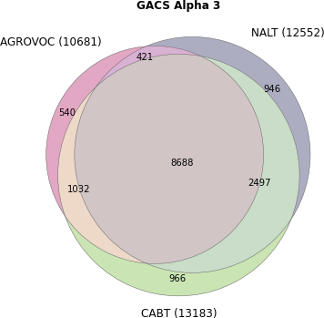
Lumps

Slide 6
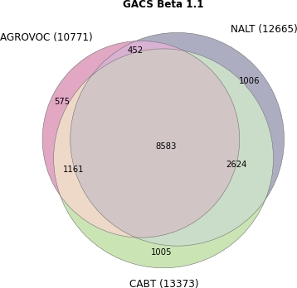
Lumps

Slide 7
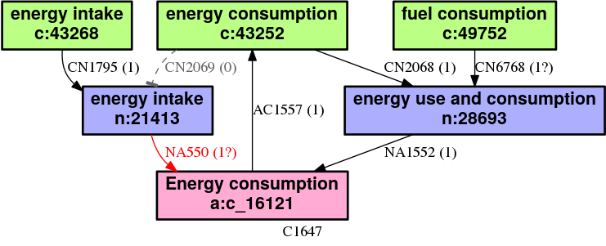
Example Lump
Six concepts
c: CABT
n: NALT
a: AGROVOC

Slide 8
Example Lump
Mappings fixed
NT
BT
About
organisms.
About natural resources.

Slide 9
Used to create
energy use and consumption
nalt:28693
energy intake
nalt:21416
gacs:?
energy consumption
agrovoc:c_16121
energy intake
cabt:43268
gacs:?
energy consumption
cabt:43252
gacs:?
fuel consumption
cabt:49752

Slide 10
...three concepts
in GACS Core
energy intake
gacs:c5381
energy consumption
gacs:c4653
BT
fuel consumption
gacs:c20300

Slide 11
...which map back
to their sources
energy use and consumption
nalt:28693
energy intake
nalt:21416
energy intake
gacs:c5381
energy consumption
agrovoc:c_16121
energy intake
cabt:43268
energy consumption
gacs:c4653
energy consumption
cabt:43252
fuel consumption
gacs:c20300
fuel consumption
cabt:49752

Slide 12
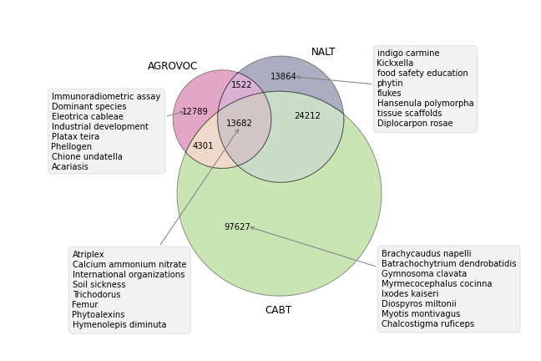
GACS Core
Result
GACS
GACS Core
15,000+ concepts
350,000+ labels in 28 languages

Slide 13
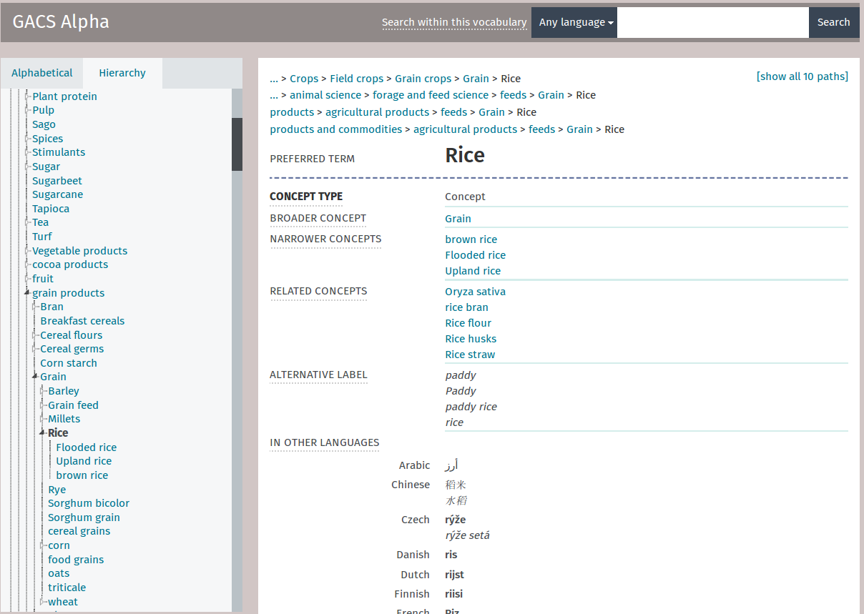
GACS browser [Skosmos, open-source]
http://browser.agrisemantics.org/gacs/en/
Loaded into Skosmos

Slide 14
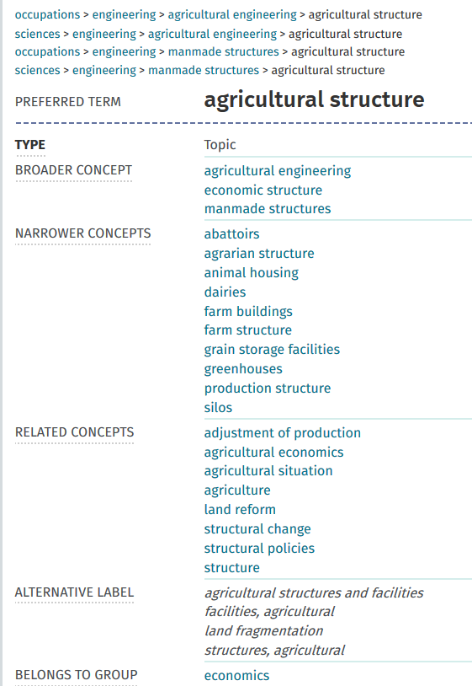
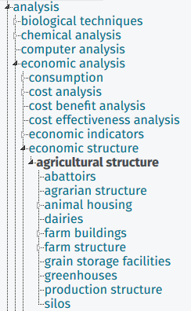
But problems:
GACS inherited
from three sources
Notes:
Example of term that is not defined by hierarchy…. Confused by hierarchy. Is this an structure that is agricultural, such as silos and farm buildings, or is this referring to the structure of agriculture in the economic sense? Had to make some tough decisions to disambiguate concepts in this work. Not easy.

Slide 15
Quality control project [nine months]
Status: 15,428 concepts
Hierarchy
  BT/NT relationships sometimes of different types
  4,226 concepts (27%) have more than one BT (“polyhierarchy”)
  578 top concepts
Thematic classification
  Based on CABT Classification / UAT
  None assigned for ~2800 concepts.
  Frequency distribution of terms to categories very uneven.
  No scope notes for the classification.
Notes:
Here are the beginning statistics of GACS Beta 3.1 version. Not that there are 578 top concepts.

Slide 16
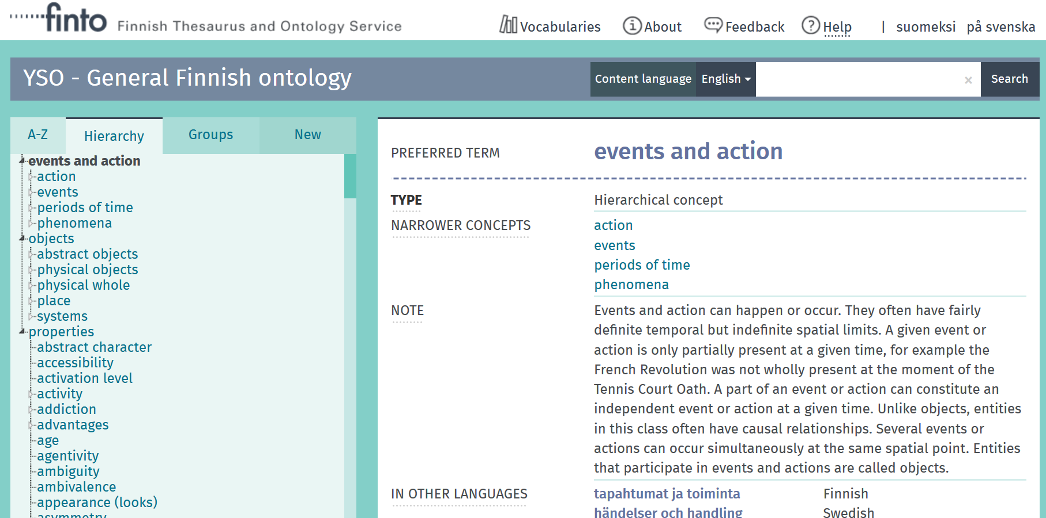
Top concepts reduced to three [based on YSO]
Notes:
Note upper structure.

Slide 17
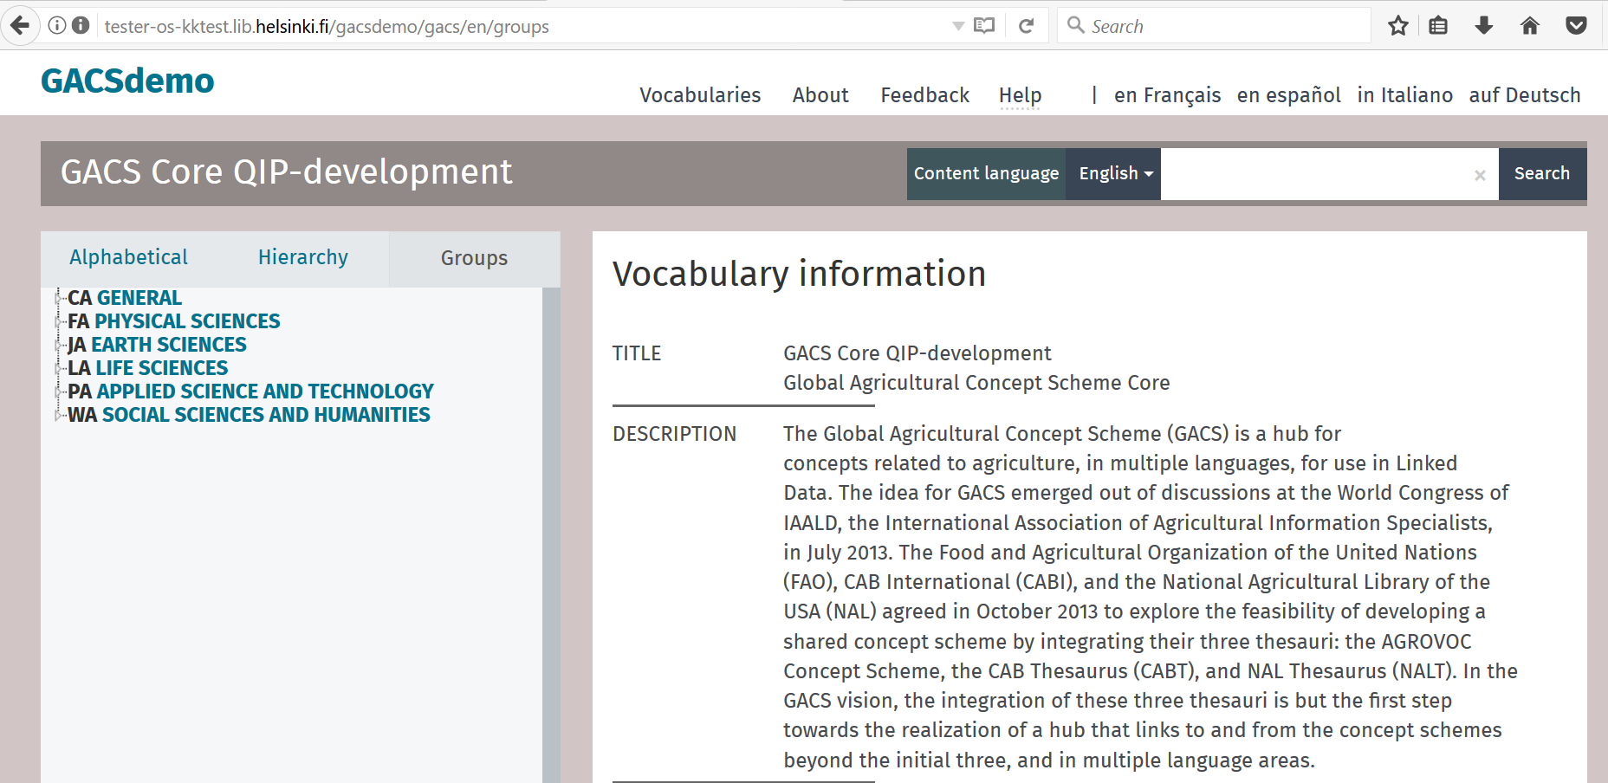
100% of concepts assigned to classification

Slide 18
GACS vision
Vision
  Was: Global Agricultural Concept Scheme
  Now: Global Agricultural Concept Space
    “Namespace of SKOS concepts (grouped into concept schemes)”
Scope
  To date: concepts used in bibliographic description
  In future: more emphasis on variables used in agricultural datasets
Goals
  Semanticize field data spreadsheets by annotating with GACS URIs
  Use generic GACS concepts as mapping targets from domain ontologies

Slide 19
Part-time effort over 3+ years
Feasibility study
  Two consultants
Creation of GACS
  Four thesaurus experts (from three partner organizations) + two consultants
Quality control
  One thesaurus expert + two consultants
Notes:
Here are the beginning statistics of GACS Beta 3.1 version. Not that there are 578 top concepts.

Slide 20
Challenges
Governance
  Building the partner coalition
  Maximize reuse and avoid duplication within the concept space
Effort
  Sustainable effort in conditions of tight budgets
  Monitor existing alignments to keep them fresh
Role within ecosystem
  Collaboration and alignment with other concept schemes, domain ontologies, Wikidata
  Best practice for annotating ”non-semantic” resources with URIs

Slide 21


