Slide 1
Aligning Strings, Things, and Shapes
Tom Baker
Workshop on
Semantic interoperability
for the multilingual web
Luxembourg, 4 June 2019

Slide 2
Strings [thesauri, 1960s thru 1990s]
Economic cooperation
-- BT Economic policy
-- RT Interdependence
-- NT Economic integration
-- NT European economic cooperation
-- NT European industrial cooperation
-- NT Industrial cooperation
Big printed books and
stand-alone databases

Slide 3
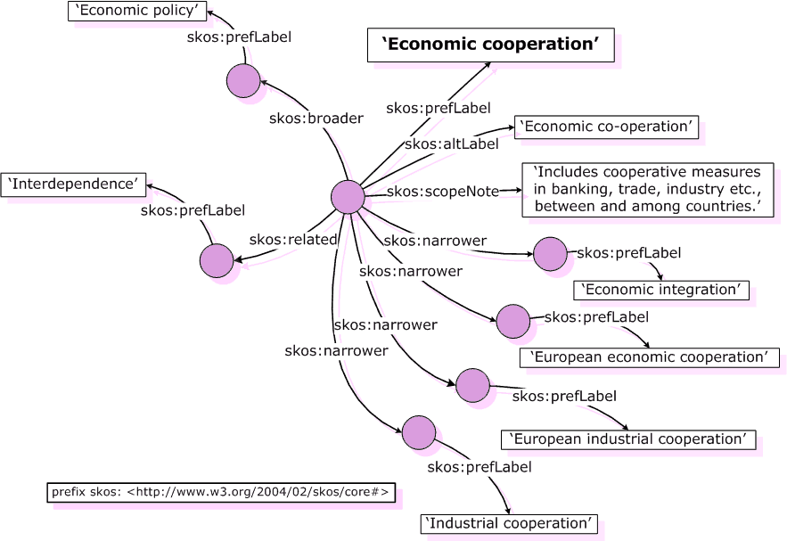
Things [thesauri and SKOS since 2000]
Machine-readable
schemas on the Web

Slide 4
EuroVoc
AGROVOC
Finto
SKOS Concept Schemes
“Ontologies”
Taxonomies
Thesauri
Things
Classes
Concepts
Properties
Mind maps
Models of reality with flexible,
intuitive semantics
Can be mapped
one-to-one
Shapes

Slide 5
Vocabularies
Properties, the “glue”
Classes
Concepts
Properties
Dublin Core
FOAF
BIBFRAME
Schema.org
Can be mapped
one-to-one
Shapes

Slide 6
FoodOn (OBO Foundry)
Gene Ontology
Crop Ontology
OWL Ontologies
RDF Schemas
Classes
Concepts
Properties
Logically precise
models of reality
Can sometimes
be mapped
one-to-one
Shapes

Slide 7
 |  | gacs:C3620 | obo:FOODON_03309832
Type
 | rdf:type | SKOS Concept | OWL Class
Annotations
 | label |  | "orange"@en
 | prefLabel | "oranges"@en
 |  | "甜橙"@zh
 |  | ...plus labels in 25 languages
 | altLabel | "sweet oranges"@en
 |  | ...plus 20 labels in 14 languages
 | definition |  | "The orange is..."

Slide 8
Hierarchy |  | GACS | FoodOn
 | broader concept | citrus fruits (concept)
 | super-class |  | orange (whole or parts) (class)
 | subclass |  | california valencia orange (class)
 | subclass |  | clementine (class)
 | subclass |  | navel orange (class)
Semantic axioms
 | member of group | Organisms, by non-taxonomic groups
 | has type | Product (class)
 | is product of | Citrus sinensis (concept)
 | is a |  | raw fruit (class)
 |  |  | hesperidium fruit (class)
 | has quality |  | whole, natural shape
 | develops from part of |  | orange plant (class)
Candidate semantic axioms
 | comment |  | "has quality: not heat-treated” (string)
 |  |  | "derives from: fruit, peel present, core, pit or seed present” (string)
Mappings
 | exact match | cabt:82282
 |  | agrovoc:c_7550
 |  | nalt:26518

Slide 9
Classes
Concepts
Properties
Templates for data
Properties, concepts, classes used
Constraints on their use
ShEx shape: “a regular expression
executed over a bag of triples
rather than a string”
Shape Expression (ShEx) Schemas
Application Profiles
Shapes

Slide 10
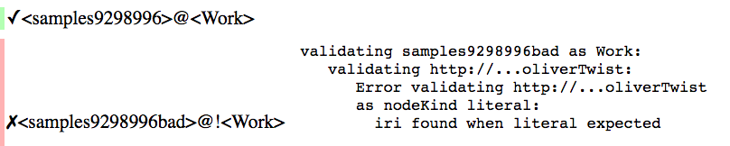
ShEx Schema [ShExC syntax]
RDF Data [Turtle syntax]
<Work> EXTRA rdf:type {
rdf:type [bf:Work] ? ;
bf:title LITERAL ;
bf:class @<Classification> * ;
bf:creator @<Person> OR @<Organization> + ;
bf:derivedFrom IRI * ;
}
<Classification>
[<http://id.loc.gov/>~]
AND
EXTRA rdf:type {
rdf:type [bf:LCC] ? ;
bf:label LITERAL ;
}
<samples9298996>
rdf:type bf:Text ;
rdf:type bf:Work ;
bf:title "Oliver Twist." ;
bf:class <id.loc.gov/…/PZ3> ;
bf:creator [
rdf:type bf:Person ;
bf:label "Dickens, Charles, 1812-1870." ;
] .
<id.loc.gov/…/PZ3>
rdf:type bf:LCC ;
bf:label "PZ3.D55O165PR4567" .
ShExC syntax looks alot like RDF Turtle
syntax, with parts to be validated replaced by keywords and by placeholders for values.
2. Against a schema.
1. Validate data.
Validation
Shape Expressions language (ShEx): schema
prescribes conditions to which RDF
data must conform to be considered
valid.
3. To yield a validation result

Slide 11
ShEx Schema [ShExJ syntax]
RDF Data [Turtle syntax]
{
"type": "Schema",
"shapes": [
{
"id": "https://rawgit.com/shexSpec/shex.js/master/doc/Work",
"type": "Shape",
"expression": {
"type": "EachOf",
"expressions": [
{
"type": "TripleConstraint",
"predicate": "http://www.w3.org/1999/02/22-rdf-syntax-ns#type",
"valueExpr": {
"type": "NodeConstraint",
"values": [
"http://bibframe.org/vocab/Work" ... ... ...
<samples9298996>
rdf:type bf:Text ;
rdf:type bf:Work ;
bf:title "Oliver Twist." ;
bf:class <id.loc.gov/…/PZ3> ;
bf:creator [
rdf:type bf:Person ;
bf:label "Dickens, Charles, 1812-1870." ;
] .
<id.loc.gov/…/PZ3>
rdf:type bf:LCC ;
bf:label "PZ3.D55O165PR4567" .
ShExJ syntax is verbose, ideal for processing by machines.
Helps in understanding structure of ShEx
2. Against a schema.
1. Validate data.
Validation
ShExJ syntax, interchangeable with ShExC.
3. To yield a validation result

Slide 12
Map (SKOS) concept to concept
SKOS concepts, by default, have no set-theoretical baggage
Thomas Gruber: “minimal semantic commitment”
Mapping relations
skos:exactMatch – if you are confident they represent the same thing
skos:closeMatch – if you think they are close but are unsure
owl:sameAs – easily misused – needs serious consideration before use

Slide 13
Map string to string
Problem
In RDF linked data, a literal cannot be the subject of mapping triple
Solution: map strings by way of things
Consider string as “literal form” associated with instance resource representing string
ex:FAO rdf:type skos:Concept;
skosxl:prefLabel ex:FAOlabel1;
skosxl:altLabel ex:FAOlabel2.
ex:FAOlabel1 rdf:type skosxl:Label;
skosxl:literalForm "Food and Agriculture Organization"@en.
ex:FAOlabel2 rdf:type skosxl:Label;
skosxl:literalForm "FAO"@en.
ex:FAOlabel2 ex:isAcronymOf ex:FAOlabel1.

Slide 14
Map (OWL) class to class
If classes represent logically consistent sets of instances
Map using OWL sub-class or equivalent class relationship
If not...
Map class to class by way of SKOS concept
Problem: map similar classes with different semantic baggage
FoodOn “orange”: subclass of union of Raw Fruit and Hesperidium Fruit
OntoFood “orange”: subclass of Fruits, itself subclass of Food Groups
Solution: map the classes to a GACS concept
GACS “oranges”: a concept narrower than Citrus Fruits – not a class!

Slide 15
Map (ShEx) shape to shape
When concepts described not by single URI but combination of URIs
Example: Blood pressure – a concept with component parts
Described in different contexts with different constellations of properties
Diastolic, systolic, body site, measuring device used...
ShExMap method – define shared “variables”
Preserve associations in complex data structures
Annotate “blood pressure” shapes for datasets A and B with “target” URI
Means: “instance data matching source shape can be re-written to match target”
Define shared concept for “blood pressure”, identify with “target” URI
Extract data from datasets A and B, convert into ”target” shape

Slide 16
ShExMap output based on target shape
<tag:b0> med:systolic _:b0.
_:b0 med:value "110"^^<http://www.w3.org/2001/XMLSchema#float>;
med:units "mmHg".
<tag:b0> med:diastolic _:b1.
_:b1 med:value "70"^^<http://www.w3.org/2001/XMLSchema#float>;
med:units "mmHg".
See: http://bit.ly/shexmap_example_bloodpressure

Slide 17


