Slide 1
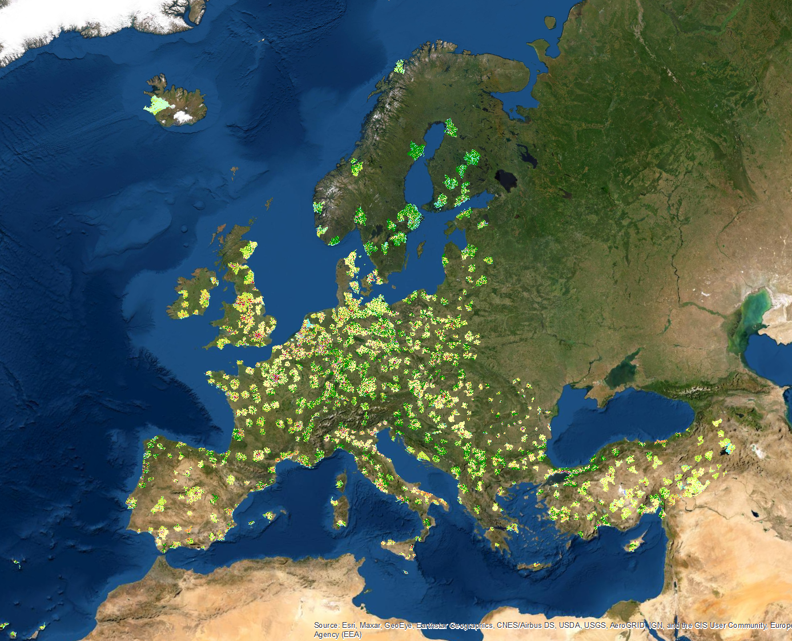
EU Datathon 2022
Copernicus Land Monitoring Service
Urban Atlas

Slide 2
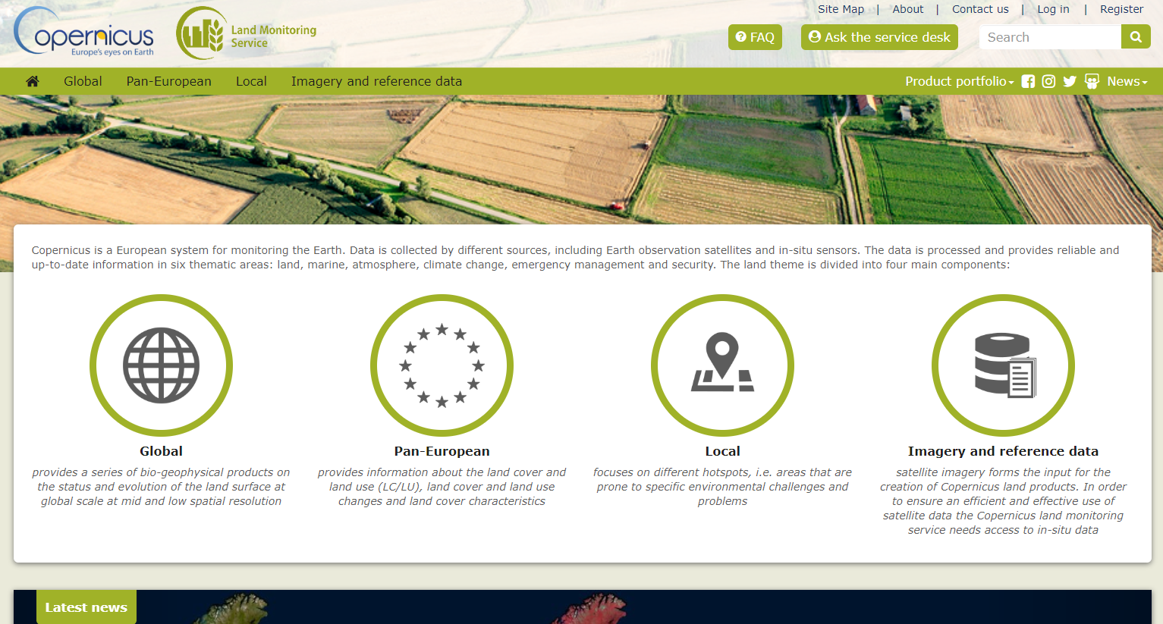






Copernicus Land Monitoring Service
CLMS (Copernicus Land Monitoring Service) implemented by the European Environment Agency (EEA) and the Joint Research Centre (JRC)
CLMS provides operational products and services, regularly updated, derived from satellite imagery and produced by industry
Products and services are made available, free and open through the Copernicus land portal https://land.copernicus.eu/ both as view and web map services and for download.

Slide 3
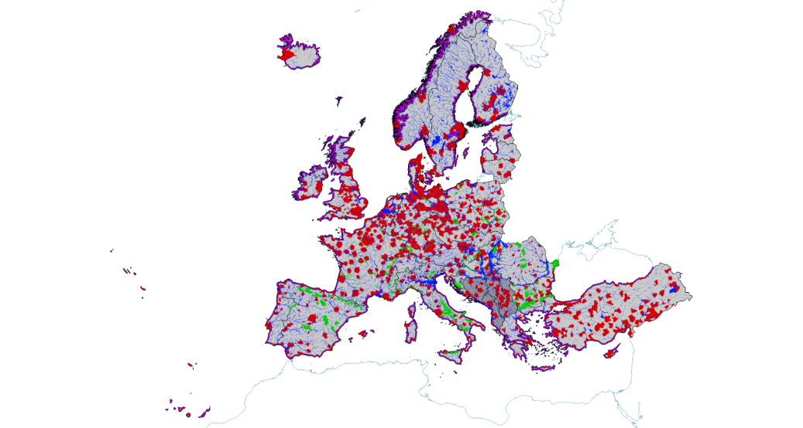
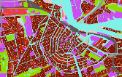
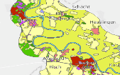

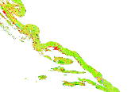
Priority Area Monitoring - overview
Vector based VHR LC/LU mapping of priority areas
MMU between 0.25ha-1ha
Tailored nomenclature
6-year cycles: status and change mapping
Urban Atlas
Riparian Zones, Natura 2000, Coastal Zones
UA
2006-12-18
RZ
2012-18
N2K
2006-12
CZ 2018

Slide 4
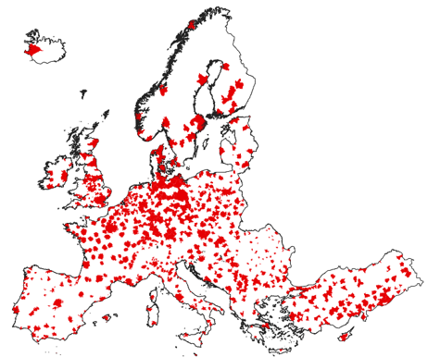
Urban Atlas (UA) – LC/LU product description
Area: approx. 1.265.800 km²
Functional Urban Area = city¹ + commuting zone
Reference years: 2006 (319 FUAs); 2012 (785 FUAs); 2018 (788 FUAs) covering EU27 + UK + EFTA countries + West Balkans + Turkey
Each polygon contains harmonised LC/LU information according to a common classification (27 classes)
MMU:
  0.25 ha for artificial classes (classes 1*) - 17 classes
  1 ha for rural classes (classes 2*-5*) – 10 classes

Slide 5
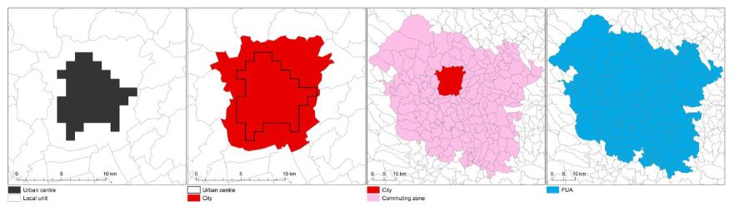
What is a Functional Urban Area?
Functional Urban Area = city¹ + commuting zone
¹ Harmonised OECD-EC city definition: purely based on population size and density https://land.copernicus.eu/user-corner/technical-library/oecd-definition-of-functional-urban-area-fua
1 The EU-OECD definition of a functional urban area based on population size and density A HARMONISED DEFINITION OF A CITY (oecd.org)

Slide 6
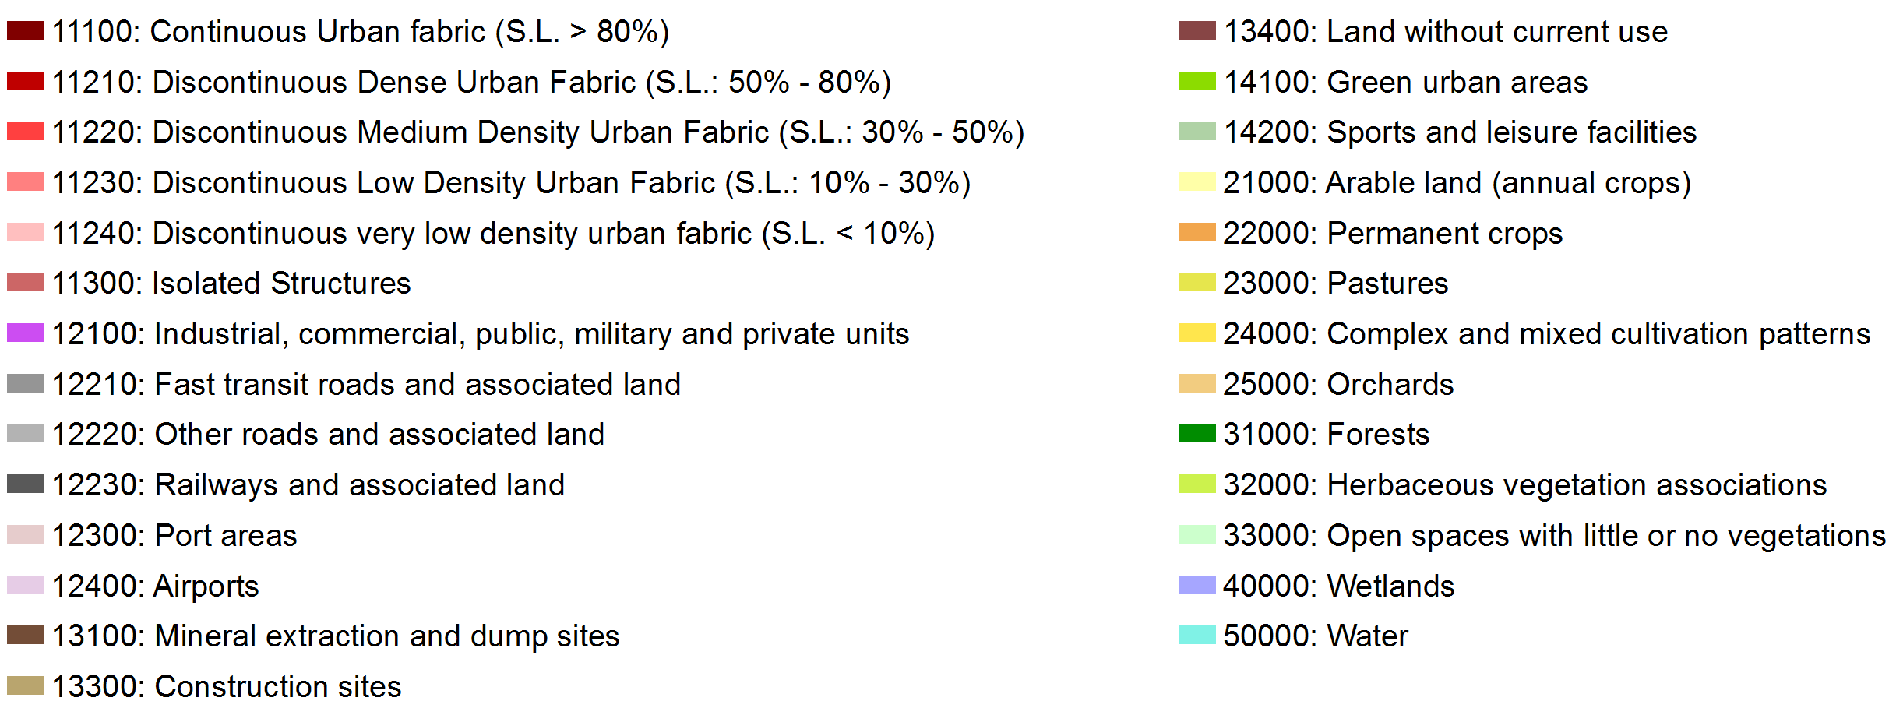
Urban Atlas - Nomenclature
Street Tree Layer
0.25 ha MMU
1ha MMU

Slide 7
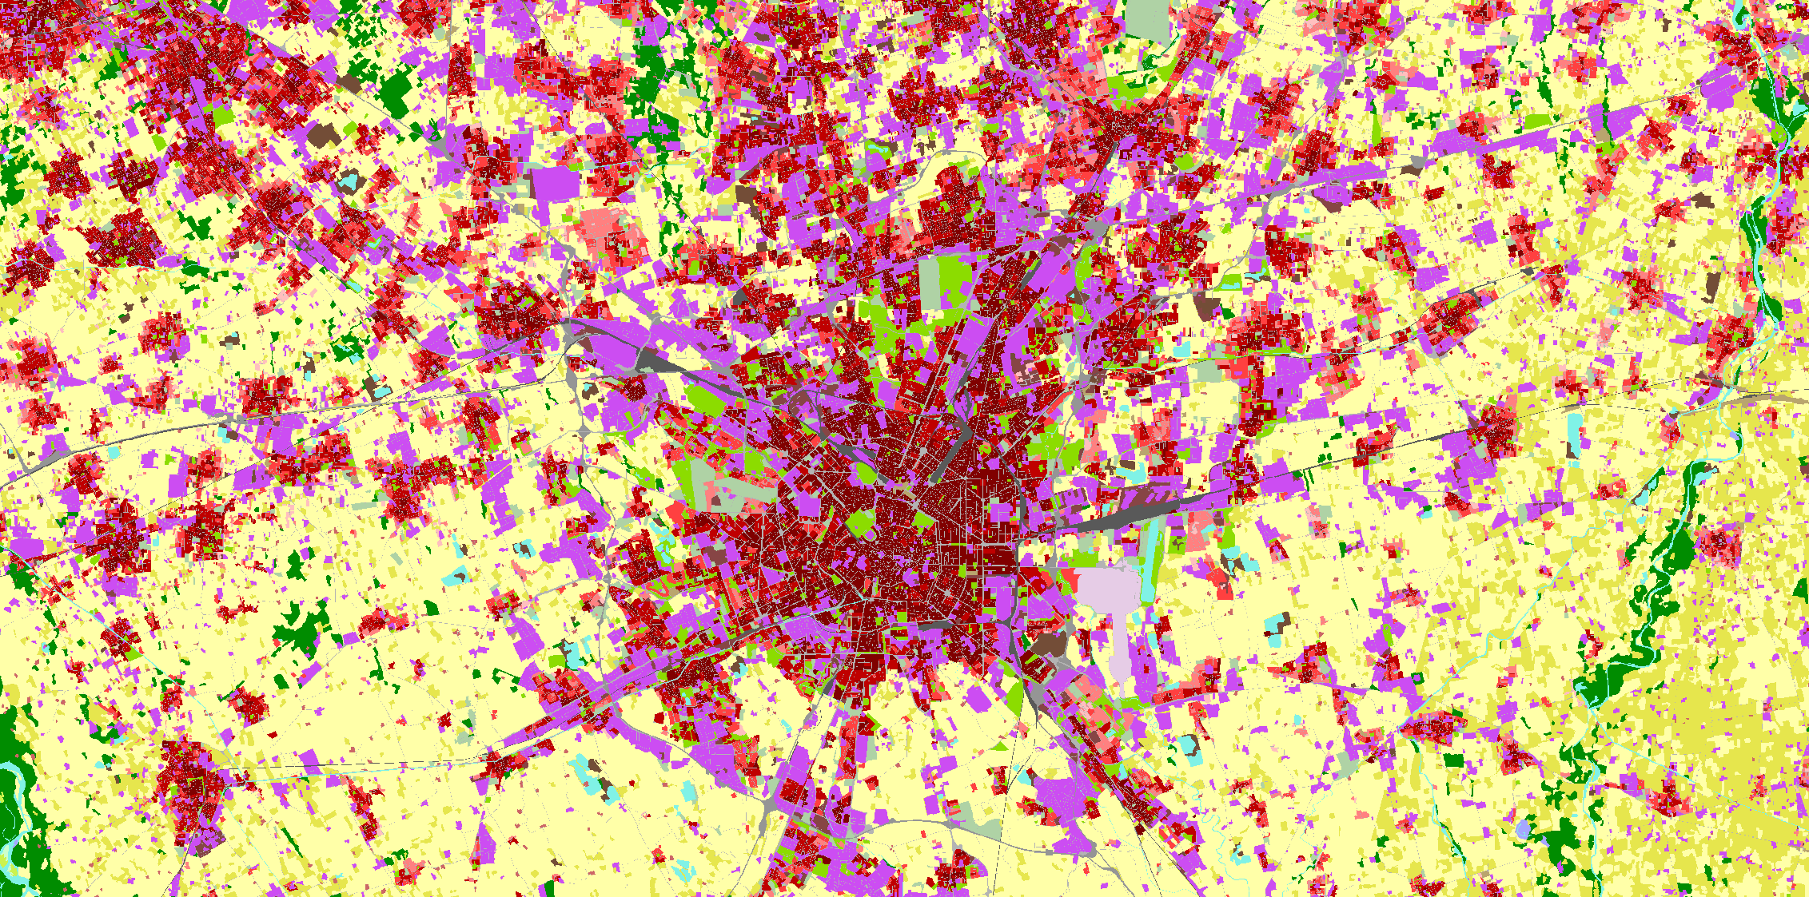
Illustration of an area in Milan (IT)

Slide 8
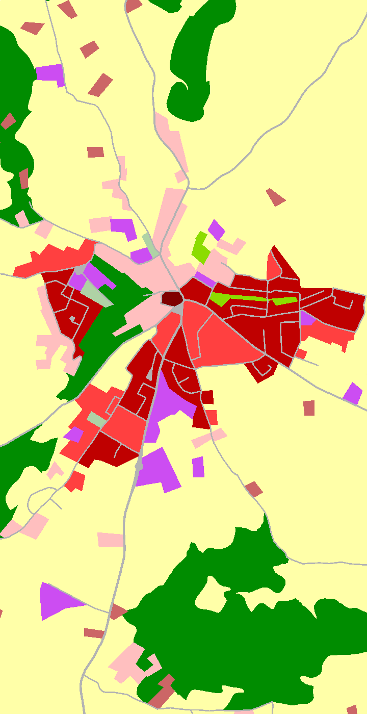
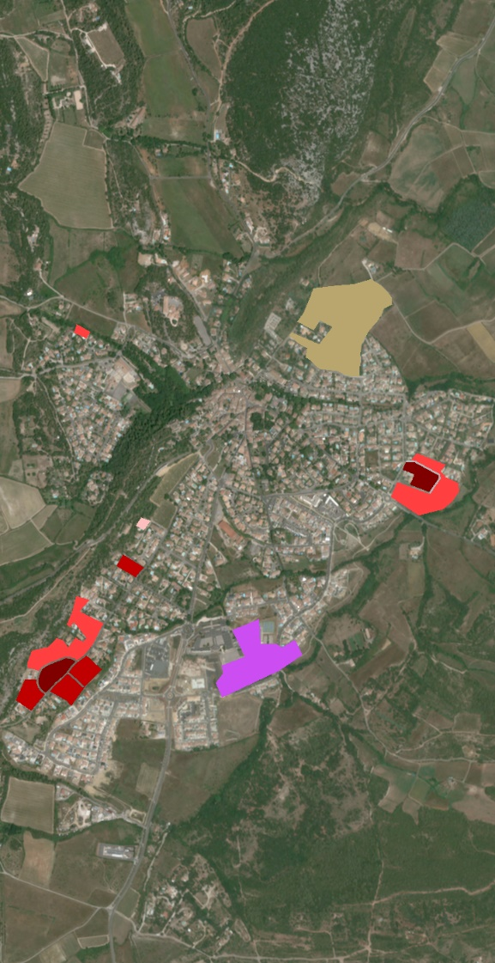
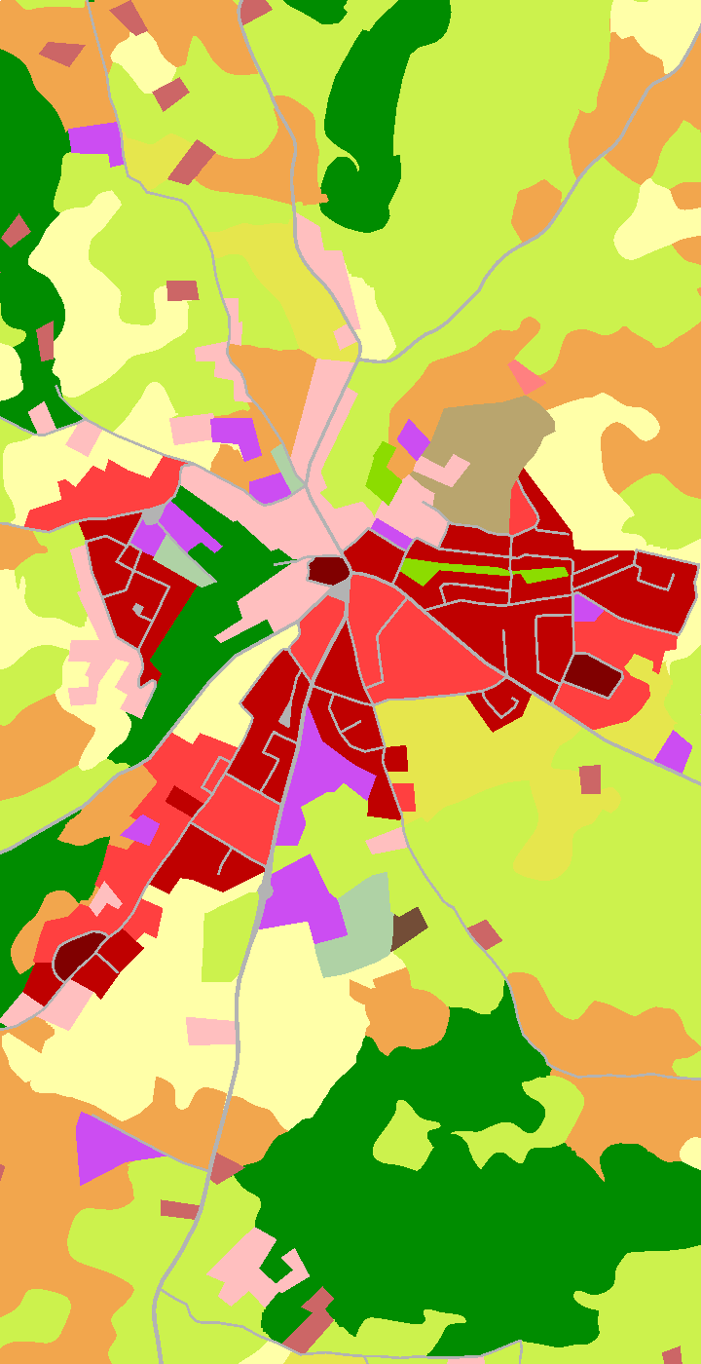
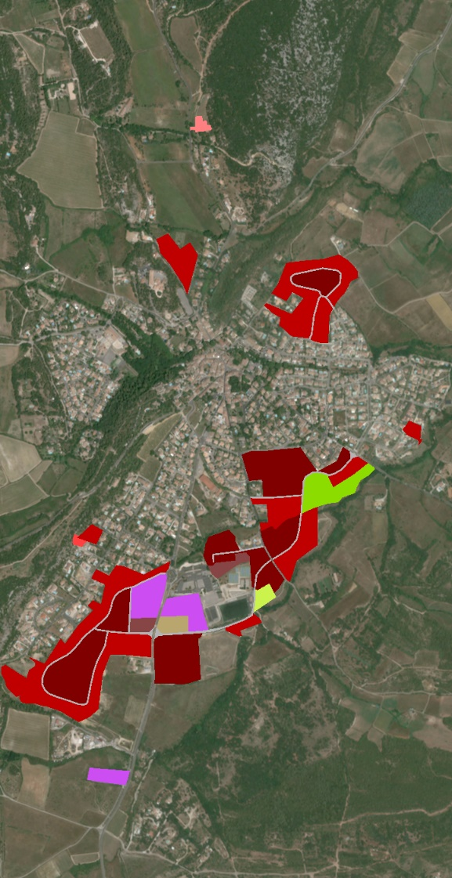
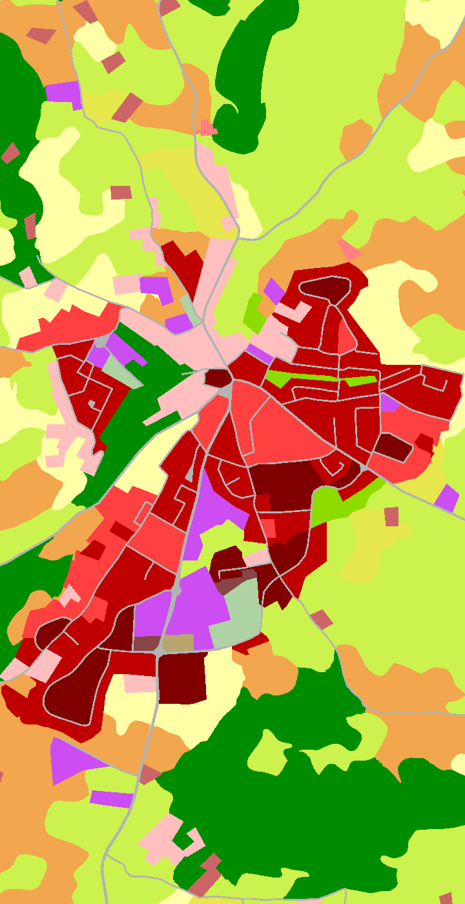
What does the data show?
Urban Atlas Evolution 2006 – 2018, LC/LU product
2006
2006-2012
2012
2012-2018
2018

Slide 9
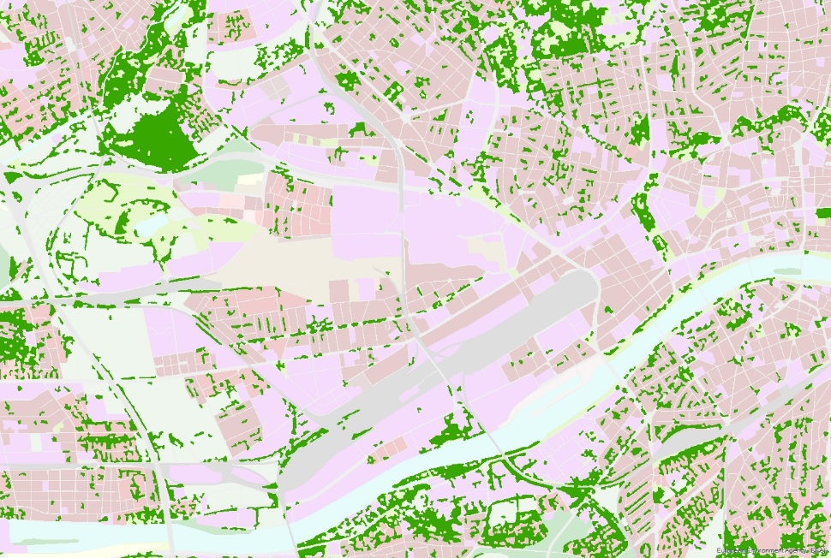
UA: Street Tree Layer (STL)
Urban Atlas (example: Frankfurt am Main)

Slide 10
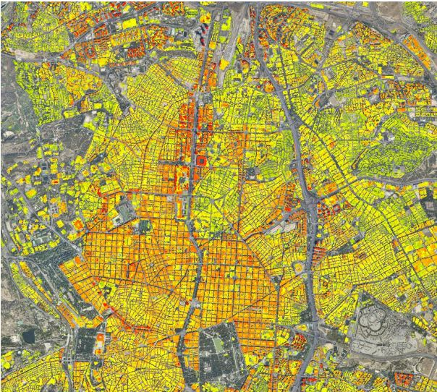
UA: Building Block Height - Milan & Madrid

Slide 11
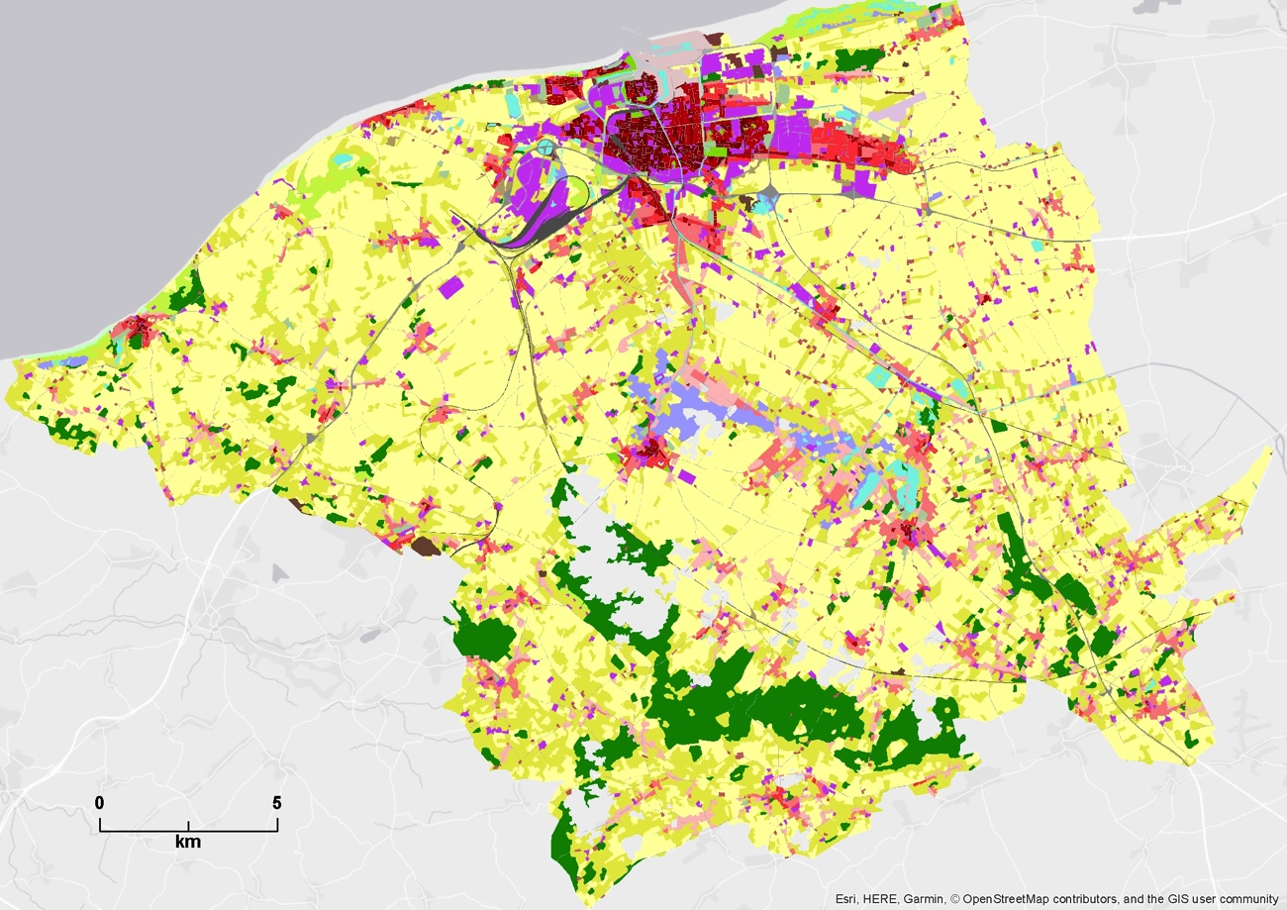
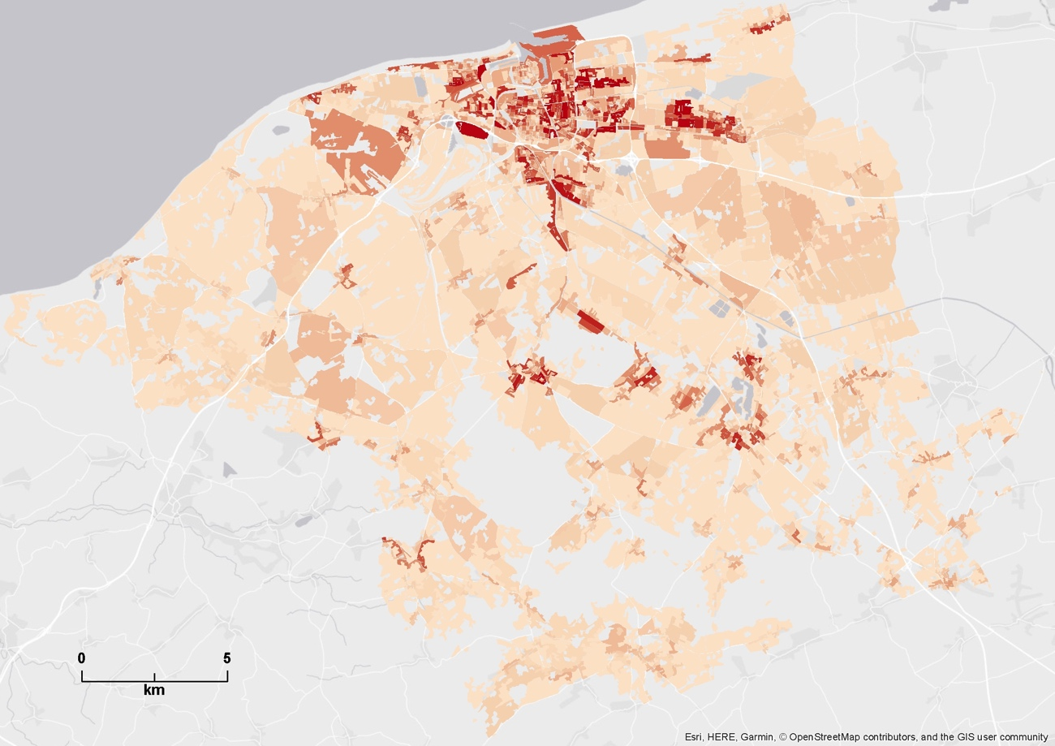
Population density estimates per UA polygons
Calais (FR)
http://publications.jrc.ec.europa.eu/repository/bitstream/JRC103756/jrc103756_uatl_population_jrc_tech_report_alt.pdf

Slide 12
In support of the work on the Nature Restoration Law on urban ecosystems (Urban Atlas derived)
Land Take in Functional Urban Areas 2012-2018
  https://www.eea.europa.eu/data-and-maps/data/data-viewers/land-take-in-functional-urban
Land take in Urban Floodplains 2012-2018:
  https://www.eea.europa.eu/data-and-maps/data/data-viewers/land-take-in-urban-floodplains
Land take in Urban Protected Areas 2012-2018:
  https://www.eea.europa.eu/data-and-maps/data/data-viewers/land-take-in-urban-protected
Urban Green Infrastructure, 2018:
  https://www.eea.europa.eu/data-and-maps/dashboards/urban-green-infrastructure-2018
Urban Tree Cover:
  https://www.eea.europa.eu/data-and-maps/dashboards/urban-tree-cover
Land use efficiency in Functional Urban Areas:
  https://www.eea.europa.eu/data-and-maps/dashboards/land-use-efficiency-in-functional

Slide 13
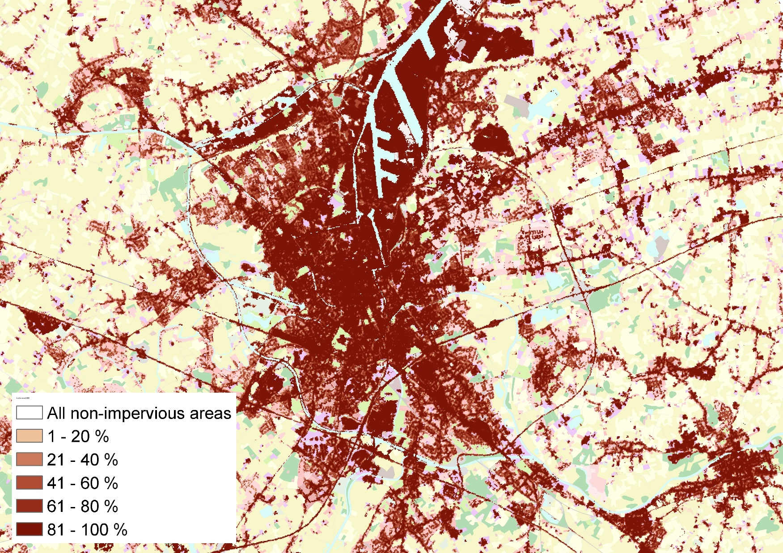
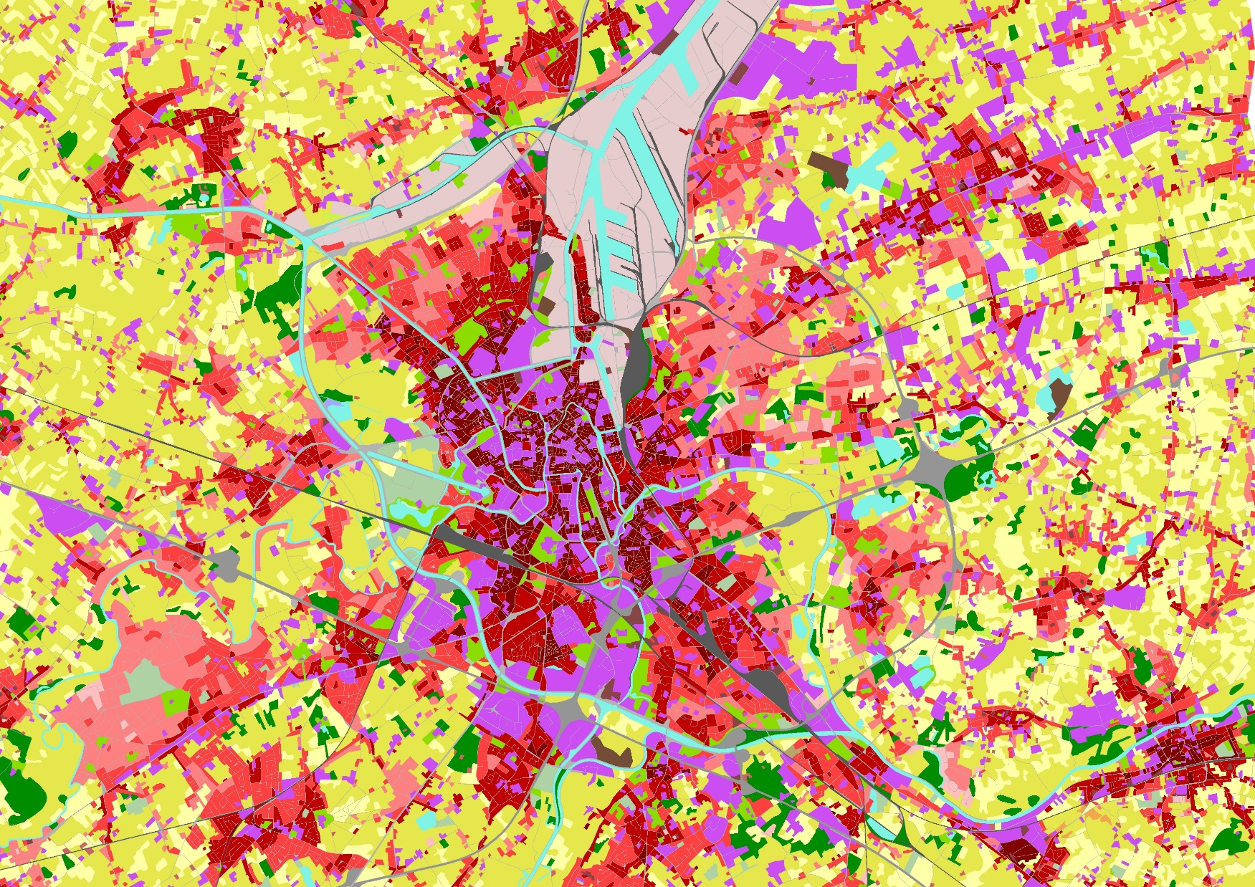
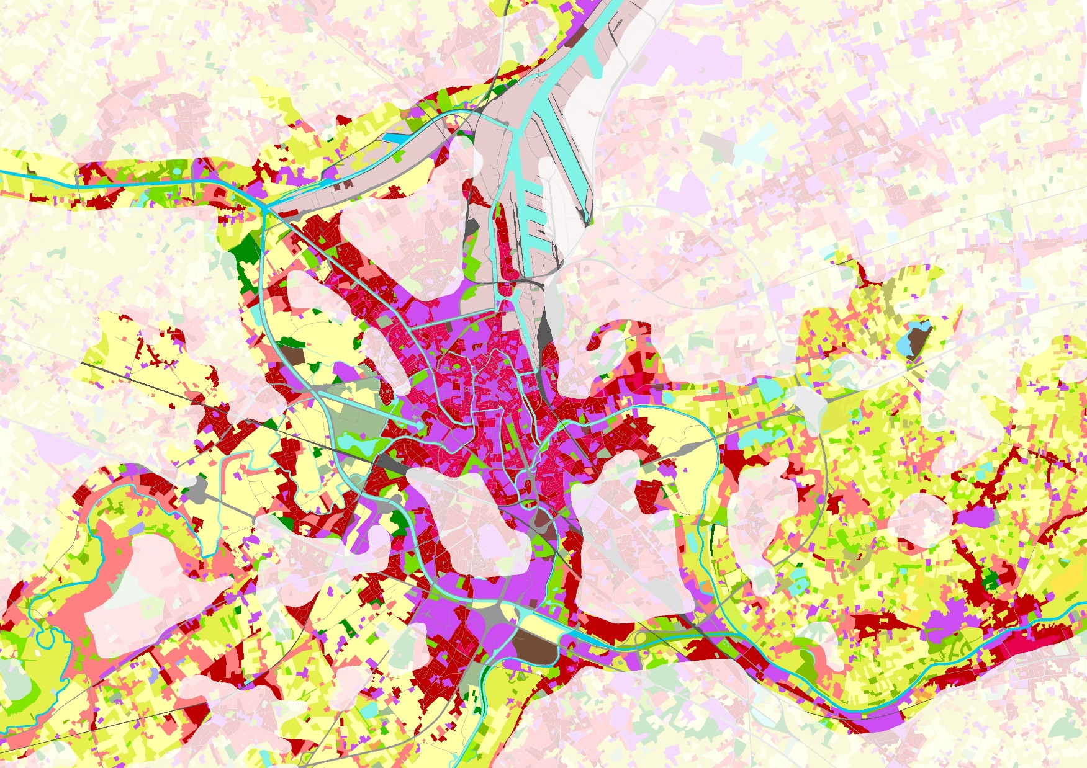
Urban Atlas, Riparian Zones and Imperviousness Density

Slide 14
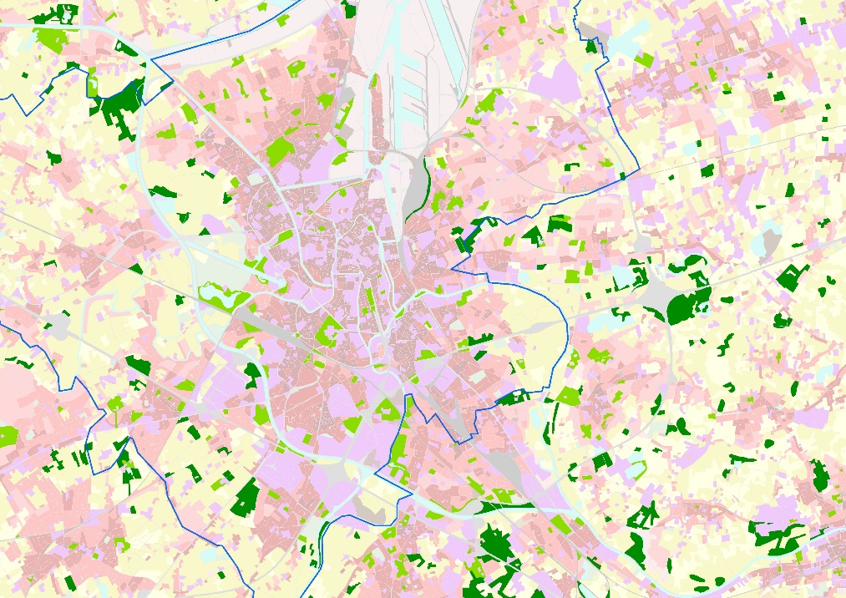
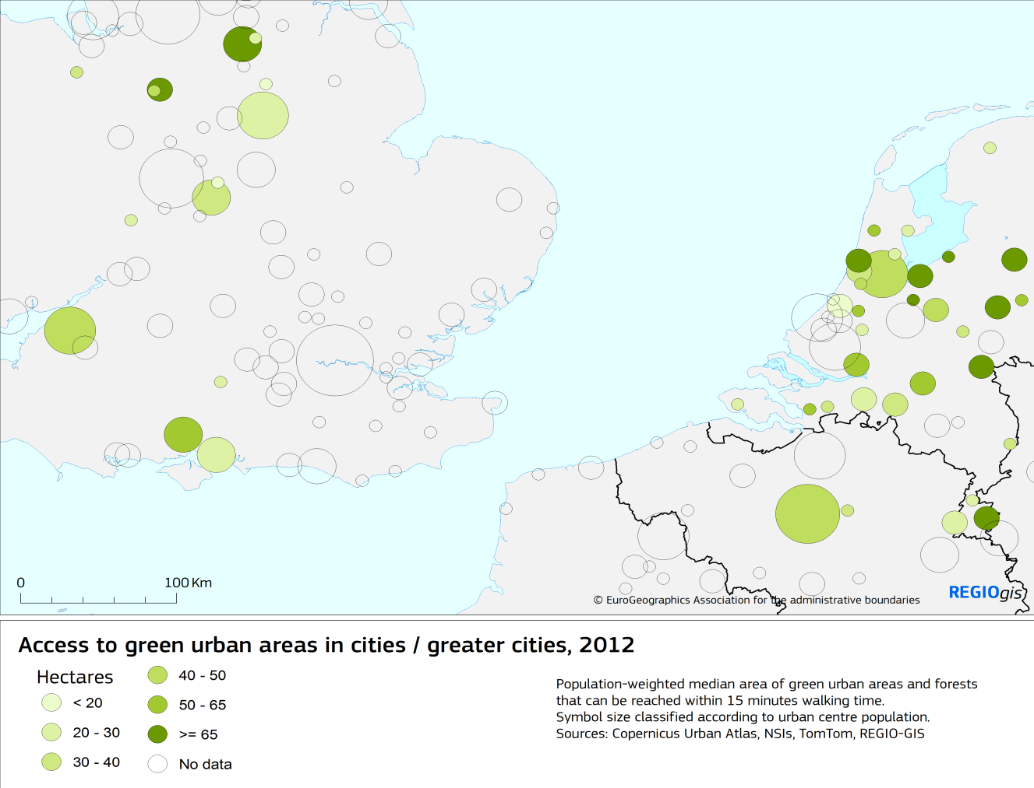
Proximity of green urban areas
Assessing the total surface of green urban areas (and forests) that can be reached within 15 (or 10) minutes walking time
Calculated at the level of each inhabited Urban Atlas polygon
Results: urban population distribution graphs by surface of green areas in the neighbourhood, or population-weighted median surface of neighbouring green urban areas

Slide 15
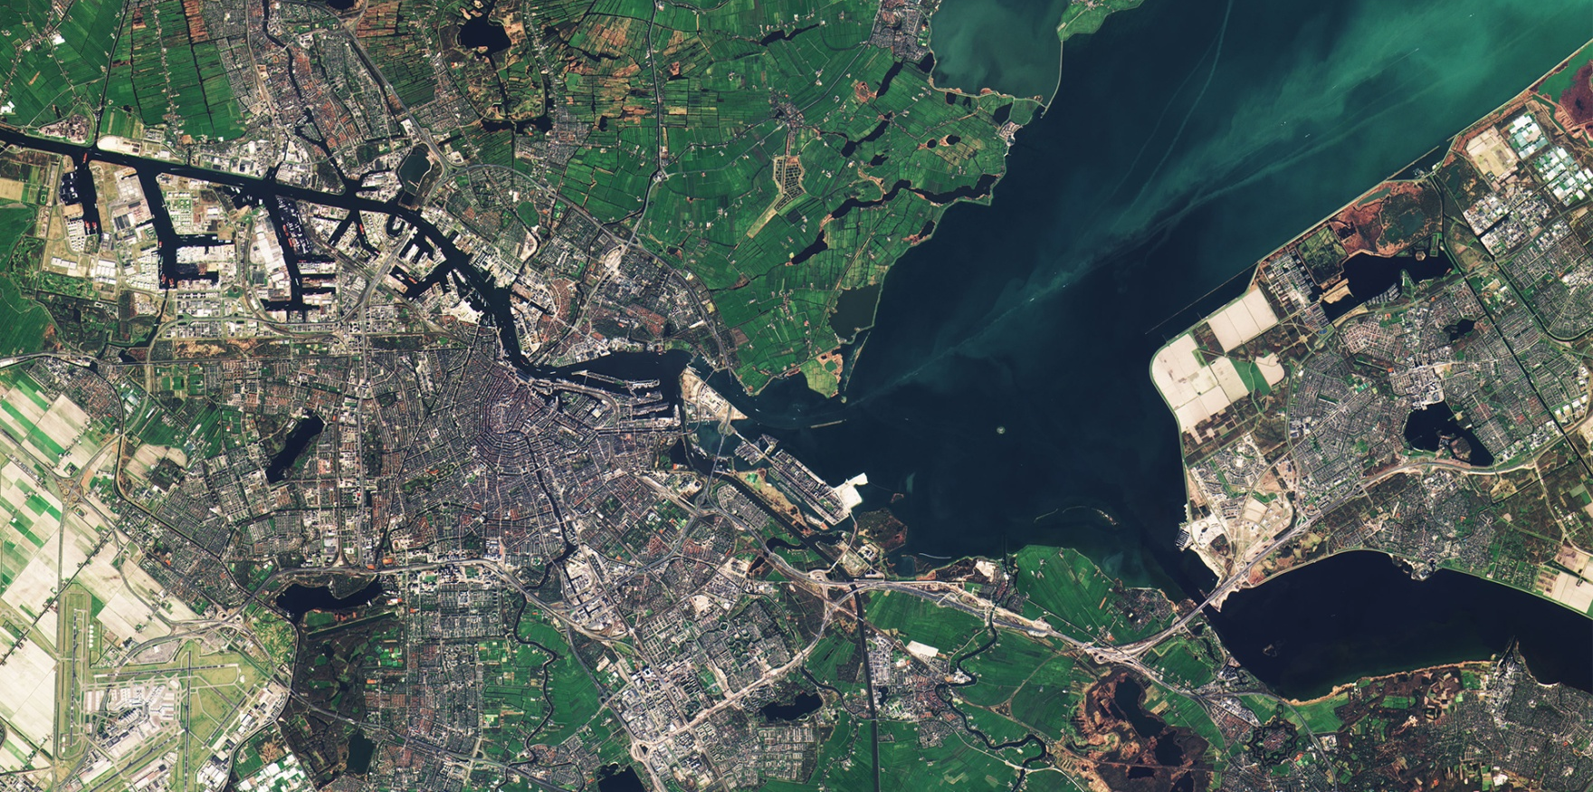
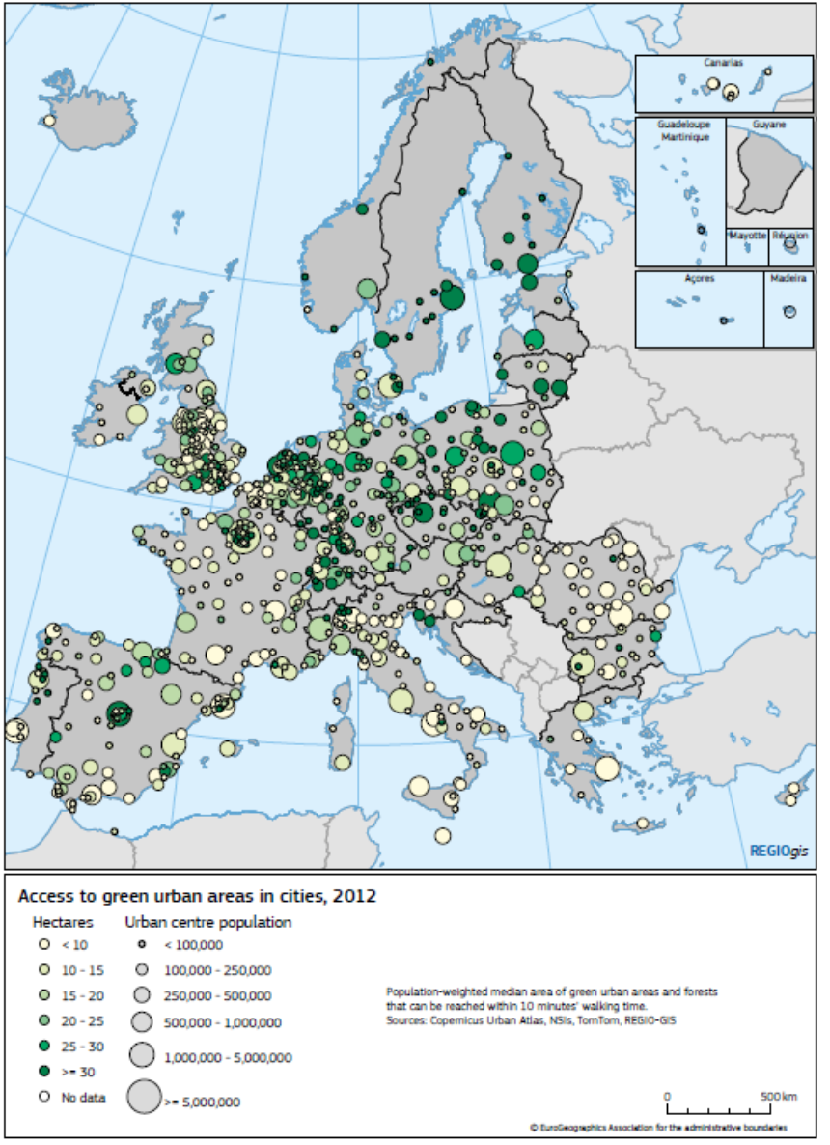
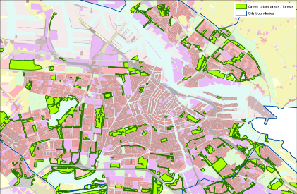
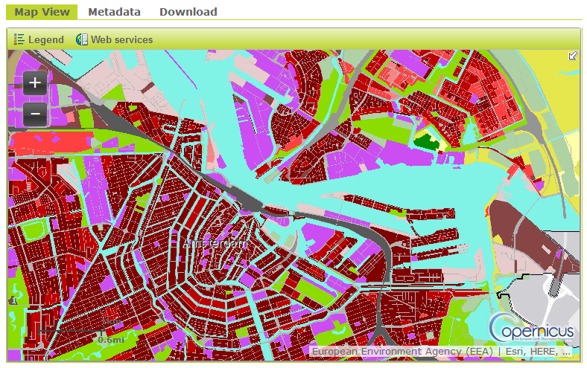
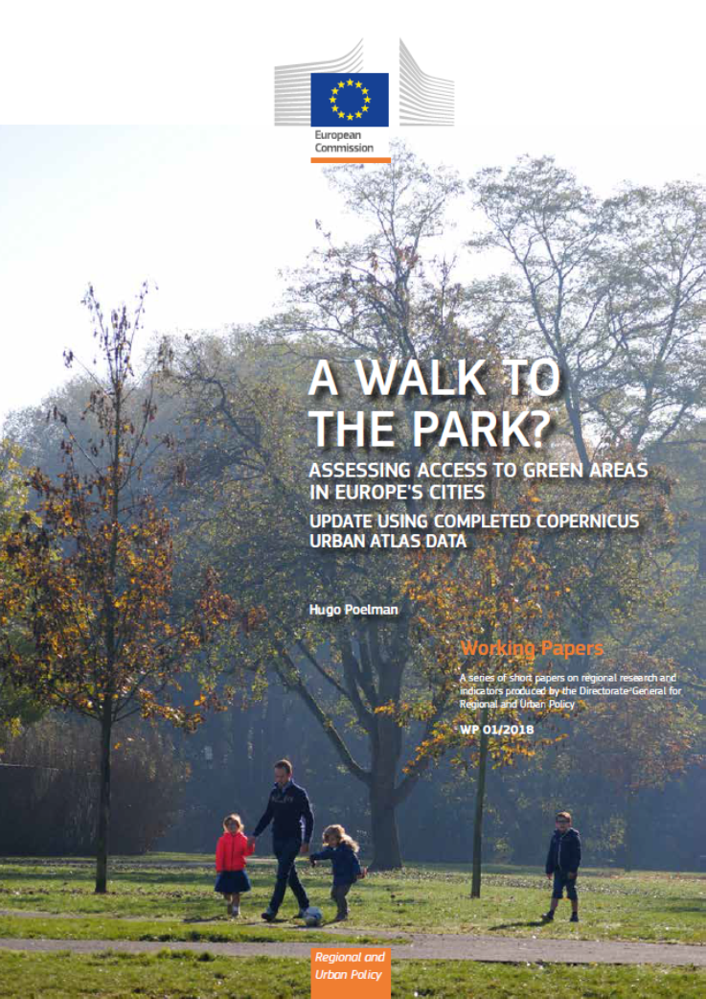
Use case: Access to green areas in cities using Urban Atlas
https://ec.europa.eu/regional_policy/sources/docgener/work/2018_01_green_urban_area.pdf
Sentinel 2 - Amsterdam

Slide 16
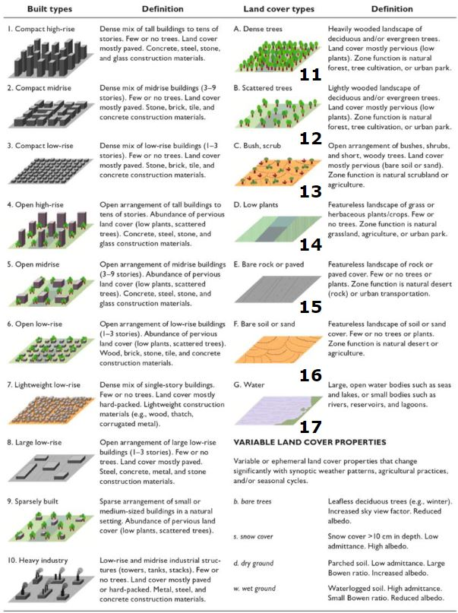
Local Climate Zones
CLMS products used to assess local climate zones
Urban Atlas LC/LU
UA: Street Tree Layer
UA: Building Block Height
HRL Imperviousness

Slide 17
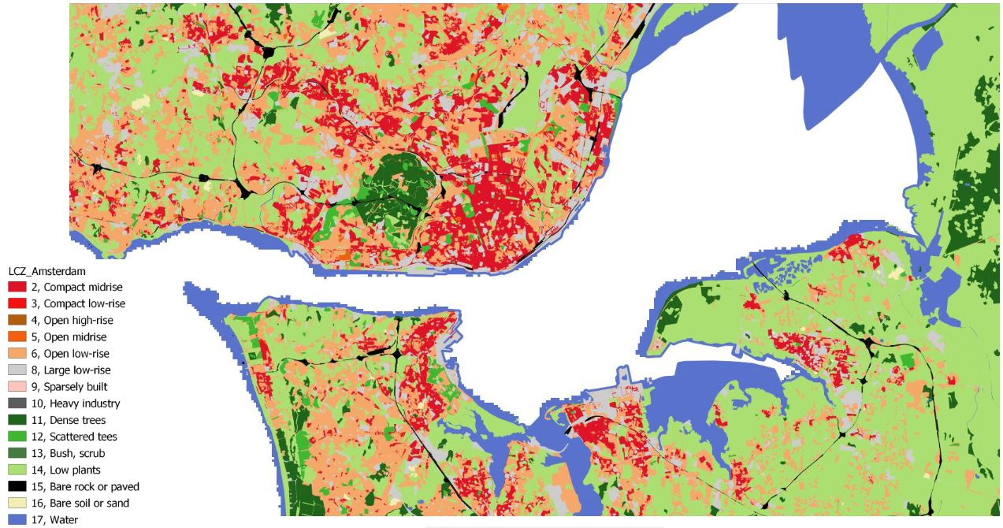
FUA Lisbon – Local Climate Zone 2012

Slide 18
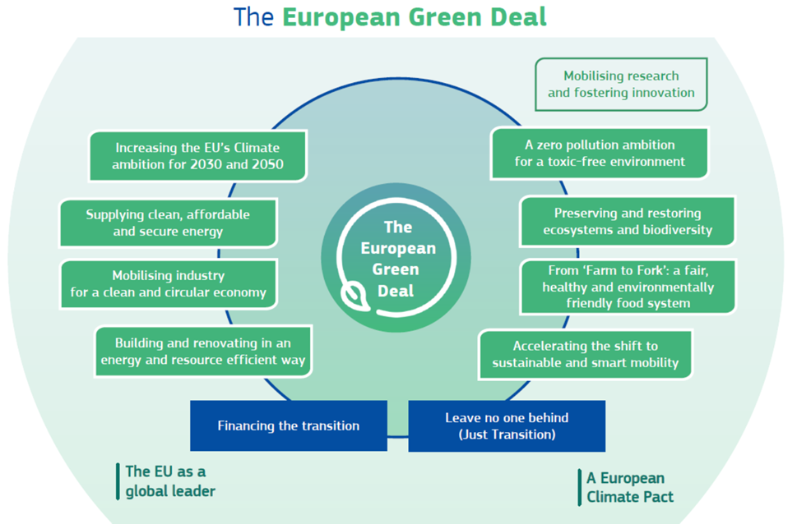
Source: COM(2019)640 final

Slide 19
Source: COM(2019)640 final

Slide 20
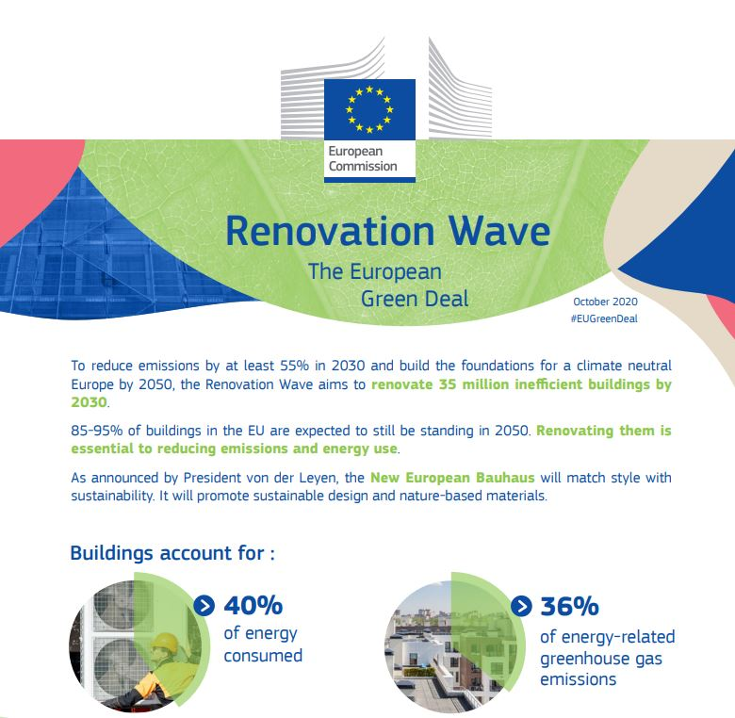
Renovation wave initiative
Aiming at “better energy performance of buildings”

Slide 21
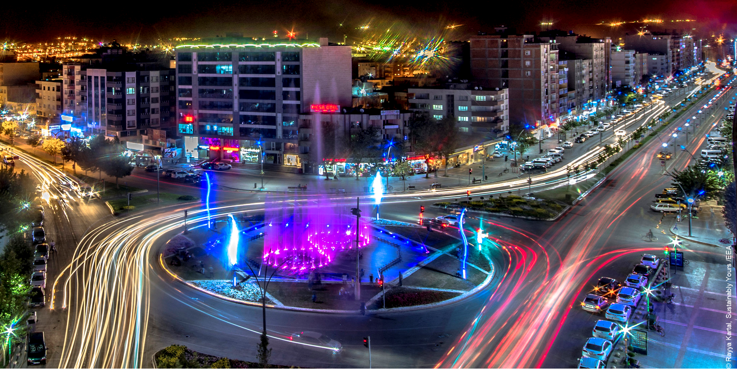
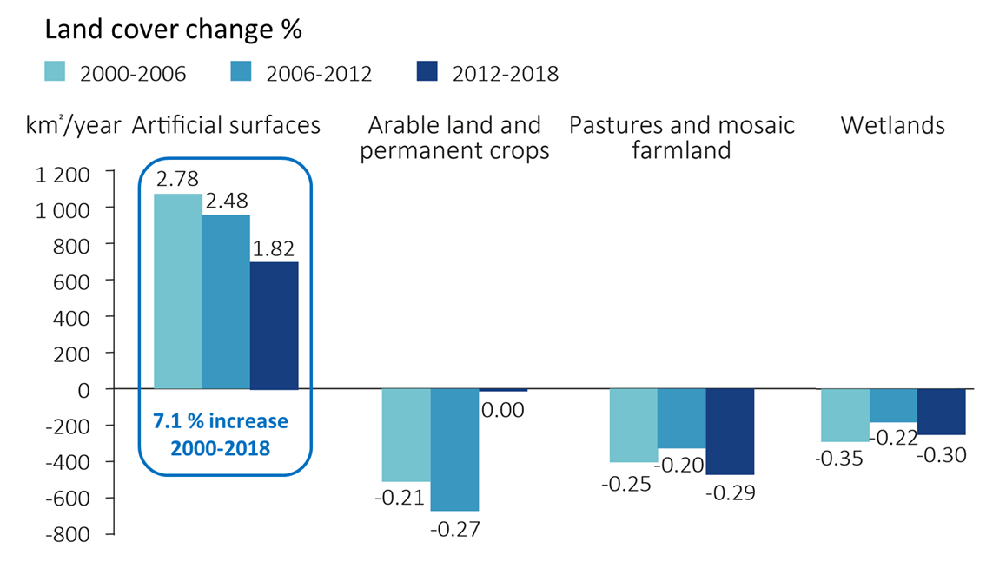
Efficient building and renovating
By 2050, 70 % of the world’s population will be living in cities
50% of which are not yet built

Slide 22
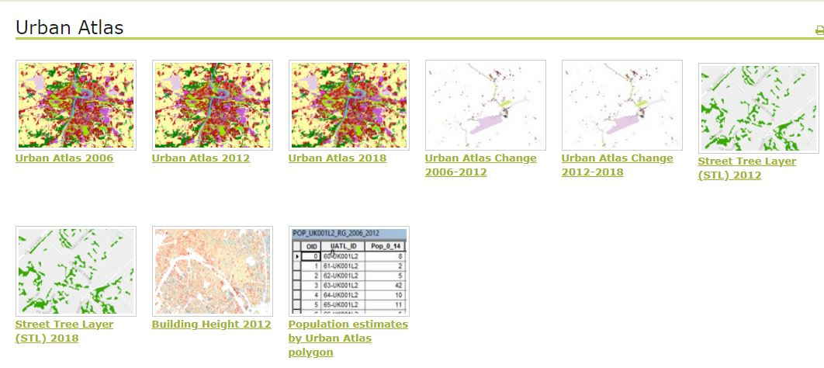
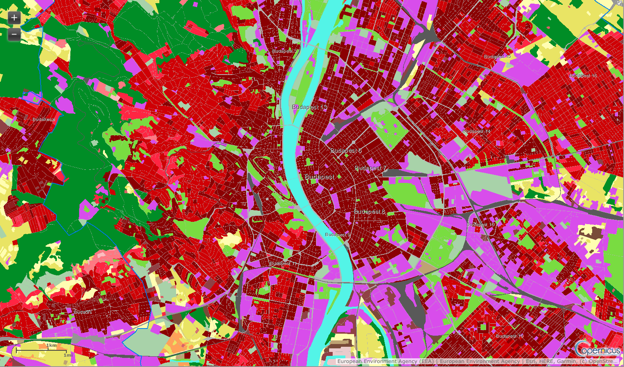
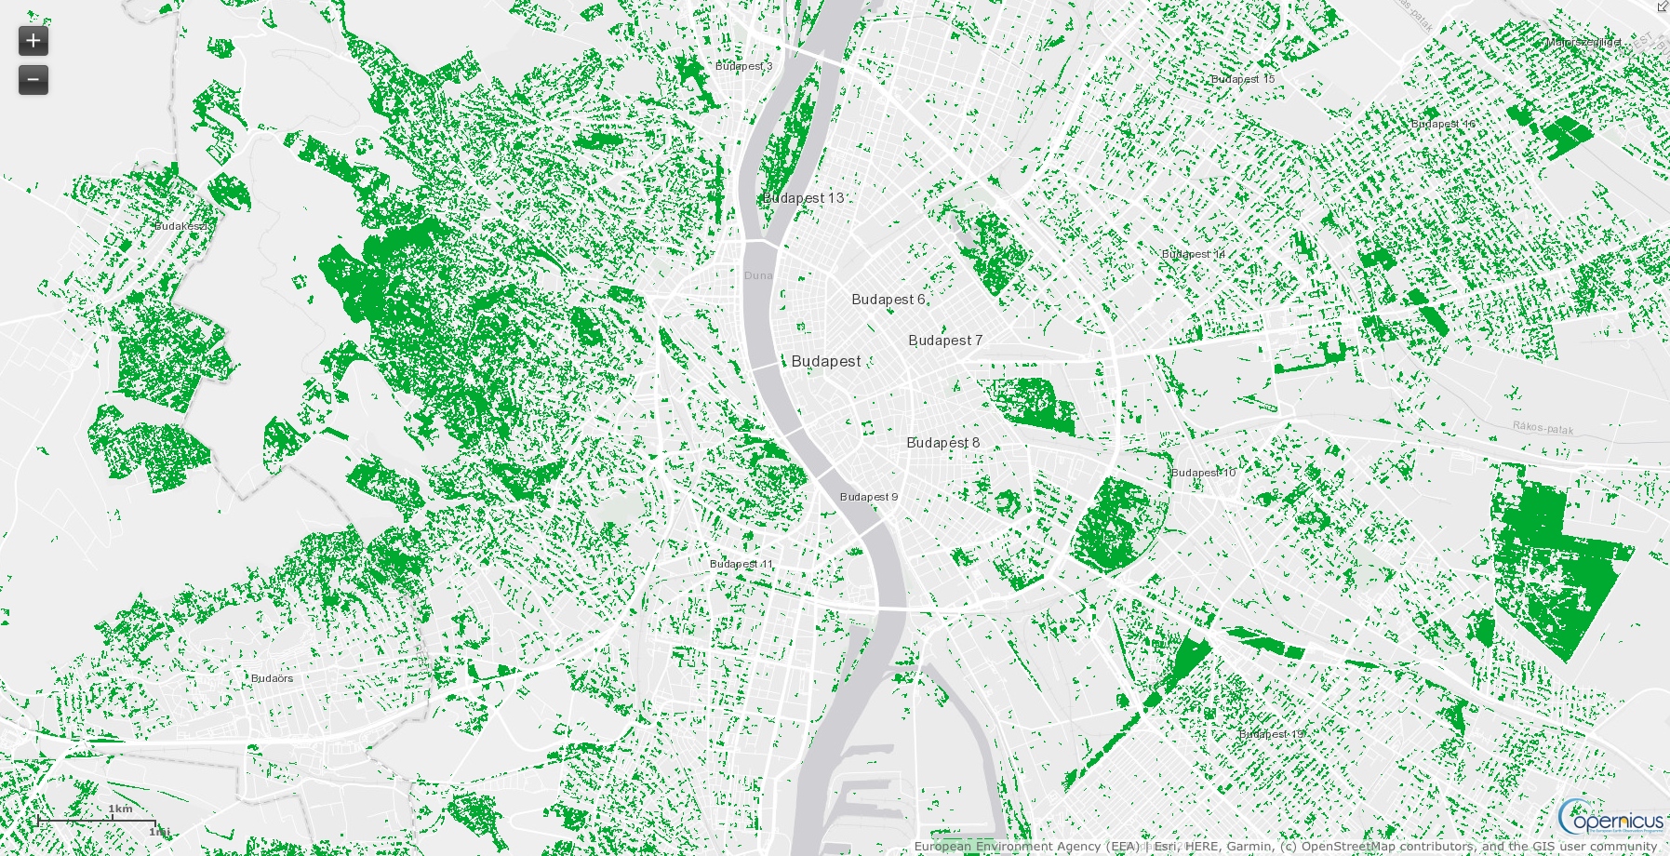
Urban Atlas 2006 – 2012 - 2018

Slide 23


I wish you THE BEST OF luck with your future challenges!!

