Slide 1
Finding data on data.europa.eu
Publications Office of the European Union

Slide 2
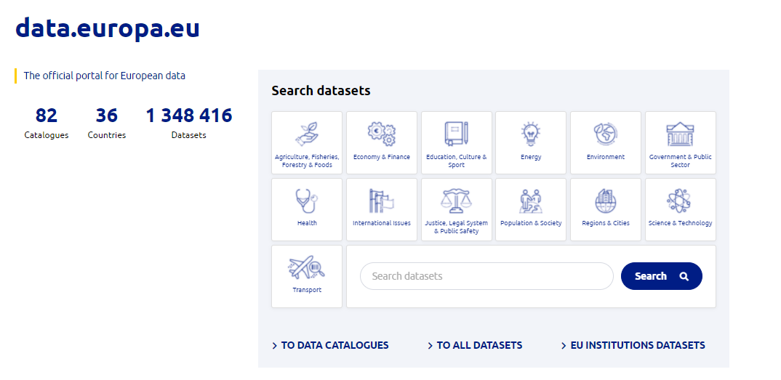
The official portal for European data
The goal?
Provide central point of access to European data and related services.

Slide 3






Data policy landscape
2011
2013
2019
2019
2020
Commission
Decision
2011/833/EU
Directive
2013/37/EU
(PSI Directive)
Recast of the PSI Directive
EC decision
adopting Creative Commons as main reuse instrument
European Strategy for Data
(draft Data Governance Act)
Amending
Directive 2003/98/EC
Other EU institutions:
Council Decision (11563/17) on open data
2012
2015
2021
Launch of
European
Data Portal
Launch of
data.europa.eu
Court of Auditors Decision No 6-2019 on the open data policy
Launch of
EU Open
Data Portal

Slide 4







What can you find there?
Data
Studies and reports
Use cases
Webinars
Learning material
News & articles
Events calendar

Slide 5
Where is the search being executed?
data.europa.eu is a catalogue of metadata
Search queries look for answers from the stored metadata (not the data itself)
Quality and presence of metadata is not constant

Slide 6
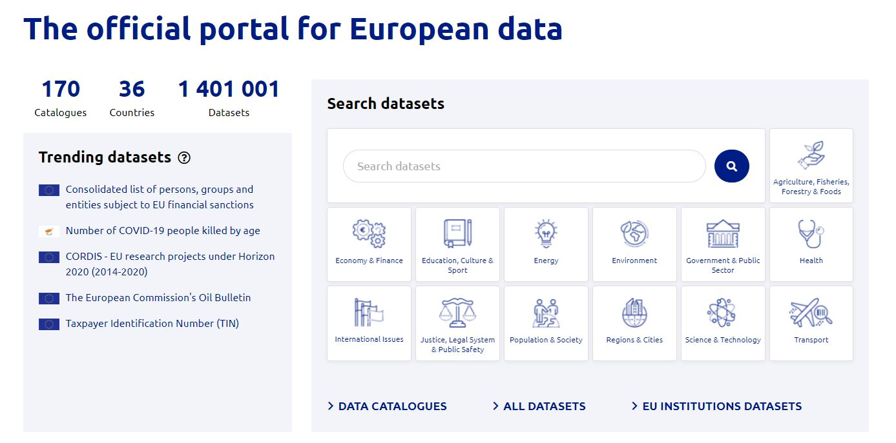
Basic search
Free text search
Browse by category

Slide 7
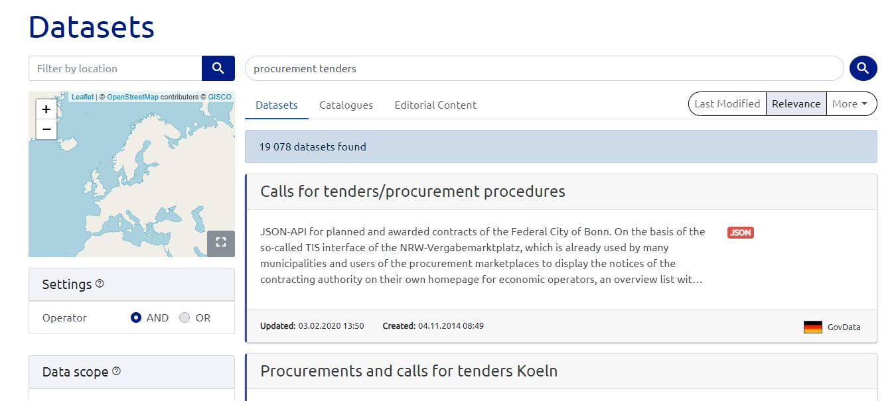
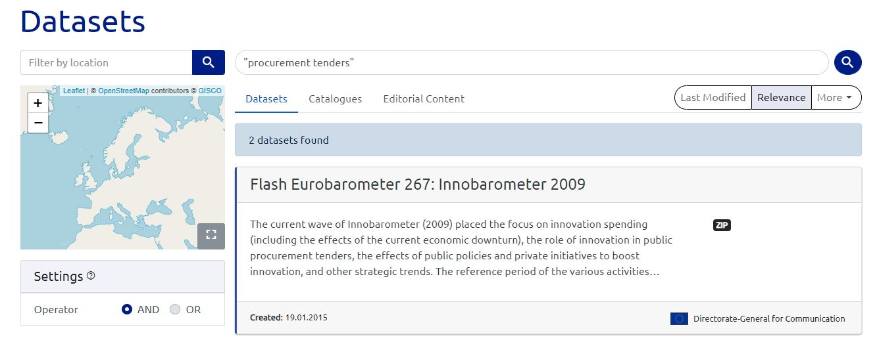
Basic search – free text
Search is executed on all indexed fields and keywords. Boolean operators are allowed
By default results are sorted by relevance

Slide 8
Basic search – relevance
Top score is applied when term is included in the Title
Second best score when term occurs in Keyword
Lower score is given when term occurs in Description
For Title and Description (indexed fields) searching for the term “tenders” will also include the terms “tender” and “tendering”
For Keywords (not indexed) only exact matches will be retrieved

Slide 9
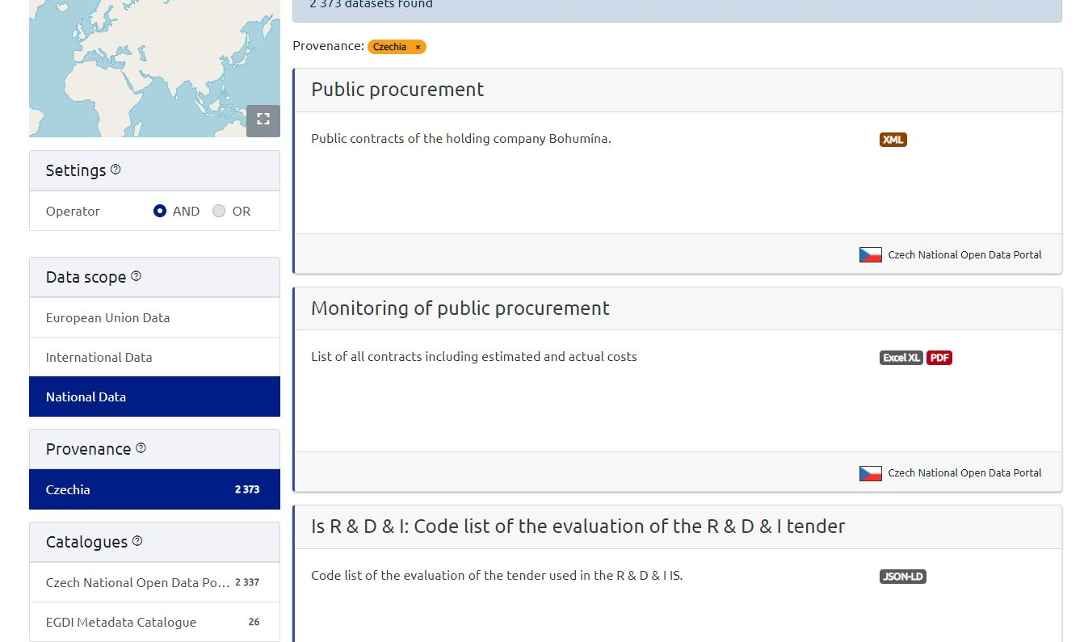
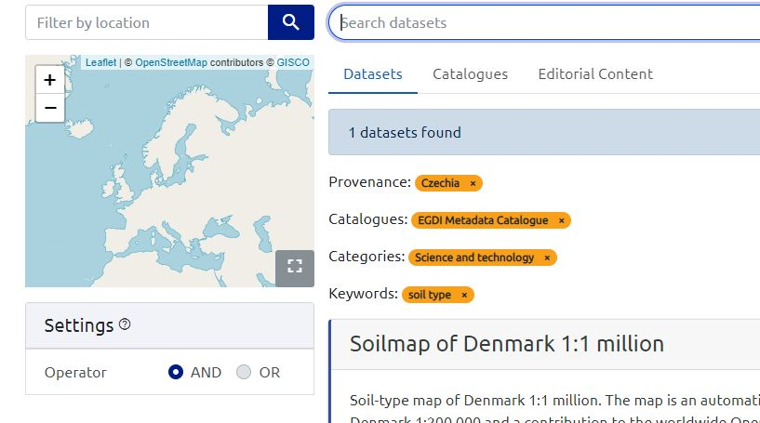
Basic search – filtering
Facets are hierarchical –
Depending on the first choice, available facets are shown for each subordinate level
https://data.europa.eu/data/datasets?locale=en&minScoring=0
Selected filters can be removed individually

Slide 10
Advanced search - Endpoints
data.europa.eu endpoints:
API – conforms to the OpenAPI Specification (ex Swagger)
  Search: https://data.europa.eu/api/hub/search/
  Read access to triple store data content: https://data.europa.eu/api/hub/repo/index.html
  Use Cases: https://data.europa.eu/en/export-use-cases
  And more (check our FAQs)
SPARQL
  YASGUI query editor – https://data.europa.eu/data/sparql
  Virtuoso - https://data.europa.eu/sparql

Slide 11
Advanced search – The Data Model
DCAT-AP (Application Profile of the Data Catalogue Vocabulary for data portals in Europe)
All metadata of datasets on the portal follow the data model
Some differences:
  Local extensions (properties)
  Specific controlled vocabularies
  Cardinality of elements
Elements that are prescribed or mandatory in the Application Profile must be respected
  https://github.com/SEMICeu/DCAT-AP/tree/2.1.0-draft/releases/2.1.0

Slide 12
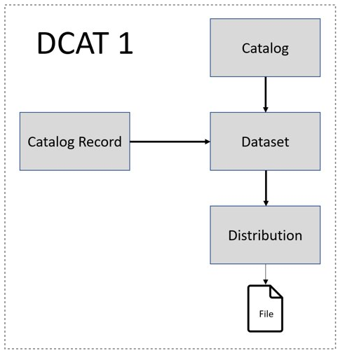
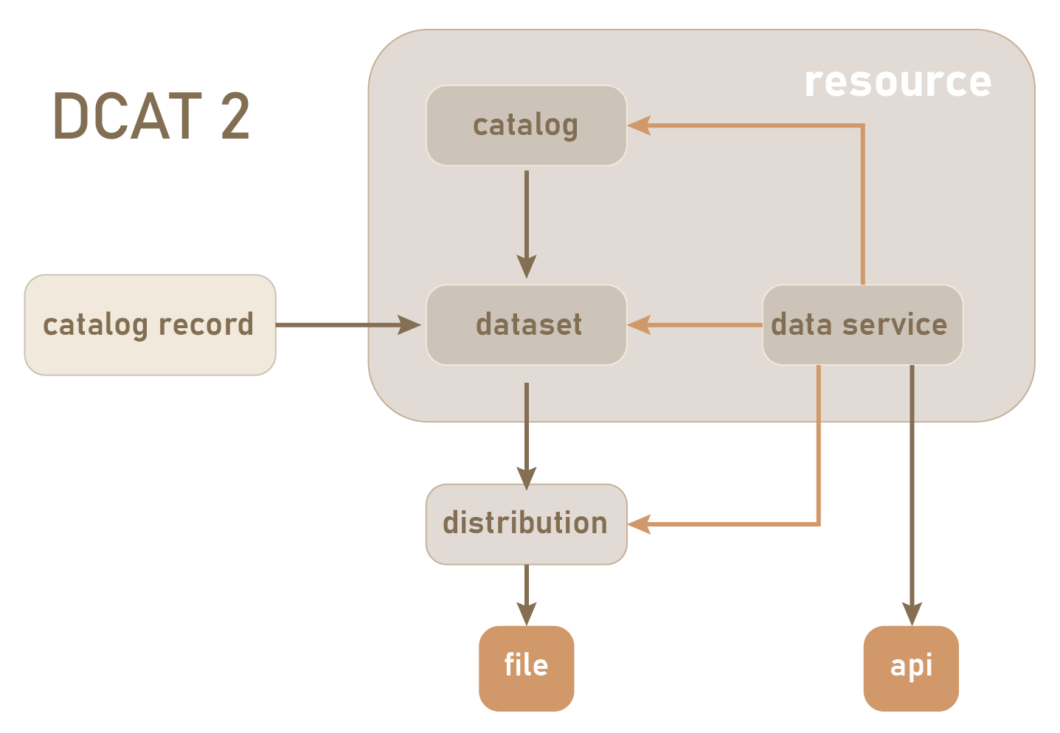
Advanced search – DCAT-AP

Slide 13
Advanced search – DCAT-AP
Our endpoints only store metadata of datasets (following DCAT-AP), not the actual data.
An exception is made for RDFs of
EU Vocabularies that are used by DCAT-AP
NUTS codes
These can be directly queried via data.europa.eu endpoints

Slide 14
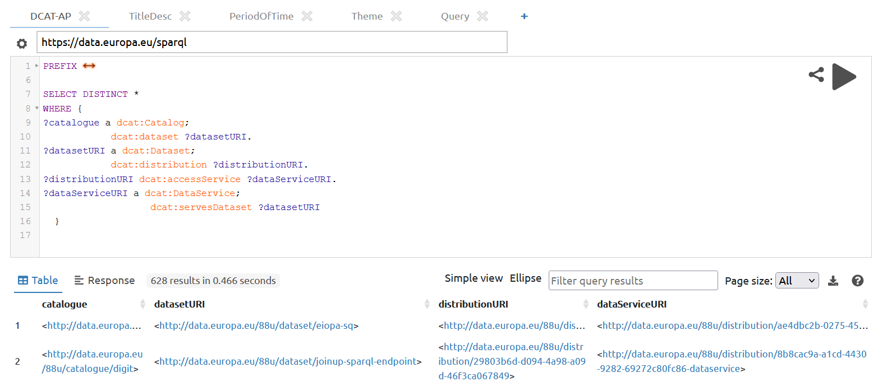
Advanced search - SPARQL
QUERY – DCAT Classes
SELECT DISTINCT *
WHERE {
?catalogue a dcat:Catalog;
dcat:dataset ?datasetURI.
?datasetURI a dcat:Dataset;
dcat:distribution ?distributionURI.
?distributionURI a dcat:Distribution;
dcat:accessService ?dataServiceURI.
?dataServiceURI a dcat:DataService;
dcat:servesDataset ?datasetURI}
#Note that Data Service is not widely used by publishers and so we recommend to include the last 3 lines within an “OPTIONAL { }” clause

Slide 15
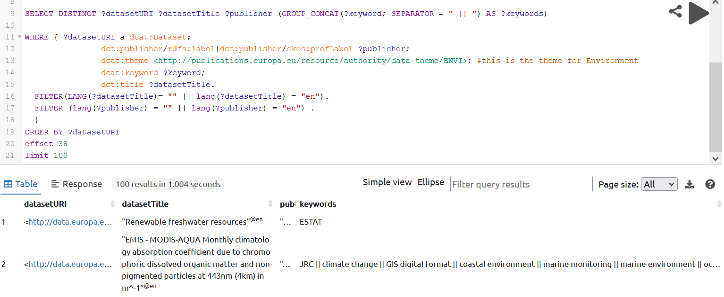
Advanced search - SPARQL
QUERY – subjects (domain dcat:Dataset) – properties dcat:theme for controlled vocabularies; dcat:keyword for literal values
SELECT DISTINCT ?datasetURI ?datasetTitle ?publisher (GROUP_CONCAT(?keyword; SEPARATOR = " || ") AS ?keywords)
WHERE {
?datasetURI a dcat:Dataset;
dct:publisher/rdfs:label|dct:publisher/skos:prefLabel ?publisher;
dcat:theme <http://publications.europa.eu/resource/authority/data-theme/ENVI>; #this is the theme for Environment
dcat:keyword ?keyword;
dct:title ?datasetTitle.
FILTER(LANG(?datasetTitle)= "" || LANG(?datasetTitle) = "en").
FILTER (LANG(?publisher) = "" || LANG(?publisher) = "en") .
}
ORDER BY ?datasetURI
#The dcat:theme value should always include at least one terms from the Data-Theme controlled vocabulary. We recommend selecting a specific there URI to avoid timeout errors.

Slide 16
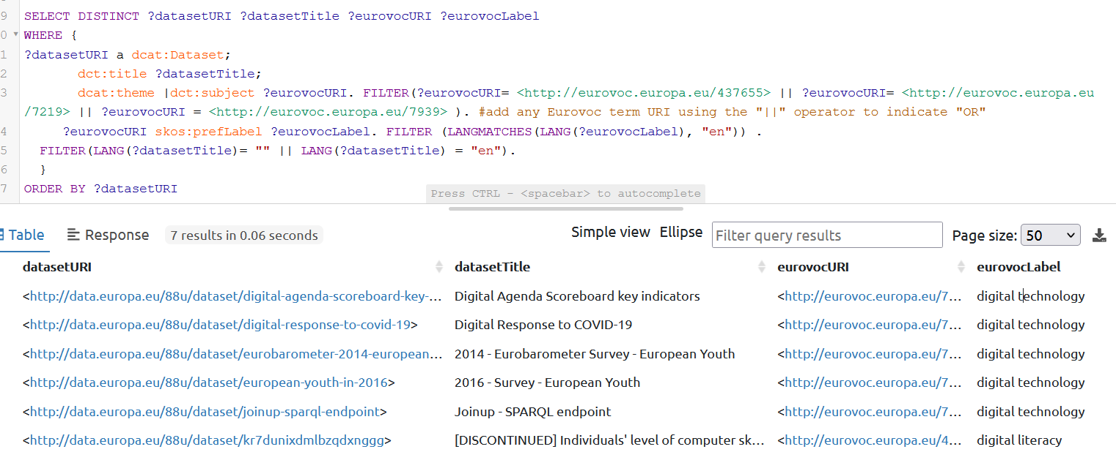
Advanced search - SPARQL
QUERY – Eurovoc – the EU Multilingual Thesaurus
SELECT DISTINCT ?datasetTitle ?eurovocURI ?eurovocLabel
WHERE {
?datasetURI a dcat:Dataset;
dct:title ?datasetTitle;
dcat:theme |dct:subject ?eurovocURI. FILTER(?eurovocURI= <http://eurovoc.europa.eu/437655> || ?eurovocURI= <http://eurovoc.europa.eu/7219> || ?eurovocURI = <http://eurovoc.europa.eu/7939> ). #add any Eurovoc term URI using the "||" operator to indicate "OR"
?eurovocURI skos:prefLabel ?eurovocLabel. FILTER (LANGMATCHES(LANG(?eurovocLabel), "en")) .
FILTER(LANG(?datasetTitle)= "" || LANG(?datasetTitle) = "en").}
#Label of terms exist in all 24 EU official languages. It is advised to filter the labels to desired language

Slide 17
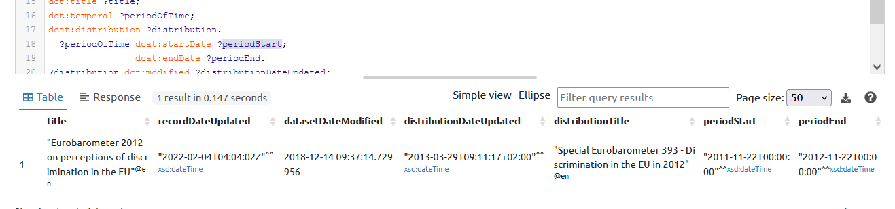
Advanced search - SPARQL
QUERY – Dates
Dates are annotated using dct:issued and dct:modified.
Different values are recorded for:
Catalogue record
Dataset
Distribution
For Datasets an additional property is dct:temporal, of type dct:PeriodOfTime

Slide 18
Advanced search - SPARQL
SELECT DISTINCT ?datasetURI ?title ?recordDateUpdated ?datasetDateModified ?distributionDateUpdated ?distributionTitle ?periodoStart ?periodEnd
WHERE { ?record a dcat:CatalogRecord;
foaf:primaryTopic <http://data.europa.eu/88u/dataset/eurobarometer-2012-on-perceptions-of-discrimination-in-the-eu>;
dct:modified ?recordDateUpdated. #last time record was re-harvested on the portal. Could be for changes on publisher or portal’s side
<http://data.europa.eu/88u/dataset/eurobarometer-2012-on-perceptions-of-discrimination-in-the-eu> a dcat:Dataset;
dct:modified ?datasetDateModified; #last time the publisher declares to have updated the dataset
dct:title ?title;
dct:temporal ?periodOfTime; #URI of the period of time covered by the dataset. Expressed with dcat:startDate and dcat:endDate
dcat:distribution ?distribution.
?periodOfTime dcat:startDate ?periodoStart;
dcat:endDate ?periodEnd.
?distribution dct:modified ?distributionDateUpdated; #last time the publisher declares to have updated the distribution
dct:title ?distributionTitle.
FILTER(LANGMATCHES(LANG(?title), "en"))
FILTER(LANGMATCHES(LANG(?distributionTitle), "en"))
}

Slide 19
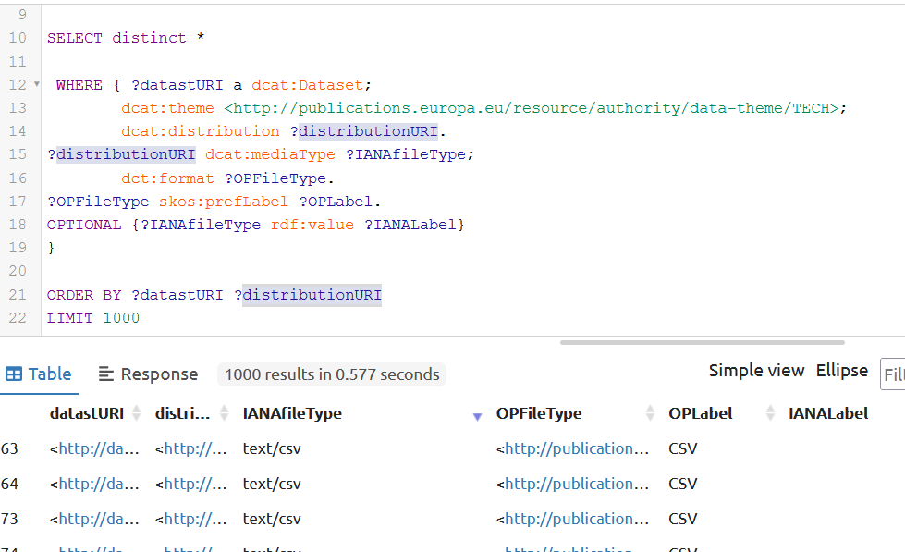
Advanced search - SPARQL
QUERY – File types – assigned to Distributions as IANA media types (MIME types) using dcat:mediaType - a subproperty of dct:format. dct:format is used with OP File Type vocabulary
SELECT distinct *
WHERE { ?datastURI a dcat:Dataset;
dcat:theme <http://publications.europa.eu/resource/authority/data-theme/TECH>;
dcat:distribution ?distributionURI.
?distributionURI dcat:mediaType ?IANAfileType;
dct:format ?OPFileType.
?OPFileType skos:prefLabel ?OPLabel.
OPTIONAL {?IANAfileType rdf:value ?IANALabel}
}
ORDER BY ?datastURI ?distributionURI

Slide 20
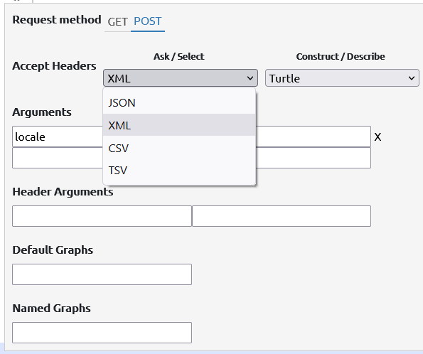
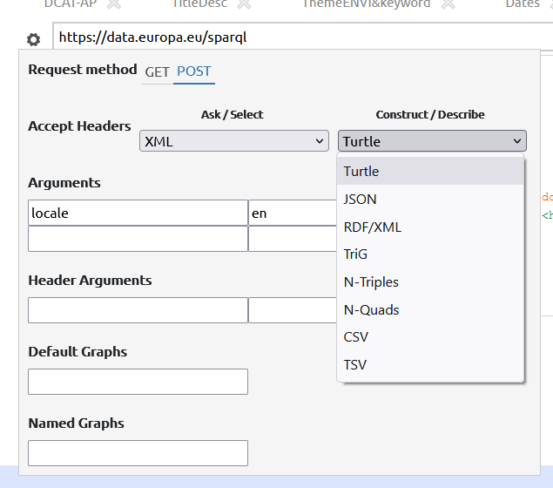
Advanced search - SPARQL
Posting and results can be obtained in various formats

Slide 21
Advanced search - SPARQL
QUESTIONS?

Slide 22



Stay updated!
Sign up for the newsletter: data.europa.eu/newsletter
Follow us on social media:
EU_opendata
Publications Office of the European Union
data.europa.eu

