Slide 1
TED – Tenders Electronic Daily
EU Datathon 2022
Laura Zambelli
Publications Office of the European Union

Slide 2
Summary
What is TED and what notices must be published on TED?
Why is publication of procurement important?
Why is OP role important?
TED Data and the EU Datathon challenges
TED website's main features
TED Open data
TED data model
TED data on the official portal for European data
What could be done with the data?
Which other data sources could be linked?
Contacts and links

Slide 3
What is TED?
TED (Tenders Electronic Daily) is the online version of the Supplement to the Official Journal (OJ S) of the EU
OP's mandate: must be published in the OJ S
  according to European Directives on public procurement, notices for procurement procedures of public authorities;
  according to Financial Regulation, notices of EU institutions
TED provides free access to business opportunities from the European Union, the European Economic Area and beyond
The notices are published 5 times a week, from Monday to Friday, at 9:00, in the 24 EU official languages (machine translation also available)
TED publishes on average 2 400 notices per edition, more than
622 000 notices per year

Slide 4
Publications Office' s responsibility in public procurement
DG GROW – Internal Market, Industry, Entrepreneurship and SMEs
  Public procurement policy
    Public procurement directives
    Standard forms
    CPV – common procurement vocabulary
      http://ec.europa.eu/growth/single-market/public-procurement_en
Publications Office
  Mandate: publication of public procurement notices
    Publication process
      TED - Tenders electronic daily
      XML version for registered users (bulk download; individual notice)

Slide 5
European public procurement legislation
The publication of procurement notices is regulated by:
4 European Directives on public procurement (general, utilities, concessions and defence)
  Directive 2014/23/EU on concession contracts
  Directive 2014/24/EU on public procurement
  Directive 2014/25/EU on water, energy, transport and postal services
  Directive 2009/81/EC (public procurement in defence field)
Financial Regulation (EU institutions, agencies, bodies)
  Regulation (EU, Euratom) 2018/1046 of the European Parliament and of the Council of 18 July 2018 on the financial rules applicable to the general budget of the Union, amending Regulations (EU) No 1296/2013, (EU) No 1301/2013, (EU) No 1303/2013, (EU) No 1304/2013, (EU) No 1309/2013, (EU) No 1316/2013, (EU) No 223/2014, (EU) No 283/2014, and Decision No 541/2014/EU and repealing Regulation (EU, Euratom) No 966/2012
European Regulation establishing standard procurement forms
  Commission Implementing Regulation (EU) 2015/1986 of 11 November 2015 establishing standard forms for the publication of notices in the field of public procurement
  Commission Implementing Regulation (EU) 2019/1780 of 23 September 2019 establishing standard forms for the publication of notices in the field of public procurement and repealing Implementing Regulation (EU) 2015/1986 (eForms)
European Regulation on public transport procurement
  Regulation (EC) No 1370/2007 of the European Parliament and of the Council of 23 October 2007 on public passenger transport services by rail and by road and repealing Council Regulations (EEC) Nos 1191/69 and 1107/70

Slide 6
What notices must be published on TED?
Notices from the countries of the Public Procurement Network (EU member states, candidate countries, EEA countries, and Switzerland)
  Public works, supplies, services
  Utilities contracts (water, energy, transport and telecommunications sectors)
  Concessions contracts
Notices from the EU institutions, agencies and other bodies
  Public works, supplies, services
  Calls for expression of interest
Notices for projects financed by:
  European Investment Bank
  European Investment Fund
  European Central Bank
  European Bank for Reconstruction and Development
  External Aid and European Development Fund (ACP countries)

Slide 7
Who publishes on TED?

Slide 8
Some numbers
Available 24/7, free of charge
More than 47 million notices consulted/year
23 million searches performed on the website/year
More than 8 million visits/year
Almost 4 million of news alert emails/year
35 000 active registered users

Slide 9
Procurement notices publication workflow (1/2)
Contracting authorities send notices to OP
  Using standard forms
  Via applications such as eNotices
  Via eSenders or TED webservices
Notices are received and checked by the OJS production team
Notices are sent to contractor for processing
  Prepare for publication
  Translation (notices from EU institutions)
Verification and validation by OP production team before publication
Notices are published on TED

Slide 10




Procurement notices publication workflow (2/2)
Reception
Preparation
Publication
Buyer
Vendor
Ted Monitor
Auditor
Reuser
Buyer
Provider

Slide 11





TED family – OP systems for the publication of procurement notices
Information on public procurement and systems
  SIMAP website https://simap.ted.europa.eu/en
Reception of notices
  eNotices https://enotices.ted.europa.eu/
  eSentool https://esentool.ted.europa.eu/
Preparation (internal production systems)
  TED-Monitor system
  External contractor
Publication
  TED https://ted.europa.eu/
Calls for tenders' publication (EU institutions, agencies, bodies)
  TED eTendering https://etendering.ted.europa.eu

Slide 12
Why is procurement important?
Procurement = Money!
Public procurement in Europe = € 2 trillion/year
Public procurement in TED = € 545 billion/year

Slide 13
Why is publication important?
Corruption
Procurement Money!
Transparency
Fraud
PUBLIC
Waste
Competition
Efficient use of public money
Equal treatment
Monitoring and control
Promote business

Slide 14
Why is publication important for the EU?
Procurement Policy
Cooperation and Development
Ethics
Transparency
PUBLIC
Trade
Competition
Strategic investment
Efficient use of public money
Internal market
Monitoring and control
Research
Equal treatment
Public investment => Growth
Promote business

Slide 15
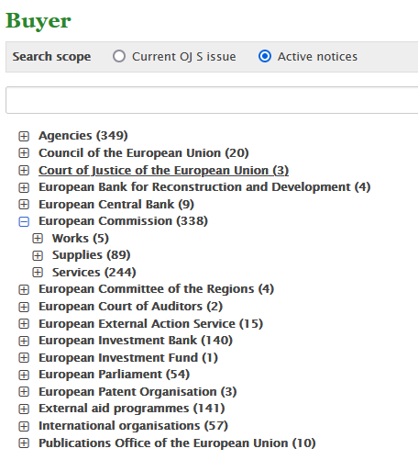
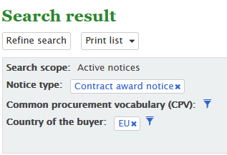
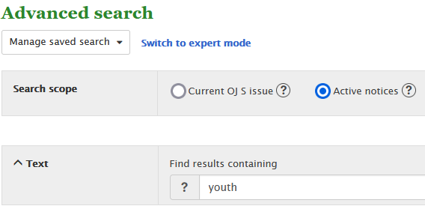
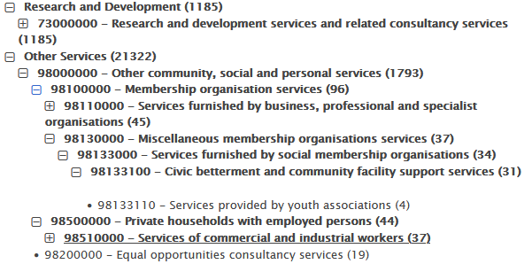
TED Data and the EU Datathon challenges
Challenge 2 – Transparency in public procurement
Transparency in public procurement helps track how public money is spent, combat fraud and analyse economic and market trends
Challenge 3 - EU public procurement opportunities for young people
Personal, social, and professional development of young people

Slide 16
TED Data website's main features
The Browse by topic functionality, for example By business opportunities, By business sector (CPV), By place of delivery (NUTS) and By buyer
The Search functionality, which includes Quick search, Advanced search, and Expert search
The Search result functionality, which allows the display and navigation of documents
The Saved search feature to save up to 25 search profiles
Customising Preferences
Subscribing and receiving documents through RSS feeds, News alert, etc.

Slide 17
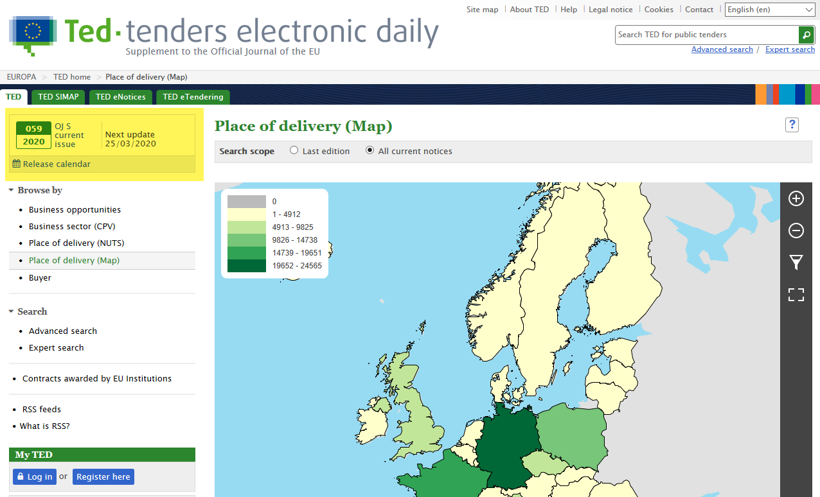
OJ S Current issue

Slide 18
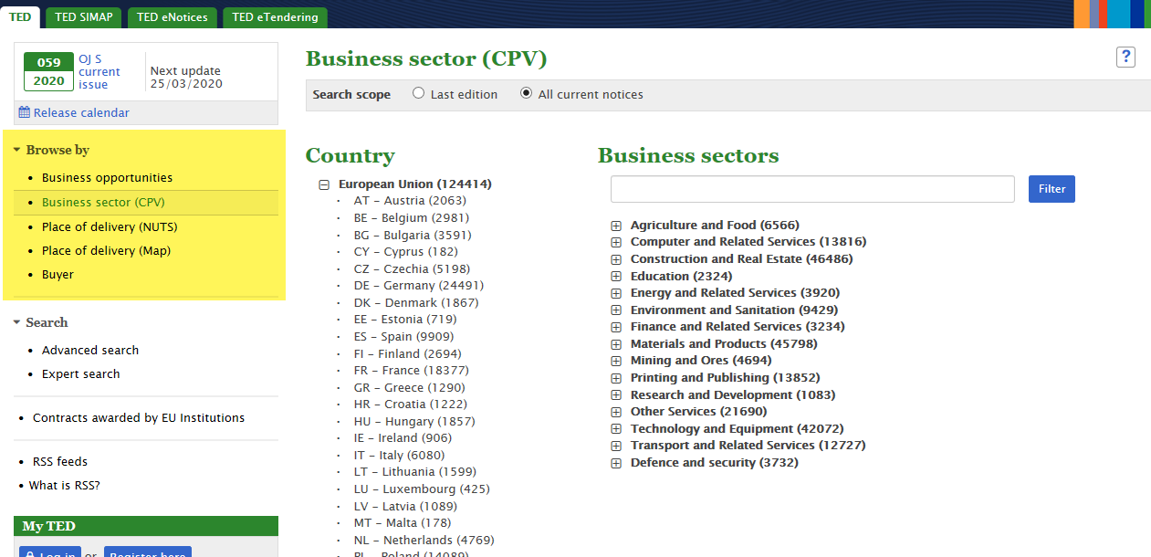
Browse

Slide 19
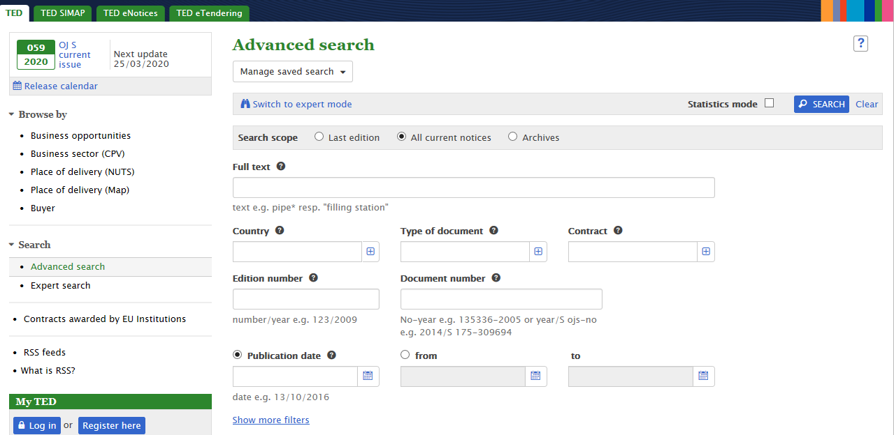
Search

Slide 20
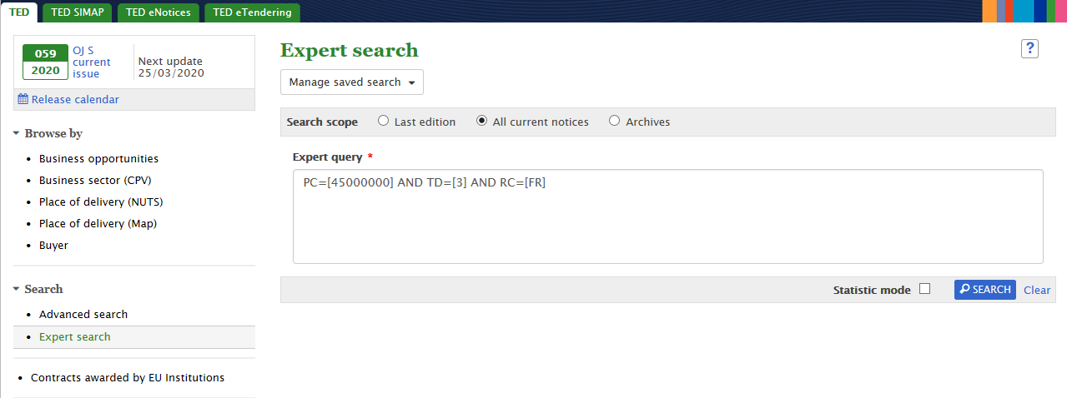
Search

Slide 21
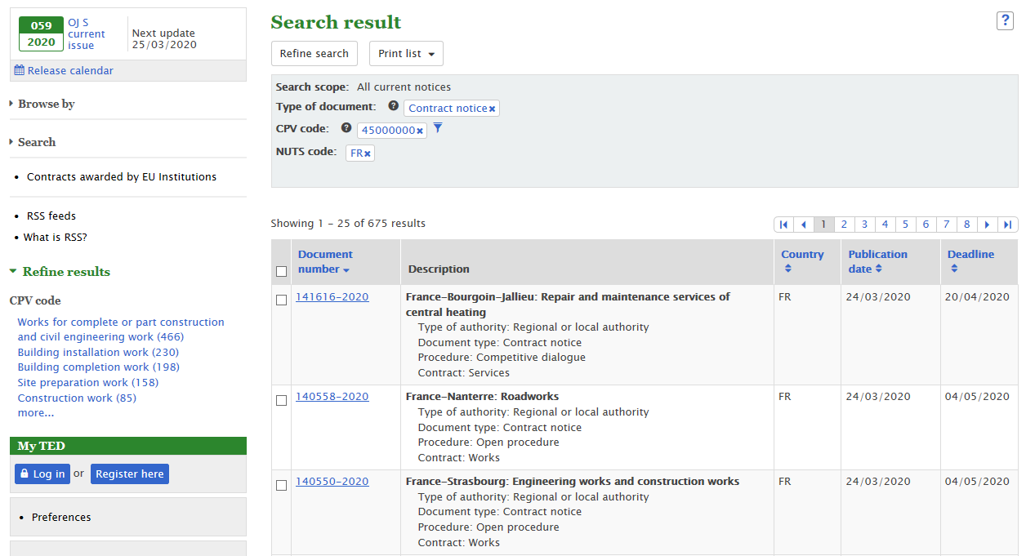
View your search results

Slide 22
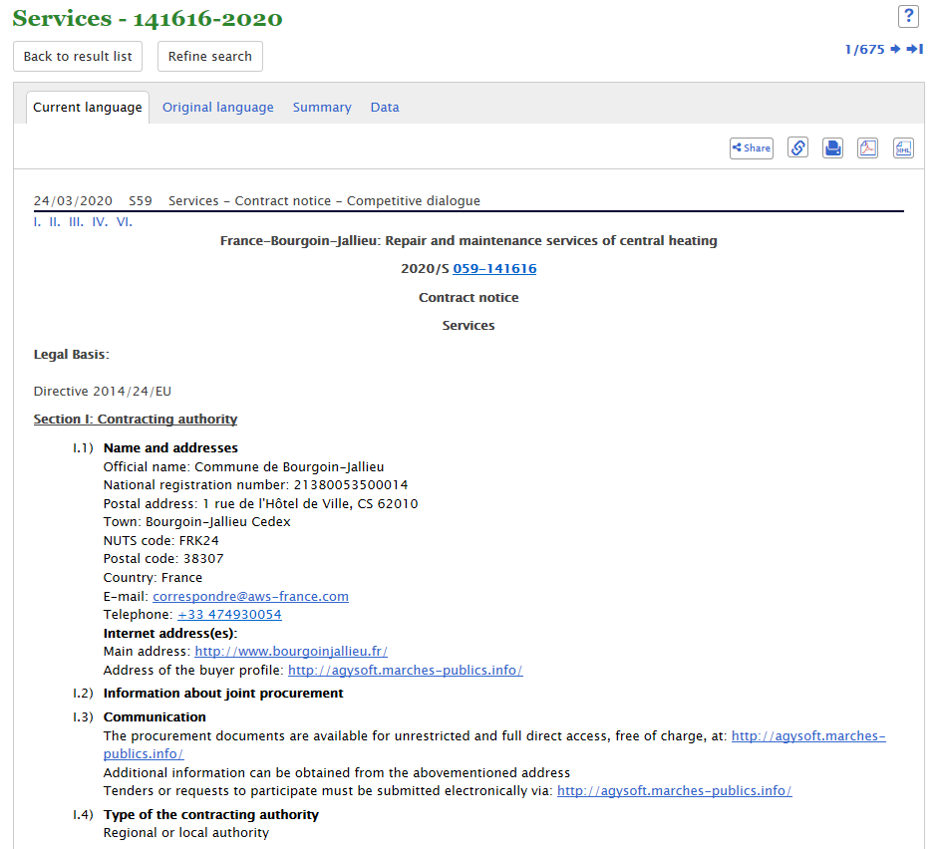
View a notice
Notices are published:
  in the original language + summary (Member States)
  translated in all EU official languages (EU institutions, agencies, bodies)

Slide 23
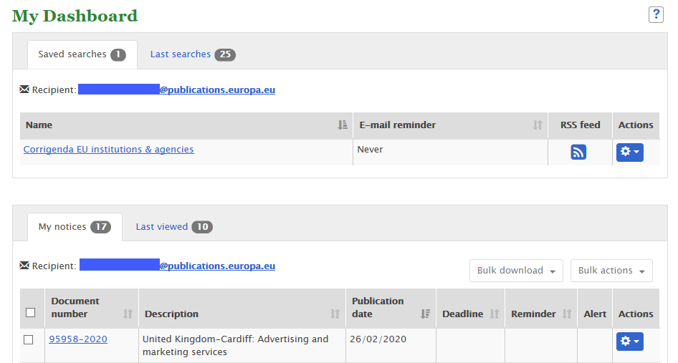
Save searches and notices in My dashboard

Slide 24
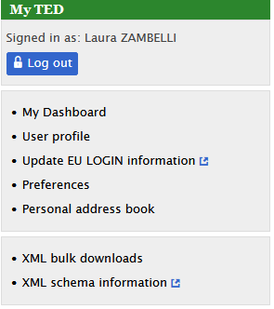
TED Open data
All notices are published in XML format for reuse according to Commission decision 2011/833/EU on the reuse of Commission documents
Notices can be downloaded in bulk:
  From the website (registered users only):
    XML packages of the daily and monthly editions from 2012
      https://ted.europa.eu/TED/misc/xmlPackagesDownload.do
  From the ftp:
    XML packages of the daily and monthly editions from 1993
      ftp://guest:guest@ted.europa.eu

Slide 25
TED Open data
Data can also be accessed through our APIs, using REST method
TED website API is used to get notice data.
  Link to the swagger user interface: https://ted.europa.eu/api/swagger-ui.html#/
  You can combine different criteria and retrieve specific information. The search query is the one used for the expert search in the website
  Use the version v2 of the API where the API key is optional
  For details, see the API documentation.
TED notice viewer API can be used to render a notice in PDF or HTML and in a specific language, based on the content of a notice in XML
  Link to the swagger user interface: https://ted.europa.eu/TEDWS/swagger-ui.html#/
  Use the v1.0 of the API
  For details, see the API documentation.
For more information on OP APIs related to TED and European public procurement, check our Developers’ corner on TED SIMAP
https://simap.ted.europa.eu/en_GB/web/simap/developers-corner

Slide 26
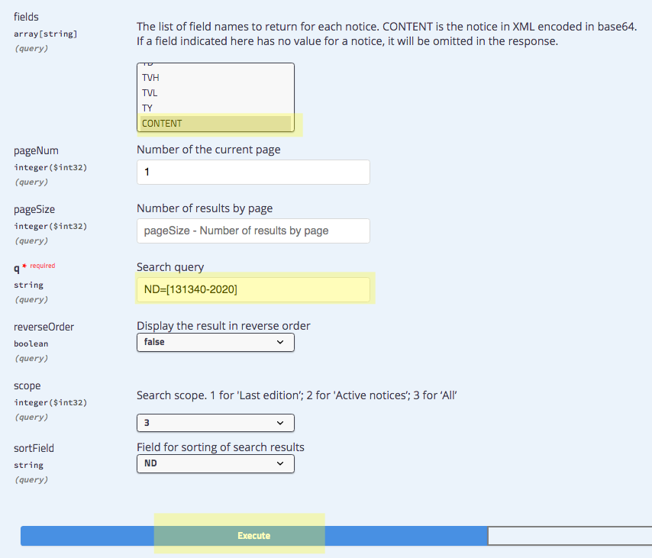
TED Open data
Example to render a specific notice
  Get the content of the notice 131340-2020 using TED website API
  curl -X GET "https://ted.europa.eu/api/v2.0/notices/search?fields=CONTENT&pageNum=1&q=
  ND%3D%5B131340-2020%5D&reverseOrder=false&scope=3&sortField=ND" -H "accept: application/json"
You will get the content of the notice XML file base64 encoded.

Slide 27
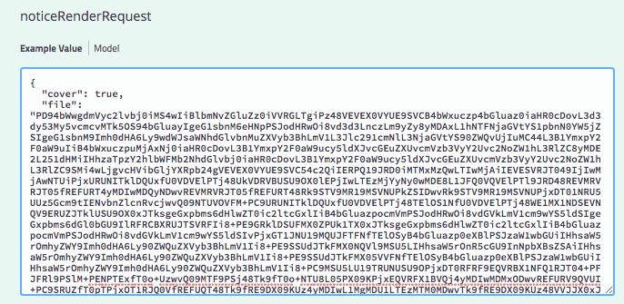
TED Open data
  Use TED notice viewer API to render the notice in HTML
curl -X POST "https://ted.europa.eu/TEDWS/api/v1.0/notices/_render" -H "accept: application/json" -H "Content-Type: application/json" -d "{ \"cover\": true, \"file\": \"PD94bWwgdm….FIj48VElfQ1k+R+\", \"format\": \"html\", \"language\": \"en\", \"qualityControl\": true}"
  Decode the notice
Use for example the online tool https://www.base64decode.org/

Slide 28
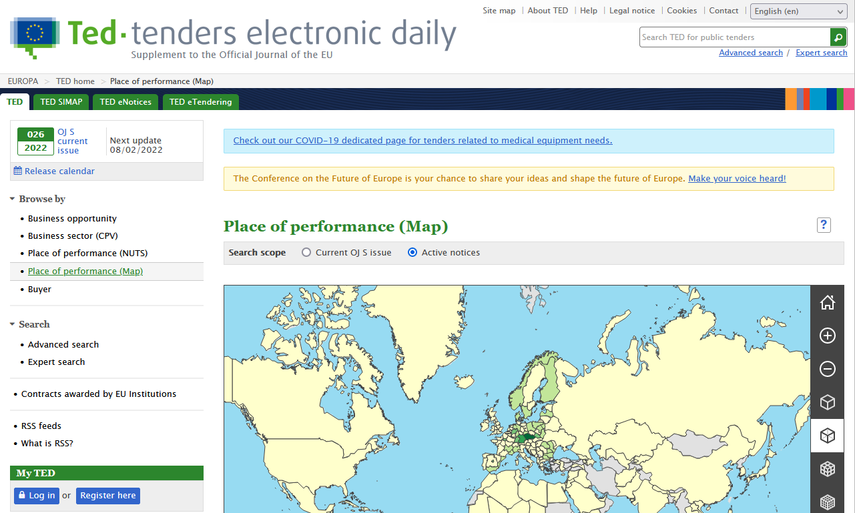
TED Open data
Search & retrieve notices
Possibility to obtain the number of notices for each geographical area (NUTS code) through a specific operation using the TED website API https://ted.europa.eu/api/swagger-ui.html#/
The TED website uses this information to create the ‘Place of delivery’ map.

Slide 29
TED data model
  The XML schemas used for notices and the corresponding documentation are available on the
  EU Vocabularies website
  XML bulk download (for registered users)
  https://ted.europa.eu/TED/misc/xmlPackagesDownload.do
  Almost 100 000 downloads per month

Slide 30
eTendering JSON list
Retrieve published calls for tenders from EU institutions and agencies
You can obtain a list of calls for tenders from EU institutions, as published on the eTendering website.
The list, which provides basic information on each call, can be filtered by:
  name of the contracting authority
  status of the call
  language
For details, see the API documentation in PDF.

Slide 31
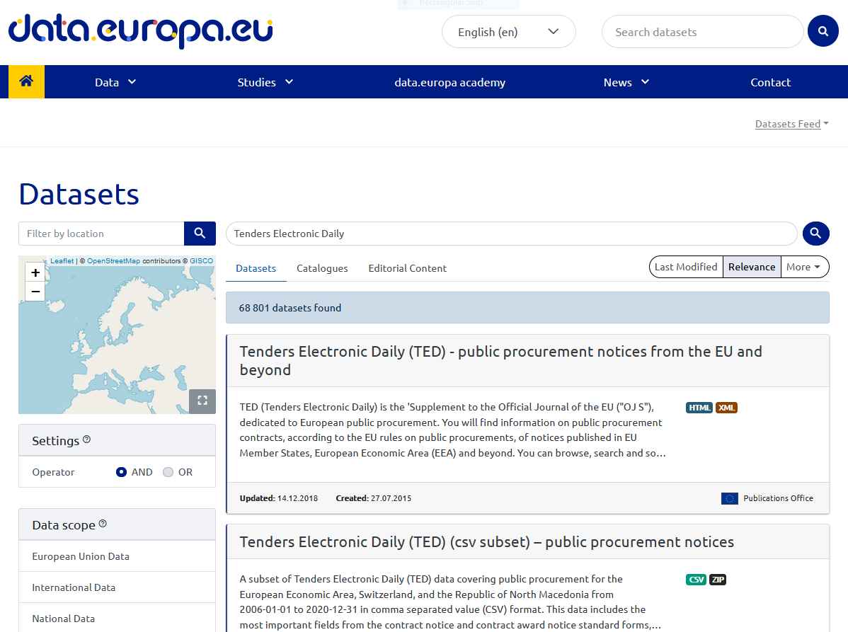
TED data on the official portal for European data
A subset of data from notices published on the TED website is also available as a dataset on the official portal for European data.

Slide 32
What could be done with the data?
You can answer the question:
    « Who buys what, from whom, when, where, for how much,
    according to which procurement procedure »
You can make public tenders more transparent
For inspiration, check:
  http://digiwhist.eu/about-digiwhist/
  http://europam.eu/?module=about
  https://monitoringeutenders.eu/
  https://opentender.eu/start

Slide 33
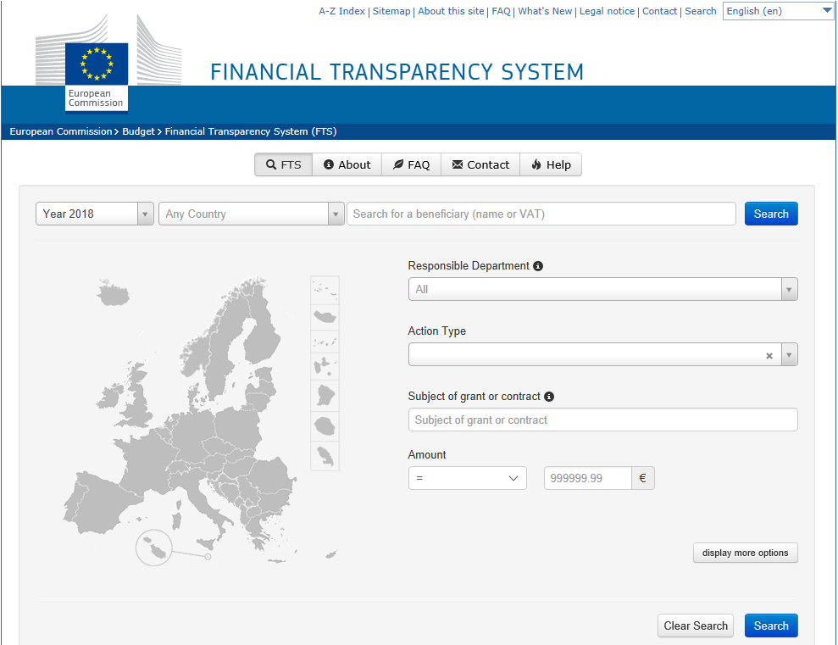
Which other data sources could be linked?
For example, you can link TED data to the Financial Transparency System
https://ec.europa.eu/budget/fts/index_en.htm

Slide 34

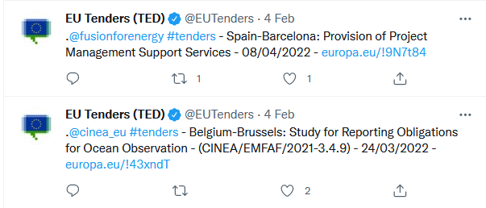
Contacts and links
https://ted.europa.eu
 ted@publications.europa.eu
@EUtenders
#EUtenders

Slide 35
ANY QUESTIONS?
Thank you

