Slide 1
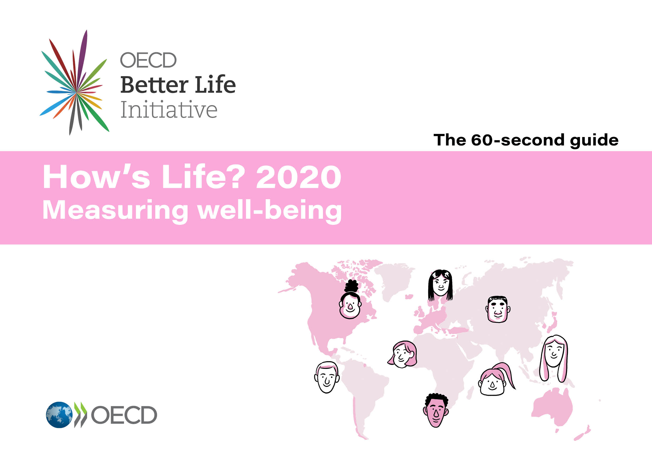
Online database
How’s Life?
Measuring Well-being

Slide 2
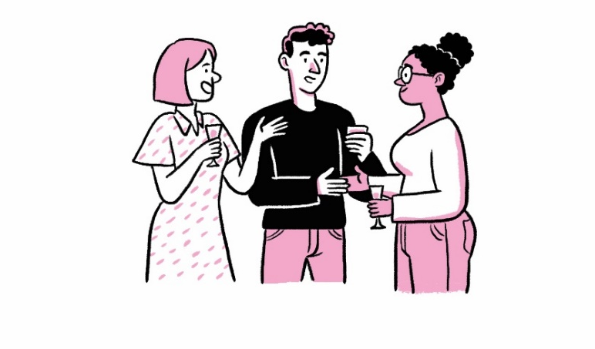
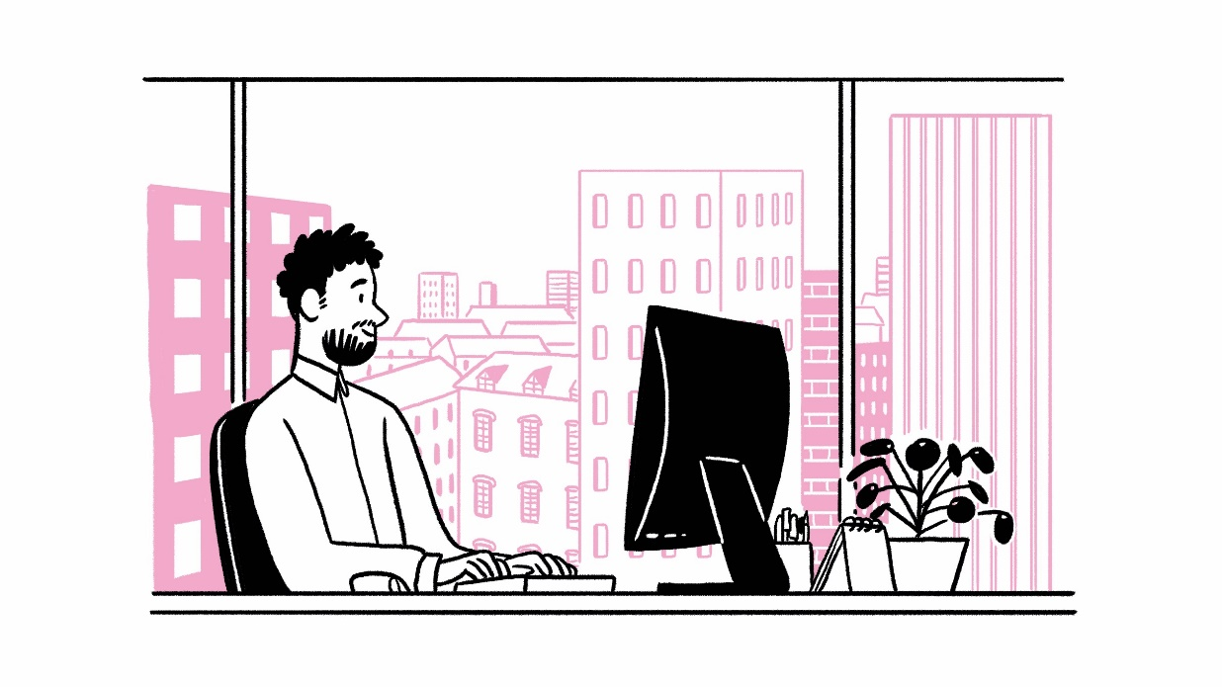
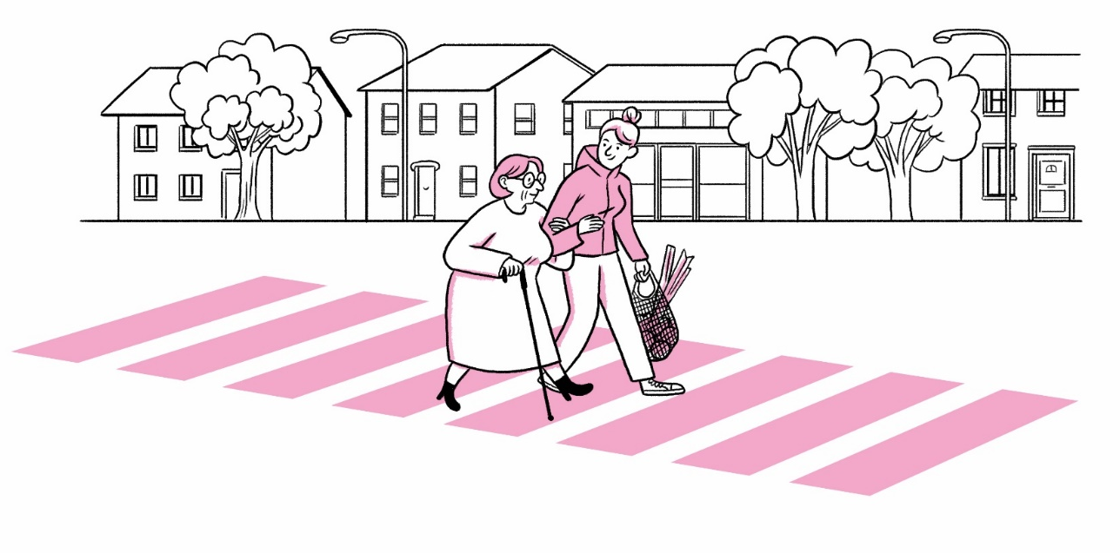
The OECD How’s Life? Well-being Database
One-stop shop for all well-being indicators
Covers 80+ data points for 41 countries (OECD members, Brazil, Colombia, Costa Rica, Russia, South Africa)
Cross-country panel data: 2005-2019
Access the database at: http://stats.oecd.org/wbos/default.aspx?datasetcode=HSL%20
Notes:
Combines a variety of data course into a supermarket
Internal OECD databases
Information from third party provides, Eurostat, geospatial data
Some data we compile ourselves from microdata, e.g. from time use surveys

Slide 3
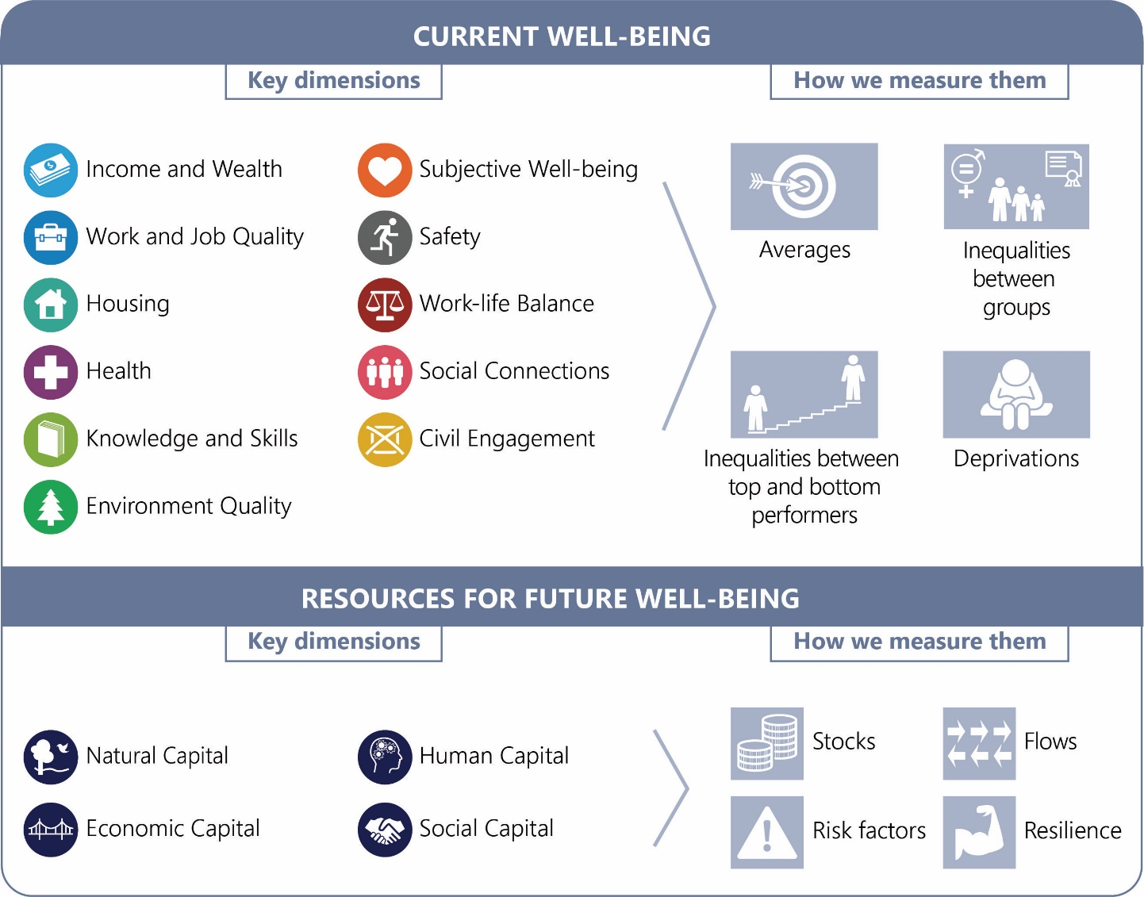
How can we measure people’s well-being?
11 dimensions of well-being outcomes “today”
well-being inequalities
the resources & risk factors that shape future well-being
Well-being data can be used to find out:
How quality of life is in your country
For which population groups life is getting better
How these outcomes correspond with what the government is doing in your country
OECD (2020) How’s Life? 2020: Measuring Well-being, OECD Publishing, Paris, https://doi.org/10.1787/23089679
www.oecd.org/howslife

Slide 4
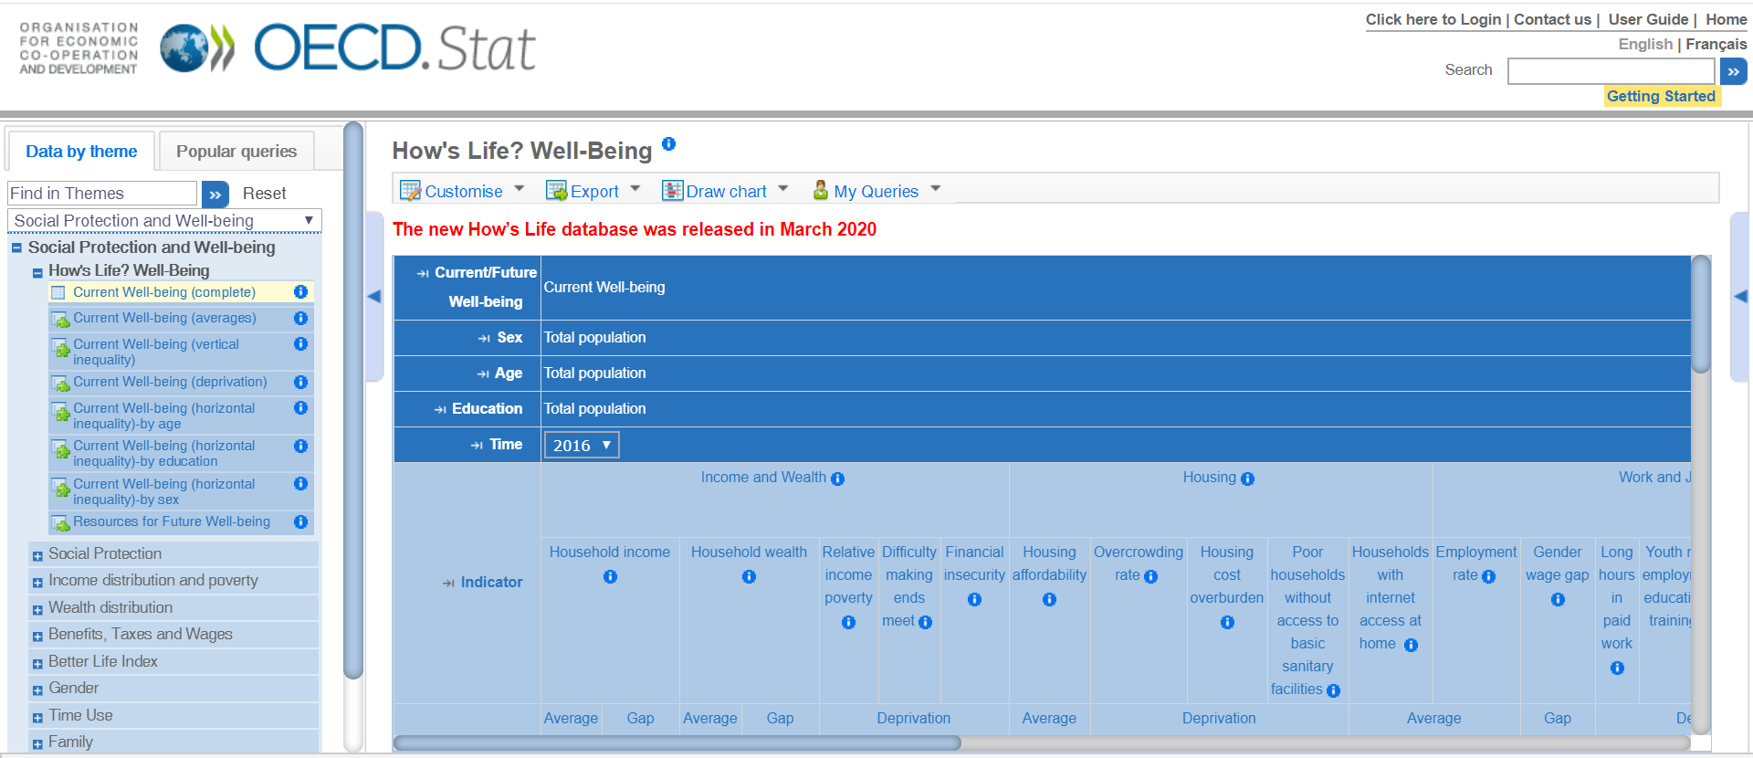
How to make sense of the database online
Notes:
. Access the database at this link, but also let us know if you have specific requirements, we can send it to you in a one go stata dataset

Slide 5

Data examples: Well-being “today” → Subjective well-being
Mean values for life satisfaction
(reported on a scale from 0 “not at all” to 10 “completely” satisfied)
Notes:
.

Slide 6
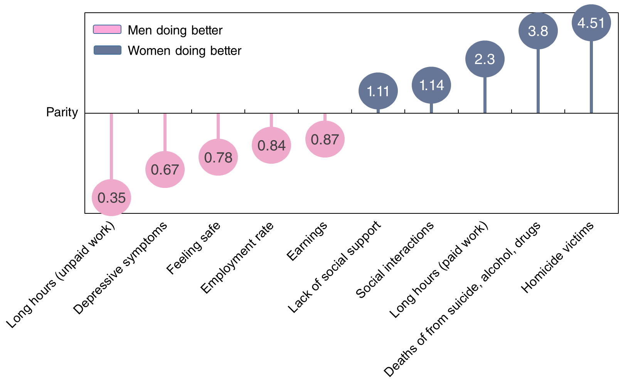

Data examples: gender inequalities in well-being
OECD average gender ratios (distance from parity)
OECD (2020) How’s Life? 2020: Measuring Well-being, OECD Publishing, Paris, https://doi.org/10.1787/23089679
www.oecd.org/howslife
Notes:
Women in OECD countries have more social connections, spend fewer long hours in paid work, and are 4.5 times less likely to die due to homicide than men. But, they also take home fewer earnings, feel less safe, and work longer unpaid hours.

Slide 7
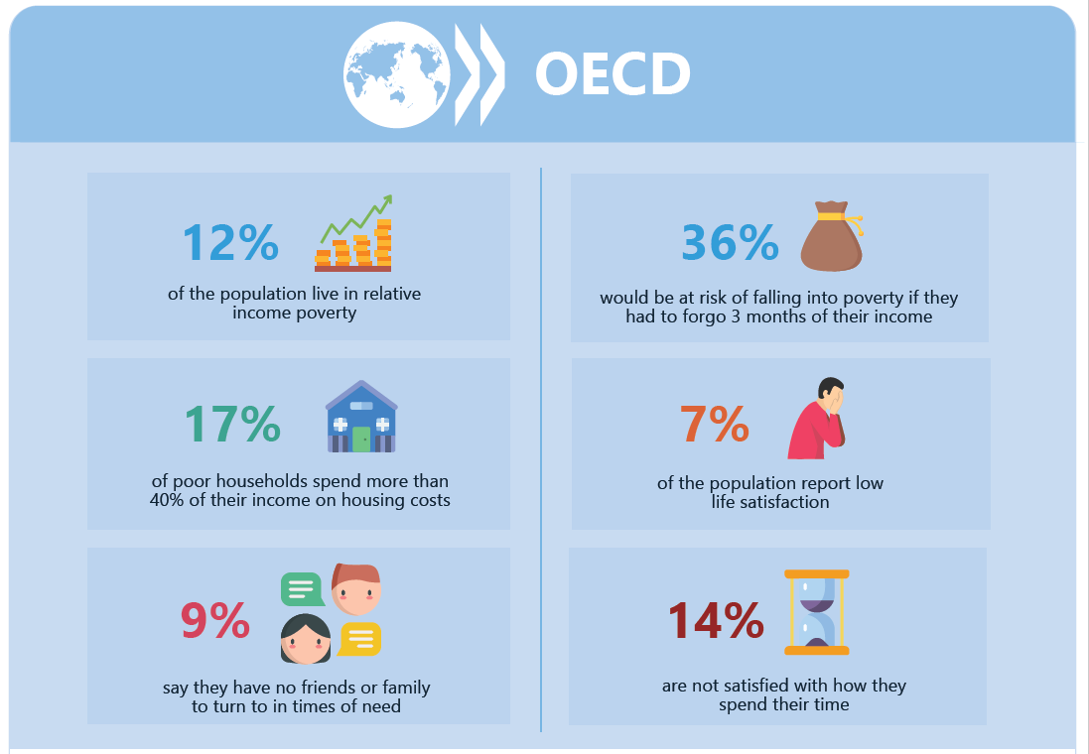
Data examples: deprivations in
well-being
OECD average result shown for illustration
OECD (2020) How’s Life? 2020: Measuring Well-being, OECD Publishing, Paris, https://doi.org/10.1787/23089679
www.oecd.org/howslife
Notes:
Note: comparison with the OECD average:
12% of the OECD population live in relative income poverty
36% of the OECD population would be at risk of falling into poverty if they had to forgo 3 months of their income
17% of poor households in the average OECD country spend more than 40% of their income on housing costs
7% of the OECD population report very low levels of life satisfaction
9% of people in OECD countries lack social support
14% of people in the average OECD country are not satisfied with how they spend their time

Slide 8
Data examples: Resources for future well-being
Results for Belgium shown for illustration
Note: ❶=top-performing OECD tier, ❷=middle-performing OECD tier, ❸=bottom-performing OECD tier. ➚ indicates consistent improvement; ↔ indicates no clear or consistent trend; ➘ indicates consistent deterioration, and “…” indicates insufficient time series to determine trends since 2010.
OECD (2020) How’s Life? 2020: Measuring Well-being, OECD Publishing, Paris, https://doi.org/10.1787/23089679
www.oecd.org/howslife
Notes:
For every country we also have a dashboard of headline indicators covering resources and risks for future well-being.
(a larger selection of indicators for each of these dimensions is available in the main report)
We have lots more data in the database…e.g carbon footprint, protected areas, renewable energy use (Natrual Captial), investment in R&D, banking sector leverage (Economic Captial), risk factors such as smoking and obesity in Human Capital, and data on volunteering and perceived government corruption under Social Capital.

Slide 9
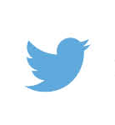
Find out more information
How’s Life? 2020: Measuring Well-being
Read free online at www.oecd.org/howslife
@OECD_STAT | #howslife
Questions? Write to us at:
wellbeing@oecd.org

