Slide 1
OECD Health STATISTICS
Overview of the OECD online database
OECD Health Division
Paris, March 2020

Slide 2
We are going to talk about …
Data on offer
1
2
How to access those data
Why are those data interesting and what could be done with them
3
Which other data sources could be linked
4
More information about the data model
5

Slide 3
Content of the OECD Health database
Datasets focusing on
Health Status, i.e. life expectancy, infant mortality, perceived health status…
Non-Medical Determinants of Health / Risk factors, i.e. tobacco and alcohol consumption, overweight & obesity rates…
Health Care Resources, i.e. employment in health (physicians, nurse, etc.), graduates, remuneration, hospital beds…
Health Care Utilisation, i.e. consultations, screening, ALOS, waiting times…
Health Care Quality Indicators, i.e. hospital admissions, prescribing, patients safety, cancer care…
Pharmaceutical Market, i.e. consumption, sales, generics…
Long-Term care Resources and Utilisation, i.e. formal LTC workers, LTC recipients…
Health Expenditure and Financing
Social Protection, i.e. public and private coverage…
Demographic References, i.e. population, by age and sex; and Economic References, i.e. GPD, average annual wages…
Access the full list of indicators available in the online database

Slide 4
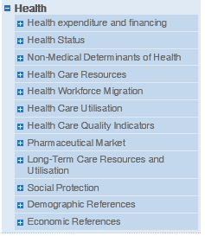
Data dissemination: how to access the data
All datasets are available in
via https://oe.cd/ds/health-statistics
Key indicators are further developed and analysed in Health at a Glance 2019: OECD Indicators (Read online or downloadable PDF options)
Selected indicators are also available in the OECD Data Portal, which enables users to visualize the data

Slide 5
Background – OECD Health questionnaires
OECD Health Statistics based on 4 distinct questionnaires, administered by different teams across the OECD Health Division
2 of the data collections are managed in conjunction with other international organisations (Eurostat and WHO-Europe)
The OECD Health Database offers the most comprehensive source of comparable statistics on health and health systems across OECD countries. It is an essential tool to carry out comparative analyses and draw lessons from international comparisons of diverse health systems
Created in the 1990s, the database has never ceased to evolve to include relevant and high quality indicators
Data are collected from all OECD members (36 countries)
As well as key partners and accession countries via a Minimum Dataset Questionnaire

Slide 6
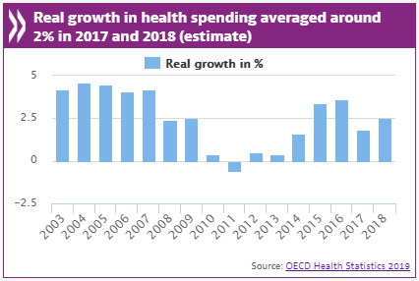
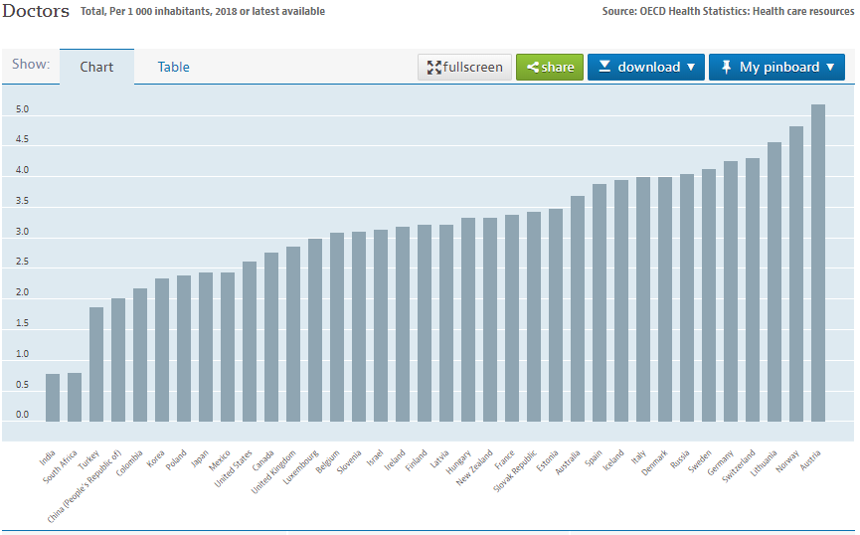
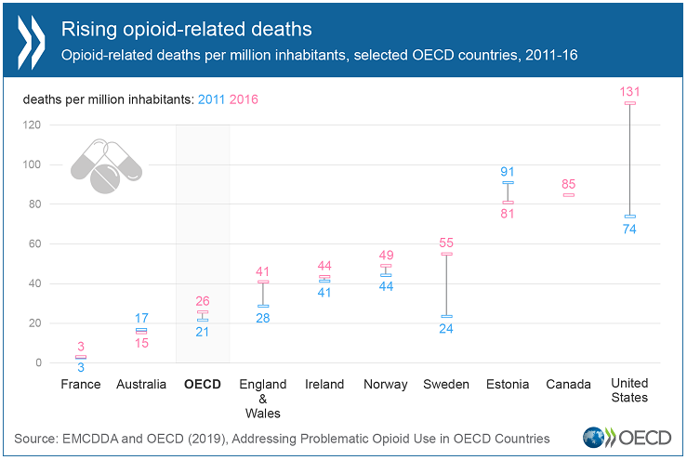
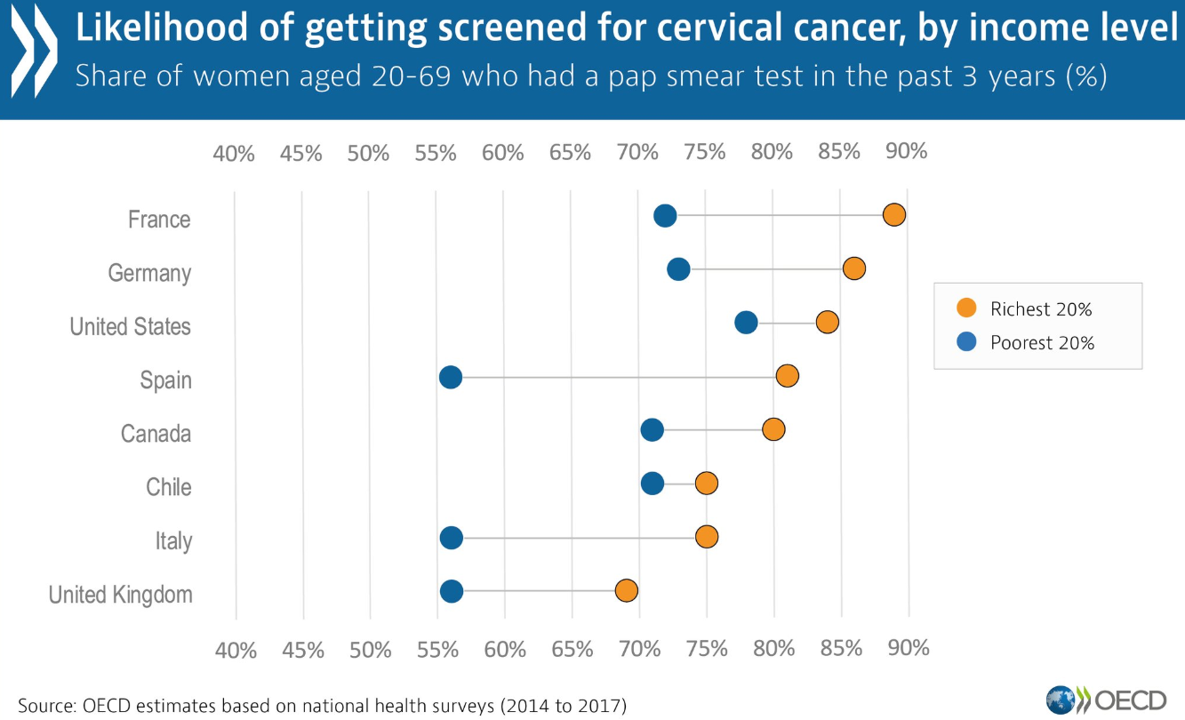
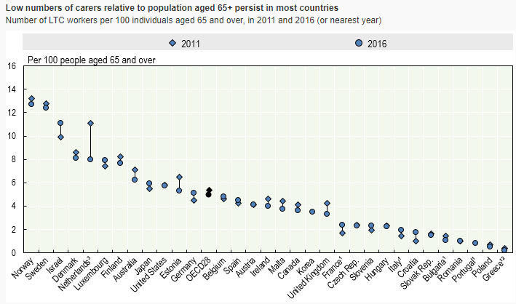
What can you do with the data ?

Slide 7
Other data sources to link to
The database already relies on collaboration with other providers of data…
International providers
ECDC (AIDS, incidence of Measles, Pertussis & Hepatitis B)
Eurostat (life expectancy, maternal and infant mortality, for EU countries)
WHO (Causes of mortality, Alcohol consumption)
OECD data
Health and social employment
Fertility
All reference series (population, by age and sex; GDP, etc.)
National sources include health surveys, hospital registries, surveillance reports, taxation statistics, labour studies, etc.
We encourage you to be creative, explore the data, build bridges !

Slide 8
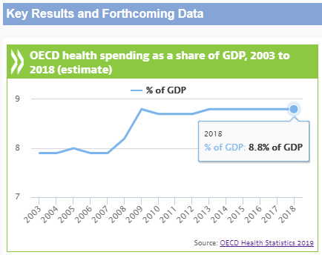
Further information: visit http://www.oecd.org/health/health-data.htm
Everything you need in one webpage
Directa ccess to OECD.Stat datasets
Frequently Requested Data for key indicators
Direct access to all metadata, i.e. Sources and Methods by indicator and by country

Slide 9
Contact us
Email us
health.contact@oecd.org
Follow us on Twitter
@OECD_social
Visit our website
www.oecd.org/health

