Slide 1
eForms
eSenders annual seminar 12th December 2022
European Commission, DG GROW, Unit G4 Data and knowledge for policy, business and people

Slide 2
eForms – Amendment 2022

Slide 3
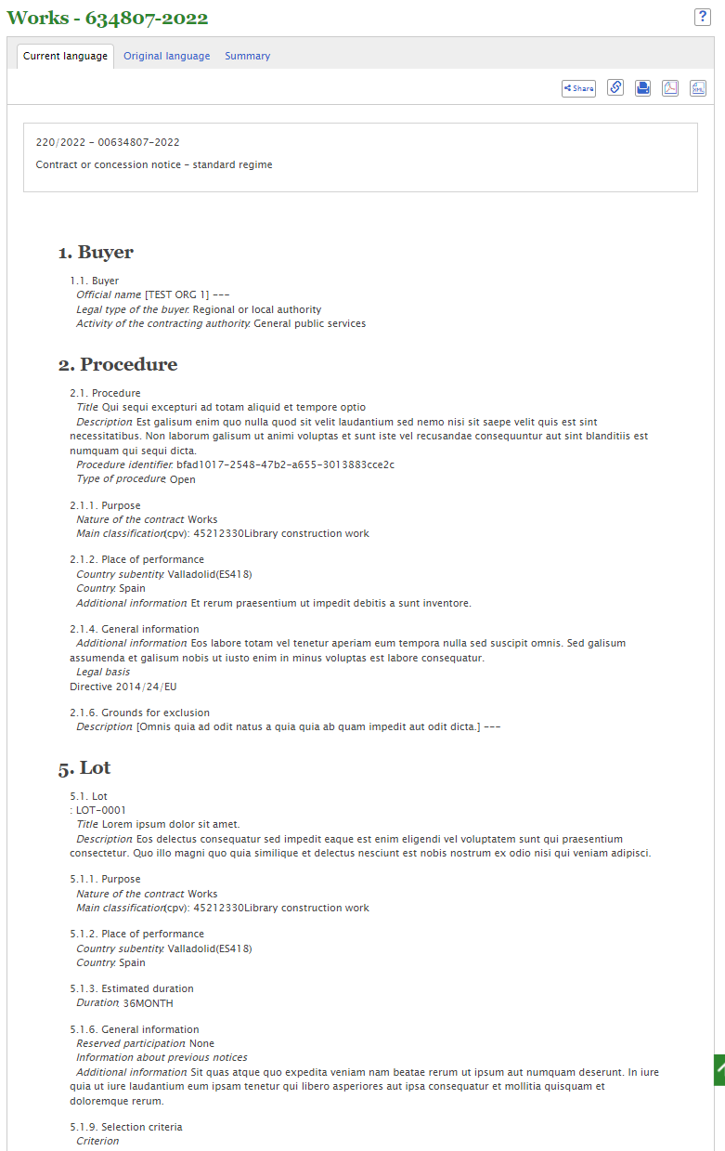
Recap on eForms The digital standard for publishing public procurement data
Reduce administrative burdens
Help businesses to find procurement notices
Improve the quality and analysis of data
Increase transparency
Increase data-driven decisions about public spendings
Adding sustainable criteria
What will the eForms add?

Slide 4
Timeline of eForms The digital standard for publishing public procurement data
2023
25th October
Mandatory use of eForms
2019
25th October
Commission Implementing Regulation 2019/1780
eForms – EU legislative standard to publish public procurement data
Next steps:
Update of the eForms implementation handbook
2nd Amendment of the Commission Implementing Regulation 2019/1780
2022
24th November
Commission Implementing Regulation 2019/1780
Adoption of the Amendment of the Commission Implementing Regulation 2019/1780
14th November
Commission Implementing Regulation 2019/1780
Voluntary use of eForms available

Slide 5
eForms amendment changes 2022
Clean Vehicle Directive
Green procurement criteria
EU funds
Notice Dispatch Date eSender
Description and labels
Non-disclosure agreement
Tender Ranked indicator
Framework agreement (Simonsen & Weel)
Not in the 2022 amendment
Improved
International Procurement Instrument (IPI) on the access of third-country economic operators
Foreign Subsidies Regulation (FSR) on distortion of the EU’s internal market
Inclusion of the voluntary forms
New

Slide 6
eForms - Tailoring

Slide 7
eForms – Tailoring
The eForms Implementing Regulation and its annex do not constitute an 'off-the-shelf' law that can be implemented by IT departments 'as is'. Public procurement decision makers must first meet with stakeholders to define the national approach to the various aspects of eForms, such as also using them for contracts below thresholds, taking into account different policies and requirements.
eForms allow for the first time to capture structured information on SPP/GPP
How could Member States make GPP mandatory?

Slide 8
eForms – General GPP logic
1st step: Define if the procurement procedure/lot has an environmental impact
2nd step: Describe this impact in the form of a (short) text
3rd step: Select what type of environmental impact (e.g. circular, pollution)
4th step: Select where the criteria comes from (EU, national, other, none)
This information, together with for example the CPV codes helps to better understand, for what procedure/lot GPP where applied
Important – The choice/decisions were done by the buyer upfront

Slide 9
eForms – Fields Related to GPP
1st step: Define if the procurement procedure/lot has an environmental impact
BT-06: Strategic Procurement (Environmental, Social, Innovative, none)
2nd step: Describe this impact in the form of a (short) text
BT-777: Strategic Procurement Description (text)
3rd step: Select what type of environmental impact (e.g. circular, pollution)
BT-774 Green Procurement (code list)
4th step: Select where the criteria comes from (EU, national, other, none)
BT-805 GPP criteria (where does this criteria comes from)
Mandatory

Slide 10
eForms – Amendment 2023

Slide 11
Next eForms amendment 2023
01
Foreign subsidy regulation
02
International Procurement Instrument
03
Energy Efficiency Recast
04
Simplification
of table 2 incl. voluntary forms
05
Additional changes like improvements on GPP

Slide 12
Next eForms amendment 2023
Feedback from MS (February- June)
Inter-service Consultation (June – July)
Public Consultation (July - August)
Comitology meeting (September)
Adoption of the new amendment(October)

Slide 13
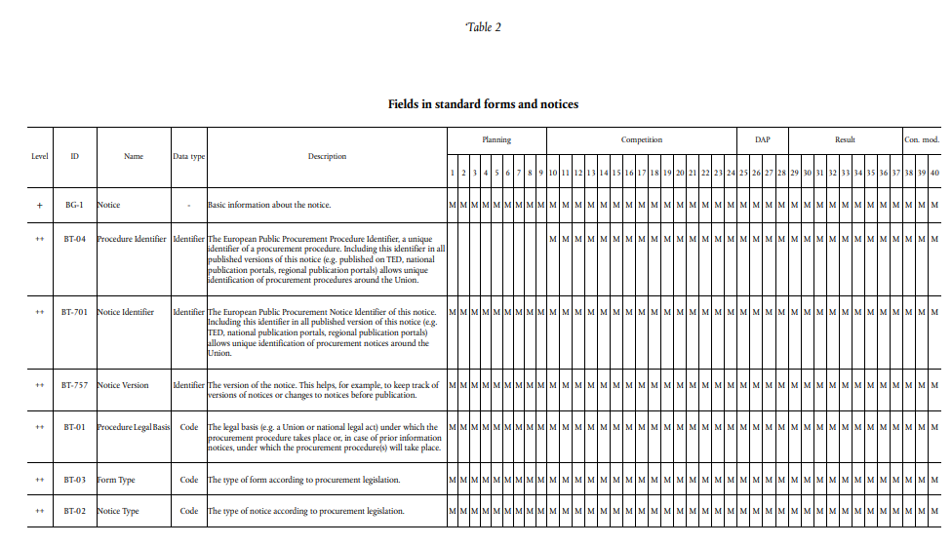
Simplification of Table 2
Additions to fields, like for the CVD requires an amendment of eForms

Slide 14
Thank you.

